Slide 1
CPC Monthly Climate Review
December 2013
(Jin Huang)
Outline:
0. January 2014 Cold air outbreak
Global Patterns (ENSO, PDO,MJO, AO/NAO)
Global and US anomalies
Forecasts, and verification
Thoughts on CPC Monthly Climate Reviews
Thanks to Huug, Yan, Kingtse, Wanqiu, Emily, Qin, Mike Tippett and Ben for various info
and CPC product, Netherland products,…

Slide 2
0. January 2014 Cold Outbreak

Slide 3
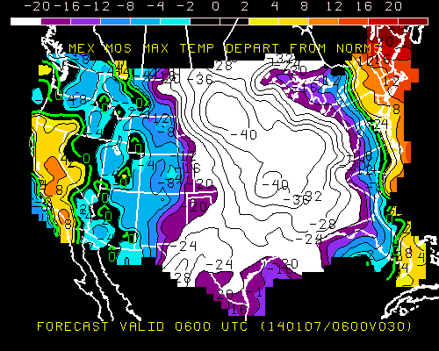
US: -40 degree below normal

Slide 4
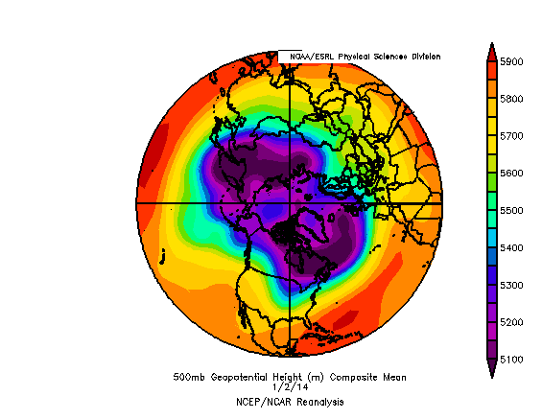
Polar Vortex

Slide 5
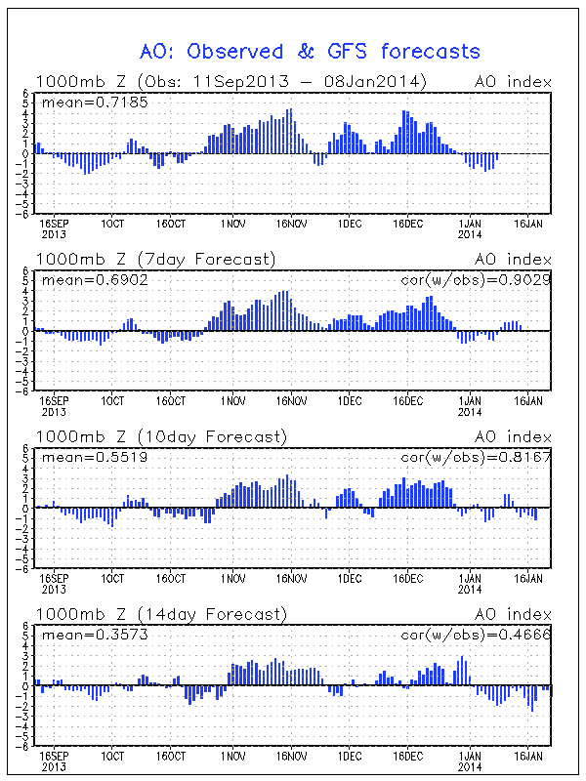
AO

Slide 6
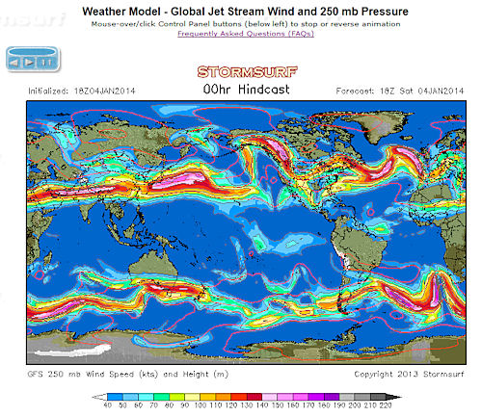

Slide 7
One Theory to Link Jetstream to extreme weather and to global warming (J. Francis)
Arctic Amplification
Poleward thickness gradient weakening
Weaker upper-level, zonal-mean flow, reduced phase speed
Peaks of upper-level ridges elongate northward, wave amplitude increases
Rossby waves progress more slowly
Weather conditions more persistent
Increased probability of extremes: cold spells, heat waves, flooding, prolonged snowfall, and drought

Slide 8
1. December 2013 Global Patterns
ENSO
PDO
MJO
AO/NAO

Slide 9
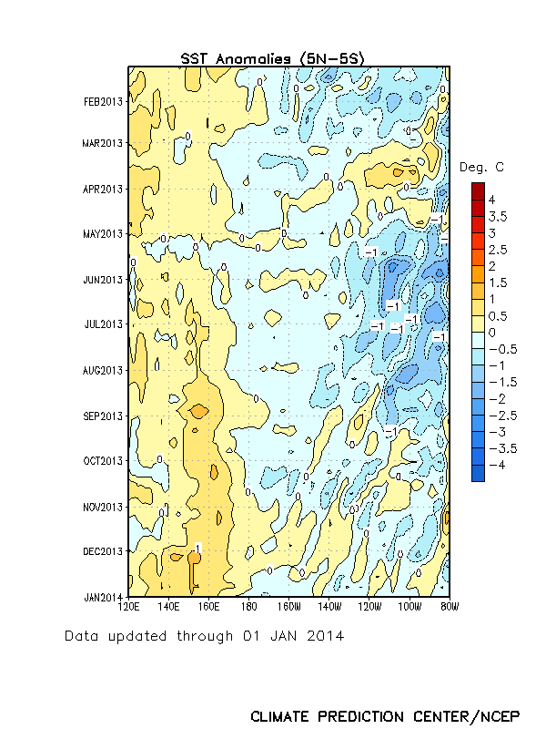
Recent Evolution of Equatorial Pacific SST Departures (ºC)
ENSO Neutral
Time
During May-September 2013, below-average SSTs were observed over the eastern half of the Pacific.
Recently, SSTs have been near-average across much of the equatorial Pacific.
Longitude

Slide 10
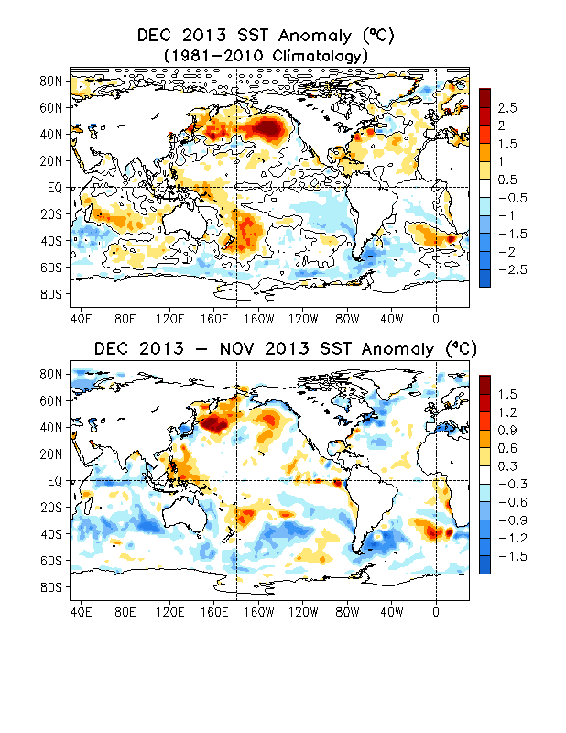
Global SST Anomaly (⁰C) and Anomaly Tendency
SST was near-normal in the central-eastern tropical Pacific.
Positive SST anomalies presented north of Japan, across the N. Pacific, and in the western equatorial Pacific.
Negative SST anomalies presented in southeast Pacific.
A warming tendency presented north of Japan and eastern N. Pacific, east of Philippe.
A cooling tendency was observed along the Gulf Stream and subpolar Arctic.

Slide 11
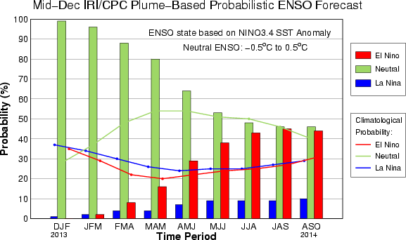
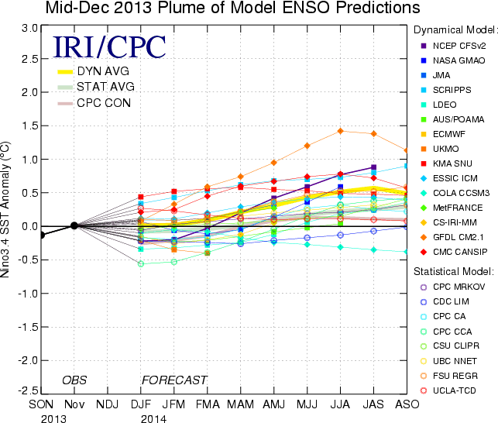
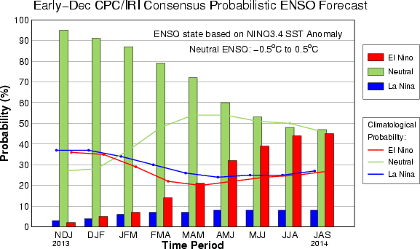
IRI/CPC NINO3.4 Forecast Plume
Most of the models predicted ENSO-neutral would continue into the Northern Hemisphere summer 2014.
The consensus forecast favors ENSO-neutral conditions in the next spring and summer 2014.

Slide 12
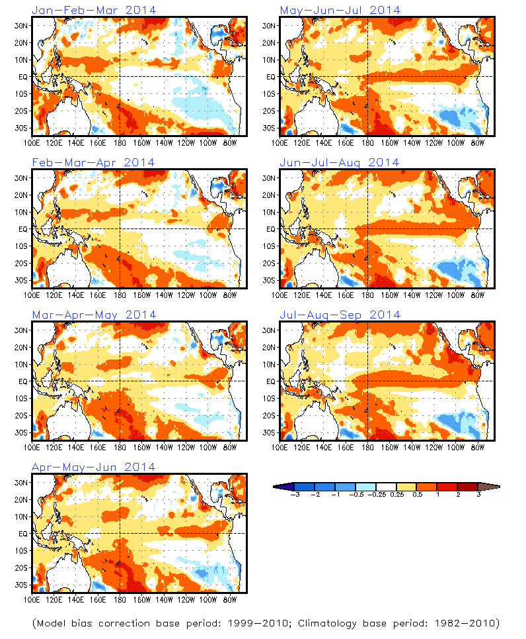
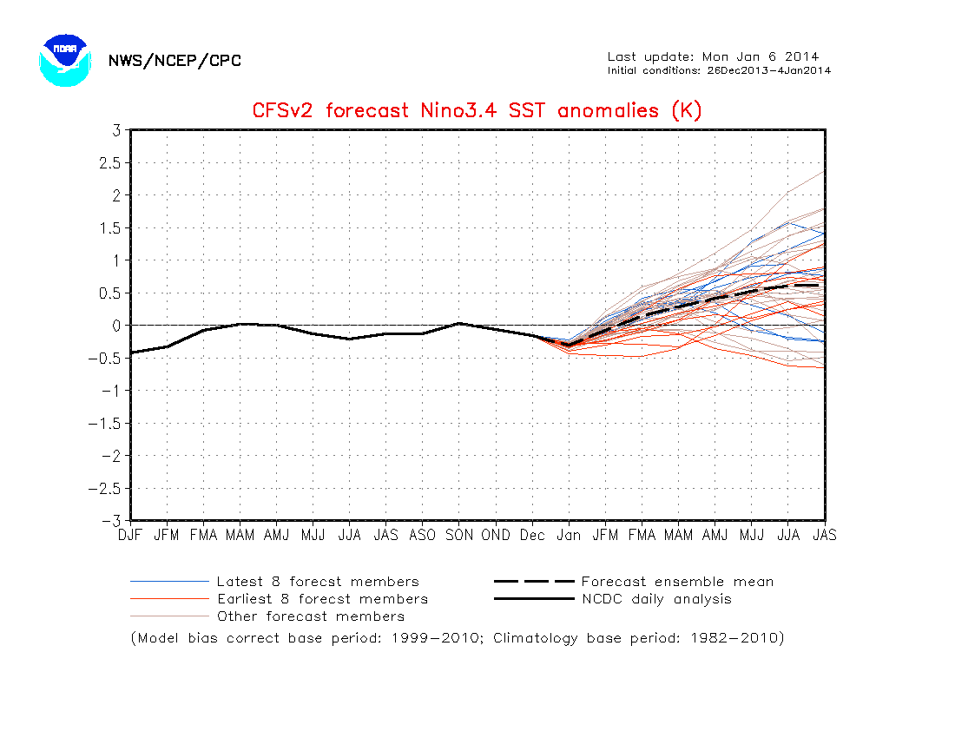
SST Outlook: NCEP CFS.v2 Forecast Issued 6 January 2014
The CFS.v2 ensemble mean (black dashed line) predicts ENSO-neutral through the N.H. spring 2014 followed by El Niño during summer 2014.

Slide 13

Time Magazine predicts:
El Niño Is On Its Way
When the Pacific Ocean warms in 2014, the weather will get weird
2014 could be the hottest year on record.
By Bryan Walsh
Jan. 13, 2014

Slide 14
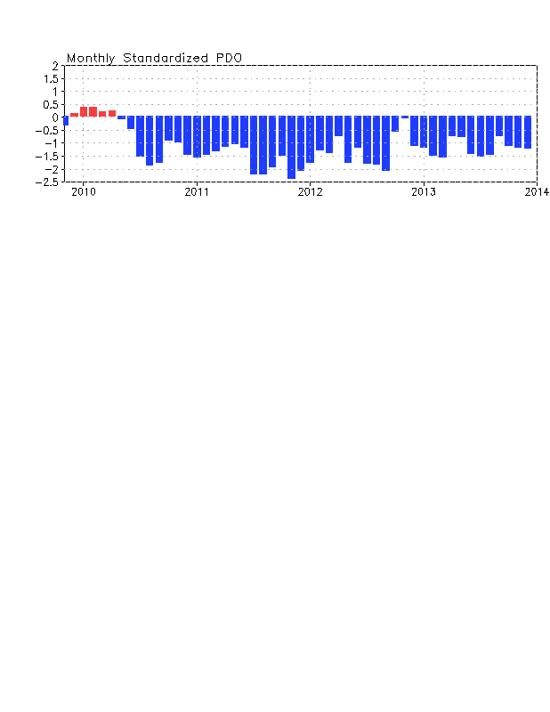
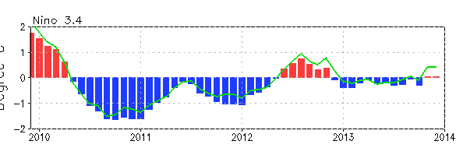
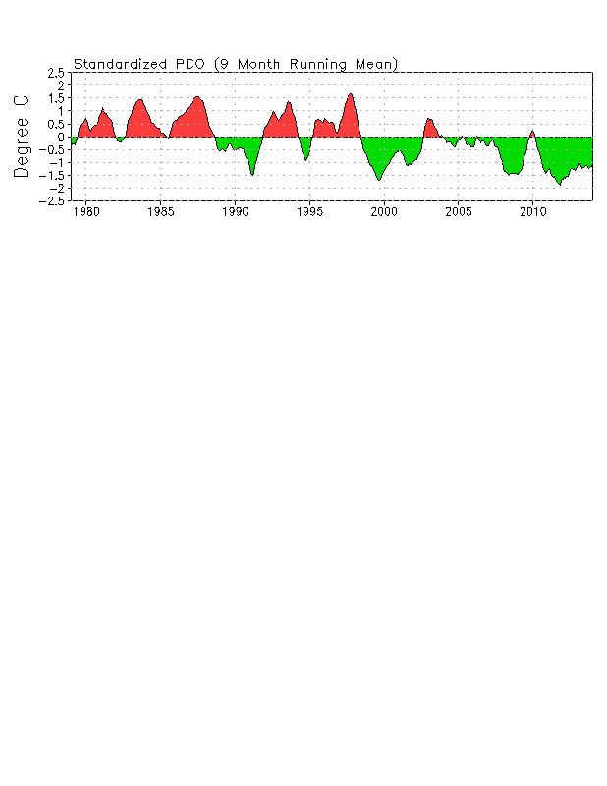
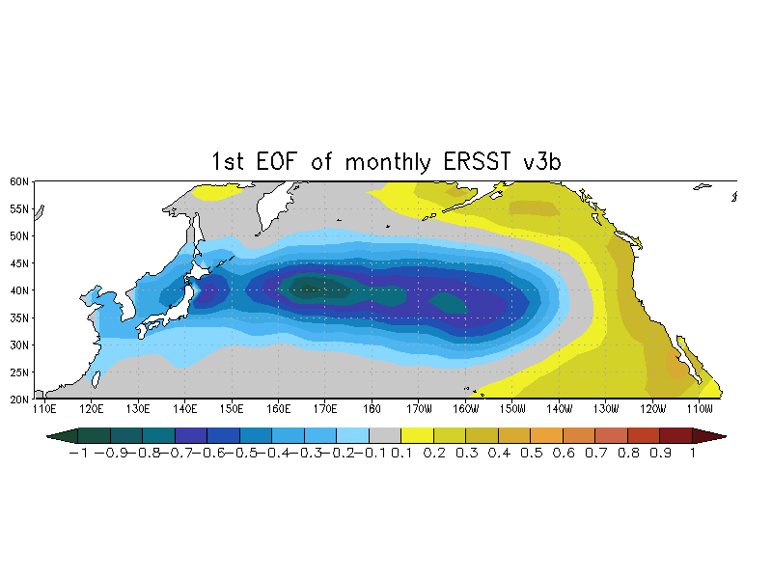
Pacific Decadal Oscillation Index
Negative PDO phase since May 2010 has persisted for 43 months now, and the negative PDO index persisted in Dec 2013.
The apparent connection between NINO3.4 and PDO index suggest connections between tropics and extratropics.
However, the negative phase of PDO since Jun 2012 seems not closely connected with the Nino3.4 SSTA.

Slide 15
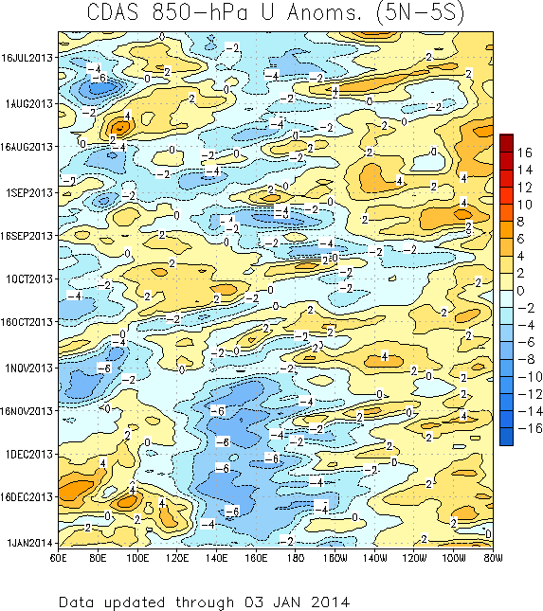
850-hPa Zonal Wind Anomalies (m s⁻¹)
Westerly anomalies (orange/red shading) represent anomalous west-to-east flow
Easterly anomalies (blue shading) represent anomalous east-to-west flow
During late July through mid-August, the MJO was weak.
In late August and early September, westerly (easterly) anomalies increased over the eastern (western) Pacific in associated with renewed MJO activity.
During October, equatorial Rossby wave activity was strong from 160E to 100E as westward movement features are evident (red box). MJO activity was less coherent during this period.
During November and December, easterly anomalies were persistent from 120E to near the Date Line. Westerly anomalies were also evident across the Indian Ocean during this period. These anomalies have decreased some during late December.
Time
Longitude
Notes:
15

Slide 16
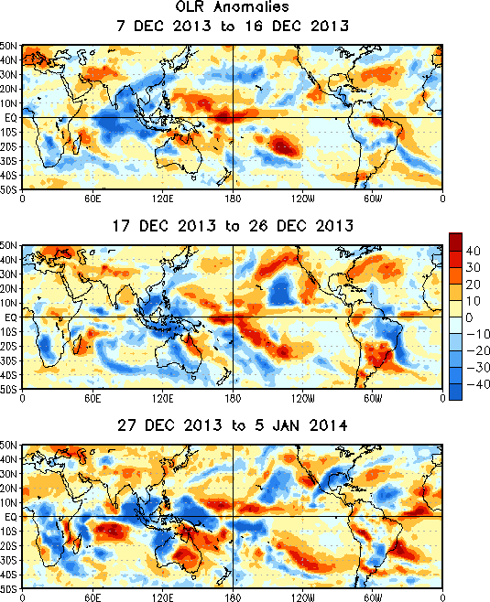
OLR Anomalies – Past 30 days
During early to mid-December, enhanced convection persisted across the Indian Ocean, while suppressed convection continued over much of the equatorial western and central Pacific.
During mid to late December, enhanced convection shifted east to the Maritime Continent with suppressed convection persisting at the Date Line. Enhanced convection intensified across Brazil with suppressed convection indicated over parts of south-central South America.
By early January, enhanced convection persisted across parts of the Indian ocean and western Pacific and increased in coverage over parts of central and southern Africa.
Notes:
16

Slide 17
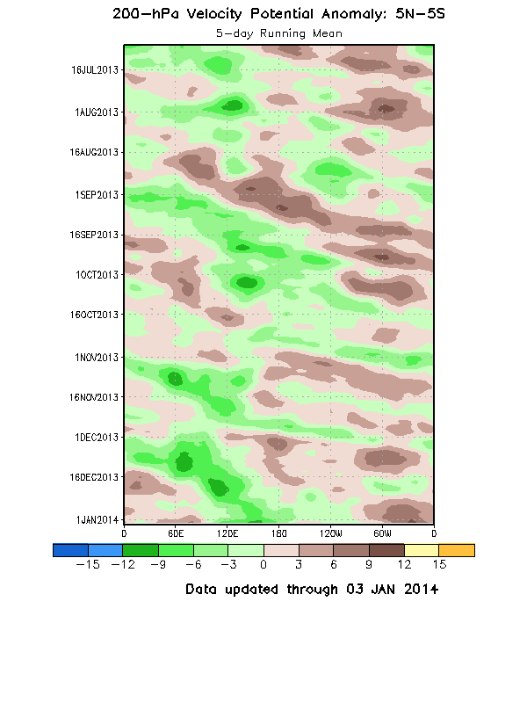
200-hPa Velocity Potential
Anomalies (5°S-5°N)
The MJO was active (alternating dashed and dotted lines) during June and early July before weakening at the end of the month.
The MJO was not active during late July and much of August, but strengthened during late August and September, with eastward propagation of robust upper-level velocity potential anomalies. Other modes of tropical intraseasonal variability are also evident.
From late October to early December, the MJO was not very strong or coherent. There was evidence of coherent eastward propagation at times during this period, but much of this activity exhibited fast propagation speeds more consistent with atmospheric Kelvin waves.
A slower eastward propagation of 200-hPa velocity potential anomalies was observed during mid-December.
Time
Longitude
Notes:
17

Slide 18
2. US and Global Anomalies
P, T, H500mb,
Snow, sea ice, ozone
Drought; Flooding

Slide 19
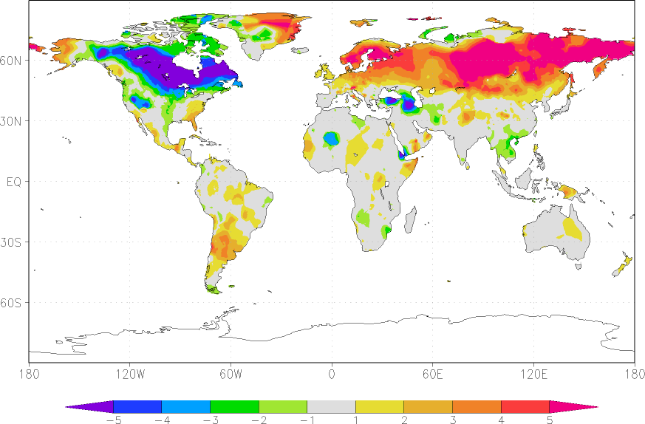
Global T2m Anomaly (Dec.13)

Slide 20
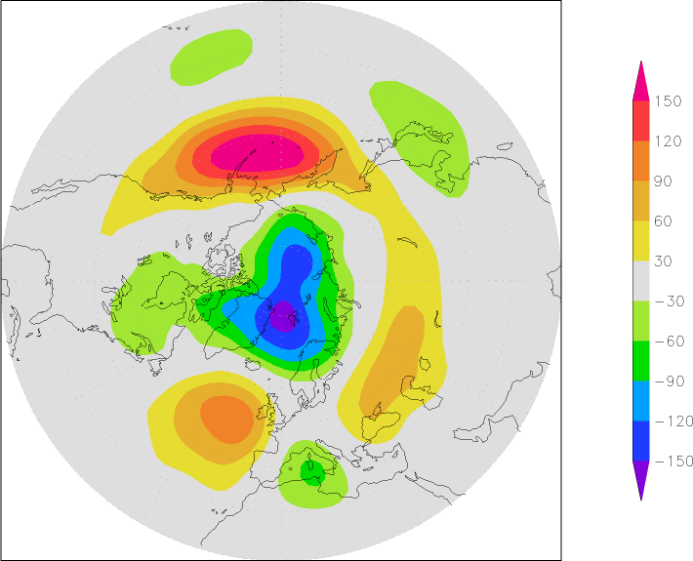
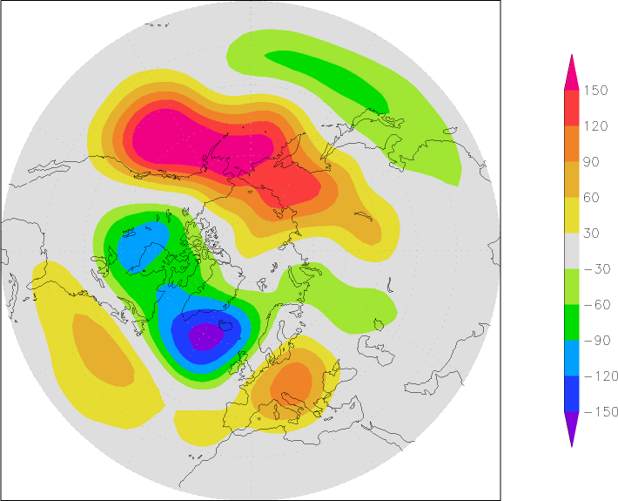
500mb Height Anomaly
Nov 2013
Dec. 2013

Slide 21
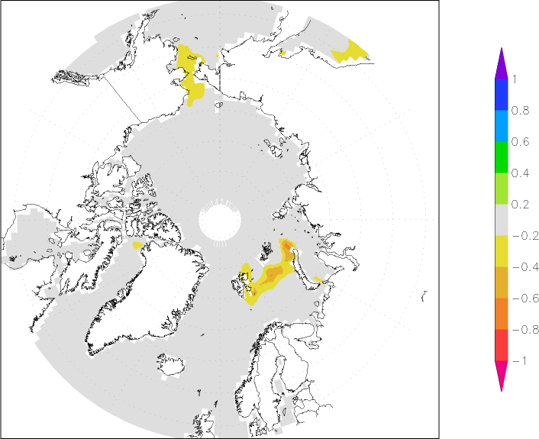
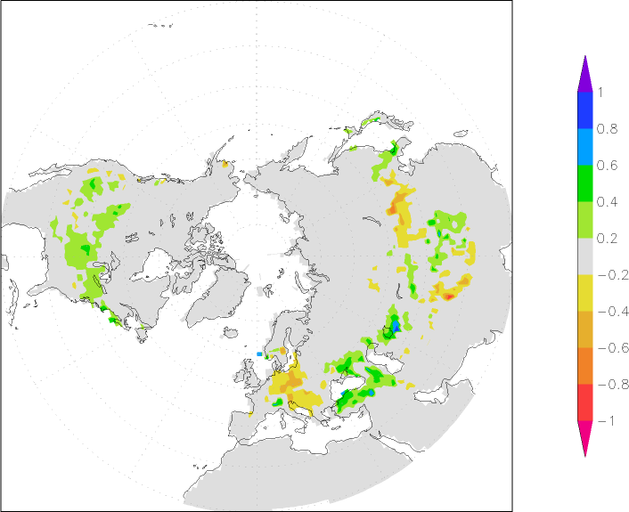
Sea ice, Snow Anomaly (Dec.13)
Sea Ice concentration
Snow cover

Slide 22
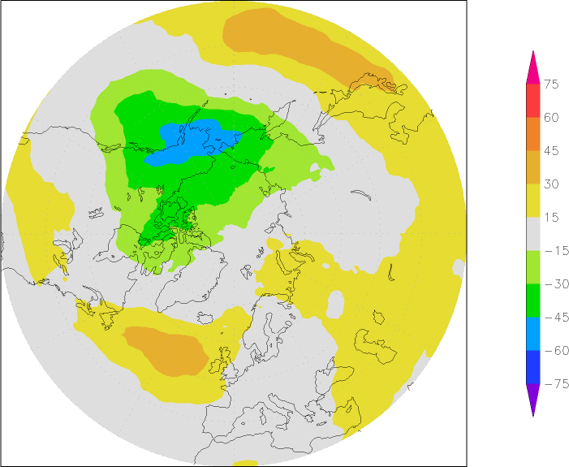
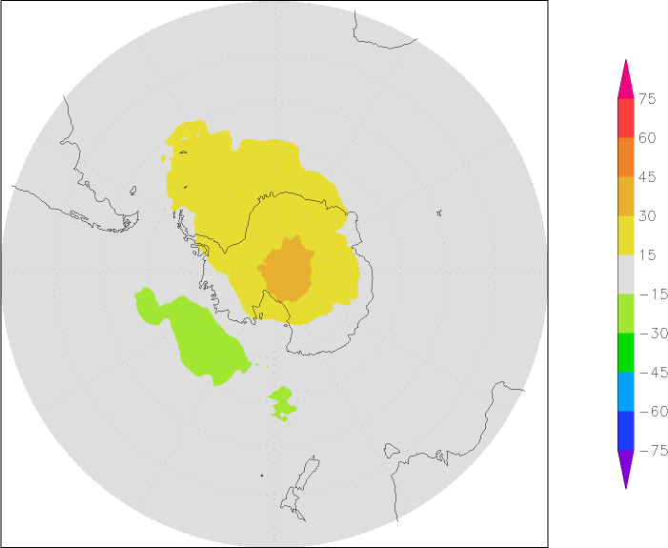
Ozone Anomaly (Dec)
NH
SH

Slide 23
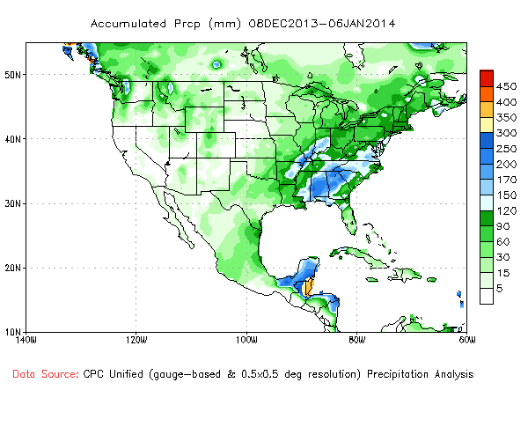
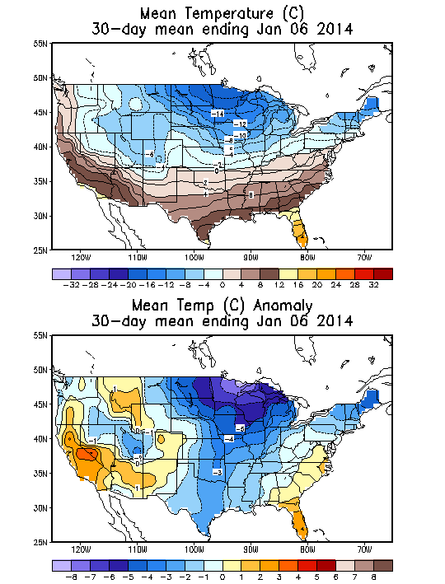
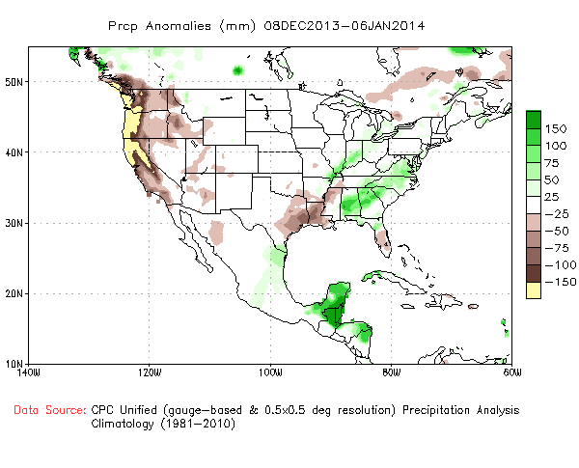
December (and early Jan) Temperature and Precipitation
Precipitation
Temperature
Monthly Mean
Anomaly

Slide 24
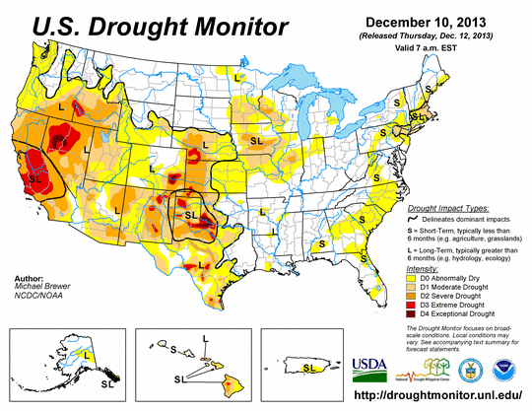
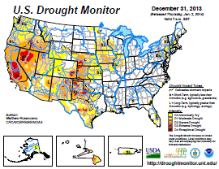
Drought Monitor
Drought conditions over California and Nevada , western Texas

Slide 25
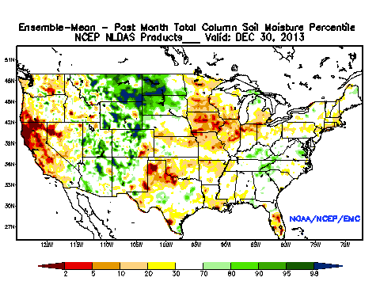
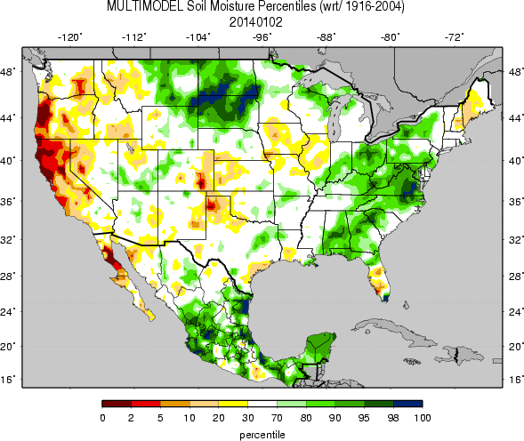
SM Percentiles
Both show dryness from California to Oregon , North Central (EMC) , Wetness over eastern Missouri and Dakotas
The UW also shows wetness over the East
EMC Dec 2013
Multi model ensemble
The UW multi model Ensemble

Slide 26
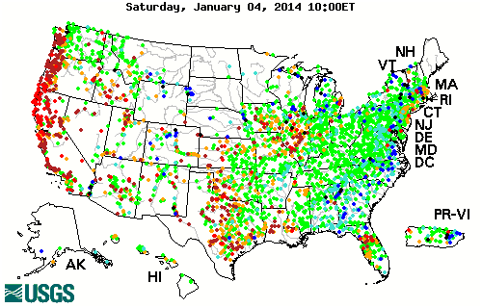
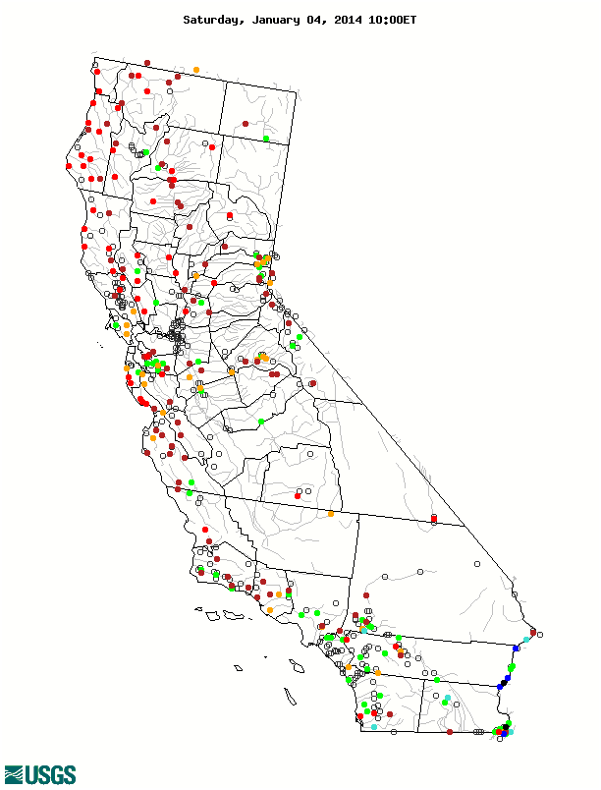

Streamflow Percentiles (USGS)
Dry: Similar to last month except California drought was more severe
Wet: wetness over Dakotas , Colorado last month improved
Dryness and low flow over most California and dryness expanded to the Pacific Northwest
More recent situation

Slide 27
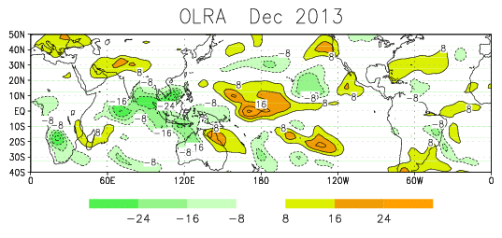
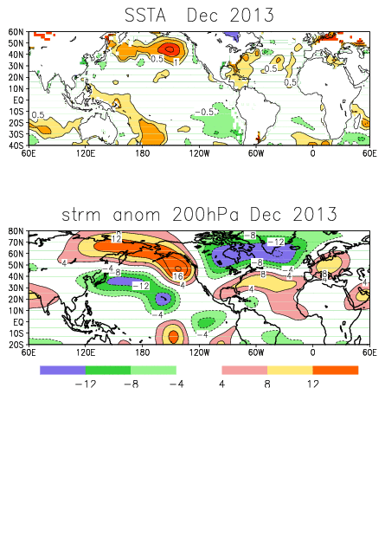
Enhanced Convection over the western Pacific centered at 120E
Suppressed convection over the Central Pacific
This pattern also has been persistent for nearly 2-3 months
Not favorable for rain over California
A PNA type of pattern with positive anomalies along the West Coast

Slide 28
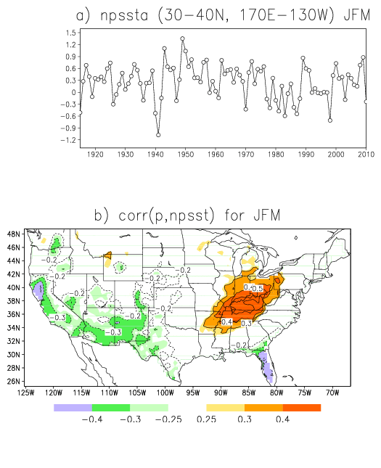
Correlation bw NPSST and P
sst: ersst
P: U. Washington P analysis 0.5 degrees
Period 1915-2010 for JFM
To be statistically significant at the 5% level, the magnitude of correlations need to be greater than 0.2
It shows positive npsst=> dryness over California, the Southwest and Florida
wetness over the Ohio Valley

Slide 29
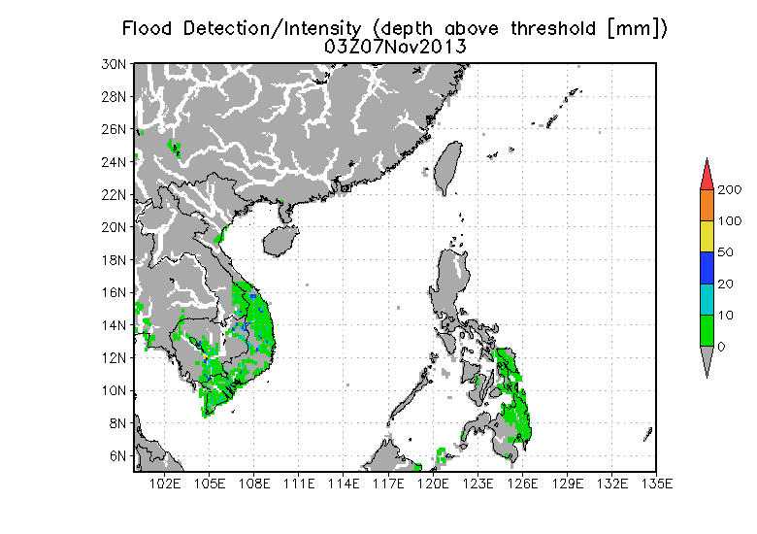
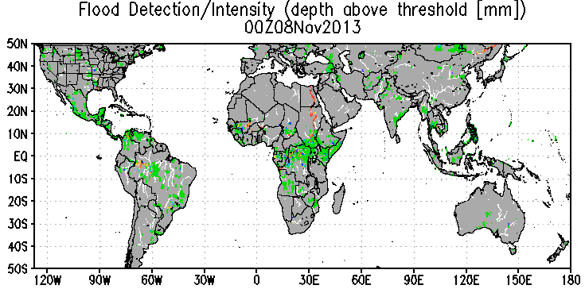
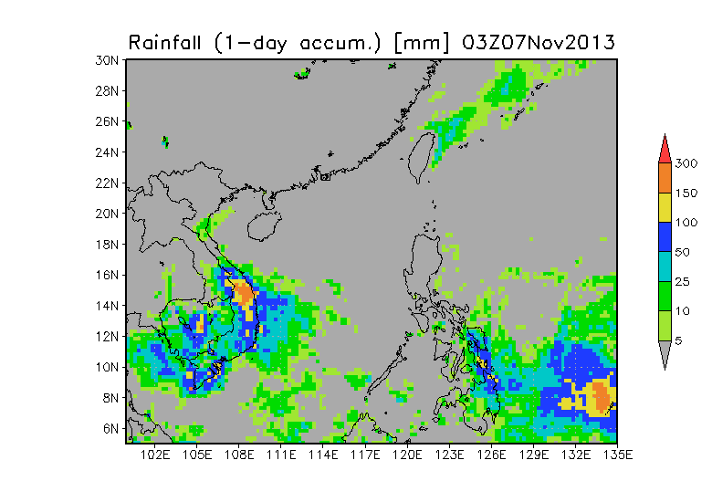
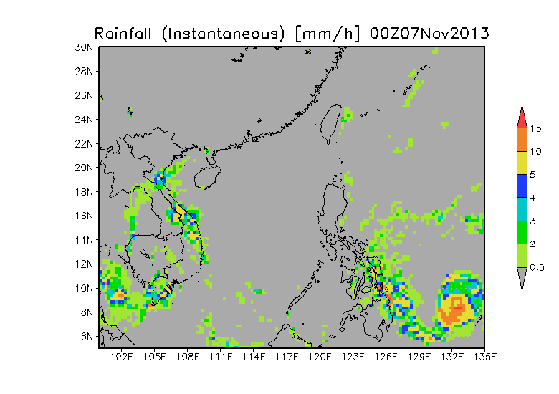
Detecting Flooding (“Haiyan” Typhoon, Nov, 2013) by Global Flood Monitoring System (GFMS)/DRIVE model
Flood detection [mm]
1-day rain [mm]
3-hour rain [mm/h]

Slide 30
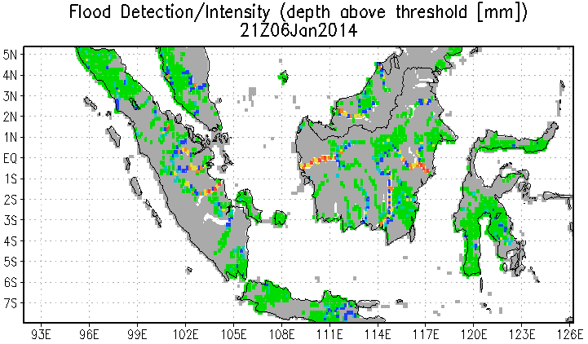
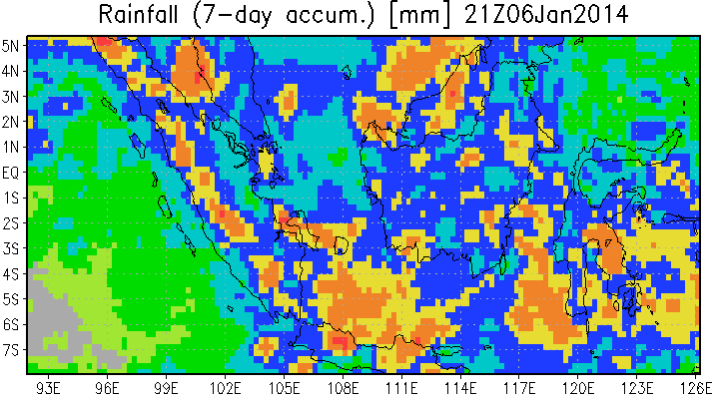
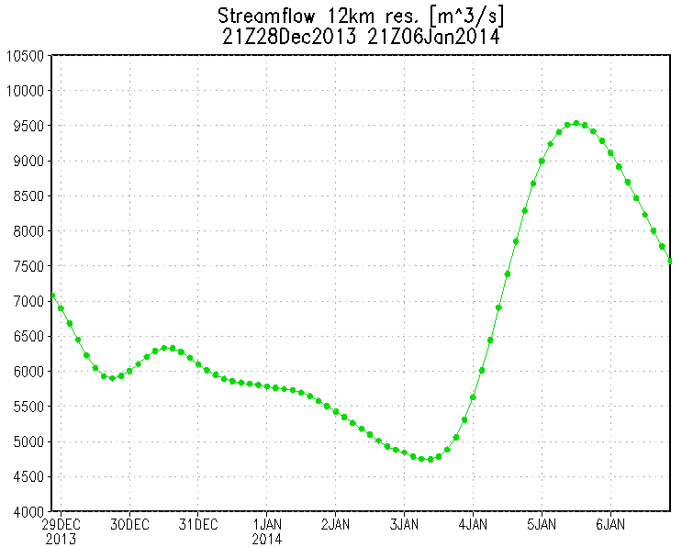
Western Indonesia Flooding
Short term precipitation and flood forecast on Jan 2, 2014
X
Streamflow [m³/s] at Lat: -1.3 Lon: 104.1
This system could be useful for
3-7 Day Hazard Outlook
NWP precipitation
For future 4~5 days
Satellite precipitation
Notes:
The flood situation in Western Indonesia will get worse in next a few days according to the short-term forecast using GEOS-5 precipitation.

Slide 31
3. Forecast and Verifications
NMME Forecasts
NMME skill assessment and real-time verification
CFSv2 forecast for Dec. severe weather

Slide 32
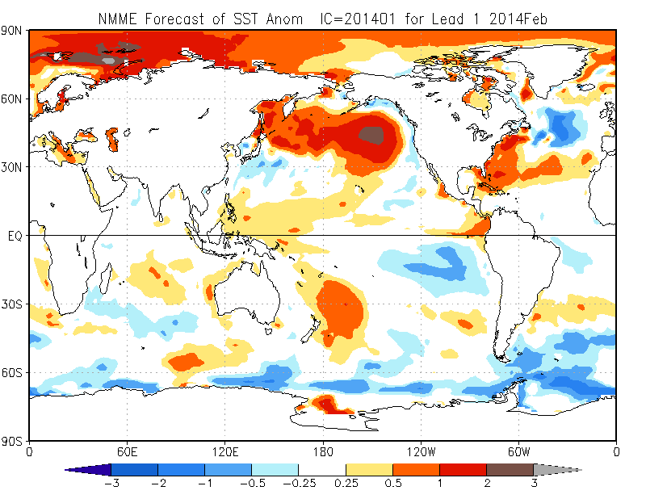
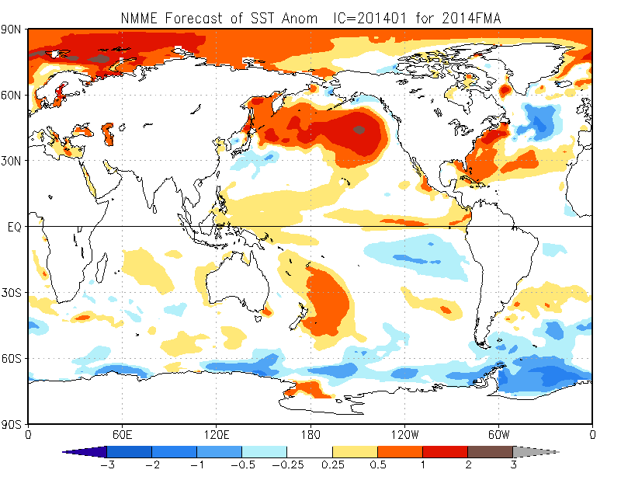
NMME SST Forecasts
Feb 2014
FMA 2014

Slide 33
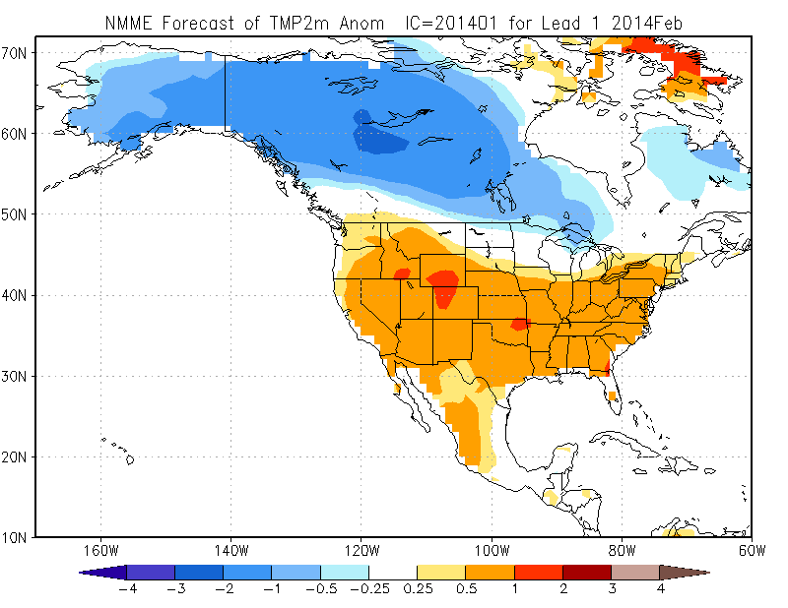
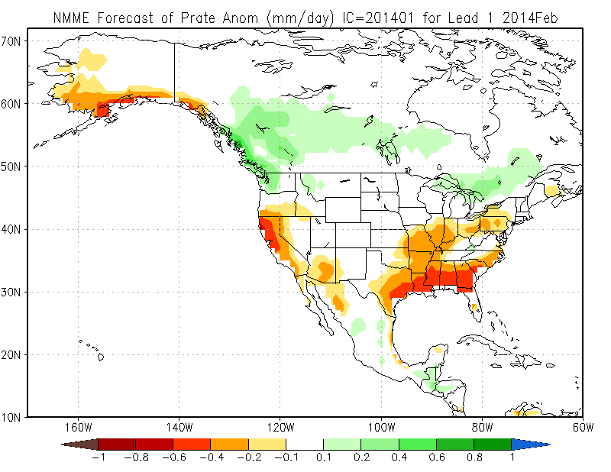
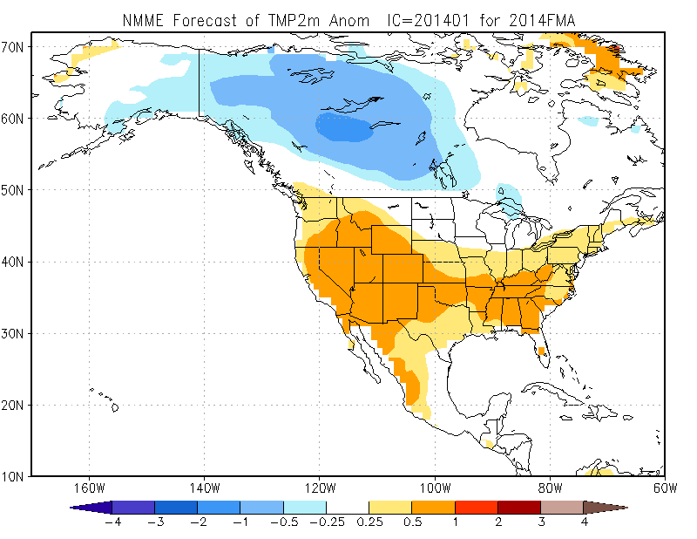
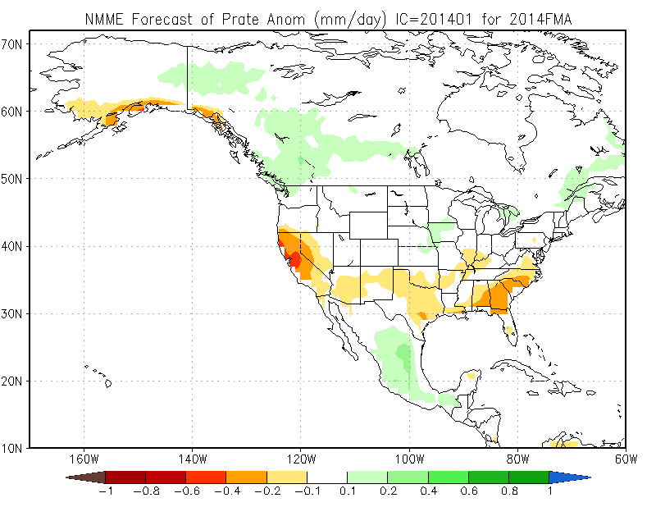
NMME T and P Forecasts
T2M Feb
Precip Feb
T2M FMA
Precip FMA

Slide 34

T2m RMSE: 20N-20S
CFSv2 Has Larger RMSE 64% of the Time
Single Model
NMME
September Starts 0.5-5.5 Lead Times

Slide 35
T2m October Starts JFM Verification

Slide 36

The winner various with variables, seasons, lead time etc. NMME is always among the best.

Slide 37









NMME Real-Time Verifications: T2m OND 2013
CFSv2
CMC1
CMC2
Temperature
Precipitation
GFDL
NCAR
NASA
NMME
Prob Fcst
Obs

Slide 38

CFS-based Extended-range Hazard Guidance:
Mississippi & Ohio Valleys Severe Thunderstorm Outbreak, December 21­-22, 2013
As early as 11 days prior, identifiably consistent CFS forecasts indicated environments favorable to severe weather.

Slide 39

CFSv2 14-day forecast of “tornado index”
06Z Dec 8, 2013 start, single ensemble member

Slide 40
4. Thoughts on CPC’s Monthly Climate Reviews
Purpose of CPC Climate Reviews?
  Any external audience?
  Is this mainly for CPC internal training?
  CPC: Climate Reviews focus on real-time monitoring and diagnosis
    However, somehow duplicated with other CPC briefings
      Drought briefing
      Ocean briefing
      Seasonal forecast conference
  NCDC: long-term monitoring; State of Climate (except ENSO)
  ESRL: Attributions of past major events
Does CPC want to do authoritative and consistent Climate Reviews on real-time monitoring, diagnosis and verification/attribution? If so,
  the reviews should be done by a few experts as CPC official products
  the audience should include external people
  May need to include additional near real-time forecast diagnosis and attributions , which will be helpful to CPC forecasters, general users, and forecast tool/modle diagnosis and improvements.

