Slide 1
CPC Monthly Climate Review
Feb 2014
Jin Huang
Outline:
Global Patterns
Extremes and US anomalies
DJF Climate Attributions
Forecast Verifications
After thoughts on the Monthly Climate Reviews

Slide 2
Global Patterns

Slide 3
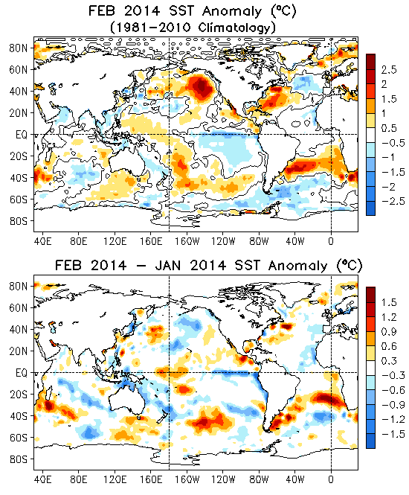
Global SST Anomaly (⁰C) and Anomaly Tendency
Positive (negative) SSTA persisted in the western (eastern) tropical Pacific.
Strong positive SSTA presented in the northeastern Pacific and was associated with negative phase of PDO.
Tripolar SST anomalies presented in the North Atlantic.
Some large SSTAs existed in the South Ocean.
Positive (negative) SST tendencies were observed in the central (eastern) equatorial Pacific Ocean.

Slide 4
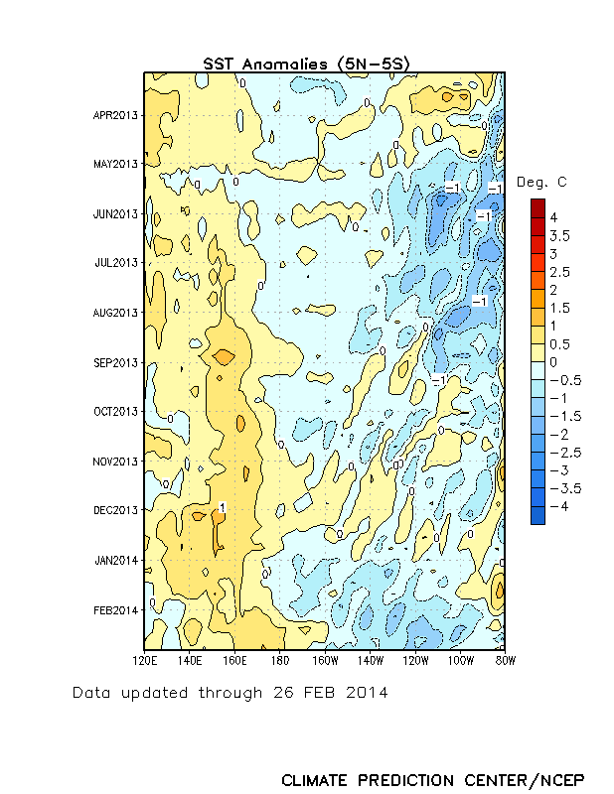
Recent Evolution of Equatorial Pacific SST Departures (ºC)
Time
During May-September 2013, well below-average SSTs were observed over the eastern half of the Pacific.
Since January 2014, SSTs have been below average across the eastern equatorial Pacific, while remaining above-average in the western Pacific.
Longitude

Slide 5
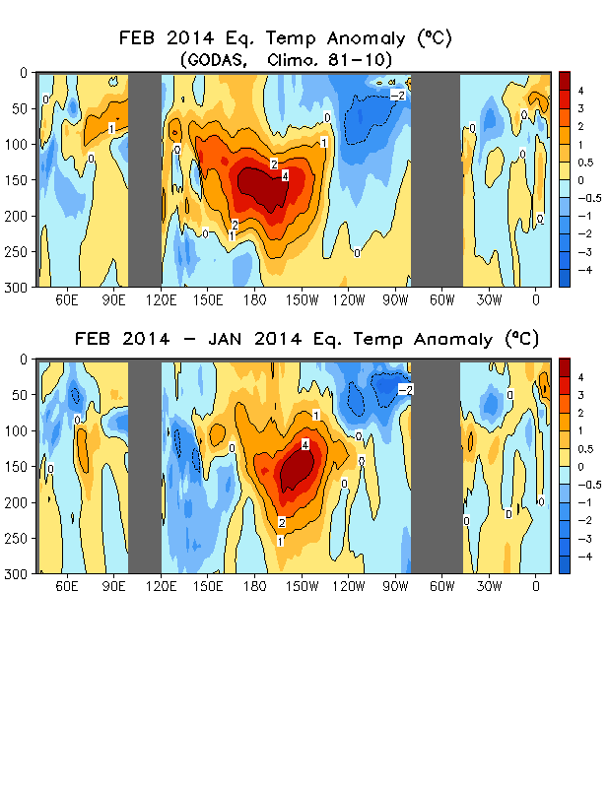
Longitude-Depth Temperature Anomaly and
Anomaly Tendency in 2^{O}S-2^{O}N
Strong positive (weak negative) ocean temperature anomalies in the western (eastern) equatorial Pacific may suggest the potential development of a warm event in this year.
Both positive and negative ocean temperature anomalies were small in the Indian and Atlantic Oceans.
Ocean temperature tendencies were positive in the central-eastern Pacific and negative in the both sides, suggesting an eastward propagation of the positive ocean temperature anomalies along the equatorial Pacific.

Slide 6
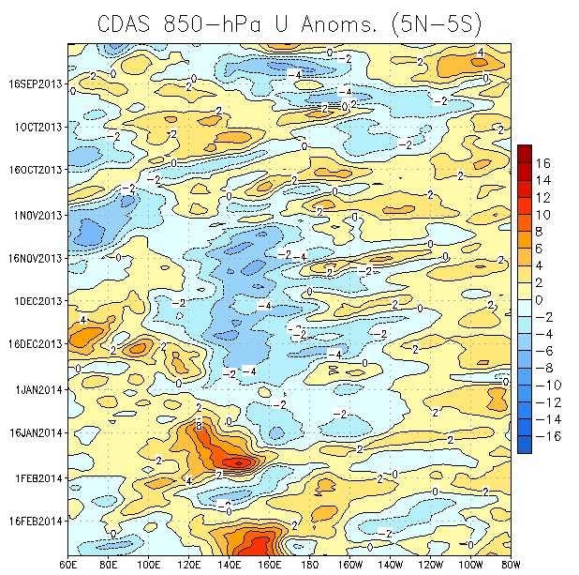
Low-level (850-hPa) Zonal (east-west) Wind Anomalies (m s⁻¹)
Westerly wind anomalies (orange/red shading).
Easterly wind anomalies (blue shading).
Time
During the last half of January 2014, a strong westerly wind burst occurred over the western equatorial Pacific. Over the last couple weeks, another strong burst has emerged.
Longitude

Slide 7
Summary of Oceans
focused on ENSO
Pacific Ocean
ENSO neutral condition continued in Feb 2014.
Positive anomalies of subsurface ocean temperature along the equator propagated eastward and westerly wind burst-like surface wind anomaly were observed in Feb 2014.
ENSO-neutral is expected to continue in spring 2014, with about a 50% chance of El Niño developing during the summer or fall.
Negative PDO persisted in Feb 2014.
Indian Ocean
Small anomalies.
Atlantic Ocean
NAO switched into positive phase

Slide 8
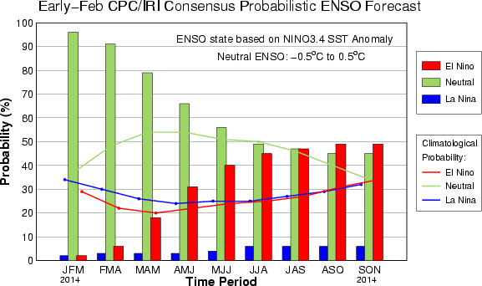
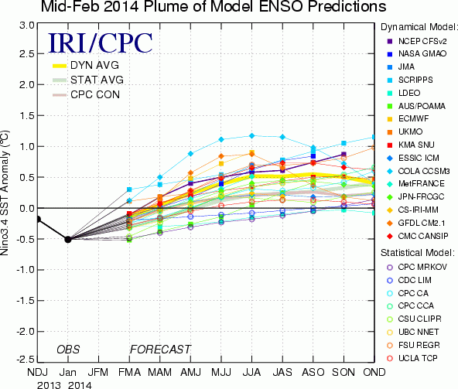
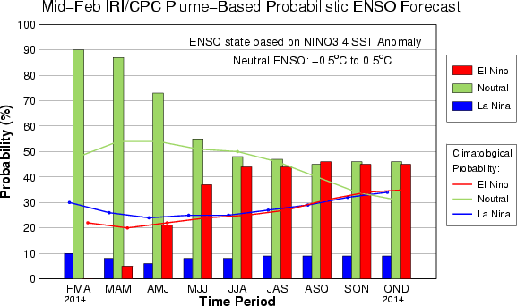
IRI NINO3.4 Forecast Plum
- All models predicted a warming tendency and a majority of dynamical models predicted an El Nino in second half of 2014.
- Consensus probabilistic forecasts slightly favor a warm phase of ENSO in 2014.
- NOAA “ENSO Diagnostic Discussion” on 06 March 2014 issued “El Nino Watch” and suggests that “ENSO-neutral is expected to continue through the Northern Hemisphere spring 2014, with about a 50% chance of El Niño developing during the summer or fall”

Slide 9
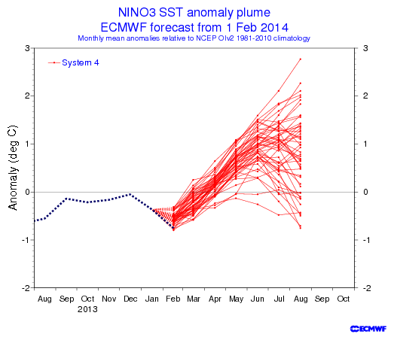
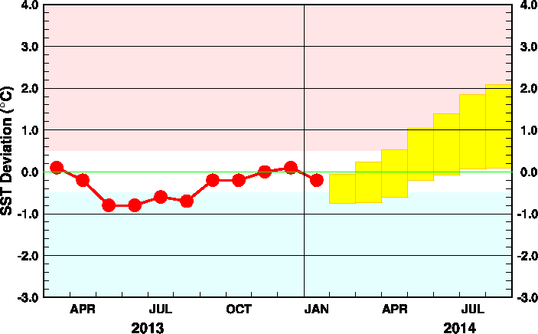
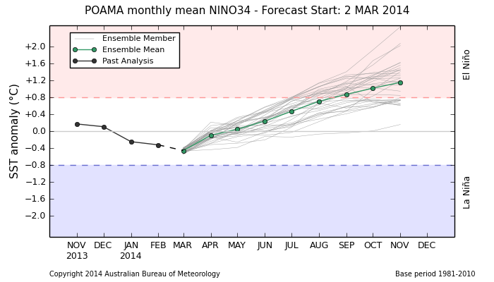
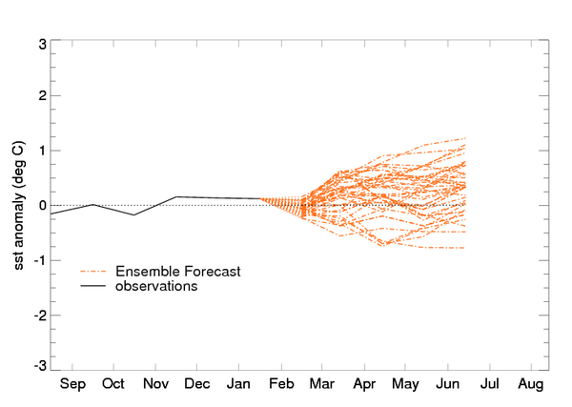
Individual Model Forecasts: warming tendency or neutral
JMA: Nino3, IC=Jan 2014
Australia: Nino3.4, IC=02Mar2014
UKMO: Nino3.4, IC=Feb2014

Slide 10
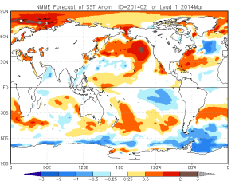
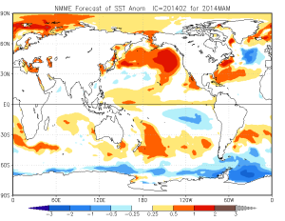
NMME SST Forecasts
March 2014
Warm SSTAs in the North Pacific strengthen
Warm SSTAs in the tropical Atlantic
ENSO neutral
This pattern has seen persistent for more than 6 months and it will persist to spring 2014
Models are consistent
MAM 2014

Slide 11
AO, NAO, PNA

Slide 12
Extremes and US anomalies
in February 2014

Slide 13
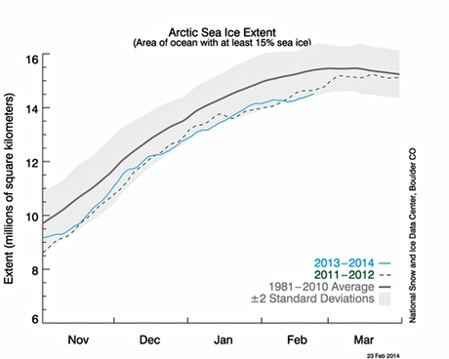

Slide 14
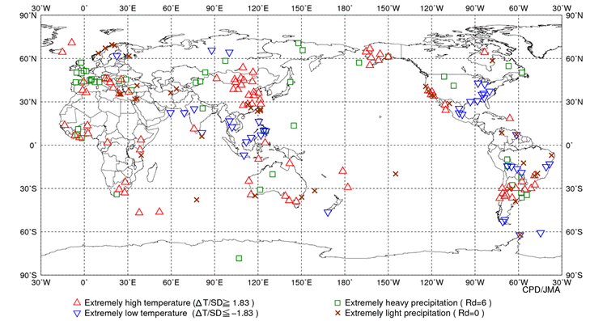
Extremes in February 2014 (updated Feb.14)
Heatwaves in part of Russia and Arctic (+11C above normal), China, Australia
Return of the polar vortex to North America.
Britain has had its wettest winter in 250 years.
Snow in Vietnam

Slide 16
U.S. Temperature and Precipitation Departures During the Last 30 and 90 Days
Last 30 Days
30-day (ending 1 Mar 2014) % of average precipitation
30-day (ending 1 Mar 2014) temperature departures (degree C)
Last 90 Days
90-day (ending 1 Mar 2014) % of average precipitation
90-day (ending 1 Mar 2014) temperature departures (degree C)

Slide 17
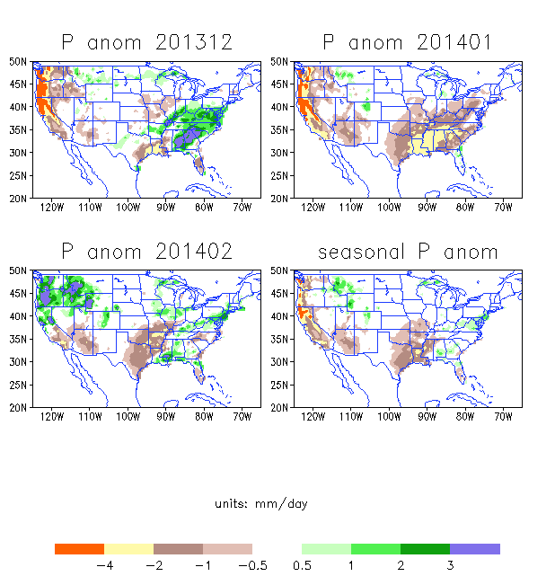

Slide 18
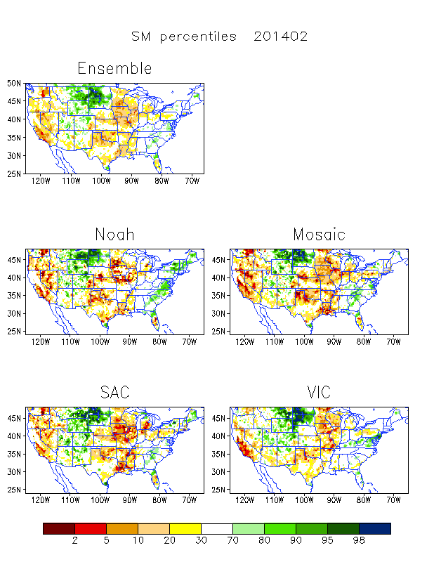
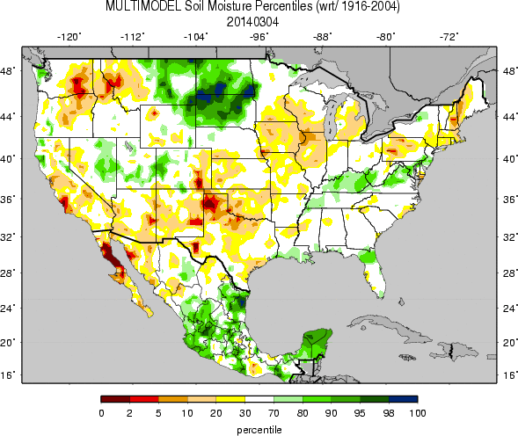
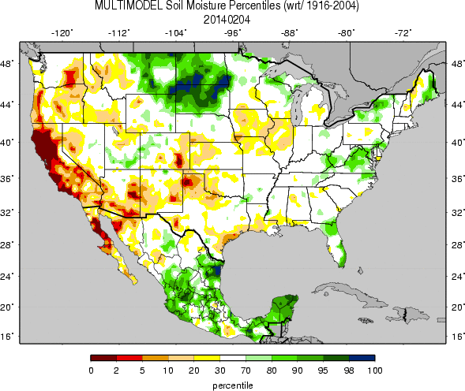
UW FEB
SM percentiles
For Feb 2014
NCEP
EMC/NCEP
The UW multi model Ensemble
EMC Dec 2013
Multi model ensemble
UW JAN
Both show improvement of California
and west coast drought
Wetness over the Dakotas continues

Slide 19
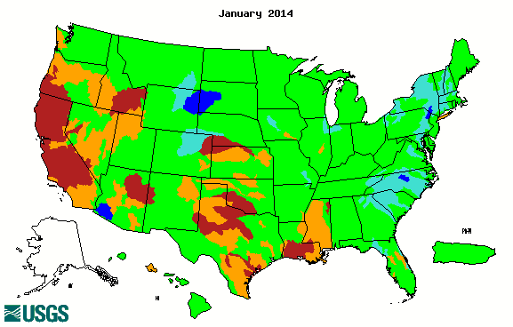
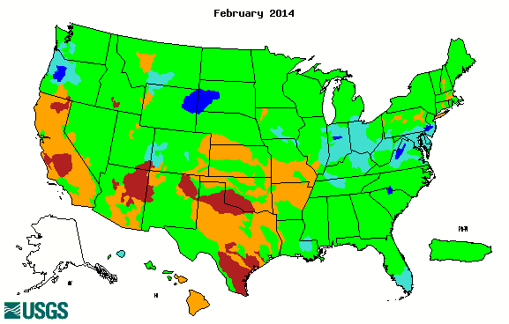
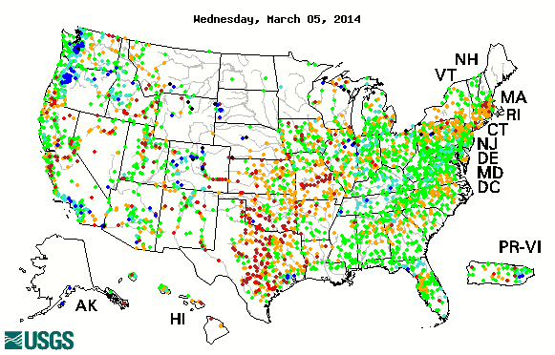
Streamflow Percentiles (USGS)
Jan 2013
Dry: Much improved over the west coast, dryness continues over Texas
FEB 2014
Feb 27-Mar 5

Slide 20
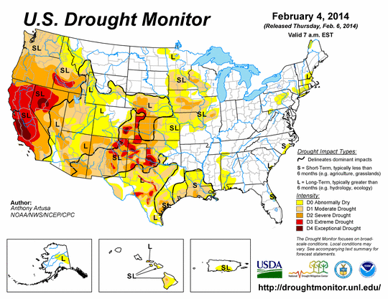
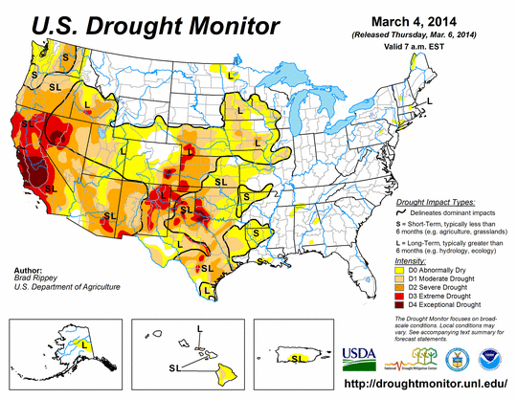
Drought Monitor
Similar to the DM last month
Drought conditions over California and Nevada and Texas

Slide 21
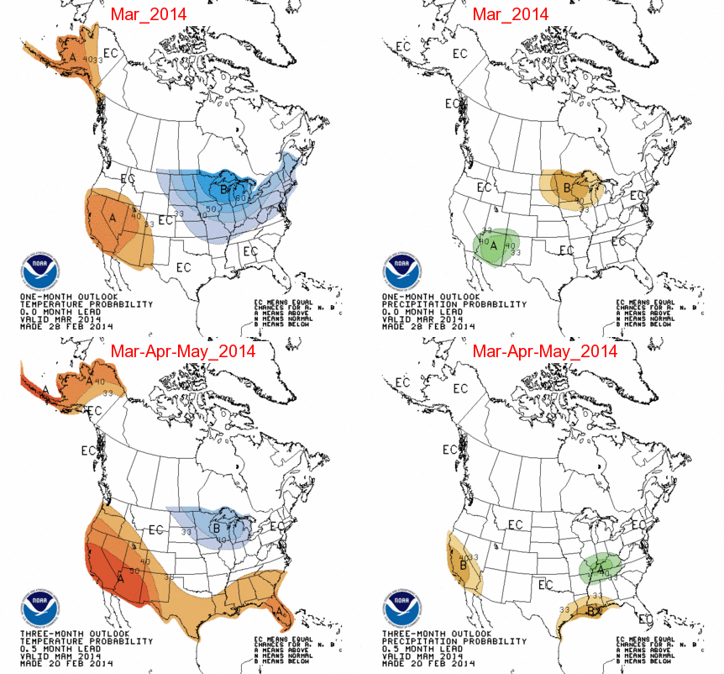
CPC Spring 2014 Temp and Precip Forecast

Slide 22
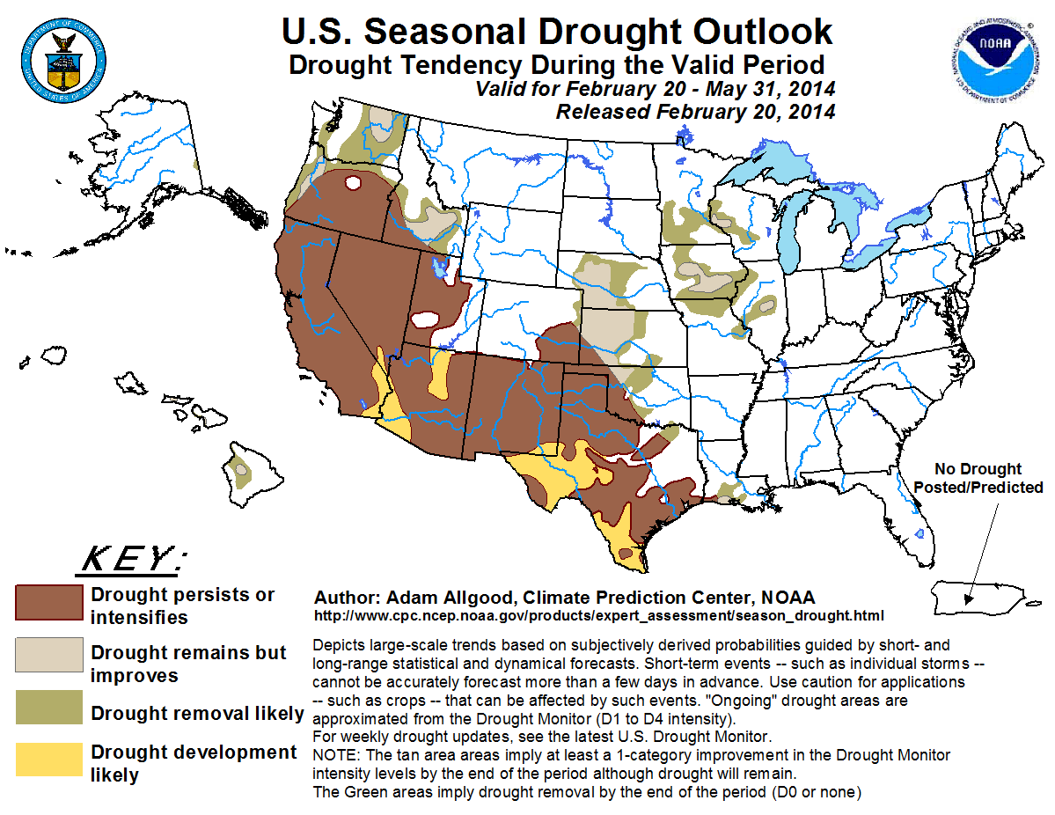
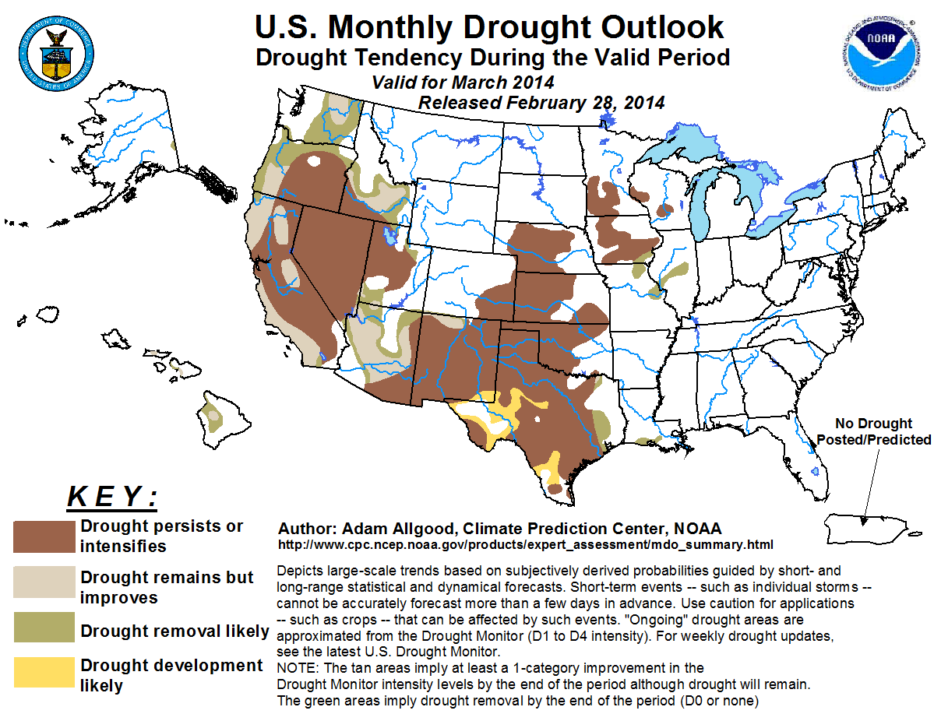
Drought Outlooks
Seasonal
Monthly
Monthly

Slide 23
DJF 2014 Climate Attributions
Constructed Analogue: Specify Z500 and Tsfc based on SST using methods (Huug)
Linear Model: Explain N. American circulation anomalies based on tropical diabetic heating (Peitao)
Mass Transport (Jan. CPC Climate Reviews and tomorrow’s seminar)
(Ming Cai)
The blind men and the elephant

Slide 24
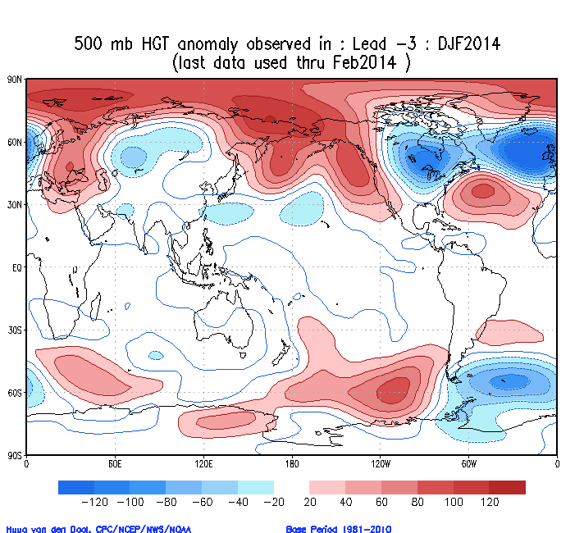

Slide 25
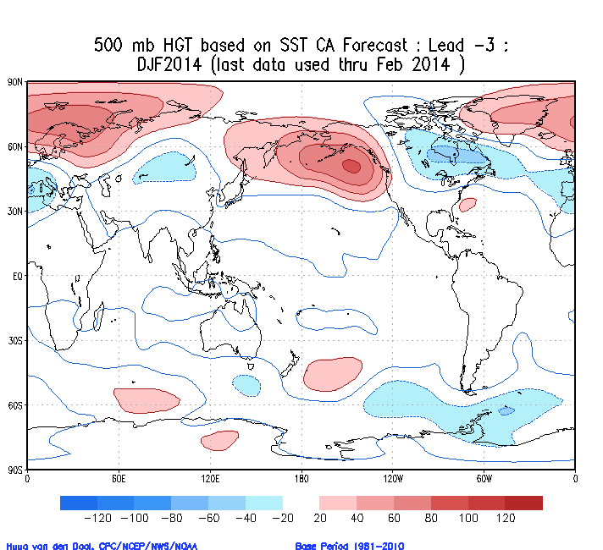
Global SST

Slide 26
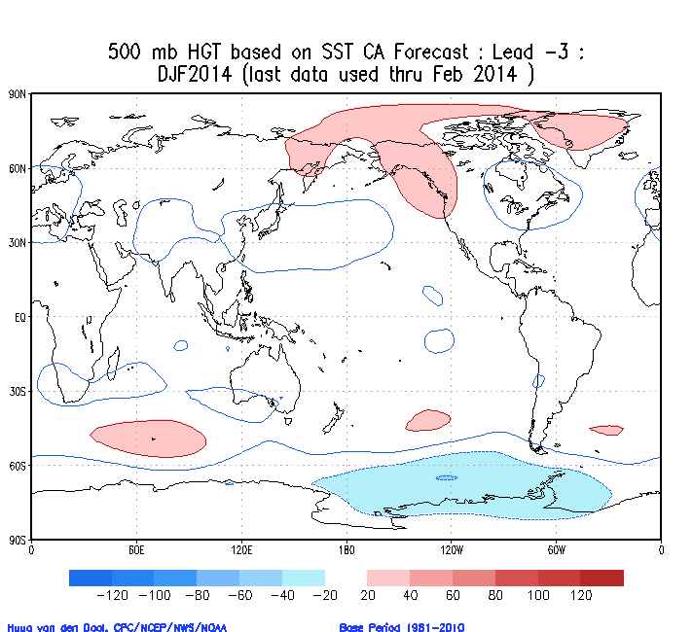
Tropical SST only

Slide 27
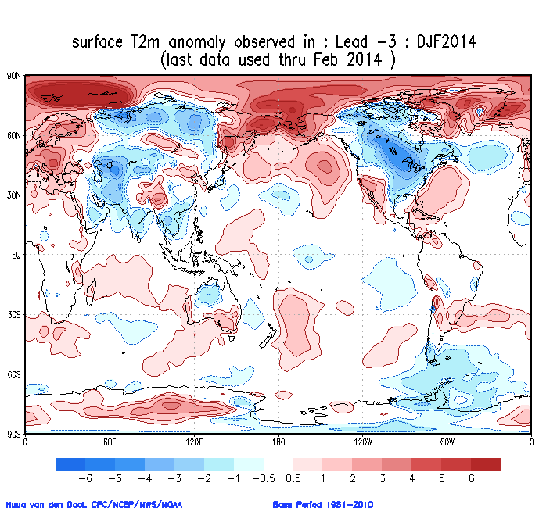

Slide 28
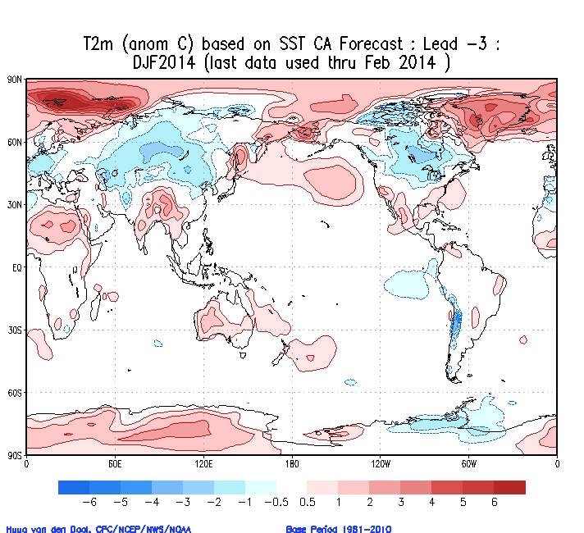
Global SST

Slide 29
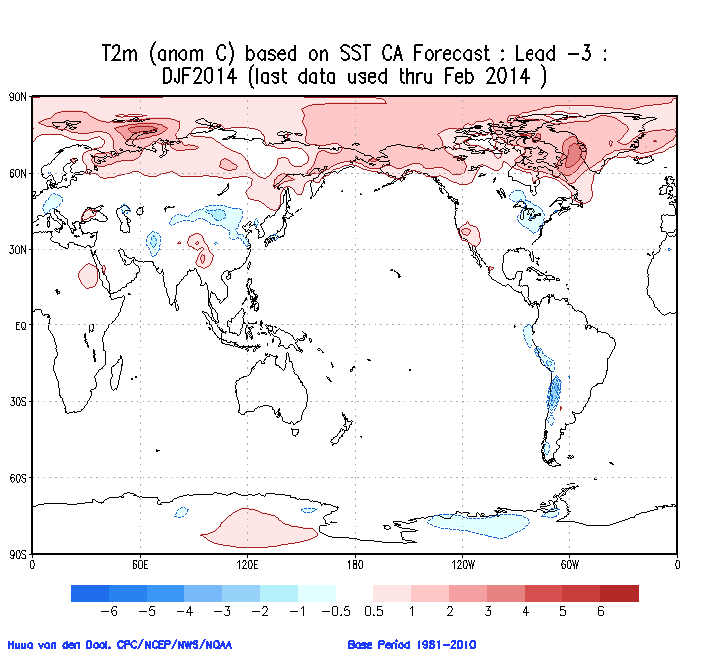
Tropical SST only

Slide 30
What caused DJF climate anomalies in North America (NA)? (from Peitao Peng)
Circulation anomalies over NA region is quite persistent during the period, and so is the warmer SST in northeast Pacific;
Is the warmer SST a forcing? maybe, but how to understand the big month-to-month variation of atmospheric circulation over it?

Slide 31
Suggestions from the Relationship between 200mb Stream Function and Precipitation Patterns
Though ENSO is neutral, significant precipitation (diabatic heating) anomalies were found in the tropics during the period;
Phase relationships between the subtropical stream function and tropical precipitation suggest the tropical diabatic heating anomalies may be responsible for the circulation anomalies to some extent.

Slide 32
What are told by wave flux vectors?
Wave flux vectors (Plumb 1995) tell how low-frequency waves propagate and where the waves are started
The waves propagating to NA region are from subtropics for the December and January, and higher latitudes for the February

Slide 33
Waves Directly Forced by Tropical Diabatic Heating Anomalies
Tropical precipitation rate are converted to 3-D diabatic heating by giving a vertical profile;
Use the tropical heating to force a dynamical stationary wave model, which is linearized about monthly climatological flow, the direct global atmospheric response to the heating are obtained;
It turns out that for the December and January, the subtropical features from which waves propagating to NA region started are simulated, but little is explained for February.

Slide 34
Peitao’s Conclusions
For Dec2013 and Jan2014, some subtropical features, from which waves propagating to NA region started, are likely forced by the tropical heating. The forced patterns may tend to modulate transient eddies, and thus generate and maintain the waves to NA region;
For Feb2014, the circulation anomalies are more likely caused by the internal dynamics of the mid-latitude atmosphere.
The effect of the warmer SSTs in northeast Pacific is not clear yet.

Slide 35
Forecast Verification

Slide 36
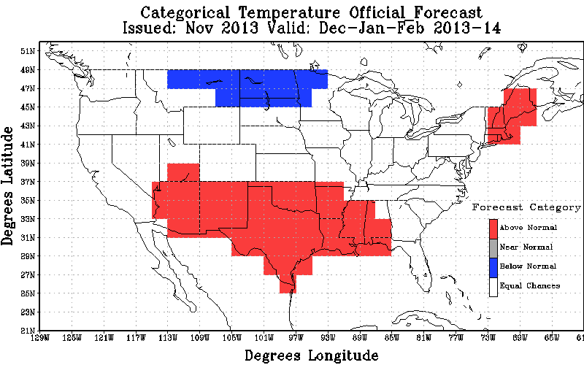
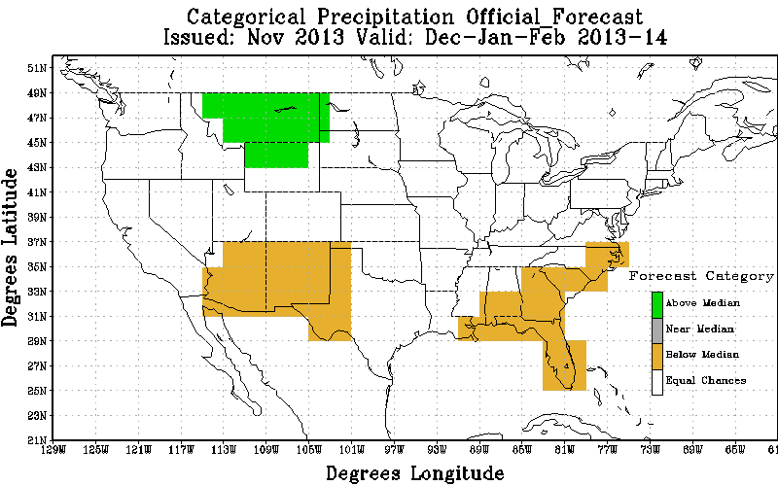
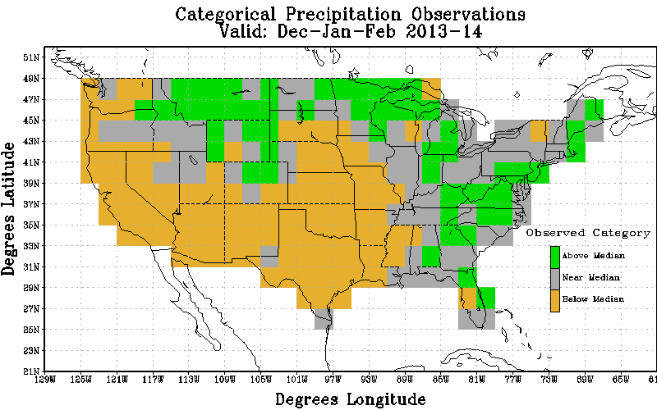
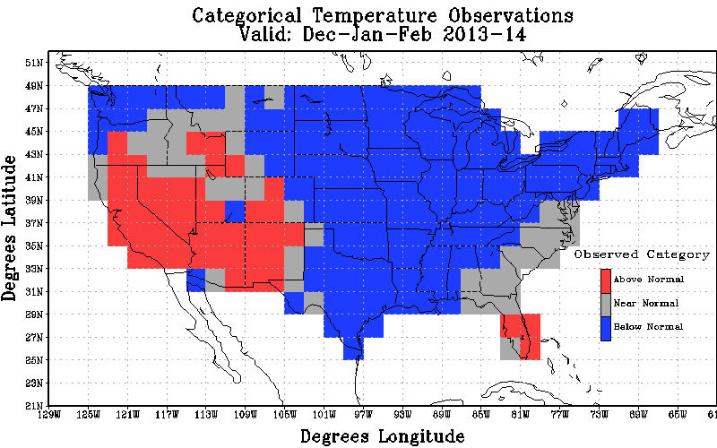
CPC DJF 2013-14 Forecast Verification
Temp
Precip

Slide 37
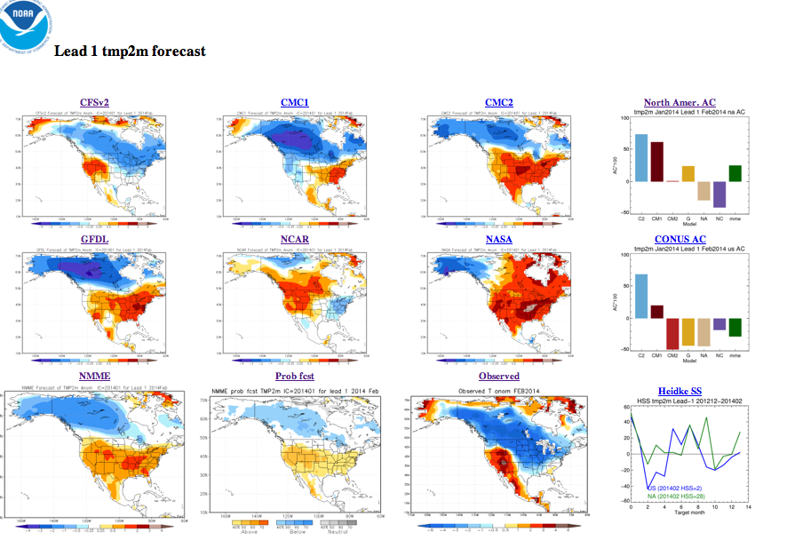

Slide 38
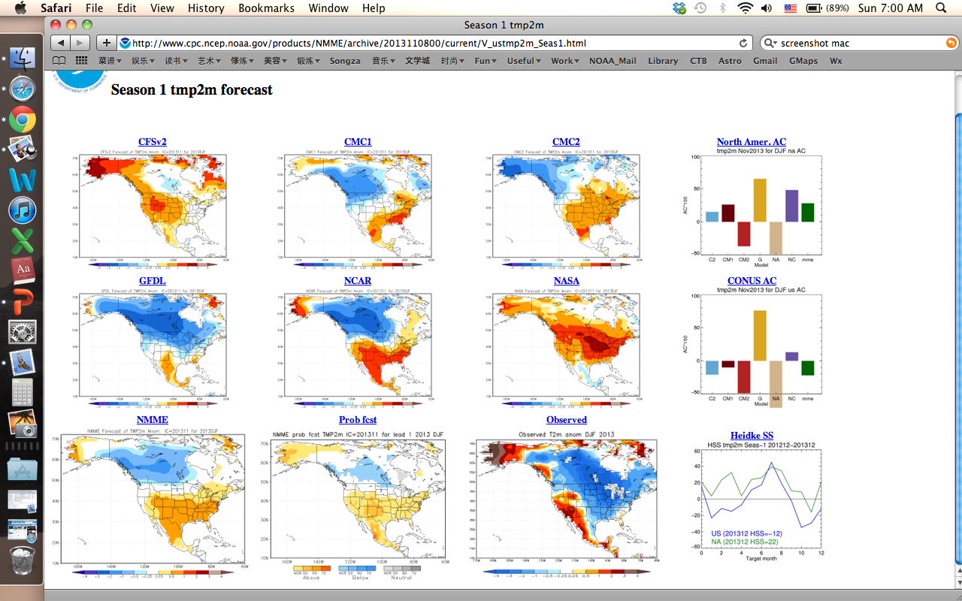
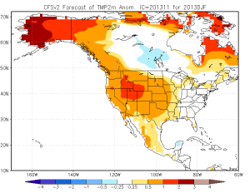
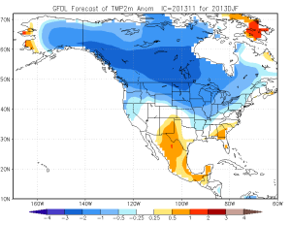
DJF 2013-14 T2m

Slide 39
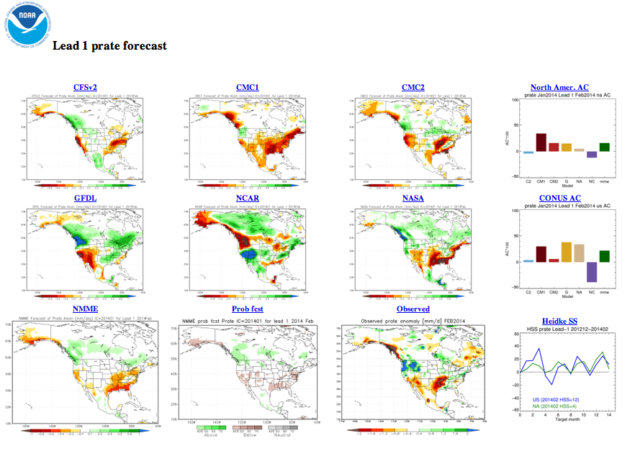

Slide 40
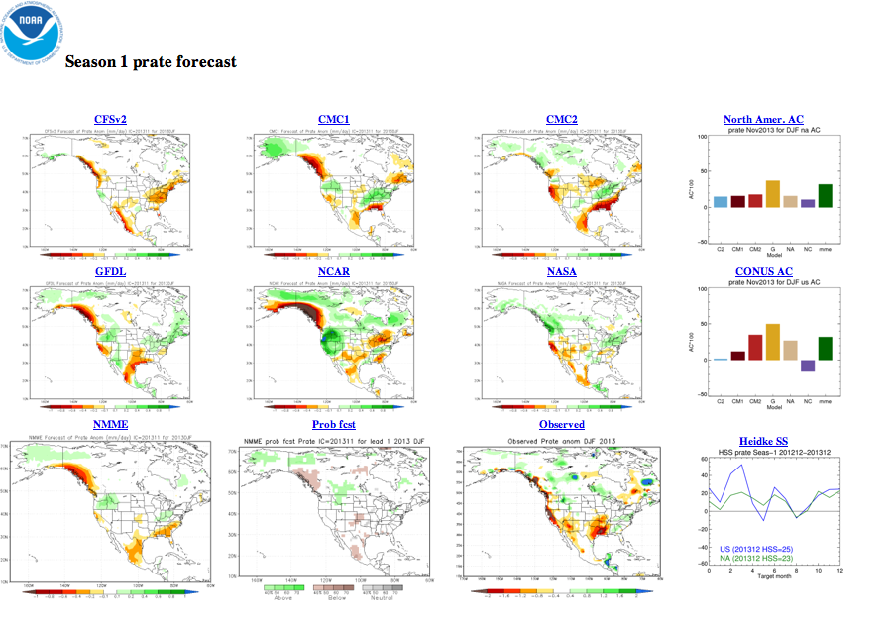

Slide 41
After Thoughts
On CPC Monthly Climate Reviews
+ Helpful to get familiar with CPC products, current Climate States, etc.
Overlap with other briefings
The Reviews could be more useful, if they are
more “official” (e.g., made by “experts”)
more unique, e.g., including
Attributions on recent climate events/anomalies
Verification/Attribution of forecast models/tools
Have external audience, so that
i) external community will turn to CPC for expert discussions on real-time climate attributions
Ii) get more eyes and brains on the issues

