Slide 1
Monthly Climate Review February 2013
March 8, 2013
Steve Baxter

Slide 2
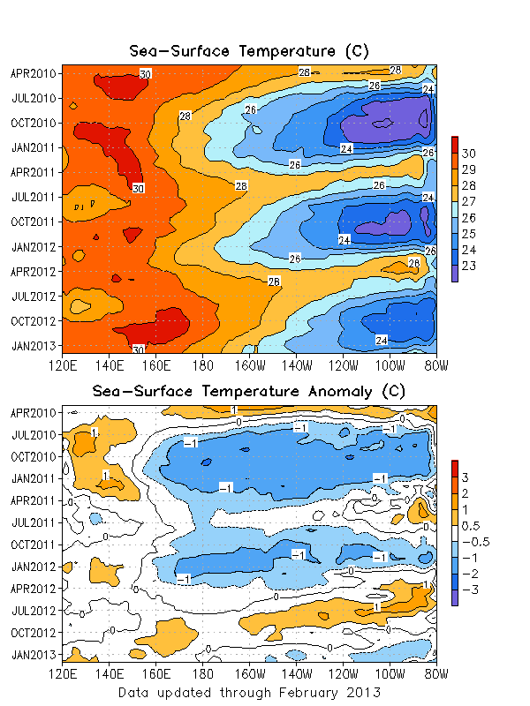
ENSO
Sea surface temperatures were near to slightly below normal across most of the equatorial Pacific.
ENSO neutral conditions persist.

Slide 3
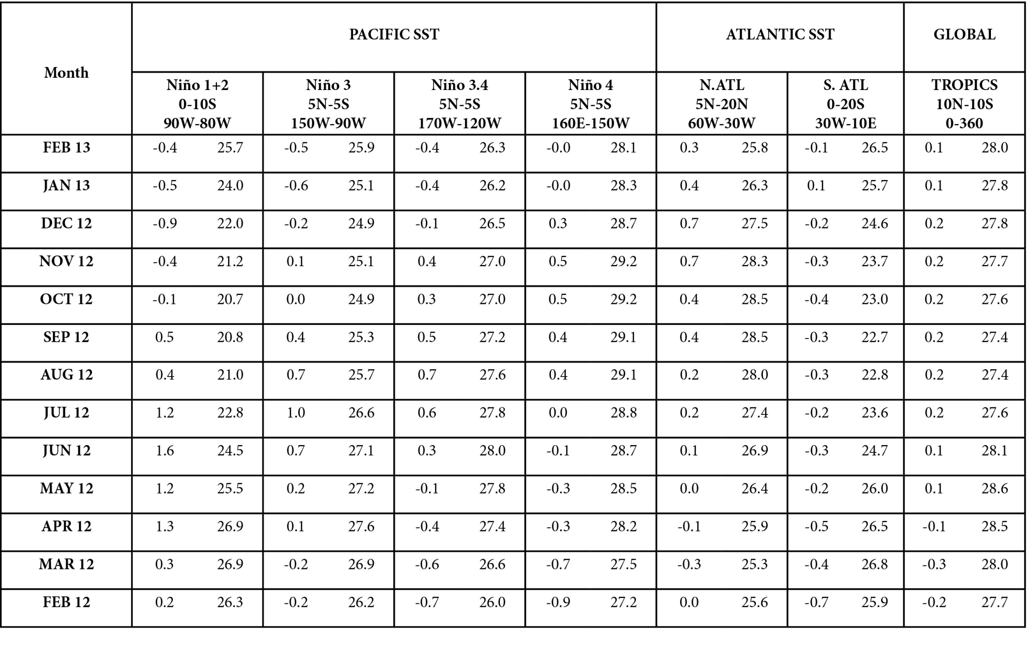

Slide 4
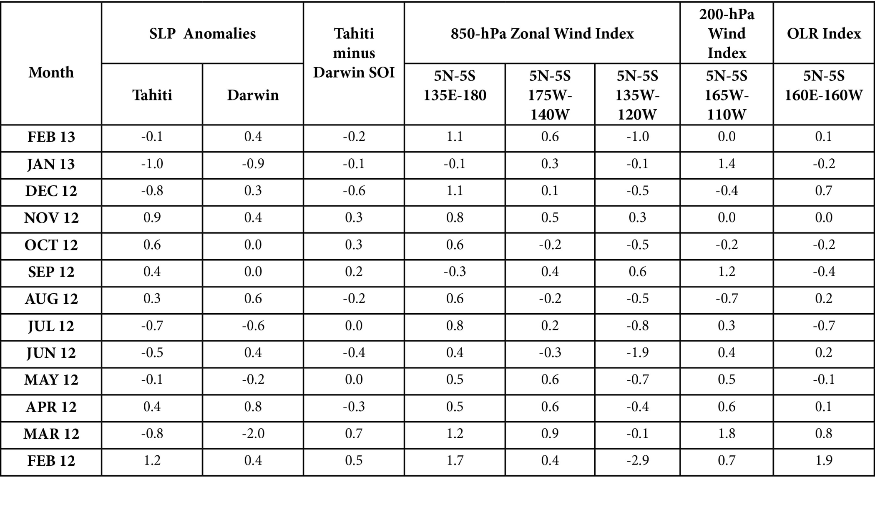

Slide 5
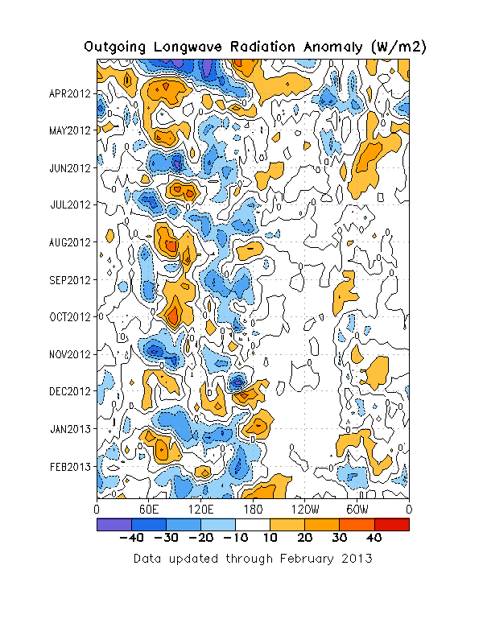
Outgoing Longwave Radiation
The OLR evolution was dominated by a combination of MJO activity and equatorial Rossby (ER) waves.
Convection was replaced by subsidence near the Date Line late in the month due to a superposition of the suppressed phase of the MJO and the ER wave.

Slide 6
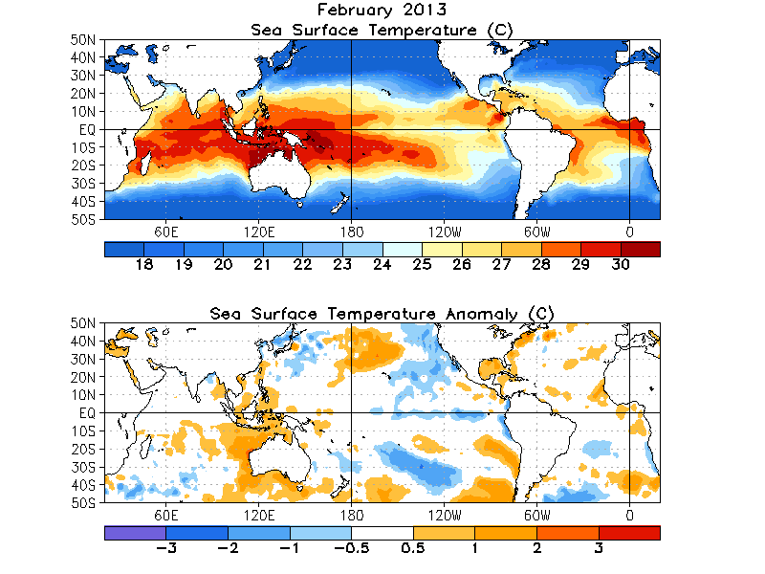
Global SST
PDO? Sort of…
Weak anomalies across the Atlantic

Slide 7
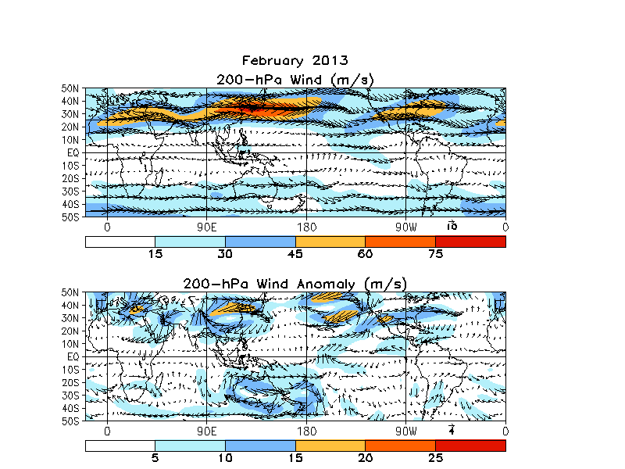
200-hPa Wind Anomalies
East Asian jet stream appeared to be slightly retracted and shifted a little north.
Strongest anomalies were a result of amplified late-month circumglobal wave pattern. Could this have been forced by North Atlantic blocking pattern? MJO likely contributed to slight retraction over Asia as convection blossomed over the Maritime Continent late in the month.

Slide 8
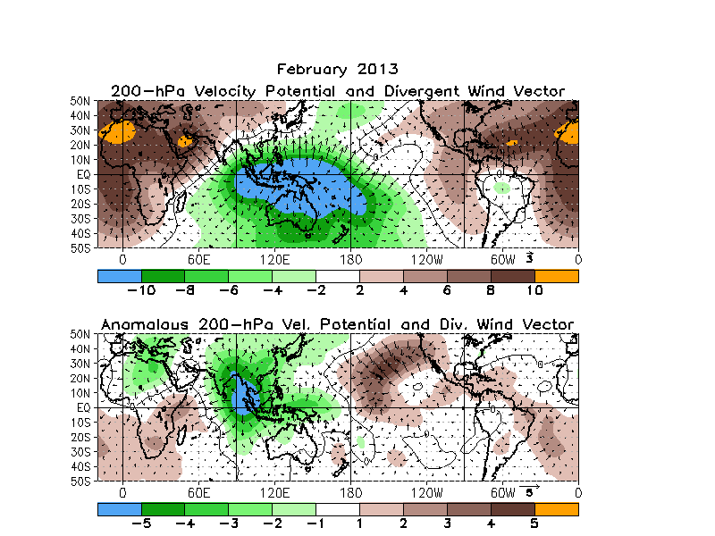
200-hPa Velocity Potential
Velocity potential resembles the mean MJO forcing, but not canonically.
Interesting couplet near and east of Hawaii seems important.

Slide 9
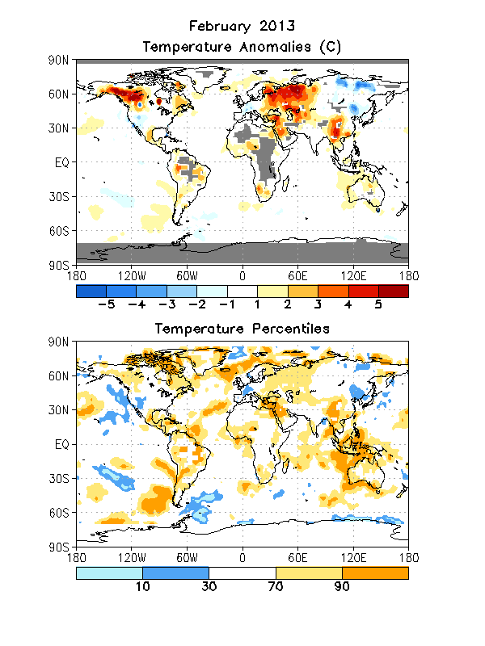
Global Temperatures
Continued cold from December and January over much of northeastern Asia.
Generally mild across northern North America; cooler across the south.
Parts of the interior Western CONUS were quite cold as in January, with lots of near normal nationwide.

Slide 10
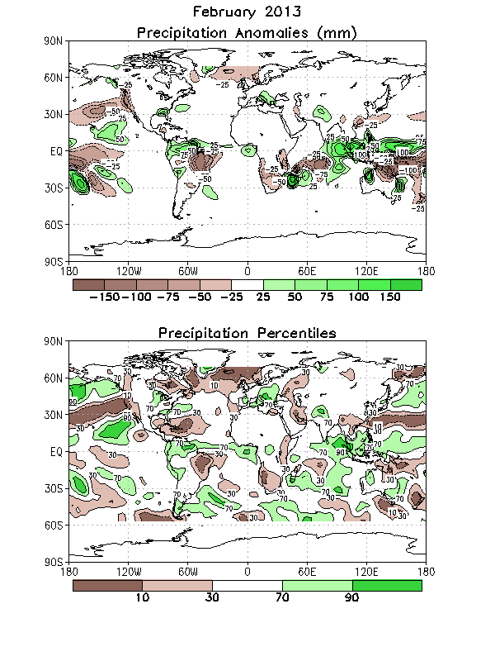
Global Precipitation
Southeast US wet; West Coast generally dry.
MJO-related precipitation anomalies were observed over much of the Maritime Continent and eastern Indian Ocean.
Precipitation dipole between northern and southern Europe a classic response to late-month –AO/NAO event.

Slide 11
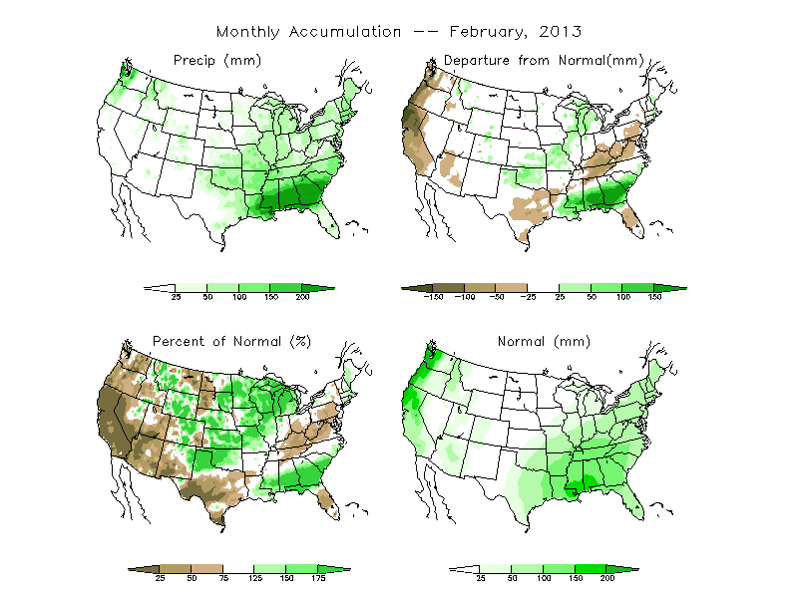
US Precipitation

Slide 12
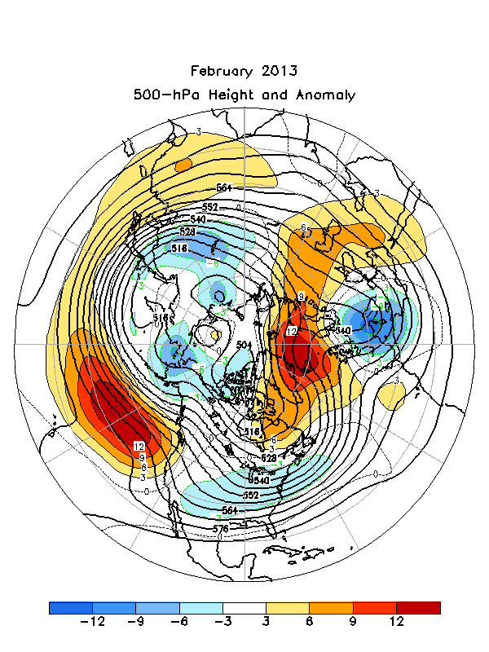
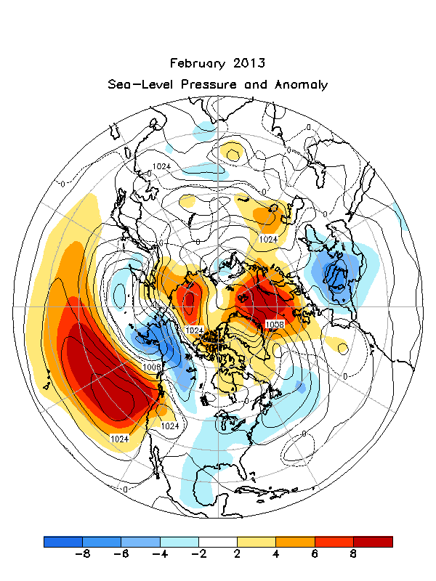
NH 500-hPa Height Anomalies and Sea-level Pressure Anomalies

Slide 13
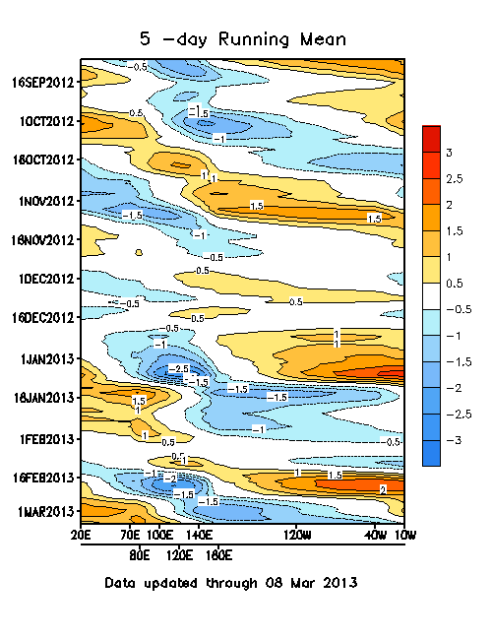
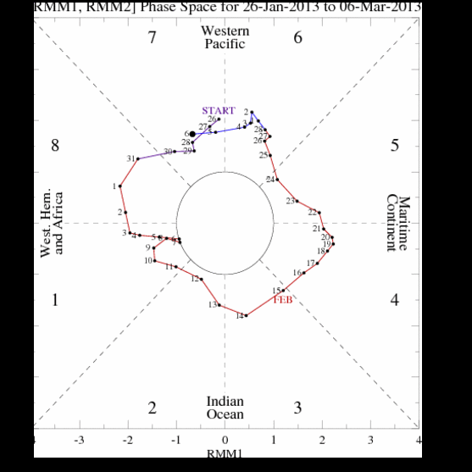
MJO Index

Slide 14
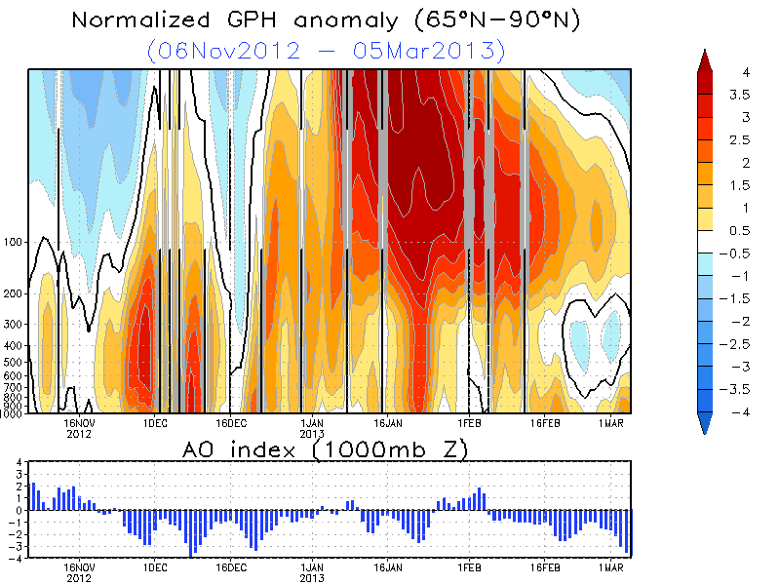

Slide 15
Verification
Monthly, Seasonal, Week-2

Slide 16
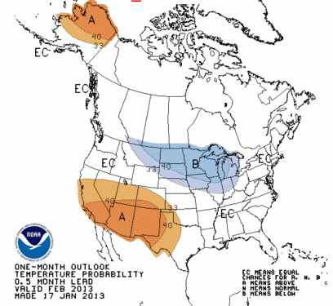
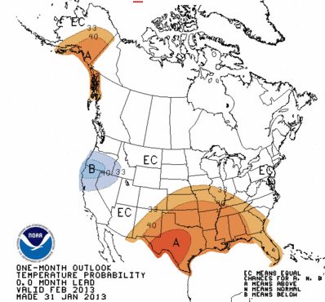
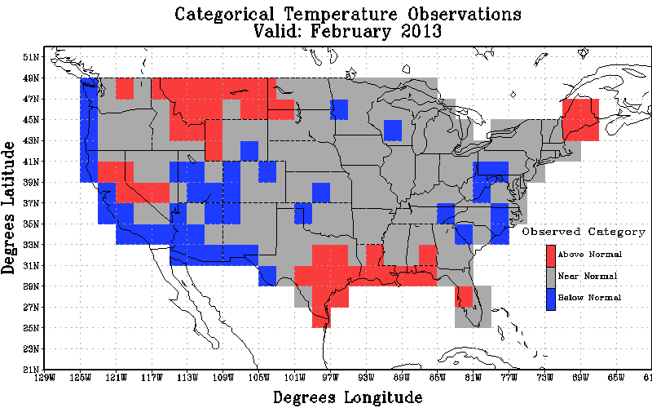
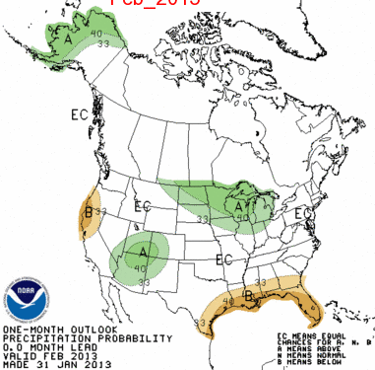
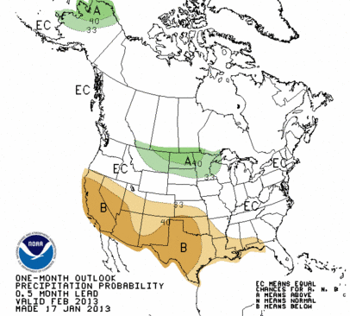
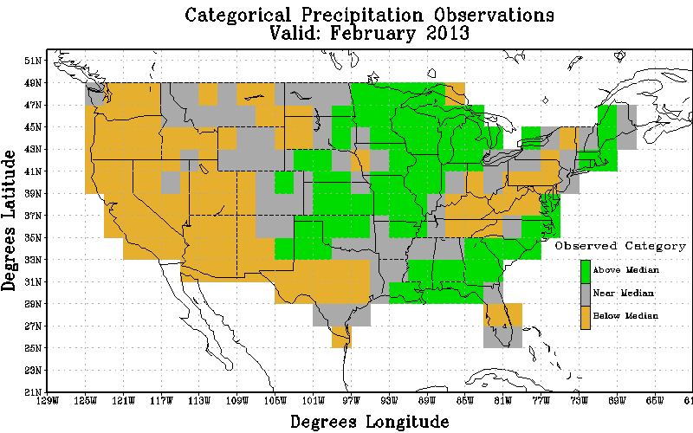
Temp
Official
Revised
Obs
Non-Equal Chance(non EC) forecasts: -39.9
All forecasts: -17.9
% coverage not Equal Chance forecasts : 44.8
Non-Equal Chance(non EC) forecasts: -16.7
All forecasts: -6.5
% coverage not Equal Chance forecasts : 38.8
Precip
Official
Revised
Obs
Non-Equal Chance(non EC) forecasts: 33.3
All forecasts: 14.2
% coverage not Equal Chance forecasts : 42.7
Non-Equal Chance(non EC) forecasts: 17.7
All forecasts: 6.2
% coverage not Equal Chance forecasts : 35.3

Slide 17
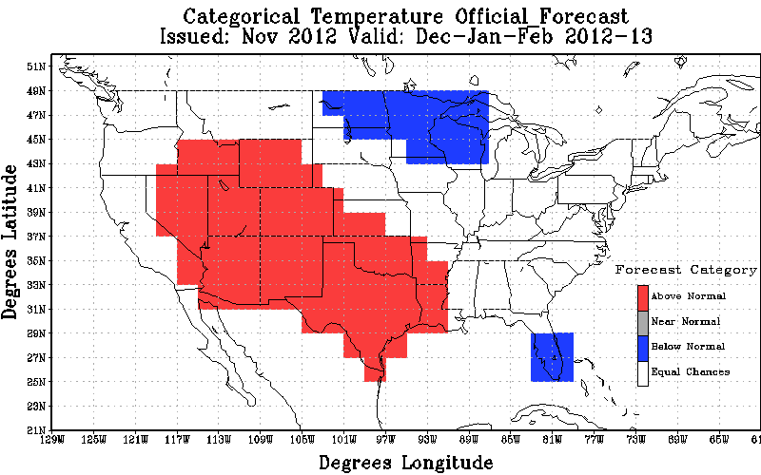
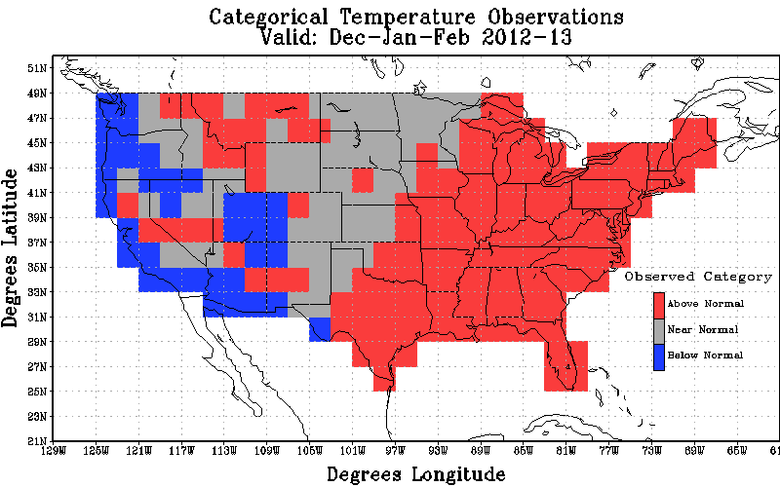
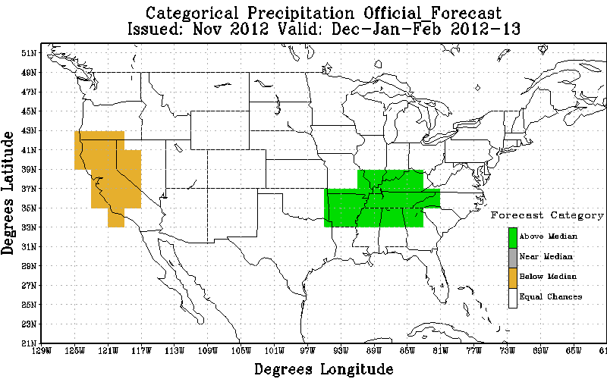
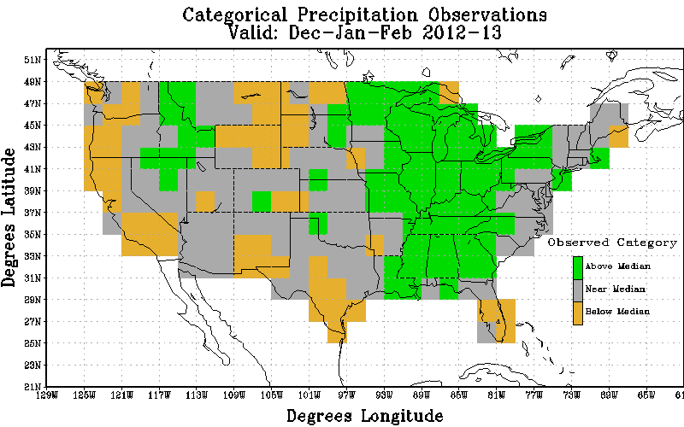
Temp
Official
Revised
Obs
Non-Equal Chance(non EC) forecasts: 1.43
All forecasts: 0.65
% coverage not Equal Chance forecasts : 45.3
Precip
Official
Revised
Obs
Non-Equal Chance(non EC) forecasts: 51.6
All forecasts: 6.9
% coverage not Equal Chance forecasts : 13.3

Slide 18
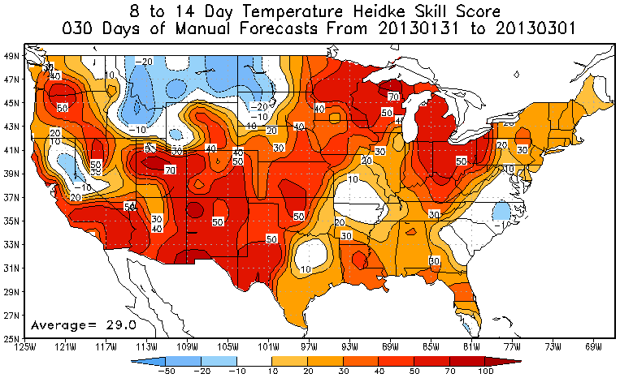
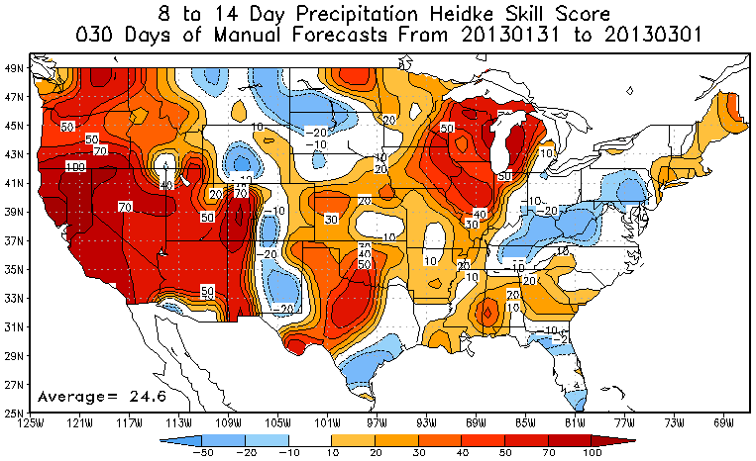
8-14 Day Temperature and Precipitation Scores

Slide 19
Current Predictions
Monthly, Seasonal, ENSO

Slide 20
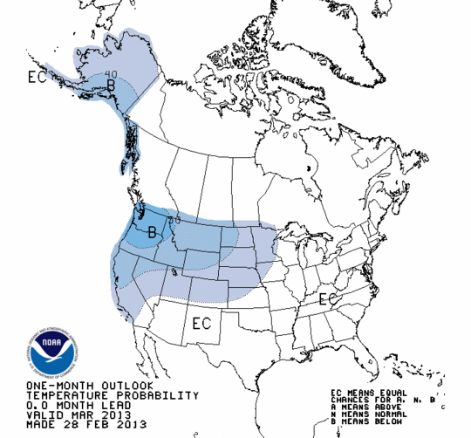
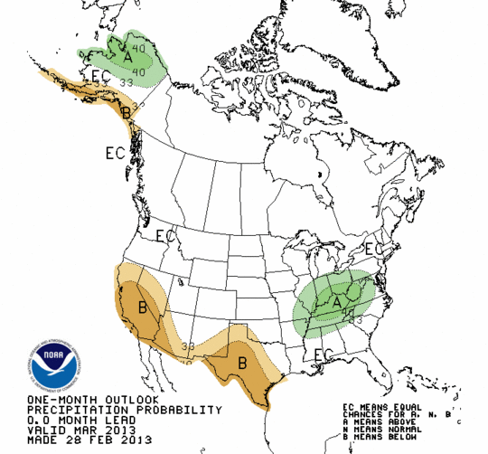
March 2013 Revised Outlook

Slide 21
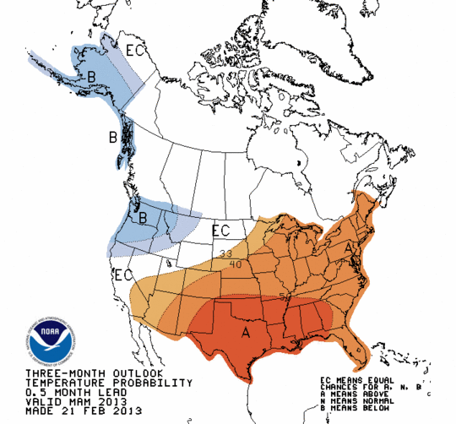
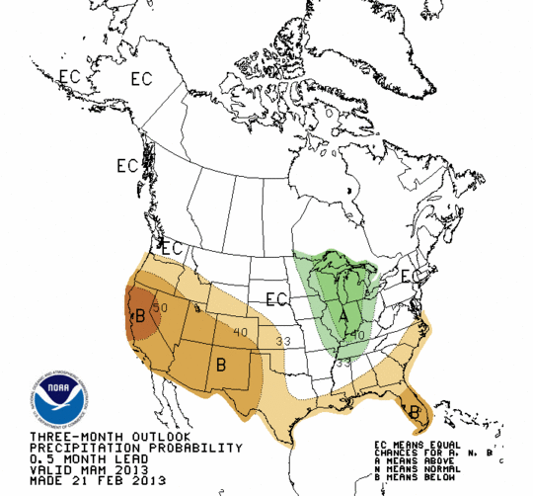
FMA 2013 Seasonal Outlook

Slide 22
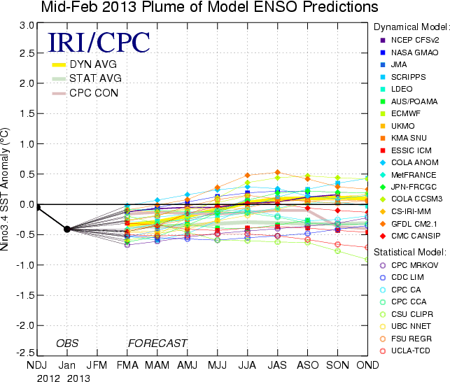
ENSO Forecast Plume

Slide 23
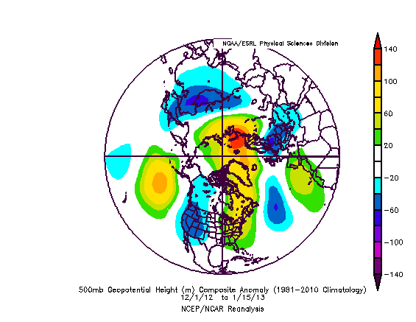
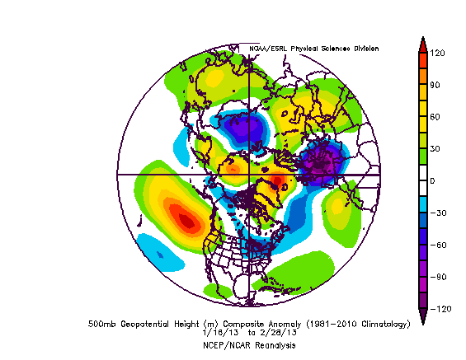
Winter 2012-13 – First Half vs. Second Half

Slide 24
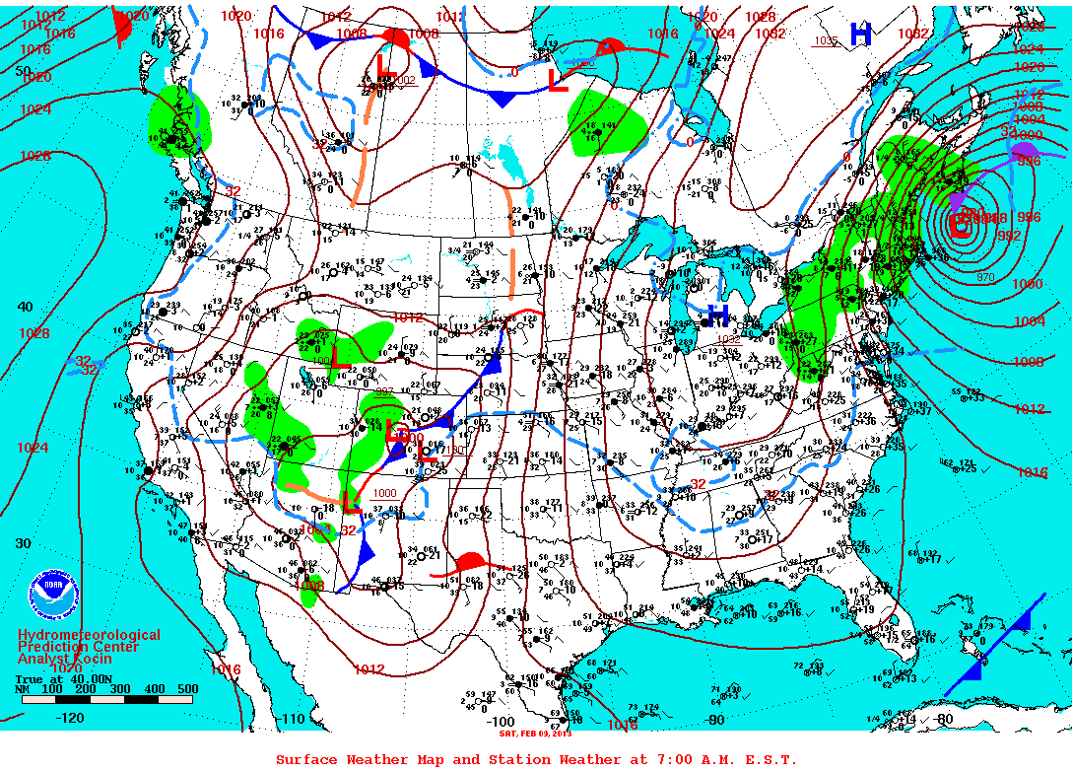
New England Blizzard

Slide 25
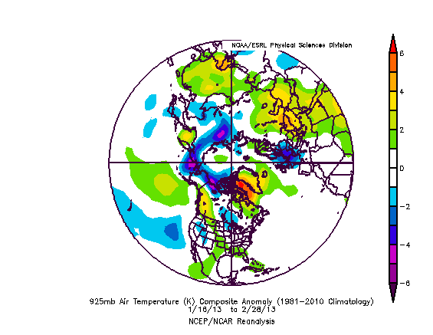
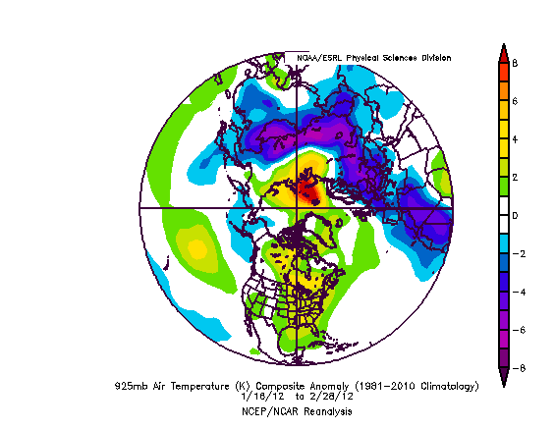
This Winter vs. Last Winter – Second Half

