Slide 1
CPC Monthly Climate Review
January 2014
Jin Huang
Outline:
Tropics (ENSO, PDO)
MJO
Global and US anomalies
CPC Forecast verification

Slide 2
Tropics (ENSO, PDO)

Slide 3
ENSO Neutral
Dec 2013 is similar to Oct –Nov 2013
Warm SSTAs over the North Pacific;
Warm SSTAs over the Atlantic coast (which has been persistent for more than 10-months)

Slide 4
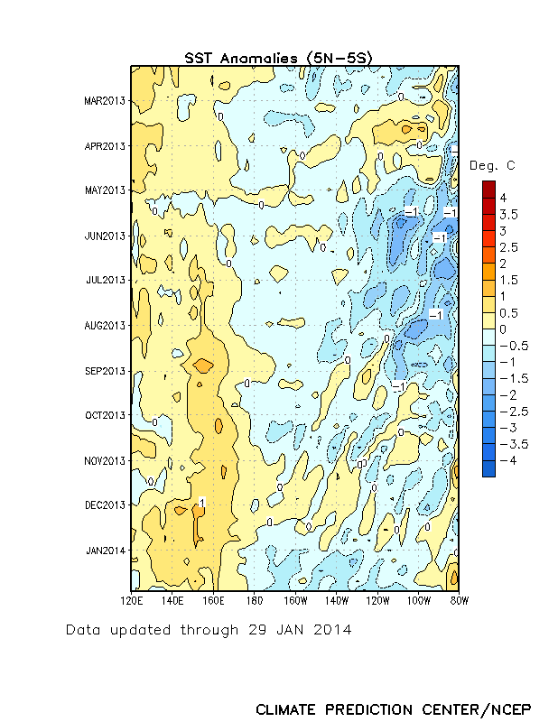
Equatorial Pacific SST Departures (ºC)
During May-September 2013, well below-average SSTs were observed over the eastern half of the Pacific.
In the last couple of weeks, SSTs have been below average between 170ºW-110ºW.
Time
Longitude

Slide 5
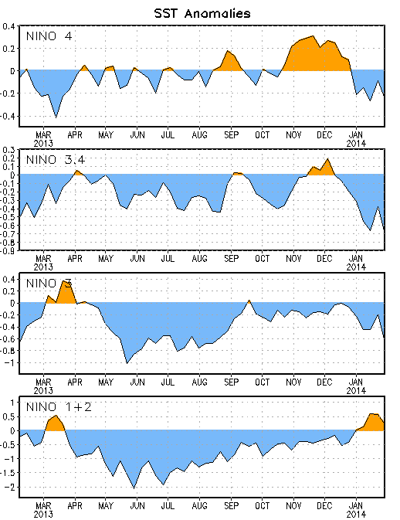
Niño Region SST Departures (ºC) Recent Evolution
The latest weekly SST departures are:
Niño 4 -0.2ºC
Niño 3.4 -0.7ºC
Niño 3 -0.7ºC
Niño 1+2 0.2ºC

Slide 6
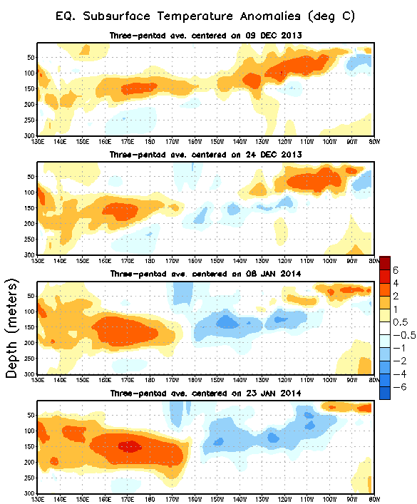
Sub-Surface Temperature Departures (ºC) in the Equatorial Pacific
During the last 2 months, below-average temperatures developed in the eastern Pacific, associated with the upwelling phase of a Kelvin wave.
Recently, negative subsurface anomalies have persisted in the eastern Pacific, while positive anomalies have shifted slightly eastward in the central Pacific.
Time
Most recent pentad analysis
Longitude
Notes:
6

Slide 7
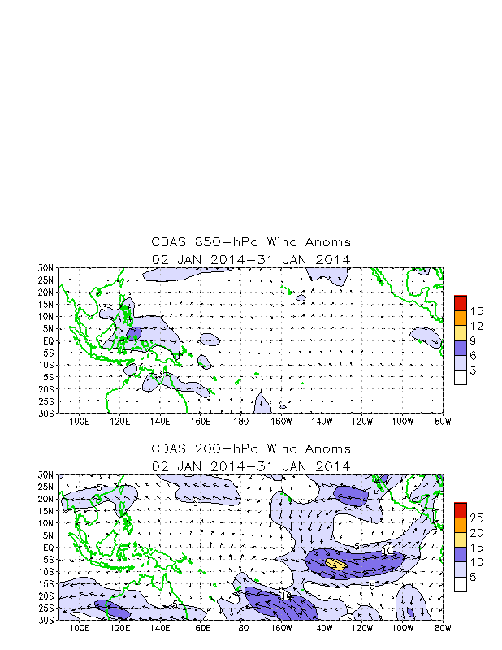
Tropical OLR and Wind Anomalies In January 2014
Negative OLR anomalies (enhanced convection and precipitation, blue shading) were observed over eastern Indonesia, the Philippines, and the equatorial western Pacific. Positive OLR anomalies (suppressed convection and precipitation, red shading) were evident over the central equatorial Pacific.
Anomalous low-level (850-hPa) westerly winds were evident in the far western equatorial Pacific.
Upper-level (200-hPa) westerly wind anomalies were evident over the eastern equatorial Pacific Ocean.

Slide 8
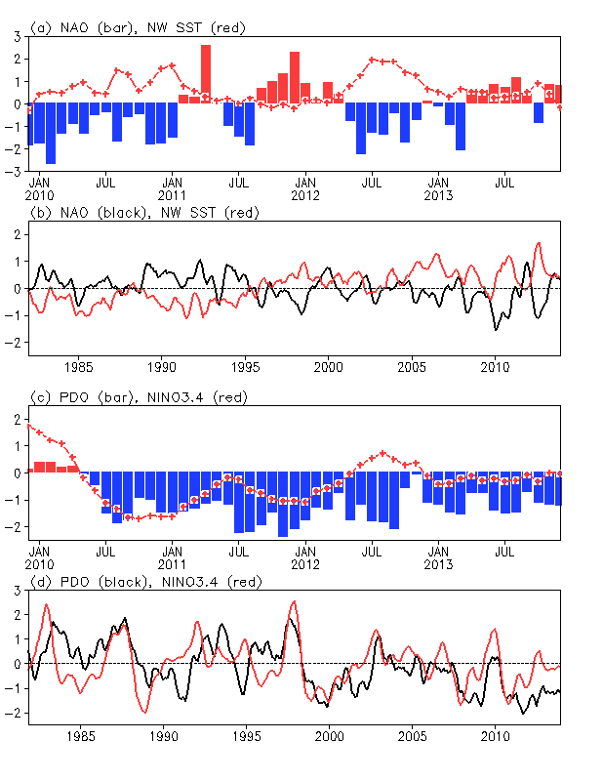
PDO and NINO3.4
There was a regime shift of PDO around 1999.
Negative PDO phase since May 2010
During the positive phase of the PDO, PDO either lagged NINO3.4 (1983-84, 1993-1994) or was in phase with NINO3.4 (1986-87, 1997-98).
The correlation between monthly PDO and NINO3.4 at zero lag is 0.3 in 1982-1998 and 0.56 in 1999-2013. The higher correlation since 1999 is partly attributed to the fact that both PDO and NINO3.4 were in prevalent negative phase since 1999.

Slide 9
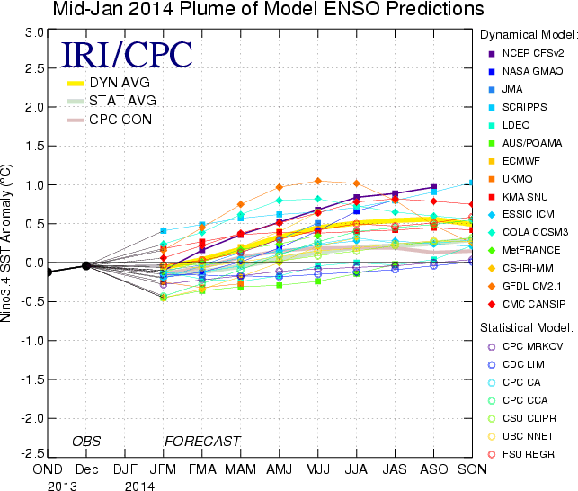
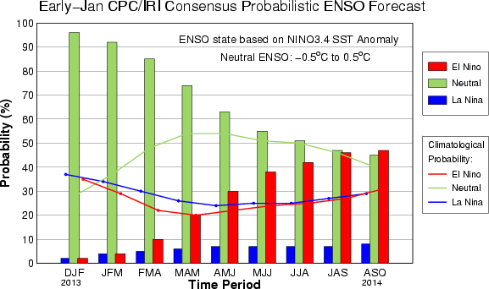
IRI/CPC NINO3.4 Forecast Plume
Most of the models predicted ENSO-neutral to continue into the Northern Hemisphere spring, but some models suggest El Nino will emerge during summer.
The consensus forecast favors ENSO-neutral conditions in spring, and the probability for ENSO-neutral and El Nino is equal in summer.

Slide 10
MJO

Slide 11
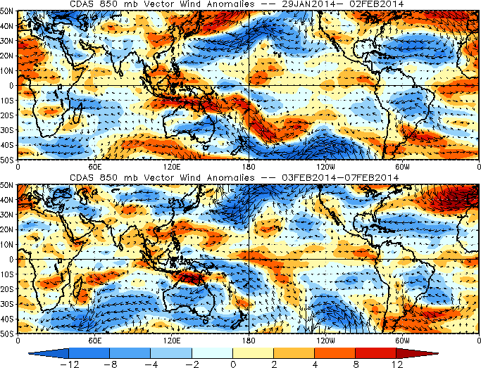
850-hPa Vector Wind Anomalies (m s⁻¹)
Note that shading denotes the zonal wind anomaly
Blue shades: Easterly anomalies
Red shades: Westerly anomalies
Westerly anomalies developed across southern Africa and parts the southwest Indian Ocean during the past five days.
Easterly anomalies expanded into the eastern Maritime Continent, while westerly anomalies persisted across the western Maritime Continent and northern Australia.
Westerly anomalies were observed across much of the equatorial Pacific east of the Date Line.
Notes:
11

Slide 12
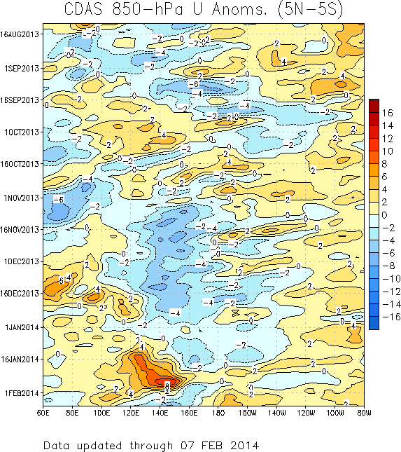
850-hPa Zonal Wind Anomalies (m s⁻¹)
Westerly anomalies (orange/red shading) represent anomalous west-to-east flow
Easterly anomalies (blue shading) represent anomalous east-to-west flow
In late August and early September, westerly (easterly) anomalies increased over the eastern (western) Pacific in associated with renewed MJO activity.
During October, equatorial Rossby wave activity was strong from 160E to 100E as westward movement features are evident (red box). MJO activity was less coherent during this period.
During November and December, easterly anomalies were persistent from 120E to near the Date Line. Westerly anomalies were also evident across the Indian Ocean during this period.
During January, westerly anomalies intensified and shifted east to the Maritime Continent and West Pacific, but easterly anomalies over the Maritime Continent disrupted the signal during early February.
Time
Longitude
Notes:
12

Slide 13
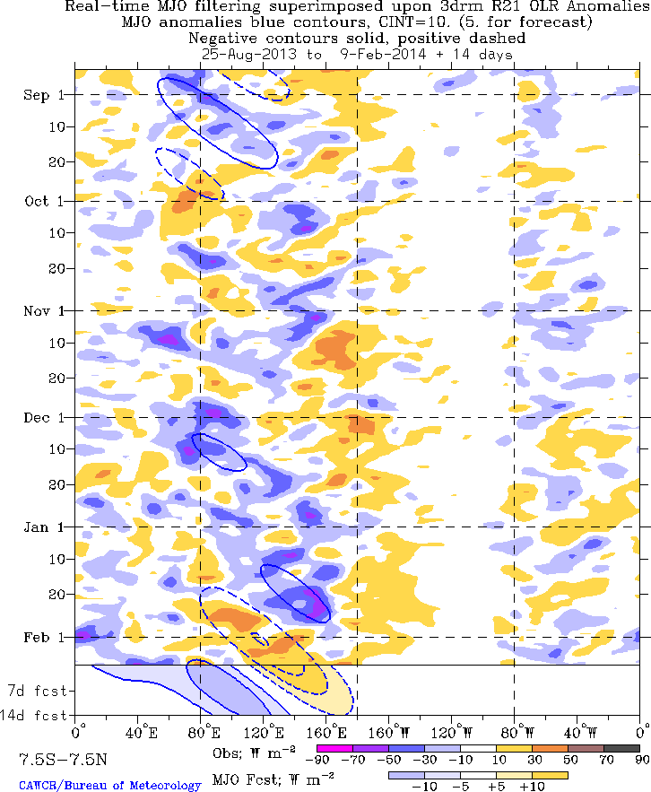
Outgoing Longwave Radiation (OLR)
Anomalies (7.5°N-7.5°S)
Drier-than-normal conditions, positive OLR anomalies (yellow/red shading)
Wetter-than-normal conditions, negative OLR anomalies (blue shading)
The MJO was active from late August through early October with the enhanced phase propagating eastward from the Indian Ocean to the western Pacific Ocean over this period.
The MJO was generally weak or incoherent for much of November and other types of coherent tropical subseasonal variability were very active.
A large area of enhanced convection developed over the Indian Ocean during late November and propagated slowly eastward to the west Pacific Ocean by late January. This feature weakened during early February as suppressed convection propagated from the Indian Ocean to the Maritime Continent.
Time
Longitude
Notes:
13

Slide 14
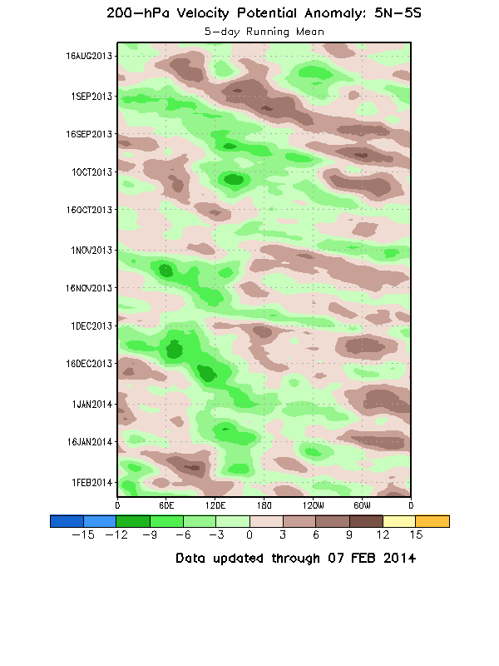
200-hPa Velocity Potential
Anomalies (5°S-5°N)
The MJO was not active during late July and much of August, but strengthened during late August and September, with eastward propagation of robust upper-level velocity potential anomalies (alternating dashed and dotted lines). Other modes of tropical intraseasonal variability are also evident.
From late October to early December, the MJO was not very strong or coherent. There was evidence of coherent eastward propagation at times during this period, but much of this activity exhibited fast propagation speeds more consistent with atmospheric Kelvin waves.
A slower eastward propagation of 200-hPa velocity potential anomalies was observed from mid-December to mid-January across the Indo-Pacific warm pool region (red box), while positive anomalies propagated from the Indian Ocean to the Maritime Continent during late January and early February.
Time
Longitude
Notes:
14

Slide 15
MJO Summary (as of Feb. 10)
The MJO remained incoherent during the past week, with influence from more localized subseasonal features, such as
tropical cyclone activity over the southwestern Indian Ocea
enhanced northern Australian monsoon activity,
suppressed convection over South America
There is considerable spread among the model guidance resolving the future evolution of the MJO
Based on the latest observations and most model forecasts, the MJO is forecast to remain weak during the next 1-2 weeks, while lower frequency signals continuing to dominate the pattern.
Notes:
15

Slide 16
Global and US anomalies in January 2014
N. American Cold events
and one diagnosis (prediction) theory
drought

Slide 17
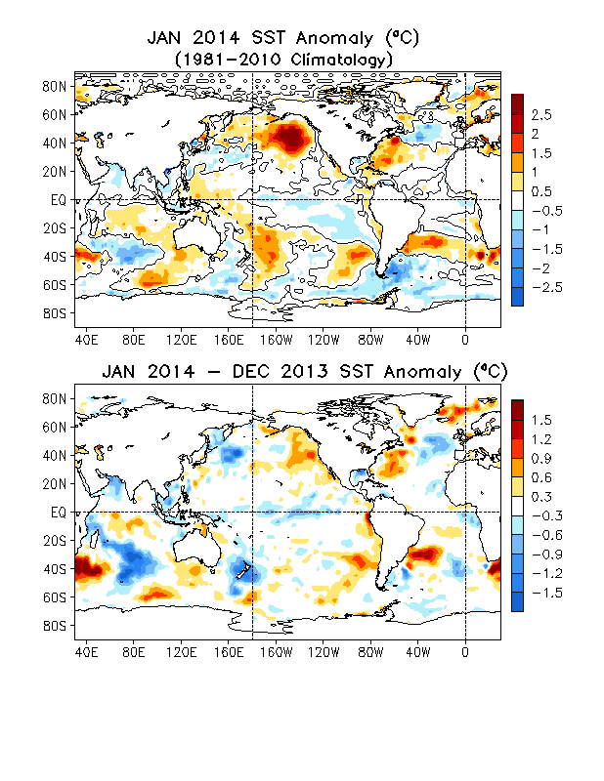
Global SST Anomaly (⁰C) and Anomaly Tendency
SST was above-normal (below-normal) in the western (central-eastern) tropical Pacific.
A north-south dipole of SSTA presented in the N. Atlantic.
A cooling (warming) tendency presented in the western (eastern) N. Pacific.
A cooling tendency was observed in the central-eastern equatorial Pacific.
A north-south dipole of SSTA tendency presented in the N. Atlantic.

Slide 18
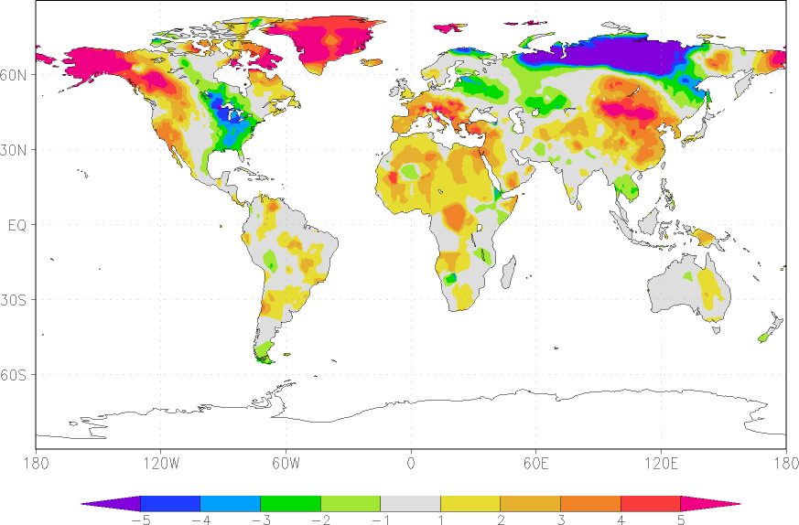
T2m Anomaly January 2014

Slide 19
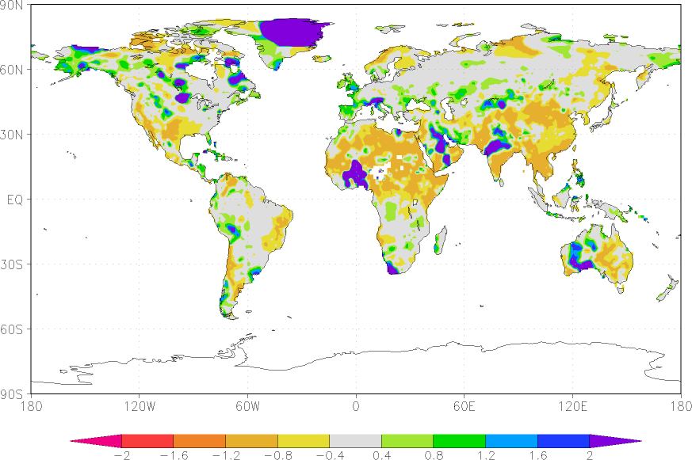
January 2014 Precipitation (Rain gauge)

Slide 20
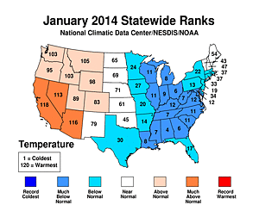
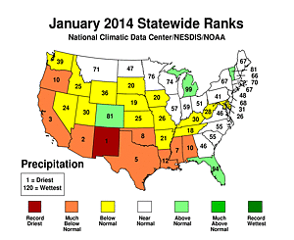
January 2014 Temperature and Precip Ranks

Slide 21
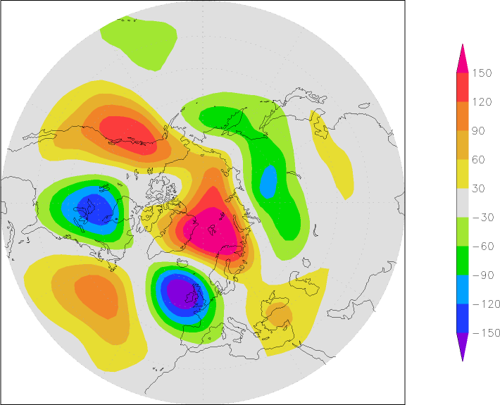
January 2014 500mb Height

Slide 22
AO and NAO

Slide 23
Variability of Mass Transport into Polar Stratosphere and Winter Cold Air Outbreaks in Mid-latitudes
Ming Cai
Department of Earth, Ocean, and Atmospheric Science, Florida State University
Acknowledgement: Huug M. van den Dool, Y-Y Yu, R-C Ren

Slide 24
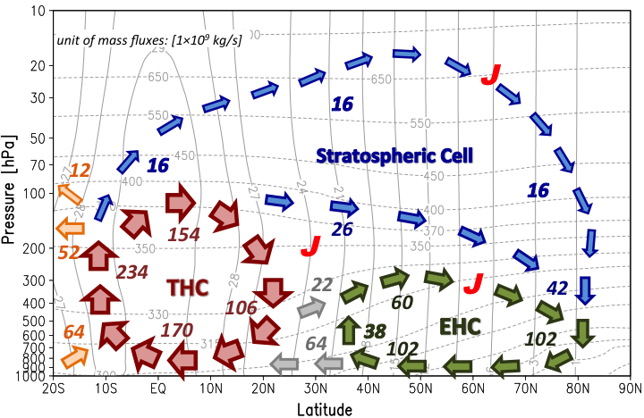
Mean meridional mass circulation in winter hemisphere (Cai and Shin 2014)

Slide 25
Mass circulation variability and cold air outbreaks in the mid-latitudes
Weaker Meridional Mass
Circulation near surface
Stronger Meridional Mass
Circulation near surface
90N
90N
Warm
air
Warm
air
60N
60N
Cold
air
Cold
air
25N
25N
Less cold air outbreaks in mid-latitudes
Coldness in high latitudes
More cold air outbreaks in mid-latitudes
Warmness in high latitudes

Slide 26
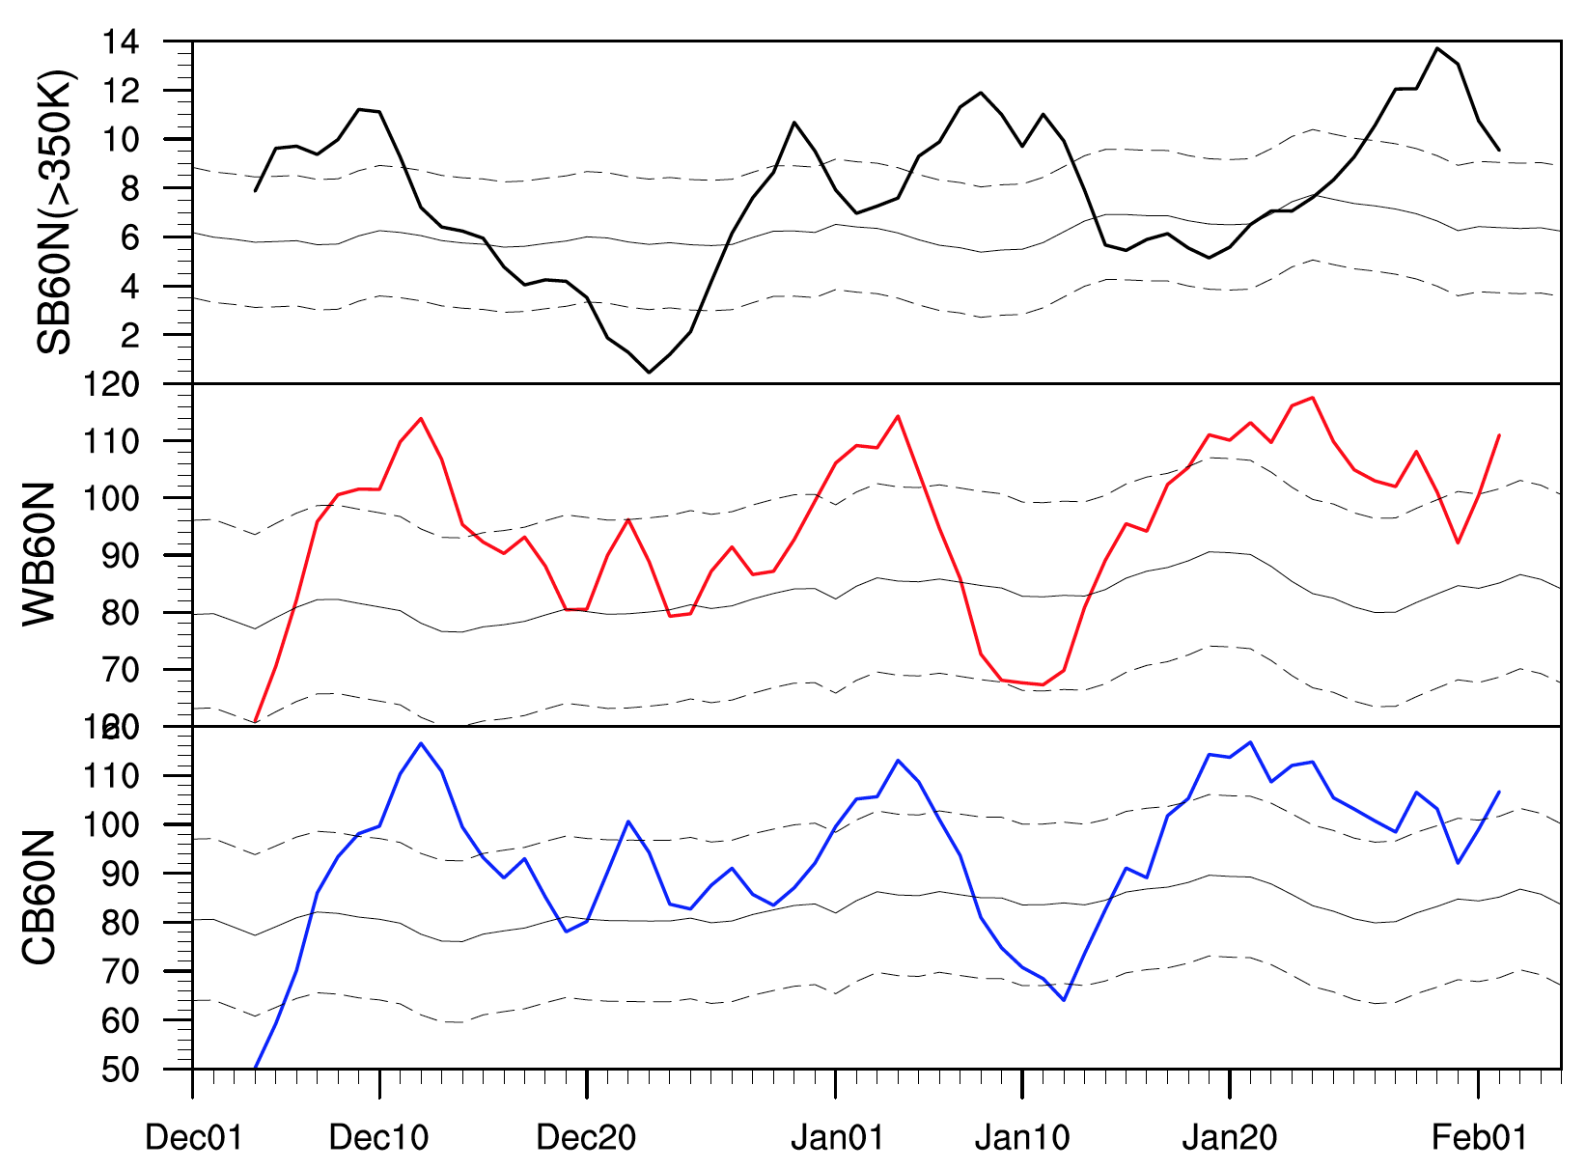
Survey of mass circulation crossing 60N in winter of 2013-14
Stratosphere
Warm Branch
12/9/13
1/1/14
1/18/14
Cold Branch
1SD
climatology
-1SD

Slide 27
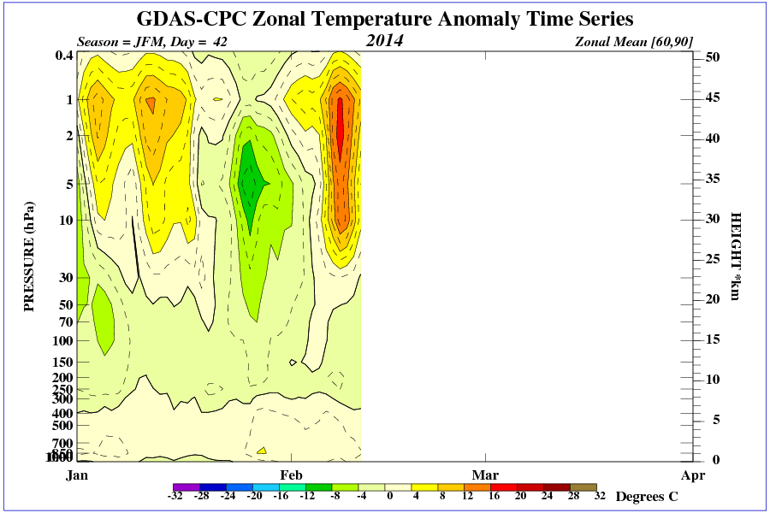
Notes:
1) The first two minor warming events in the earlier Jan. are after the first two stronger poleward mass flux crossing 60N into polar stratosphere.
2) The major warming in the early Feb is after the strongest poleward mass flux crossing 60N into polar stratosphere
3) The stronger mass circulation into polar Stratosphere is following stronger cold air discharge from the Arctic to mid-lats several days after.

Slide 28
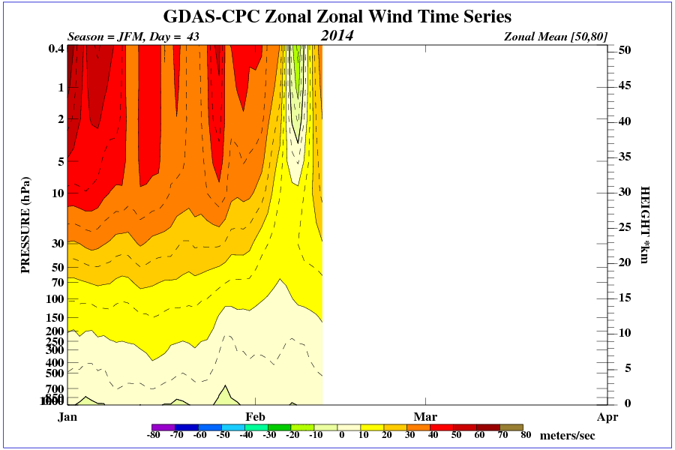
Notes:
The major warming events causes a total collapsing of stratosphere polar vortex, as indicated by the reversal of westerly wind to easterly wind surrounding the polar circle In the stratosphere.

Slide 29
Global and US anomalies in January 2014
N. American Cold events
drought

Slide 30
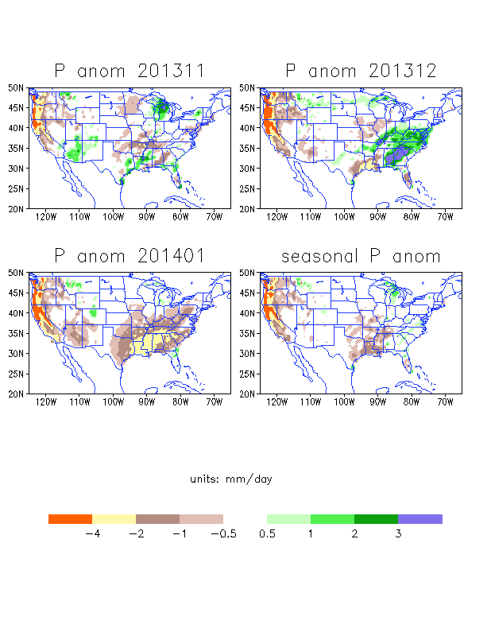
P anomalies over the United States
January
A very dry month
Over the west coast, it has been dry since Oct 2013 and in January ,rainfall anomalies were 4mm/day below normal
Rainfall also was below normal over the Southeast and the Gulf states
Seasonal
A very dry season

Slide 31
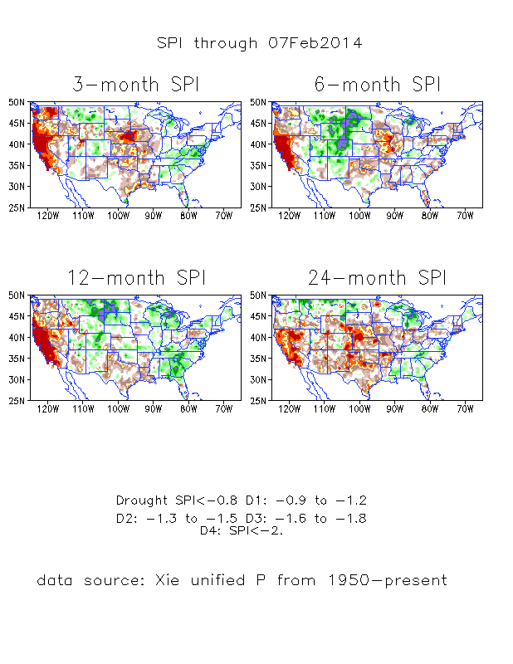
SPI
SPI3:
SPI3 shows D3-D4 Drought over the Pacific Northwest and California
Drought over the Great Plains
SPI6:
D3-D4 drought over California, D3 drought over the Central U.S.
dryness over California appeared in SPI6-24

Slide 32
Enhanced Convection over the western Pacific centered at 120- 180
Suppressed convection over the Central Pacific
This pattern shifted about 20degrees in comparison to Dec 2013.
This convection pattern still implies dryness over California
A PNA type of pattern with positive anomalies over the West Coast, the wave train also shifted inland in comparison to the last month

Slide 33
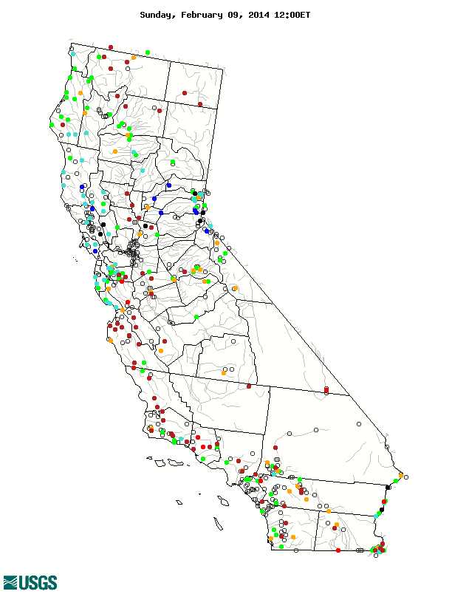
28Jan-8Feb
California rainfall
USGS Feb 9
Soil moisture and Runoff monthly means
still show dryness ( both NLDAS)

Slide 34
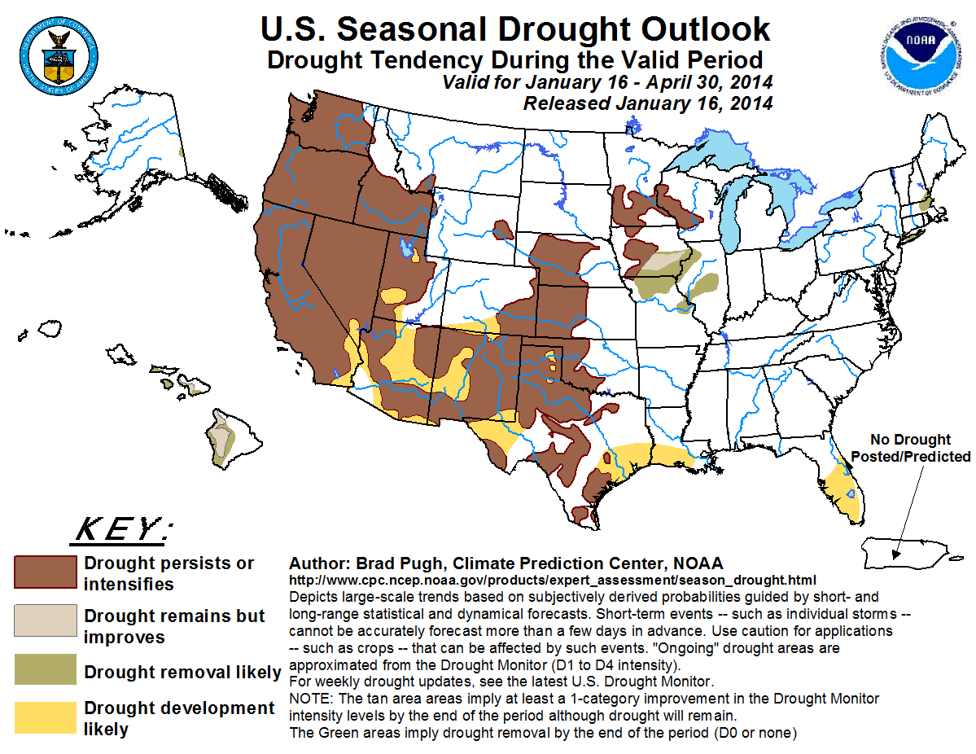
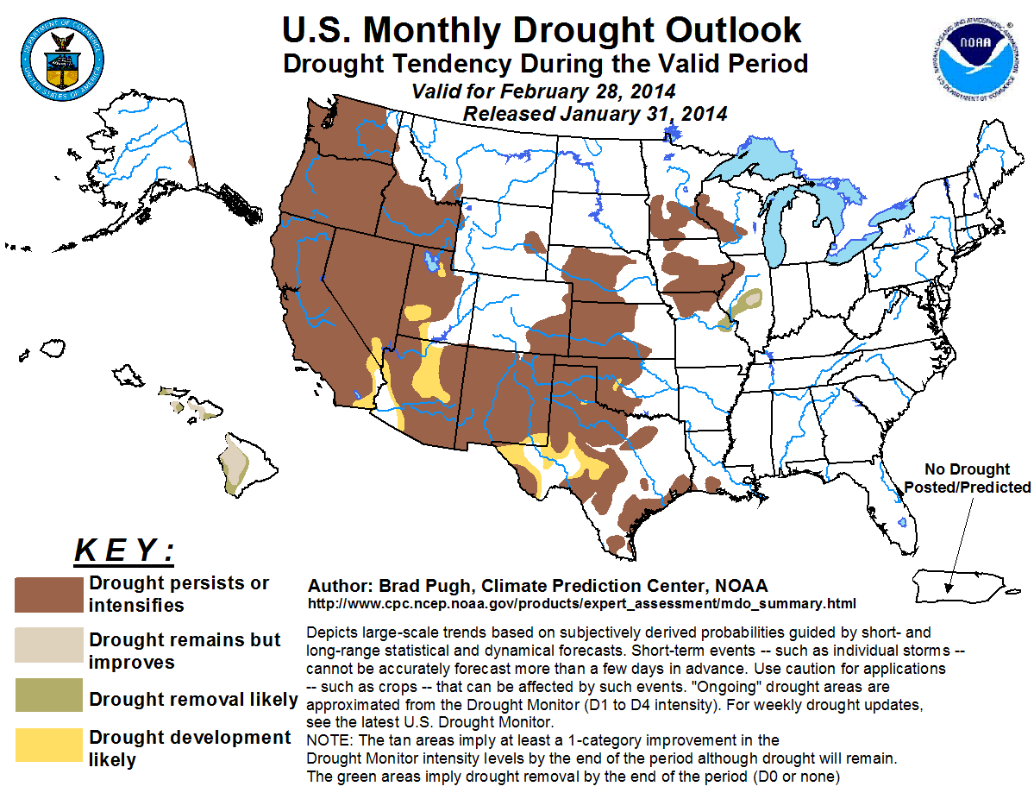
Drought Outlooks
Seasonal
Monthly
Monthly

Slide 35
Forecast Verification

Slide 36
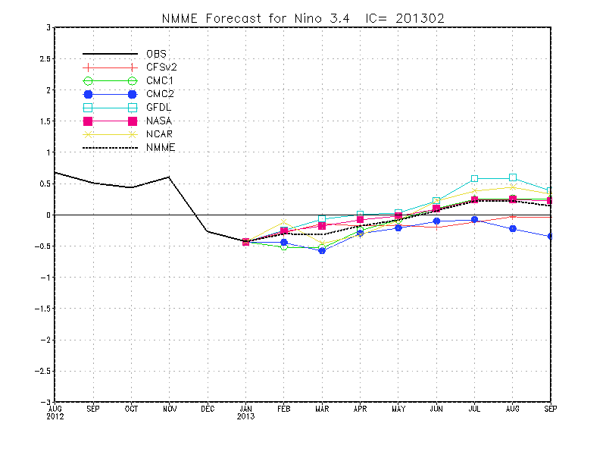
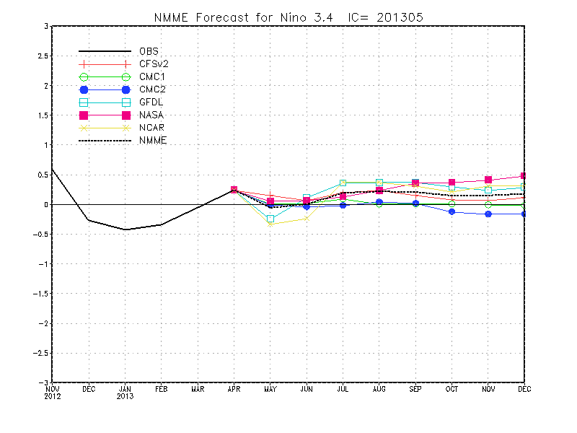
The North America Multi-Model Ensemble (NMME)
http://www.cpc.ncep.noaa.gov/products/NMME/
All models from NMME forecast the ENSO-neutral 2012/13 winter well.

Slide 37
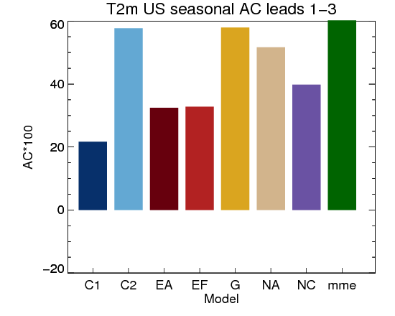
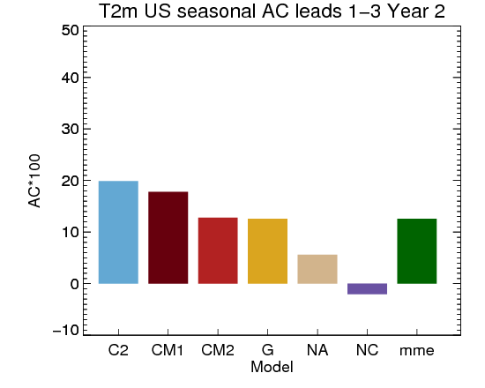
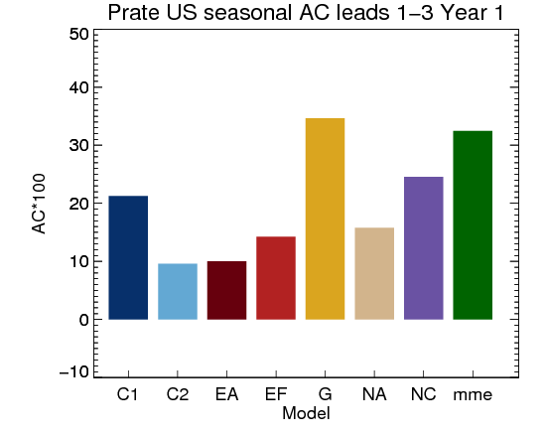
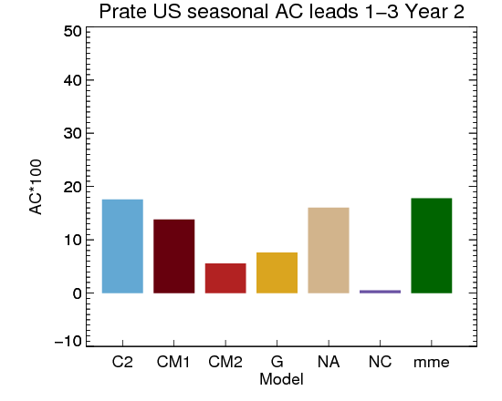
RT verification: CONUS
NMME Forecast Verification for Last 2 years
Year 1
Year 2
T2m
Prate

Slide 38
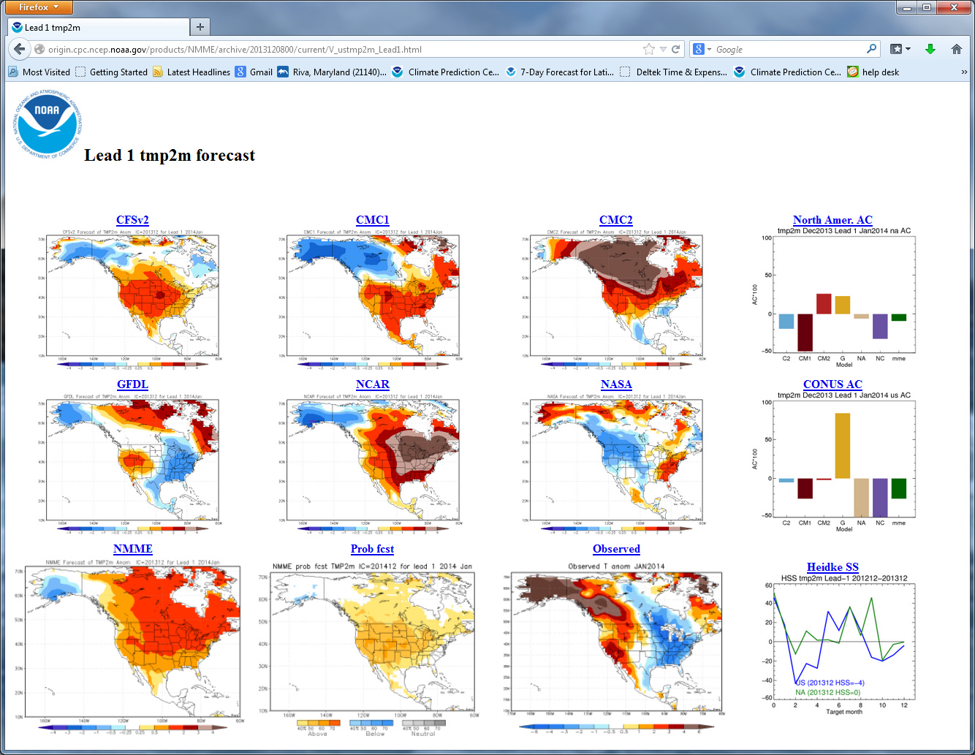
NMME Jan. 2014 T2m Forecast Verification

Slide 39
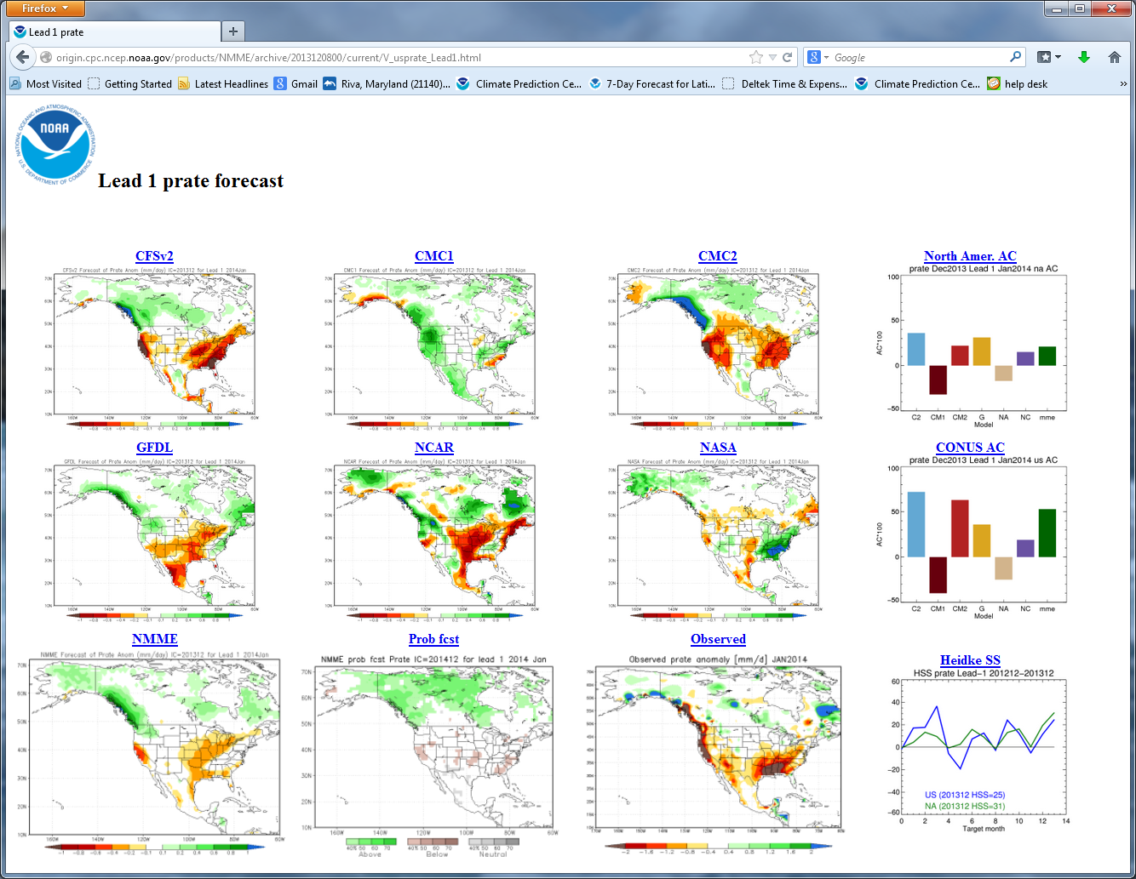
NMME Jan. 2014 Precip Forecast Verification

