Slide 1
Monthly Climate Review January 2013
February 8, 2013
Steve Baxter

Slide 2
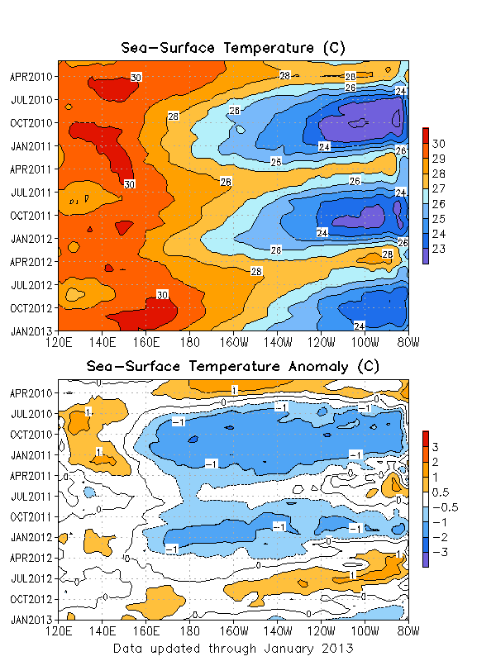
ENSO
Sea surface temperatures were near to slightly below normal across most of the equatorial Pacific.
ENSO neutral conditions persist.

Slide 3
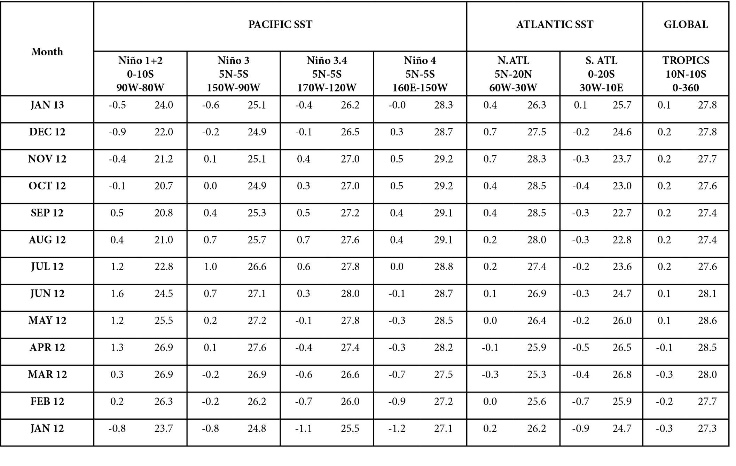

Slide 4
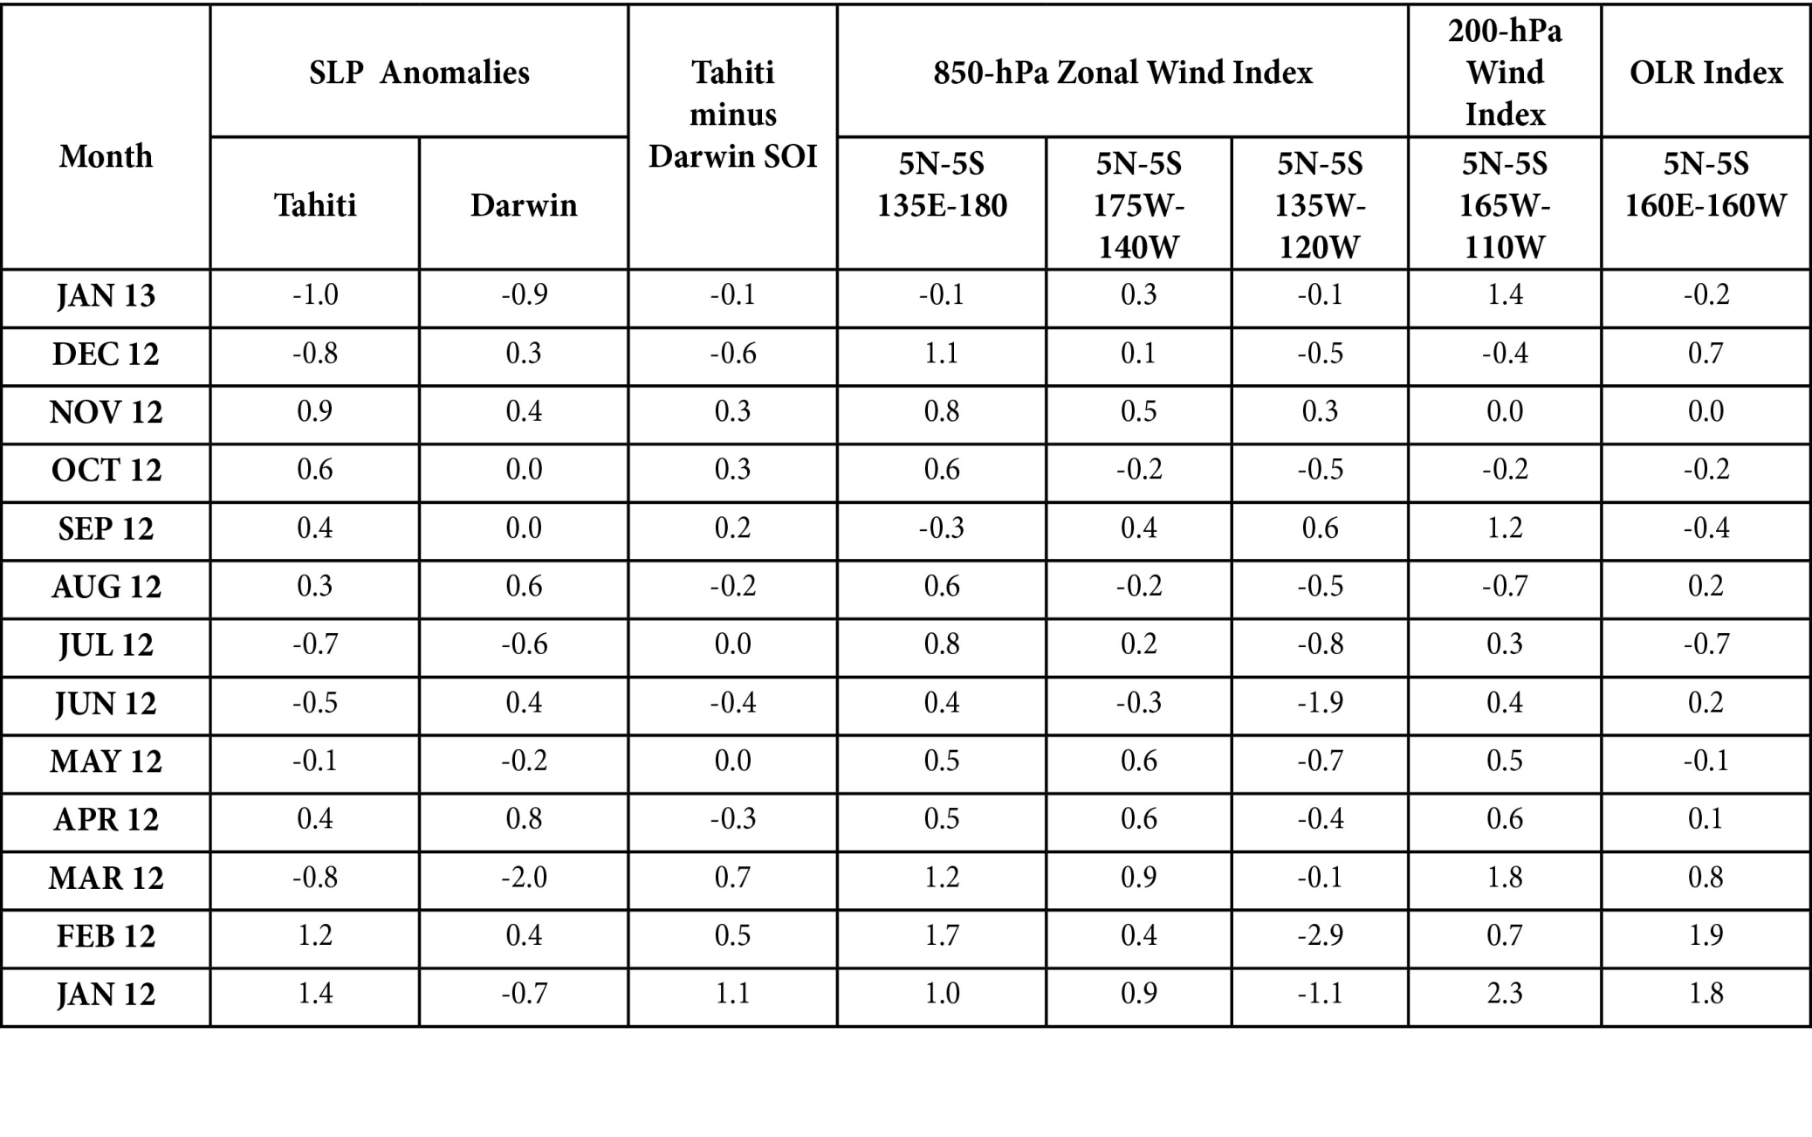

Slide 5
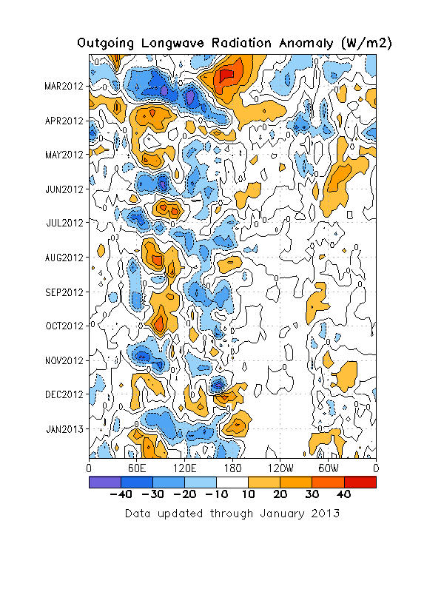
Outgoing Longwave Radiation
The OLR evolution was dominated mainly by robust MJO activity.
Convection became more persistent late in the month near the Date Line.

Slide 6
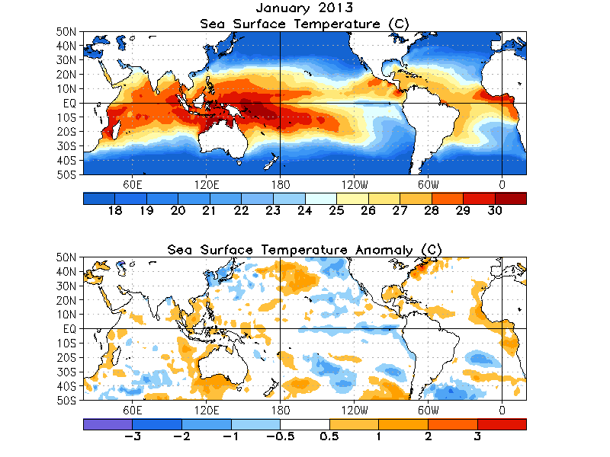
Global SST

Slide 7
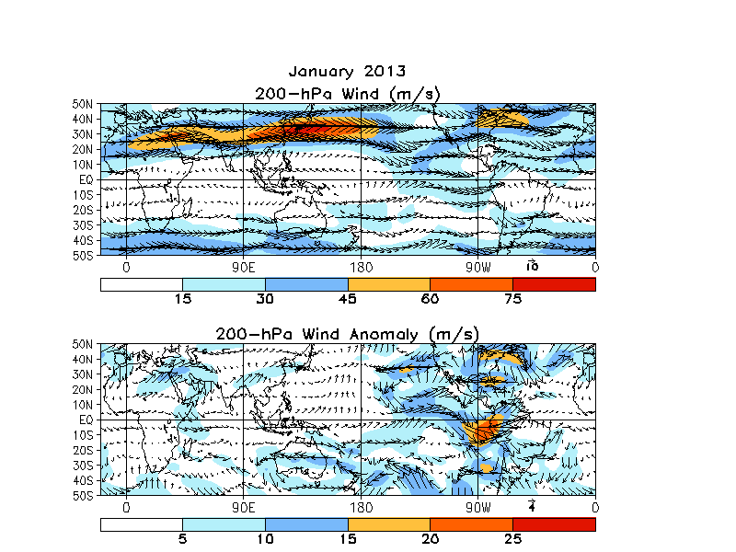
200-hPa Wind Anomalies
East Asian jet stream appeared to be near climatology; likely as a result of shift between a retracted jet early and an extension late.
Strongest anomalies were over the Americas. Late-month subtropical trough dominates in the mean over the southeastern North Pacific.

Slide 8
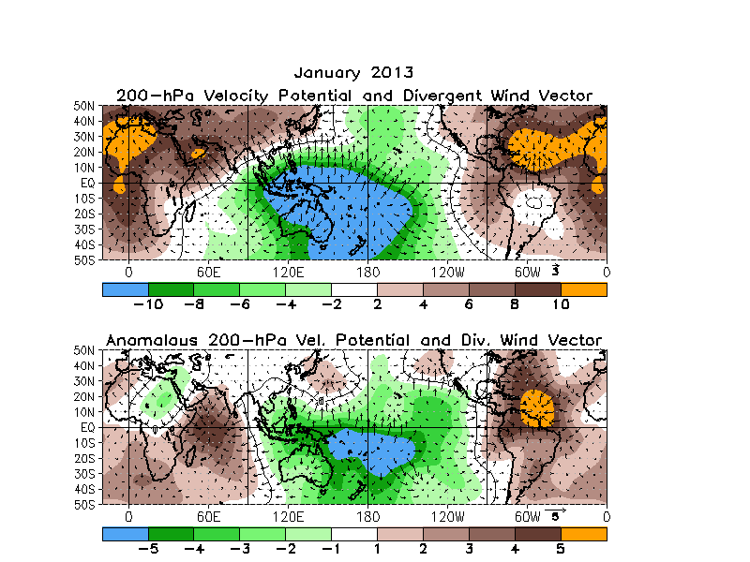
200-hPa Velocity Potential
Velocity potential pattern nicely combines strong MJO activity with the persistent late-month convection near the Date Line.

Slide 9
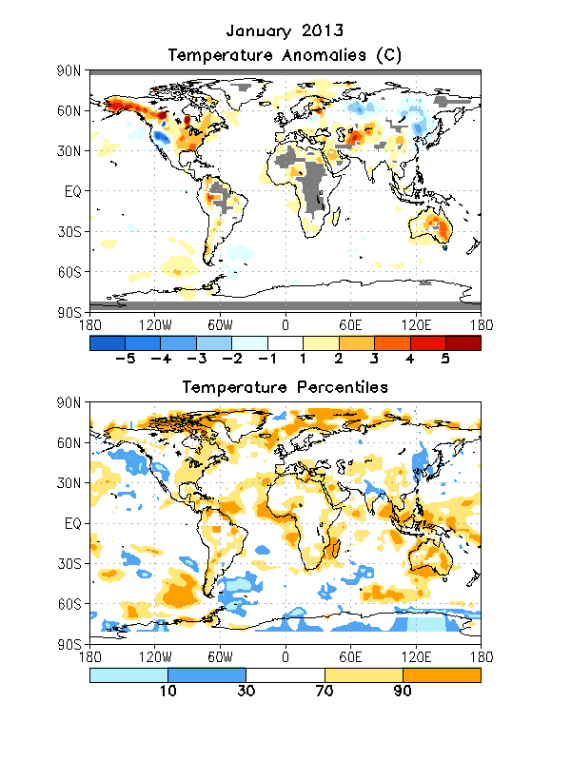
Global Temperatures
Continued cold from December over much of northern and eastern Asia.
Late-month cold over much of northern CONUS not nearly enough to tip the monthly mean.
Parts of the interior Western CONUS were quite cold.
Note the extreme heat over Australia. There was an intense heat wave associated with the delayed onset of the monsoon there.

Slide 10
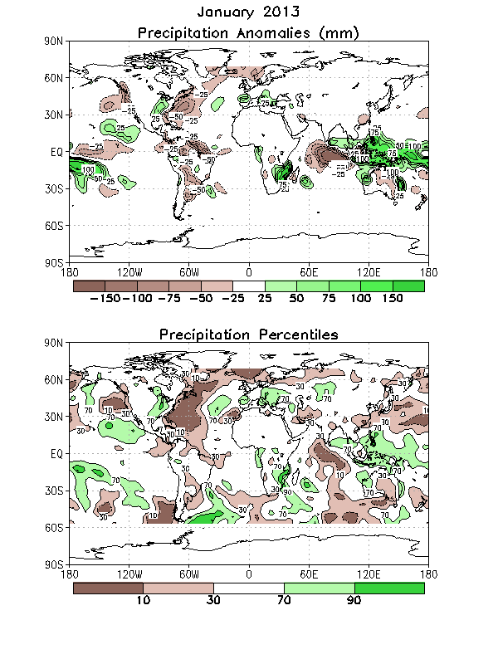
Global Precipitation
Interior eastern US was wet; West Coast generally dry.
MJO-related precipitation anomalies were observed over much of the Maritime Continent.
The western Atlantic seemed especially dry.

Slide 11
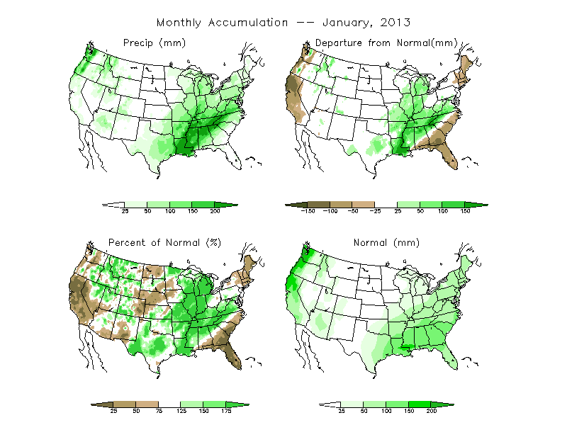
US Precipitation

Slide 12
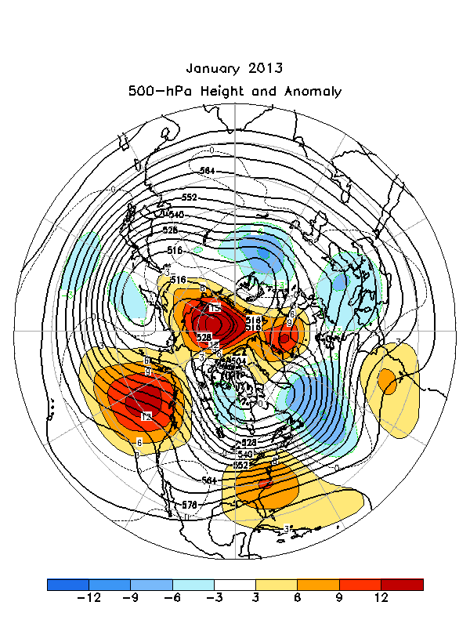
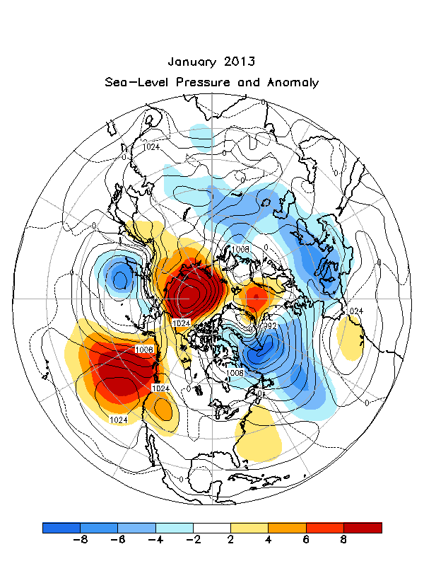
NH 500-hPa Height Anomalies and Sea-level Pressure Anomalies

Slide 13
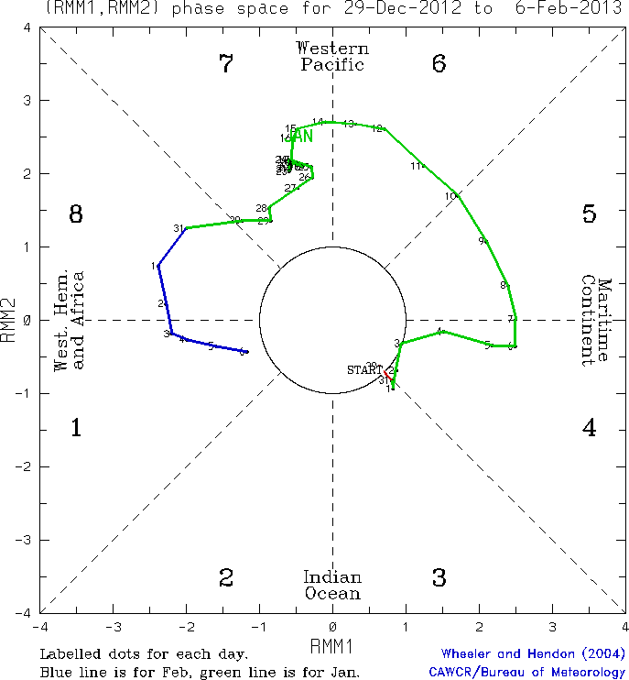
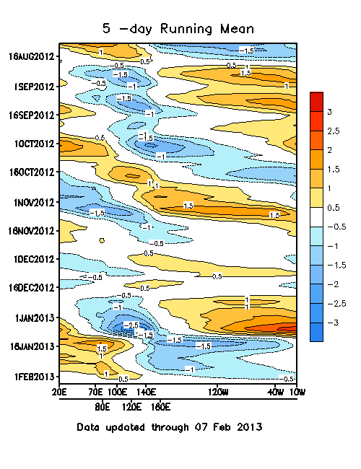
MJO Index

Slide 14
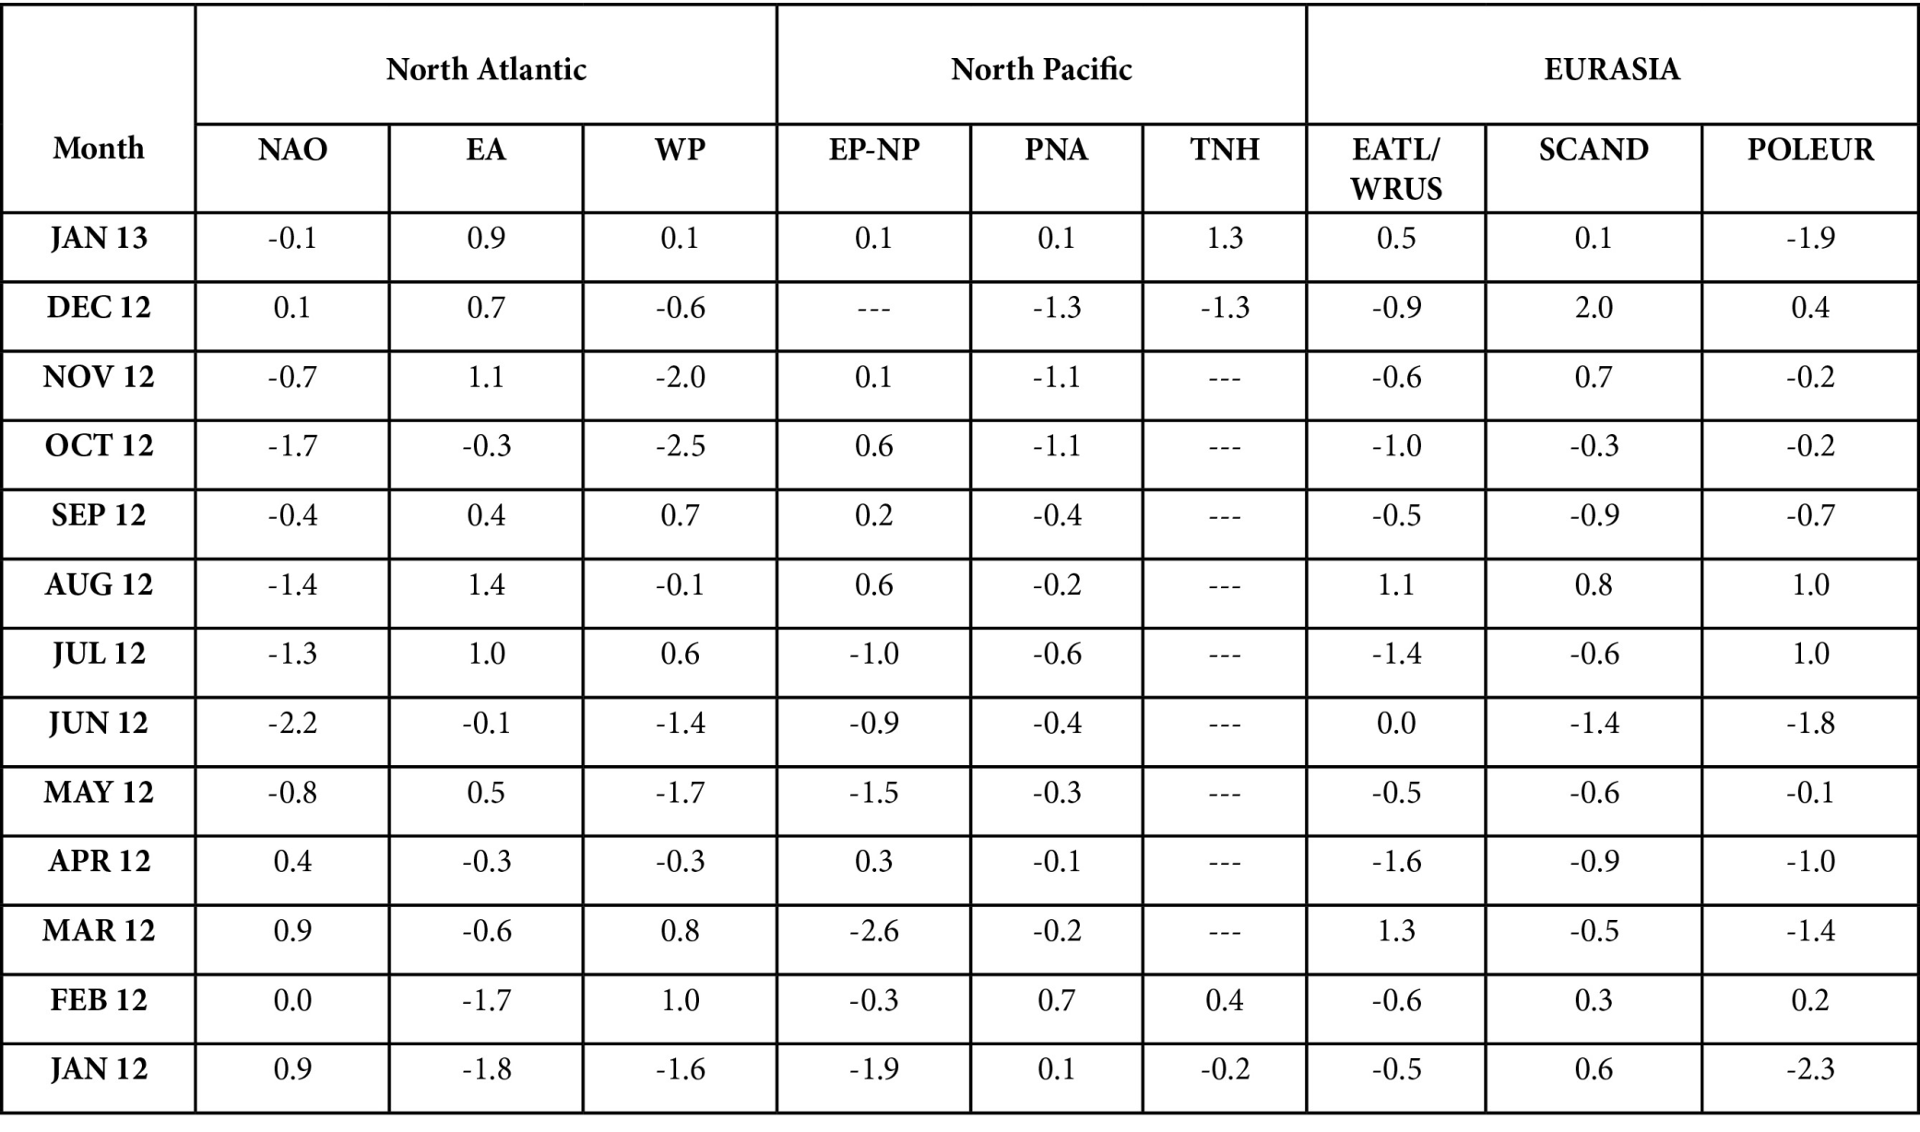
Teleconnections

Slide 15
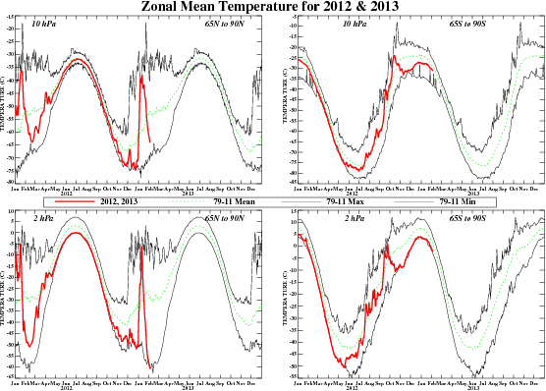
Stratospheric Sudden Warming
Major stratospheric warming occurred on January 6.
This is seen as the spike in 10-hPa temperature

Slide 16
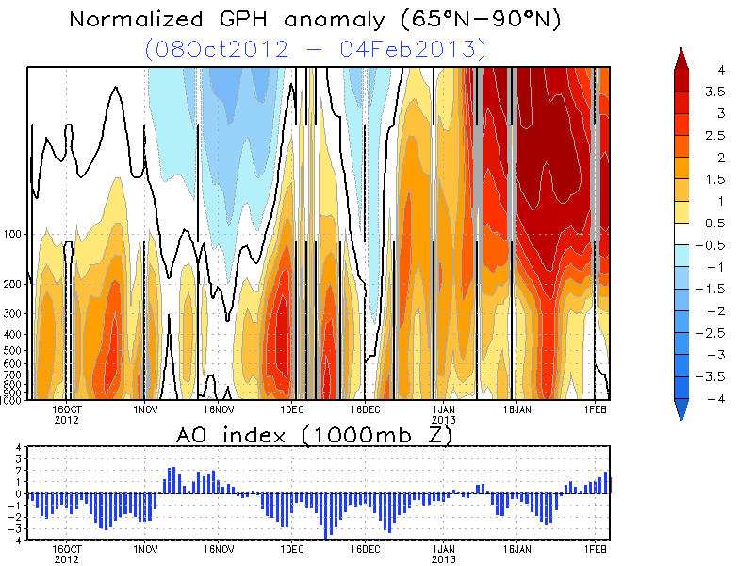

Slide 17
Verification
Monthly, Seasonal, Week-2

Slide 18
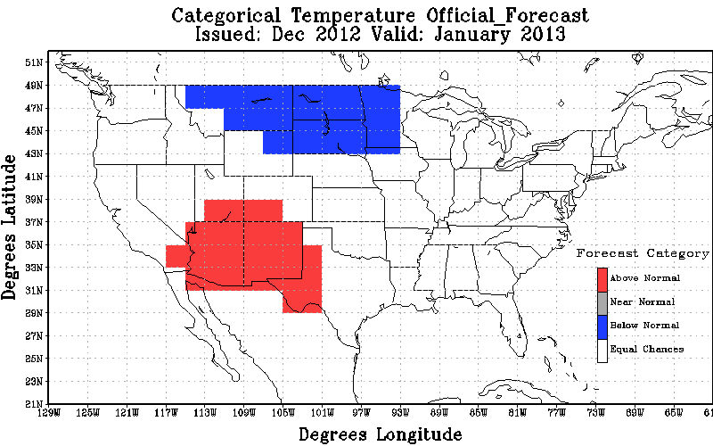
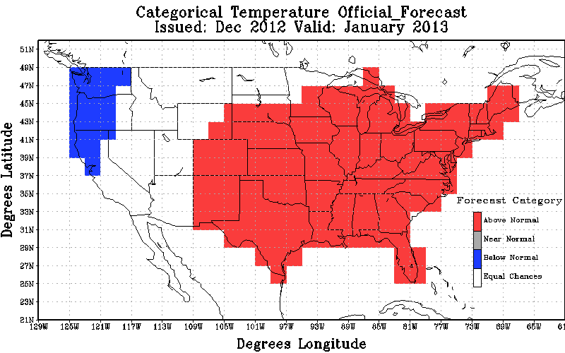
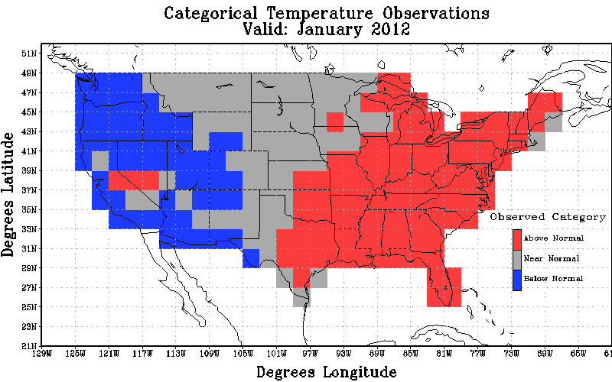
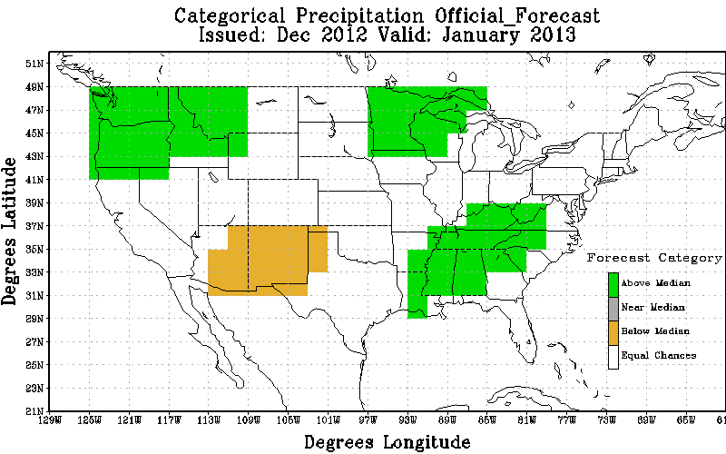
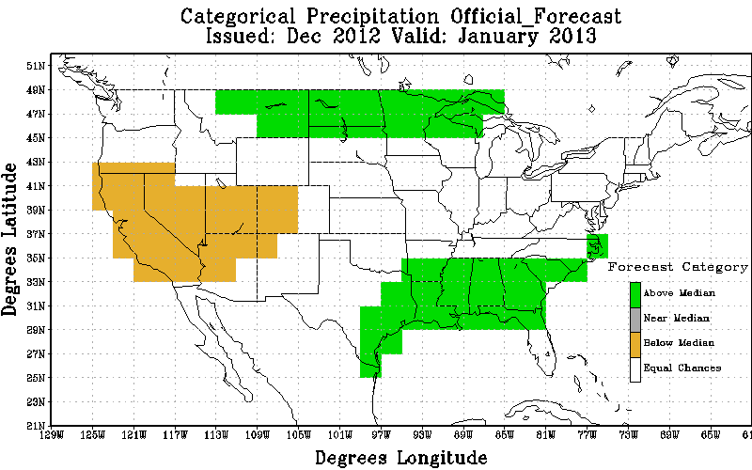
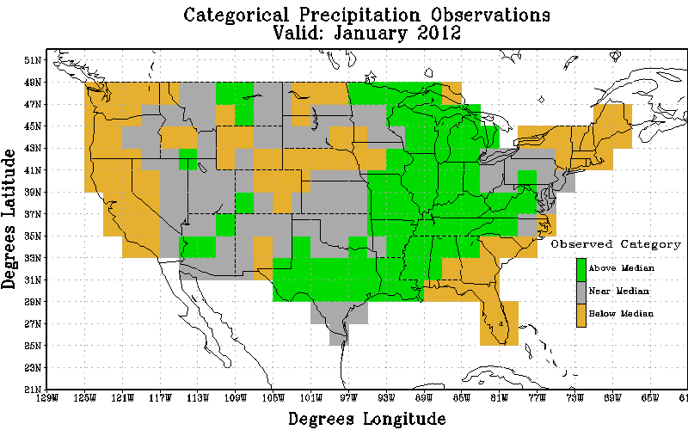
Temp
Official
Revised
Obs
Non-Equal Chance(non EC) forecasts: -50.0
All forecasts: -11.64
% coverage not Equal Chance forecasts : 23.3
Non-Equal Chance(non EC) forecasts: 52.44
All forecasts: 37.07
% coverage not Equal Chance forecasts : 70.7
Precip
Official
Revised
Obs
Non-Equal Chance(non EC) forecasts: 8.12
All forecasts: 2.8
% coverage not Equal Chance forecasts : 34.5
Non-Equal Chance(non EC) forecasts: 19.2
All forecasts: 7.54
% coverage not Equal Chance forecasts : 39.2

Slide 19
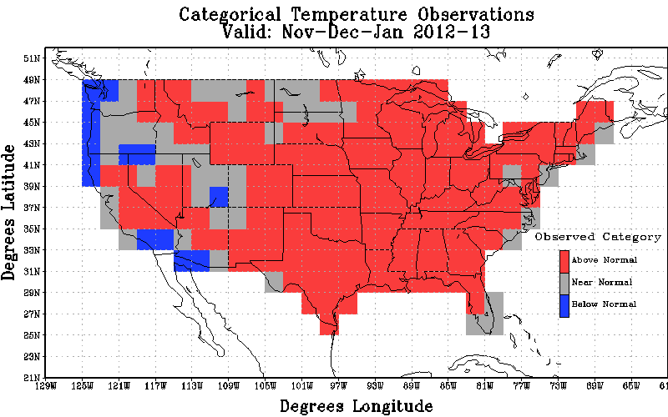
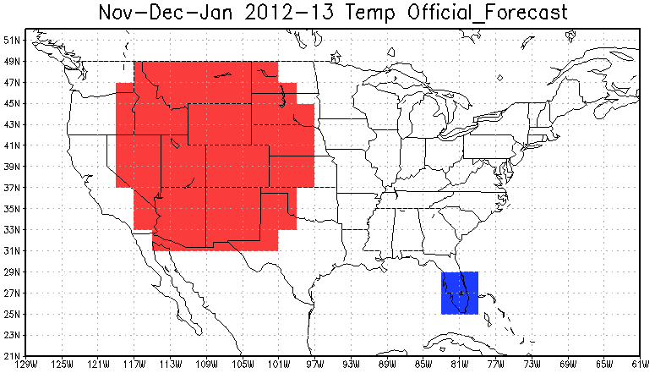
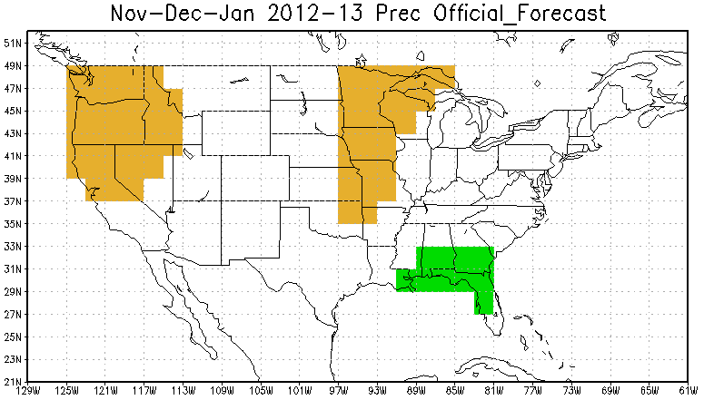
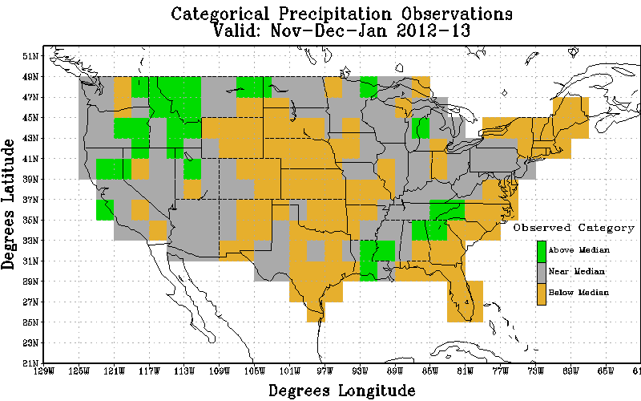
Temp
Official
Revised
Obs
Non-Equal Chance(non EC) forecasts: 45.60
All forecasts: 17.89
% coverage not Equal Chance forecasts : 39.22
Precip
Official
Revised
Obs
Non-Equal Chance(non EC) forecasts: -16.42
All forecasts: -4.74
% coverage not Equal Chance forecasts : 28.88

Slide 20
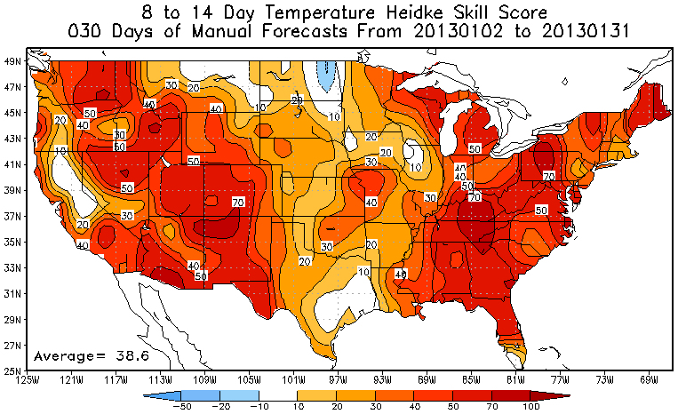
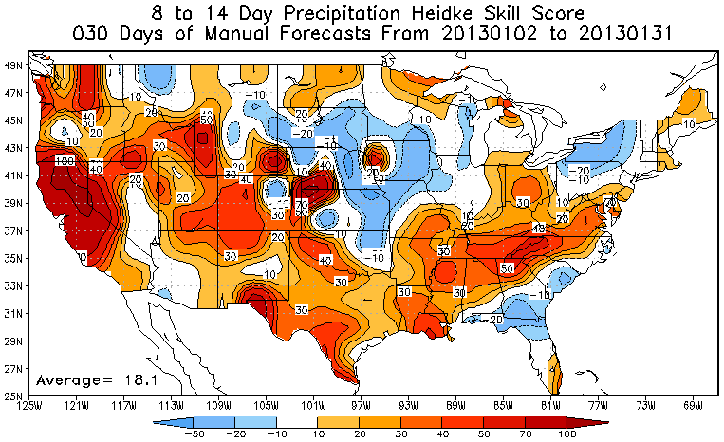
8-14 Day Temperature and Precipitation Scores

Slide 21
Current Predictions
Monthly, Seasonal, ENSO

Slide 22
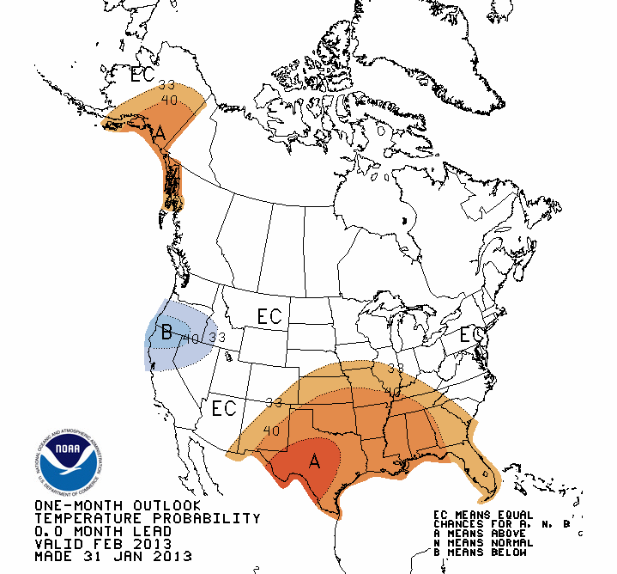
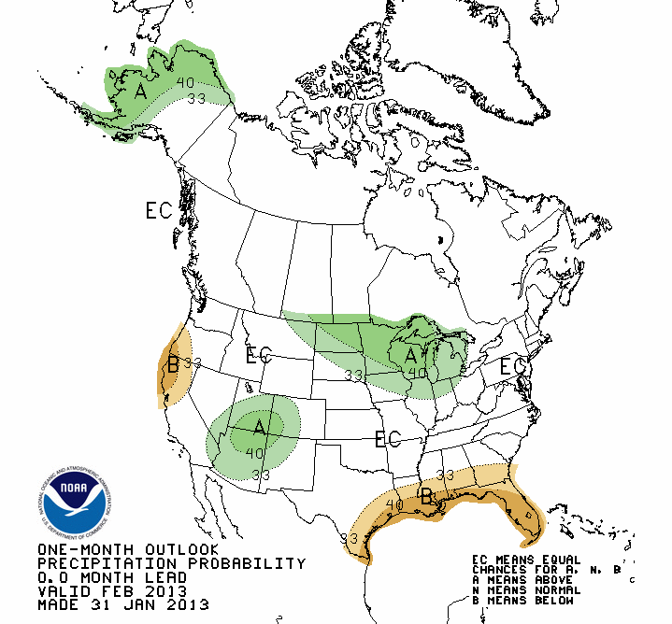
February 2013 Revised Outlook

Slide 23
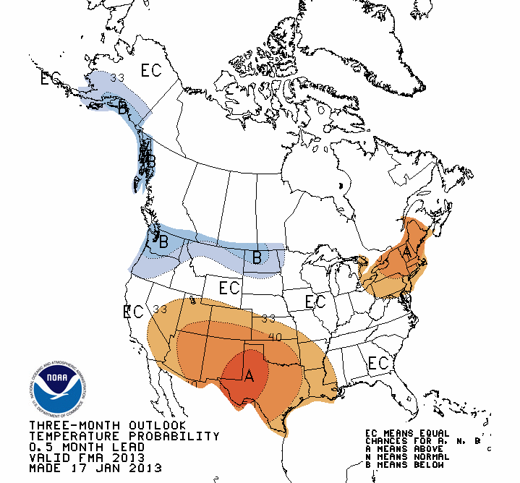
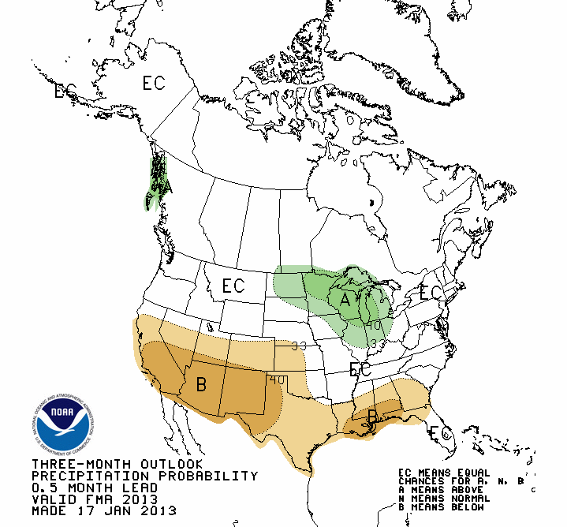
FMA 2013 Seasonal Outlook

Slide 24
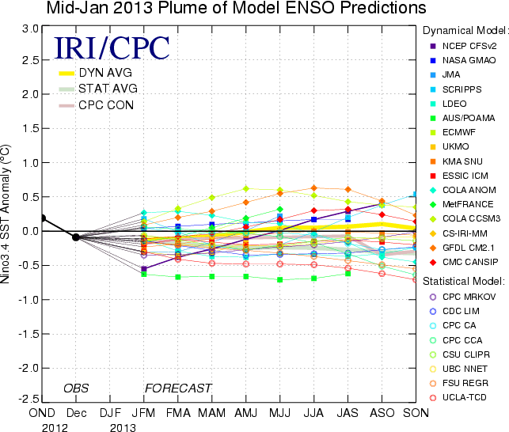
ENSO Forecast Plume

Slide 25
Evolution of 500-hPa Pattern

