Slide 1
CPC Monthly Climate Review
March 2013
Wanqiu Wang

Slide 2
Outline
ENSO and associated tropical fields
Global anomalies
Tropical cyclones and MJO
CPC Forecast verification
ENSO forecast

Slide 3
ENSO and associated fields

Slide 4
CPC Climate Diagnostics Bulletin
Equatorial temperature anomalies (K)
Dec 2012
Feb 2013
Jan 2013
Mar 2013

Slide 5
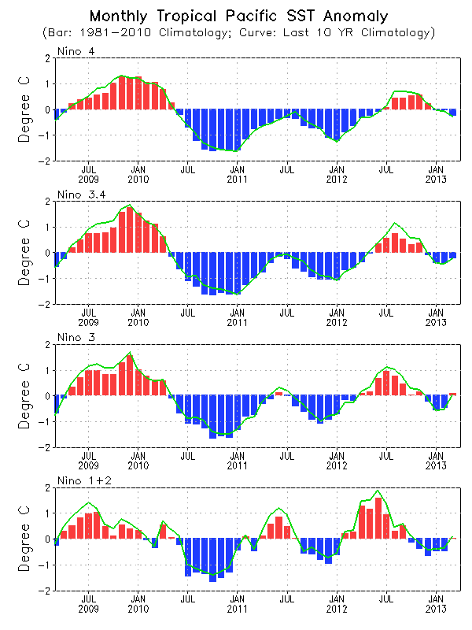
Evolution of Pacific NINO SST Indices
CPC Ocean briefing
Nino4
Nino3.4
Nino3
All Nino indices were near-normal and NINO 3.4 = -0.2ºC.
NINO 3.4 was above 0.5ºC in Jul-Sep 2012, but the duration was too short to meet El Nino definition.
The indices were calculated based on OISST. They may have some differences compared with those based on ERSST.v3b.
Nino1.2
Fig. P1a. Nino region indices, calculated as the area-averaged monthly mean sea surface temperature anomalies (ºC) for the specified region. Data are derived from the NCEP OI SST analysis, and anomalies are departures from the 1981-2010 (bar) and last ten year (green line) means.

Slide 6
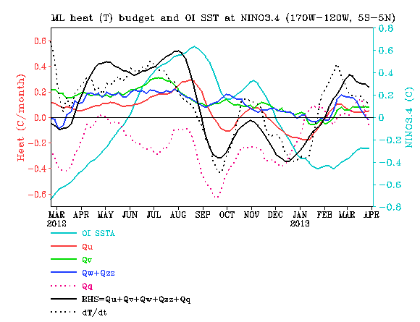
CPC Ocean briefing
NINO3.4 Heat Budget
SSTA tendency (dT/dt) in NINO3.4 region (dotted black line) was positive, but decreased in Mar 2013.
All the advection terms, as well as thermodynamical term (Qq) were positive, consistent with weakening of negative SSTA
Huang, B., Y. Xue, X. Zhang, A. Kumar, and M. J. McPhaden, 2010 : The NCEP GODAS ocean analysis of the tropical Pacific mixed layer heat budget on seasonal to interannual time scales, J. Climate., 23, 4901-4925.
Qu: Zonal advection; Qv: Meridional advection;
Qw: Vertical entrainment; Qzz: Vertical diffusion
Qq: (Qnet - Qpen + Qcorr)/ρcph; Qnet = SW + LW + LH +SH;
Qpen: SW penetration; Qcorr: Flux correction due to relaxation to OI SST

Slide 7
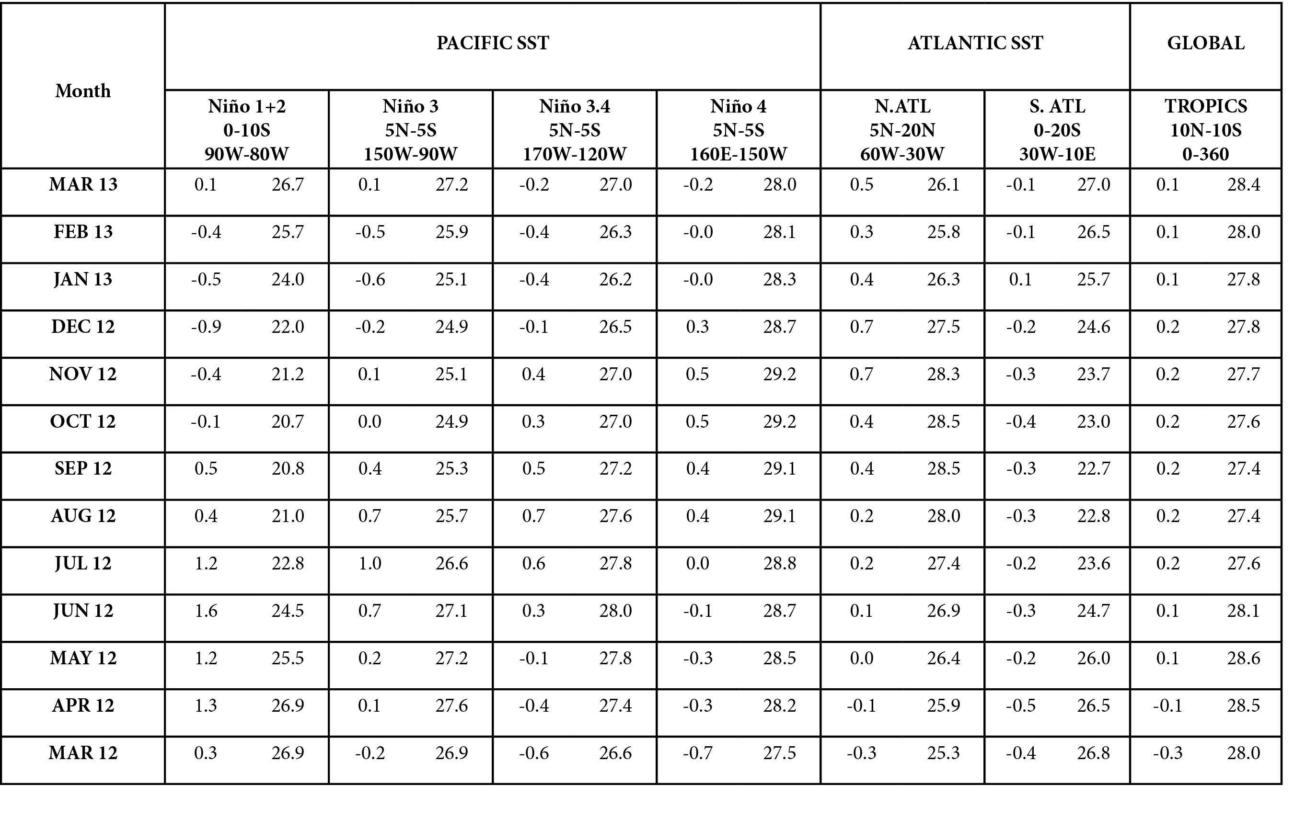
SST Indices
CPC Climate Diagnostics Bulletin

Slide 8
5S-5N average
CPC Climate Diagnostics Bulletin

Slide 9
2. Global monthly mean anomalies in March 2013

Slide 10
Global SST Anomaly (⁰C)
CPC Ocean briefing
SST was slightly above (below) normal in the eastern (central) equatorial Pacific.
Negative phase PDO associated SSTA presented in North Pacific.
Positive SSTA was observed in the Indian Ocean and western Pacific.
Above-normal SST occurred in high and low latitudes of North Atlantic.
Large SST anomalies were observed in the South Ocean.

Slide 11
A warming tendency presented in the equatorial eastern Pacific, and tropical North Atlantic.
A cooling tendency was observed in Gulf of Mexico, and SE Indian Ocean.
Large tendencies were observed in the mid-latitudes of the Southern Hemisphere.
Fig. G1. Sea surface temperature anomalies (top) and anomaly tendency (bottom). Data are derived from the NCEP OI SST analysis, and anomalies are departures from the 1981-2010 base period means.
Climate Diagnostics Bulletin

Slide 12
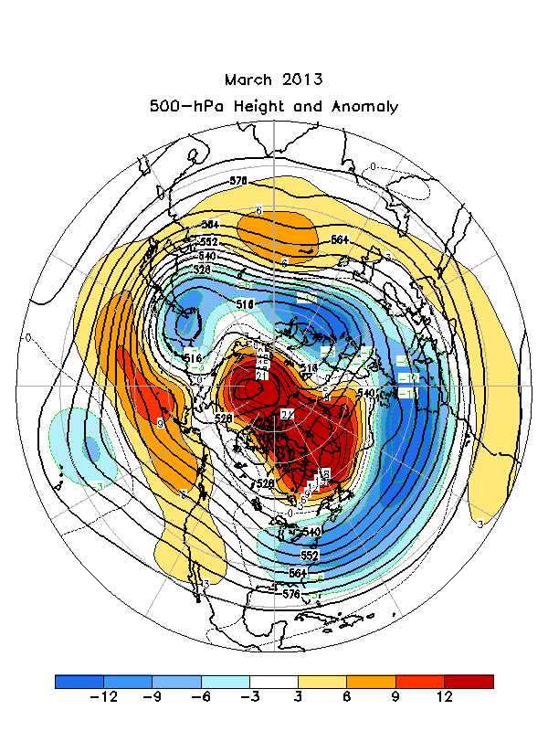
Climate Diagnostics Bulletin

Slide 14
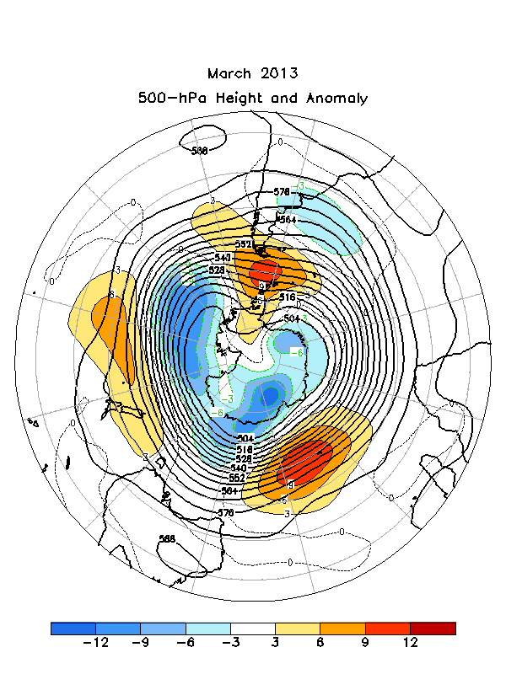
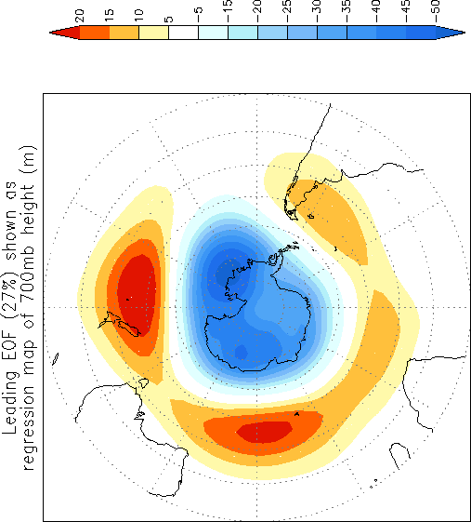
Climate Diagnostics Bulletin

Slide 15
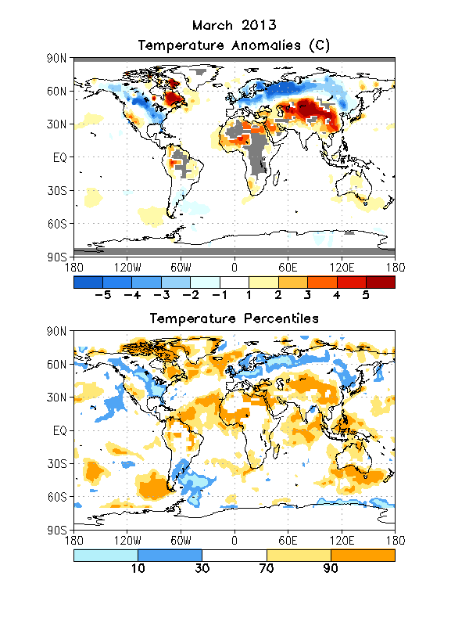
Climate Diagnostics Bulletin

Slide 16
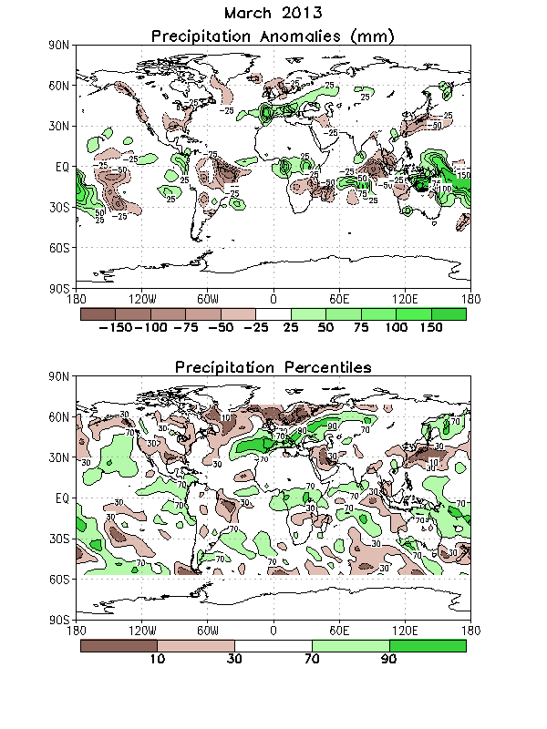
Climate Diagnostics Bulletin

Slide 17
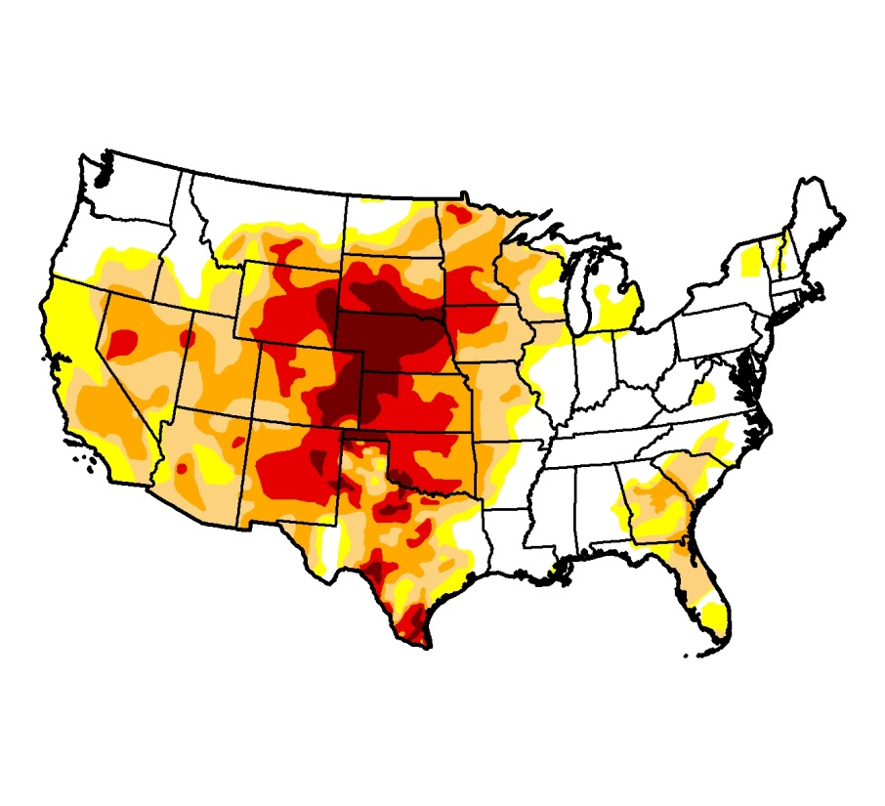
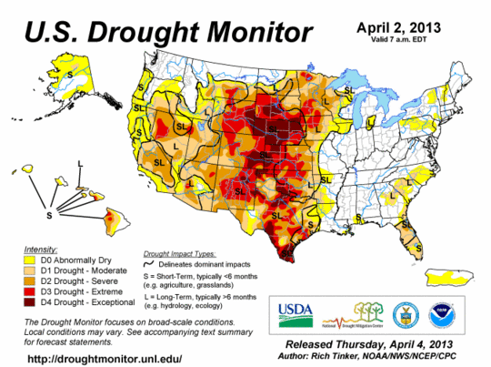
Feb 26,2013
CPC Drought briefing
Drought monitor
Drought over the Great Plains continues
Drought Intensified over Texas, but improved east of 90 W
Intensify over Texas

Slide 18
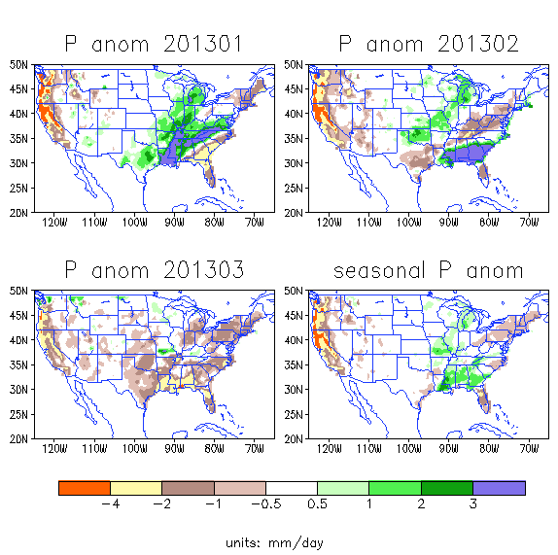
CPC Drought briefing
P anomalies over the United States
High lights:
March 2013
Except the Pacific Northwest, (Washington) precipitation was below normal for much of the United States
seasonal p anomaly shows dryness over the western region and wetness over the Gulf states (Florida was still dry) .

Slide 19
3. Tropical cyclones and MJO

Slide 20
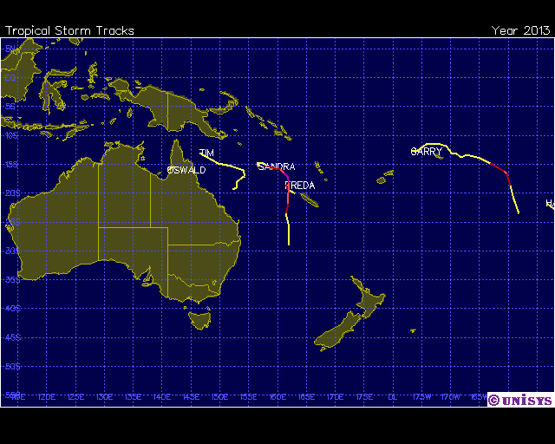
2013 Hurricane/Tropical Data for Southern Pacific
# | Name | Date | Wind | Pres | Cat
5 | Cyclone-3 SANDRA | 07-14 MAR | 110 |  | 3
6 | Tropical Storm TIM | 13-17 MAR | 55 |  | -

Slide 21
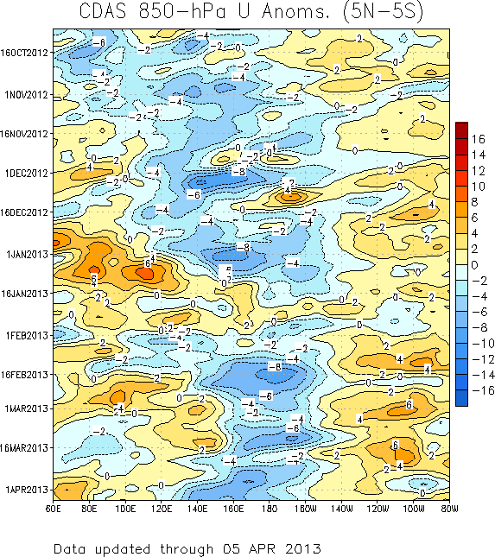
850-hPa Zonal Wind Anomalies (m s⁻¹)
Westerly anomalies (orange/red shading) represent anomalous west-to-east flow
Easterly anomalies (blue shading) represent anomalous east-to-west flow
Westward propagation (dashed/solid lines sloping down and to the left) of anomalies during much of November and early December were primarily due to equatorial Rossby wave activity as the MJO was then generally weak.
During late December the MJO strengthened (alternating dotted/dashed lines).
During March, anomalies indicate signs of being influenced by equatorial Rossby wave activity with less eastward propagation evident.
Time
Longitude
CPC MJO briefing
Notes:
21

Slide 22
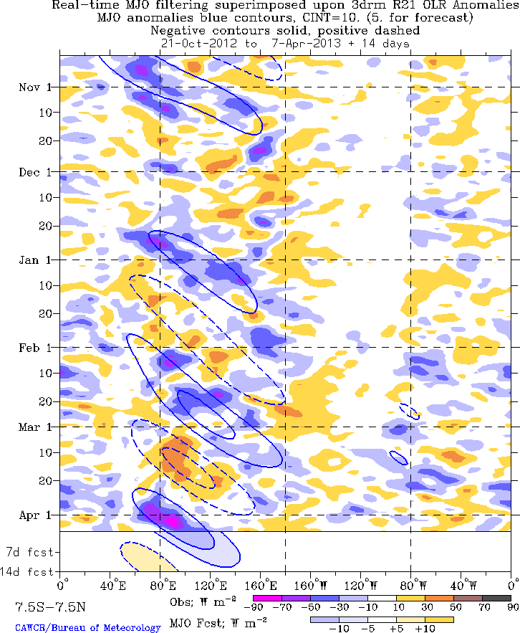
Outgoing Longwave Radiation (OLR)
Anomalies (7.5°S-7.5°N)
Drier-than-normal conditions, positive OLR anomalies (yellow/red shading)
Wetter-than-normal conditions, negative OLR anomalies (blue shading)
(Courtesy of CAWCR Australia Bureau of Meteorology)
Time
The MJO (alternating dashed and dotted lines) was active during October into November with enhanced convection developing over Africa during mid-October and shifting eastward to the western Pacific by mid-November.
During late November and much of December, convective anomalies were disorganized.
The MJO was again a dominant mode of variability across the Tropics from January into March as indicated by the alternating dashed and dotted lines.
Near the end of March, the anomalies show signs of influence from other modes of tropical variability.
Longitude
CPC MJO briefing
Notes:
22

Slide 23
4. CPC Forecast verification

Slide 24
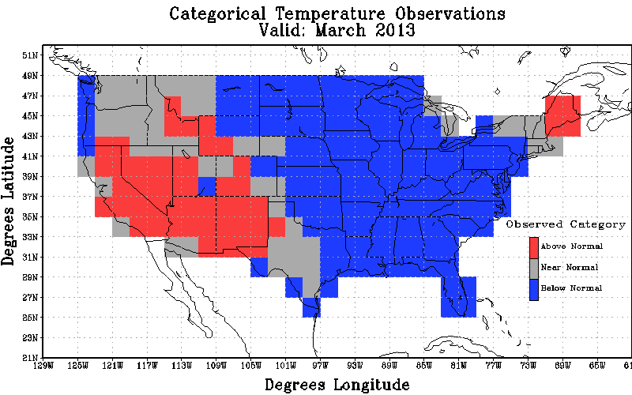
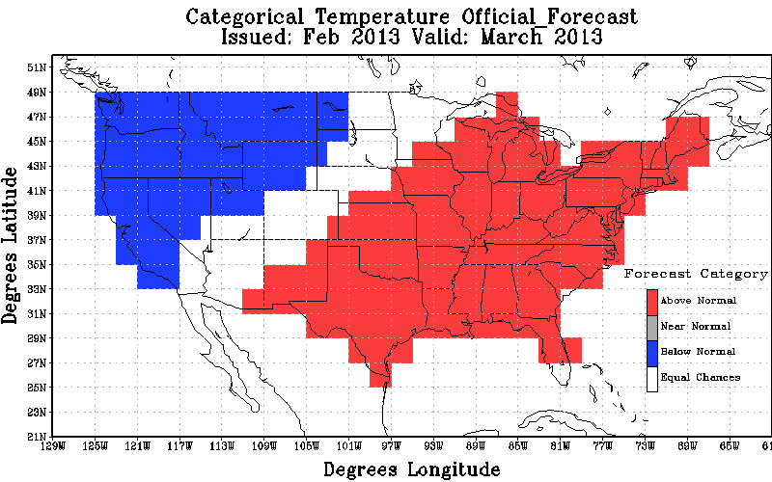
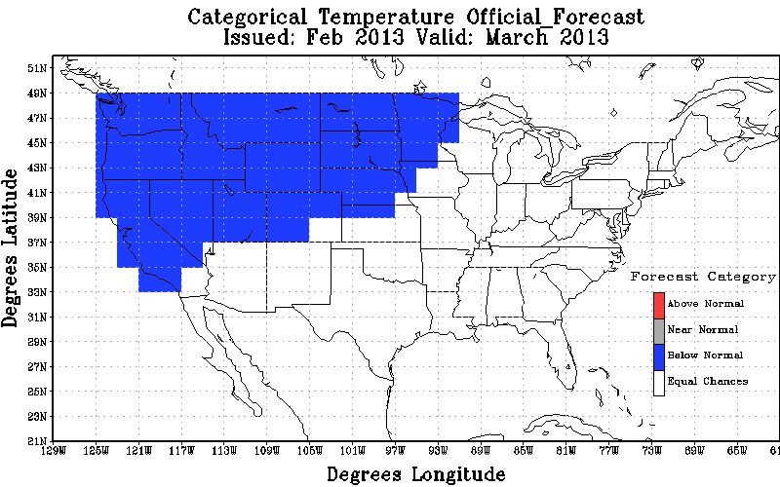
Mar 2013 T2m
Observation
Original Forecast
Revised Forecast
Heidke Skill Scores : Non-EC: -27.66 All: -22.41 % coverage non-EC: 81.03
Heidke Skill Scores : non-EC: 10.64 All: 4.31 % coverage non-EC: 40.52

Slide 25
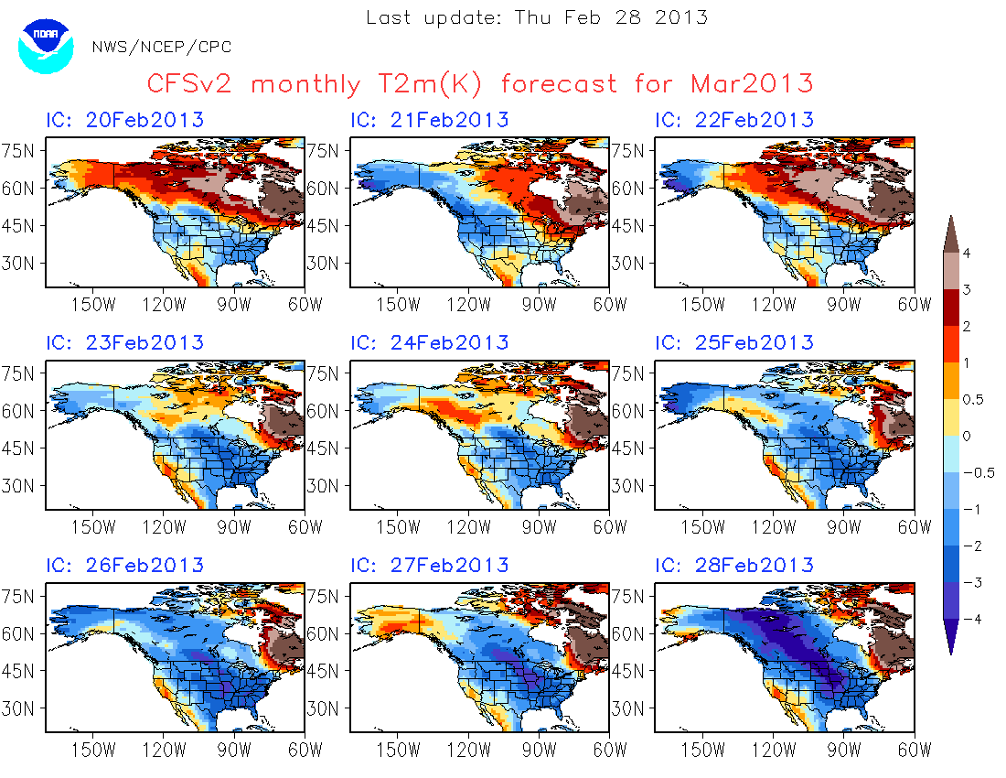
http://www.cpc.ncep.noaa.gov/products/people/mchen/CFSv2FCST/monthly/images/summaryCFSv2.NaT2m.201303.gif

Slide 26
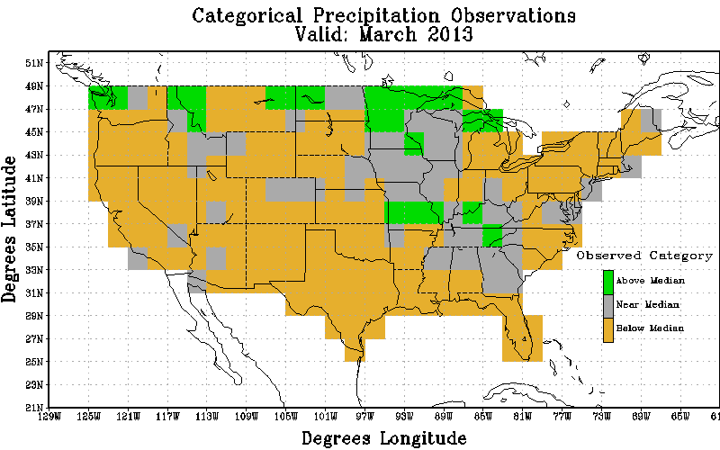
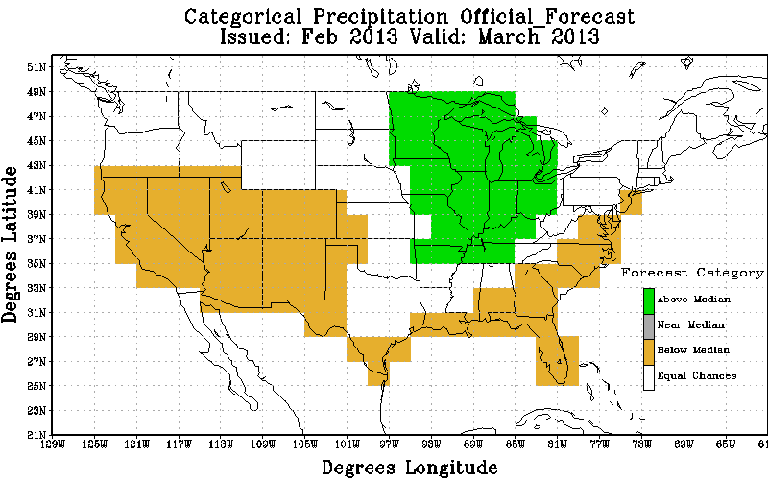
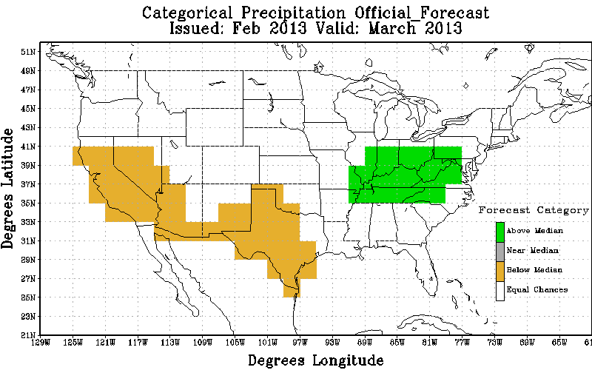
Mar 2013 precipitation
Observation
Original Forecast
Revised Forecast
Heidke Skill Scores : Non-EC: 47.06 All: 27.59 % coverage non-EC: 58.62
Heidke Skill Scores : non-EC: 53.85 All: 15.09 % coverage non-EC: 28.02

Slide 27
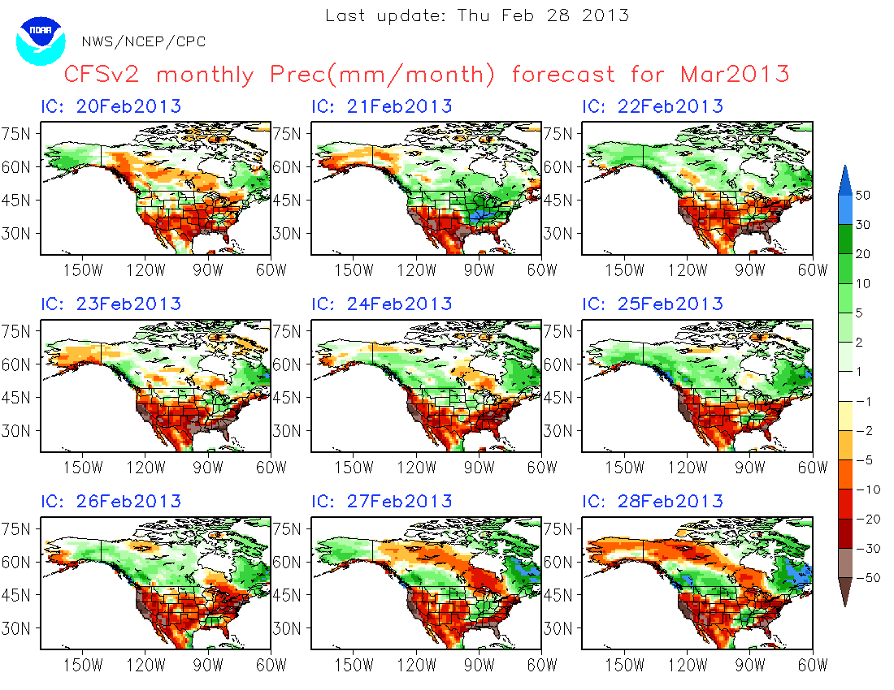
http://www.cpc.ncep.noaa.gov/products/people/mchen/CFSv2FCST/monthly/images/summaryCFSv2.NaT2m.201303.gif

Slide 28
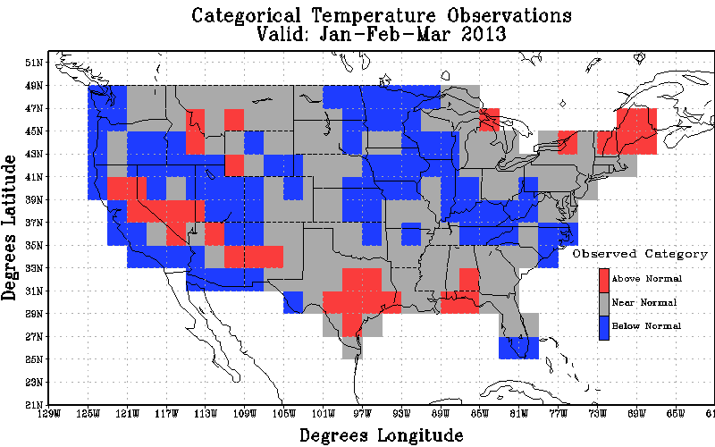
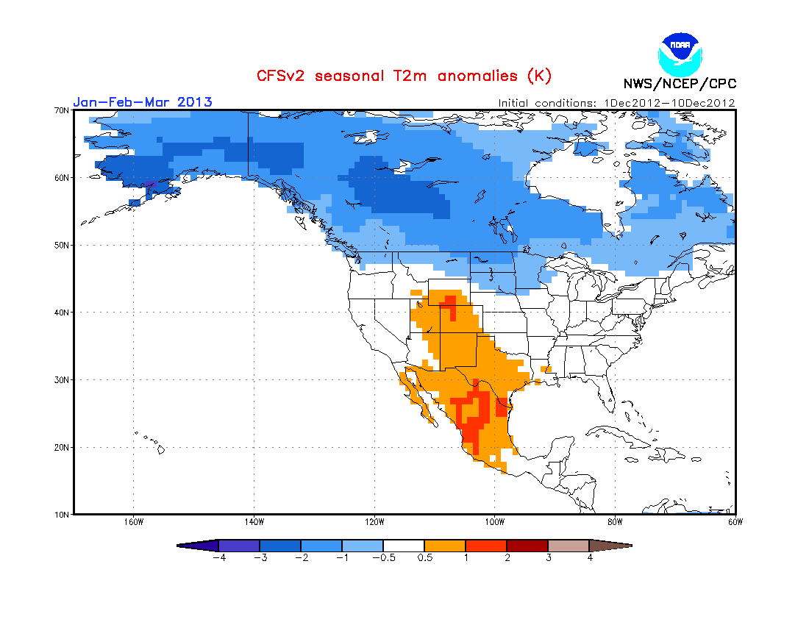
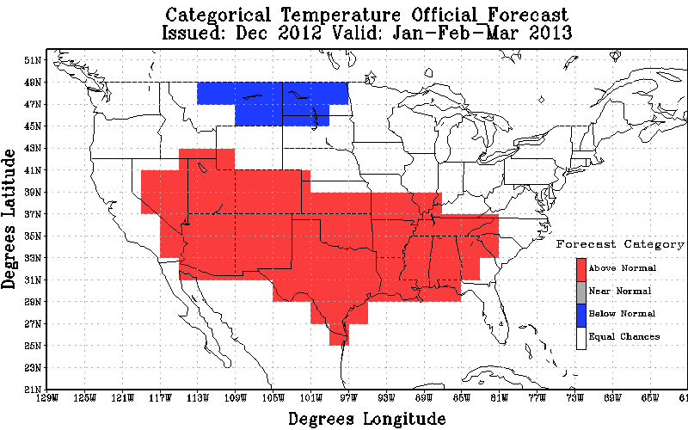
JFM 2013 T2m
Observation
Official Forecast
CFSv2 from Dec1-10, 2012
Heidke Skill Scores : non-EC: -20.56 All: -9.48 % coverage non-EC: 46.12

Slide 29
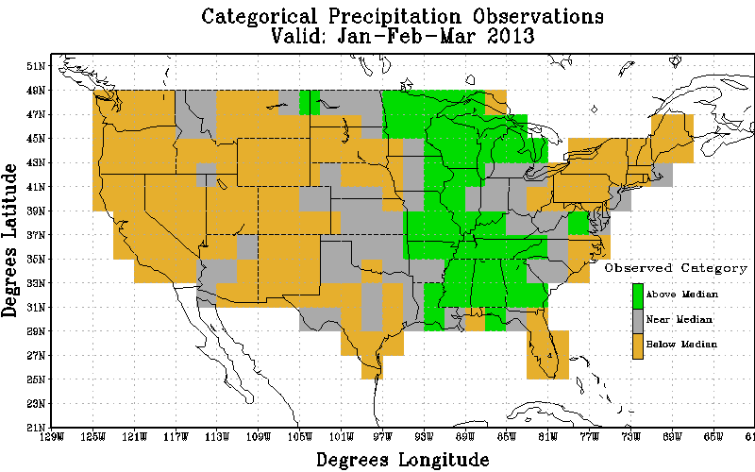
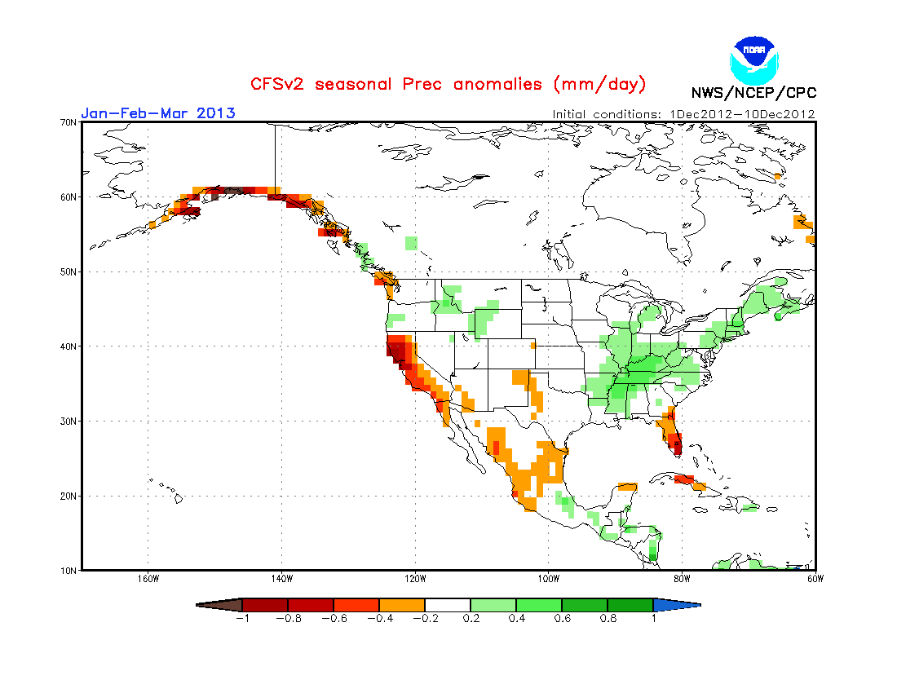
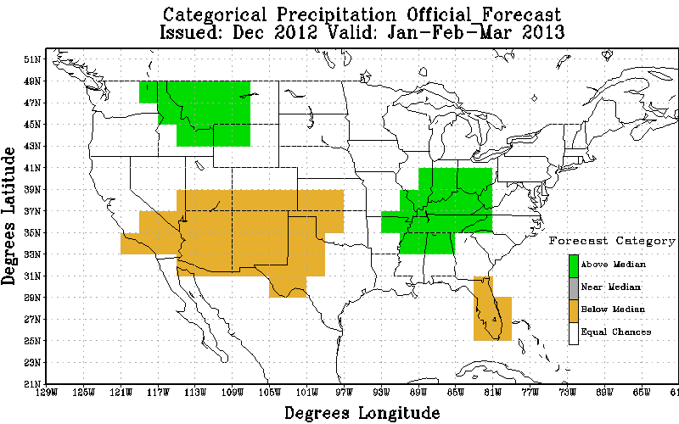
JFM 2013 precipitation
Observation
Official Forecast
CFSv2 from Dec1-10, 2012
Heidke Skill Scores : non-EC: 35.44 All: 12.07 % coverage non-EC: 34.05

Slide 30
5. ENSO forecast

Slide 31
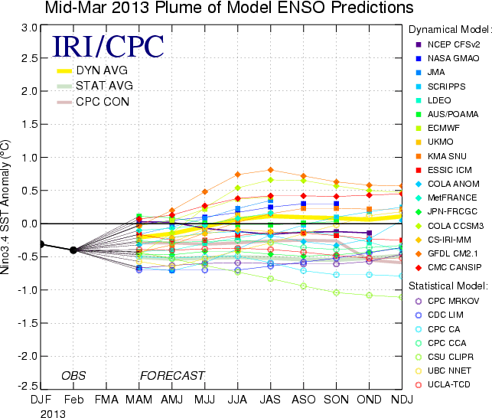
CFSv2

Slide 32
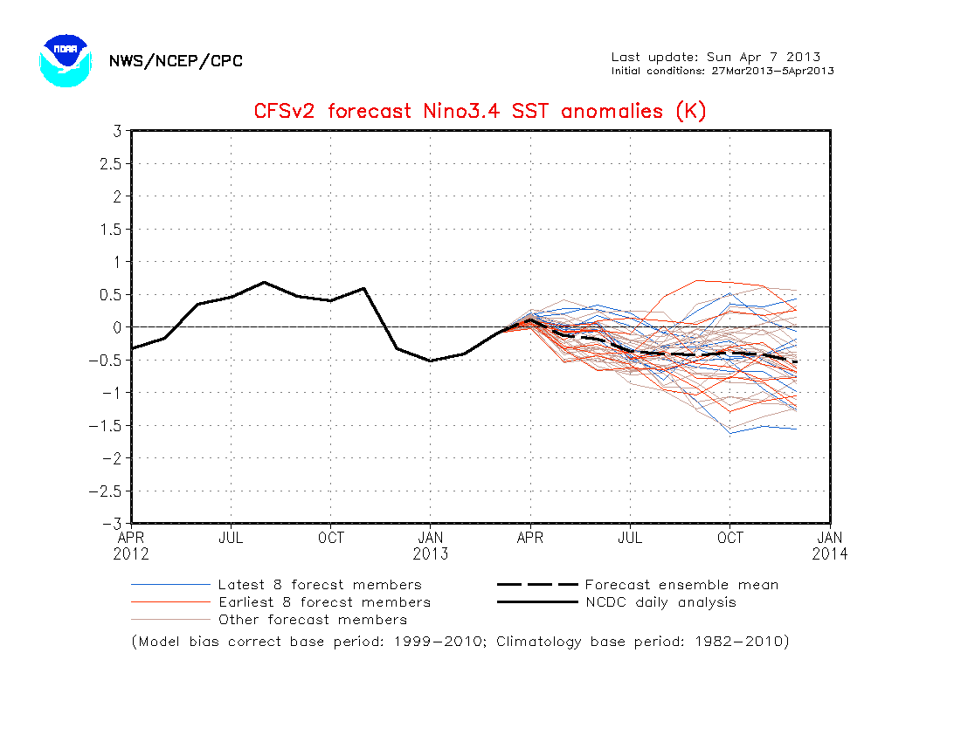

Slide 33
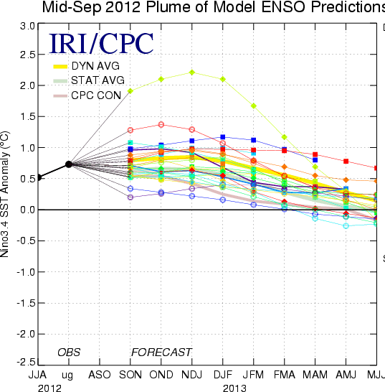
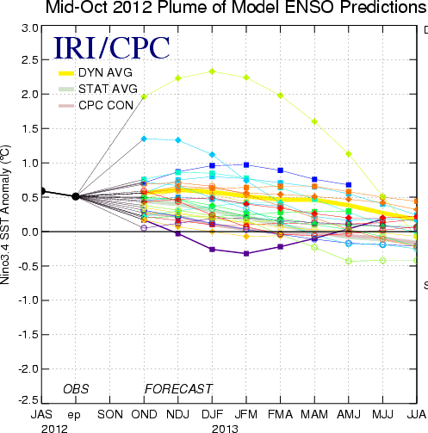
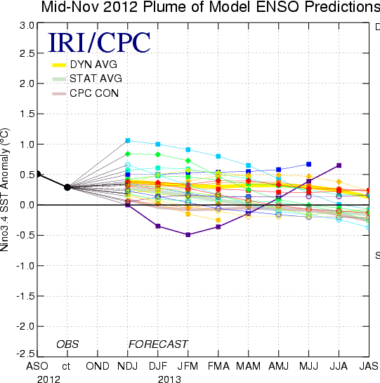
CFSv2
CFSv2

Slide 34
CFSv2
CFSv2
CFSv2

