Slide 1
CPC Monthly Climate Review
May 2013
Wanqiu Wang

Slide 2
Outline
ENSO and associated tropical fields
Global anomalies
Tropical MJO and cyclones
CPC Forecast verification
ENSO forecast

Slide 3
ENSO and associated fields

Slide 4
CPC Climate Diagnostics Bulletin
Equatorial temperature anomalies (K)
Feb 2013
Apr 2013
Mar 2013
May 2013
Evolution in the E Pacific is not consistent with CPC GODAS monitoring and Nino indices.

Slide 5
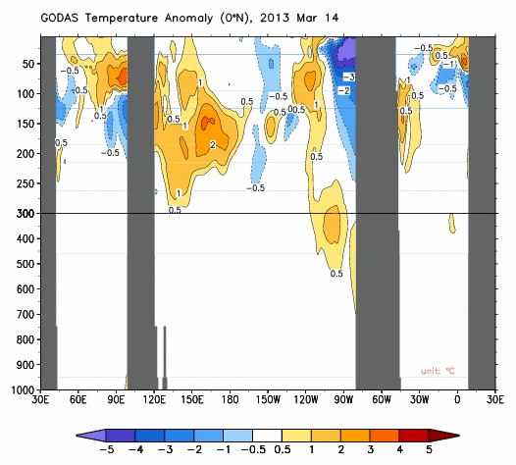
CPC GODAS monitoring
http://www.cpc.ncep.noaa.gov/products/GODAS/pent_gif/xz/movie.temp.0n.gif

Slide 6
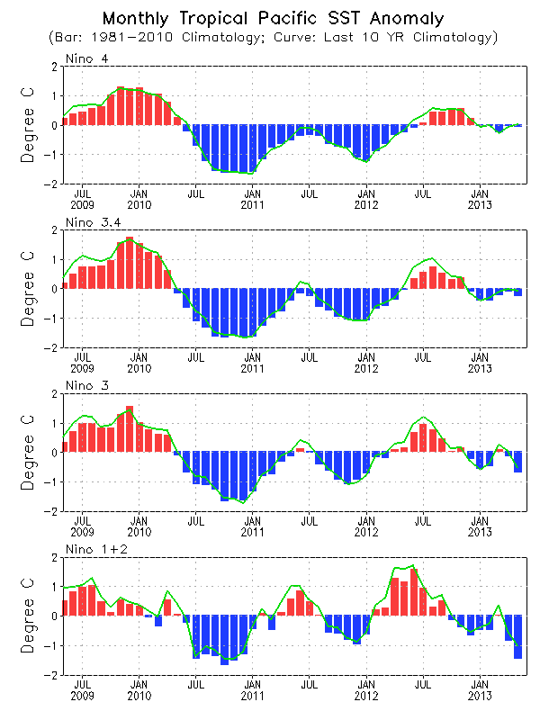
Evolution of Pacific NINO SST Indices
CPC Ocean briefing
All Nino indices were negative: Nino1+2=-1.4C, Nino3=-0.7C, NINO 3.4=-0.3ºC.
The indices were calculated based on OISST. They may have some differences compared with those based on ERSST.v3b.
Fig. P1a. Nino region indices, calculated as the area-averaged monthly mean sea surface temperature anomalies (ºC) for the specified region. Data are derived from the NCEP OI SST analysis, and anomalies are departures from the 1981-2010 (bar) and last ten year (green line) means.

Slide 7
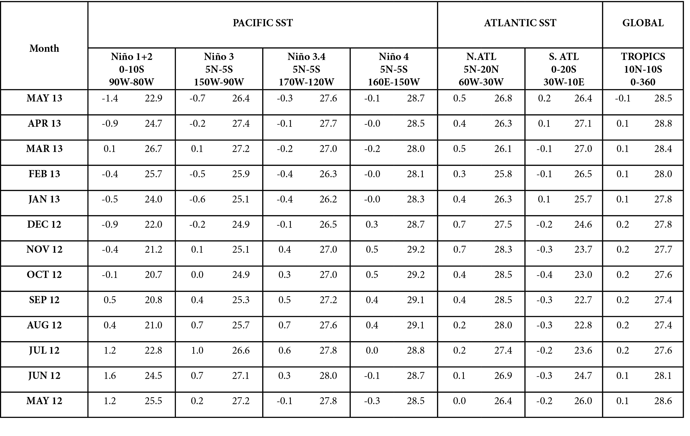
SST Indices
CPC Climate Diagnostics Bulletin

Slide 8
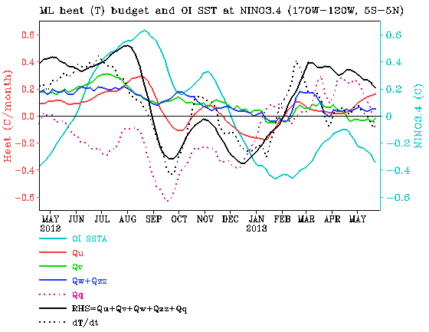
CPC Ocean briefing
NINO3.4 Heat Budget
SSTA tendency (dT/dt) in NINO3.4 region (dotted black line) was near zero in May 2013.
All the advection terms were small since mid-Jan 2013.
The thermodynamical term (Qq) were positive most time in May 2013.
The RHS and dT/dt had large differences during Mar-May 2013.
Huang, B., Y. Xue, X. Zhang, A. Kumar, and M. J. McPhaden, 2010 : The NCEP GODAS ocean analysis of the tropical Pacific mixed layer heat budget on seasonal to interannual time scales, J. Climate., 23, 4901-4925.
Qu: Zonal advection; Qv: Meridional advection;
Qw: Vertical entrainment; Qzz: Vertical diffusion
Qq: (Qnet - Qpen + Qcorr)/ρcph; Qnet = SW + LW + LH +SH;
Qpen: SW penetration; Qcorr: Flux correction due to relaxation to OI SST

Slide 9
5S-5N average
CPC Climate Diagnostics Bulletin

Slide 10
2. Global monthly mean anomalies in May 2013

Slide 11
Global SST Anomaly (⁰C) and Anomaly Tendency
CPC Ocean briefing
Negative SSTA presented in the e. Pacific.
Negative phase PDO associated SSTA pattern continued in N. Pacific.
Positive SSTA was observed in the e. Indian and w. Pacific Oceans.
Tripolar SSTA presented in N. Atlantic.

Slide 12
Climate Diagnostics Bulletin

Slide 13
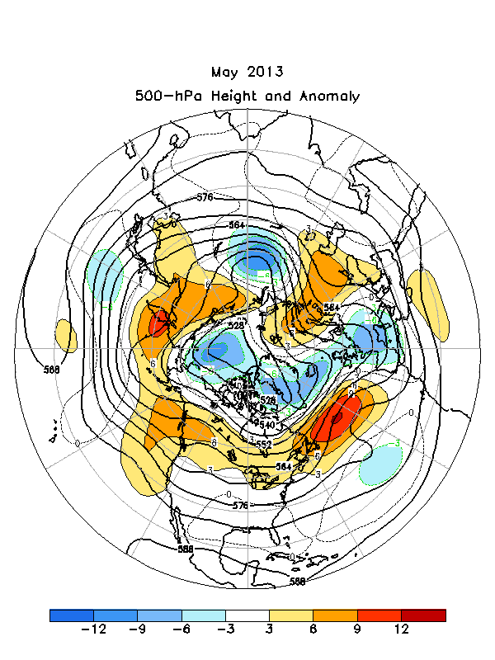

Slide 15
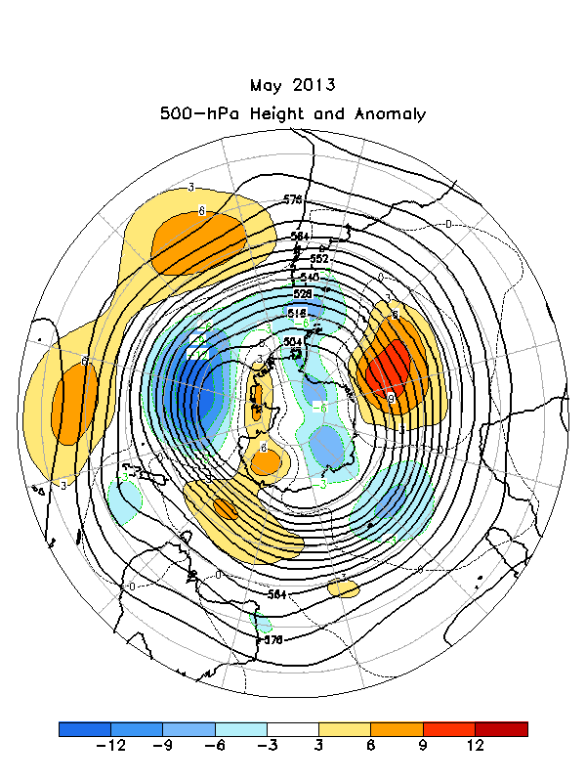
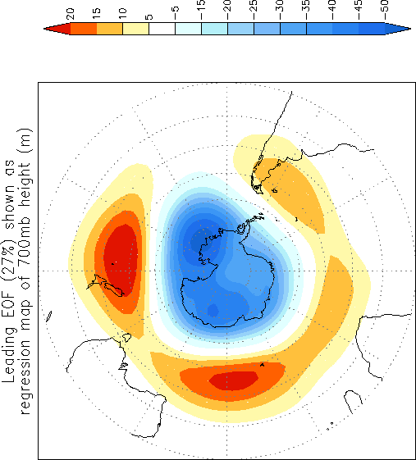

Slide 16
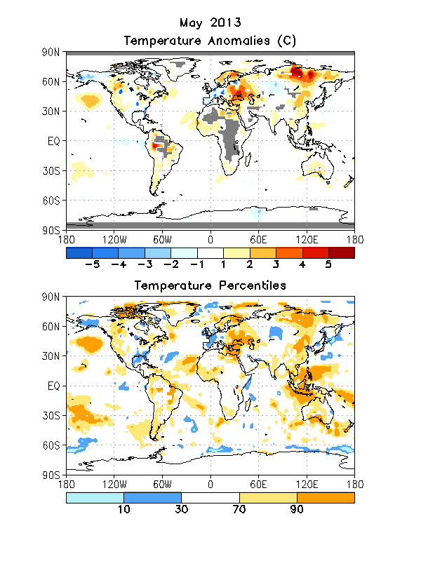

Slide 17
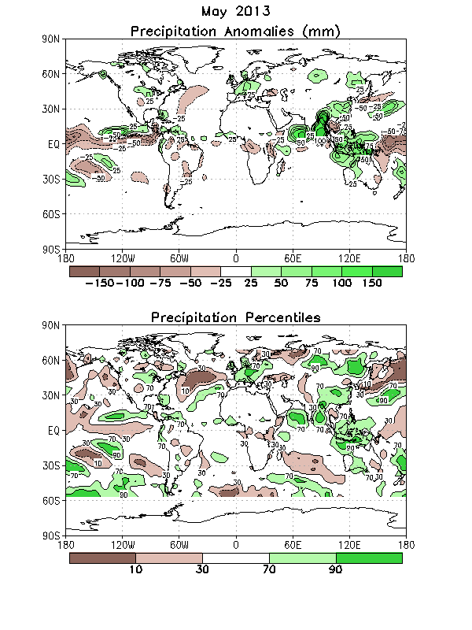

Slide 18
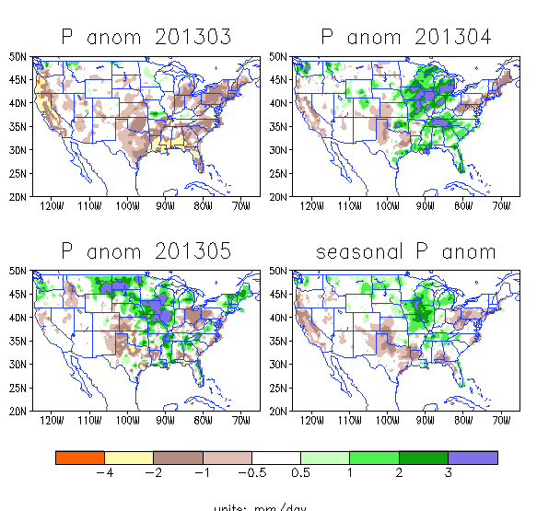
CPC Drought briefing
P anomalies over the United States
High lights:
May 2013
above normal rainfall over the North Central and Midwest caused flooding
Texas continues to be dry and May started its raining season.
For seasonal mean, the Northeast ,Texas and California had below normal rainfall

Slide 19
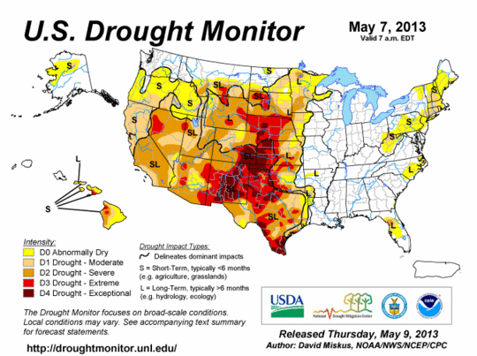
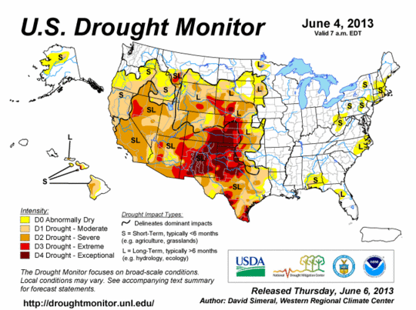
Feb 26,2013
CPC Drought briefing
Drought monitor
The eastern U.S. is free from drought.
Drought continues over the Southern Plains,
the Western States are still under drought except Washington and Montana

Slide 20
3. Tropical cyclones and MJO

Slide 21
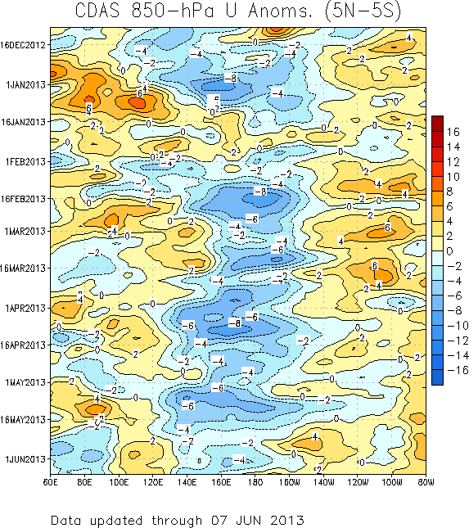
850-hPa Zonal Wind Anomalies (m s⁻¹)
Westerly anomalies (orange/red shading) represent anomalous west-to-east flow
Easterly anomalies (blue shading) represent anomalous east-to-west flow
Westward propagation (dashed/solid lines sloping down and to the left) of anomalies during early December were primarily due to equatorial Rossby wave activity as the MJO was then generally weak.
During late December the MJO strengthened (alternating dotted/dashed lines).
During March and early April, anomalies indicate signs of being influenced by equatorial Rossby wave activity with less eastward propagation evident.
The MJO strengthened during early May with eastward propagation of low-level wind anomalies noted. More recently, other sub-seasonal modes have limited eastward propagation.
Time
Longitude
CPC MJO briefing
Notes:
21

Slide 22
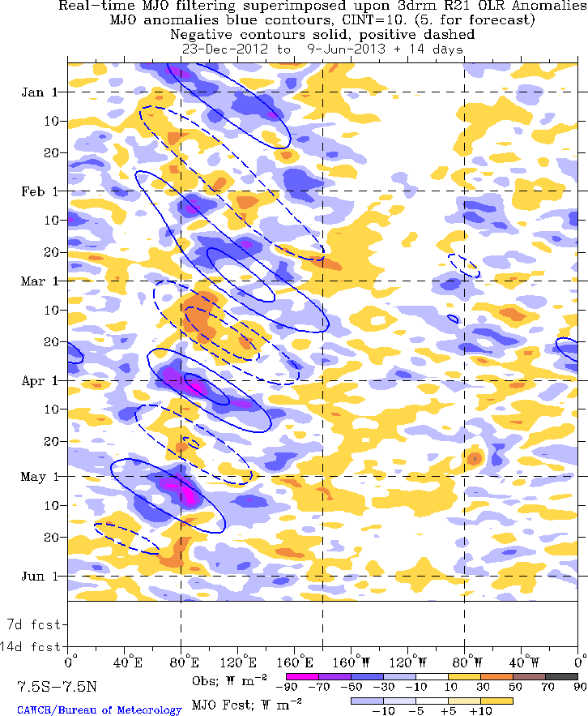
Outgoing Longwave Radiation (OLR)
Anomalies (7.5°S-7.5°N)
Drier-than-normal conditions, positive OLR anomalies (yellow/red shading)
Wetter-than-normal conditions, negative OLR anomalies (blue shading)
(Courtesy of CAWCR Australia Bureau of Meteorology)
Time
The MJO was a dominant mode of variability across the Tropics from January into March as indicated by the alternating dashed and dotted lines.
Near the end of March, the anomalies show signs of influence from other modes of tropical variability. However, MJO activity reemerged in early April across the Indian Ocean.
During early May, OLR decreased significantly (stronger negative anomalies) across the Indian Ocean. The MJO signal broke down during the middle of the month and remains fairly weak, with other modes of variability influencing the pattern.
Longitude
CPC MJO briefing
Notes:
22

Slide 23
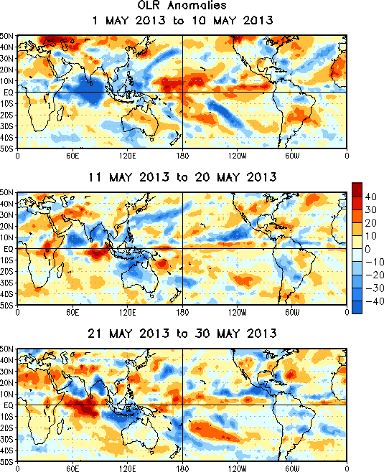
OLR Anomalies – Past 30 days
Drier-than-normal conditions, positive OLR anomalies (yellow/red shading)
Wetter-than-normal conditions, negative OLR anomalies (blue shading)
During early May, convection rapidly developed across the Indian Ocean, while the west-central Pacific experienced suppressed convection.
During mid-May, the OLR field became less coherent with generally enhanced convection north of the Equator across the Indian Ocean and Maritime Continent. Convection also increased in parts of the East Pacific due to a northward displaced ITCZ
Most recently in late May, the OLR field has remained incoherent with respect to the MJO. A convective dipole across the Indian Ocean and anomalous convection across Central America appear to be the dominant features.
CPC MJO briefing
Notes:
23

Slide 24
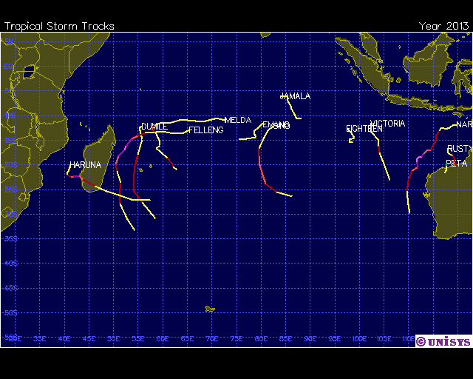
2013 Hurricane/Tropical Data for Southern Indian Ocean
MJO event
# | Name | Date | Wind | Pres | Cat
12 | Tropical Storm JAMALA | 08-11 MAY | 45 |  | -

Slide 25
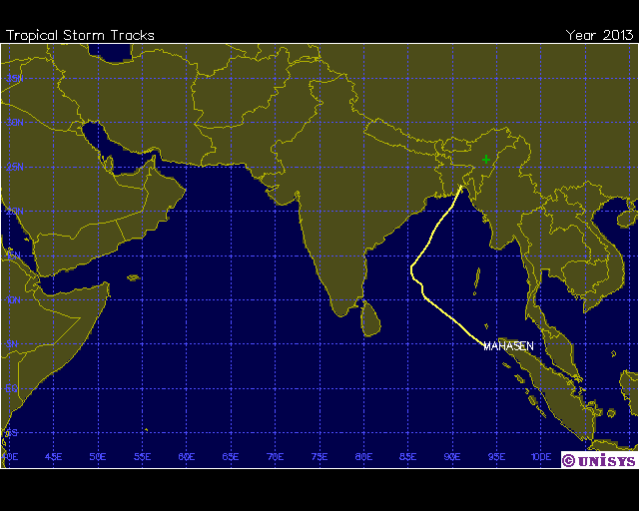
2013 Hurricane/Tropical Data for Northern Indian Ocean
Initiated by the MJO event?
# | Name | Date | Wind | Pres | Cat
1 | Tropical Storm MAHASEN | 10-16 MAY | 50 |  | -

Slide 26
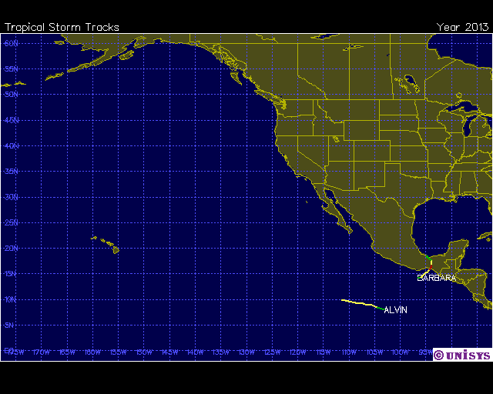
2013 Hurricane/Tropical Data for Eastern Pacific
# | Name | Date | Wind | Pres | Cat
1 | Tropical Storm ALVIN | 15-17 MAY | 45 |  | -
2 | Hurricane-1 BARBARA | 28-30 MAY | 65 |  | 1

Slide 27
5. CPC Forecast verification

Slide 28
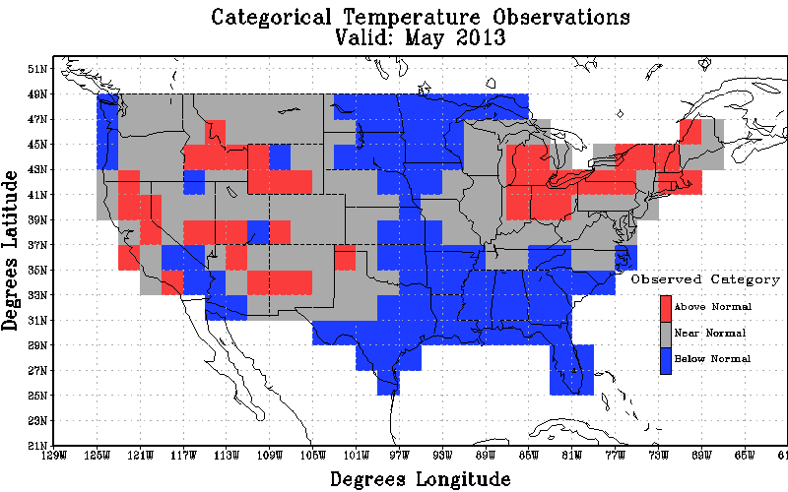
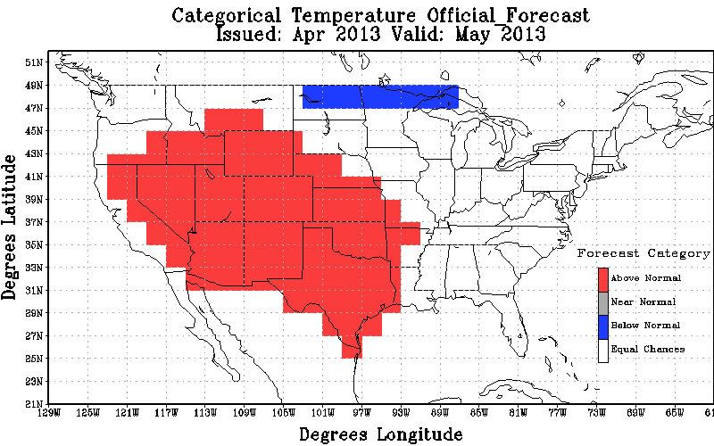
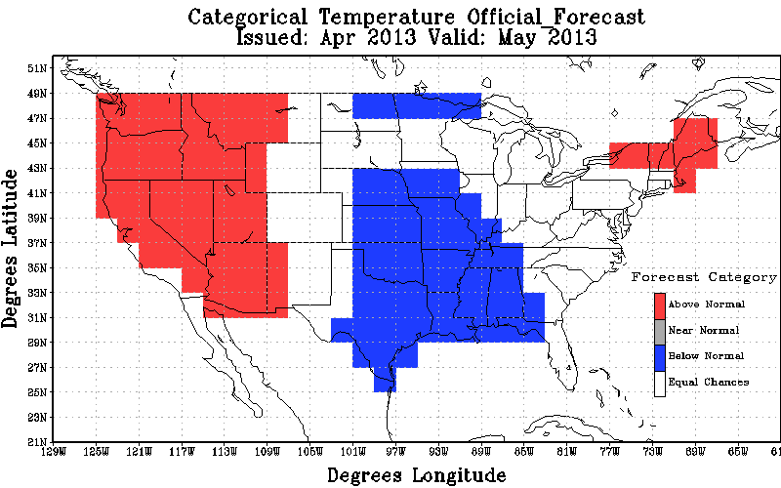
May 2013 T2m
Observation
Original Forecast
Revised Forecast
Heidke Skill Scores : Non-EC: -10.38 All: -4.74 % coverage non-EC: 45.69
Heidke Skill Scores : non-EC: 23.90 All: 14.01 % coverage non-EC: 58.62

Slide 29
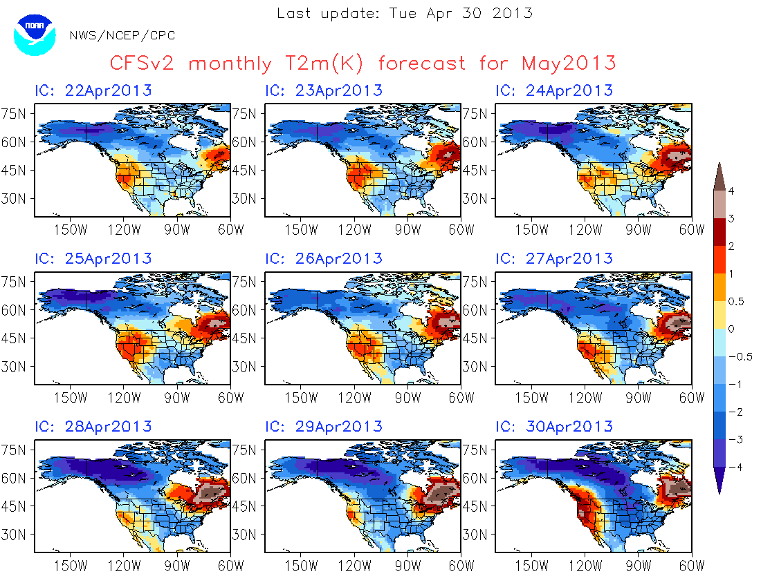
http://www.cpc.ncep.noaa.gov/products/people/mchen/CFSv2FCST/monthly/images/summaryCFSv2.NaT2m.201305.gif

Slide 30
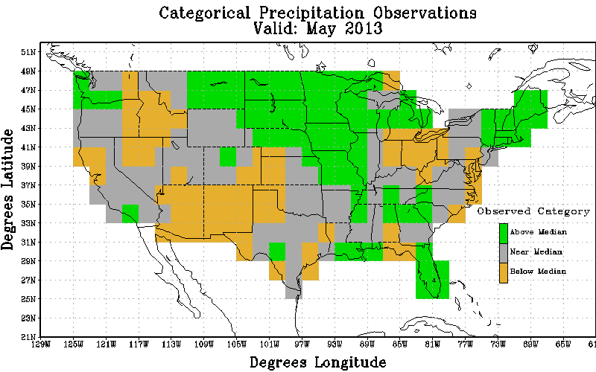
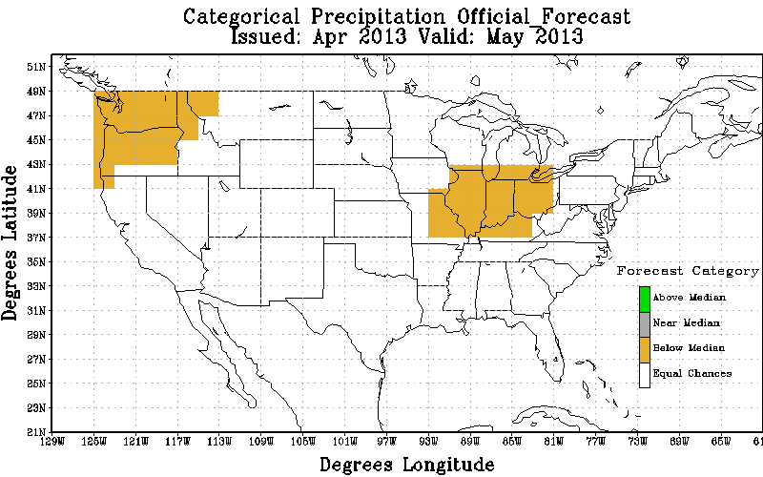
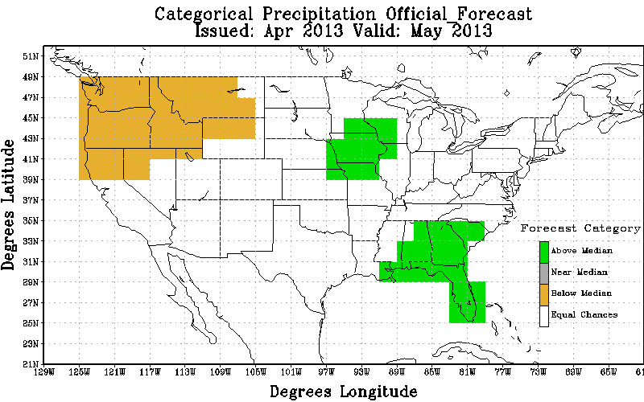
May 2013 precipitation
Observation
Original Forecast
Revised Forecast
Heidke Skill Scores : Non-EC: -3.13 All: -0.43 % coverage non-EC: 13.79
Heidke Skill Scores : non-EC: 26.12 All: 7.54 % coverage non-EC: 28.88

Slide 31
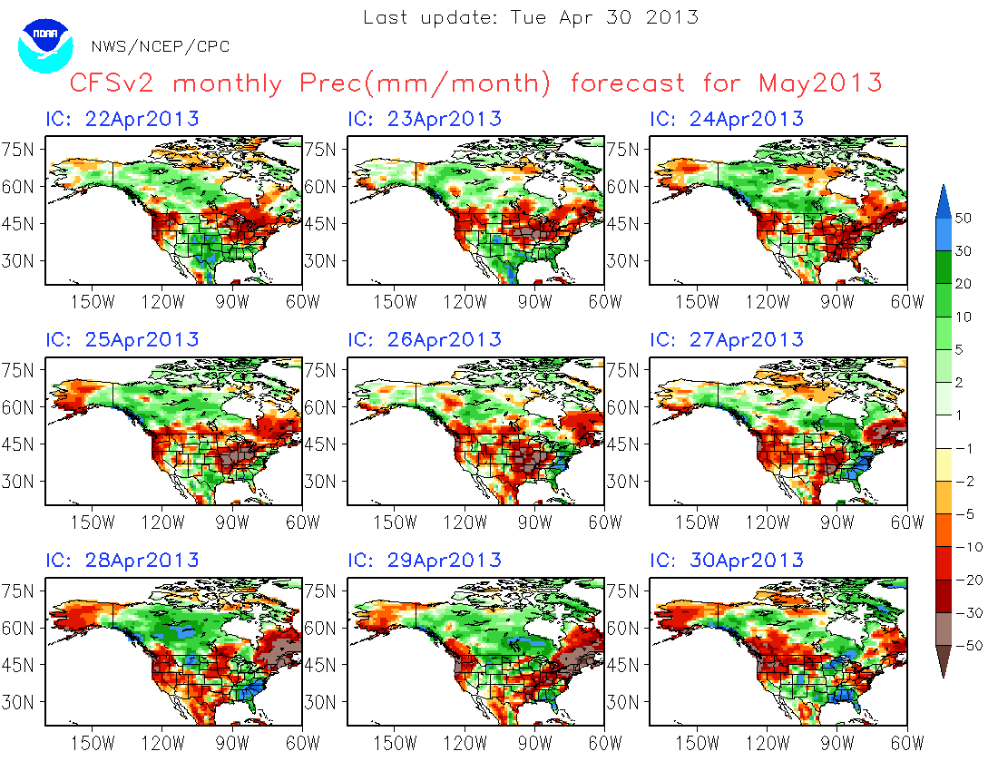
http://www.cpc.ncep.noaa.gov/products/people/mchen/CFSv2FCST/monthly/images/summaryCFSv2.NaT2m.201303.gif

Slide 32
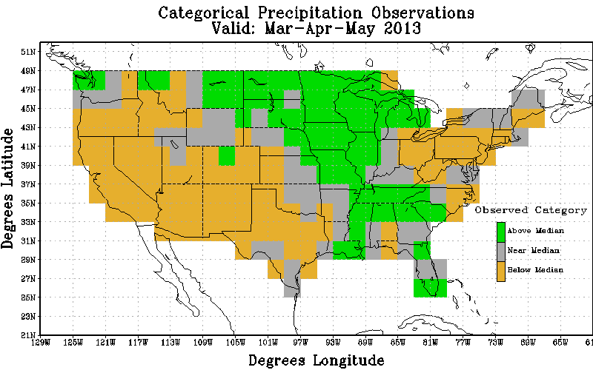
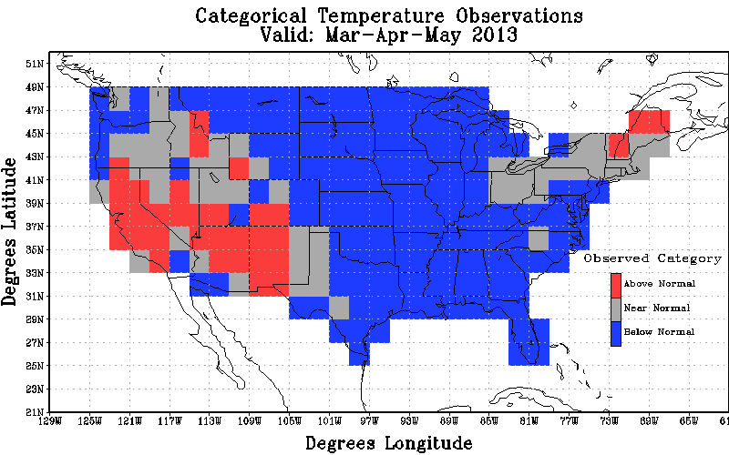
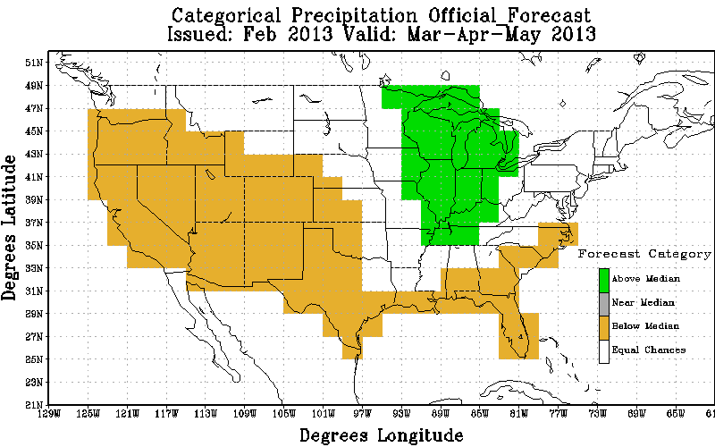
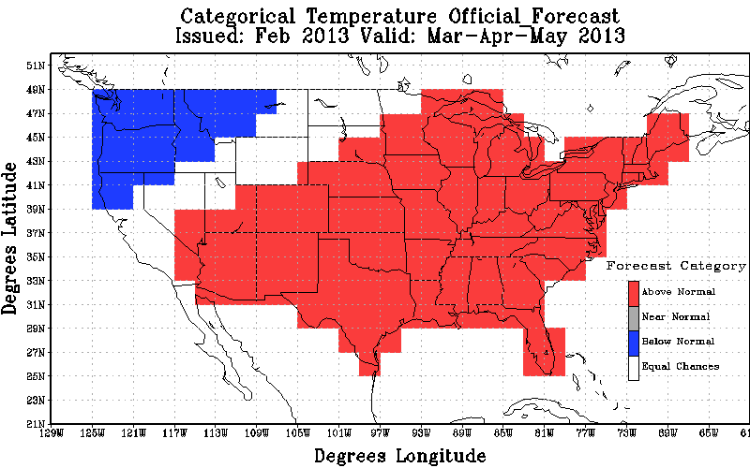
MAM 2013 T2m
MAM 2013 precipitation
Observation
Observation
Official Forecast
Official Forecast
Heidke Skill Scores : non-EC: -204.48 All: -24.47 % coverage non-EC: 83.62
Heidke Skill Scores : non-EC: 58.45 All: 37.28 % coverage non-EC: 63.79

Slide 33
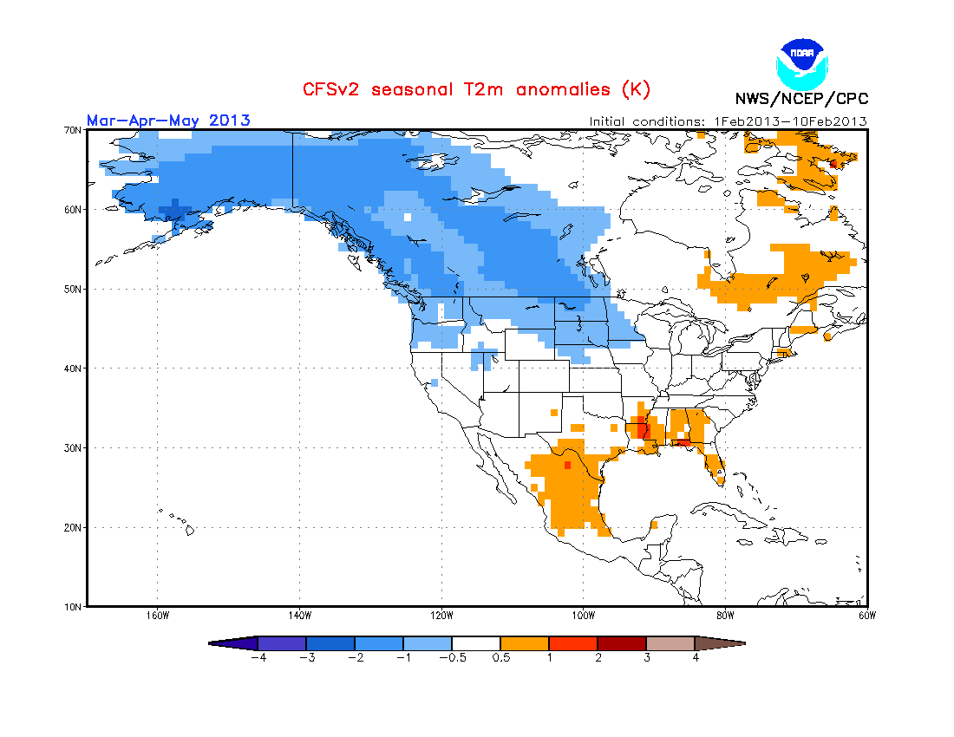
MAM 2013 T2m
Observation
Official Forecast
CFSv2 from Feb 1-10, 2012
Heidke Skill Scores : non-EC: -204.48 All: -24.47 % coverage non-EC: 83.62

Slide 34
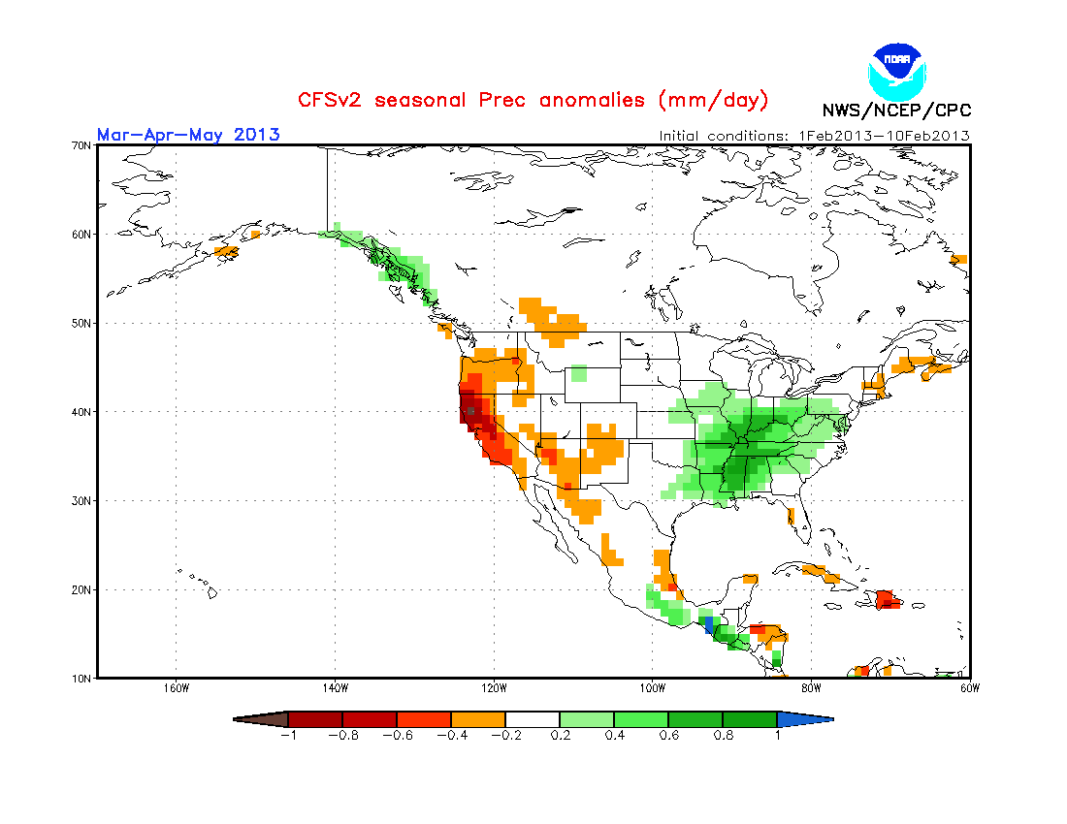
MAM 2013 precipitation
Observation
Official Forecast
CFSv2 from Feb1-10, 2012
Heidke Skill Scores : non-EC: 58.45 All: 37.28 % coverage non-EC: 63.79

Slide 35
6. ENSO forecast

Slide 36
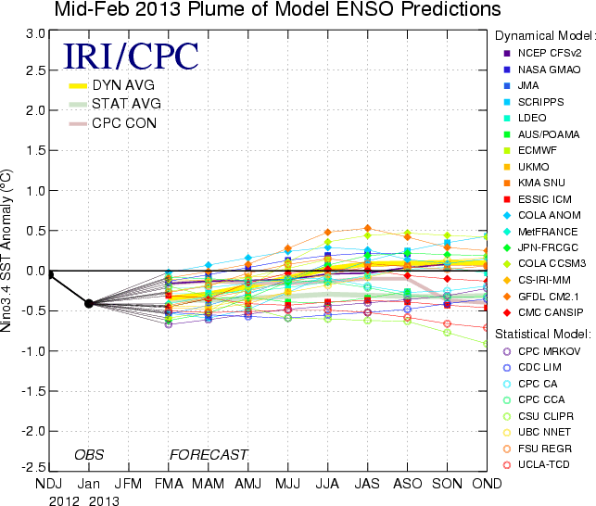
CFSv2

Slide 37
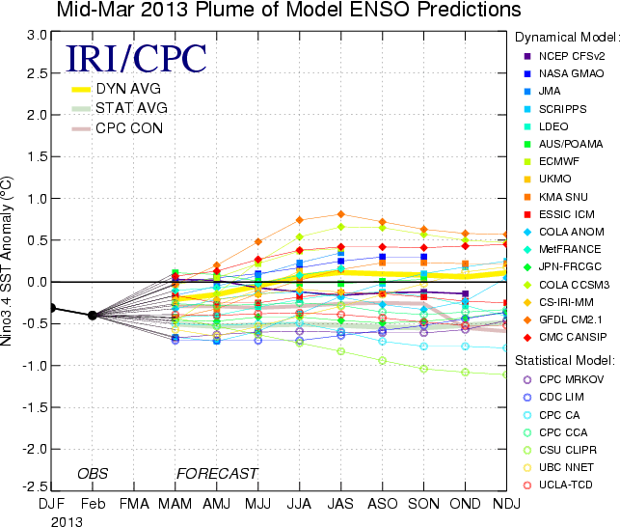
CFSv2

Slide 38
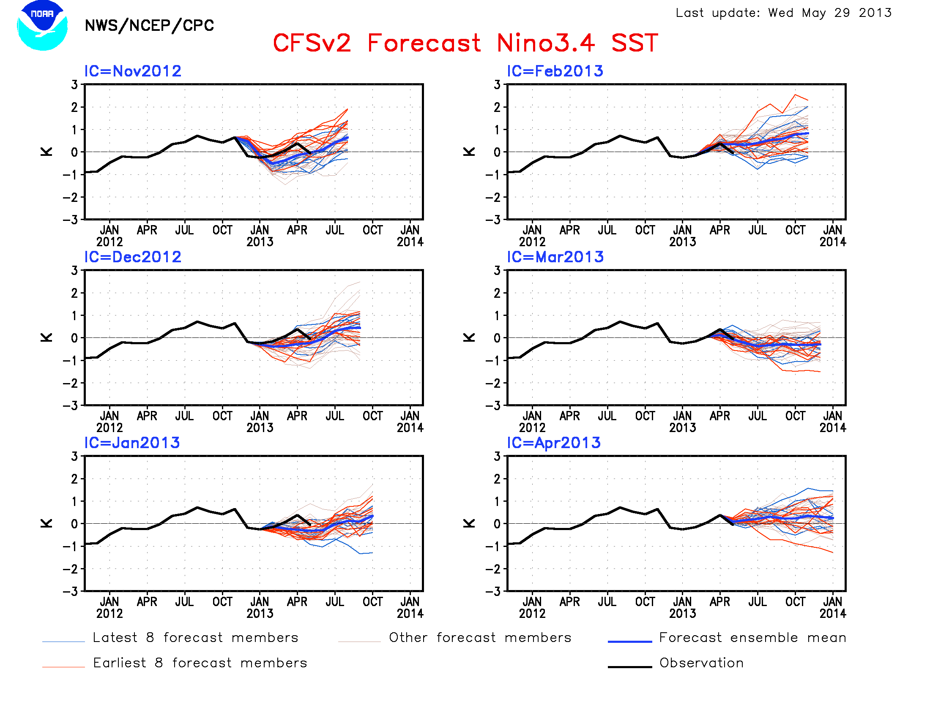
Courtesy Mingyue Chen

Slide 39
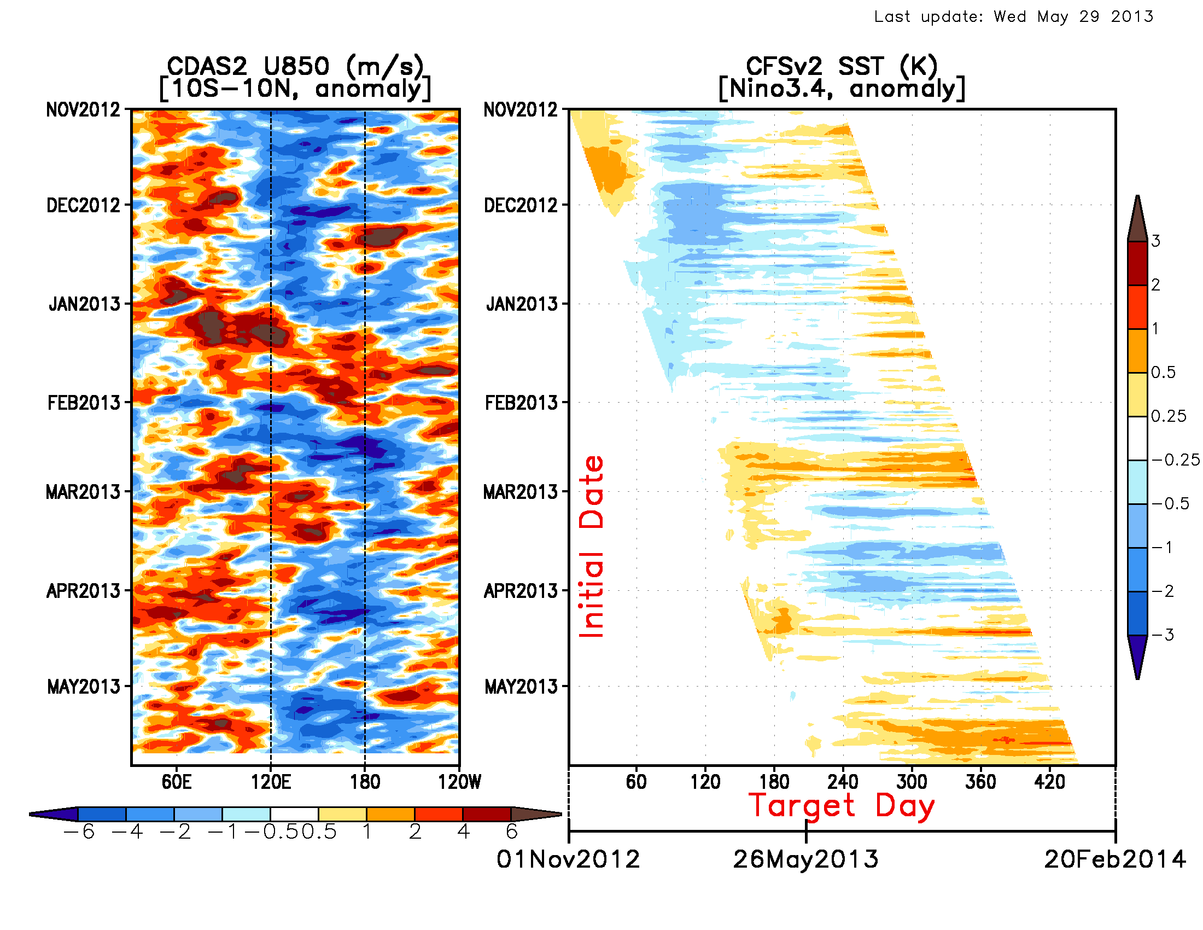
Courtesy Mingyue Chen

Slide 40
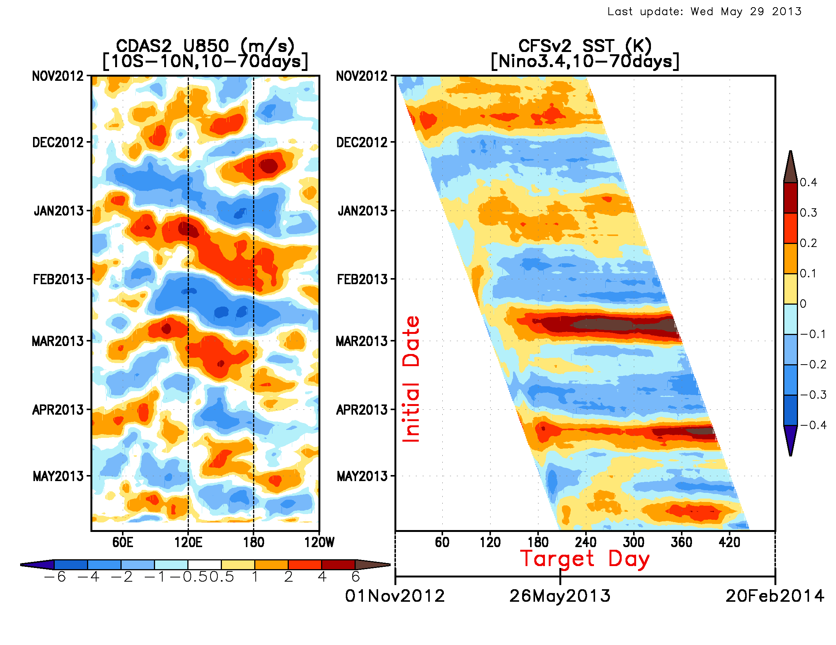
Intraseasonally filtered anomaly with respect to initial time
Courtesy Mingyue Chen

