Slide 1
Monthly Review – November 2013
Some tropical indices and SST, and MJO
Some mid-latitude anomalies
Global climate change issues
Noteworthy weather events
Other ongoings
Special: “The fluid is falling”, both in the ocean/atmosphere
Huug van den Dool, Dec, 6, 2013

Slide 2
6th of the month is early
No NMME
Only some monthly updates are in

Slide 3
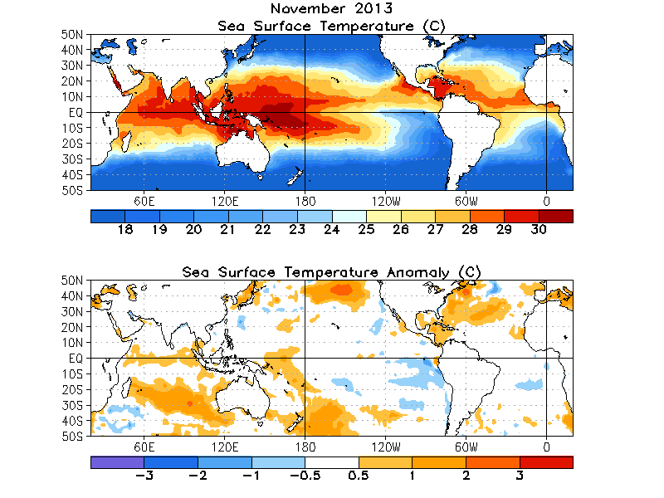

Slide 4
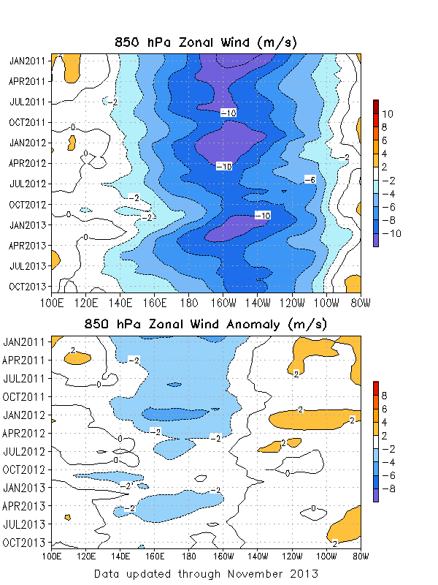

Slide 5
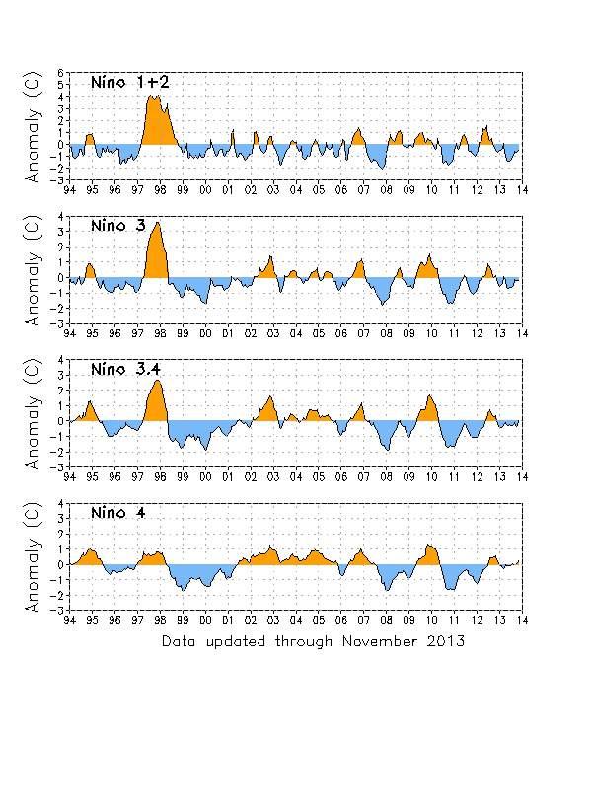
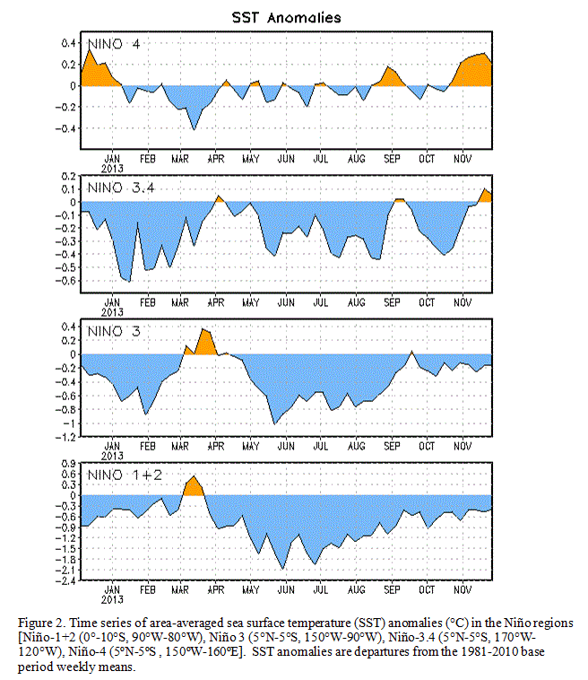

Slide 6
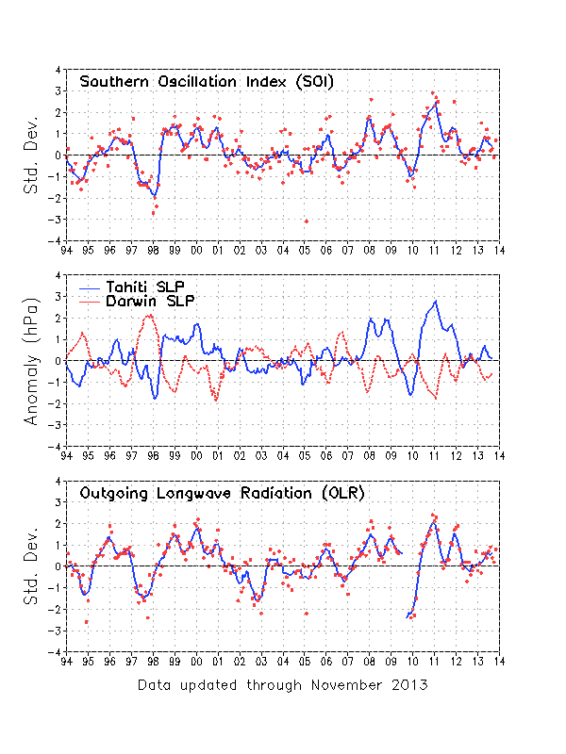
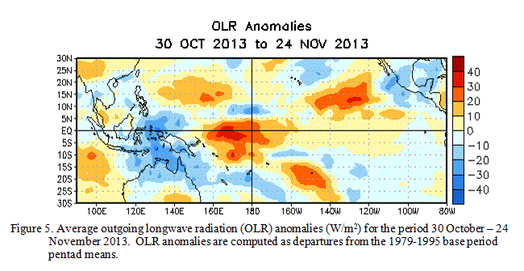

Slide 7
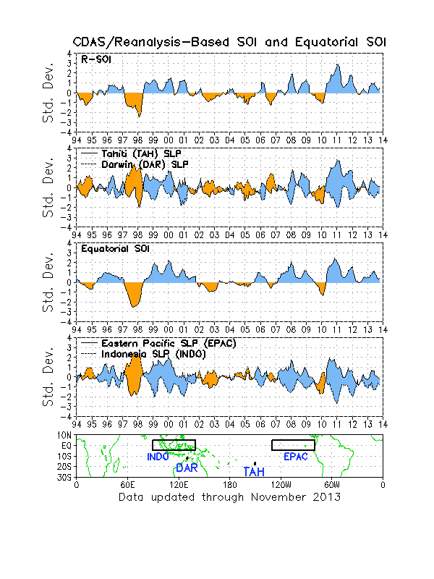

Slide 8
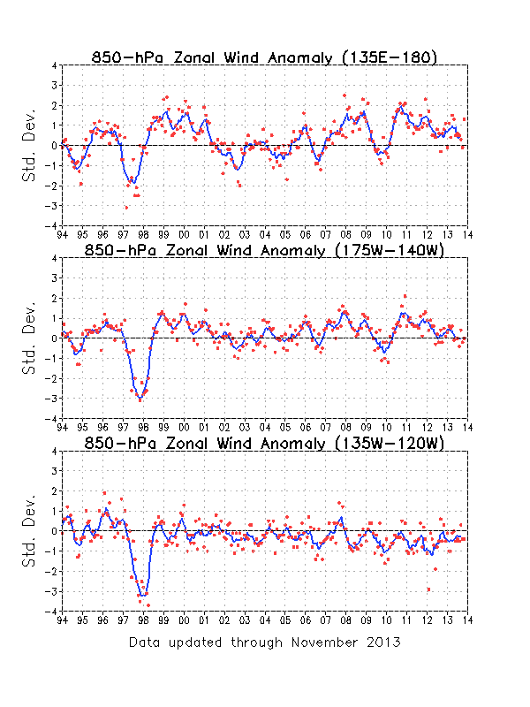
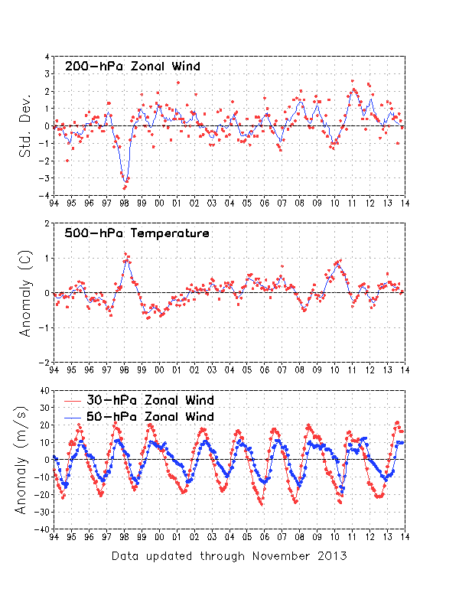

Slide 9
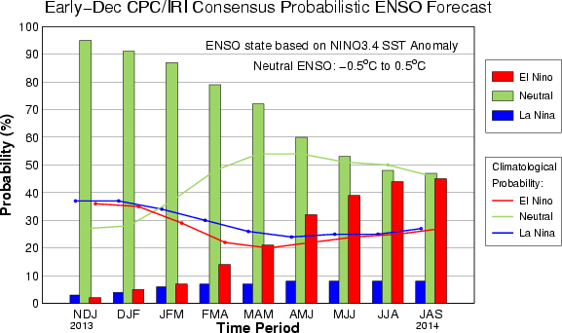
Synopsis: ENSO-neutral is
expected to continue
into the Northern Hemisphere
summer 2014.

Slide 10
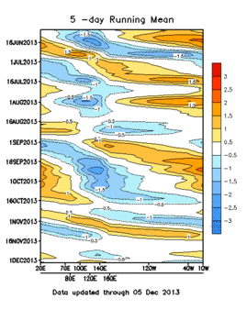
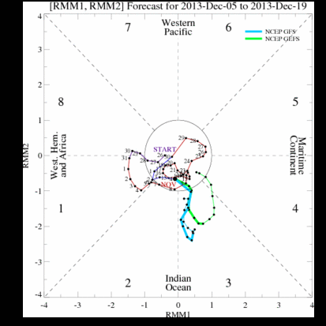
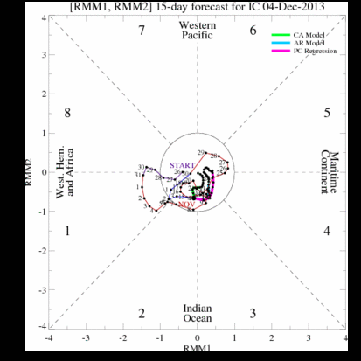
MJO

Slide 11
Mid-Latitude (or global)

Slide 12
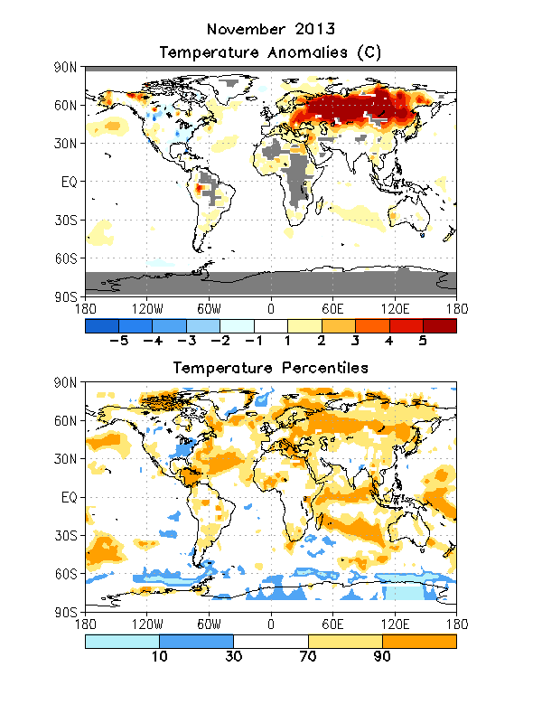
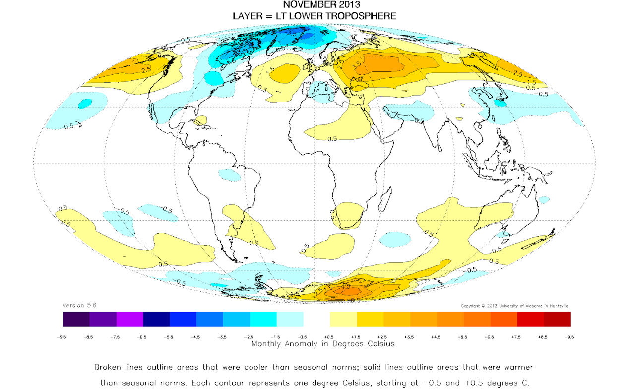

Slide 13
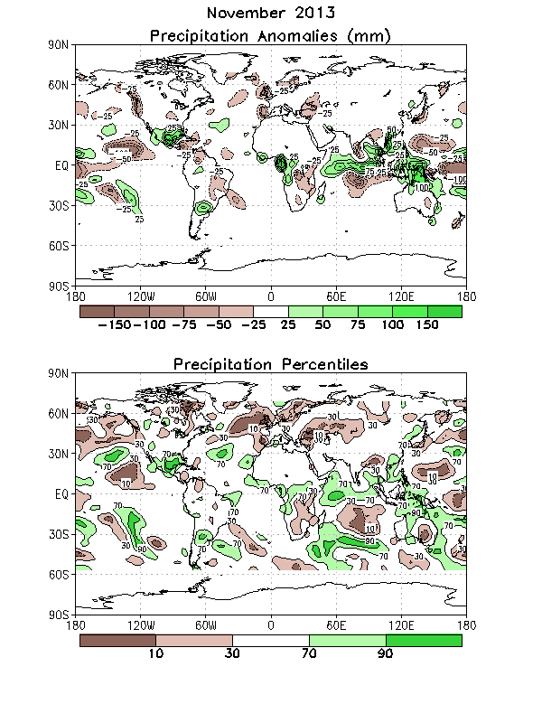

Slide 14
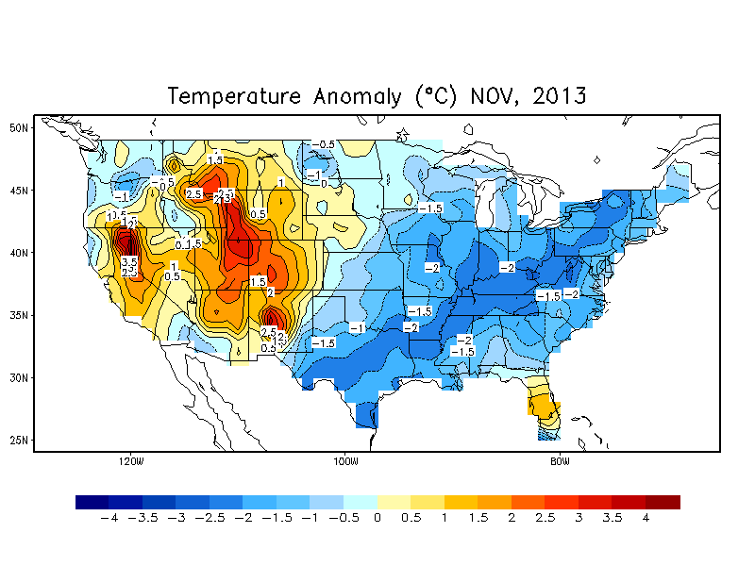
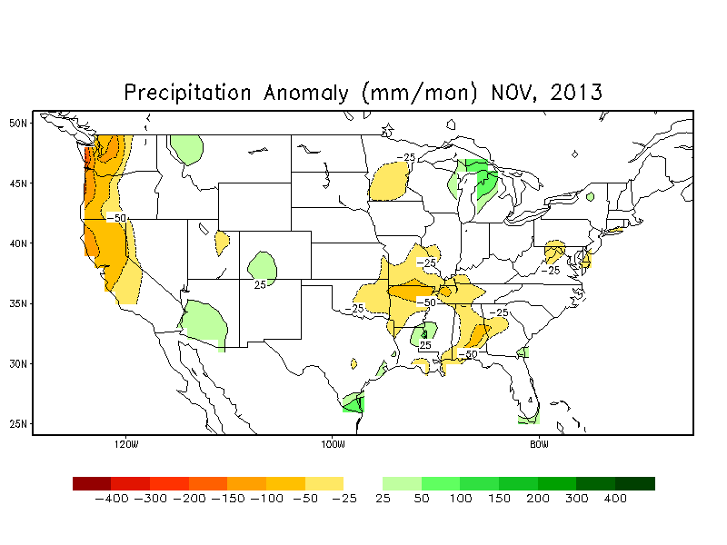

Slide 15
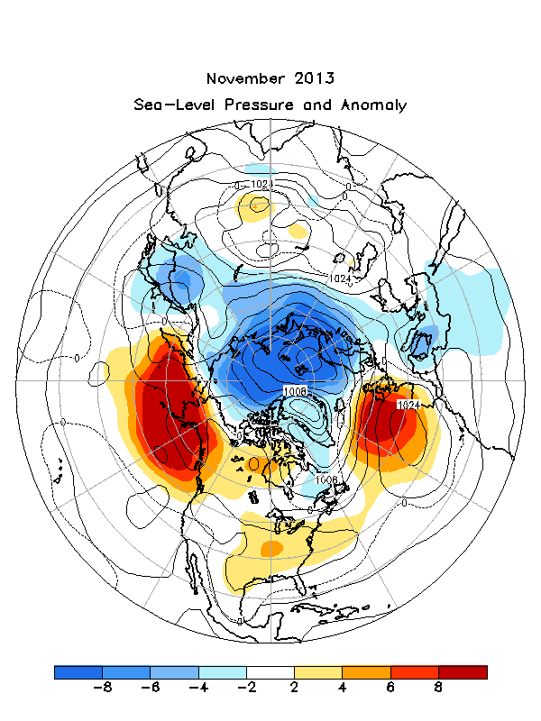

Slide 16
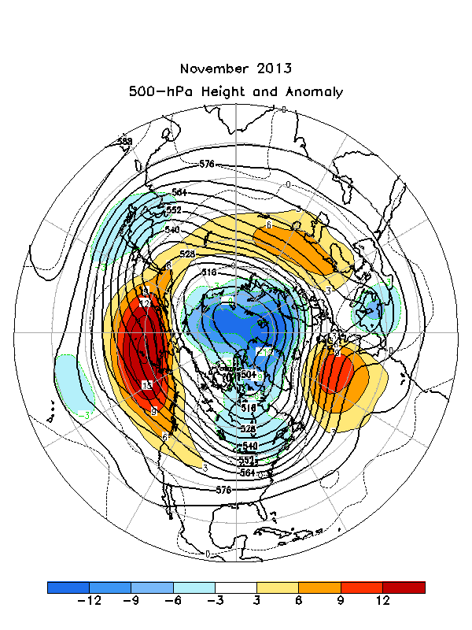

Slide 17
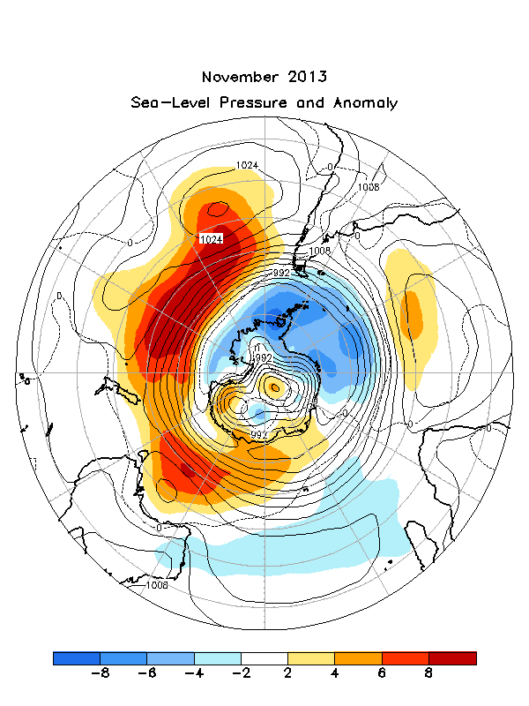

Slide 18
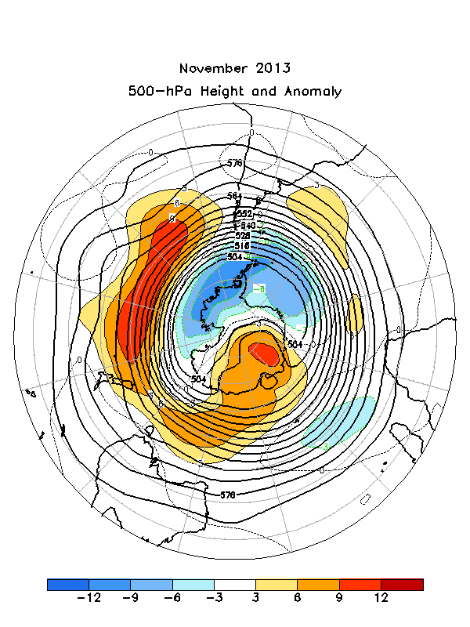

Slide 19
A few global climate change issues

Slide 20
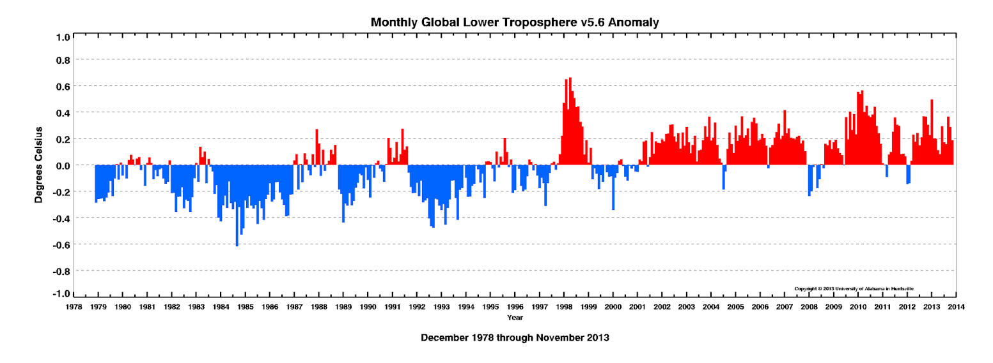

Slide 21
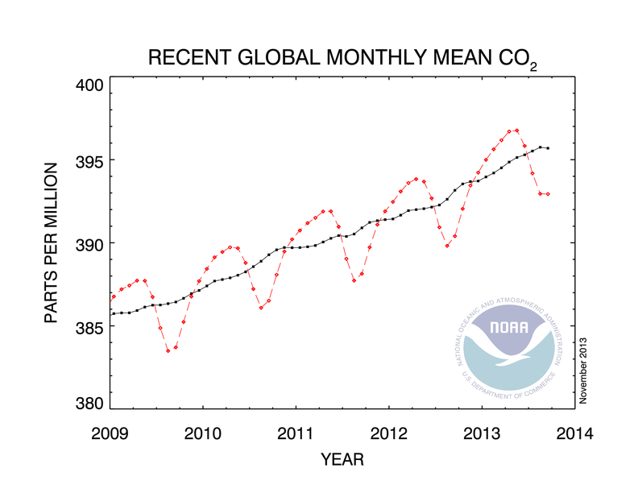
September 2013: 392.93 ppm September 2012: 390.40 ppm

Slide 22
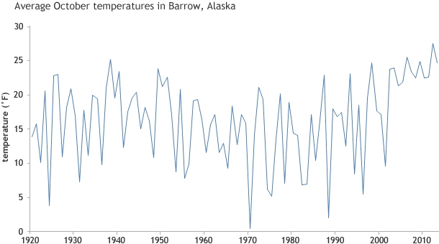

Slide 23
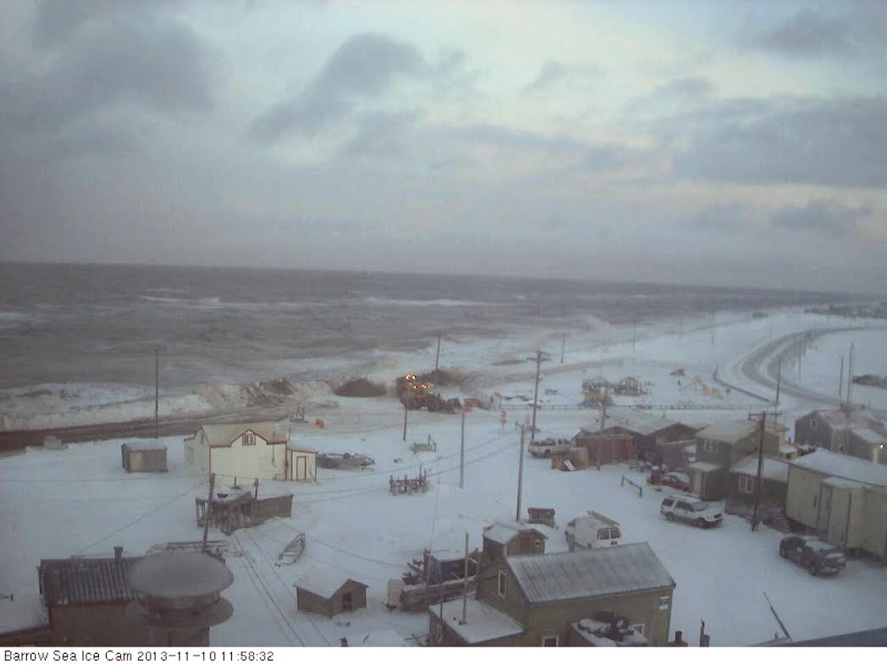

Slide 24
Noteworthy weather

Slide 25
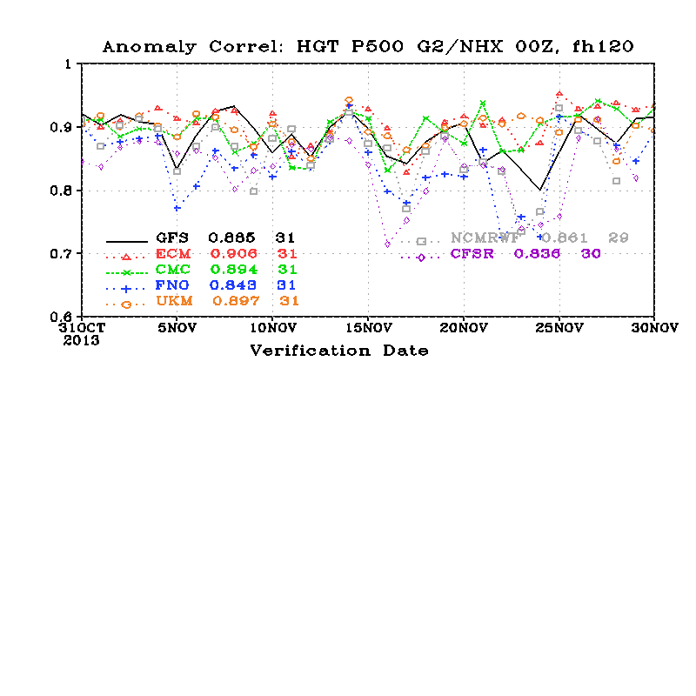

Slide 26
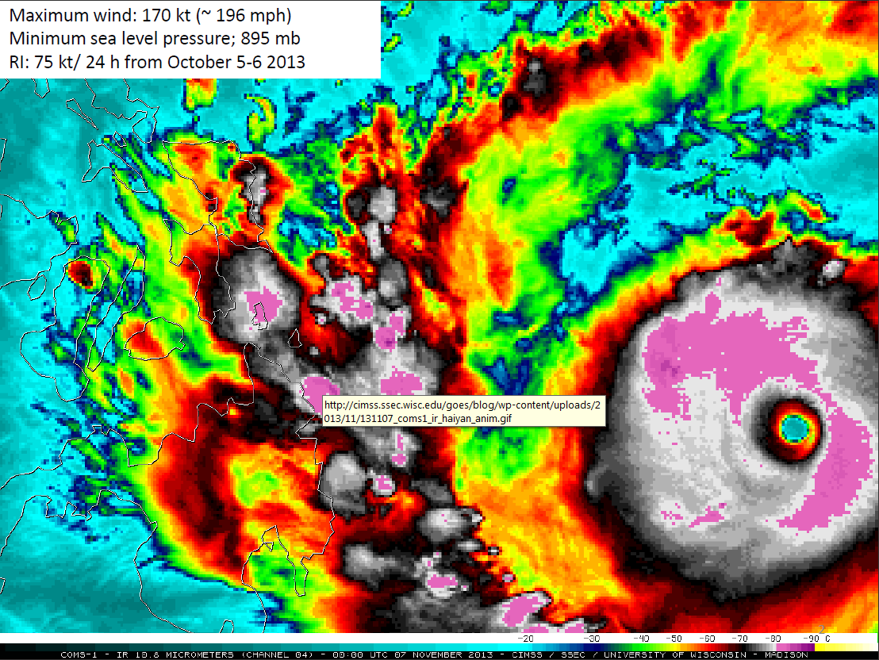
/home/www/cpc/htdocs/products/people/wd51hd/sst/201311

Slide 28
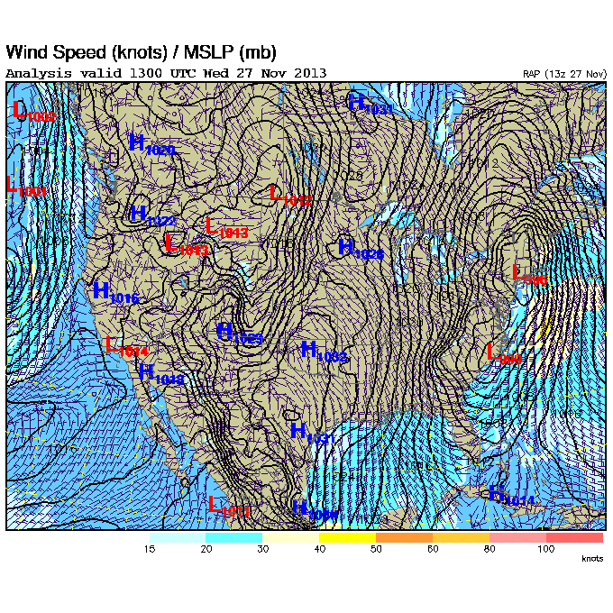
Thanksgiving eve!

Slide 29
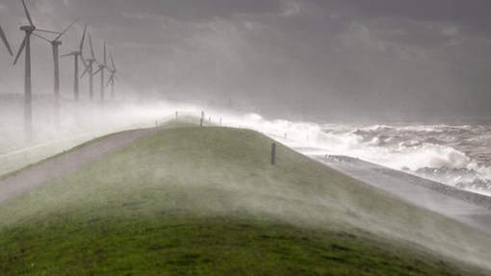
2nd “once in 20 year” storm in NW Europe, in a 2 month window!
Dec, 5 and Oct, 28.

Slide 30
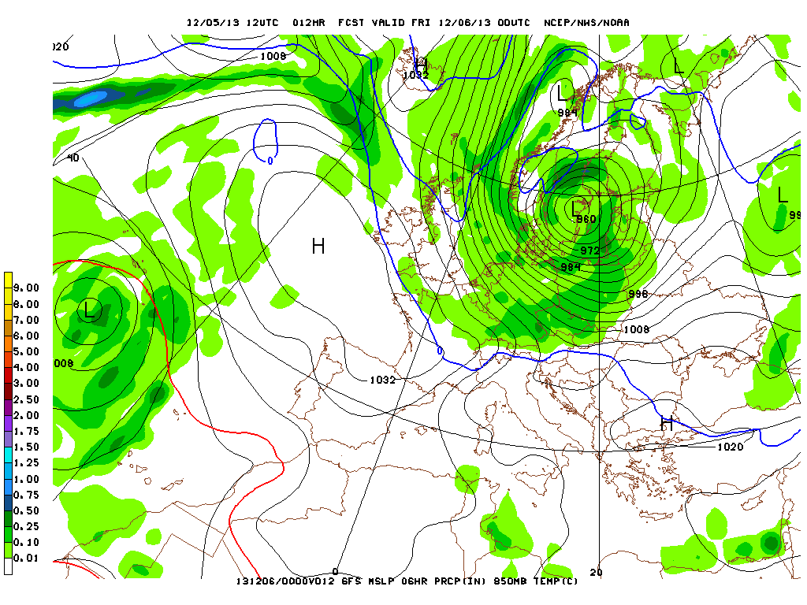
Greatest pressure drop: 12 mb/6 hours.

Slide 31
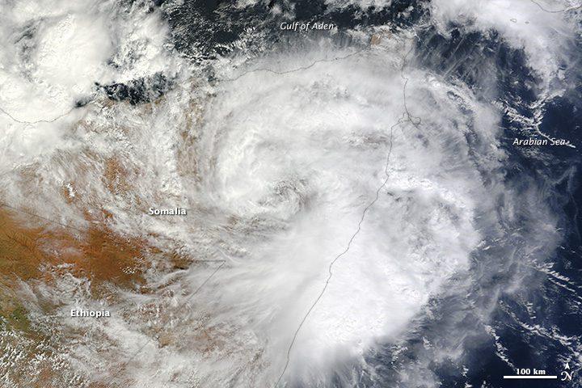
Nov, 13, 2013: Tropical cyclone 3A hitting Somalia

Slide 34
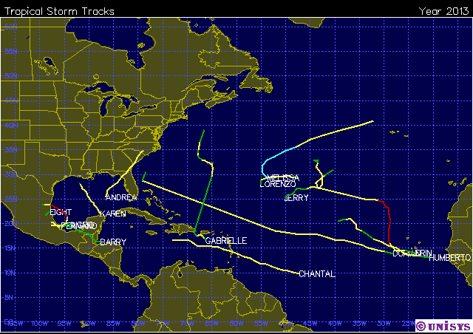
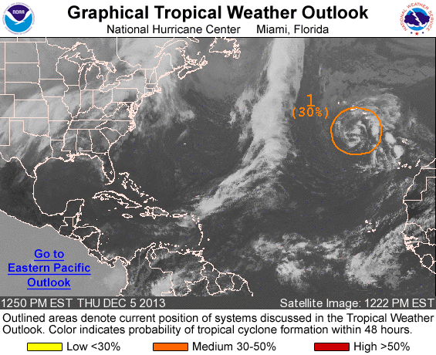

Slide 35
Other ongoings

Slide 36
Year | Wgt | Year | Wgt | Year | Wgt | Year | Wgt | Year | Wgt | Year | Weigt
1956 | 1 | 1966 | 0 | 1976 | -2 | 1986 | -7 | 1996 | 3 | 2006 | 2
1957 | 5 | 1967 | 6 | 1977 | 4 | 1987 | -11 | 1997 | -7 | 2007 | 3
1958 | 4 | 1968 | 0 | 1978 | 4 | 1988 | -1 | 1998 | -3 | 2008 | 8
1959 | 3 | 1969 | 2 | 1979 | 11 | 1989 | -3 | 1999 | -8 | 2009 | 6
1960 | -2 | 1970 | 4 | 1980 | -7 | 1990 | 11 | 2000 | 6 | 2010 | 13
1961 | -6 | 1971 | -1 | 1981 | -1 | 1991 | -3 | 2001 | 9 | 2011 | 8
1962 | 0 | 1972 | 4 | 1982 | -5 | 1992 | -2 | 2002 | 3 | 2012 | 5
1963 | -6 | 1973 | -1 | 1983 | -8 | 1993 | -11 | 2003 | 4 | 2013 | NA
1964 | -3 | 1974 | -6 | 1984 | 2 | 1994 | 2 | 2004 | 1
1965 | -3 | 1975 | -6 | 1985 | -8 | 1995 | 0 | 2005 | 6
CA-SST weights at the end of October 2013

Slide 37
Year | Wgt | Year | Wgt | Year | Wgt | Year | Wgt | Year | Wgt | Year | Weigt
1956 | 1 | 1966 | -1 | 1976 | -2 | 1986 | -5 | 1996 | 3 | 2006 | 2
1957 | 5 | 1967 | 4 | 1977 | 4 | 1987 | -11 | 1997 | -6 | 2007 | 6
1958 | 4 | 1968 | 0 | 1978 | 3 | 1988 | 1 | 1998 | -4 | 2008 | 5
1959 | 5 | 1969 | 4 | 1979 | 8 | 1989 | 3 | 1999 | -7 | 2009 | 7
1960 | -2 | 1970 | 4 | 1980 | -4 | 1990 | 8 | 2000 | 4 | 2010 | 9
1961 | -2 | 1971 | -3 | 1981 | -2 | 1991 | -5 | 2001 | 9 | 2011 | 8
1962 | 0 | 1972 | 7 | 1982 | -4 | 1992 | -2 | 2002 | 3 | 2012 | 7
1963 | -4 | 1973 | -1 | 1983 | -5 | 1993 | -13 | 2003 | 7 | 2013 | NA
1964 | -3 | 1974 | -5 | 1984 | -2 | 1994 | 2 | 2004 | 3
1965 | -4 | 1975 | -5 | 1985 | -6 | 1995 | -3 | 2005 | 4
CA-SST weights at the end of November 2013
Little changes in weight in one month (that is good!)
Last 13 years are positive (supports or is consistent with “OCN”)
Weights are small, only three in excess of |0.10|, very unusual
1987 continues as a high –ve weight. Reaching 2 years soon. Determinism?

Slide 38
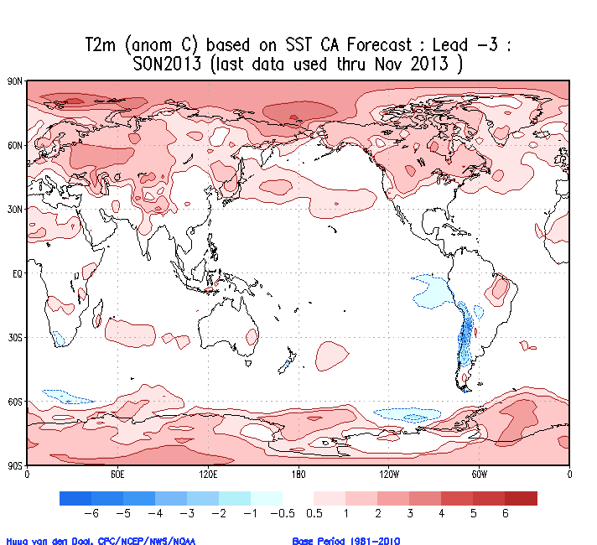
Specification or
down-scaling at lead -3

Slide 39
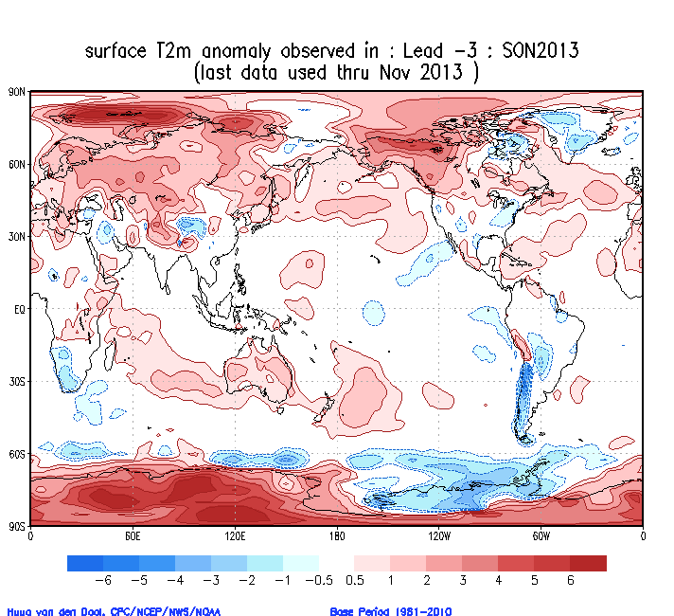
Specification or
down-scaling at lead -3

Slide 40
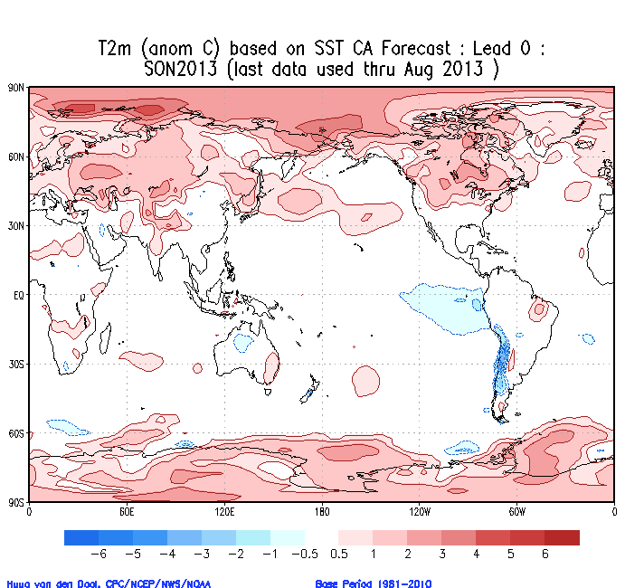

Slide 41
The fluids are falling
Not about November
- Heat Burst (atmosphere)
- Brinicle (ocean)

Slide 42
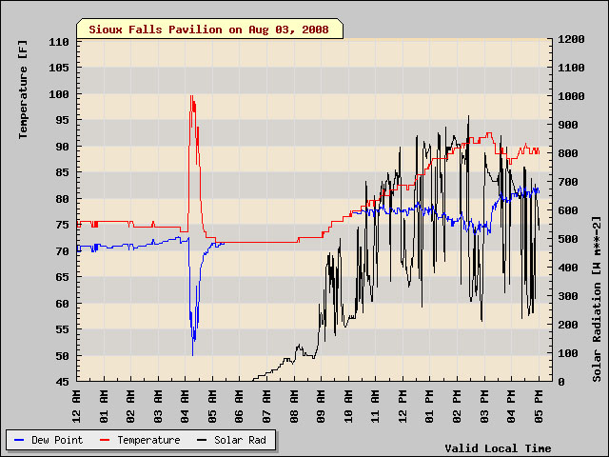

Slide 43
http://www.bbc.co.uk/nature/15835017

Slide 44
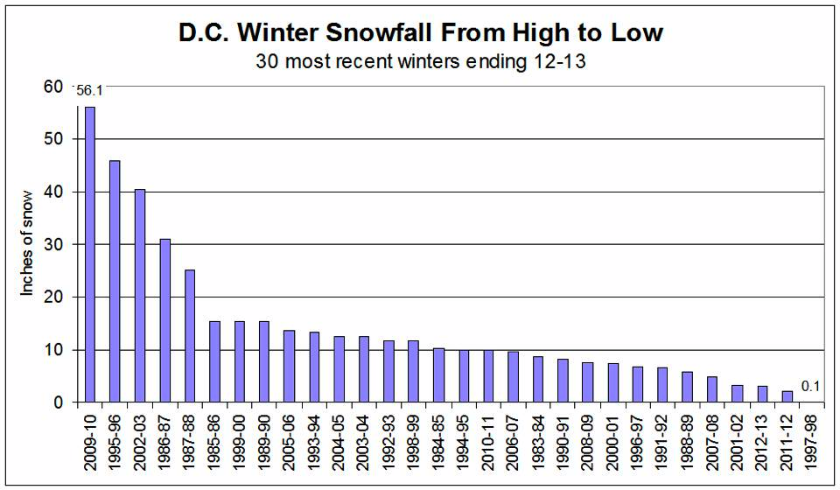
Have a safe Sunday, Dec, 8, 2013

