Slide 1
National Climate Predictions and Projections Platform (NCPP)
Introduction, Status, Plans
August 23, 2011
NCPP Core Organizing Team
(Richard B. Rood, presenting)

Slide 2
Core Organizing Team (20110823)
Ammann, Caspar
Anderson, Donald
Barsugli, Joseph
Buja, Lawrence
DeLuca, Cecelia
Guentchev, Galina
Herring, David
Higgins, R. Wayne
Ray, Andrea
Rood, Richard
Treshansky, Allyn

Slide 3
National Climate Predictions and Projections (NCPP) Platform
Mission and Strategy
Status
Short-Term and Long-Term Goals
Technical Team Activities
Climate Science Applications Team
FY12 Deliverables
Connections
Benefits for NOAA
Summary
Appendix

Slide 4
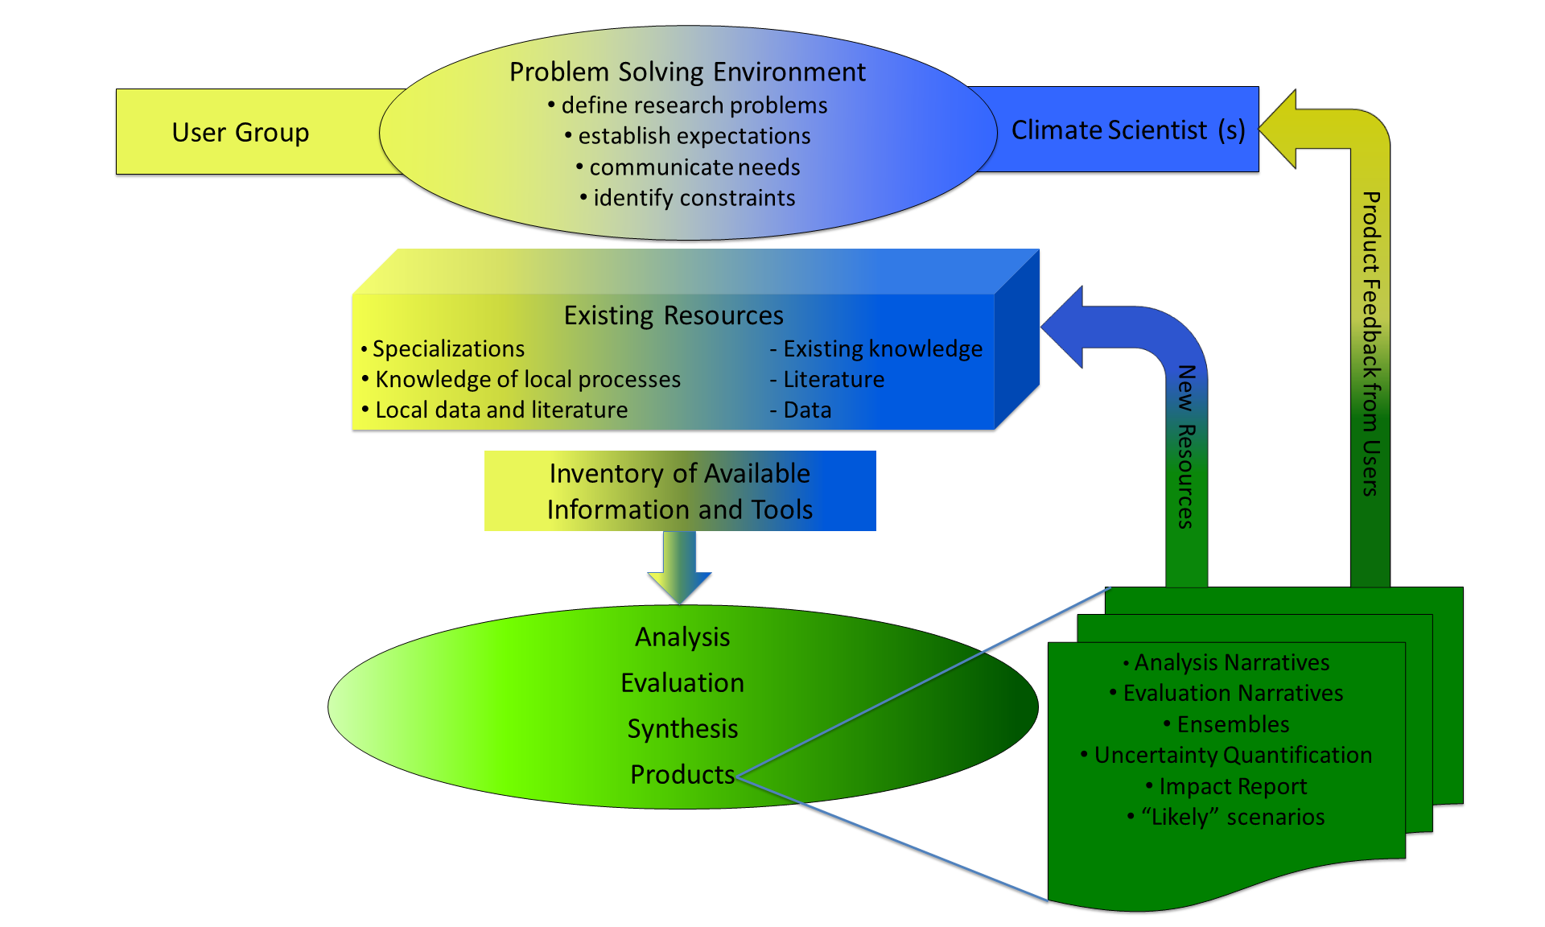
Mission and Strategy
Mission: Supports state-of-the-art approaches to develop and deliver comprehensive regional climate information and facilitate its use in decision making and adaptation planning.
Strategy: A community enterprise where climate information users, infrastructure developers, and scientists come together in a collaborative problem solving environment.

Slide 5
NCPP is an emergent community
Focused on the synthesis of existing climate capabilities spread across federal agencies, regional and local governments, universities, professional societies, nonprofits, and commercial activities
Community participation in development of capabilities and problem solving
Evolving governance structure → based on open-source, open-innovation principles

Slide 6
What is different in the past decade?
Emergence of open-source, open innovation communities for software development and complex problem solving.
Evolution of governance practices and management approaches that lead to functioning, sustainable organizations.
Development and deployment of tools to build and support communities.
Structured, co-developed problem solving with multiple constituencies
Notes:
Rood has led DAO, NCCS, CISTO, JCSDA … this organization is informed by all of this, but it is fundamentally different. DeLuca has led ESMF, ES Curator, GIP and Commodity Governance. Successful open communities. Both have worked on governance for years. The idea is a participatory, product-delivering community, not an organization that makes things for a community, not an organization that makes stuff available, not an organization that seeks community input. The goal of NCPP is an open climate community that scales across intellectual resources to accelerate climate change problem solving.

Slide 7
NCPP Status (Current and Interim)
Organization
Technical team
40+ members from federal agencies, universities, and other organizations
NOAA, DOI/(USGS, Reclamation), NCAR, NASA, DOE, universities
Core organizing team (responsible for NCPP)
9 full time and part time people + 2 in NOAA Management
Interim Climate Science Applications Team
Current focus, downscaled data sets
Work through use cases and pilot projects that support
Development of IT infrastructure
Provision of quality-assessed, digital climate data
Evaluation of models and analysis of credibility
Provision of guidance and advisory narratives

Slide 8
NCPP Status (Current and Interim)
Extend capabilities through engagement of existing networks
e.g., NOAA RISA, USGS CSC, …
e.g., Professional Societies, ICLEI, American Planning Association,
e.g., Local consortia, University, Private
Notes:
A frequent question is how does such a small group of scientists serve such a large need. This is a fundamental question for any climate service activity. The strategy, here, is to recognize the existing and growing resources already present in the country. The connect together the capabilities and the networks that already exist to accelerate climate-change problem solving.

Slide 9
Short-Term Goals
Short-term goals include
Identification of most relevant existing capabilities to achieve NCPP mission
Contribute to fulfillment of needs of the NCA;
Focus on sustainability of NCA
Downscaling workshop in 2013
Assist in coordination of portal efforts (e.g. front-end and back-end solutions for climate.gov, the National Climate Model Portal and the (USGCRP) Climate Change Portal)
Pilot activities to couple NOAA programs and key user groups with needs for (downscaled) climate predictions and projections / Exploratory investigation of development of narrative information tailored for stakeholders

Slide 10
NCPP Relevance to National Climate Assessment
NCPP Relationship:
Develop infrastructure to sustain the NCA beyond 2013:
Assemble downscaling expertise for NCA (inc. 2013 Downscaling Workshop)
Provide digital & scientific infrastructure for downscaled climate information, derived indices, & translational info ; prototype architecture
Provide repository of products, tools, manuscripts, guidance & translational documents as a resource for the NCA
Web-based data and tools

Slide 11
Long-Term Goals
Long-term goals include
Provide digital infrastructure to supply downscaled data in user-friendly formats (e.g. GIS)
Assemble a collection of tools to be employed in climate impacts studies (QC, validation, ensemble analysis, uncertainty description)
Provide an environment for collaborative qualitative and quantitative analysis
Provide information, expertise, and capability base through community interactions

Slide 12
Draft Architecture (technologies and services are examples)
Not complete or final!
Information
Interpretation
NCPP website, project workspaces for communities of practice
CoG for community connections
Interface layer
Support for inter-comparison projects and workflows representing solution patterns
Curator display, CoG
Composition and display of guidance documents and other text related to the use of climate data
climate.gov approaches
Downscaling and data formatting services, visualization, faceted data search, bookmarking
OpenClimateGIS, LAS, ESGF search, USGS tools, ENSEMBLES
Search and semantic services associated with web content and other sources
Consiliate, Drupal database tools
Service layer
Federated data archival and access
ESGF, THREDDS, data.gov platforms
Data at USGS, PCMDI, NASA, NOAA, …
Federated metadata collection and display
Curator tools, METAFOR, Kepler and other workflow solutions
Resource layer

Slide 13
Technical Development Strategy
Outline an overall architecture based on broad and long-term needs
Identify key standards and existing software to build on
Define incremental releases based on use cases
Use community-based approaches for prioritization, implementation, and review during development
ESGF role:
ESGF (Earth System Grid Federation) is a potential component of the data system that includes key services (e.g. faceted search) and enables other services to be developed on top of it
ESGF node installed at NOAA ESRL during summer 2011, starting integration with other system elements; planned nodes at NCDC and GFDL

Slide 14
Earth System Grid Federation
•ESGF is an open consortium of institutions, laboratories and centers around the world that are dedicated to supporting research on climate change, and its environmental and societal impacts
•Historically originated from Earth System Grid project, expanded beyond its constituency and mission to include many other partners in U.S., Europe, Asia and Australia
•Many contributing projects: ESG, Earth System Curator, Metafor, GIP, IS-ENES...
•U.S. funding from DOE, NASA, NOAA, NSF
• U.S.: PMEL, LLNL/PCMDI, LBNL, USC/ISI, NCAR,
LANL, ORNL, ANL, JPL, GFDL, ESRL, NCDC
• Europe: BADC, UK-MetOffice, DKRZ, MPIM, IPSL,
LSCE
• Asia: Univ. of Tokyo, Japanese Centre for Global
Environmental Research, Jamstec, Korea
Meteorological Administration
• Australia: ANU, Australian Research Collaboration
Service, Government Department of Climate Change, Victorian Partnership for Advanced Computing, Australian Environment and Resource Management
• ... and more ...
ESGF Architecture

Slide 15
Interim Climate Science Applications Team
Initial focus: Downscaled climate information and its use
Science-based evaluation
Uncertainty description
Guidelines
Current Membership: K. Dixon (GFDL), K. Hayhoe (Texas Tech), R. Horton (Columbia Univ.), K. Kunkel (NCDC; NC State), X.-Z. Liang (Maryland), L. Mearns (NCAR), J. Winkler (MSU), A. Wood (NWS/CBRFC)
Current Focus: Provide scientific foundation for 2013 workshop on “Evaluation of Downscaling Techniques”
Future: Evolve CSAT as an advisory and decision-making component of NCPP that oversees broad-based NCPP applications

Slide 16
Some Examples of Needs for Downscaling
National Climate Assessment
High resolution climate projections (regional T&P changes; extremes; persistent)
NIDIS
Objective drought monitor & outlook with skill at regional / local level
Operational Seasonal Prediction
Evolve from national to regional
Regional Applications – NOAA NGSP needs assessment perspective
Extremes (e.g. NIDIS regional pilots; Early Warning Systems (heat, cold, floods, droughts)
Marine Ecosystems (e.g. NMFS arctic marine species status; climate and fisheries)
Coastal Sustainability (e.g. NOS assessment and predictions of sea-level change impacts)
Water (e.g. NOAA Decision Support System for Devils Lake and Red River).

Slide 17
Some Key Issues to Establish Downscaling Framework
Courtesy Katharine Hayhoe
Guidance regarding practice in selection, combination, and interpretation of multiple GCM and scenario simulations to generate regional projections.
A basis for selection and interpretation of dynamical and statistical downscaling techniques.
Characterizing the degree to which new CMIP5 simulations might change the story of what we expect for specific regions, compared to AR4 generation simulations.
Establishing a way to standardize across the results of previously published impact literature that is based on a wide variety of GCM / scenario / downscaling approaches, some dating back more than 20 years.

Slide 18
FY12 Deliverables
Install an ESGF Node as part of a NCPP development platform (FY12Q1)
Establish initial NCPP use cases and pilots (FY12Q2)
Develop strategy and prototype for federated access to key datasets (e.g. USGS ) and interoperability of services (FY12Q2)
Complete initial pilot with early portal prototype with linkages to NCA (FY 12Q2)
Define pilots for NOAA Next Gen. Strat. Plan themes areas (FY12Q3)
Establish team to coordinate efforts to evaluate approaches to downscaled climate data towards 2013 downscaling workshop (FY11Q4)
Establish standardized basis for comparing downscaled datasets currently available on a consistent basis (FY12Q2)
Planning 2013 Workshop (ongoing)
Deliver NCPP Science & Implementation Strategy (FY12Q4)

Slide 19
Details on some NCPP Connections
National Climate Assessment above
NOAA Programs
Predictions and Projections
NGSP theme Needs Assessments
Climate.gov
Class / Climate Model Portal
Interagency
National Climate Assessment (above)
Regional Pilots and Use Cases
USGS, Geo Data Portal
USGCRP Global Change Portal

Slide 20
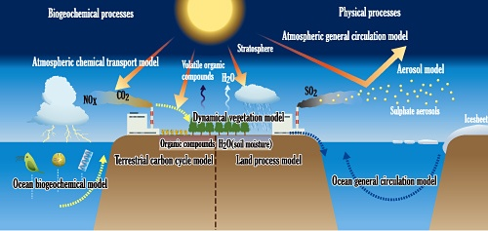
NCPP Connection to NOAA Predictions & Projections Program
NOAA Predictions and Projections Objective:
Improve scientific understanding & modeling
NCPP Relationship:
Provide scientific infrastructure to accelerate development & implementation of a National Multi-Model Ensemble prediction system (Note: MAPP Program is the lead).
Facilitate development of a NOAA-wide strategy for reanalysis / Integrated Earth System Analysis (Note: MAPP Program is the lead).
Requirements informed by NOAA NGSP needs assessments.
Anticipate HPC platform requirements and support data archive and user-access

Slide 21
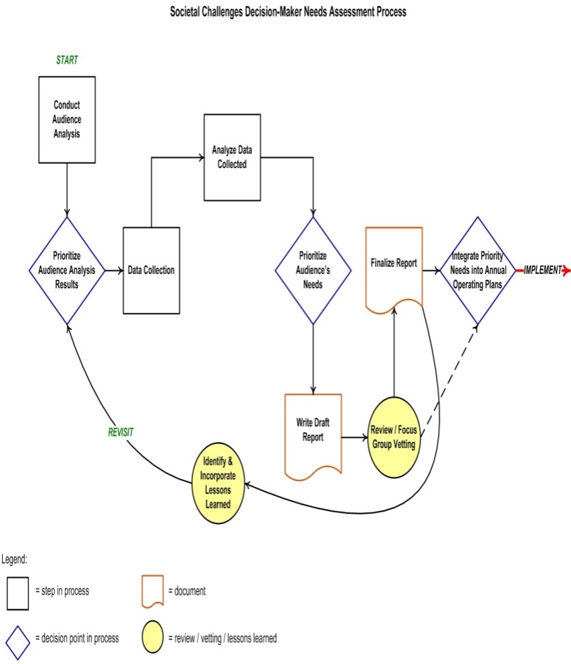
NCPP Connection to NOAA Societal Challenge Needs Assessments
Needs Assessments Objective:
Determine priority customer needs associated with each societal challenges
NCPP Relationship:
Lead the “Changes in Extremes of Weather & Climate” needs assessment
Facilitate engagement of internal & external partners (e.g. link to the NCA Regional Workshops)
Provide infrastructure to sustain the assessment process

Slide 22
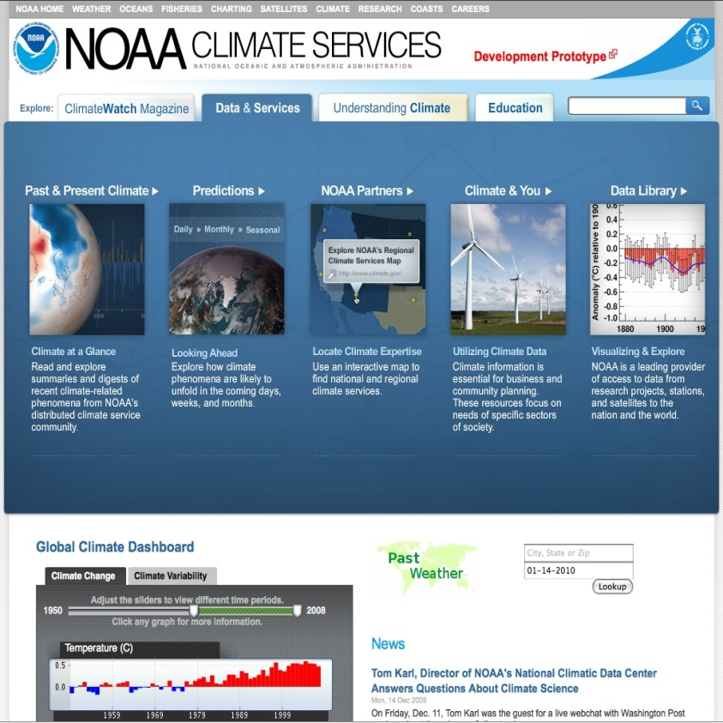
NCPP Connection to NOAA Climate Portal
Climate Portal Objective:
Provide integrated, contextualized access to NOAA’s climate data & info services
NCPP Relationship:
Develop NCPP component of climate.gov, including information for the integration of existing and planned downscaled data sets
Recommend additions & adjustments regarding data discoverability, accessibility, interoperability, interpretation, and application
Broaden engagement & facilitate interface design based upon user feedback
Synergies between CoG and Consiliate

Slide 23
NCPP Connection to CLASS / Climate Model Portal
NOAA downscaled information will be served through the CLASS archive and NOMADS/NCMP access
NCPP will help connect ESGF, CLASS and NOMADS/NCMP to help NOAA address the following questions:
What are NOAAs contributions to downscaling going to be?
What needs to be archived and distributed?

Slide 24
NCPP Connection to Users: Regional Pilots
Objective: Prototype use of climate information in decision making
Activities:
NCPP partnering with DOI North Central Climate Science Center (CSC) (Hestbeck/Ojima) to provide the regional climate information at scales needed for decision making.
Clarify the needs of key users for climate information on regional scales, including regionally important phenomena
Explore “best available science,” for policy, planning, and decision making
Identify needs for applied research topics to address gaps
Note that NCPP isn't creating everything, it's providing intelligent pathways, tools, recommendations/guidance.
Additional pilots will be informed by NOAA needs assessments and RISAs, the RCCs, and RCSDs
Notes:
AJR edited this slide – see Andrea e-mail to update -- AJR – some background -- its not just Buja/NCAR, b/c WWA and ESRL are also partners in the CSC, and we’re also working the NCPP-CSC connection as an agency-to agency activitiy that may result in an implementing agreement under the DOI-DOC MOU on climate. They have been involved in conversations. O’Malley is DOI/USGS lead for all the CSCs. NCCSC leads are Ojima (CSU) and Hestbeck (USGS in Lakewood)
I’m sending the draft 2pp pilot proposal

Slide 25
Summary
NCPP is focused on the synthesis of existing capabilities to build a sustained capability. Relies on the past decade’s:
Investments in use of climate information
Investments in information technology infrastructure
Emergence of successful approaches to govern distributed communities
Status
Identifying and evaluating capabilities
Engaging communities and organizations
Design, planning, and review of IT architecture and governance
Implementation of prototype activities through use cases and pilot projects.

Slide 26
Benefits for NOAA
NCPP is a timely opportunity for NOAA:
Its approach to regional climate information and services draws on existing climate components of NWS, OAR and NESDIS in a way not seen before within NOAA.
It provides the necessary coupling between the centers/labs, takes advantage of who they are, helps them with their challenges.
It expands on climate information NWS, OAR and NESDIS already provides to the broad spectrum of customers, agencies.
It bridges weather through ISI climate to decadal to connect preparedness and adaptation.
It draws on existing community-based infrastructure.
It is a platform for advancing NOAA’s climate services.

Slide 27
Appendix : Some Details

Slide 28
Temporary URLs for more info
NCPP Mission and Strategy
NCPP Initial Use Cases
NCPP Meeting Minutes
NCPP Core Team Capability Summaries
Initial ESGF Portal (installed only)

Slide 29
Summary of some other NCPP Connections
Interagency:
Portals: facilitate connections between portal efforts (USGCRP Climate Change Portal, NOAA Climate Model Portal and Climate.gov Portal), inc front and back end solutions
Regional Pilots: prototype use of climate information in decision making; establish partnerships (e.g. DOI/ North Central Climate Science Center); clarify key user needs
NOAA:
Programs: connect NOAA climate programs that complement & inform NCPP (includes CPO / MAPP (modeling, reanalysis, multi-model ensembles), NIDIS, NOAA needs assessments, regional services
Labs and Centers: activities involve all 5 NOAA LO’s, many labs, NOAA Regional Networks (RISAs, RCCs, CSDs)
Regional Pilots: involve all 5 NOAA LO’s, partner with NMFS, NOS, NGSP themes

Slide 30
NCPP Connection to Global Change Portal
NCPP Relationship:
Facilitate interdisciplinary connections between existing portal efforts (e.g. Climate Model Portal and Global Change Portal)
Front-end solutions that support requirements for assessment reports (NCA)
Back-end solutions for data access, content management systems,
Assist development of methodologies that support portal efforts
Requirements
Program Management
Core Operating Teams
Notes:
From USGCRP meeting

Slide 31
Current Engagement Activities
Engaging multiple communities with specific near term focus (downscaling): (list in not complete)
USGS, Geo Data Portal
National Climate Assessment
ESGF, CLASS, National Climate Model Portal
USGCRP Global Change Portal
Regional Pilots and Use Cases
Establishing connections to NOAA Programs that complement & inform NCPP (list is not complete)
Predictions and Projections
Climate.gov Portal
NGSP theme Needs Assessments
Regional Services
Developing Implementation Strategy

Slide 32
NCPP and Other NOAA Labs / Centers
Connects NOAA climate programs (hence labs and centers) that complement & inform NCPP in unprecedented ways
OAR / ESRL / PSD – NIDIS; Regional Pilots tied to NOAA needs assessments, RISAs, RCCs, and RCSDs
NESDIS / NCDC – CLASS / NCMP and ESGF; GIP
NWS / NCEP – CPC needs for downscaling / RCI; SLA’s for CFS;
OAR / GFDL – CMIP-5; NMME; Reanalysis
NOS / CSC – needs assessments; data formats/GIS
NMFS – e.g. Visiting scientist from Norway @ CPO/GFDL for RCI in the North Atlantic

Slide 33
NCPP Connection to NOAA Regional Services Program
NOAA Regional Services Objective:
Cultivate integrated regional strategy
NCPP Relationship:
Facilitate development & implementation of integrated regional strategy
Establish NOAA-wide coordinating mechanisms for enhanced regional services (RISA, SARP, TRACS, NWS)
Target RCSD engagement of NOAA close partners
Facilitate implementation of regional aspects of DOI-DOC climate Memorandum of Agreement

