Slide 1
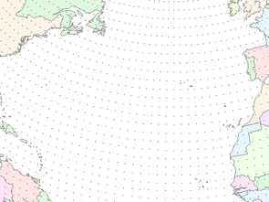



NWS Headquarters
August 10, 2011
CBRFC Decision Support for Colorado River Water Management
Kevin Werner
NWS Colorado Basin River Forecast Center

Slide 2
Outline
Colorado River Primer
CBRFC Climate Services
Gap and Chasms

Slide 3


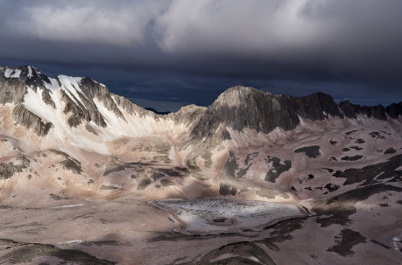
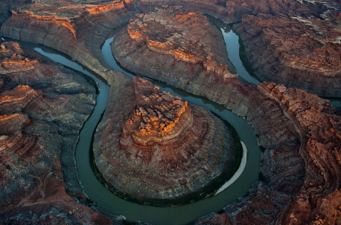
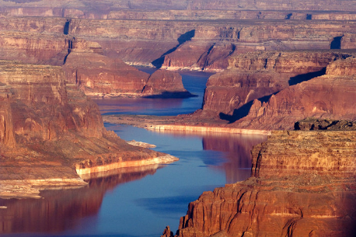
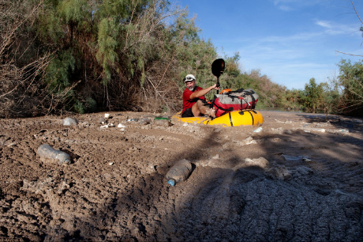
Why the Colorado River Stopped Flowing
-All Things Considered, July 14, 2011

Slide 4
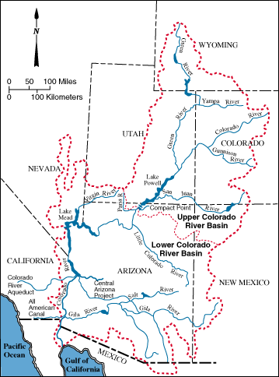
Colorado River
25 million people rely on Colorado River water
3.5 million acres of irrigation
85% of runoff comes from above 9000 feet
Mean annual discharge is about 12.4 MAF
Storage capacity is about 60 MAF (4 times mean annual flow)
River is fully used and little flows to ocean

Slide 5
Colorado River Allocation
Colorado Compact (1922) divided water between the upper basin and lower basin – 7.5 MAF each
Mexican Water Treaty (1944) allocated Mexico 1.5 MAF
Arizona v. California (1964) allocated water among lower basin states
Interim Guidelines (2007) specify shortages and surpluses through 2026 that are tied to forecasts
Key facts:
  River is over-allocated: original allocation (16.5 MAF) was based on a series of wet years. Actual average flow is 12.4 MAF
  Lower basin states (AZ, CA, NV) use full 7.5 MAF each year
  Mexico uses its full 1.5 MAF
  Upper basin states (CO, WY, UT, NM) are still “developing” their 7.5 MAF
  No shortage has ever been declared on the river
  Shortages would affect lower basin states first (and AZ first of all)

Slide 6
Long Term Supply / Demand

Slide 7
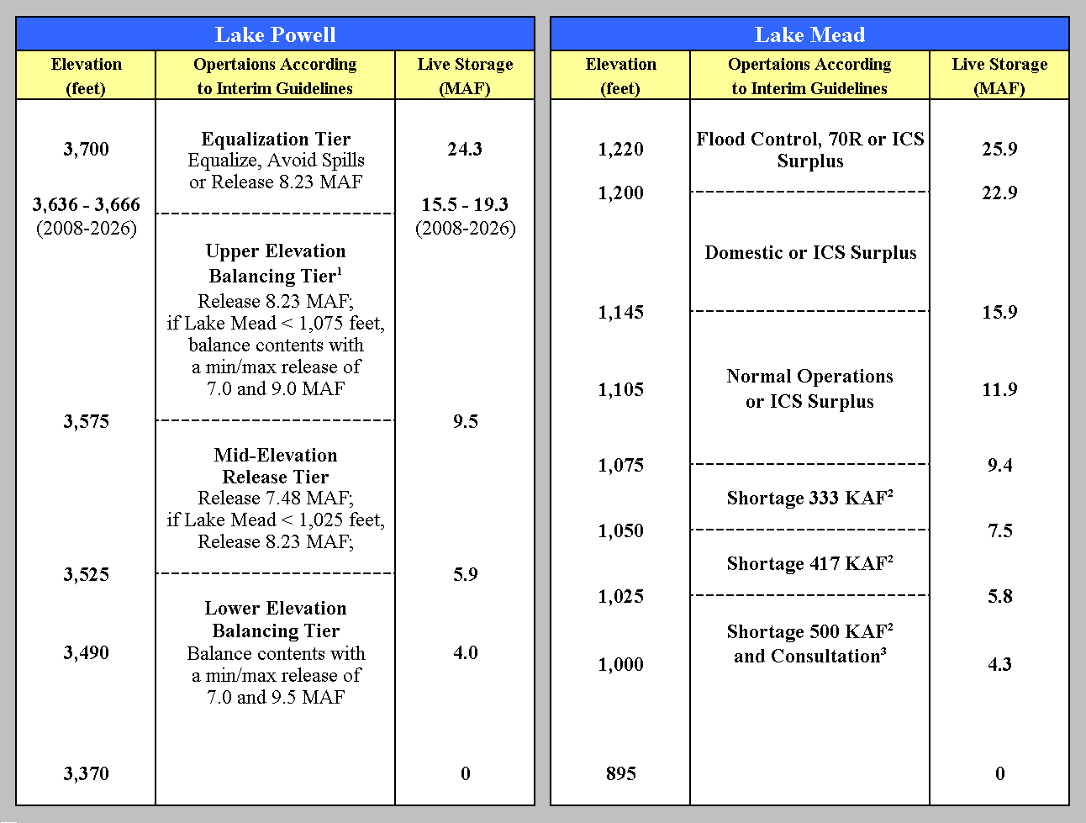
Interim Operating Guidelines
Guidelines specify how shortages and surpluses will be distributed among the basin states
USBR directed to operate reservoirs based, to a large extent, on CBRFC/NRCS official forecasts
Most years 8.23 MAF released from Lake Powell to Lake Mead
In wet years when Lake Mead is low (such as 2011), “extra” water can be released. This is called equalization and/or balancing.
“Most probable” release schedule based on CBRFC/NRCS April 1 forecast is 11.63 MAF
14.7 MAF
3,629
1/1/2011
Projection
10.3 MAF
1,086
1/1/2011 Projection

Slide 8
Value
Damage from 1/10 AZ storm: $11mª
Damage from 6/10 UT flooding: $6.5mª
Damage from 12/10 UT/NV storm: $35mª
Damage from spring 2011 UT/CO/WY flooding: <$200m
Colorado River average runoff: 12.4 MAF
Replacement value of $330/AF -> $4b^{b}
**Economic value of water resources far greater than flooding damages
Sources:
a: WFO, FEMA (via stormdata); b: MWD (via Hasencamp, private communication

Slide 9
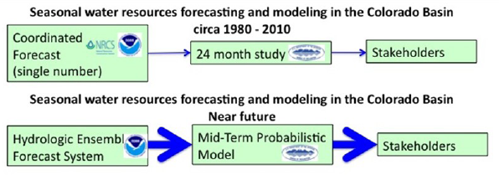
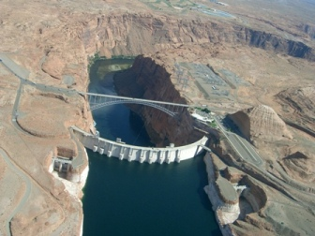
Water Supply Decision Support
The
past
The
future
Efforts in parallel --
CBRFC working to improve probabilistic flow forecasts
BOR working to implement probabilistic water management model

Slide 10
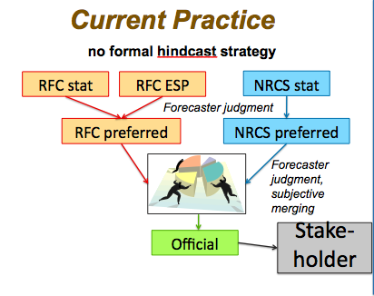
Past CBRFC Methods
Official forecasts coordinated each month with NRCS/NWCC
Skill primarily from accumulating snow pack
Updated monthly or semi-monthly
Probabilistic but not ensemble based
Not repeatable
Subjective
Forecaster Role:
  Monitor forecast process and system
  Add judgement to forecast process

Slide 11
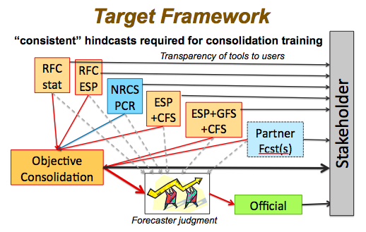
Future CBRFC Methods
Objective, repeatable ensemble forecasts
Integrate skill from weather and climate predications
Tailor to stakeholder thresholds and concerns
Forecaster role:
  Monitor forecast process and system
  Apply judgement (less frequently?)
  Decision support
  Work to improve forecast system and processes based on objective standards
  Follow best practices identified by CPC

Slide 12
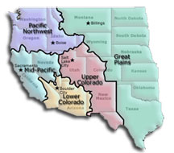
Core Partner: USBR
Mission: “manage, develop, and protect water and related resources in an environmentally and economically sound manner in the interest of the American public”
Operates major water projects in 17 western states
CBRFC works with 2 of 5 USBR regions (Lower and Upper Colorado)

Slide 13
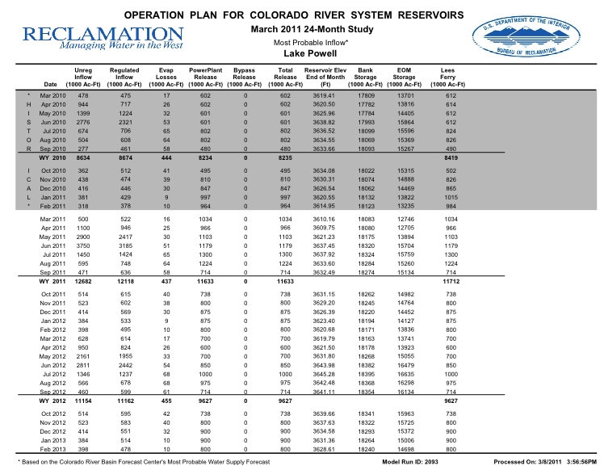
Past USBR Methods
Upper and Lower Colorado Regions operate reservoirs based on the 24 month study
24 month study:
  Updated monthly
  Extends out 24 months
  Specifies reservoir releases and target levels
  Single value output (except Aug, Jan, Apr when it has reasonable min and reasonable max)
  Labor intensive and subjective

Slide 14
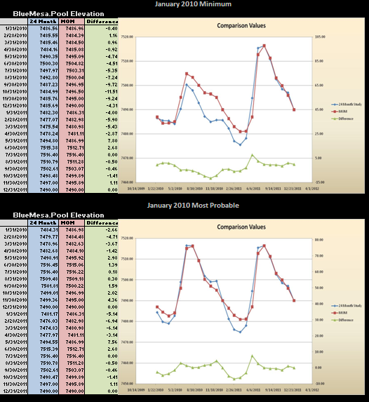
Future USBR Method
Mid-Term Probabilistic Model:
Uses CBRFC ensemble forecasts for first two years
Uses “rules” (prioritized logic) to determine releases
Output will be ensemble forecast for reservoir operations
Currently undergoing testing
Expected deployment by WY2012

Slide 15
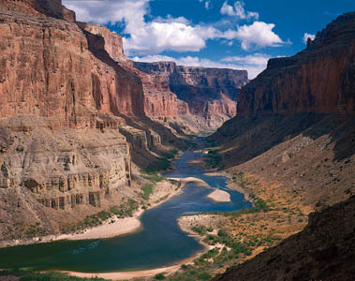
Barriers, Gaps, Chasms

Slide 16
Common Stakeholder Requirements
More frequent updates of our long lead products
More analysis - often involving climate science plus water resources
More metadata and data about our forecast process:
  raw model forecasts
  snow distribution
  model forcing information
Longer lead forecasts - even with minimal skill

Slide 17
Institutional Barriers
NWS largely unaware of current water supply climate services and the challenges in addressing stakeholder requirements
  No metrics for measuring water supply / resources forecasts
  No mechanism for connecting needed climate science to water resources modeling
  No method for collecting stakeholder requirements – especially those difficult to meet
NOAA and NWS personnel resources dispersed and often disconnected
  NWS Service Hydrologists disconnected from RFC
  NOAA and NWS climate science and services efforts unaware of existing RFC climate services and needs
RFC staffing profile designed around NWS flood forecasting mission – not climate services

Slide 18
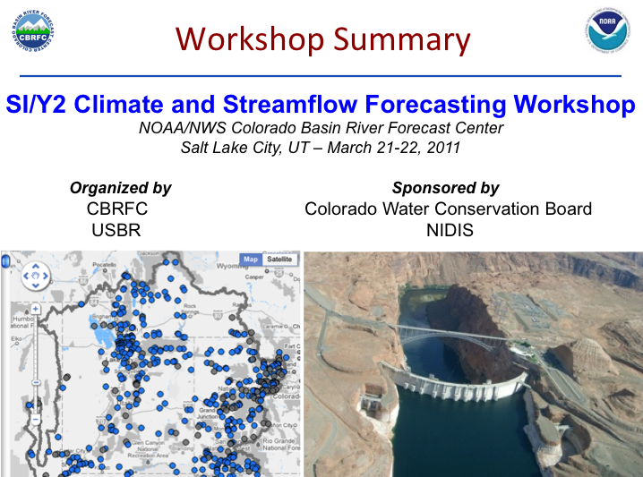
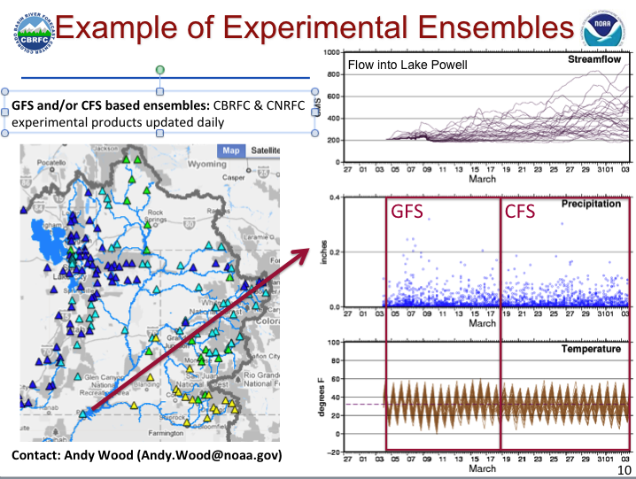
Service Gaps &
Science Challenges
Skillful seasonal forecast for Upper Colorado (minimal ENSO signal)
2-5 year forecasts
Water Demand / ET forecasts
Probabilistic streamflow forecasts across time scales
Dust on snow
Beetle kill
Connecting forecasts and science to stakeholder decisions

Slide 19

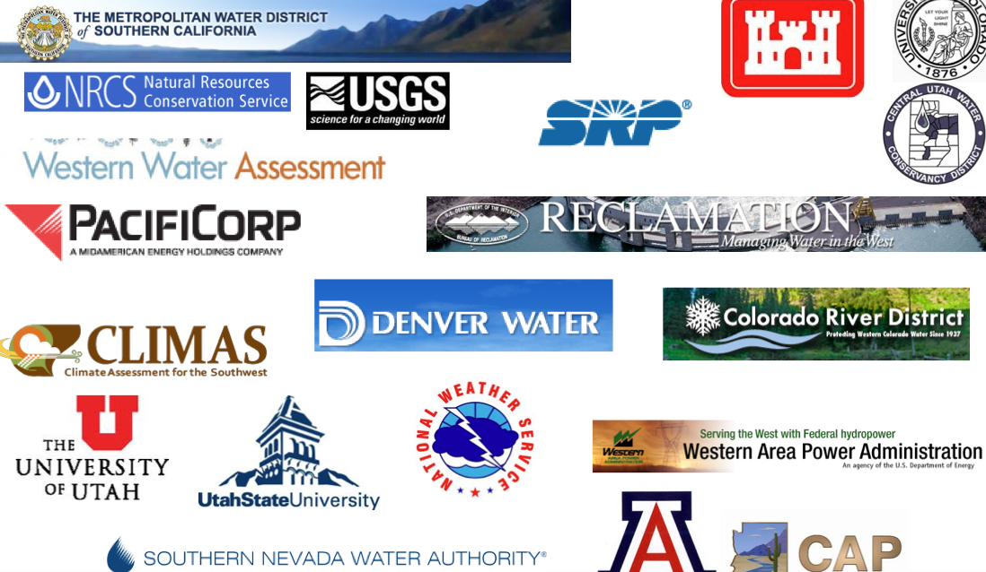
Chasm
Colorado River water resources stakeholders
Mission: To understand and predict changes in the Earth’s environment … to meet our Nation’s economic, social, and environmental needs

Slide 20


Questions?
Kevin Werner
CBRFC Service Coordination Hydrologist
Phone: 801.524.5130
Email: kevin.werner@noaa.gov

