Slide 1
The Seasonal Footprinting Mechanism in CFSv2:
Simulation and Impact on ENSO Prediction
Kathy Pegion
University of Colorado/CIRES & NOAA/ESRL/PSD
Michael Alexander
NOAA/ESRL/PSD

Slide 2
What is the Seasonal Foot Printing Mechanism (SFM)?
NPO in NDJ (-1)
⇓
Winds & Heat Flux
⇓
SST in FMA (0)
⇓
Tropical Winds
Feedback (e.g. WES)
JJAS(0)
⇓
El Nino in NDJ(0)
Vimont et al. 2001, GRL; 2003a&b, J. Climate
Notes:
The downwelling Kelvin can then produce warming in the eastern equatorial Pacific, which triggers a Bjerknes feedback. An El Nino event is excited.

Slide 3
Subtropical => Tropical Connection
Wind Evaporation SST (WES) feedback (Vimont et al. 2009, Alexander et al. 2010)
Rossby wave excitation ~5N and reflection off western boundary (Alexander et al. 2010)
“Charging” Mechanism (Anderson et al. 2013)

Slide 4
The effectiveness of the SFM to force ENSO events depends on whether the Tropics are pre-conditioned (Vimont et al. 2003; Anderson 2007; Alexander 2010)
from Anderson 2007

Slide 5
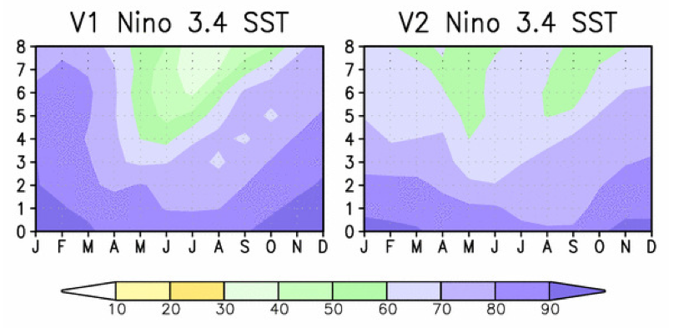
Why is the SFM Important?
Improving Predictions across the Spring Predictability Barrier
From Saha et al 2013

Slide 6
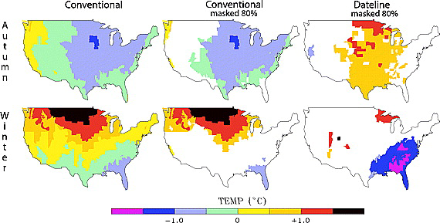
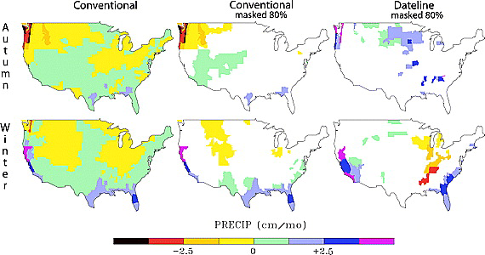
Why is the SFM Important?
Extratropically forced ENSO events may be more likely to maximize in the Central Pacific ( Yu and Kim 2011; Yu et al. 2010); this could have an impact on extratropical teleconnections and seasonal predictions
Temperature
Precipitation
from Larkin and Harrison 2005 GRL
Notes:
6
El Niño‐Seasonal Average U.S. Temperature Anomaly Associations for Autumn(SON) and Winter(DJF). The left two columns are based on the “Conventional” 1950–2003 El Niño seasons; the right column is based on the “Dateline” El Niños. The right two columns are masked for 80% statistical significance. See text for details.
© This slide is made available for non-commercial use only. Please note that permission may be required for re-use of images in which the copyright is owned by a third party.

Slide 7
Can the SFM provide information to improve long-lead ENSO forecasts?
Does the NCEP/CFSv2 Simulate the SFM and its relationship with ENSO?
2. Can the NCEP/CFSv2 predict ENSO based on SFM-related pre-cursors?

Slide 8
ENSO Pre-cursor Indices
Sea Level Pressure Index (SLPI)
Identifies when the SFM is active
Nov(-1)-Mar(0)
[10°N-25°N;175°W-145°W]
Anderson 2003, 2007
2. Depth of 15°C isotherm Index (Z15I)
Identifies whether the Tropics are pre-conditioned
Dec(-1)-Feb(0)
[5°S-5°N;160°E-180°]
Anderson 2007, but for JJASO (12-18 months in advance of ENSO)

Slide 9
Does the NCEP/CFSv2 Simulate the SFM and its relationship with ENSO?
COLA/CFSv2 Decadal Experiments
Model | Atm ICs | Ocn ICs | Land ICs | CO2 | Duration | Initialization Dates
CFSv2 | CFSR | ECMWF/NEMO-ODA | CFSR | Time-varying | 30 years | 1,2,3,4, Nov 1960,1980,2005

Slide 10
Composites of SLP (hPa) & SST (°C)
SLPI (<1σ) minus SLPI (>1σ)
Obs (1958-2007)
NCEPR1/Hadley (1958-2007)
CFSv2
DJF (-1/0)
MAM(0)
JJA(0)
SON(0)

Slide 11
Composites of 10m Winds (m/s) & Z15 (m)
SLPI (<1σ) minus SLPI (>1σ)
CFSv2 (30 years)
NCEPR1/SODA (1958-2007)
CFSv2
DJF (-1/0)
MAM(0)
JJA(0)
SON(0)

Slide 12
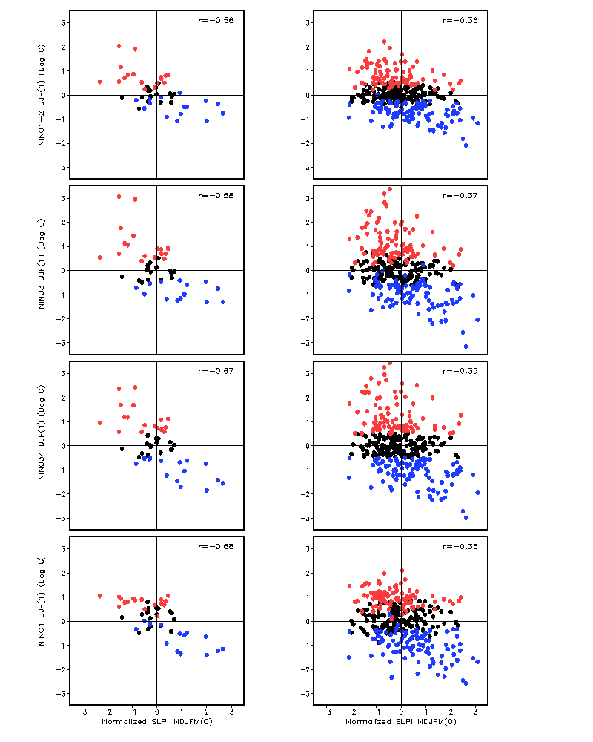
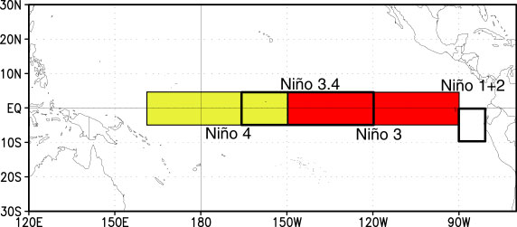
OBS
CFSv2
Nino1+2
Nino3
Nino34
Nino4
Courtesy of NOAA/NWS/NCEP/CPC

Slide 13
Anderson 2007 (JJASO)
OBS: -0.37/-0.72
Deser et al. 2012 (JJASO)
CCSM4: -0.22/-0.69
SLPI & Z15I have same sign
SLPI & Z15I have opposite sign

Slide 14
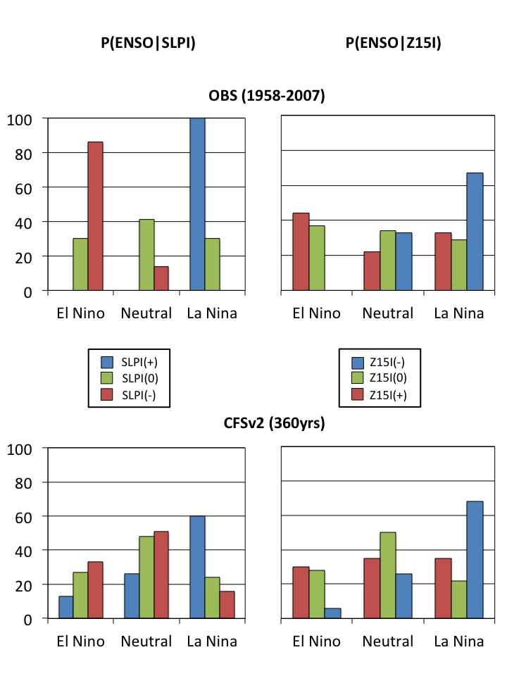

Slide 15
To Review…
Fluctuations in the north Pacific SLP anomalies in winter leave a SST footprint in the subtropics in spring and summer that impacts ENSO the following winter (Vimont et al. 2001, 2003a,b; Anderson 2003 )
The effectiveness of the SFM to force ENSO events depends on whether the Tropics are pre-conditioned ( Vimont et al. 2003; Anderson 2007; Alexander 2010)
CFSv2 is able to simulate these basic characteristics of the SFM and its relationship with ENSO

Slide 16
Can the NCEP/CFSv2 predict ENSO based on SFM-related pre-cursors?
NCEP CFSv2 Retrospective Forecasts
Model | AGCM | OGCM | Duration | Years | Initialization
CFSv2 | GFS T126 ICs: CFSR | MOM4 ICs: CFSR | 0-9 months | 1982-2009 | Every 5th day @ 0,6,12,18z 24 ensemble members per month (except Nov = 28)

Slide 17
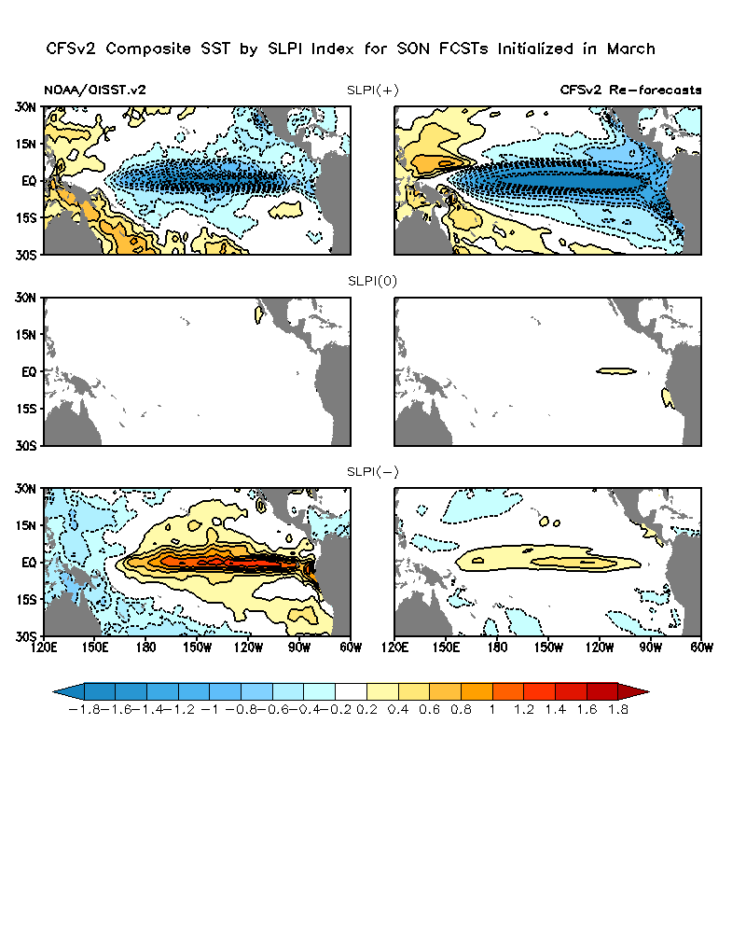
SLPI(+) > 1σ (N=5)
SLPI(0) (N=14)
SLPI(-) < 1σ (N=9)

Slide 18
Forecast Reliability
Initialized: Feb, Mar, Apr 1982-2009 Valid: ASO, SON,OND
4-member Ensembles
SLPI(0)
SLPI(-)
SLPI(+)
El Nino
La Nina
Neutral

Slide 19
Forecast Reliability
Initialized: Feb, Mar, Apr 1982-2009 Valid: ASO, SON,OND
4-member ensembles
El Nino
La Nina
Neutral
Opposite Sign
Same Sign

Slide 20
Conclusions
There is no strong preference for ENSO “flavor” in the model or reanalysis based on the SFM-related pre-cursors.
The correct sign of the response to the SFM-related forcing is simulated and predicted by CFSv2 in a composite sense. However, its predicted amplitude is weak for El Nino and strong for La Nina.
The CFSv2 does not produce reliable forecasts of ENSO based on the SFM-related pre-cursors. Is this because of small ensemble, model deficiency, or fundamental predictability?

