Slide 1
Objective Drought Classification
Kingtse C. Mo
CPC/NCEP/NWS
and
Dennis P. Lettenmaier
University of Washington

Slide 2
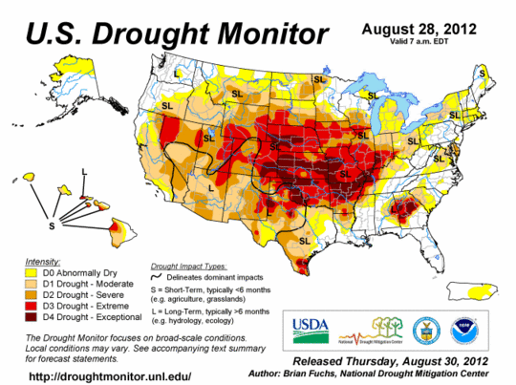
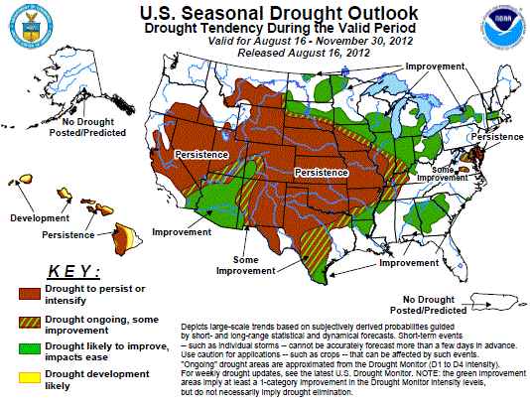
Mission
CPC issues operational monthly and seasonal drought outlook and participates in the Drought Monitor
These products are used by government, NIDIS, local state government , regional centers and private sectors
72% of the U.S. under drought

Slide 3
Current status of drought monitoring
Currently, Drought monitoring is based on three drought indices :
Standardized precipitation index (SPI)- P deficits
Soil moisture (SM) percentile (SMP)- SM deficits
Standardized runoff index (SRI)- streamflow deficits
SM and runoff are taken from the NLDAS
Usually, the ensemble mean SPI6, SRI3 and SMP are used for monitoring

Slide 4
The EMC NCEP system
Four models: Noah, VIC, Mosaic and SAC
Climatology: 1979-2008
On 0.125 degrees grid
P forcing : From the CPC P analysis based on rain gauges with the PRISM correction.
Other atmospheric forcing: From the NARR
The University of Washington system
Four models: Noah, VIC, SAC and CLM (different versions)
Climatology: 1915-2008
On 0.5 degrees grid
P, Tsurf and low level winds are derived from the NOAA/NCDC co-op stations
P from index stations

Slide 5
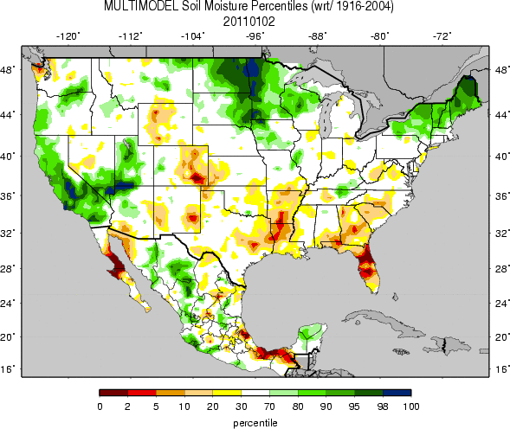
Multi model ensemble SM %
Different systems are able to select the same drought event, but they may not classify drought in the same category
EMC
U Washington
The patterns are similar, but magnitudes are differences:
Over Dakotas and Minnesota, percentiles are higher on the UW map,
Over the Southeast, UW percentiles are also higher
4

Slide 6
75-85W,31-35N
A wet region
6 mo running mean black line
drought
3 mo running mean (black line)
No smoothing
Red line: monthly mean, no smoothing
SM 1-2 months delay

Slide 7
Challenges
There are large uncertainties in the drought indices
Uncertainties come from
1. different NLDAS systems, land models, input data
2. different scales of indices
e. g. SM may lag the SPI6 at the onset / demise stage of drought

Slide 8
Status
All indices are able to select the same drought event, but uncertainties are too large to classify drought in the (D1, --- D4) categories.
We are not able to give risk managers the best and worst scenarios and the occurrence probability.

Slide 9
Possible solutions
Joint distribution: AghaKouchak (2012)
Youlong Xia – reconstruct DM
Ensemble means (Dirmeyer et al. 2006)
The averaging process decreases the magnitudes of the ensemble mean
How to assess the uncertainties of the ensemble mean?
A probabilistic approach

Slide 10
Data used for this study (total 18 fields)
SPI– two sets :
(1) the UW index stations
(2) the CPC unified analysis
Soil moisture SM- 8 sets:
4 models from the NCEP/EMC NLDAS (Noah, VIC, Mosaic, SAC)
4 models from the UW NLDAS (Noah, VIC,CLM and SAC).
Runoff-8 sets: same as SM
Period: Jan 1979– Nov 2012
Resolution: 0.5 degrees

Slide 11
procedures
Grand mean index as the major indicator
Form ensemble mean for P, SM and runoff
Calculate the drought index (SPI6, SMP and SRI3) from the corresponding mean time series
Put indices in percentiles
grand mean index=> Equally weighted mean of SPI6(en), SMP(en) and SRI3(en)

Slide 12
Drought categories
The drought category is assigned according to percentiles: (Svoboda et al. 2002 BAMS)
2% or less---D4;
2-4.9 %---D3;
5- 9.9%---D2;
10-19.9%---D1;
20-30%----D0

Slide 13
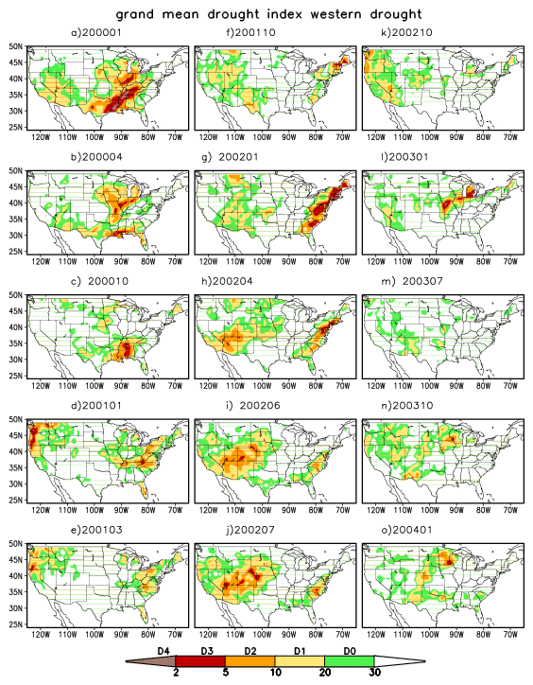
Grand mean index
It captures the evolution of drought well;
Three episodes
2001 winter PNW
2002 summer: Southwest
2003 return of drought
2.SW
2.SW
1.PNW
1.PNW
3. return
The month that the state declared drought emergency

Slide 14
Uncertainties of indices
SPI6(en)
SRI3(en)
SMP(en)
D0-D1
D4
D2-D3

Slide 15
Probability of drought occurrence in each drought category D0-D4
Original time series :18 variables=> 18 indices in percentiles
The drought category is assigned according to percentiles:
For a given month , we count the number of indices in each category for each grid cell. e.g.
N (D1) for the number of indices in D1 category. Then the probability of D1 occurrence is
P(D1)= N(D1) *100/total number of indices,
The probability of the total drought occurrence D_{total} is the sum of P(D0) to P(D4)

Slide 16
PNW episode
JAN
MAR
Grand mean index
D3 & D4
D1
Most possible scenario
D3 or D4 for winter 2001 over the coastal areas of the PNW
Drought over the inland Missouri basin was weaker
It was not in D3 or D4
It is likely in D1 with a 20-40% prob

Slide 17
Prob of drought occurrence in
D1
D2
D3 & D4
Grand mean index
SW phase
Grand mean
Intensified from spring to summer
In the Four Corners, the drought was in or above D2 : a 40-60% prob for D3 or D4 drought to occur
Outside of the core region, only D1 (more regional details)

Slide 18
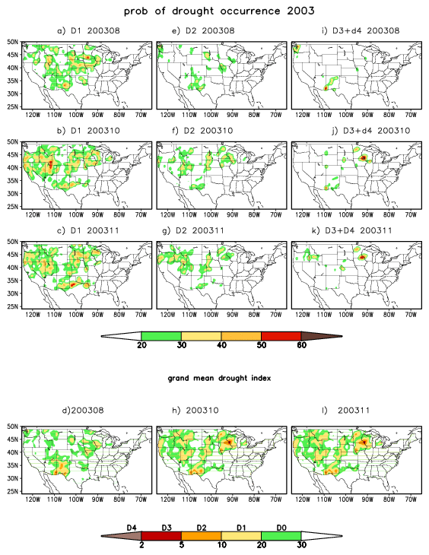
Returning of drought
There was little chance for the D3- D4 occurrence.
The intensity was not as strong as that at the peak of drought.
The West was in the D1 or at most D2 category with a 20-40% prob.
strong
Too weak
D1 drought less organized

Slide 19
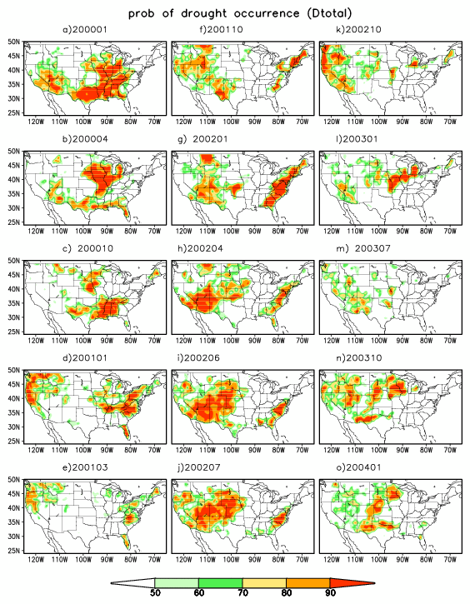
Probability of drought occurrence (Dtotal
1. There is a good correspondence between the grand mean index and prob of Dtotal
2. Stronger mean index⬄ larger prob
3. Capture the drought evolution
2.SW
1PNW
3.return
return
Grand mean index
D3 & D4 90%
D2 80%
D1 67%
D0 51%

Slide 20
Grand mean index & Prob of drought occurrence
grand mean index in the Y category
Grand mean D3 & D4
D2
D1
D3 & D4
Prob of Occurrence in x category when the grand mean index is in the y category
D2
X category
When the G index is in the D3 & D4, a 50-70 % prob is in the D3 and D4;
When G index is in D1, Prob is 30-40% in D1 and 20-30 % in D2
if G index is in D2, equally likely in D2 or higher
D1
Do

Slide 21
What do we learn?
The grand mean index captures the drought evolution and the prob is a good approach to assess the uncertainties in the grand mean index
At the extremes, grand mean index in D3 or D4, more than 60% of prob in D3 and D4
If the grand mean index is in D1, then a 20-30% prob in D2. The grand mean index has a tendency to underestimate drought intensity.
The prob can also discriminate : give the scenario that is unlikely to happen
It shows more detailed regional features.

Slide 22
Drought Characteristics
Area coverage;
Duration
Severity
The SAD curve (Severity-Area-Duration)
Andreadis et al (2005),
Sheffield et al. (2006)

Slide 23
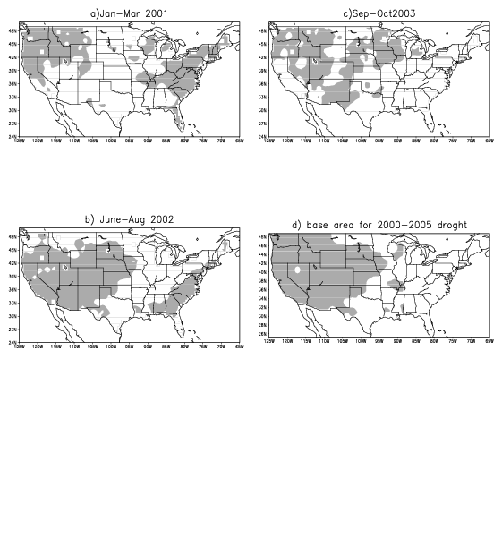
Base area
1. Select drought centers: PNW, SW and return of drought in 2003
2. Take mean of the grand mean during the peak of each episode and shaded areas where the mean < 30%
3. Base area: West of 90W and the grid point is in one of shaded areas of mean maps
Base area: 59% of the United States
SW

Slide 24
Area coverage
For each index, % of grid cells over the U.S. in the base area that the index is below 30%. (Green – based on spi6, Black- SRI3 and blue– SMP, grand mean(red open circles)
For the probability approach, % of the grid cells over the US in the base area that D_{total} is greater than 50% (yellow open circles)
1. The area coverage of drought
shows large uncertainties .
2. The daily coverage was about 30-40% of the U.S.
3. The area coverage's determined from the prob or the grand mean are similar
peak
onset
duration
uncertainties

Slide 25
Mean severity
S=1-index
Spi6 (Green) strongest
Grand mean index- underestimate the drought severity (red)

Slide 26
For each drought category D1-D4, we computed the percentage of grid cells in the base area that the probability for that category to occur is greater than 20%
Three peaks
2012 has the wide coverage and severity with D3 occurrence.
D4 mostly occurred at the peak of drought.
D2
D1
D3
D2
D4
D3
D4

Slide 27
2000-2005 drought
Duration:: winter of 2000 to the winter of 2005.
Three episodes:
2000-2001: drought center was over the coast of the Pacific Northwest with a > 60% probability for the D3 and D4 drought to occur and D1 in the inland areas
2002 : D3-D4 over the Four Corners with D1 in the vicinity.
2003 Fall: Most D1-D2 categories over the Southwest

Slide 28
A contrast to the western drought
1987-1989 case 2000-2005 case
central eastern U.S. Western U. S.
Wet area Dry area,
SM persists about 6 mos SM persists 24 months
NLDAS has smaller NLDAS has larger
uncertainties uncertainties
Strong heat waves

Slide 29
The 1987-1989 drought
onset
strengthening
Grand mean index
onset
strengthening
1988-1989 drought
Drought did not shift from one place to another;
There were two centers:
North central and the Midwest from Montana to Minn.
3. The North Central had the D3-D4 drought, but the Midwest drought was less intense.
Midwest drought
weakening
Extent to East

Slide 30
Mostly D1
may
At the peak of drought, 80-90% prob for the D3 D4 to occur over the North Central.
It did not occur suddenly. In May , the D2 drought had 20-40% to occur.
Over the Midwest, the prob for D4 to occur was low. There were 20-30% for the D1 drought to occur until September, then the prob for the D2 drought increased slightly
June
July
More d2
sept
Oct

Slide 31
1987-1989 area coverage
Duration
Only one episode
Less uncertainties among indices;
The base area was 60% of the United States;

Slide 32
1987-1989 case
D2
Only one episode
At the peak, large percentages of area covered by the D2 and D3 drought.
D3
D4
D2
D3
Duration 1987-1989
Black –D1, Green-D2, Blue-D3 and Red – D4

Slide 33
The 1987-1989 drought
1988-1989 drought had shorter duration
There were 50-60% of the U.S. covered by drought. It had only one episode with two centers: the North Central and the Midwest.
There were less spread among indices for the 1987-1989 case because its severity and because less uncertainties in the NLDAS

Slide 34
Recent drought
2011-2012 grand mean index
Did drought come up suddenly?
Onset of the 2012 case
Onset 2012
Intensification from Arkansas to Illinois and another center in Colorado
Texas drought
Intensified
Texas –NM case
intensification

Slide 35
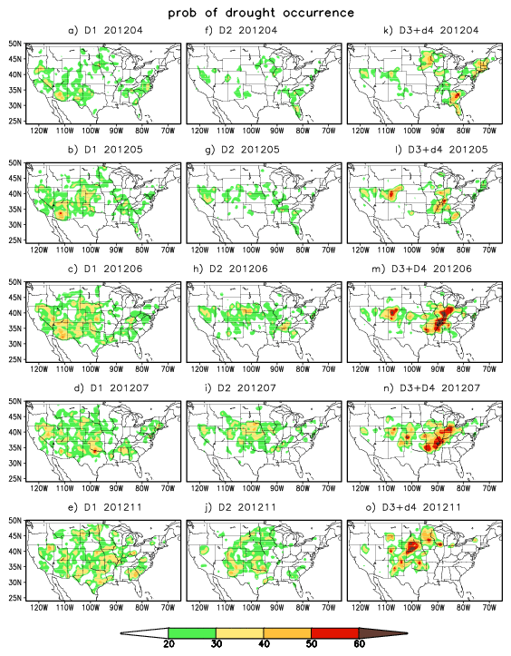
April
May
June

Slide 36
Advantages of the probability approach
The grand mean index should be analyzed together with the probability of drought occurrence in each category.
Detailed regional Information
Take into consideration of the uncertainties in the NLDAS and different drought indices.
To give risk managers the best/worse situation with the probability for it to occur
A better way to analyze a drought event: area coverage. Duration and drought evolution

Slide 37
Shortcoming ------
1. All drought indices are not really independent .e.g. They are driven by the same forcing for a given system and the land surface models tend to have similar physics (but they do not have systematic relationships)
2. At this point, we use the probability only to assess the uncertainties of the grand mean index
3. We need to add more fields so it will not entirely depend on the NLDAS e. g. ESI or satellite derived fields
4. We should add the Snow water equivalent (SWE) to SM so it had better representation of SM in winter.

Slide 38
Discussions
Does this approach by using both the grand mean index and the probability of occurrence add information to the drought assessment?
Can we improve upon this?
If we make it operational, what form do you need? GIS?

