Slide 1
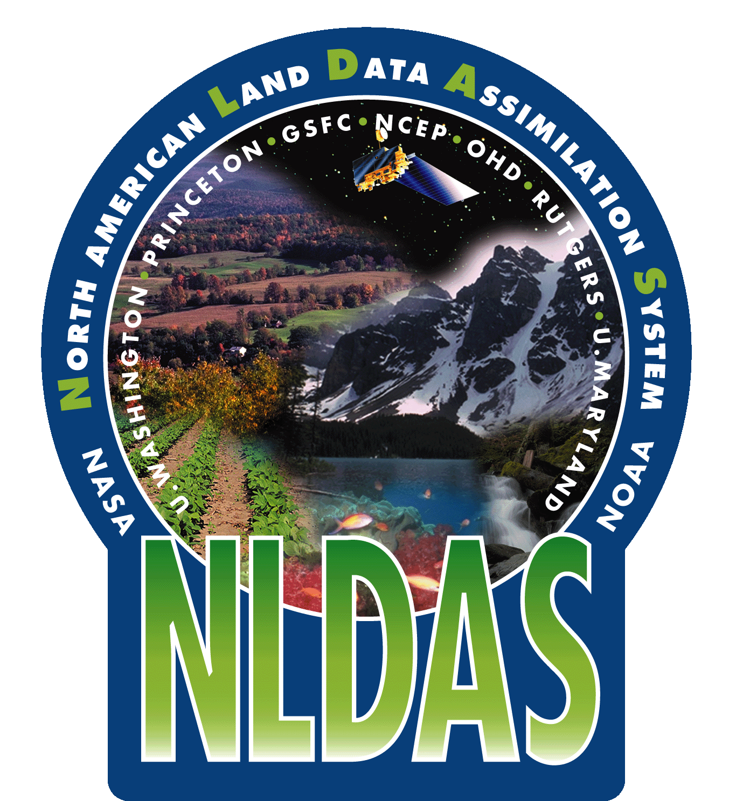
Application
of USDM Statistics in NLDAS-2:
Objective Blends of Ensemble-Mean NLDAS Drought Indices over the Continental United States
Youlong Xia¹, Michael B. Ek¹, Christa D. Peters-Lidard², David Mocko², Justin Sheffield³, and Eric F. Wood³
¹Environmental Modeling Center (EMC), National Centers for Environmental Prediction, College Park, MD
²Hydorlogical Sciences Laboratory, NASA/GSFC, Greenbelt, MD
¹Department of Civil and Engineering, Princeton University, Princeton, NJ
1/37
CTB Seminar Series
NCWCP, College Park, 24 April 2013

Slide 2
OUTLINE
1. NLDAS Drought Monitor, US Drought Monitor (USDM), and CPC Experimental Objective Blends
2. Development of an Objectively Blending Approach
3. Experiment of Ensemble Mean NLDAS Drought Indices
4. Evaluation of Blended NLDAS Drought Index
5. Future Work and Summary
2/37
Notes:
NCEP LDAS includes two parts: North American LDAS and Global LDAS. Yellow arrow represents a executing work and white arrow represents a planning work.

Slide 3
NLDAS Drought Monitor
Acknowledgments:
NLDAS project was supported by NOAA/OGP GAPP Program, NASA Terrestrial Hydrology Program, NOAA/CPO CPPA Program (Climate Program of the Americas), and NOAA/CPO MAPP Program (Modeling, Analysis, Predictions and Projections).
3/37

Slide 4
NLDAS Collaboration Partners
NLDAS Development
NCEP/EMC: Michael Ek, Youlong Xia, Jiarui Dong, Jesse Meng, Helin Wei
Princeton University: Eric Wood, Justin Sheffield, Ming Pan
NASA/GSFC: Christa Peters-Lidard, David Mocko, Sujay Kumar
NWS/OHD: Victor Koren, Brian Cosgrove
University of Washington: Dennis Lettenmaier, Ben Livneh
NLDAS Products Application
NCEP/CPC: Kingtse Mo, Li-Chuan Chen
USDA: Eric Luebhusen, U.S. Drought Monitor Author Group
NASA/GSFC: Data distribution group - Hualan Rui, Guang-Di Lou
NCEP/EMC: Youlong Xia, Michael Ek
NLDAS Input Data Support
NCEP/CPC: Ming-Yue Chen, Wesley Ebisuzaki
4/37

Slide 5
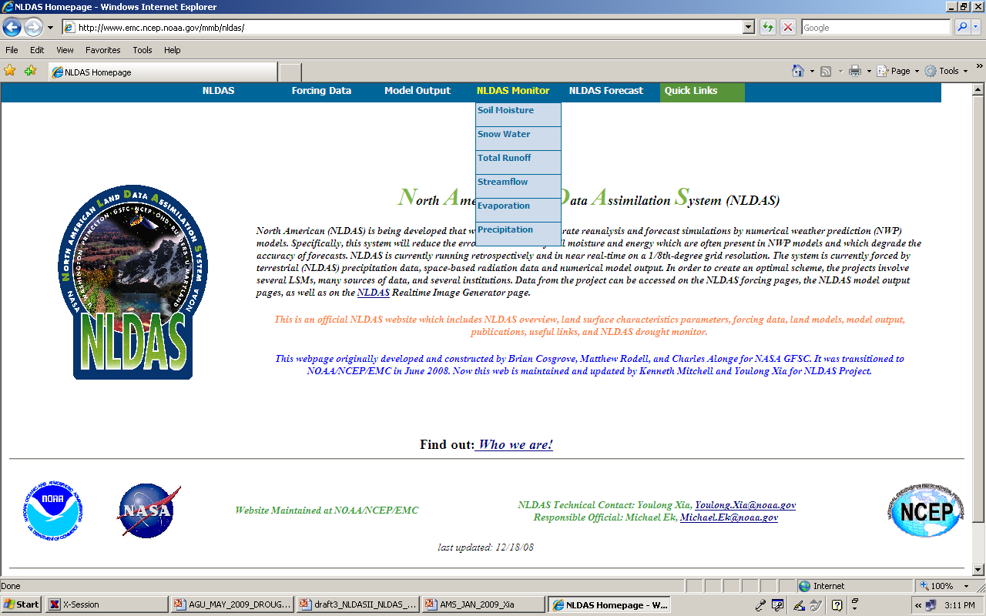
NCEP/EMC NLDAS website
www.emc.ncep.noaa.gov/mmb/nldas
NLDAS
Drought Monitor
Ensemble-Mean total runoff, top 1m and total column soil moisture percentiles for three time scales are directly provided to USDM author group through a daily Cron job
Anomaly and percentile for six variables and three time scales:
• Soil moisture, snow water, runoff, streamflow, evaporation, precipitation
• Current, Weekly, Monthly
5/37
Notes:
NLDAS website: NLDAS drought monitor and NLDAS drought prediction.

Slide 6
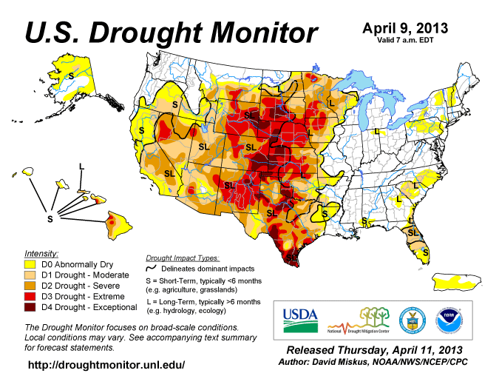
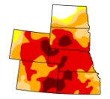
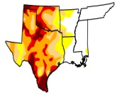
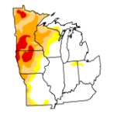
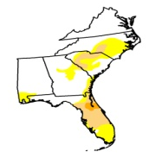
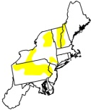
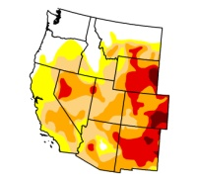
US Drought Monitor and its Statistics
http://droughtmonitor.unl.edu/archive.html
(1)
Six Regions:
High Plains
Midwest
Northeast
South
Southeast
West
Percentile
Percentile
D4 D3 D2 D1 D0
Drought Classification
(2)
Drought area percentage for US, each USDM region, each state, and each county
USDM Statistics (CONUS, Region, State)
(3)
(4)
6/37

Slide 7
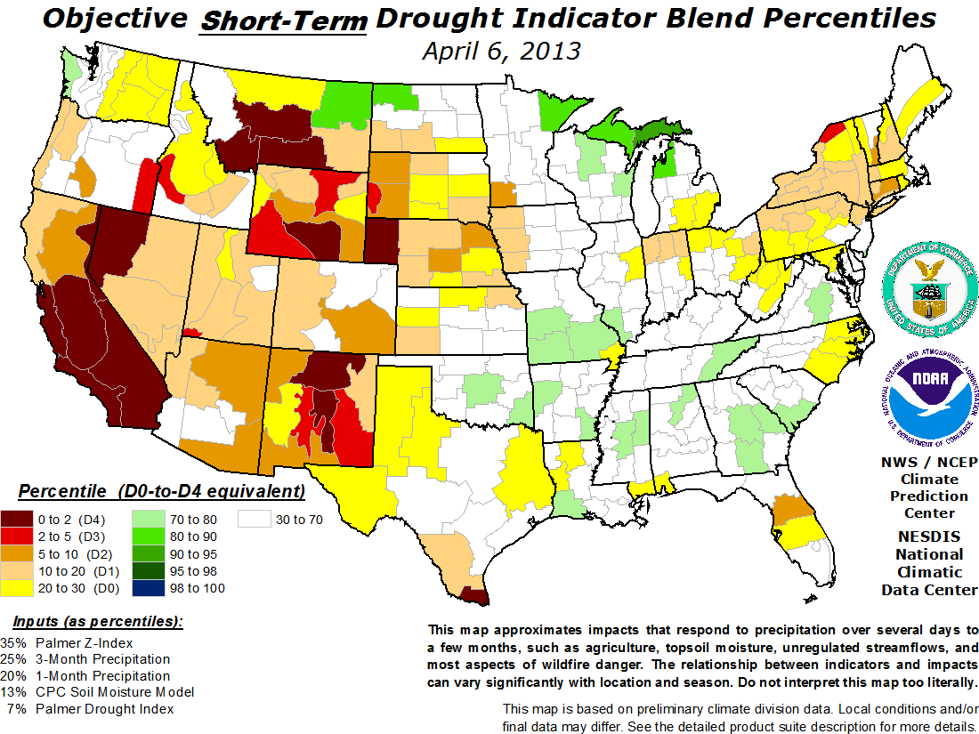
CPC Experimental Objective Blends (Empirical Weights)
http://www.cpc.ncep.noaa.gov/products/predictions/tools/edb/droughtblends.php
Weights and Indices
7/37

Slide 8
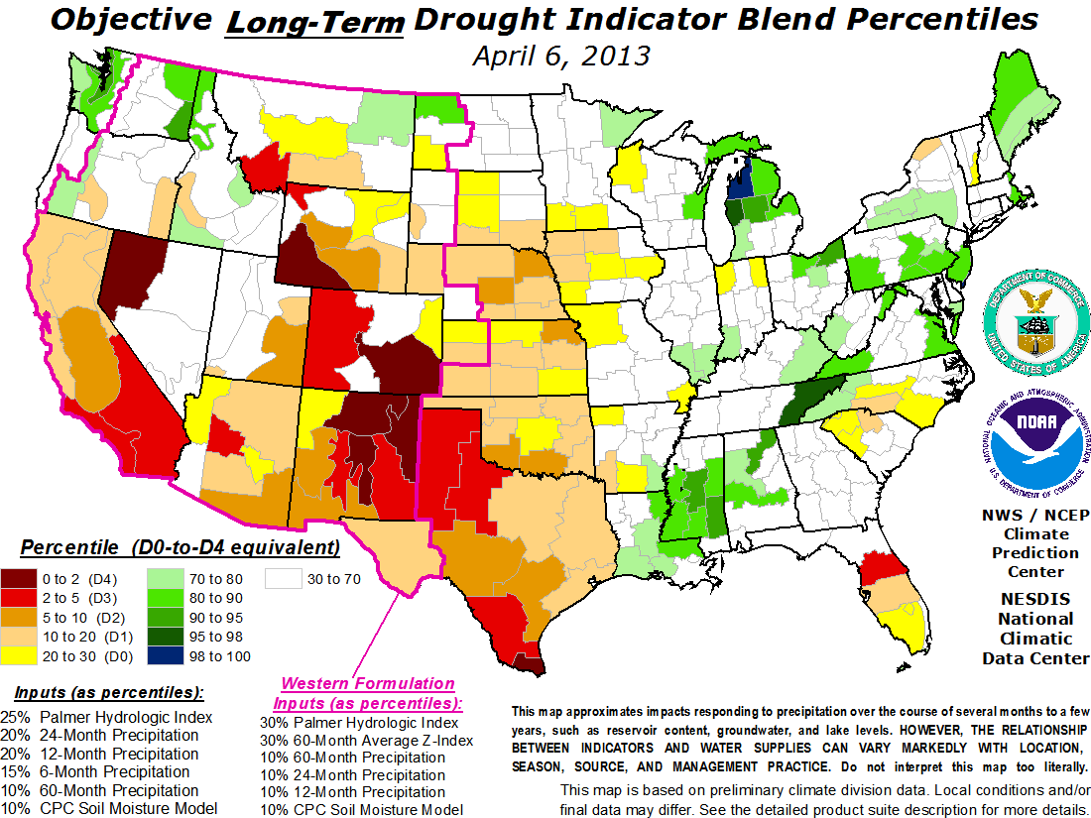
CPC Experimental Objective Blends (Empirical Weights)
Weights and Indices
8/437
Notes:
NLDAS data sets include land data sets such as soil type, vegetation type, vegetation fraction, aldeo ect and forcing data such as radiation, air temperature, precipitation, wind, relative humidity etc.

Slide 9
2. Development of an
Objectively Blending Approach
USDM and CPC experimental blends provide the basis to allow us to develop an approach:
Objectively Select Optimal Weights to Blend Drought Indices
Acknowledgments:
NLDAS project was supported by NOAA/OGP GAPP Program, NASA Terrestrial Hydrology Program, NOAA/CPO CPPA Program (Climate Program of the Americas), and NOAA/CPO MAPP Program (Modeling, Analysis, Predictions and Projections).
9/37

Slide 10
Objectively Blending Approach
Hypothesis:
USDM is assumed as “Target/Reference Data”
Weekly drought area percentages for 5 categories were downloaded from USDM website (Archive)
for CONUS, six USDM regions, and 48 States
Monthly drought area percentages were calculated using number of days as the weights
Monthly drought area percentages were calculated using a blended NLDAS ensemble mean percentile (w₁I₁+w₂I₂+w₃I₃ ……) , mask file (i.e., CONUS, Region, State), and USDM drought classification criteria
Error Function = RMSE(USDM-NLDAS Blended)
Select Weight w₁, w₂, w₃, … via minimize Error Function
using an optimization approach
10/37

Slide 11
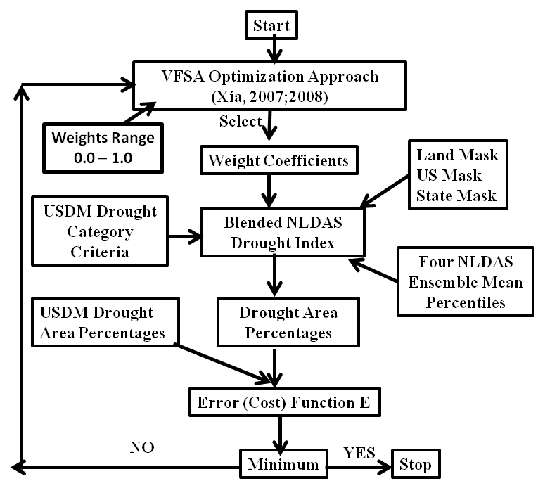
Objectively Blending Approach
Use USDM as the ground “truth”
1000 iterations to converge
11/37

Slide 12
3. Experiment of Ensemble Mean NLDAS Drought Indices
Ensemble-mean Monthly Percentile
(NLDAS drought Indices)
Top 1m soil moisture (SM1)
Total column soil moisture (SMT)
Evapotranspiration (ET)
Total runoff (Q)
To support CPC Experimental Objective Blends of Drought Indicators
http://www.cpc.ncep.noaa.gov/products/predictions/tools/edb/droughtblends.php
12/37

Slide 13
Experiment Setup
Three Tests:
CONUS, Region (6 USDM regions), State (48 states)
Two periods:
Training period (120 months from 2000 to 2009)
Validation period (24 months from 2010 to 2011)
NLDAS-2 products were routinely used by USDM author group from January 2010
Very Fast Simulated Annealing Approach was used to search for optimal weights in this study
13/37

Slide 14
Experiment Setup
Objective Blended NLDAS drought Index (OBNDI) is expressed as
OBNDI = W₁SM1 + W₂SMT+ W₃ET +W₄Q
(1)
(2)
Calculate
Error (cost) function E can be expressed as Root Mean Square Error between drought area percentage calculated from NLDAS and derived from USDM:
(3)
Experiment is run for CONUS, each of six regions, and each of forty-eight states separately. Total 1000 runs are needed to achieve to converge a global minima for each run. Total 55,000 runs are executed. This process will search for optimal weight coefficients for each state and variable. The weight coefficients searched from this process will be shown in next slide.
NLDAS drought area percentage
USDM drought area percentage
14/37

Slide 15
Table 1: Optimal weight coefficients for CONUS and Region experiment (maximum in bold)
(Optimal Blended drought index =
W₁SM1 + W₂SMT + W₃ET + W₄Q)
U.S./Region | W₁ | W₂ | W₃ | W₄ | Cost
CONUS | 0.6253 | 0.0253 | 0.0033 | 0.0001 | 0.0488
West | 0.1083 | 0.3935 | 0.0000 | 0.0000 | 0.1674
High Plains | 0.1940 | 0.2816 | 0.0000 | 0.0002 | 0.1380
South | 0.2438 | 0.3585 | 0.0502 | 0.0000 | 0.0900
Midwest | 0.7551 | 0.0757 | 0.0433 | 0.0175 | 0.0542
Southeast | 0.1706 | 0.1490 | 0.0001 | 0.3115 | 0.1622
Northeast | 0.6651 | 0.2571 | 0.0478 | 0.0027 | 0.0649
15/37

Slide 16
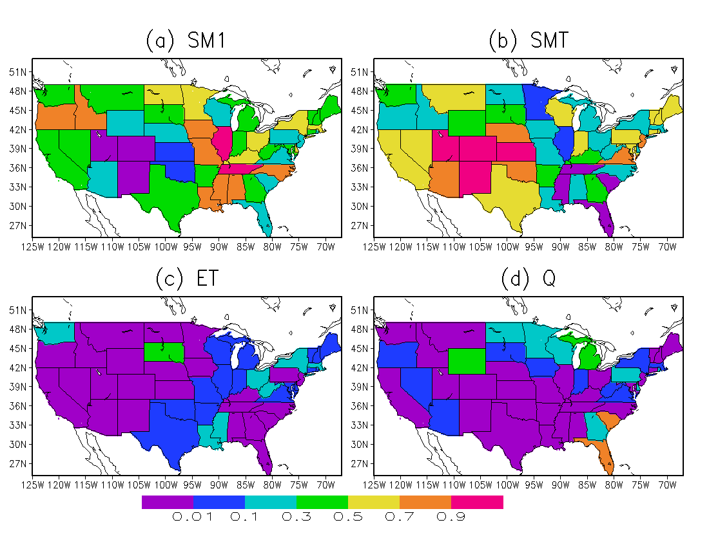
Normalized weight coefficients for NLDAS ensemble-mean monthly top 1m soil moisture (SM1), total column soil moisture (SMT), evapotranspiration (ET), and total runoff (Q) percentiles – Objective Blended NLDAS drought Index (OBNDI)
State depended
ET and Q play a negligible role (<1%) for most of forty-eight states, and a modified role for some states.
NLDAS soil moisture (SM1 and SMT) plays a dominant role for all forty-eight states except for FL and SC
Cropland (1m root zone)
Shrub land, Woodland, Grasslands
(2m root zone)
16/37

Slide 17
Evaluation of Blended NLDAS Drought Index
Evaluation Metrics:
Cumulative Density Function (CDF), Root Mean Square Error (RMSE), Bias, Correlation Coefficient (R), Nash-Sutcliffe Efficiency (NSE)
Acknowledgment : This work is supported by MAPP and CTB
17/37

Slide 18
Cumulative Density Function of R and RMSE for 48 States
Training Period 2000-2009
upper line means better performance (larger R, smaller RMSE)
18/37

Slide 19
Cumulative Density Function (CDF) of R and RMSE for 48 States
Validation Period 2010-2011
19/37

Slide 20
Region and State performs better than CONUS
State performs slightly better than Region
State experiment will be discussed
for following slides
20/37

Slide 21
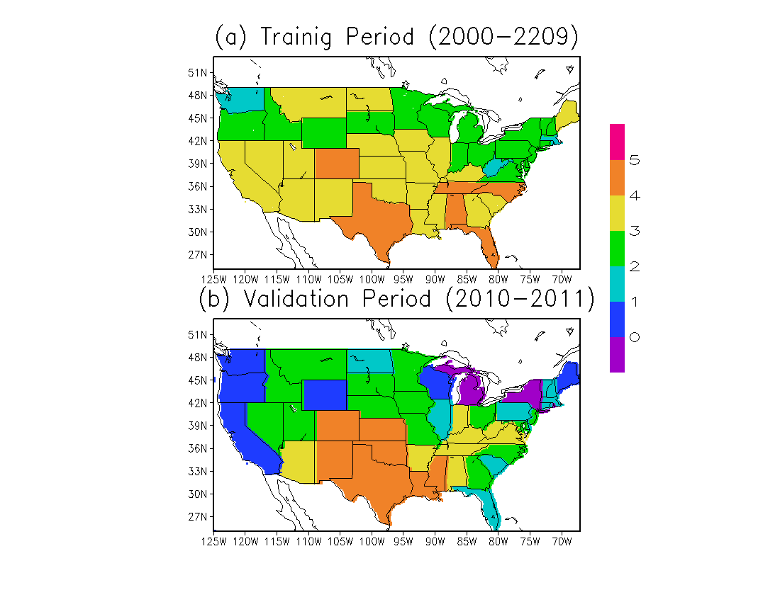
Spatial distribution of STATE’s capacity (correlation)
2009
Mo et al., 2012
Number of gauge stations has been largely reduced since 2002
In South, Southeast, and Midwest, STATE performs well
Number of categories with significant correlation at the 95% confidence level
for training (top) and validation (bottom) period
21/37

Slide 22
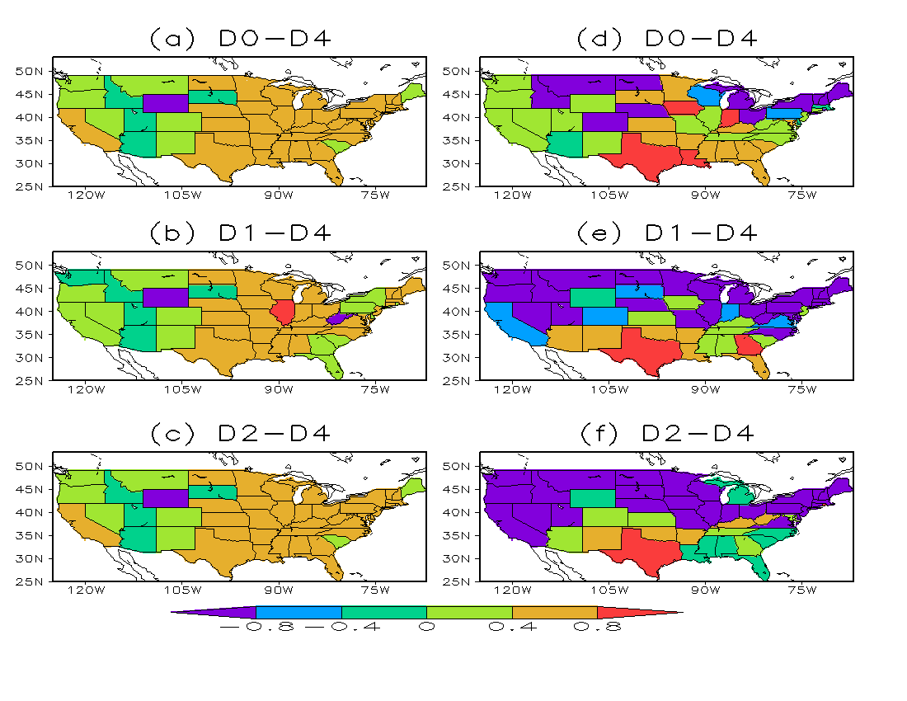
Nah-Sutcliffe Efficiency (NSE) over Continental United States
Training Period
Validation Period
where A is modeled drought area percentage, and O is USDM drought area percentage.
NSE = 0.0
Modeled is as same accurate as mean of USDM drought area percentage
NSE > 0.0
Modeled is better than the mean (>0.4 skillful)
NSE<0.0 Modeled is worse than the mean
As drought severity is increased
Performance is decreased
22/37

Slide 23
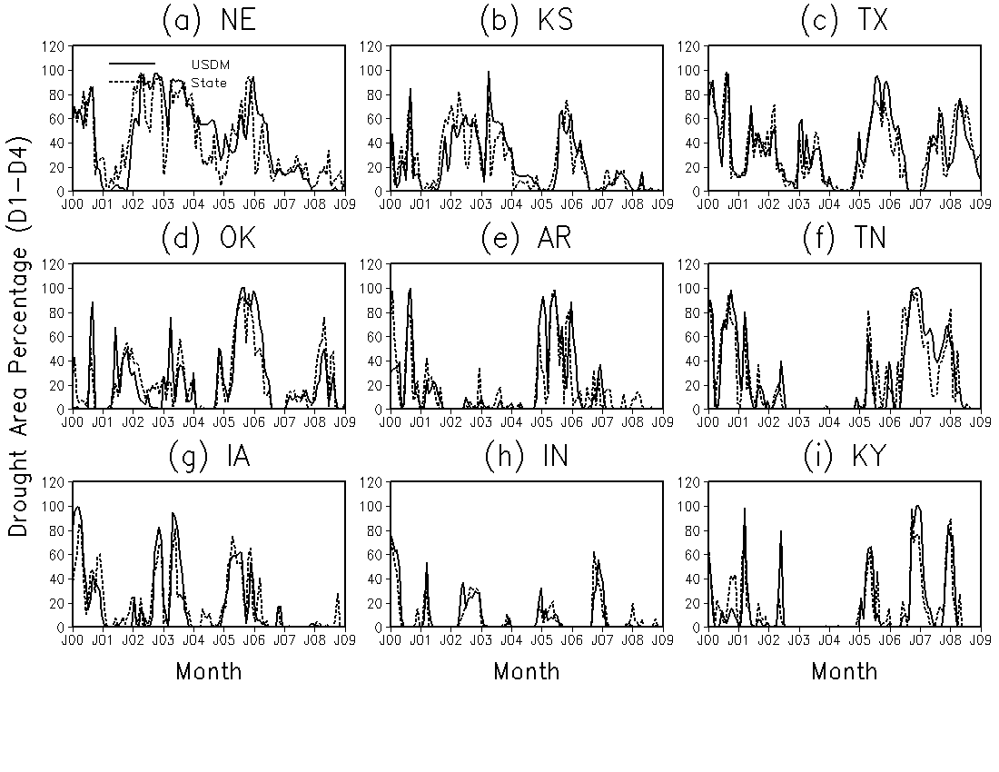
USDM is used as the ground “Truth”
Comparison of USDM and NLDAS drought area percentage in nine states for D1-D4 (from moderate drought to exceptional drought) category and 2000-2009 (training period)
________ USDM ------------- NLDAS/State
23/37

Slide 24
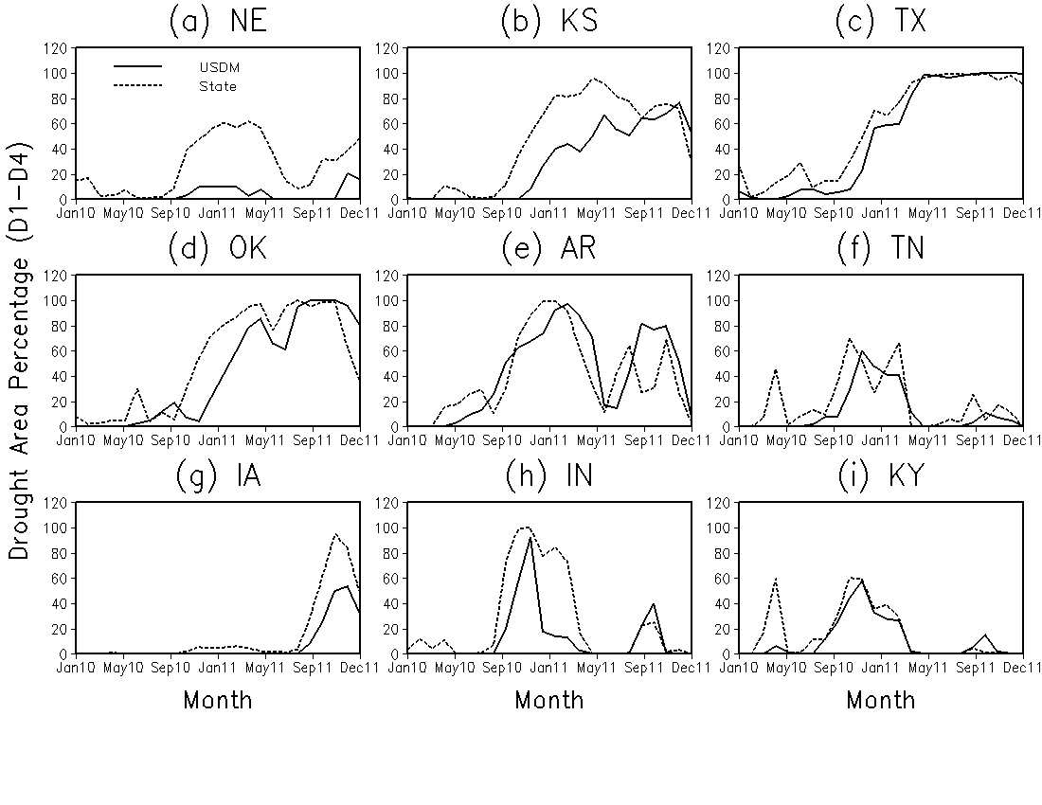
Comparison of USDM and NLDAS drought area percentage in nine states for D1-D4 category
2010-2011 (validation period)
________ USDM ------------- NLDAS/State
24/37

Slide 25
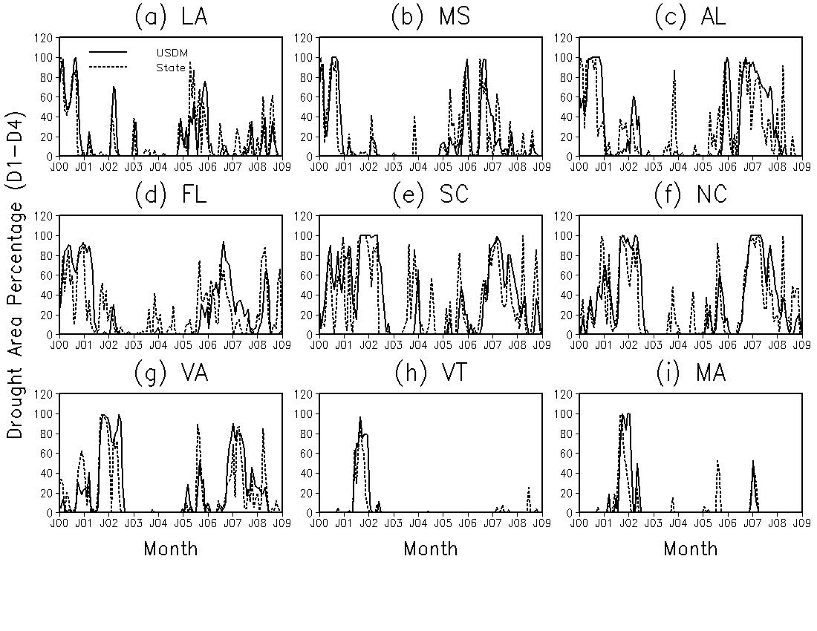
Southeast and Northeast
Overall performance of State is good except for a few cases
The reason for wrong simulations needs to be indentified
________ USDM ------------- NLDAS/State
25/37

Slide 26
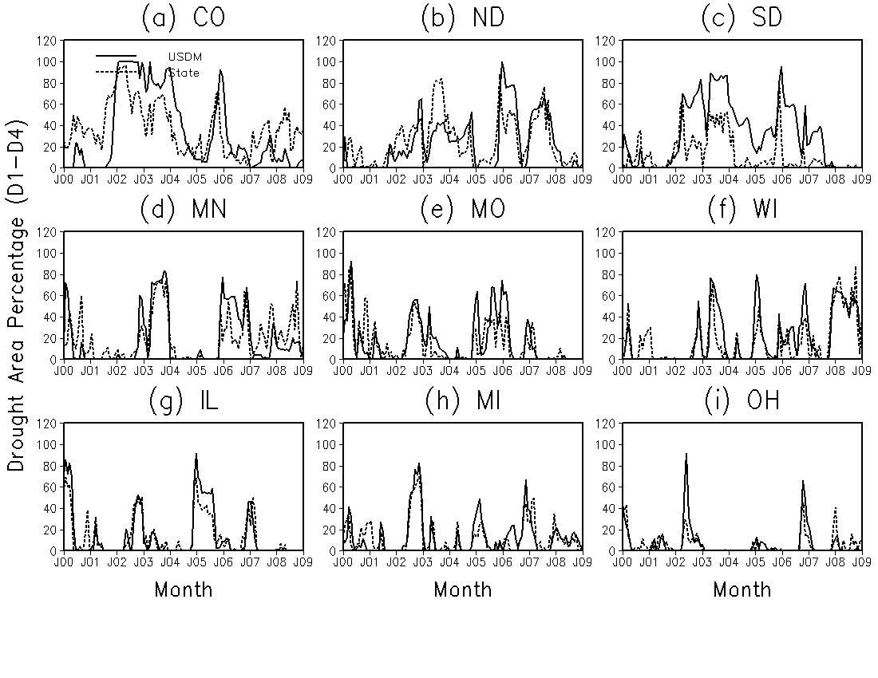
Midwest Region
Low skill
Overall performance of State is good for some states in this region
________ USDM ------------- NLDAS/State
26/37

Slide 27
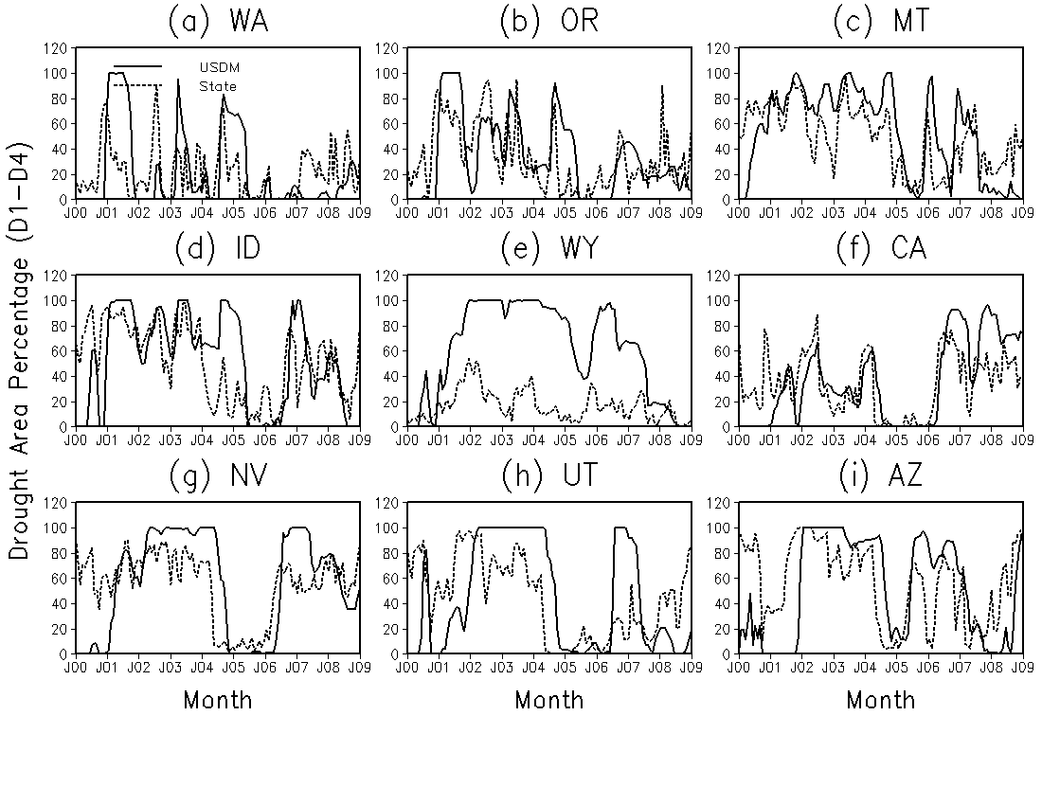
West Region
Performance of State is worse than the other regions and need to be improved in future
________ USDM ------------- NLDAS/State
27/37

Slide 28
Evaluation of Optimally Blended
NLDAS Drought Index (State) in Texas
5 Drought Categories: D0-D4, D1-D4, D2-D4,D3-D4, D4-D4
For severe drought (D2 or above), the blend underestimates USDM
Xia et al. (2013d), in preparation
2011 Texas Drought
28/37

Slide 29
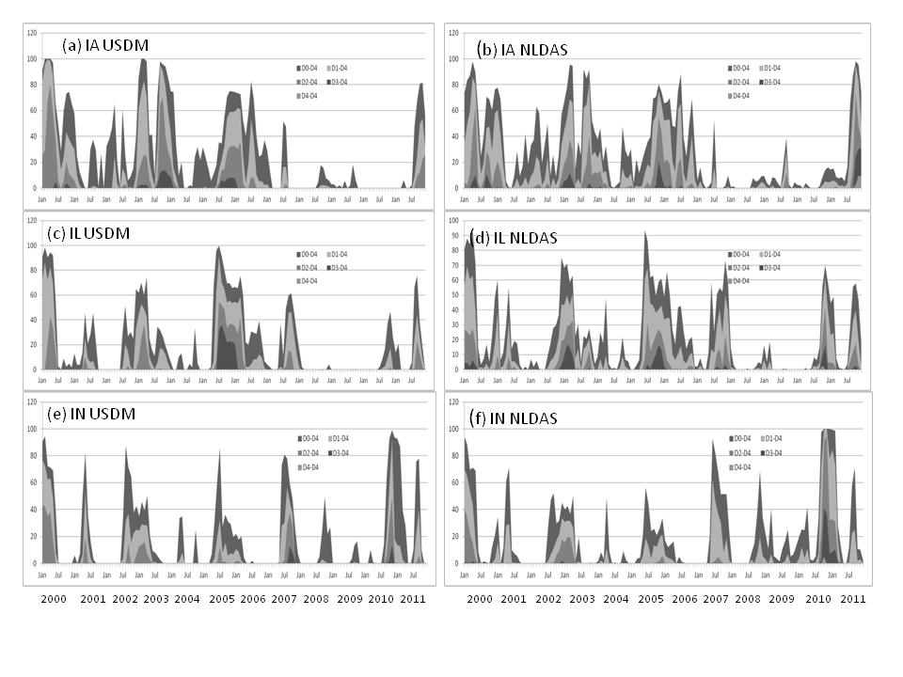
Comparison of USDM and NLDAS at three states
2000-2011 for five drought categories
in Iowa, Illinois, Indiana
USDM drought area variation
NLDAS drought area variation
Comparison of USDM and NLDAS shows good performance for NLDAS blends
29/37

Slide 30
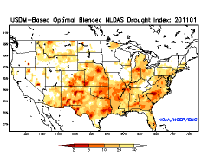
2011-2012 Drought Variation:
Monthly Animation
Comparison of Optimally Blended NLDAS Drought Index and USDM 2011
NLDAS
USDM
30/37

Slide 31
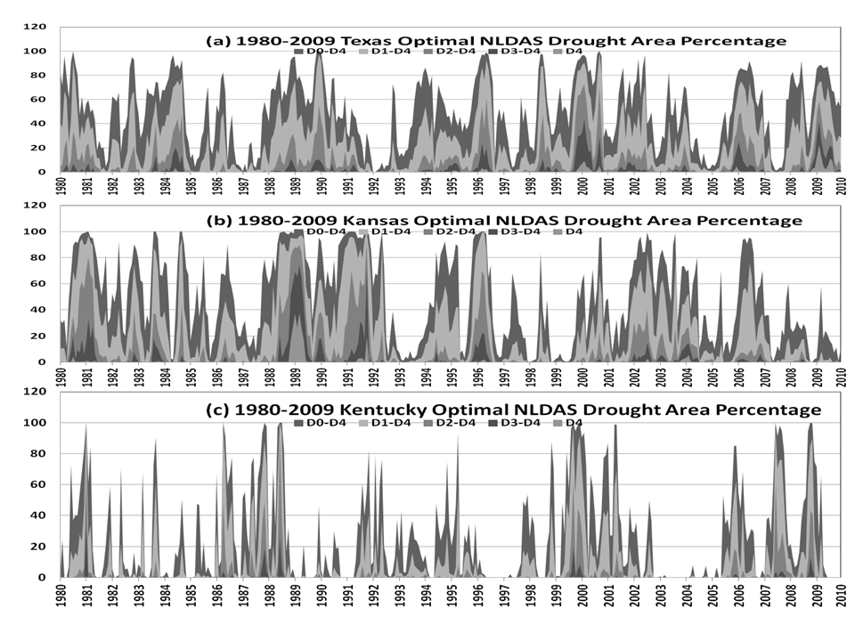
30-year (1980-2009) monthly
drought area percentage reconstruction
Xia et al. (20113d), in preparation
Texas
Kansas
Kentucky
Drought area percentage variation depends on state and month/year
31/37

Slide 32
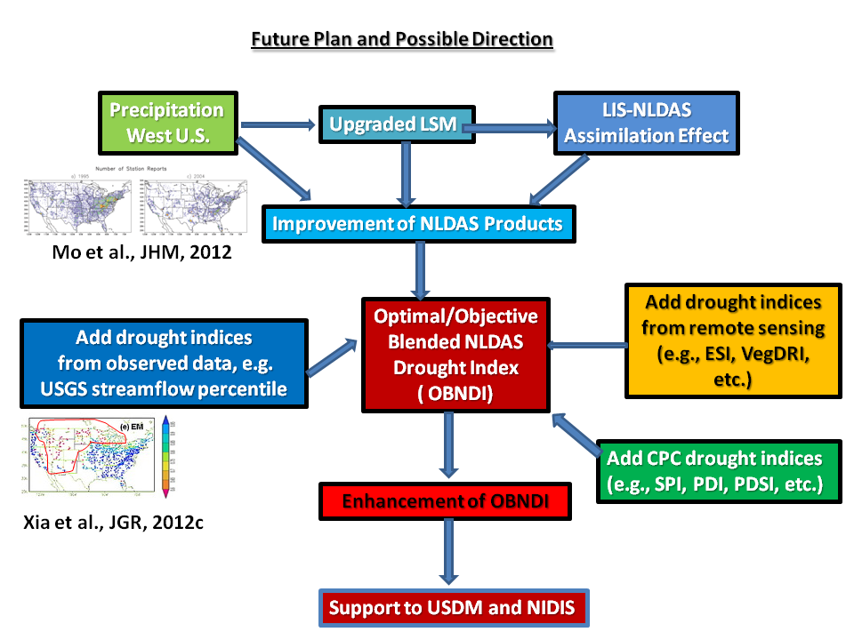
Land Information System (LIS) developed by NASA
(1)
Gauges reduced from 2002
GRACE-based
ground water storage
(2)
ESI-Evaporative Stress Index
VegDRI – Vegetation Drought Index
SPI – Standard Precipitation index
PDI – Palmer Drought Index
PDSI – Palmer Drought Severity Index
Monthly anomaly correlation
NLDAS has poor streamflow simulation
in circled area
32/37

Slide 33
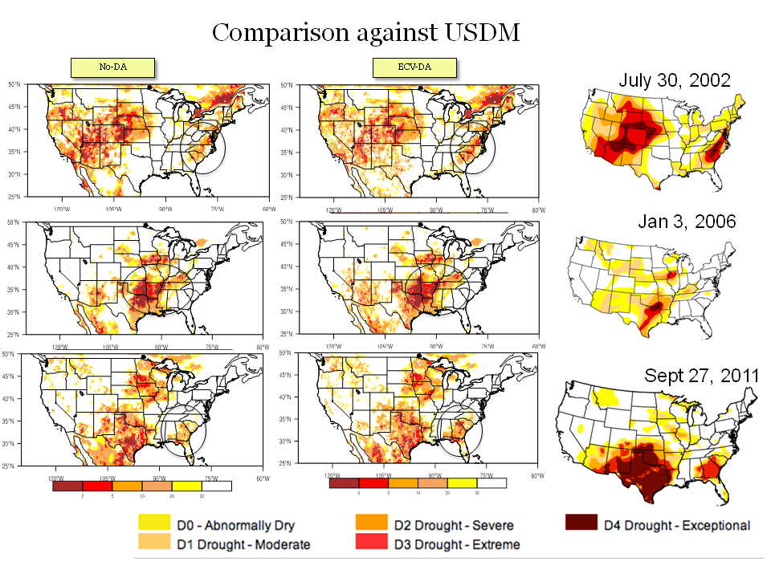
SCAN soil moisture is assimilated to NLDAS-2 (NASA LIS-NLDAS)
(from Christa Peters-Lidard’s AMS talk 2013)
some improvements
in circled area
33/37

Slide 34
Some Preliminary Thoughts
Can we explore this work to CPC experimental objective blends?
Can we reconstruct long-term drought area percentage using long-term CPC operational drought indices (from 1900 –present) if we can use this framework?
Should we use this framework for long-term drought and short-term drought separately as done in CPC? If so, can USDM provide drought area percentage statistics separately for short-term and long-term drought as the indices controlling these two drought types may be different?
How to collaborate with research community to explore the possibility of objectively blending drought indices based on current USDM statistics, experiences, and expertise?
How to select drought indices according to data accuracy and reliability? drought type - meteorological, hydrologic, and agricultural. Short-term and long-term. Data source – observed (low spatial resolution, long-term data), remotely-sensed (high spatial resolution, short-term data), and modeled (from low to high resolution, from short-term to long-term data)
More research is needed ……
34/37

Slide 35
Summary of Objective Blends
of Multiple NLDAS Drought Indices
1. NLDAS blend can basically capture USDM drought area percentage for 1/3 -1/2 of 48 states for category D0-D4, and D1-D4, in particular for the training period.
2. Most reliable states are located in the Midwest, South and Southeast region, and the results for West region and Northeast should be cautiously used as blend shows low simulation skills, in particular for validation period and D3-D4 and D4-D4 category. For very severe drought, the blend largely underestimates USDM and shows low skills as we have a small-size sample only.
3. Texas, as the most reliable state, blend has the best performance and simulation skills for both training and validation period and for all five drought categories.
4. In spite of existing weakness, drought index reconstruction can be executed in the continental United States. The reconstructed drought index is reproducible (repeatable).
5. The framework still have big room to improve through adding more drought indices from observations (e.g., streamflow), remote sensing, and CPC operational drought indices . USDM county-scale statistics will be tested as high-resolution (4km) NLDAS will become EMC quasi-operational products in near future.
35/37

Slide 36
References for VFSA
Xia, Y., 2007: Calibration of LaD model in the Northeast United States using observed annual streamflow. J. Hydrometeor., 8,
1098-1110.
Xia,Y., 2008:Adjustment of global precipitation data for orographic effects using observed annual streamflow and
the LaD model, J. Geophys. Res., 113, D04106, doi:10.1029/2007JD008545.
References for NLDAS-2
Ek, M.B., Y. Xia, E.F. Wood, J. Sheffield, L. Luo, D. Lettemaier, and NLDAS team, 2011: North American Land Data
Assimilation Phase 2 (NLDAS-2): Development and Applications, GEWEX news, 21, 6-7.
Xia, Y., B. Cosgrove, M. B. Ek, J. Sheffield, L. Luo, E. F. Wood, K. Mo, and NLDAS team, 2013a: Overview of North American
Land Data Assimilation System, chapter 11 in Land Surface Observation, Modeling and Data Assimilation, edited by
Shunlin Liang et al., World Scientific, 335-376pp.
Xia, Y., M.B. Ek, J. Sheffield, B. Livneh, M. Huang, H. Wei, S. Feng, L. Luo, J. Meng, and E. Wood, 2013b: Validation of Noah-
simulated soil temperature in the North American Land Data Assimilation System Phase 2. J. Appl. Meteor. Climatol. 52,
455-471.
Xia, Y., K.E. Mitchell, M.B. Ek, J. Sheffield, B. Cosgrove, and NLDAS team, 2012a: Continental-scale water and energy flux
analysis and validation for the North American Land Data Assimilation System project phase 2 (NLDAS-2): 1.
Intercomparison and application of model products, J. Geophys. Res., 117, D03109, doi:10.1029/2011JD016048.
Xia, Y., K.E. Mitchell, M.B. Ek, B. Cosgrove, J. Sheffield, and NLDAS team, 2012b: Continental-scale water and energy flux
analysis and validation for North American Land Data Assimilation System project phase 2 (NLDAS-2): 2. Validation of
model-simulated streamflow, J. Geophys. Res., 117, D03110, doi:10.1029/2011JD016051.
Xia, Y., J. Sheffield, M. B. Ek, J. Dong, N. Chaney, H. Wei, J. Meng, and E. F. Wood, 2013c, Evaluation of multi-model
simulated soil moisture in NLDAS-2, J. Hydrology (in revision).
Xia, Y., M.B. Ek, C. Peters-Lidard, D. Mocko, J. Sheffield, and E.F. Wood, 2013d: Application of USDM statistics in NLDAS-2:
objectively blended NLDAS drought Index over the continental United States, J. Geophys. Res. (in preparation).
36/37

Slide 37
Thank You!
Welcome to use NLDAS products
NOAA NLDAS Website
http://www.emc.ncep.noaa.gov/mmb/nldas/
NASA NLDAS Website
http://ldas.gsfc.nasa.gov/nldas/
Comments and suggestions to the following scientists:
EMC LDAS General (NLDAS, HRAP-NLDAS, GLDAS): Michael.Ek@noaa.gov
NLDAS EMC: Youlong.Xia@noaa.gov , NLDAS NASA: David.Mocko@nasa.gov
HRAP-NLDAS: Jiarui.Dong@noaa.gov, GLDAS: Jesse.Meng@noaa.gov
37/37

