Slide 1
Testbeds, Model Evaluation, Statistics, and Users
11 February 2013
Barbara Brown, Director (bgb@ucar.edu)
Joint Numerical Testbed Program
Research Applications Laboratory
NCAR

Slide 2
Topics
Testbeds, the JNT, and the DTC
New developments in forecast verification methods
  Probabilistic
  Spatial
  Contingency tables
  Measuring uncertainty
  (Extremes)
Users
  What makes a good forecast?
  How can forecast evaluation reflect users’ needs?
    User-relevant verification
Resources

Slide 3
Testbeds
From Wikipedia:
“A testbed (also commonly spelled as test bed in research publications) is a platform for experimentation of large development projects. Testbeds allow for rigorous, transparent, and replicable testing of scientific theories, computational tools, and new technologies.”
For NWP / Forecasting, this means independent testing and evaluation of new NWP innovations and prediction capabilities
However, in weather prediction, we have many flavors of testbed

Slide 4

Joint Numerical Testbed Program
Director: B. Brown
Science Deputy: L. Nance
Engineering Deputy: L. Carson
Mesoscale Modeling Team
Data Assimilation Team
Tropical Cyclone Modeling
Team
Statistics / Verification Research
Team
Ensemble Team
Functions and Capabilities: Shared Staff
Community Systems
Testing and Evaluation
Statistics and Evaluation Methods

Slide 5
Focus and goals
Focus:
Support the sharing, testing, and evaluation of research and operational numerical weather prediction systems (O2R)
Facilitate the transfer of research capabilities to operational prediction centers (R2O)
Goals:
Community code support
  Maintain and support community prediction and evaluation systems
Independent testing and evaluation of prediction systems
  Undertake and report on independent tests and evaluations of prediction systems
State-of-the-art tools for forecast evaluation
  Research, develop and implement
Support community interactions and development on model forecast improvement, forecast evaluation, and other relevant topics
  Workshops, capacity development, training

Slide 6
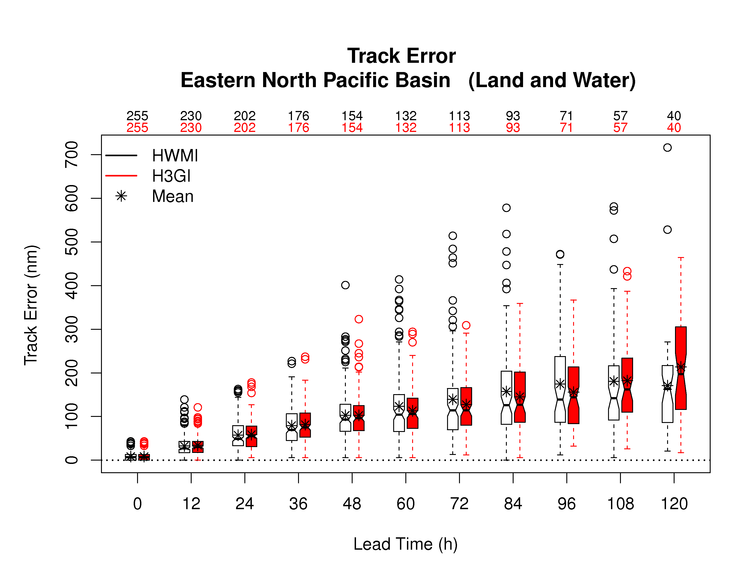
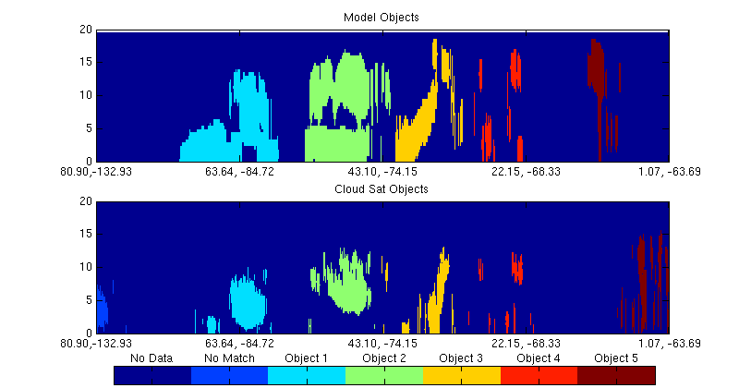
Major JNT activities
Developmental Testbed Center
Hurricane Forecast Improvement Project (HFIP)
  Research model testing and evaluation
  Evaluation methods and tools
Forecast evaluation methods
  Uncertainty estimation
  Spatial methods
  Climate metrics
  Energy forecasts
  Satellite-based approaches
  Verification tools
Research on statistical extremes
Hurricane track forecast verification
Use of CloudSat to evaluate vertical cloud profiles

Slide 7
Major JNT activities
Developmental Testbed Center
Hurricane Forecast Improvement Project (HFIP)
  Research model testing and evaluation
  Evaluation methods and tools
Forecast evaluation methods
  Uncertainty estimation
  Spatial methods
  Climate metrics
  Satellite-based approaches
  Verification tools
Research on statistical extremes
Hurricane track forecast verification
Use of CloudSat to evaluate vertical cloud profiles

Slide 8
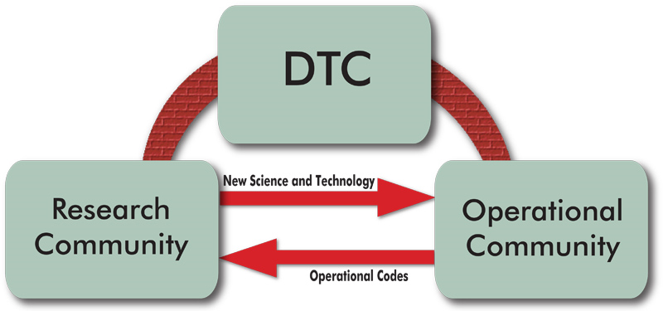

Developmental Testbed Center (DTC)
DTC is a national effort with a mission of facilitating R2O and O2R activities for numerical weather prediction.
Sponsored by NOAA, Air Force Weather Agency, and NCAR/NSF.
Activities shared by NCAR/JNT and NOAA/ESRL/GSD
NCAR/JNT hosts the National DTC Director and houses a major component of this distributed organization.

Slide 9
Bridging the Research-to-Operations (R2O) Gap
By providing a framework for research and operations to work on a common code base
By conducting extensive testing and evaluation of new NWP techniques
By advancing the science of verification through research and community connections
By providing state-of-the-art verification tools needed to demonstrate the value of advances in NWP technology
Notes:
Transition to verification part

Slide 10
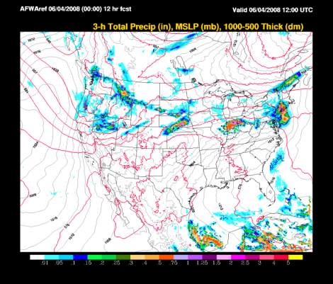
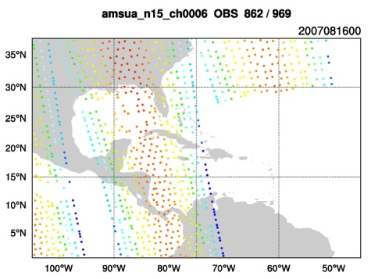
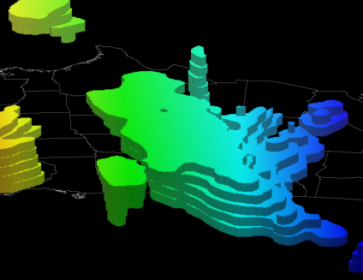
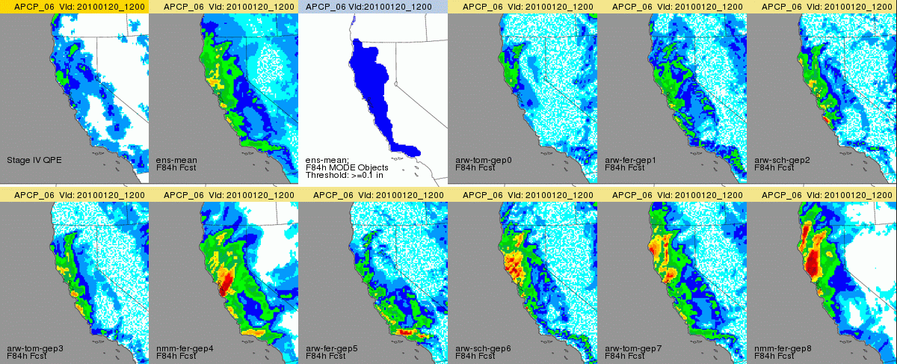
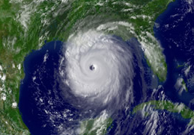
Mesoscale Modeling
Data Assimilation
Hurricanes
Ensembles
Verification
Notes:
Initial focus areas were Mesoscale Modeling and Verification. More recently, expanded into DA, hurricanes and very recently ensembles

Slide 11
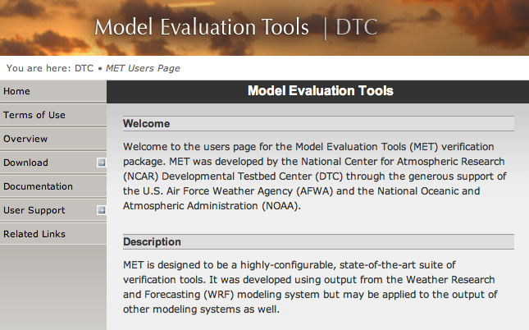
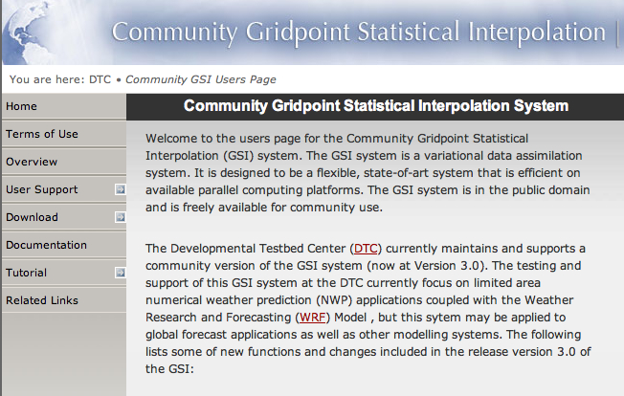
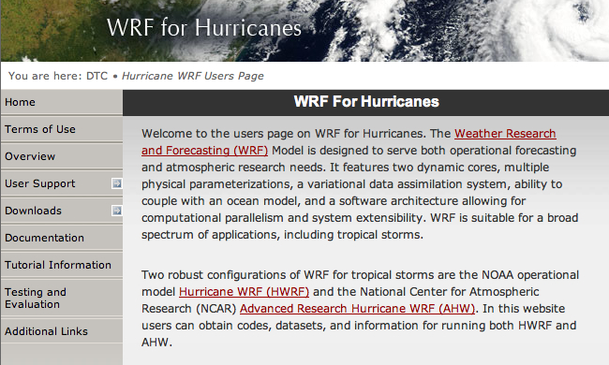

Community Software Projects
Weather Research and Forecasting Model
  WRF
  WPS: Preprocessor
  WPP/UPP: Post Processor
Model Evaluation Tools (MET)
Gridpoint Statistical Interpolation (GSI) data assimilation system
WRF for Hurricanes
  AHW
  HWRF
Notes:
Community software: A free and shared software resource with distributed development and centralized support
Public Outreach
Includes Web site, User guides and Technical documents; Workshops and Tutorials; User Support; Scientific Visitors; Community Code Management
Repositories/Software management/Version control; Testing and Evaluation; Coordination with Operational Center; Steering Committee; Developers Committee

Slide 12

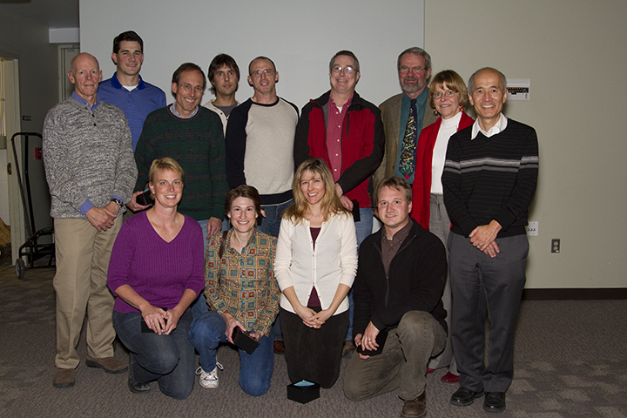
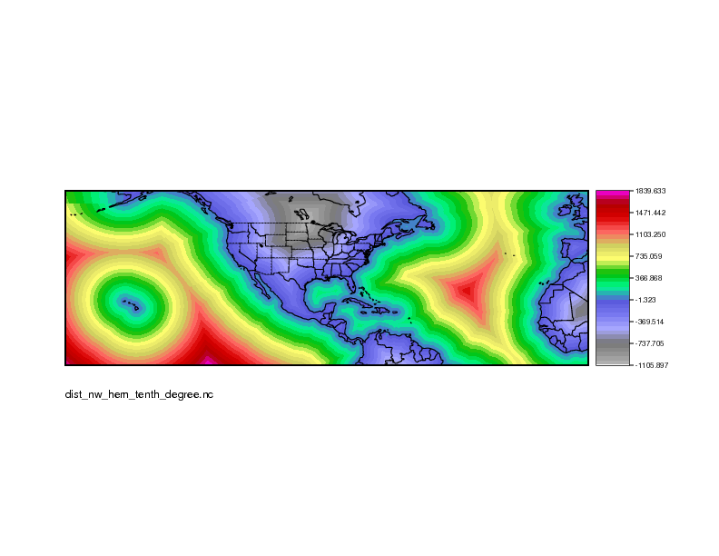
Community Tools for Forecast Evaluation
Traditional and new tools implemented into DTC Model Evaluation Tools (MET)
Initial version released in 2008
Includes
  Traditional approaches
  Spatial methods (MODE, Scale, Neighborhood)
  Confidence Intervals
Supported to the community
  Close to 2,000 users (50% university)
  Regular tutorials
  Email help
MET-TC to be released in Spring 2013 (for tropical cyclones)
MET team received the 2010 UCAR
Outstanding Performance Award for
Scientific and Technical Advancement
http://www.dtcenter.org/met/users/
Notes:
To make this research useful, and to provide the community with state-of-the-art tools for verification, the new methods have been implemented into the Model Evaluation Tools – a toolkit that also includes traditional verification approaches.
The initial version of MET was released in 2008, and there now are over 1300 registered users (50% from universities).
MET has brought tools for forecast evaluation to a large community of users who previously did not have tools available to do these evaluations.
It is worth noting that the MET team received the 2010 UCAR Outstanding Performance Award for Scientific and Technical Advancement for this effort.
And now Jamie will show you some of these tools in action in our testing and evaluation efforts.

Slide 13
Testing and Evaluation
JNT and DTC Philosophy:
Independent of development process
Carefully designed test plan
  Specified questions to be answered
  Specification and use of meaningful forecast verification methods
Large number of cases
Broad range of weather regimes
Extensive objective verification, including assessment of statistical significance
Test results are publicly available

Slide 14
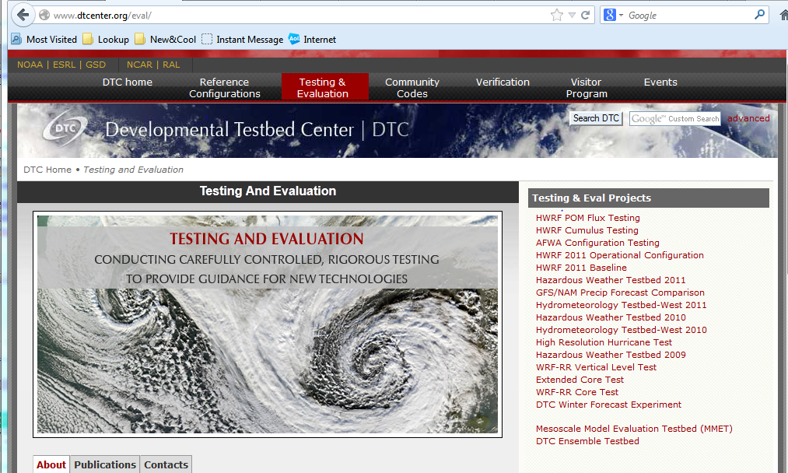
DTC tests span the DTC focus areas
Notes:
This clip from the DTC web page shows a list of links to test results from DTC testing activities, related to WRF, HWRF, AFWA configurations, HWT and HMT, SREF, and other ensemble tests
Note that DTC has also contributed over several years to the Hazardous Weather Testbed (HWT) and Hydrometeorological Testbed (HMT) (more about this later, in slide

Slide 15
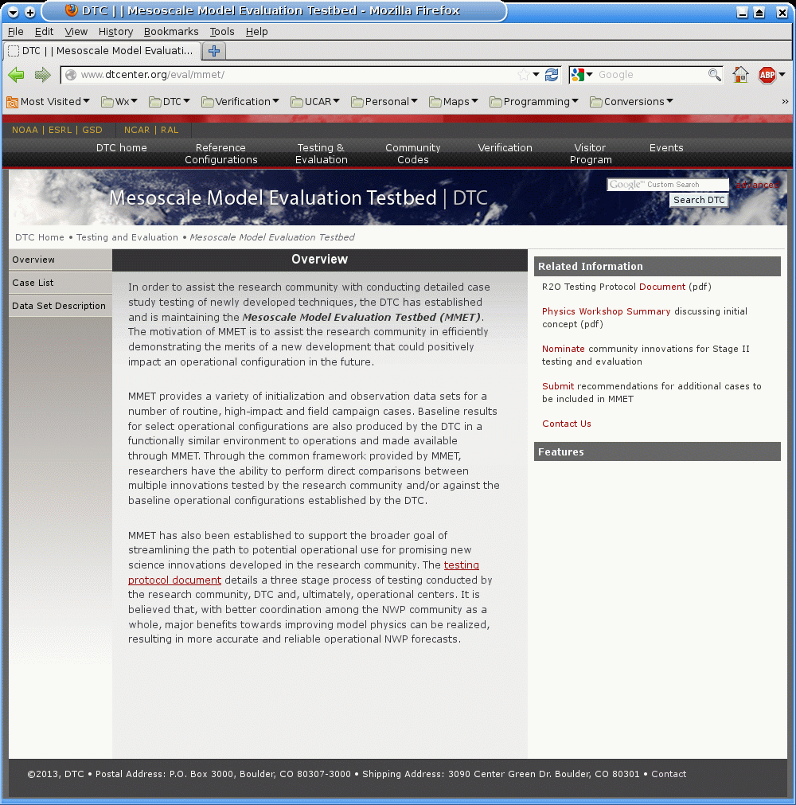
Mesoscale Model Evaluation Testbed
What: Mechanism to assist research community w/ initial stage of testing to efficiently demonstrate the merits of a new development
  Provide model input & obs datasets to utilize for testing
  Establish & publicize baseline results for select operational models
  Provide a common framework for testing; allow for direct comparisons
Where: Hosted by the DTC; served through Repository for Archiving, Managing and Accessing Diverse DAta (RAMADDA)
  Currently includes 9 cases
  Variety of situations and datasets
www.dtcenter.org/eval/mmet

Slide 16
Verification methods: Philosophy
One statistical measure will never be adequate to describe the performance of any forecasting system
Before starting, we need to consider the questions to be answered before proceeding – What do we (or the users) care about? What are we trying to accomplish through a verification study?
Different problems require different statistical treatment
Care is needed in selecting methods for the task
  Example: Finley affair
Measuring uncertainty (i.e., confidence intervals, significance tests) is very important when comparing forecasting systems
  But also need to consider practical significance

Slide 17
What’s new in verification?
Contingency table performance diagrams
  Simultaneous display of multiple statistics
Probabilistic
  Continuing discussions of approaches, philosophy, interpretation
Spatial methods
  New approaches to diagnostic verification
Extremes
  New approaches and measures
Confidence intervals
  Becoming more commonly used

Slide 18
Computing traditional verification measures
Continuous statistics
Yes/No contingency table
Use error values to estimate a variety of measures
Mean Error
MAE
MSE, RMSE
Correlation
 | Observed
 | Yes | no
yes | hits | false alarms
No | misses | correct negatives
Forecast
Use contingency table counts to compute a variety of measures
  POD, FAR, Freq. Bias, Critical Success Index (CSI), Gilbert Skill Score (= ETS), etc.
Important issues:
(1) Choice of scores is critical
(2) The traditional measures are not independent of each other

Slide 19
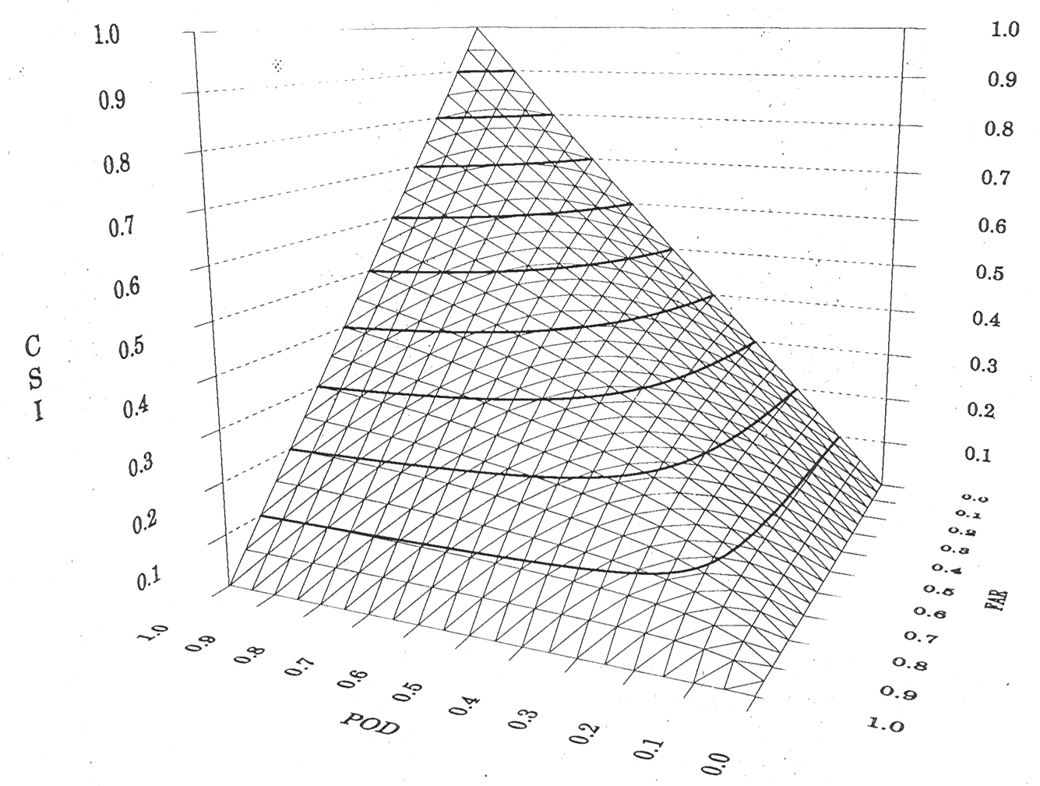
Relationships among contingency table scores
CSI is a nonlinear function of POD and FAR
CSI depends on base rate (event frequency) and Bias
CSI
Very different combinations of FAR and POD lead to the same CSI value
(User impacts?)
FAR
POD

Slide 20
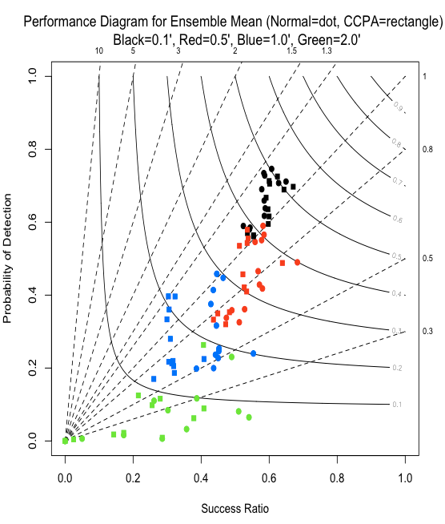
Performance diagrams
Best
Take advantage of relationships among scores to show multiple scores at one time
Only need plot POD and 1-FAR
Equal lines of CSI
Probability of Detection
NOTE: Other forms of this type of diagram exist for different combinations of measures (see Jolliffe and Stephenson 2012)
Equal lines of Bias
Success Ratio
Success ratio = 1 - FAR
After Roebber 2009 and C. Wilson 2008

Slide 21
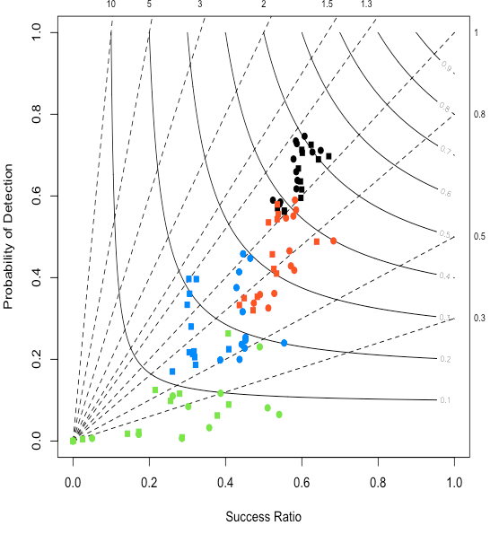
Example: Overall changes in performance resulting from changes in precip analysis
Colors = Thresholds
Black = 0.1”
Red = 0.5”
Blue = 1”
Green = 2”
Dots = Stage IV
Rectangles = CCPA
Larger impacts for higher thresholds
Notes:
Legend: Verification of 6h precipitation forecasts aggregated over 5 major precipitation events in the HMT during winter 2010-11. Circles denote verification using stageIV, rectangles denote verification using CCPA; colors indicate 6h precipitation thresholds as shown. Sequence of same-color characters are for prgressive lead time, 6h-72h, normally starting with the furthest upper right point. CCPA-StageIV comparison can be made by noting the simliar pattern (but offset) between same-colored circle and rectangle pairs. Success ratio is 1-FAR, solid contour lines are CSI, and diagonal dashed lines are frequency bias.

Slide 22
Measure | Attribute evaluated | Comments
Probability forecasts
Brier score | Accuracy | Based on squared error
Resolution | Resolution (resolving different categories) | Compares forecast category climatologies to overall climatology
Reliability | Calibration
Skill score | Skill | Skill involves comparison of forecasts
Sharpness measure | Sharpness | Only considers distribution of forecasts
ROC | Discrimination | Ignores calibration
C/L Value | Value | Ignores calibration
Ensemble distribution
Rank histogram | Calibration | Can be misleading
Spread-skill | Calibration | Difficult to achieve
CRPS | Accuracy | Squared difference between forecast and observed distributions Analogous to MAE in limit
log p score (Ignorance) | Accuracy | Local score, rewards for correct category; infinite if observed category has 0 density

Slide 23
Ignorance score (for multi-category or ensemble forecasts)
is the category that actually was observed at time t
Based on information theory
Only rewards forecasts with some probability in “correct” category
Is receiving some attention as “the” score to use

Slide 24
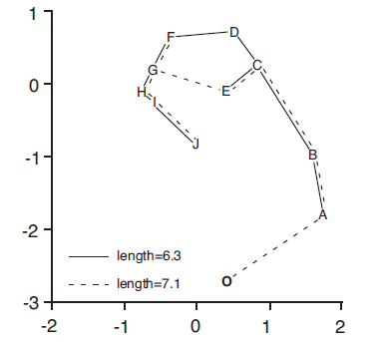
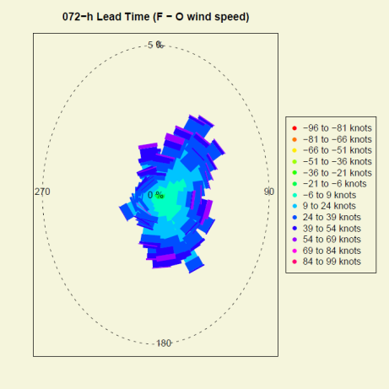
Multivariate approaches for ensemble forecasts
Minimum spanning tree
  Analogous to Rank Histogram for multivariate ensemble predictions
  Ex: Treat precipitation and temperature simultaneously
  Bias correction and Scaling recommended (Wilks)
Multivariate energy score (Gneiting)
  Multivariate generalization of CRPS
Multivariate approaches allow optimization on the basis of more than one variable
From Wilks (2004)
Bearing and Wind speed errors

Slide 25
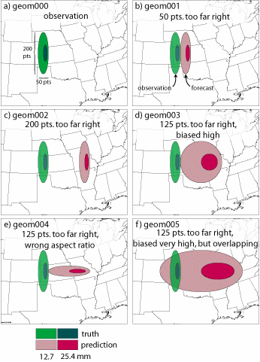
Traditional approach for gridded forecasts
Consider gridded forecasts and observations of precipitation
OBS
1
Which is better?
2
3
4
5
Notes:
These are the geometric cases from the ICP – but you don’t need to mention that here.
Just say that these are artificial precipitation forecasts and observations. The graphs are pretty self-explanatory.
The upper left is the observed field, the others show various forecasts to be compared to the obs.

Slide 26
Traditional approach
Scores for Examples 1-4:
Correlation Coefficient = -0.02
Probability of Detection = 0.00
False Alarm Ratio = 1.00
Hanssen-Kuipers = -0.03
Gilbert Skill Score (ETS) = -0.01
OBS
1
Scores for Example 5:
Correlation Coefficient = 0.2
Probability of Detection = 0.88
False Alarm Ratio = 0.89
Hanssen-Kuipers = 0.69
Gilbert Skill Score (ETS) = 0.08
2
3
4
5
Forecast 5 is “Best”
Notes:
This is a summary of the “traditional” results for the artificial cases. Basically all results point to Forecast 5 being the best.
Whether Forecast 5 actually IS the best, of course, depends on the user. But many users (I believe) would NOT prefer this forecast over Forecast 1 (i.e., part b in the graph)

Slide 27
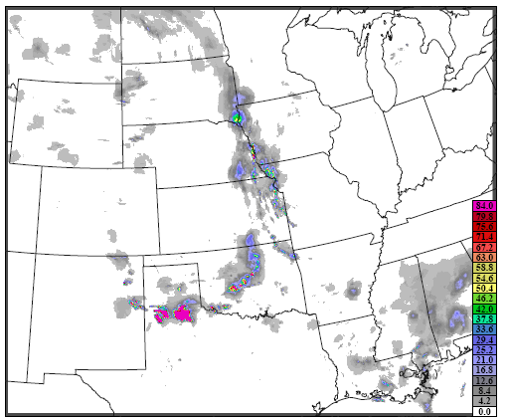
Impacts of spatial variability
Grid-to-grid results:
POD = 0.40
FAR = 0.56
CSI = 0.27
Forecast
Observed
Traditional approaches ignore spatial structure in many (most?) forecasts
  Spatial correlations
Small errors lead to poor scores (squared errors… smooth forecasts are rewarded)
Methods for evaluation are not diagnostic
Same issues exist for ensemble and probability forecasts
Notes:
REMOVE?

Slide 28
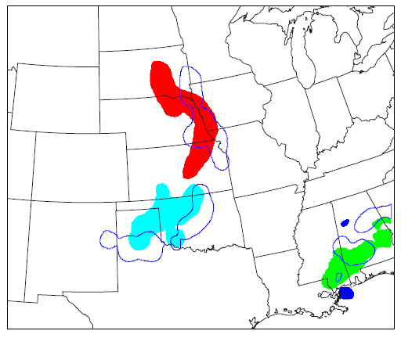
Method for Object-based Diagnostic Evaluation (MODE)
Traditional verification results:
Forecast has very little skill
Forecast
Observed
MODE quantitative results:
Most forecast areas too large
Forecast areas slightly displaced
Median and extreme intensities too large
BUT – overall – forecast is pretty good
1
3
2
Outline = Observed
Solid = Forecast
Notes:
This figure shows the forecast objects with outlines of the observed objects overlaid.
How does traditional verification compare to what we would get from MODE for this example?
Traditional methods suggest that the forecast field has very little skill.
However, if we apply MODE, the quantitative comparisons of the objects indicate a number of results. In particular, …
This method has been implemented and is now being used in a variety of research and operational situations.
However, it turns out that MODE was just one of a large number of new spatial methods that were being developed.

Slide 29
What are the issues with the traditional approaches?
“Double penalty” problem
Scores may be insensitive to the size of the errors or the kind of errors
Small errors can lead to very poor scores
Forecasts are generally rewarded for being smooth
Verification measures don’t provide
  Information about kinds of errors (Placement? Intensity? Pattern?)
  Diagnostic information
    What went wrong? What went right?
    Does the forecast look realistic?
    How can I improve this forecast?
    How can I use it to make a decision?

Slide 30
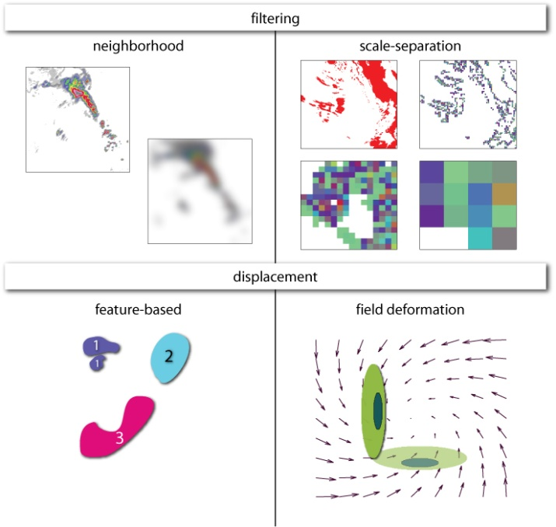
New Spatial Verification Approaches
Object- and feature-based
Evaluate attributes of
identifiable features
Neighborhood
Successive smoothing of forecasts/obs
Gives credit to "close" forecasts
Scale separation
Measure scale-dependent error
Field deformation
Measure distortion and
displacement (phase error) for
whole field
  How should the forecast be
  adjusted to make the best match
  with the observed field?
http://www.ral.ucar.edu/projects/icp/
Notes:
In particular, many researchers around the world were developing methods that our work indicated would fit into 4 basic categories. One is the category that includes MODE – feature-based. But other methods took different approaches – neighborhood methods, which evaluate performance as scale is broadened to include smoother scales; scale separation, which consider performance at individual scales; and field deformation which evaluates how much a forecast would have to change in order to best match the observed field.
So – several questions arose: How should a user determine what method to use for a particular application? What are the attributes and properties of these different methods?

Slide 31
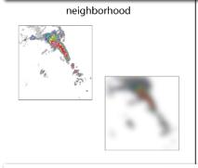
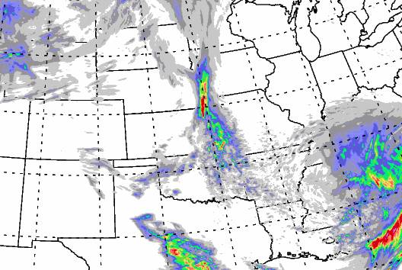
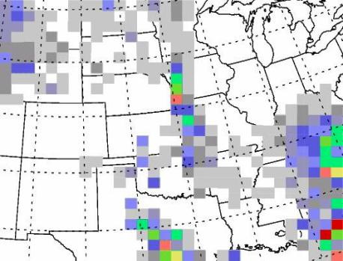
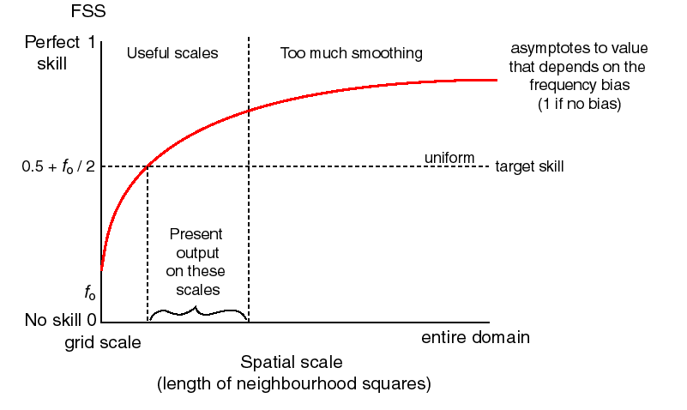
Neighborhood methods
Goal: Examine forecast performance in a region; don’t require exact matches
Also called “fuzzy” verification
Example: Upscaling
  Put observations and/or forecast on coarser grid
  Calculate traditional metrics
Provide information about scales where the forecasts have skill
Examples: Roberts and Lean (2008) – Fractions Skill Score; Ebert (2008); Atger (2001); Marsigli et al. (2006)
From Mittermaier 2008

Slide 32
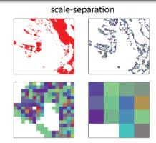
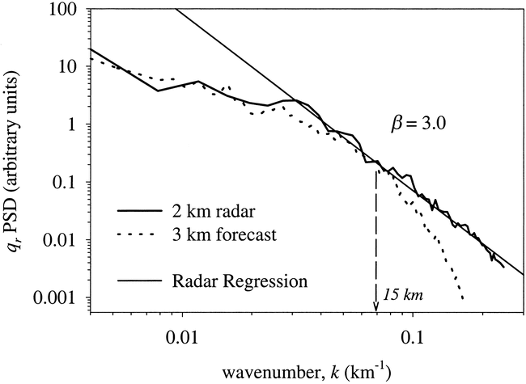
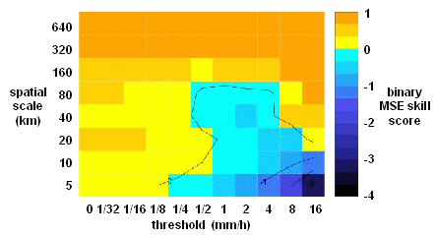
Scale separation methods
Goal:
Examine performance as a function of spatial scale
Examples:
  Power spectra
    Does it look real?
    Harris et al. (2001)
  Intensity-scale
  Casati et al. (2004)
  Multi-scale variability (Zapeda-Arce et al. 2000; Harris et al. 2001; Mittermaier 2006)
  Variogram (Marzban and Sandgathe 2009)
From Harris et al. 2001

Slide 33
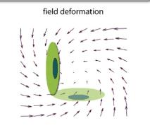
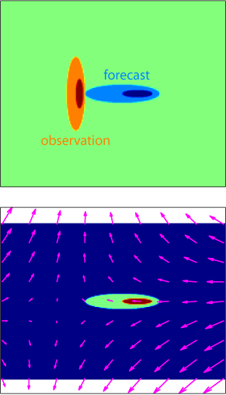
Field deformation
Goal: Examine how much a forecast field needs to be transformed in order to match the observed field
Examples:
Forecast Quality Index (Venugopal et al. 2005)
Forecast Quality Measure/Displacement Amplitude Score (Keil and Craig 2007, 2009)
Image Warping (Gilleland et al. 2009; Lindström et al. 2009; Engel 2009)
Optical Flow (Marzban et al. 2009)
From Keil and Craig 2008

Slide 34
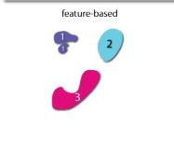
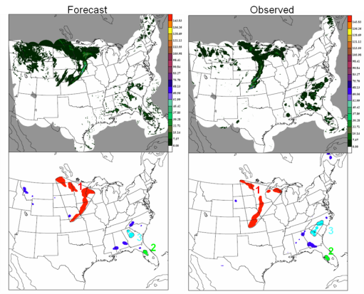
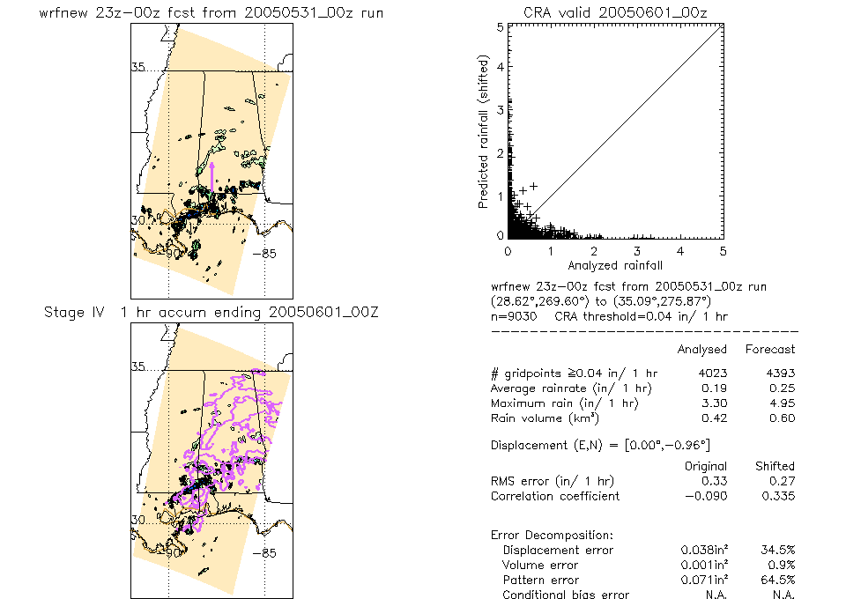
Object/Feature-based
Goals: Measure and compare (user-) relevant features in the forecast and observed fields
Examples:
Contiguous Rain Area (CRA)
Method for Object-based Diagnostic Evaluation (MODE)
Procrustes
Cluster analysis
Structure Amplitude and Location (SAL)
Composite
Gaussian mixtures
MODE example 2008
CRA: Ebert and Gallus 2009

Slide 35
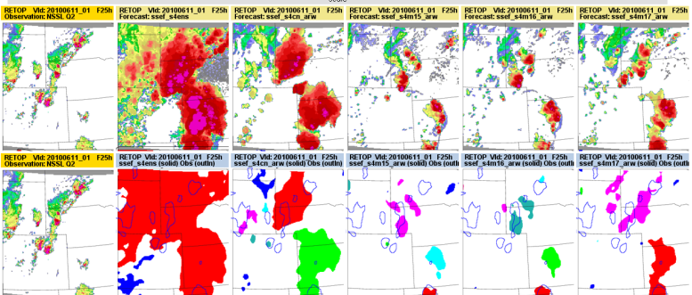
MODE application to ensembles
Observed
CAPS PM Mean
Radar Echo Tops (RETOP)
RETOP

Slide 36
Accounting for uncertainty in verification measures
Sampling
  Verification statistic is a realization of a random process.
  What if the experiment were re-run under identical conditions?
Observational
Model
  Model parameters
  Physics
  Etc…
Accounting for these other areas of uncertainty is a major research need

Slide 37
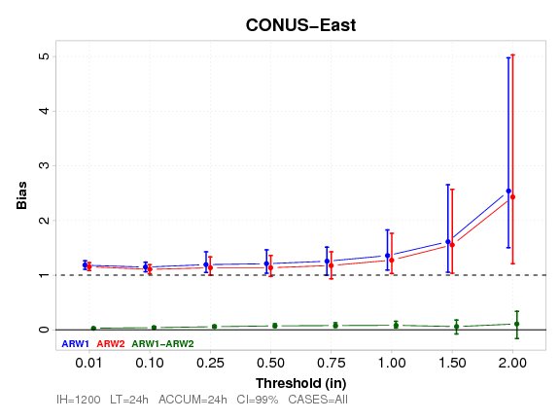
Confidence interval example (bootstrapped)
Significant differences may show up in differences but not when looking at overlap in confidence intervals
Sometimes significant differences are too small to be practical – need to consider practical significance

Slide 38
Forecast value and user-relevant metrics
Forecast Goodness
Depends on the quality of the forecast
AND
The user and his/her application of the forecast information
It would be nice to more closely connect quality measures to value measures

Slide 39
Good forecast or bad forecast?
F
O
Many verification approaches would say that this forecast has NO skill and is very inaccurate.

Slide 40
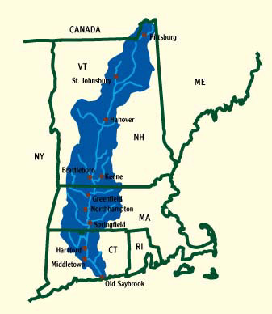
Good forecast or Bad forecast?
If I’m a water manager for this watershed, it’s a pretty bad forecast…
F
O

Slide 41
Good forecast or Bad forecast?
F
O
O
If I only care about precipitation over a larger region
Different users have different ideas about what makes a forecast good
It might be a pretty good forecast
Different verification approaches can measure different types of “goodness”

Slide 42
User value and forecast goodness
Different users need/want different kinds of information
Forecasts should be evaluated using user-relevant criteria
Goal: Build in methods that will represent needs of different users
  One measure/approach will not represent needs of all users
Examples:
  Meaningful summary measures for managers
  Intuitive metrics and graphics for forecasters
  Relevant diagnostics for forecast developers
  Connect user “values” to user-relevant metrics

Slide 43
Value Metrics Assessment Approach (Lazo)
Expert Elicitation / mental modeling
  Interviews with users
  Elicit quantitative estimates of value for improvements
Conjoint experiment
  Tradeoffs for metrics for weather forecasting
  Tradeoffs for metrics for application area (e.g., energy)
  Tie to economic value to estimate marginal value of forecast improvements w.r.t. each metric
Application of approach being initiated (in energy sector)

Slide 44
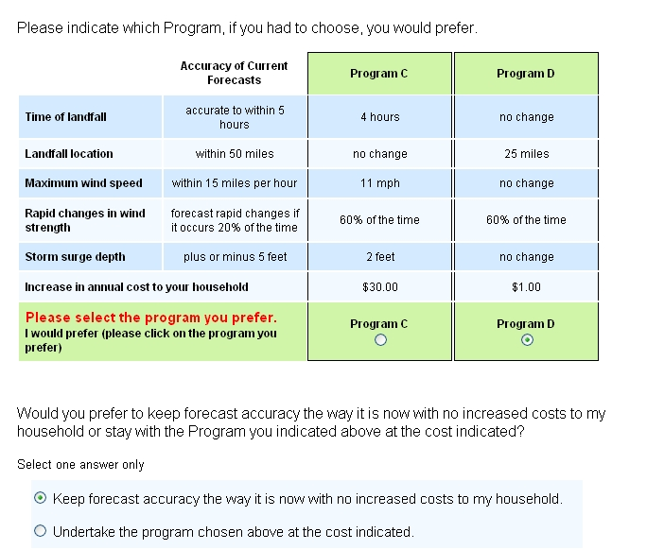
Example of a Survey Based Choice Set Question
Courtesy, Jeff Lazo

Slide 45
Concluding remarks
Testbeds provide an opportunity for facilitating the injection of new research capabilities into operational prediction systems
Independent testing and evaluation offers credible model testing
Forecast evaluation is an active area of research…
  Spatial methods
  Probabilitistic approaches
  User-relevant metrics

Slide 46
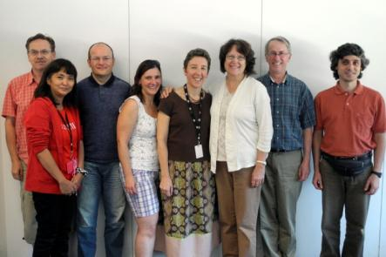

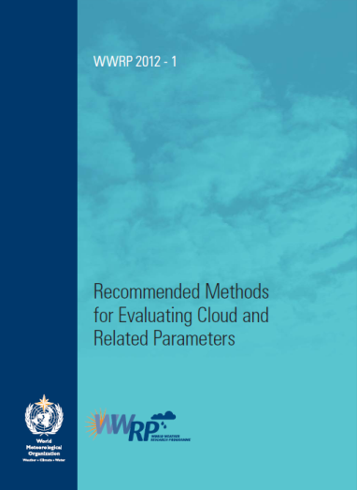
WMO Working Group on Forecast Verification Research
Working Group under the World Weather Research Program (WWRP) and Working Group on Numerical Experimentation (WGNE)
International representation
Activities:
  Verification research
  Training
  Workshops
  Publications on “best practices”: Precipitation, Clouds, Tropical Cyclones (soon)
http://www.wmo.int/pages/prog/arep/wwrp/new/Forecast_Verification.html

Slide 47
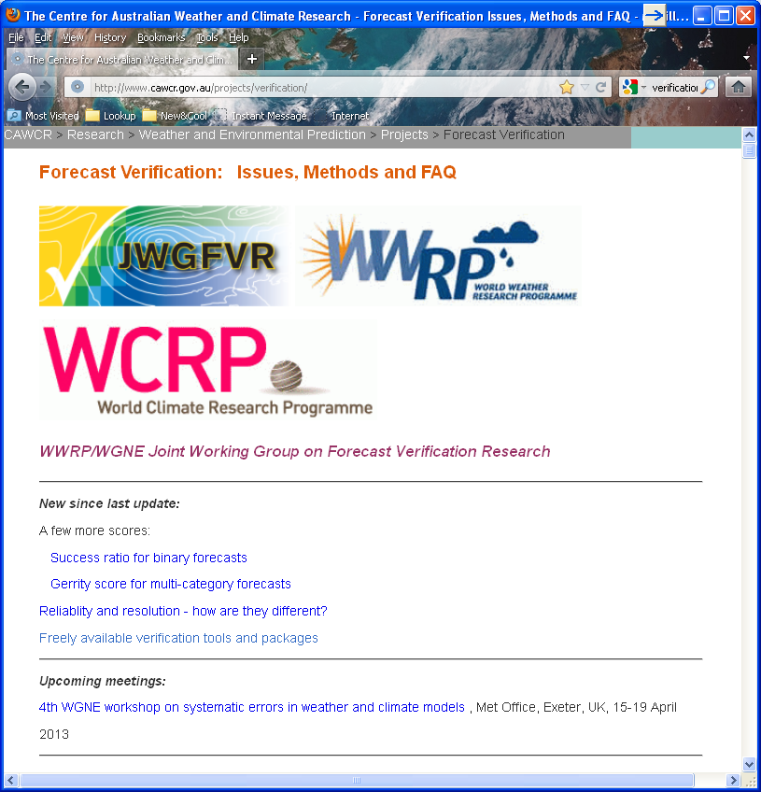
Resources: Verification methods and FAQ
Website maintained by WMO verification working group (JWGFVR)
Includes
  Issues
  Methods (brief definitions)
  FAQs
  Links and references
Verification discussion group:
http://mail.rap.ucar.edu/mailman/listinfo/vx-discuss
http://www.cawcr.gov.au/projects/verification/

Slide 48


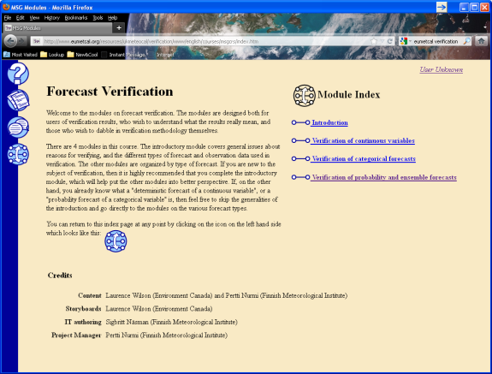
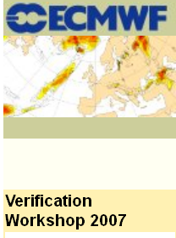
Resources
WMO Tutorials (3rd, 4th, 5th workshops)
  Presentations available
EUMETCAL tutorial
  Hands-on tutorial
http://cawcr.gov.au/events/verif2011/
http://www.space.fmi.fi/Verification2009/
3rd workshop:
http://www.ecmwf.int/
newsevents/meetings/
workshops/2007/jwgv/
general_info/index.html
http://www.eumetcal.org/-Eumetcal-modules-

Slide 49
Resources: Overview papers
Casati et al. 2008: Forecast verification: current status and future directions.
  Meteorological Applications, 15: 3-18.
Ebert et al. 2013: Progress and challenges in forecast verification
  Meteorological Applications, submitted (available from E. Ebert or B. Brown)
Papers summarizing outcomes and discussions from 3rd and 5th International Workshop on Verification Methods

Slide 50


Resources - Books
Jolliffe and Stephenson (2012): Forecast Verification: a practitioner’s guide, Wiley & Sons, 240 pp.
Stanski, Burrows, Wilson (1989) Survey of Common Verification Methods in Meteorology (available at http://www.cawcr.gov.au/projects/verification/)
Wilks (2011): Statistical Methods in Atmospheric Science, Academic press. (Updated chapter on Forecast Verification)

Slide 51
Thank you!

Slide 52
Extra slides

Slide 53
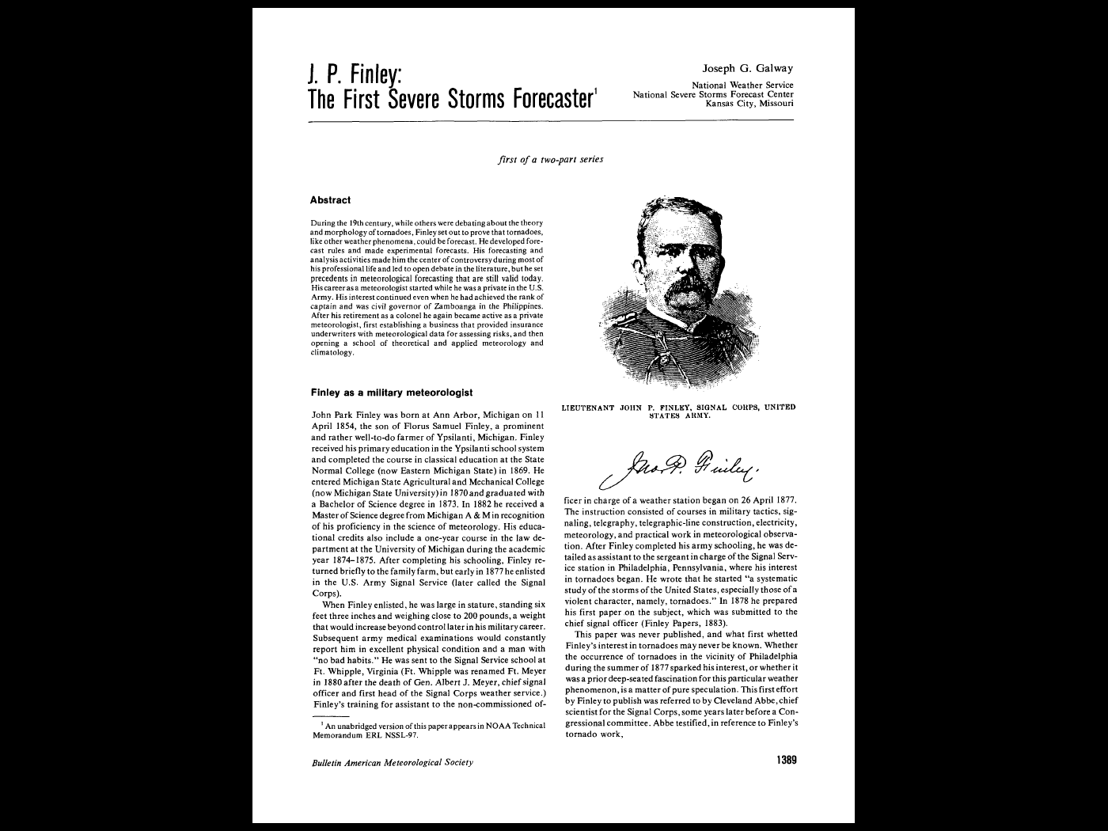
Finley Tornado
Data (1884)
Forecast focused on the question:
Will there be a tornado?
Observation answered the question:
Did a tornado occur?
YES
NO
YES
NO
Answers fall into 1 of 2 categories  Forecasts and Obs are Binary

Slide 54
A Success?
Percent Correct = (28+2680)/2803 = 96.6% !

Slide 55
What if forecaster never forecasted a tornado?
Percent Correct = (0+2752)/2803 = 98.2%
See Murphy 1996 (Weather and Forecasting)

Slide 56
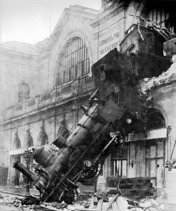
Extreme weather
Typical focus on high-impact weather – heavy precip, strong wind, low visibility, high reflectivity, etc.
“Extreme” weather often implies “Rare” or infrequent event – i.e., small samples
  Infrequent events (low “base rate”) often require special statistical treatment...
Maybe difficult to observe
Gare Montparnasse, 1895

Slide 57
Methods for evaluating extremes
Typical approach: Standard contingency table statistics
  Some measures actually developed with extremes in mind… (e.g., CSI)
Stephenson:
  All of the standard measures are “degenerate” for large values…
    That is, they tend to a meaningless number (e.g., 0) as the base rate (climatology) gets small – as the event becomes more extreme
    Result: It looks like forecasting extremes is impossible

Slide 58
New measures for extremes
“Extreme dependency scores” developed starting in 2008 by Stephenson, Ferro, Hogan, and others
Based on asymptotic behavior of score with decreasing base rate
All based on contingency table counts
Catalog of measures
  EDS – Extreme Dependency score
    Found to be subject to hedging (over-forecasting)
  SEDS – Symmetric EDS
    Dependent on base rate
  SEDI – Symmetric Extremal Dependency Index
    Closer to a good score
    Being used in practice in some places
(See Chapter 3 in Jolliffe and Stephenson 2012; Ferro and Stephenson 2011; Weather and Forecasting)

Slide 59
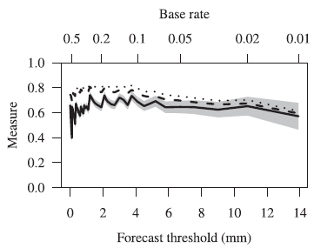
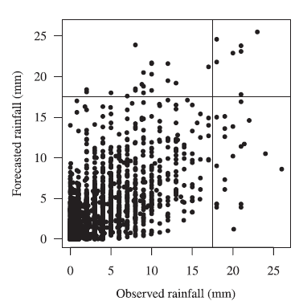
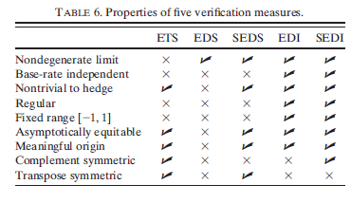
EDS Example
SEDI
EDI
EDS
6-h rainfall (Eskdalemuir)
From Ferro and Stephenson 2011 (Wx and Forecasting)

