Slide 1
Antarctic Ozone “Hole” Review
2012
Craig S. Long¹
Larry Flynn², Bryan Johnson³
NOAA
1-NWS/NCEP/Climate Prediction Center
2-NESDIS/STAR/Satellite Meteorology & Climatology Division
3-OAR/ESRL/Global Monitoring Division

Slide 2
Outline
Quick ozone review
  Ozone generation cycle
  Ozone depletion cycles
Ozone recovery expectations
NOAA-centric perspective
2012 ozone “hole” in context of 32 previous years
  Various ways to monitor and measure ozone “hole”
Meteorological conditions accountable for 2012 ozone size and longevity

Slide 3
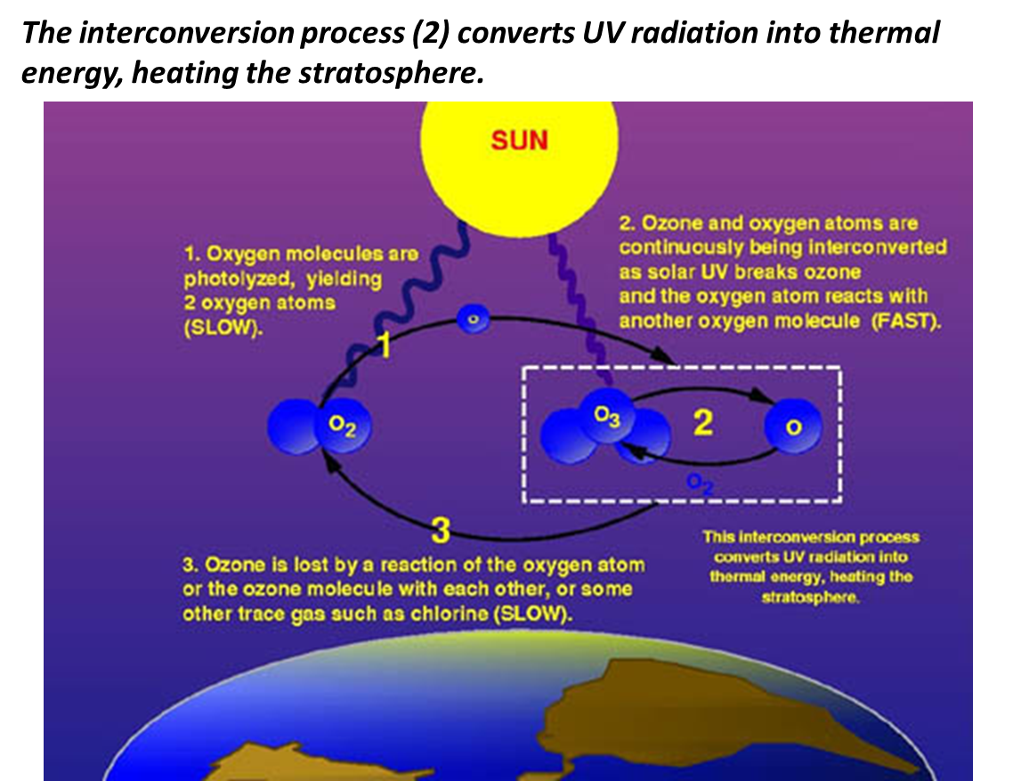
Ozone “Life” Cycle

Slide 4
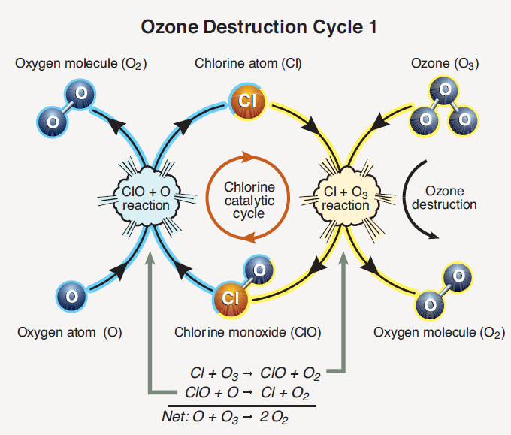
Ozone Destruction Cycle
From 2010 Ozone Assessment

Slide 5
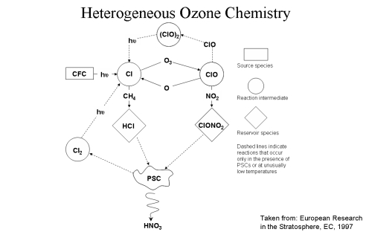
Reservoir molecules
DeNitrification
Activation

Slide 6
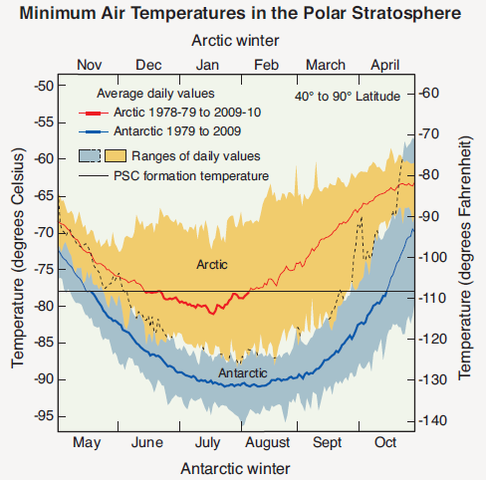
Why Ozone Holes form over Antarctica and Not the Arctic
From 2010 Ozone Assessment

Slide 7
Ozone Recovery Protocols
From 2010 Ozone Assessment

Slide 8
Ozone Recovery Expectations
From 2010 Ozone Assessment

Slide 9
Ozone Recovery Expectations
From 2010 Ozone Assessment

Slide 10
2012 Antarctic Ozone “Hole”
Ozone “Hole” definition:
  Area in which total column ozone is less than 240 DU
Satellite Perspective
South Pole Perspective

Slide 11

Suomi-NPP OMPS Total Ozone

Slide 12
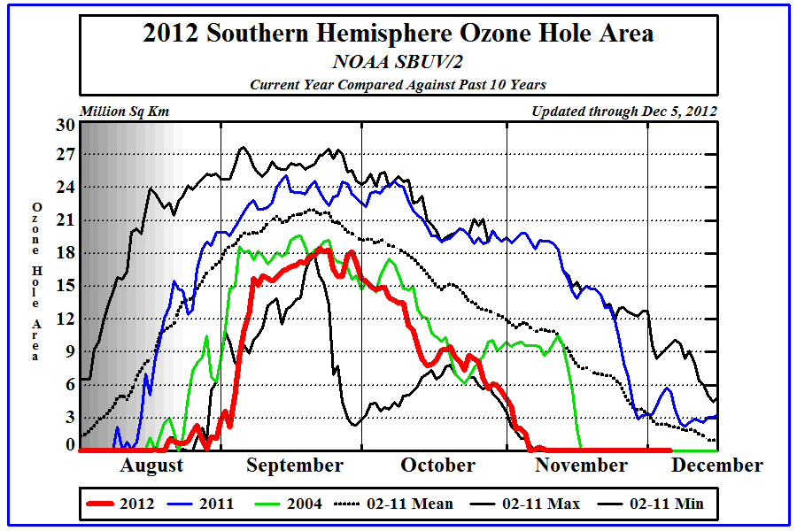
Ozone “Hole” Time Series

Slide 13
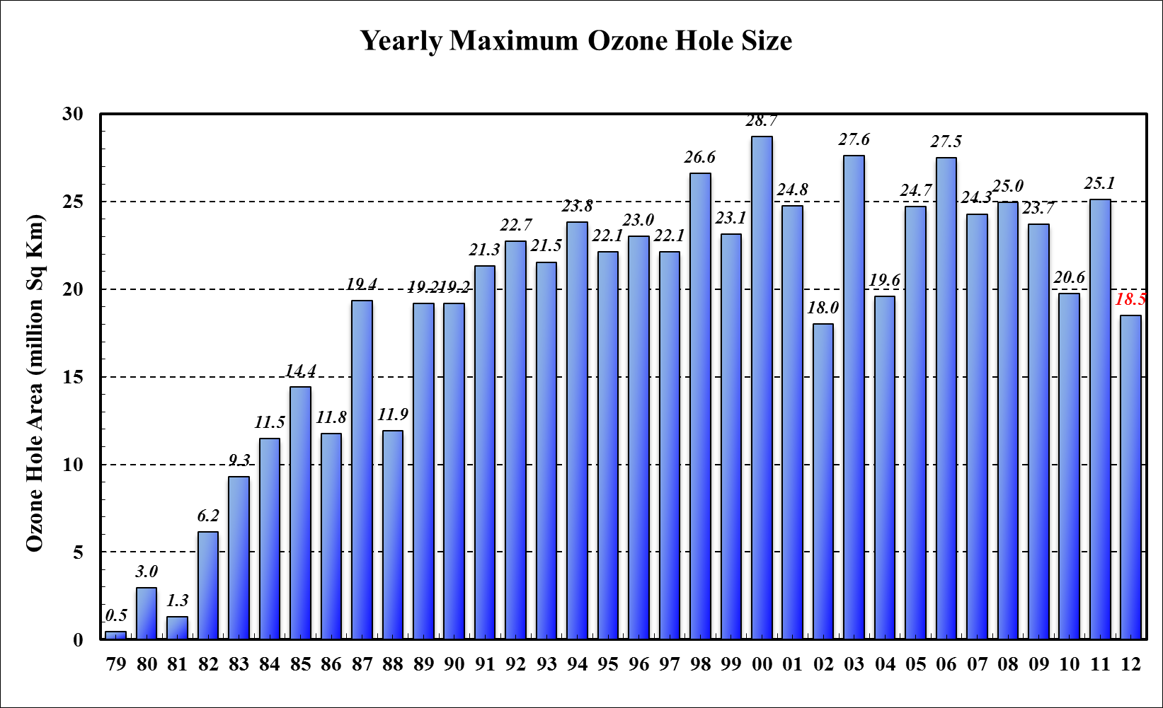
Ozone “Hole” Annual Maximum Size

Slide 14
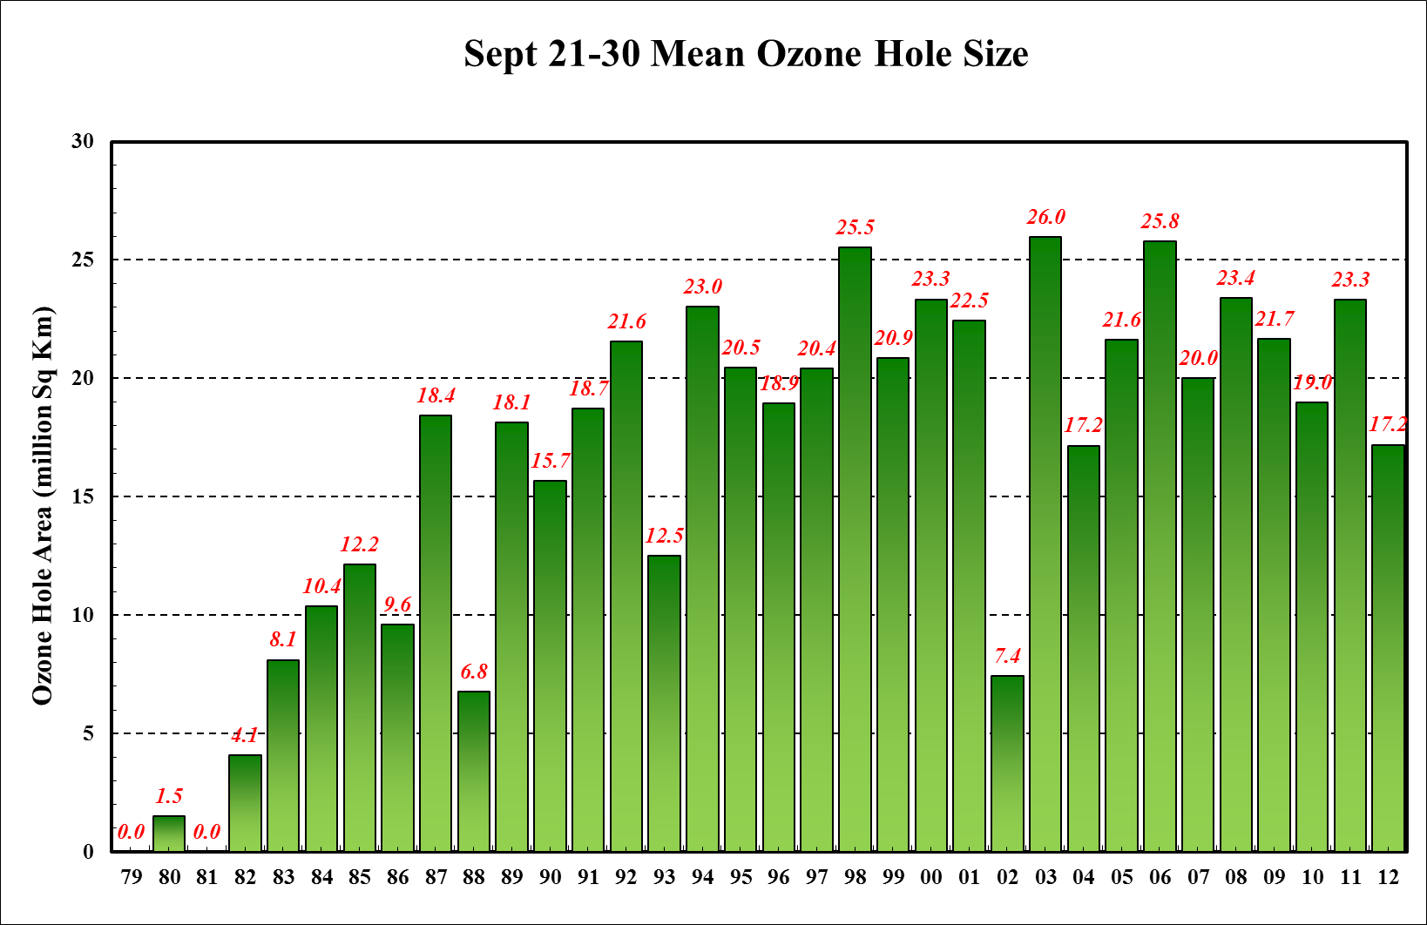
Ozone “Hole” Annual Mean Size Late Sept

Slide 15
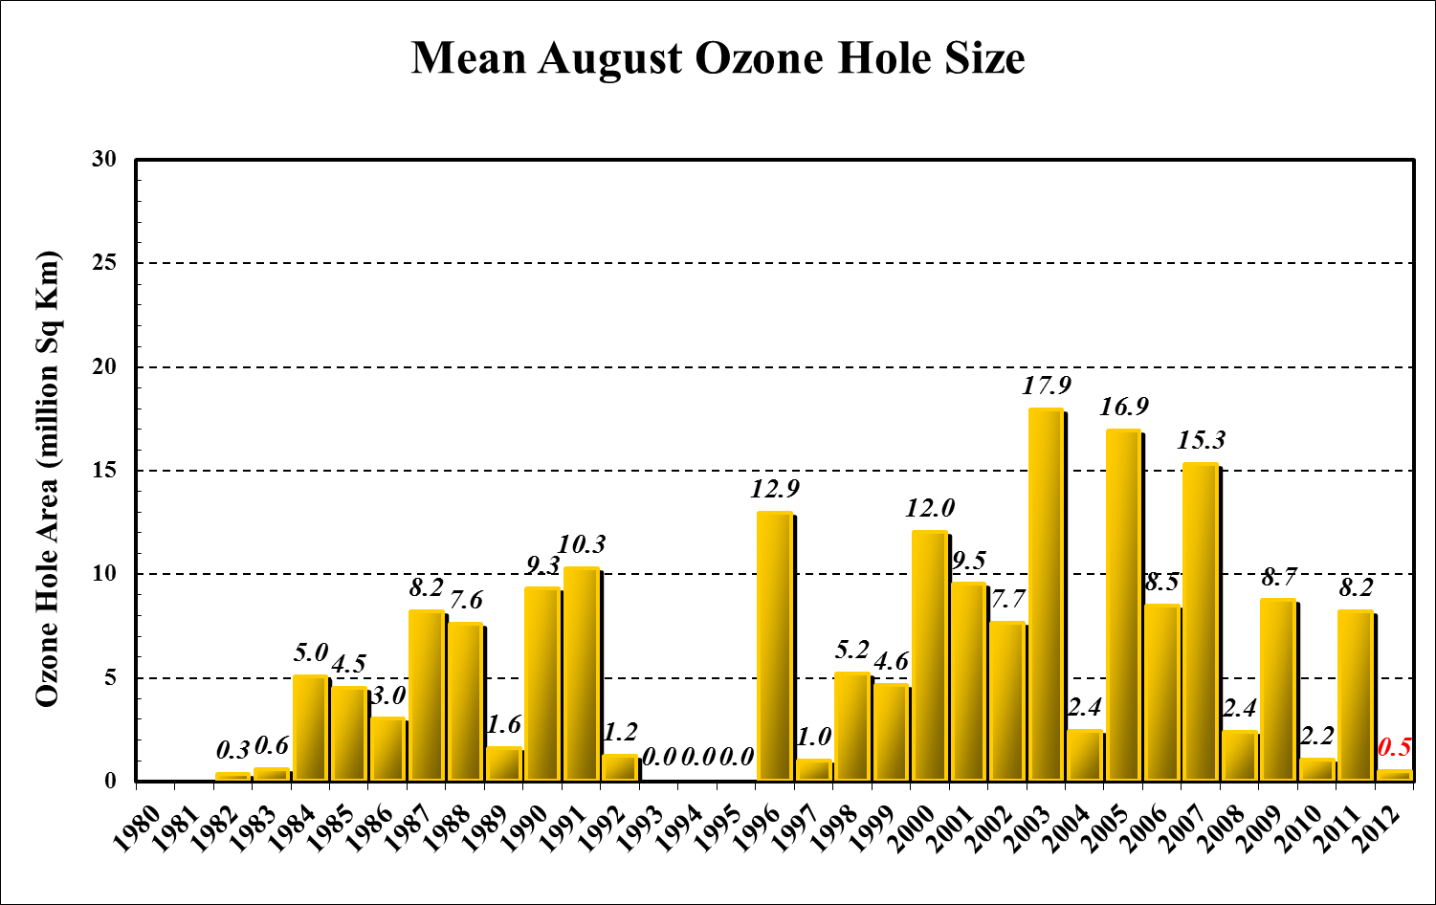
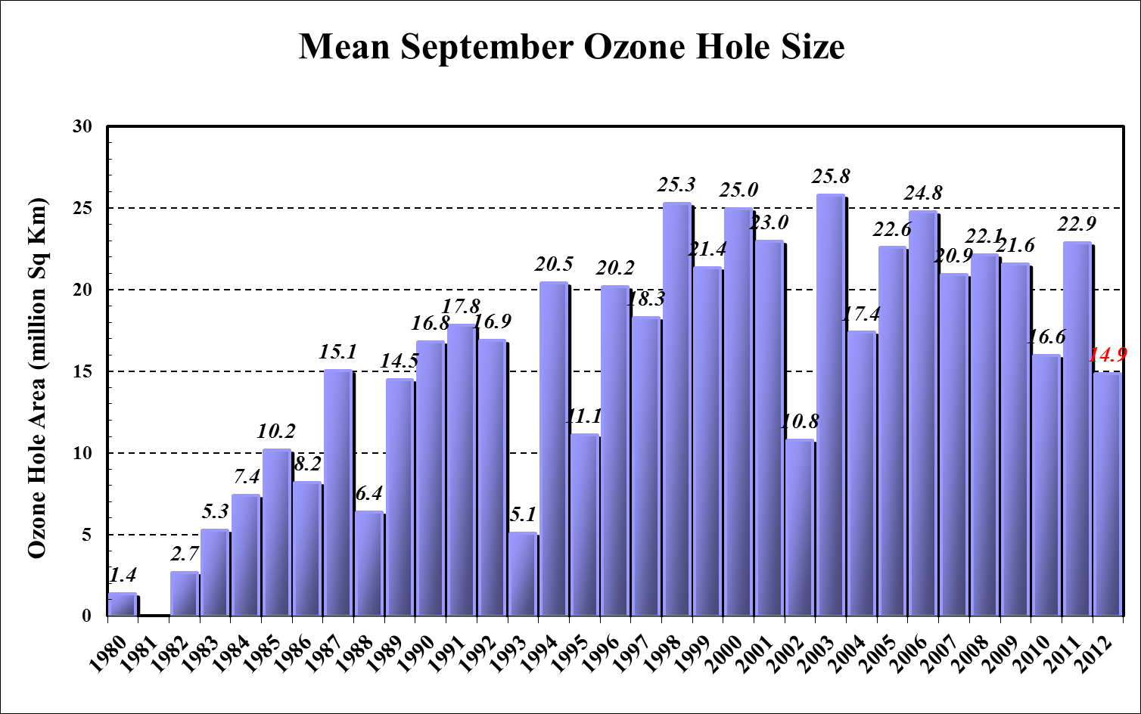
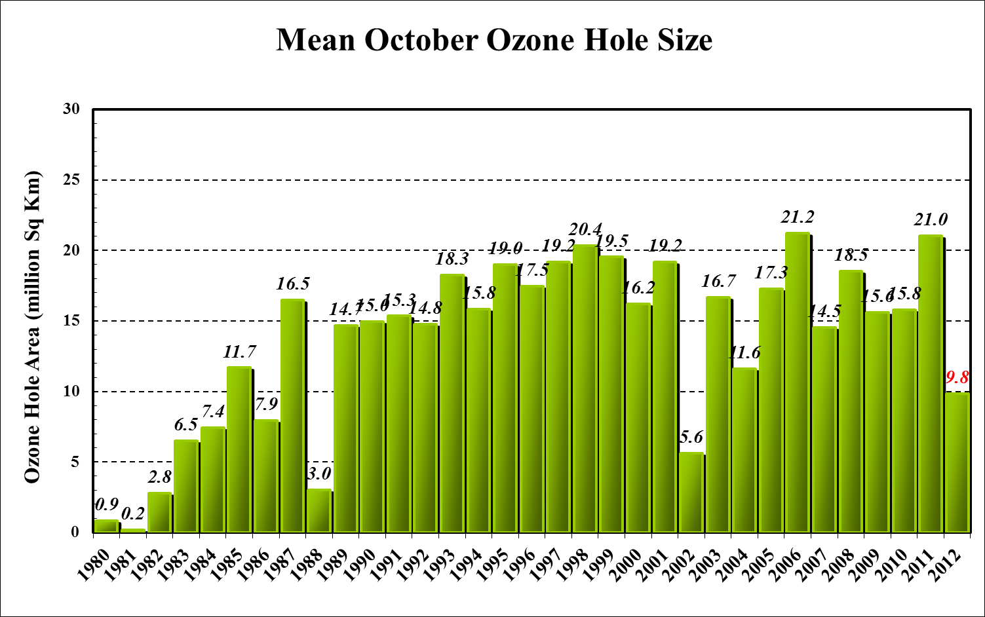
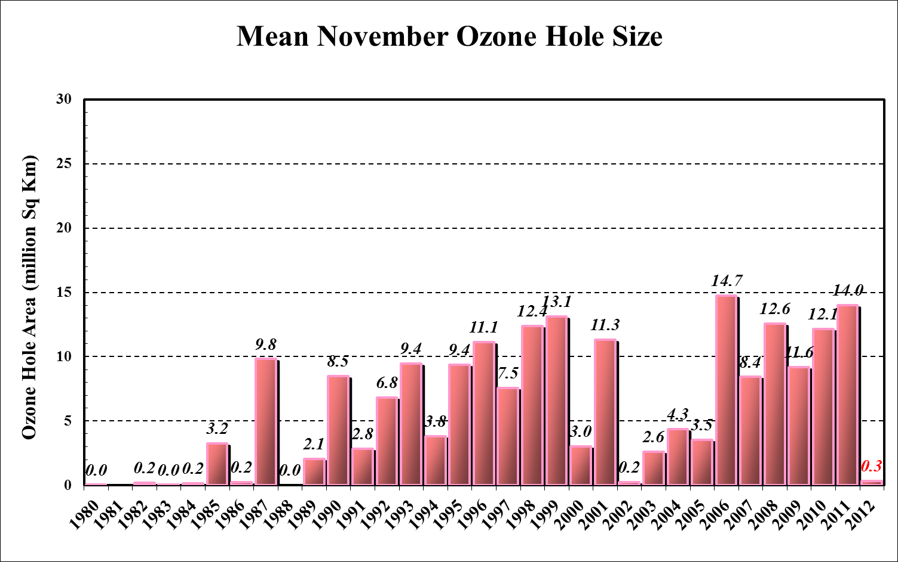
Ozone “Hole” Monthly Mean

Slide 16
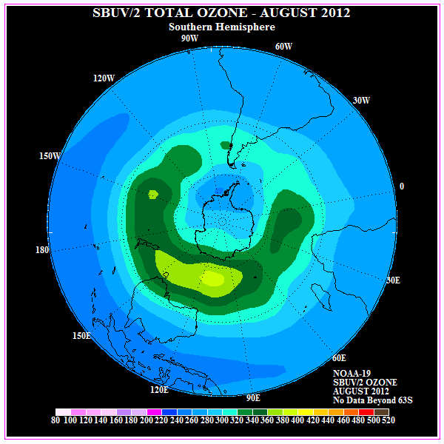
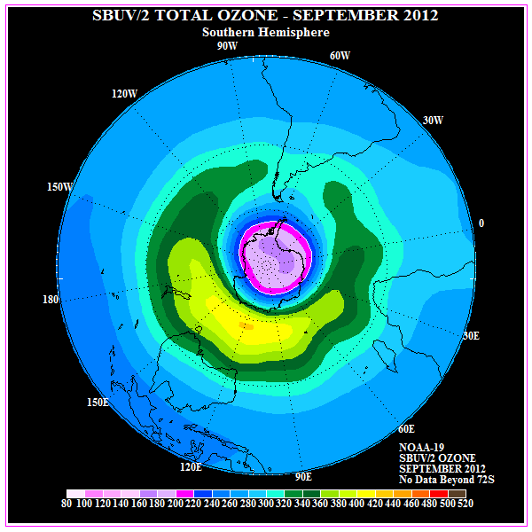
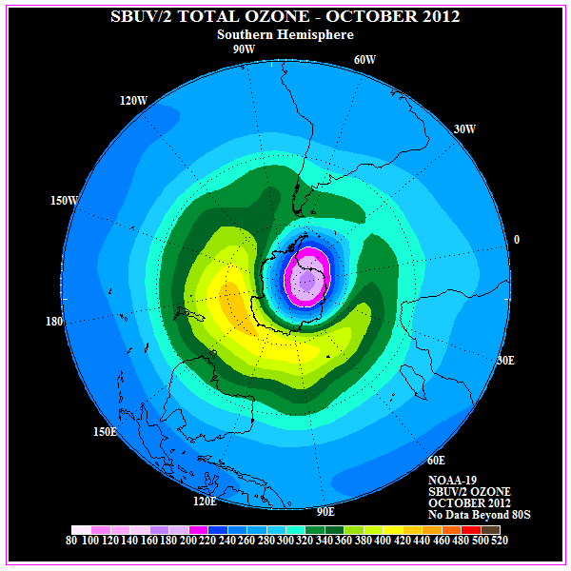
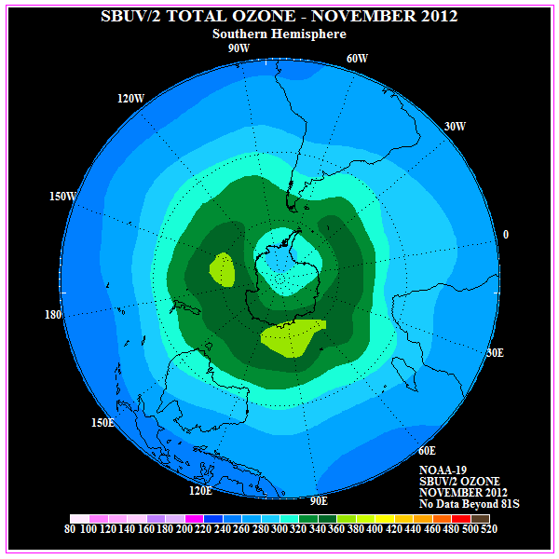
Monthly Mean Ozone Analysis

Slide 17
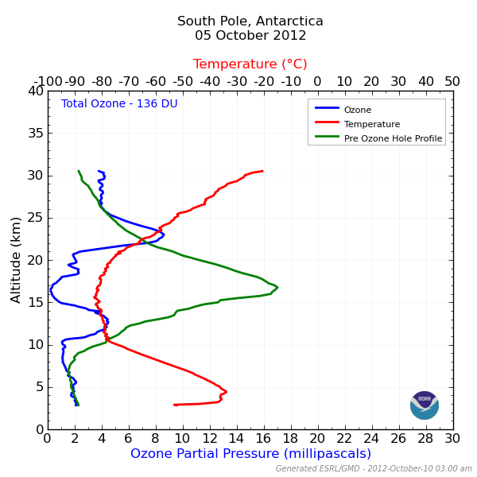
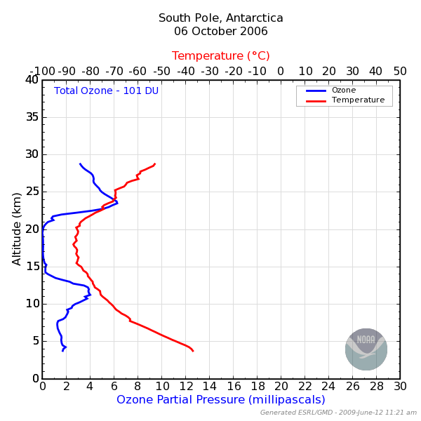
South Pole Ozonesonde Measurements

Slide 18
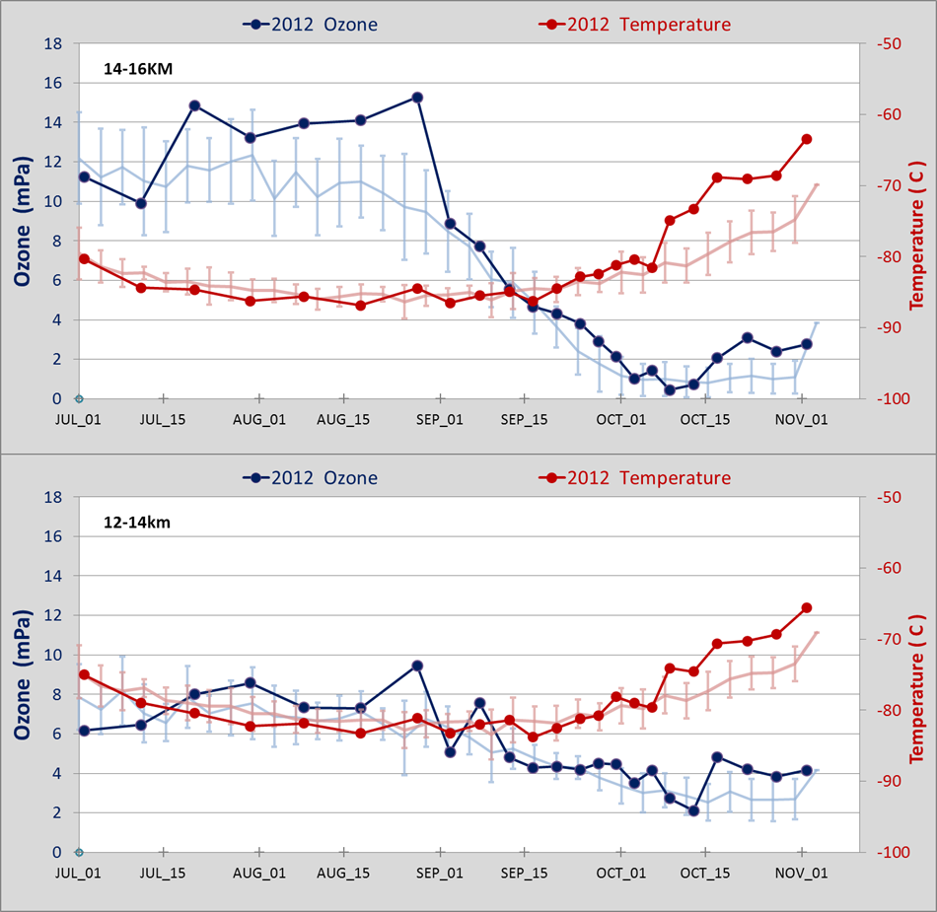
South Pole Ozonesonde Measurements

Slide 19
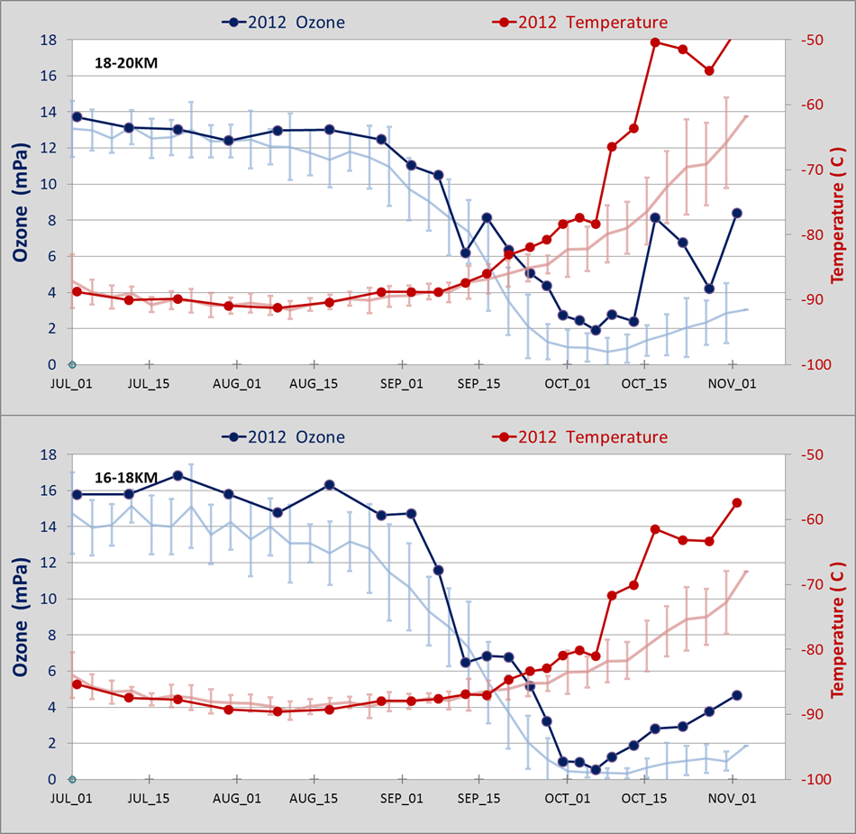
South Pole Ozonesonde Measurements

Slide 20
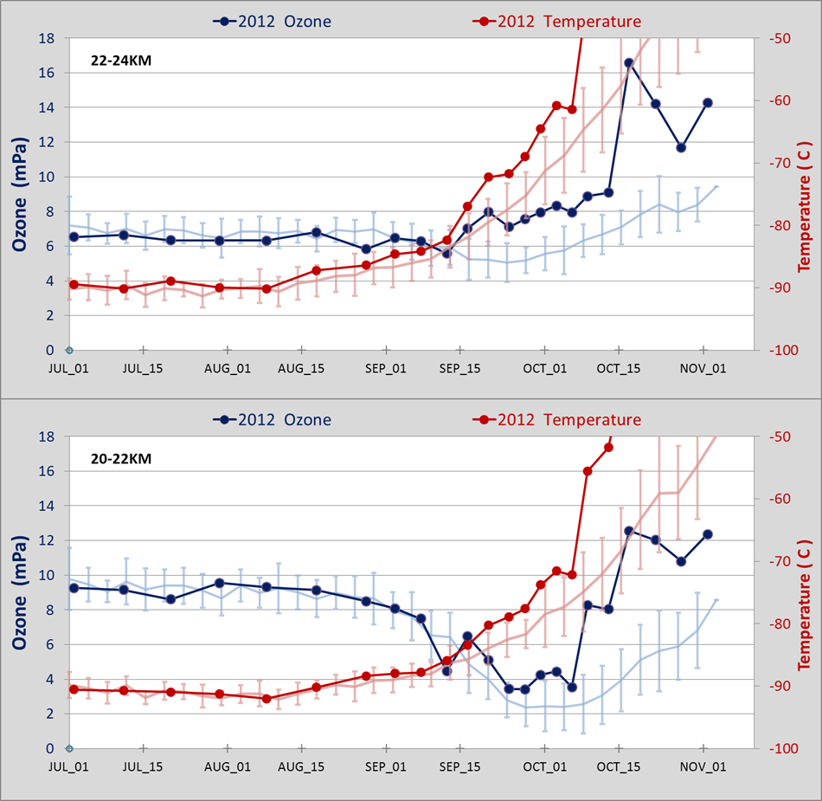
South Pole Ozonesonde Measurements

Slide 21
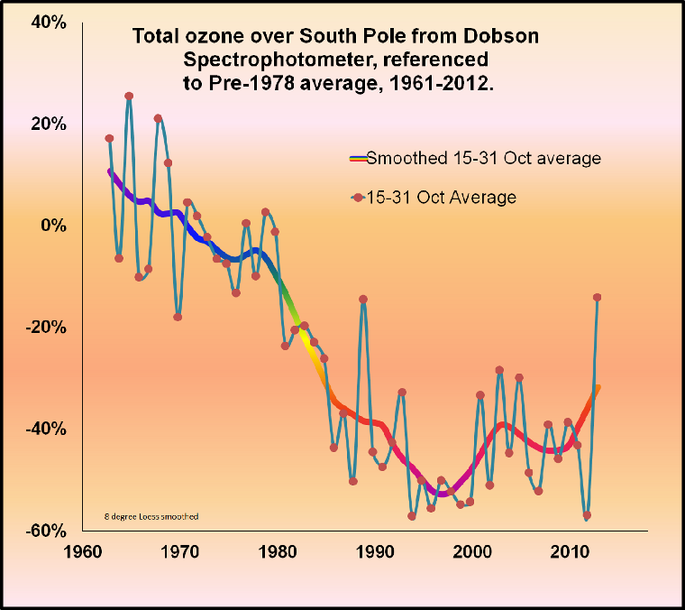
South Pole Spectrophotometer Measurements
Late October

Slide 22
Meteorological Conditions
PSC Area
  Defines the potential size of ozone depleted air
Vortex Area
  Separates cold/ozone depleted polar air from ozone rich warmer mid-latitude air
  Defines longevity of ozone hole
What modulates these:
  Wave activity and heat flux from mid-latitudes

Slide 23
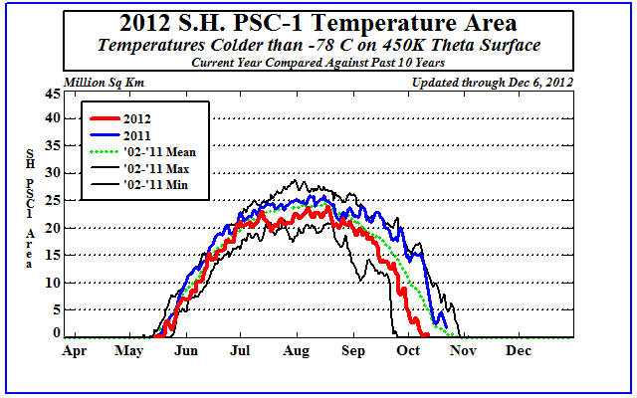
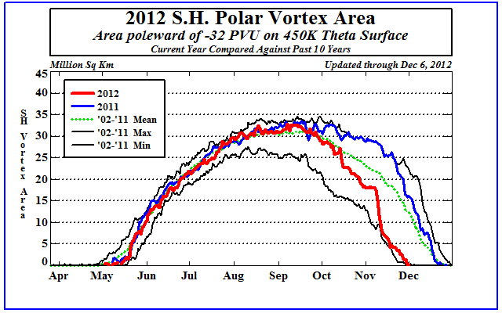
Area of PSC Temps and Polar Vortex

Slide 24
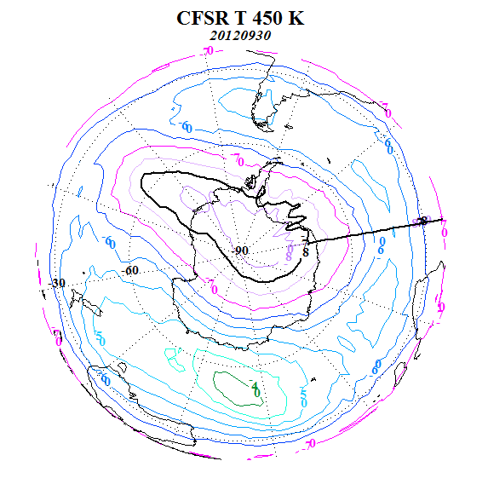
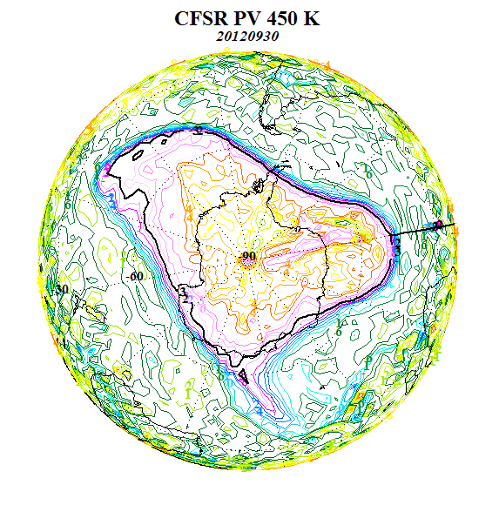
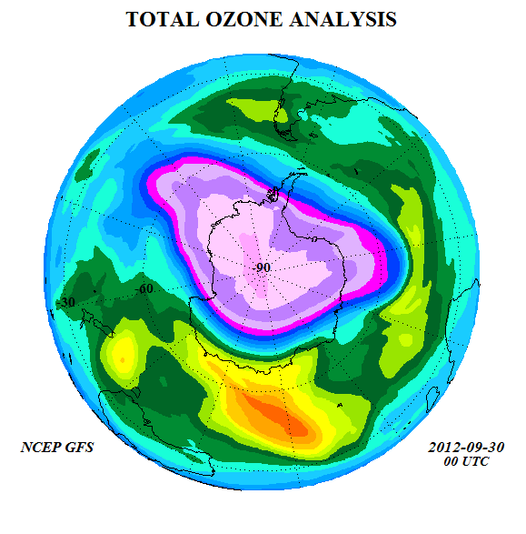
Vortex, Temperature, Ozone Relationship

Slide 25
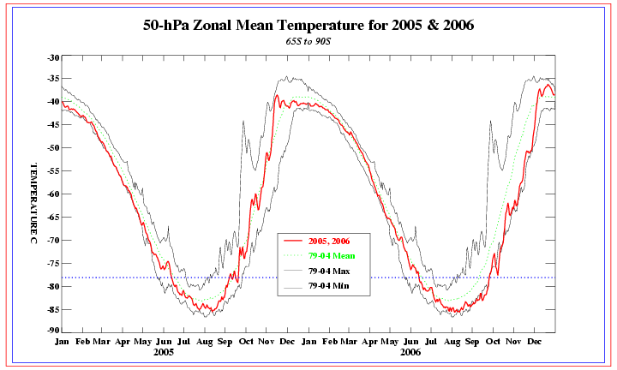
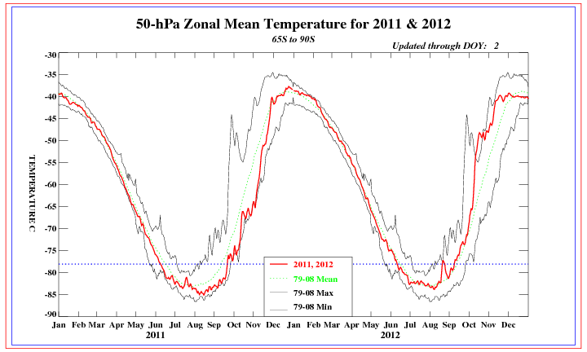
SH Polar Temperatues

Slide 26
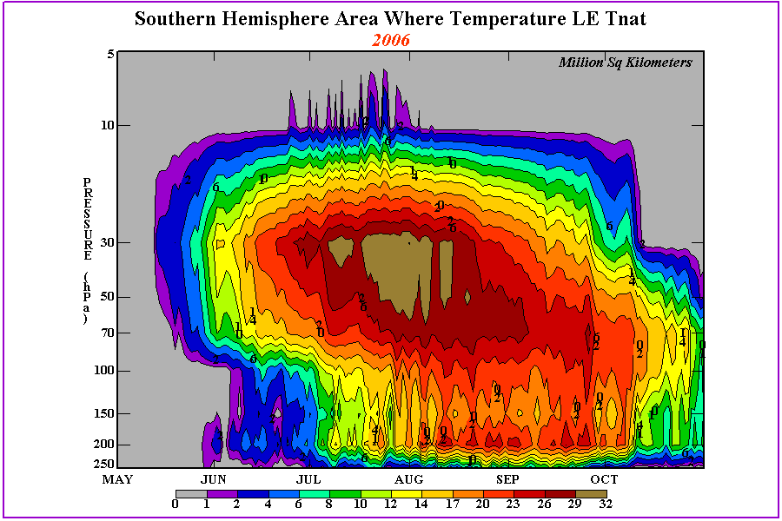
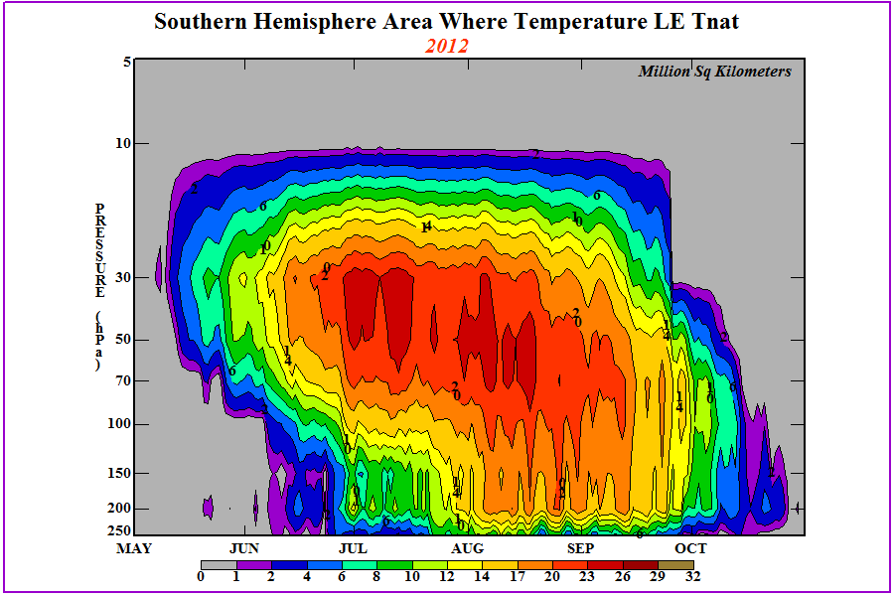
Volume of Cold Air
2006
2012

Slide 27
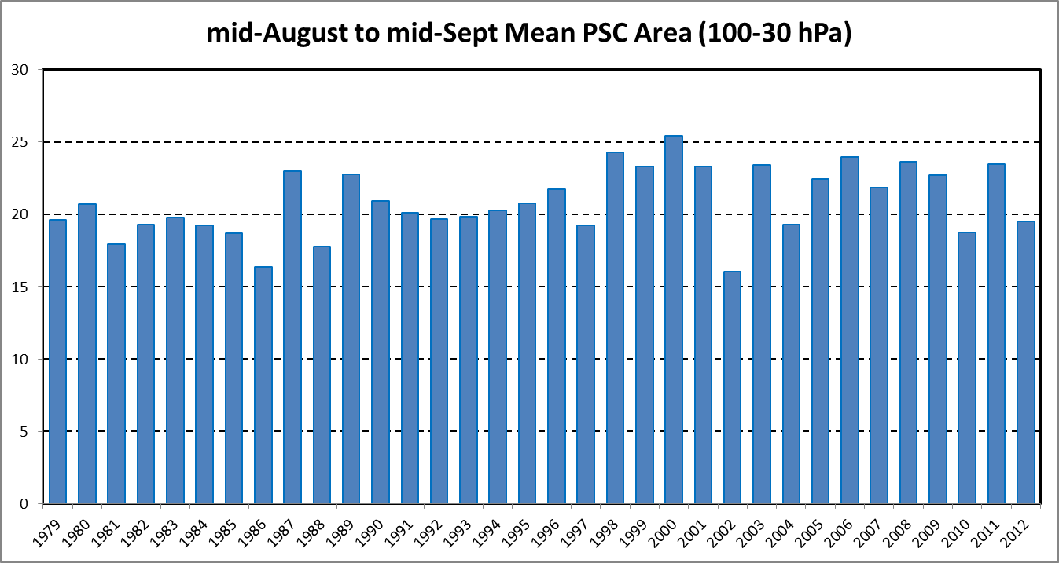
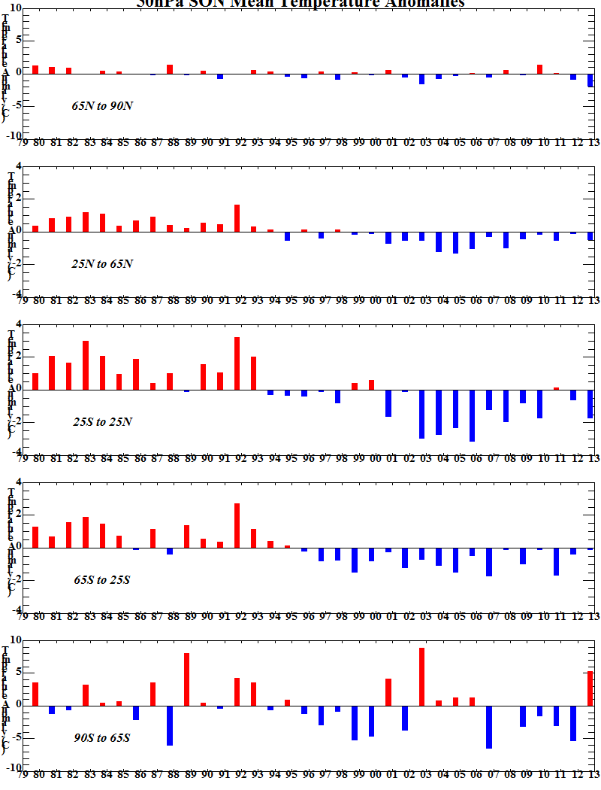
Comparison of 2012 PSC Area with Previous Years
Zonal Mean Temperature Anomaly

Slide 28
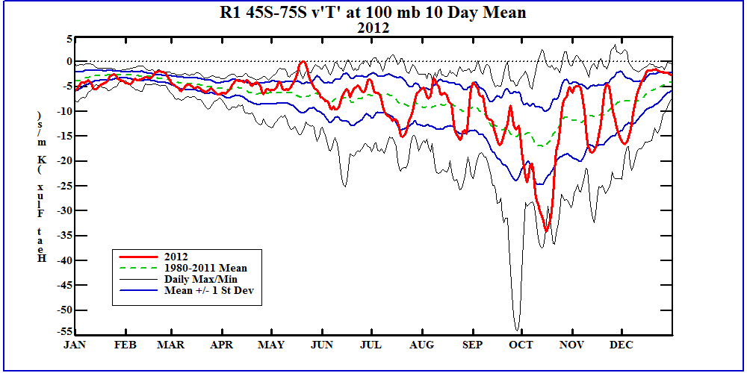
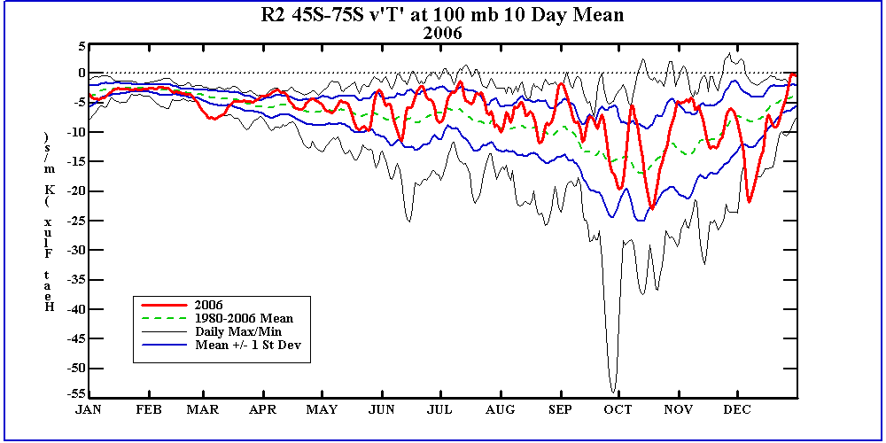
SH Poleward Heat Flux

Slide 29
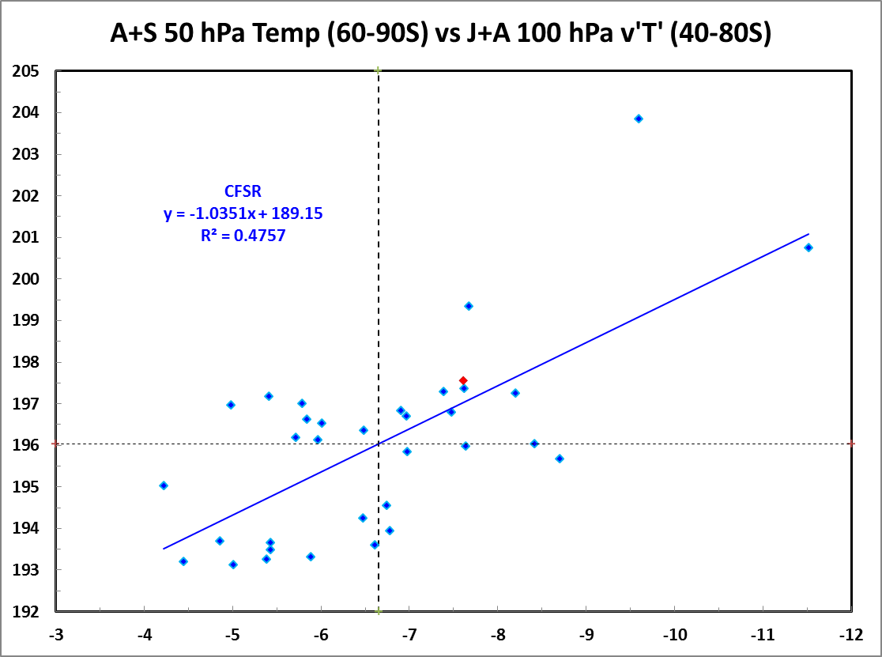
Jul/Aug 100mb Heat Flux vs Aug/Sep 50mb Temps
50 hPa Temperature
Heat Flux [v’T’] (deg m sec⁻¹)

Slide 30
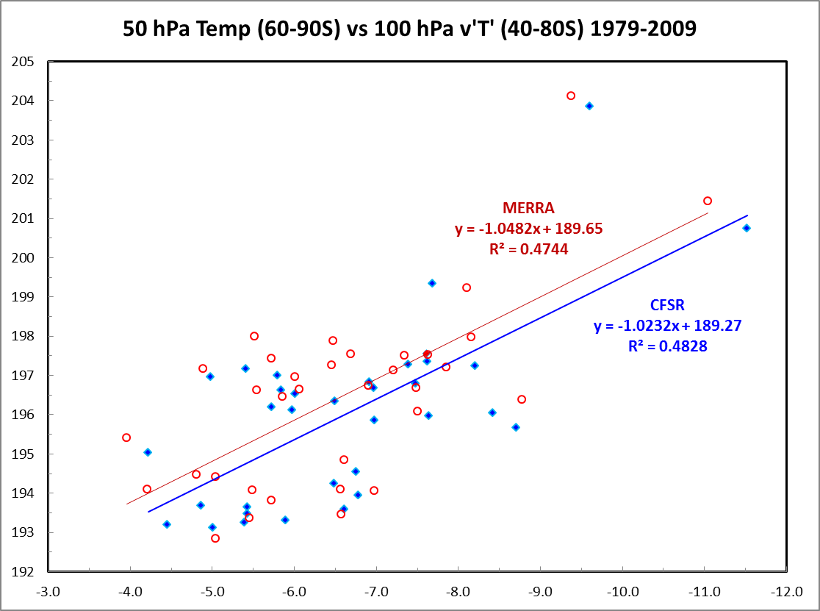
Comparison of Heat Flux/Temp Relationship between MERRA and CFSR
50 hPa Temperature
Heat Flux [v’T’] (deg m sec⁻¹)

Slide 31
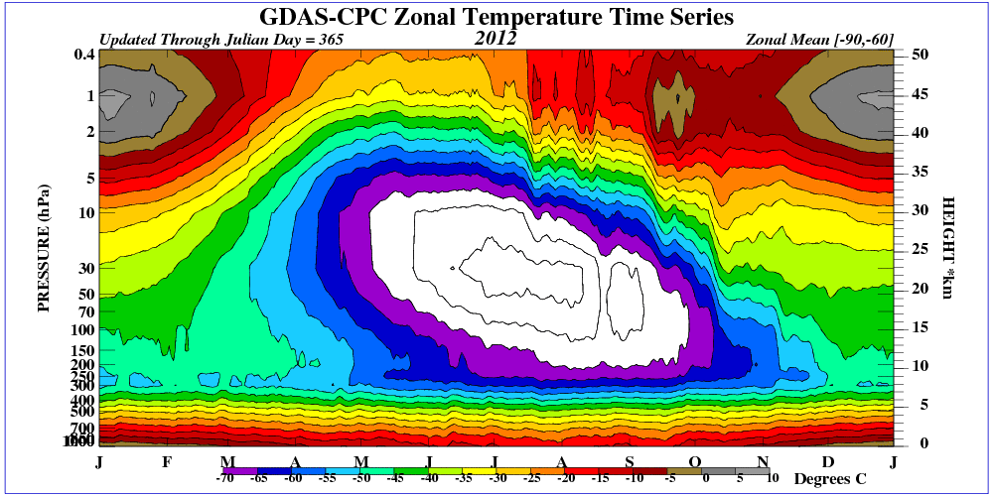
Heat Flux Impacts on Polar Temperatures
Wave 1 and 2 activity transports heat towards polar region.
Increases the temperature in the polar vortex. Shrinks the area of PSCs.

Slide 32
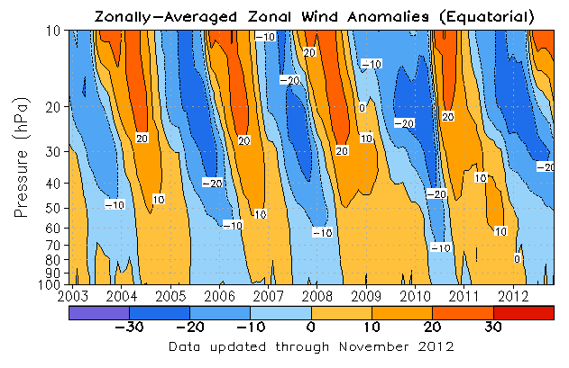
Role of QBO
Descending
easterlies

Slide 33
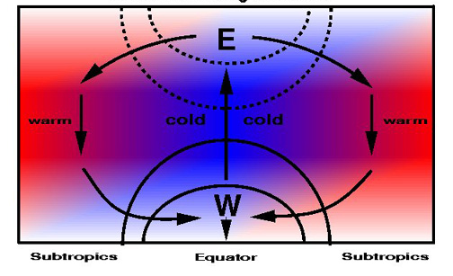
Descending Easterlies
BD Circulation Speeds Up
High Polar Ozone
Low Tropical Ozone
High Polar Ozone

Slide 34
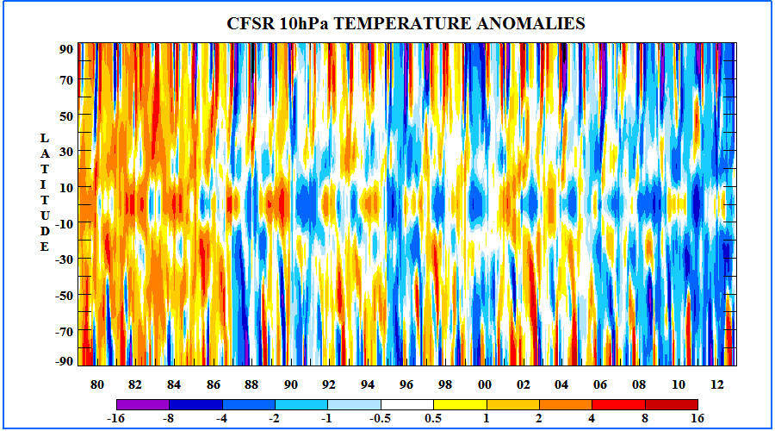
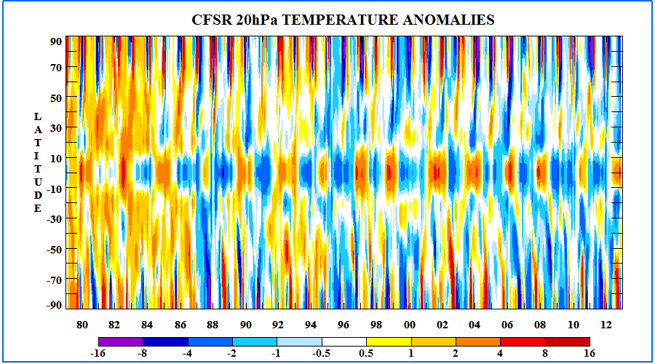
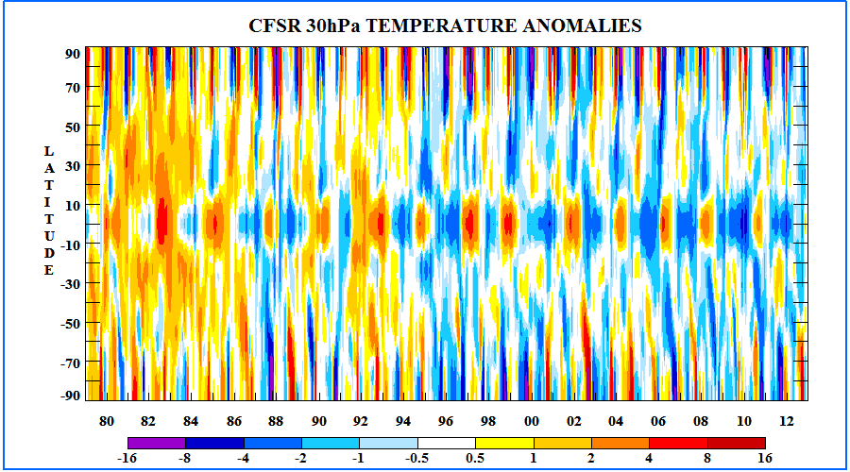
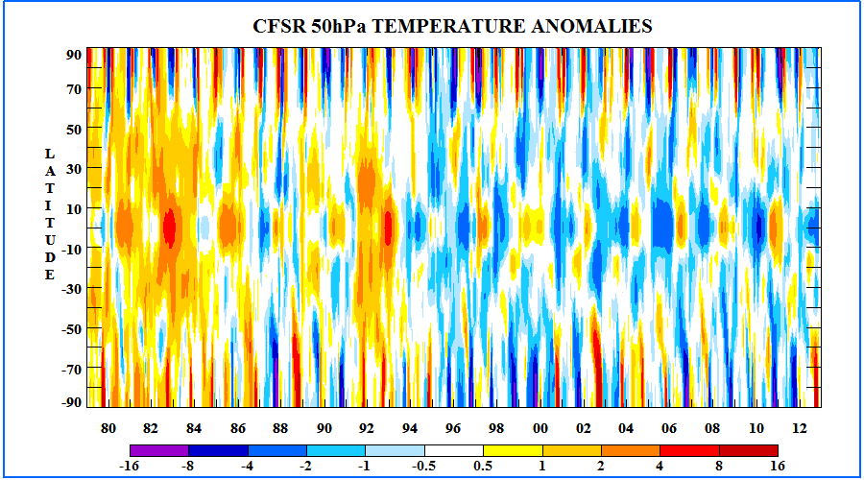
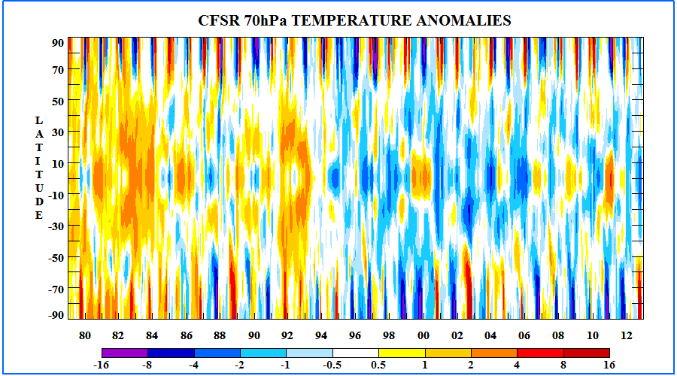
Descending cold anom

Slide 35
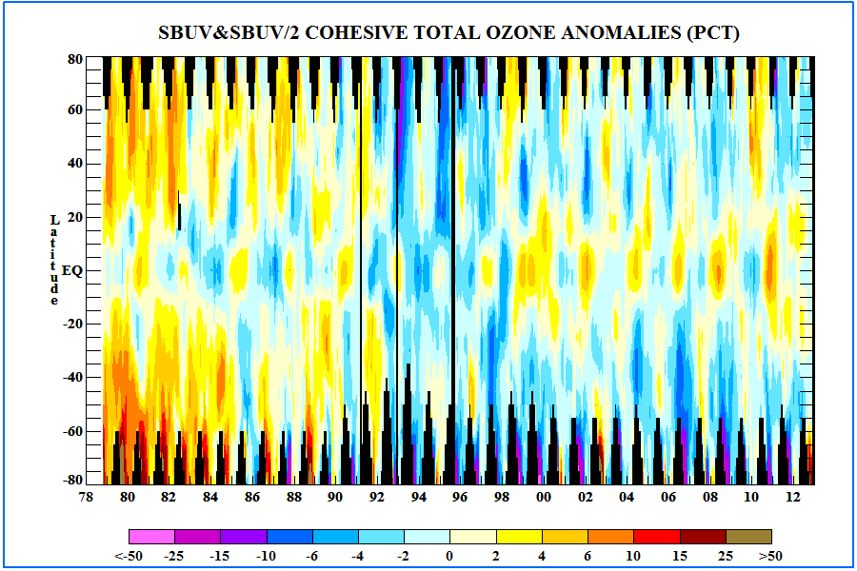
Low Ozone in Tropics

Slide 36
SP August Ozone Levels are well above mean

Slide 37
Summary
SH Polar temperatures were warm
Heat Flux activity was great
PSC area was small
Ozone Hole size is extremely small
Wave activity and temperatures don’t necessarily explain why the ozone hole size was so small.
South Pole ozonesondes imply ozone levels were well above normal.
Perhaps ozone depletion was equivalent to other years yet due to higher starting point the area below 240 DU threshold was smaller than those same years.
Strong wave activity in Oct resulted in early end of ozone hole

