Slide 1
CPC / NOAA: Satellite Rainfall Estimation and Applications for FEWS-NET
Nick Novella
CPC / NCEP /NOAA
Nicholas.Novella@noaa.gov
NOAA / FEWS / Chemonics Training Session

Slide 2
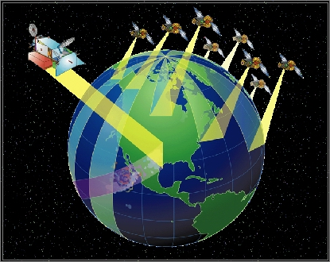
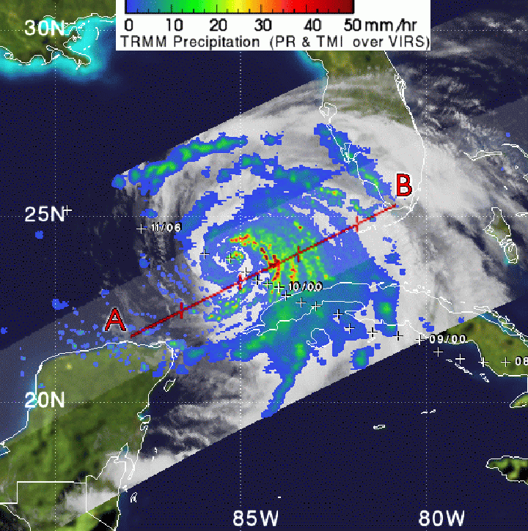
Satellite Rainfall Estimation
Purpose:
For a more complete spatial and temporal coverage for the monitoring of precipitation over the globe.
Implications:
It is germane for the monitoring of variability of weather and climate (operations & research)
Common Products within Community:
GPCP (NASA), CMAP (CPC)
TRMM (NASA)
CMORPH (CPC)
HydroEstimator (NESDIS)
TAMSAT (University of Reading, UK)
CHIRPS (USGS / UCSB)

Slide 3
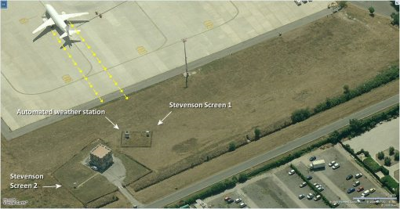
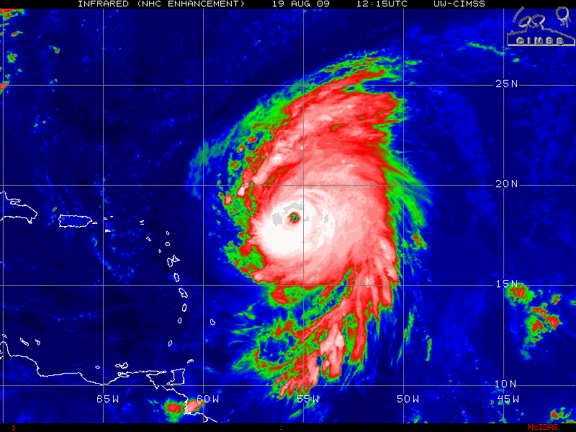
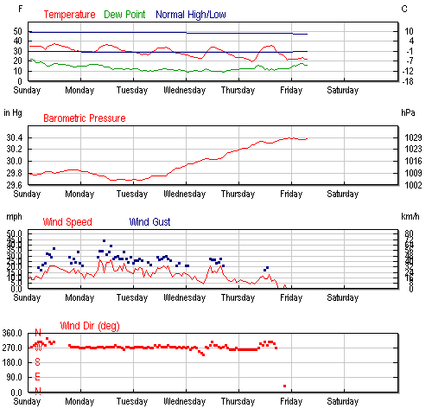
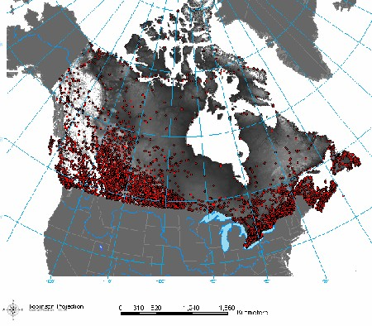
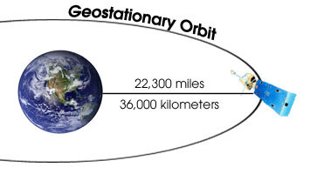
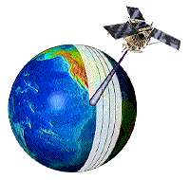
Why is remote sensing needed??
Station / gauge (in-situ) data:
Can be unreliable, inconsistent, poorly maintained.
Is subject to local quality control methods that can contribute to heterogeneity in dataset
Can not represent long-range spatial distribution of meteorological properties.
Is limited to land masses.
Understanding the behavior of precipitation is difficult ,and it differs greatly compared to other observations in meteorology
Discontinuous and Episodic (bounded quantity), and does not follow a normal distribution, except in some mean annual cycles.
Greater need for constant coverage with consistent accuracy!
Offers insight to the shape/structure of meteorological disturbances that can produce significant rainfall. This is achieved by two fundamental classes of remote sensing:
Geostationary platform
Polar Orbiting platform

Slide 4
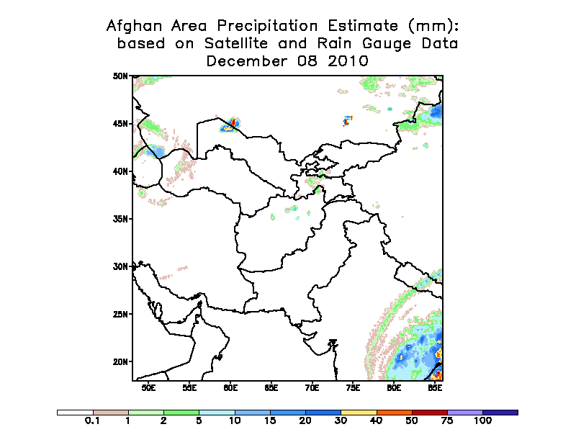
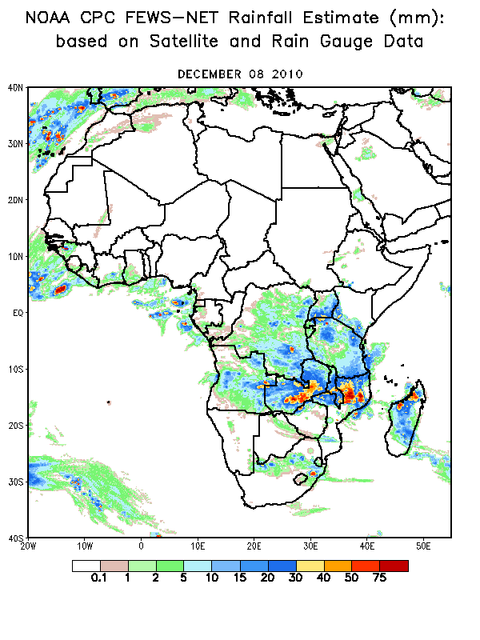
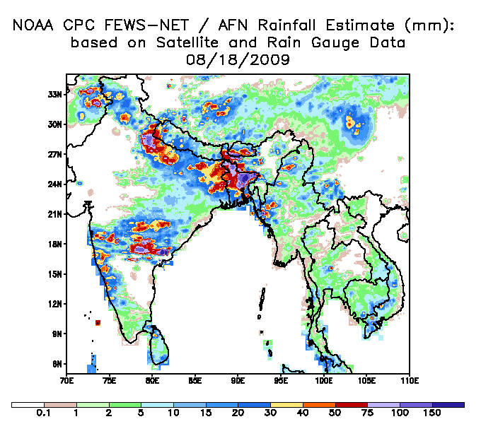
RFE : Rainfall Estimator
Inputs:
Gauge (GTS)
IR (GPI)
SSM / I (PM)
AMSU –B (PM)
Resolution:
Daily Analysis (06Z-06Z)
0.1˚ gridded spatial resolution from 40S to 40N / -20W to 55E
2001-present
Domains
Africa / SE Asia / Afghanistan

Slide 5
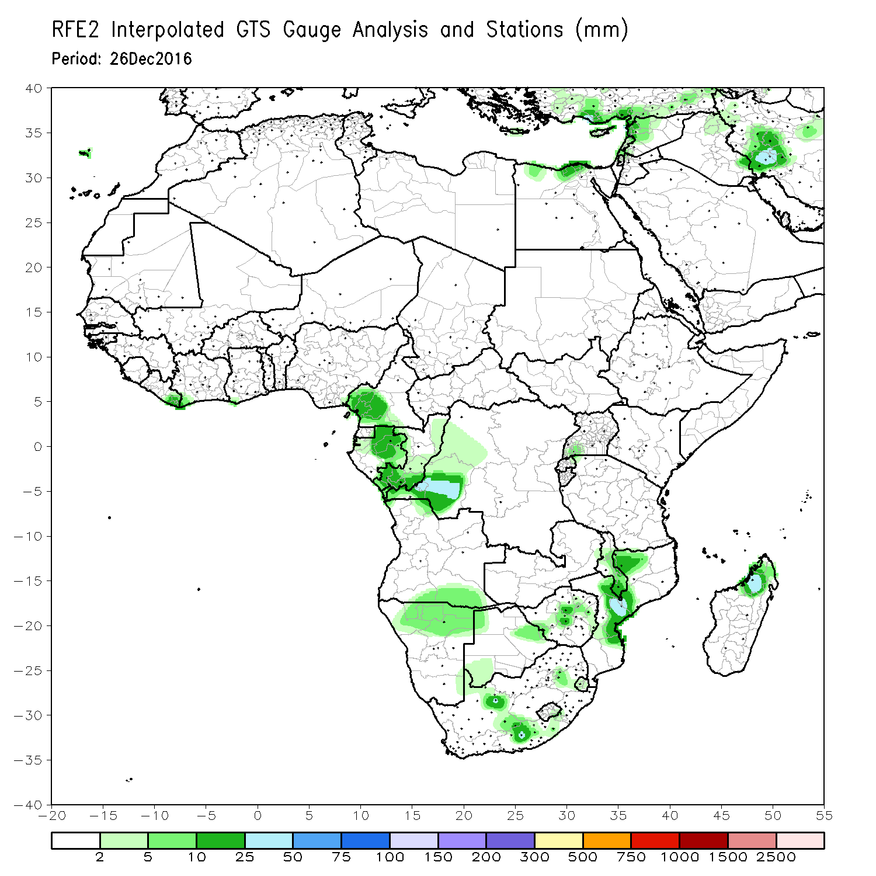
RFE Inputs: GTS
Data collected from rain gauges from a global network system of synoptic observations (GTS).
Provided by the World Meteorological Organization (WMO)
Data ingestion at CPC consists of:
Station extraction within each domain, routine QC methods, gridding via “Shepard” interpolation.
Approx. 2000 stations available for RFE
A variable number report daily (200-1000 stations) from 06Z – 06Z
Gauge data is the most accurate and “true” form of rainfall measurement, but suffers from aforementioned weaknesses...
Sparse coverage (e.g. 1 in 23,300 km² gauge to area ratio across the African continent)
Errors / bias resulting from spatial interpolation

Slide 6
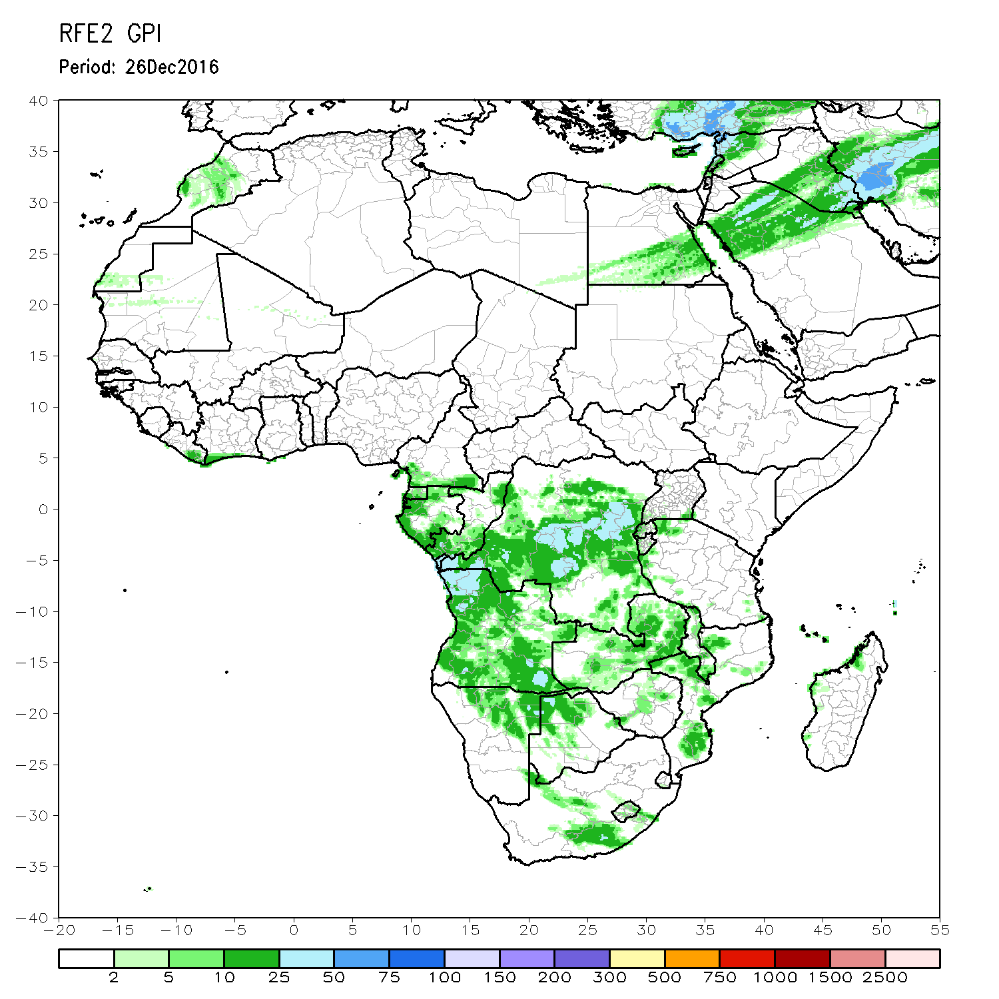
RFE Inputs: Infra-Red (GPI)
GOES Precipitation Index (GPI) based on IR temperatures from Geostationary satellites.
METEOSAT’s 2- 9 : centered at 0° Longitude
Imagery taken every ½ hour, with 48 snapshots daily
Spatial resolution of 0.05° / ~4km.
Given these attributes, GPI is the best capturer of the spatial distribution of rainfall.
Cloud Top Temperatures used as proxy to derive rainfall
Assumes monotonic relationship where rain intensity is proportional to the duration cloud top temperatures over a 24hr period.
Threshold temperature to define a cold cloud <= 235°K
Thus, the longer a cloud having temps below a threshold, the greater the rainfall
Caveats
GPI poor in mid and higher latitudes,
Underestimates rainfall from convective processes on fine scales.
Jet Streaks (cirrus)

Slide 7
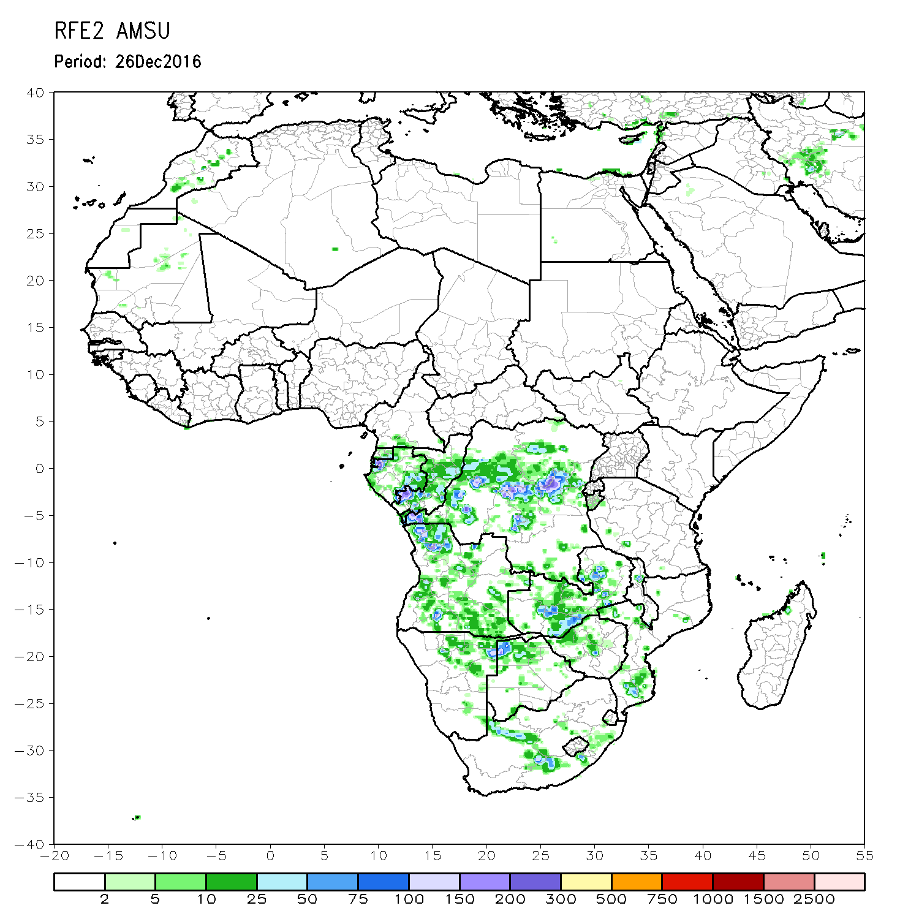
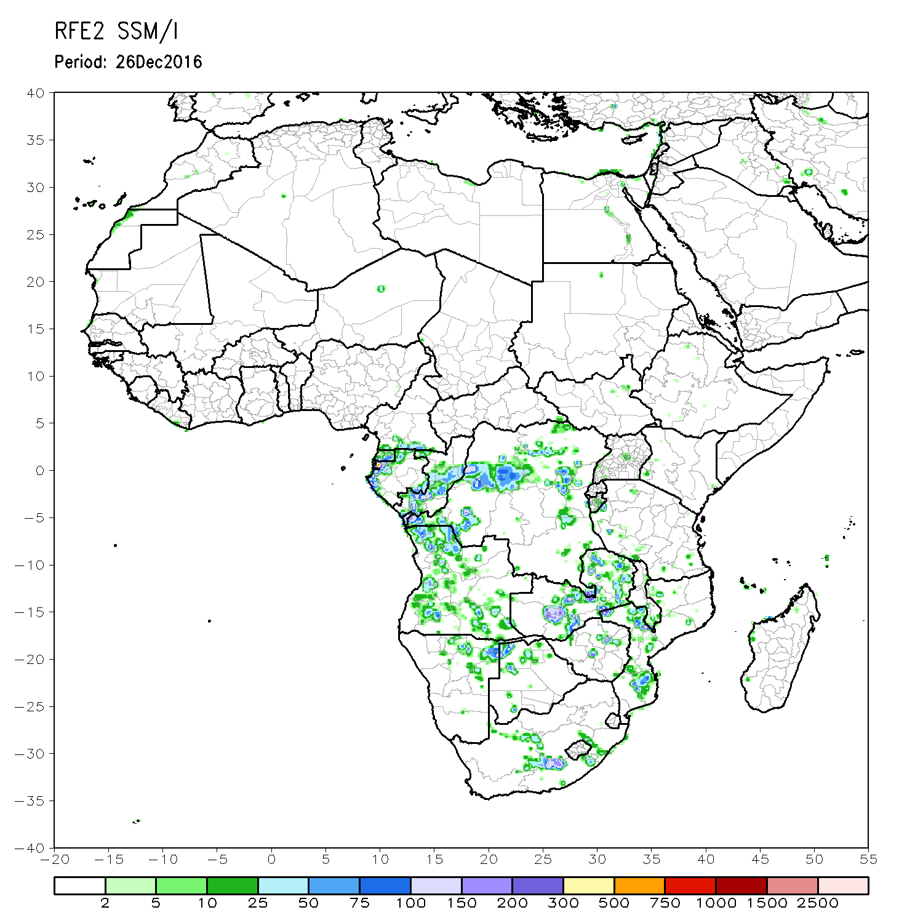
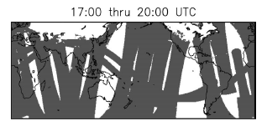
RFE Inputs: SSM/I and AMSU-B
Special Sensor Microwave Imager (SSM/I), and Advanced Microwave Sounding Unit (AMSU-B)
Both derive daily rainfall totals from detecting upward scattering / emission of radiation associated with atmospheric water/ice.
Unlike IR, passive microwave (PM) sensors onboard polar-orbiting satellites (lower altitude ~1000km, orbital period ~100minutes)
Translates into decreased sampling frequency (poorer temporal & spatial coverage)
The tradeoff, however, is a more accurate, high resolution rainfall estimate, with exceptional performance associated with locally, intense convective rainfall.

Slide 8
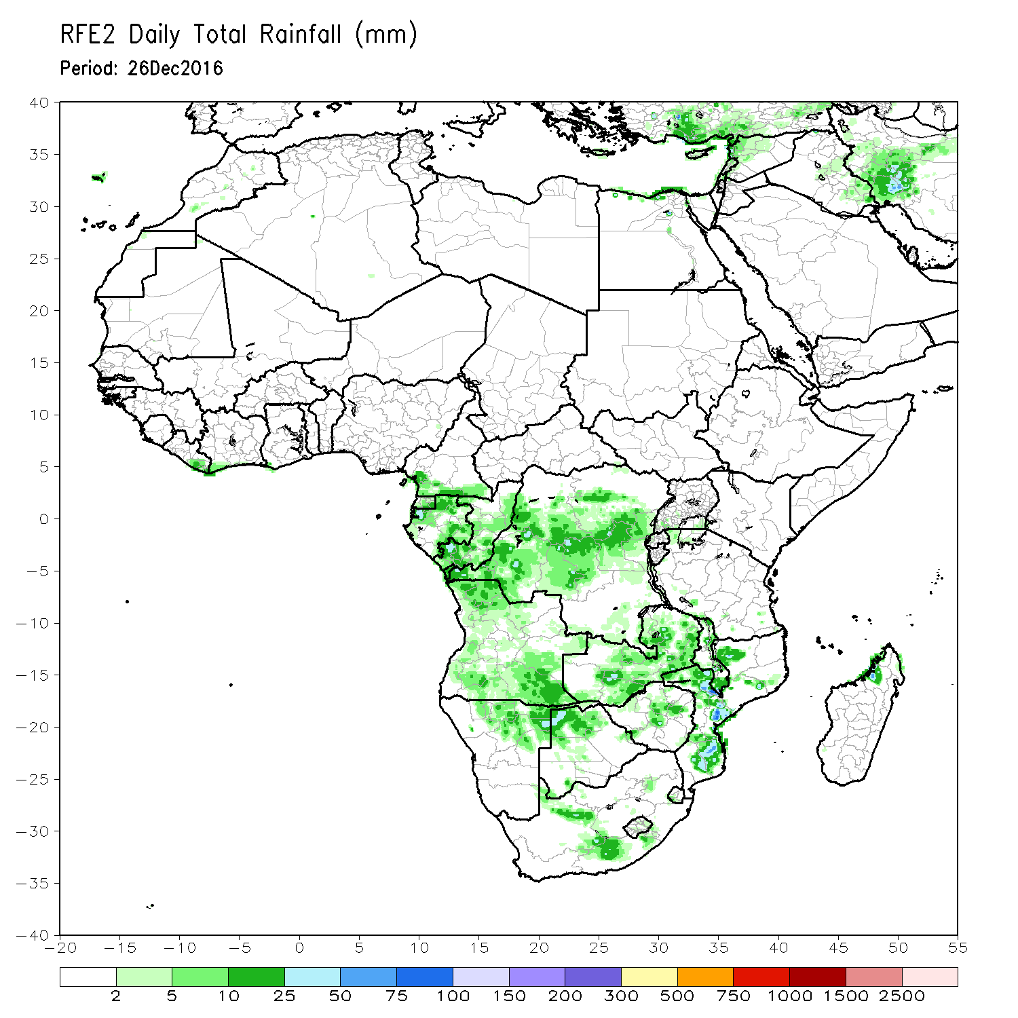
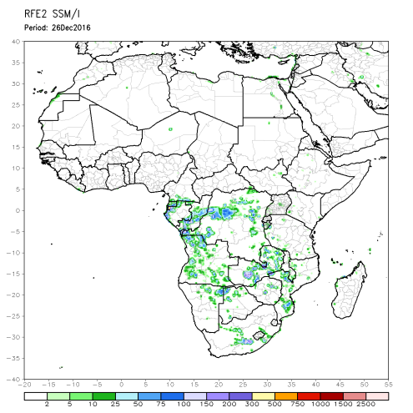
RFE Inputs: Merging of all 4 inputs
Gridded GPI, SSM/I, AMSU-B and rain gauge analyses are computed to ascertain random error fields, and then reduced by maximum likelihood estimation methods (Xie & Arkin,1996).
In short, satellite-based estimates primarily are used to determine the “shape” of the rainfall distribution, while gauge-based estimates are used to quantify the “magnitude” of the rainfall distribution.
By doing so, final RFE estimates in close proximity to a station retain the value of the gauge report, and increasingly relies more on the satellite estimate as distance increases from that station.
+
+
+
=
+

Slide 9
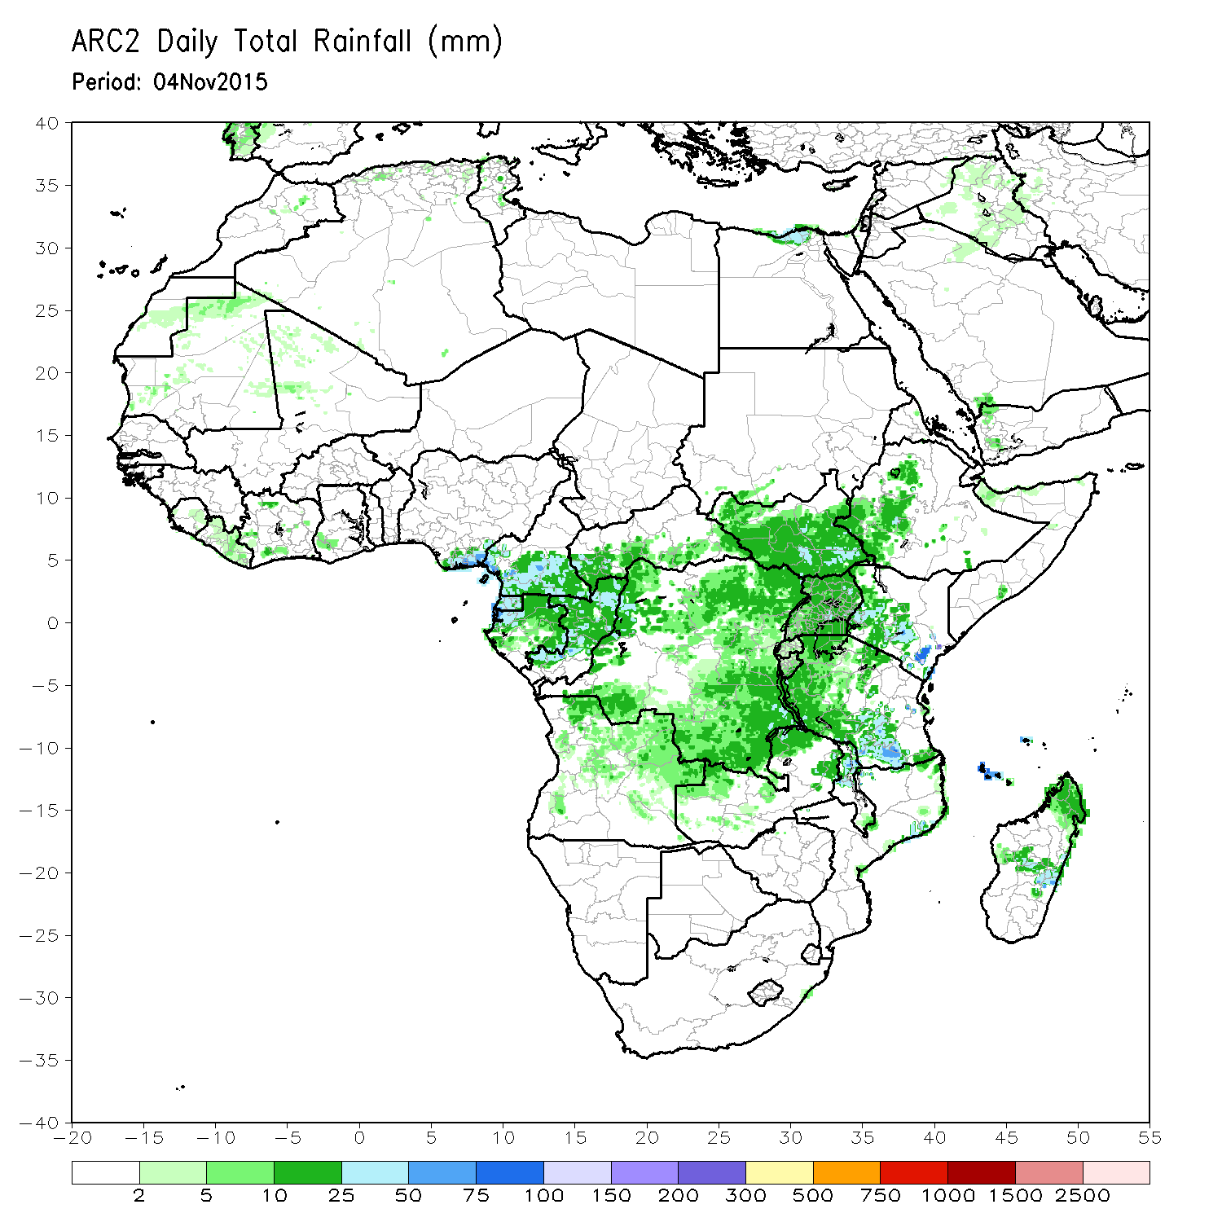
ARC2 : African Rainfall Climatology
Synopsis (CPC):
Used specifically for operational climate monitoring with meaningful anomalies based on a long-term satellite record.
Inputs: (a subset of the RFE)
Gauge (GTS)
IR (GPI)
Resolution:
Daily Analysis (06Z-06Z)
0.1˚ gridded spatial resolution
1983-present
Domains
Africa

Slide 10
RFE vs. ARC for FEWS
Why have two? …. First, lets compare estimators:
ARC well captures the spatial distribution of precipitation, but misses locally, intense rainfall due to the absence of PO MW inputs.
Question: If ARC is always drier than RFE, then why do we use it?

Slide 11
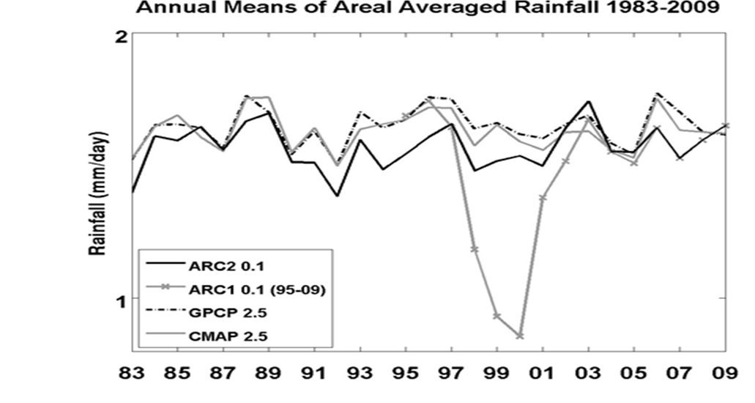
Answer: Because ARC2 is consistently dry, which lends itself to homogeneity in the long term precipitation time series. Attributed to the (GTS and IR) inputs.
Rain_{current} – Rain_{normal} = Anomaly
Dry bias
Dry bias
No Dry Bias

Slide 12
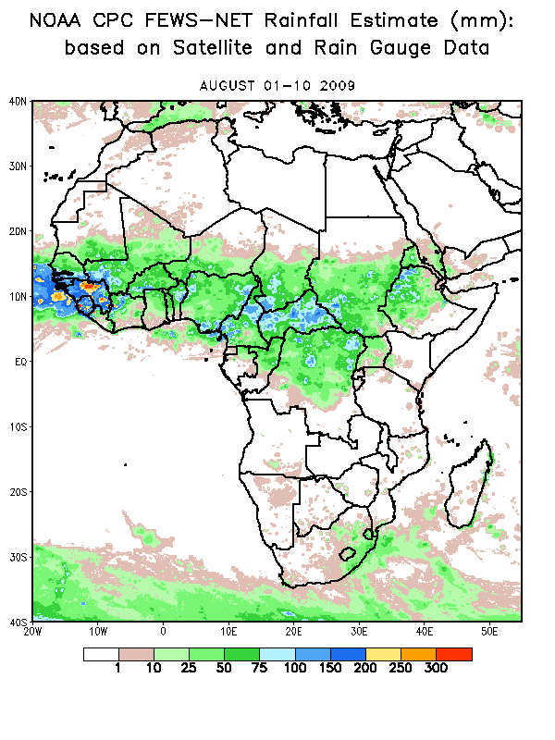
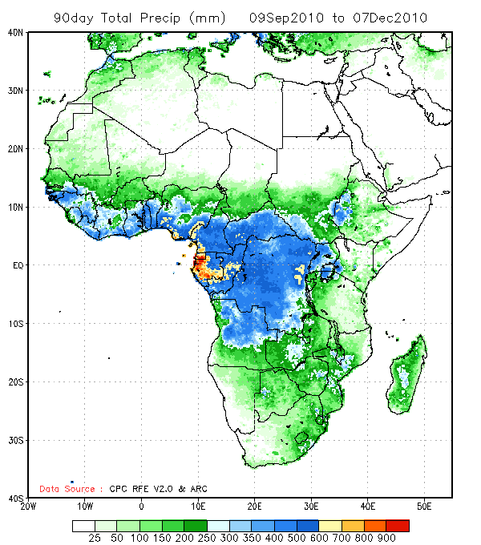
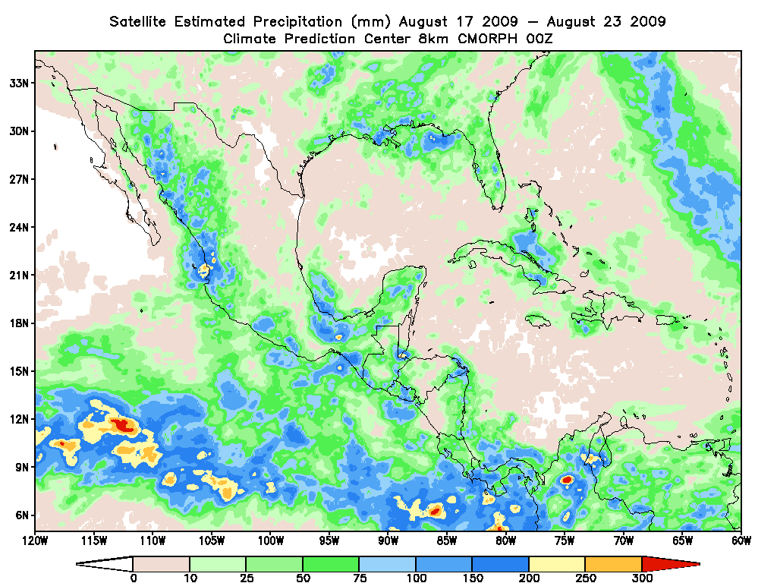
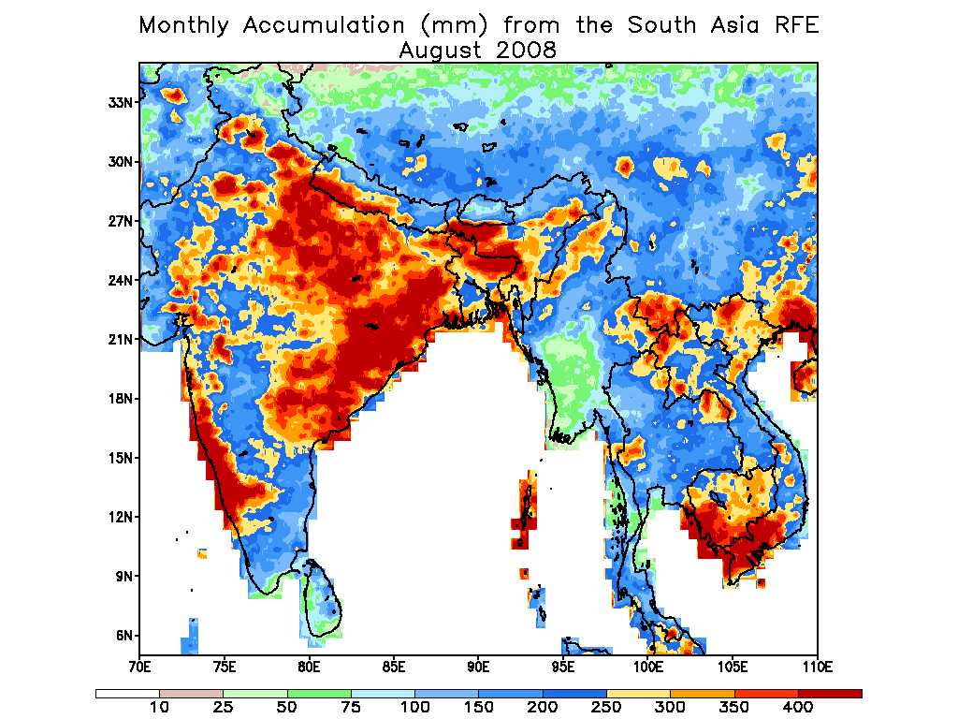
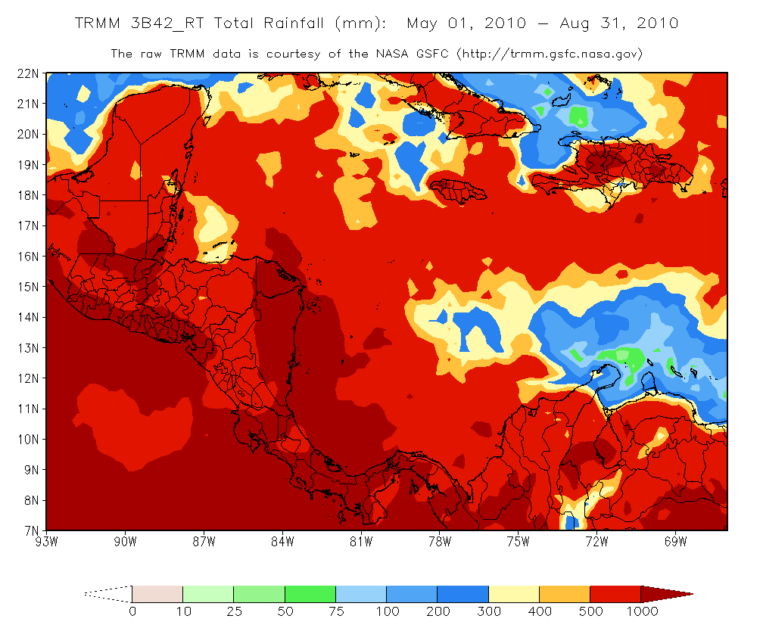
Products: Satellite Rainfall Estimator Analyses
High resolution, daily rainfall data are easily aggregated into (totals / means) :
Dekadal (10-Day)
Running Intervals (7,10,30,60,90,180-Day)
Weekly
Monthly
Seasonal / Annual
These analyses are instrumental in illustrating short-term and long-term cycles of precipitation (e.g. ITCZ fluctuations, special event / monsoon totals)

Slide 13
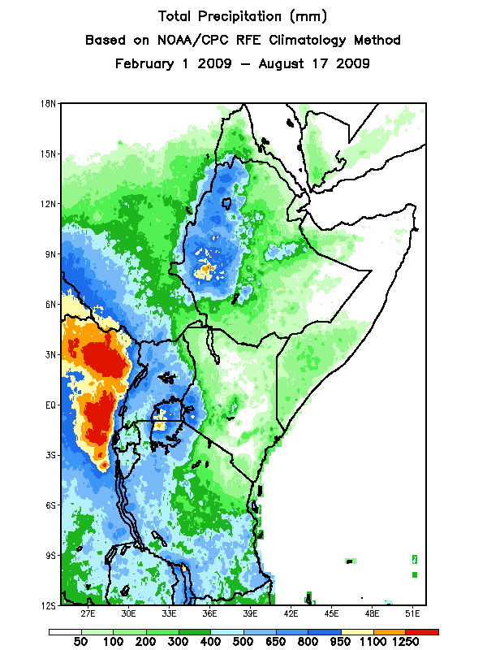
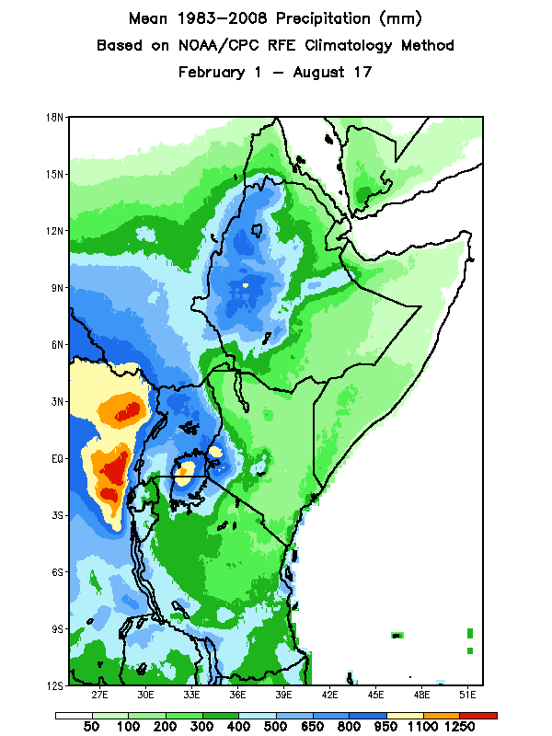
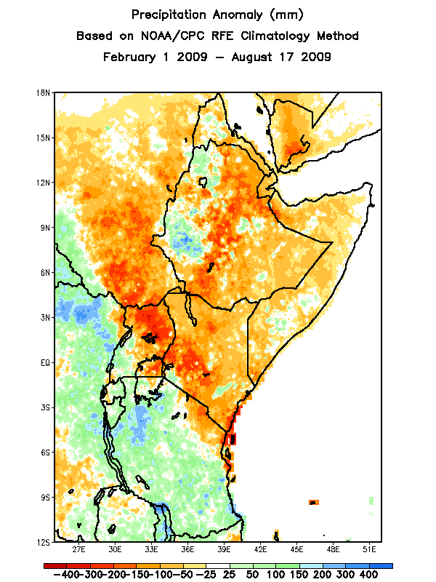
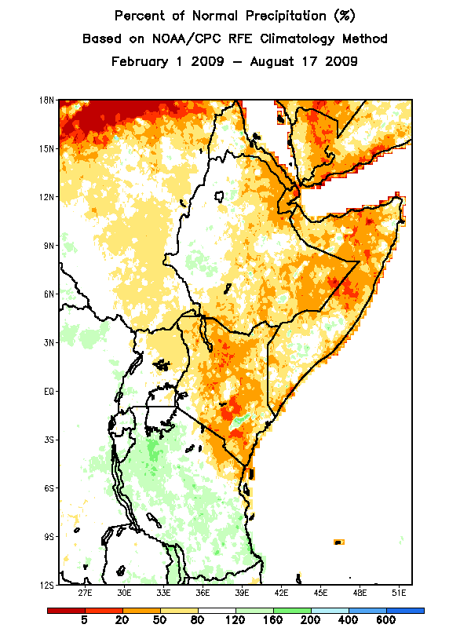
Products: Satellite Rainfall Estimator Analyses
If a sufficient record length exists for satellite rainfall products, a rainfall climatology may be computed (e.g. ARC, almost RFE):
Anomaly = Observed Rainfall ( for x period) minus Climatological Rainfall ( for x period)
Percent of Normal = Observed Rainfall ( for x period) / Climatological Rainfall ( for x period) * 100
-
/
=
These analyses are instrumental in illustrating both short-term / long-term trends of precipitation (e.g. flooding / drought) :

Slide 14
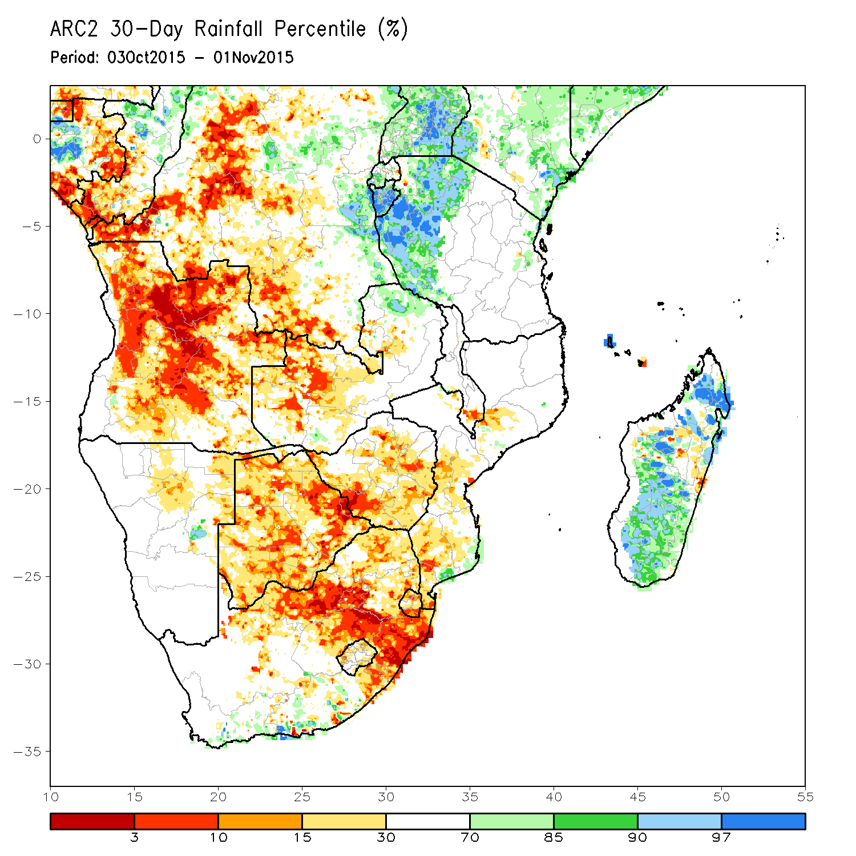
Percentile Anomaly
Rainfall percentile analyses place current anomaly fields in an historical context.
Suppose for a given gridpoint (i,j) during some period…
2015 = 150mm
2014 = 430mm
2013 = 560mm
2012 = 210mm
….
1983 = 440mm
These values are then ranked (sorted) to determine where 2015 falls with respect to all previous year’s rainfall.
perc(i,j) = (100/(nyr-0.5))*((nyr-rank+1)-0.5)
perc(i,j) = 1.67 %

Slide 15
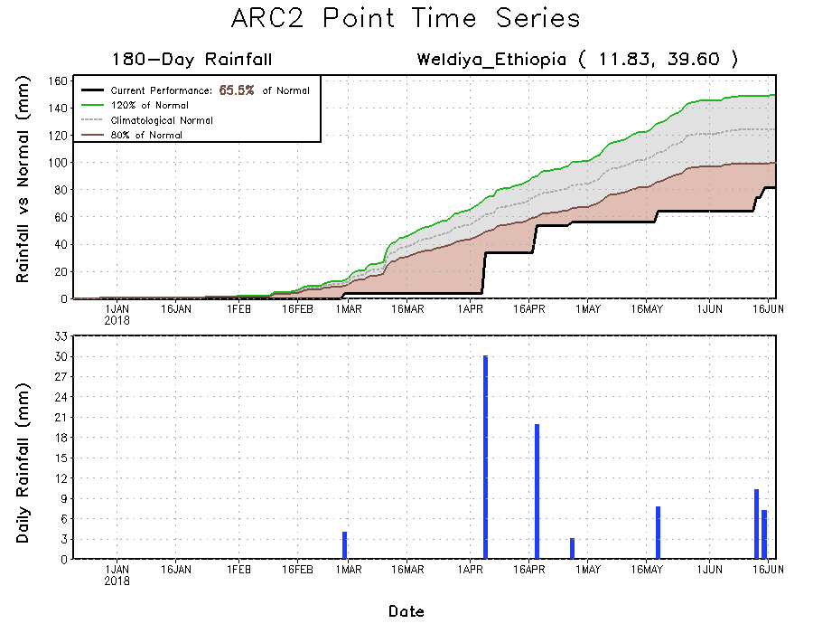
Point and Areal Average (Box) Time Series
Although maps are useful for analyzing spatial distribution of rainfall, the temporal distribution is just as important for operational climate monitoring.
Weather and climate datasets are often 3 dimensional: X, Y, T, for some variable.
Maps are X and Y varying with T fixed, whereas
Time series are X and Y fixed with T varying.

Slide 16
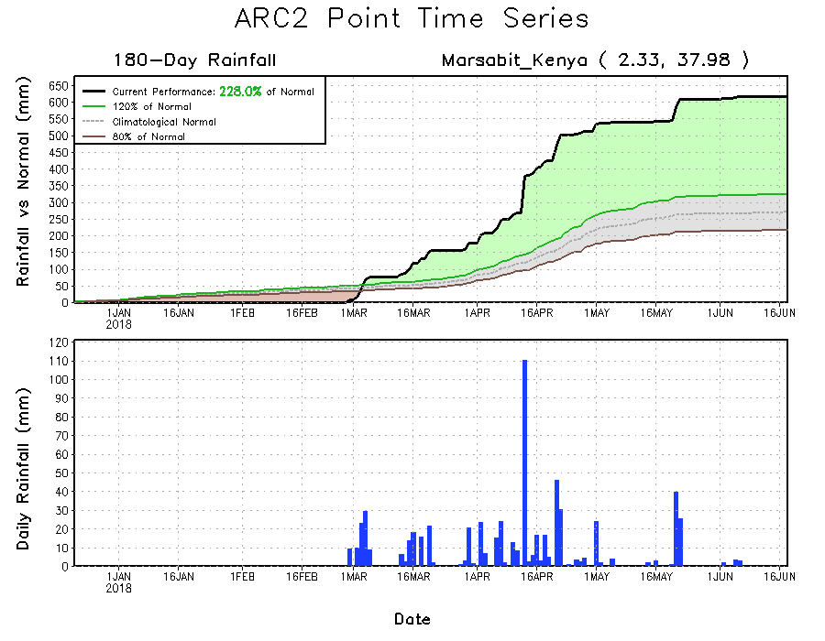
Point and Areal Average (Box) Time Series
Although maps are useful for analyzing spatial distribution of rainfall, the temporal distribution is just as important for operational climate monitoring.
Weather and climate datasets are often 3 dimensional: X, Y, T, for some variable.
Maps are X and Y varying with T fixed, whereas
Time series are X and Y fixed with T varying.

Slide 17
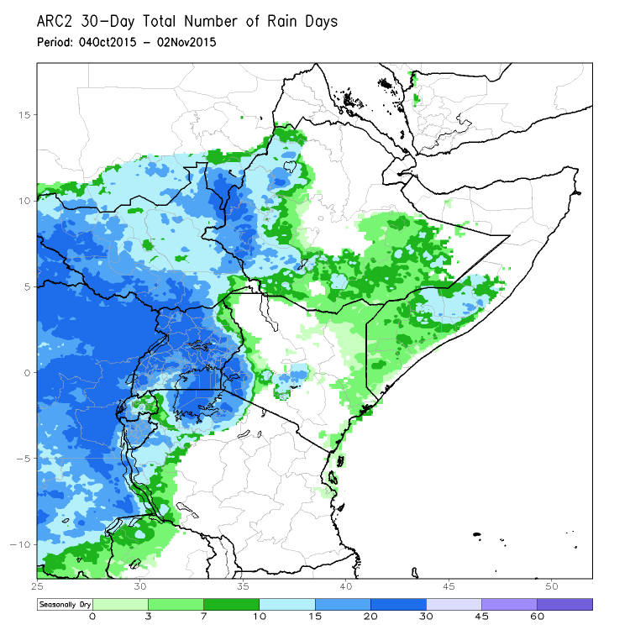
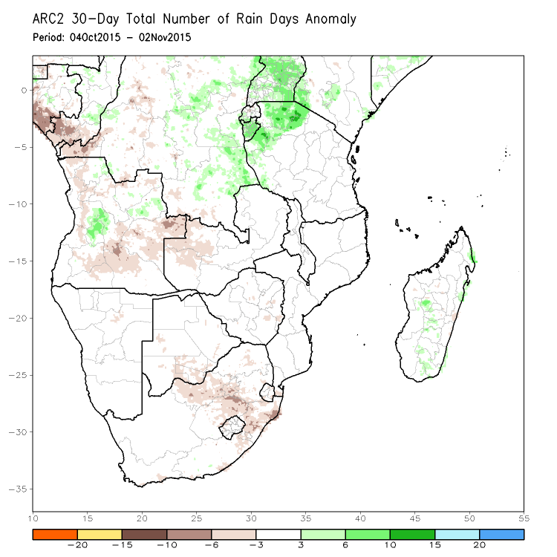
Rainfall Frequency: “Rain Days”
All rainfall estimate discussion has been based on the estimating/calculating the “magnitude” of rainfall (i.e. continuous quantity → [0:Inf] )
But what about the temporal behavior of rainfall?
Consider a hypothetical situation where a monsoonal area experiences nearly all of their normal total by early in the season. Following this extreme rainfall event, monsoonal rain virtually ceases causing a dry spell to negatively impact ground conditions for the remainder of the season. This may lead to misleading anomaly analyses.
We can define a “rain day” as some gridpoint (i,j) having received >= 1mm/day
Doing so for all of ARC2 will result in essentially a binary [0,1] dataset from represented simply as either rain, or, non rain events for every gridpoint and for all days.
We can then go back and compute current totals and climatology on this converted data to depict rain frequency totals and anomalies.

Slide 18
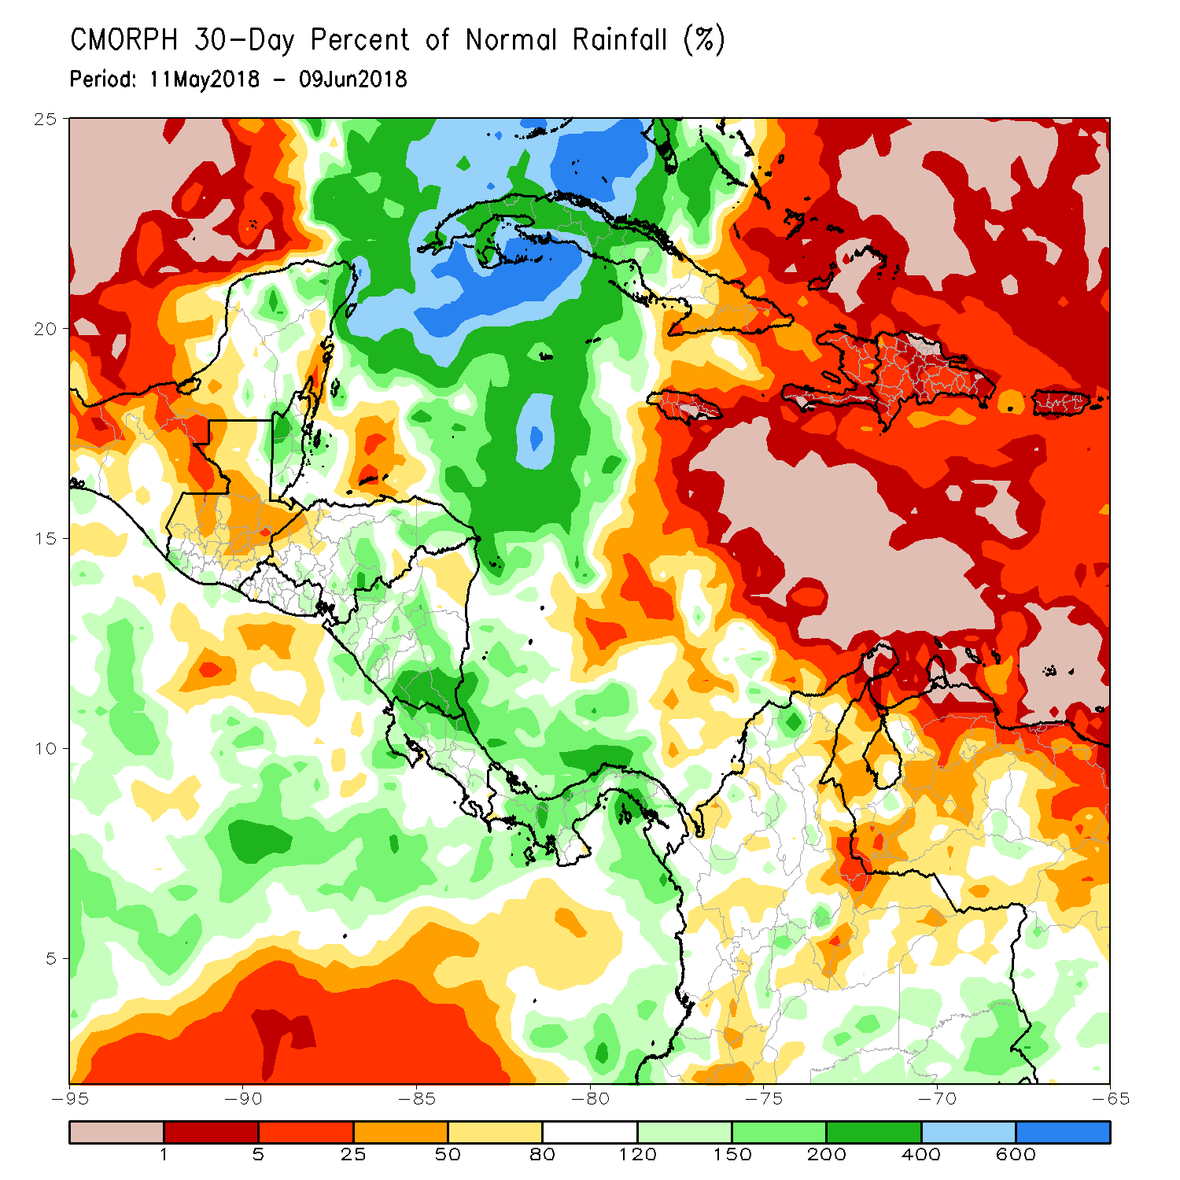
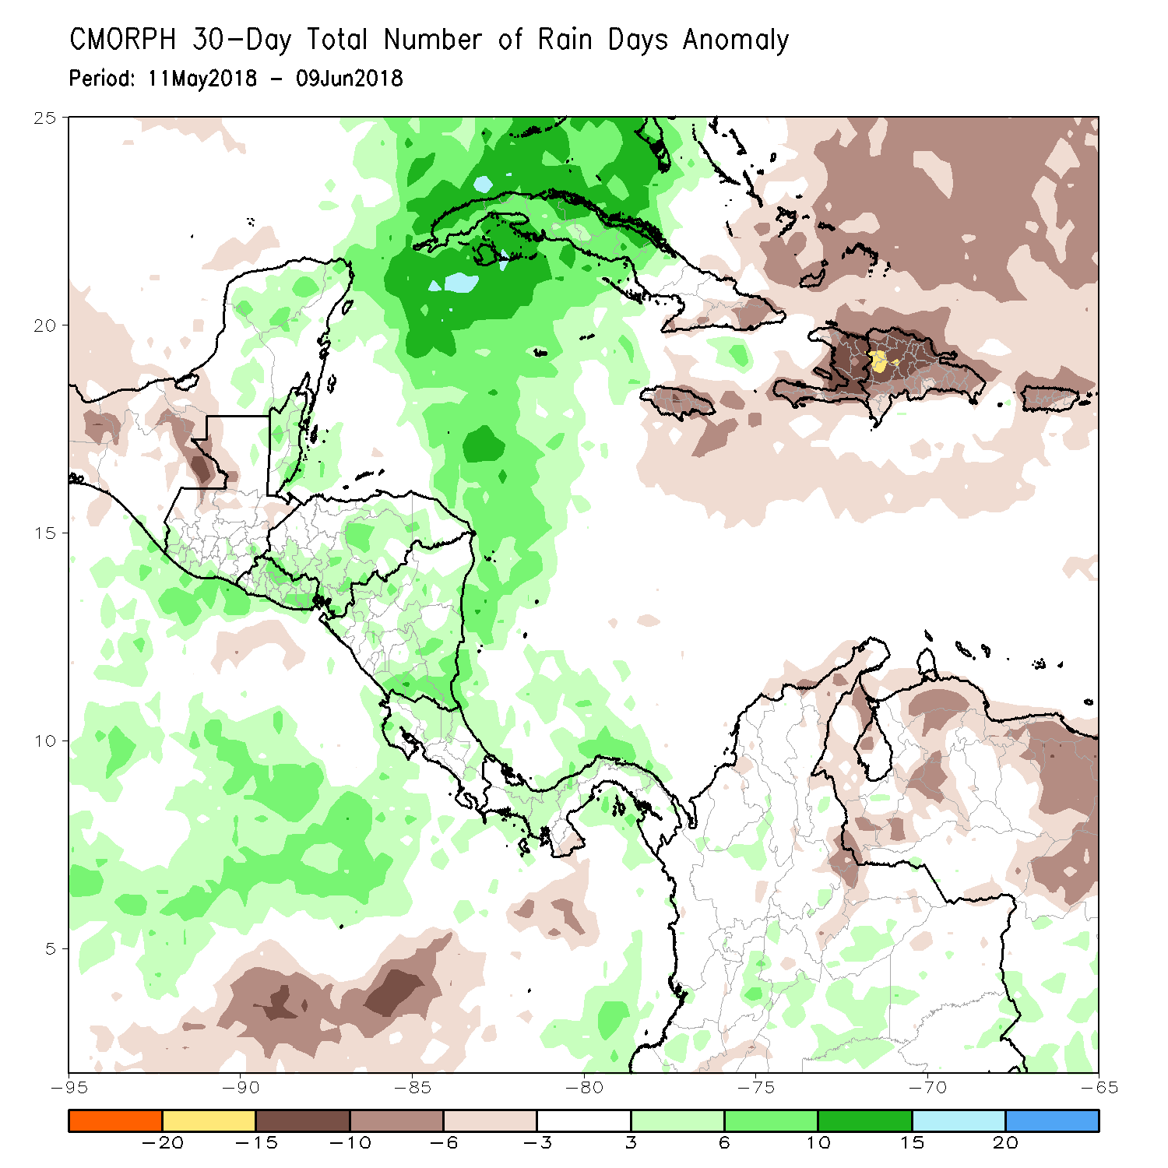
Rainfall Frequency: “Rain Days”
While rainfall frequency and magnitude often go hand-in-hand, some active cropping areas can benefit more from a sufficient number of rain days (frequency), rather than total deficits during the season.

Slide 19
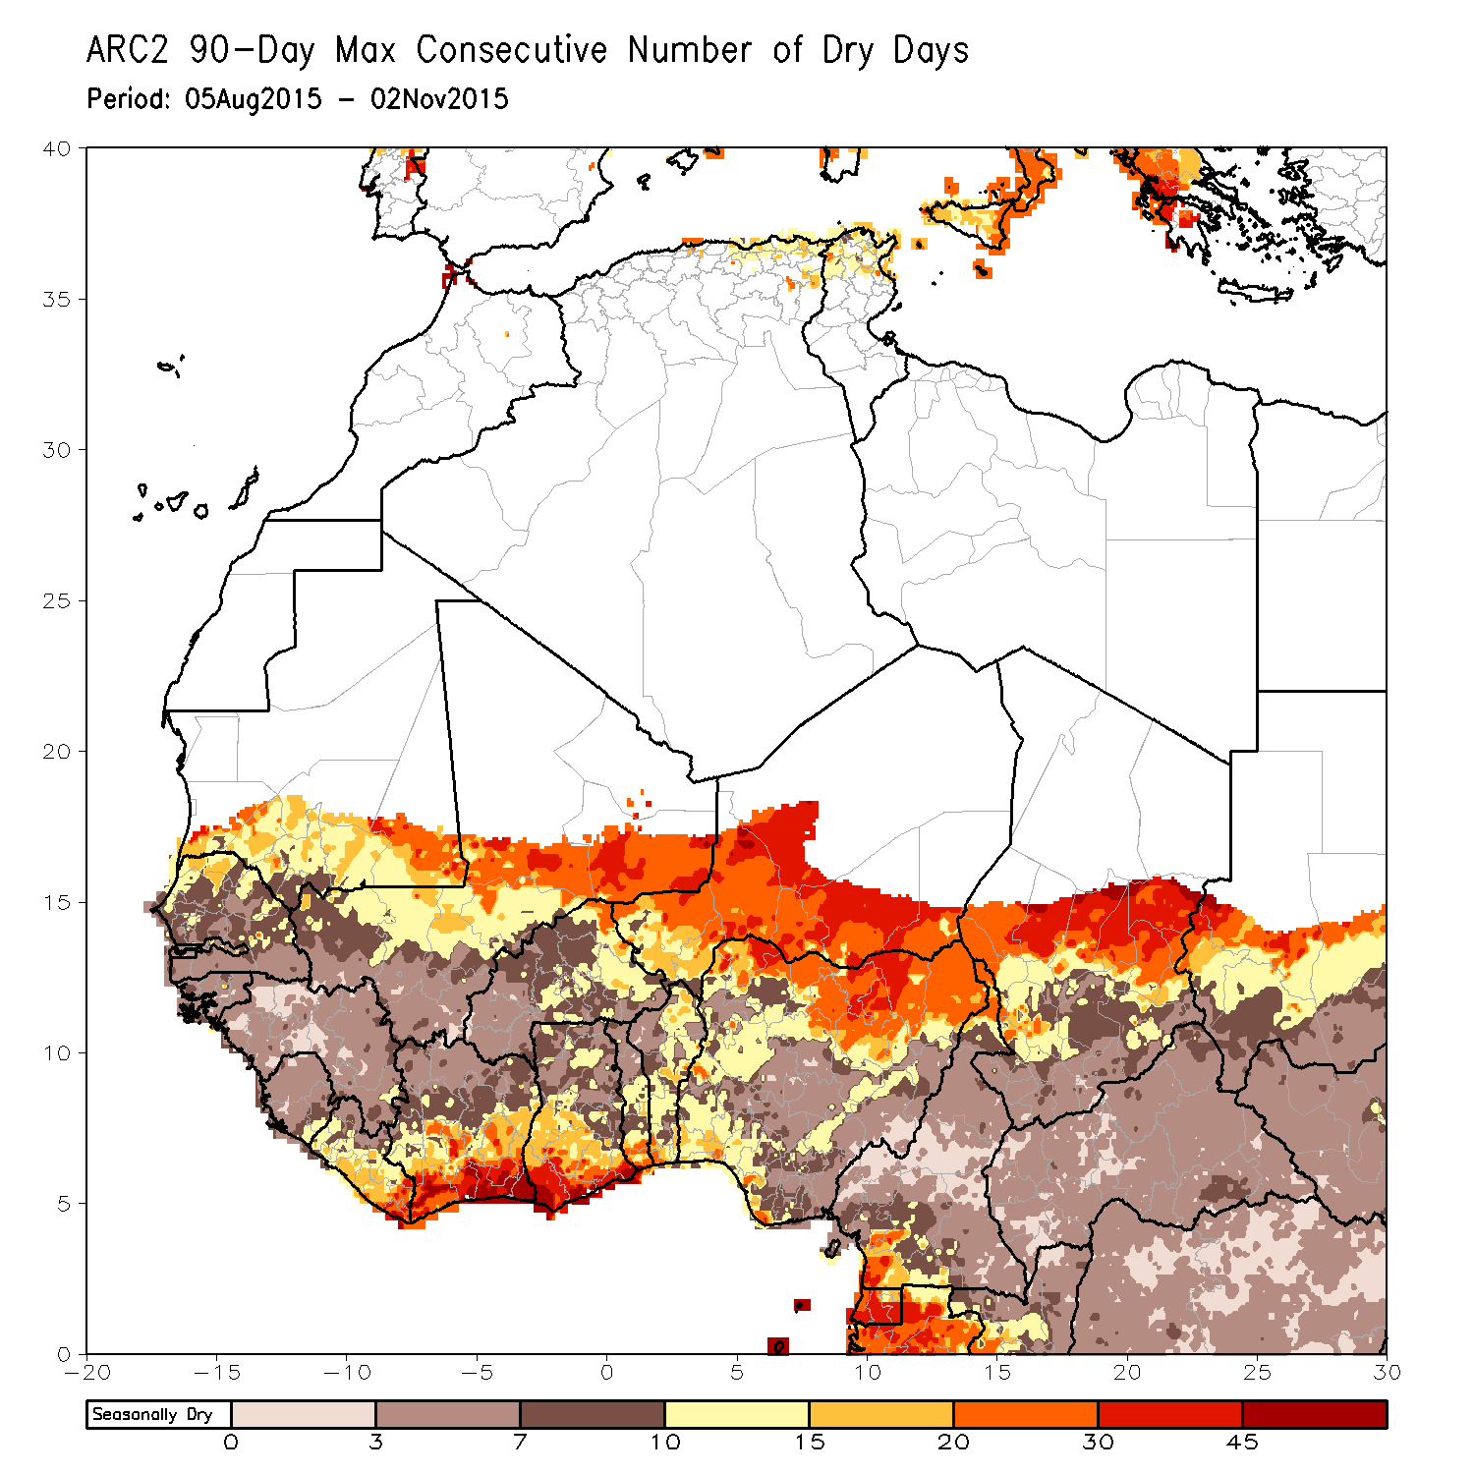
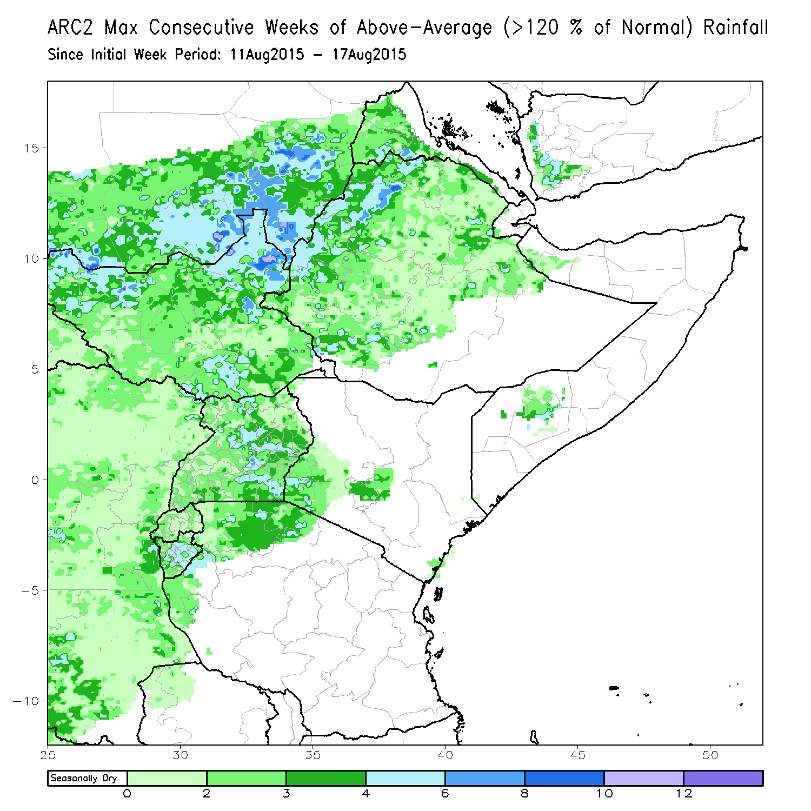
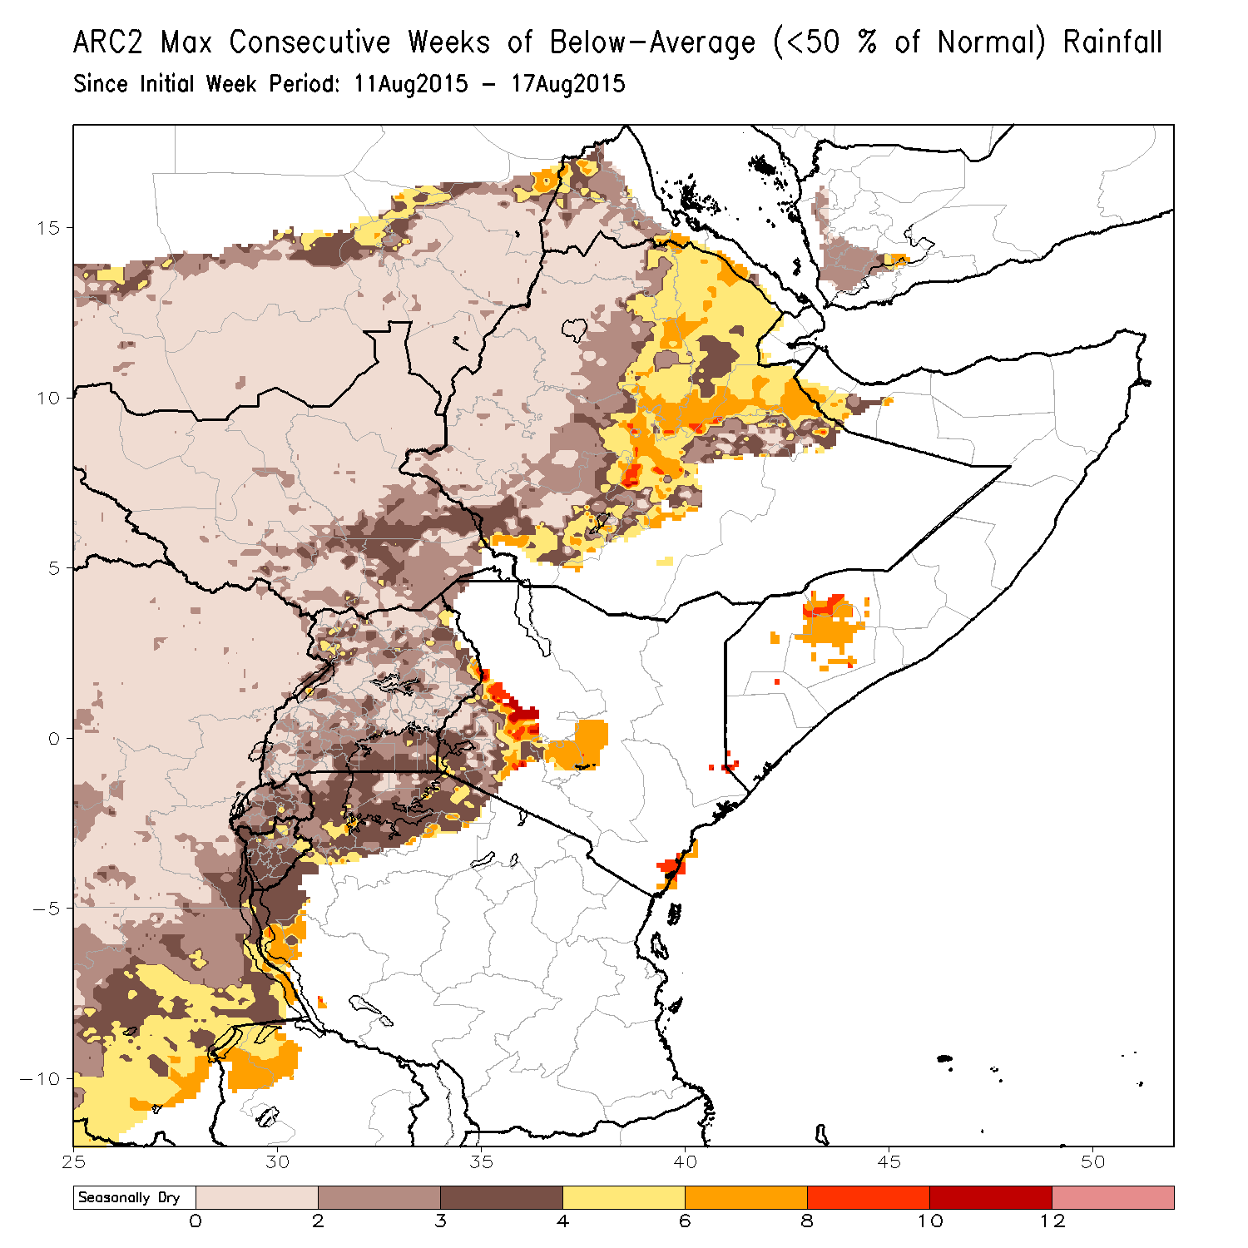
Rainfall Frequency: “Consecutiveness”
A Discrete ARC2 [0,1] record may be used to determine “consecutiveness” of either wet/dry conditions.
Time scale may also be lengthened to weeks. This becomes useful for hazard criteria.

Slide 20
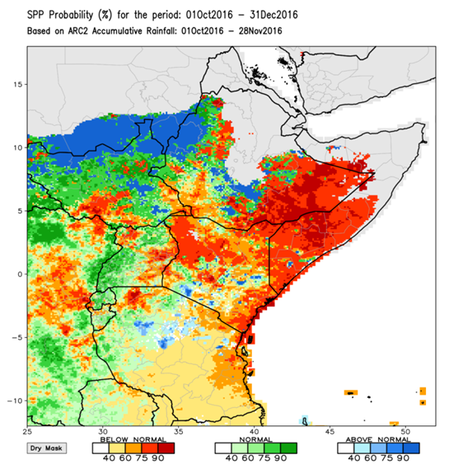
Seasonal Rainfall Performance Probability (SPP)
Consider an active rainfall region, where the behavior of rainfall exhibits an increase (onset), peak (max), then decrease (cessation) of rainfall over some period.
From this classic monsoonal cycle, the certainty of a seasonal outcome (BA, A, AA) invariably increases as the remaining monsoon season grows shorter (e.g. probability of winning a baseball game when leading 10-0 in the 4th vs. the 9th inning).
SPP quantifies the probability of seasonal / sub-seasonal precipitation to finish at pre-defined anomaly thresholds over Africa.
SPP uses Kernel Density Estimate (KDE) methods to generate PDF’s of projected rainfall for the season based on ARC2 data by utilizing a daily long-term (1983-present) historical record of precipitation performances.
SPP is processed daily, and produces probability maps and point time series at a 0.1 degree resolution.
< 25% of normal
< 50% of normal
< 80% of normal
80% - 120% of normal
> 120% of normal

Slide 21
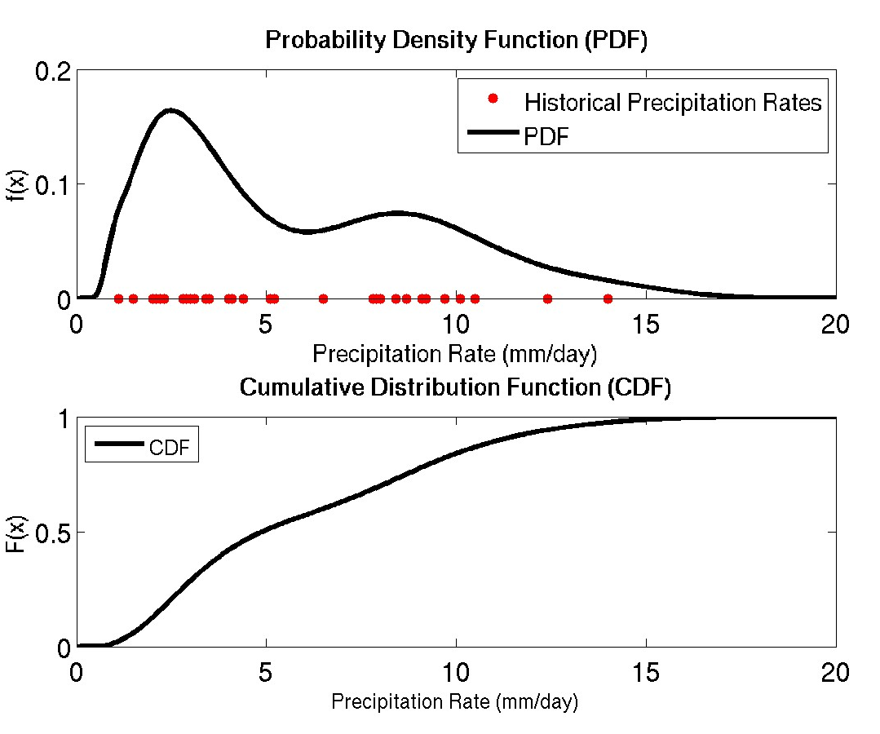
Observed Total @ Tc = 100mm
Climatological Total @ Tc = 150mm
% of Normal @ Tc = 66%
Climatological Total @ Tf = 500mm
Days Remaining in Season = 60 days
T0
Tc
Tf
Mar 1, 2016
Apr 1, 2016
May 1, 2016
May 31, 2016
Well.., 400mm of rain in 60 days is required for seasonal rains to reach “normal”, which works out to be a future prate of 6.66 mm/day from Tc to Tf.
Similarly, future prates, x, consisting of:
0.42 mm/day is required to be at least 25% of normal
2.50 mm/day is required to be at least 50% of normal
5.00 mm/day is required to be at least 80% of normal
6.66 mm/day is required to be at least 100% of normal
8.33 mm/day is required to be at least 120% of normal
10.8 mm/day is required to be at least 150% of normal
15.0 mm/day is required to be at least 200% of normal
Based on the 30+ year history of observed prates, x(i) from Tc to Tf, how likely are these hypothetical prates, x, to happen in the future?
Solve KDE using x and x(i) to yield f(x).
Take integral to get CDF

Slide 22
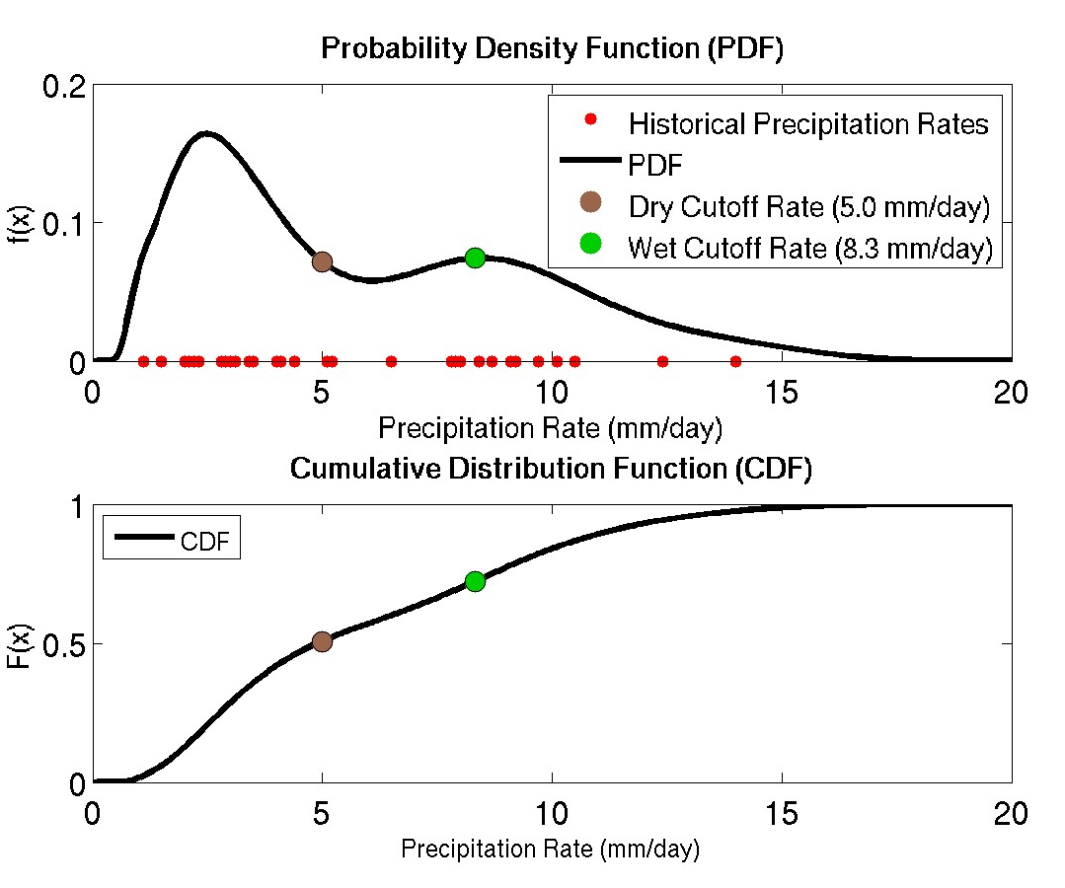
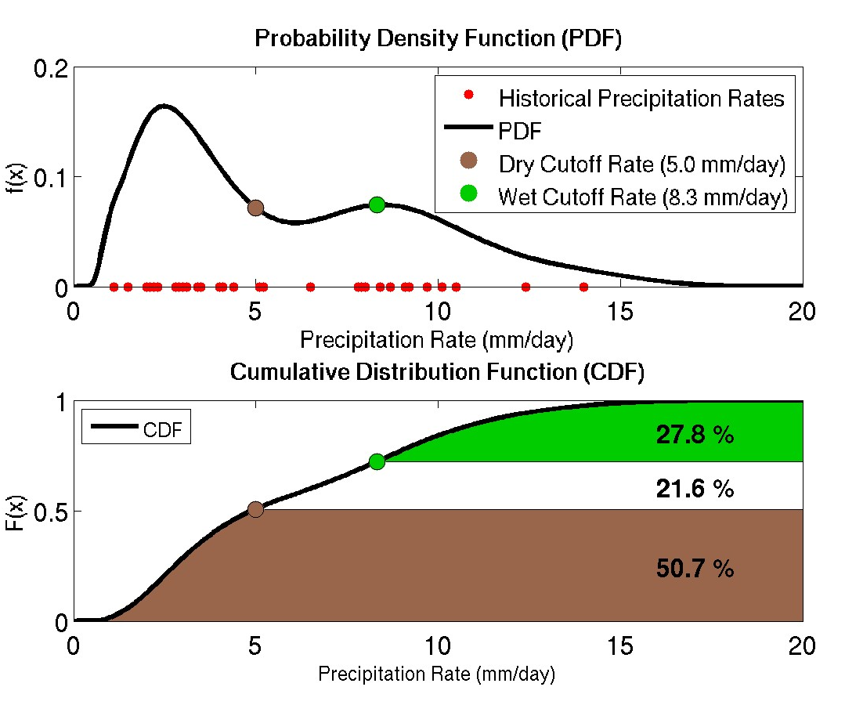
Observed Total @ Tc = 100mm
Climatological Total @ Tc = 150mm
% of Normal @ Tc = 66%
Climatological Total @ Tf = 500mm
Days Remaining in Season = 60 days
T0
Tc
Tf
Mar 1, 2016
Apr 1, 2016
May 1, 2016
May 31, 2016
Well.., 400mm of rain in 60 days is required for seasonal rains to reach “normal”, which works out to be a future prate of 6.66 mm/day from Tc to Tf.
Similarly, future prates, x, consisting of:
0.42 mm/day is required to be at least 25% of normal
2.50 mm/day is required to be at least 50% of normal
5.00 mm/day is required to be at least 80% of normal
6.66 mm/day is required to be at least 100% of normal
8.33 mm/day is required to be at least 120% of normal
10.8 mm/day is required to be at least 150% of normal
15.0 mm/day is required to be at least 200% of normal
Based on the 30+ year history of observed prates, x(i) from Tc to Tf, how likely are these hypothetical prates, x, to happen in the future?
Solve KDE using x and x(i) to yield f(x).
Take integral to get CDF
Plot critical prates for:
Below-Normal (<80% of normal)
Normal (80-120% of normal)
Above-Normal (>120% of normal)
This will then yield the respective probabilities for these anomaly categories by the end of the season.

Slide 23
Observed Total @ Tc = 100mm
Climatological Total @ Tc = 150mm
% of Normal @ Tc = 66%
Climatological Total @ Tf = 500mm
Days Remaining in Season = 60 days
T0
Tc
Tf
Mar 1, 2016
Apr 1, 2016
May 1, 2016
May 31, 2016
In this example, the persistence of below-normal rainfall is climatologically favored (~51%) over a seasonal recovery according to ARC2.
Historical precipitation exhibits a bimodal distribution, with greater density located in the 1st mode, and lesser density in the 2nd mode, for the remainder of the season.
Interestingly, the historical mean (5.83 mm/day → 90% of Norm) is actually centered between the two modes in a PDF minima, suggesting either a wet/dry anomaly is more likely by end of season.
This example demonstrates how the rainfall climatology can create a more insightful outlook, rather than using the simple mean as a projection.

Slide 24
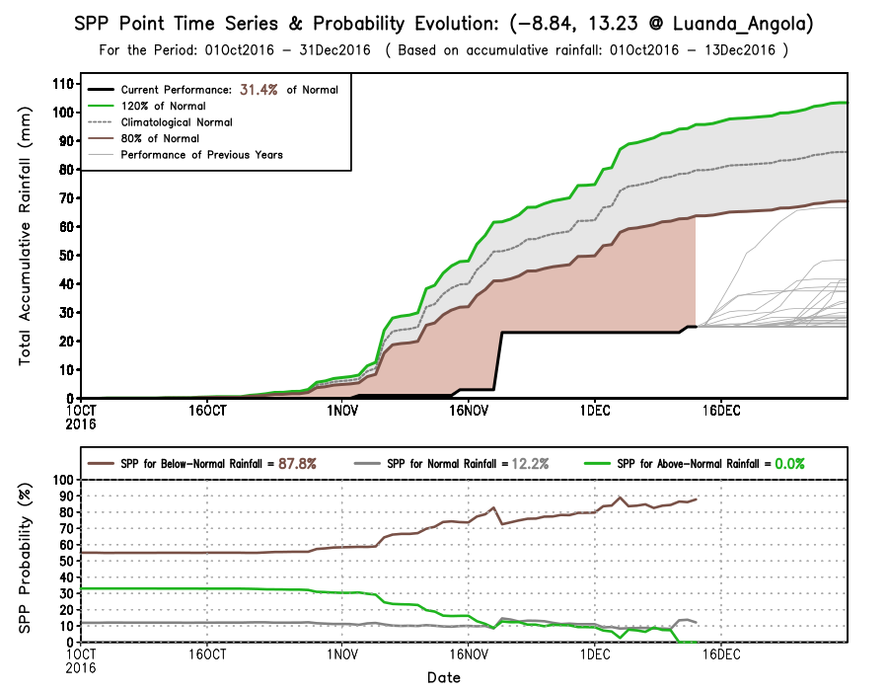
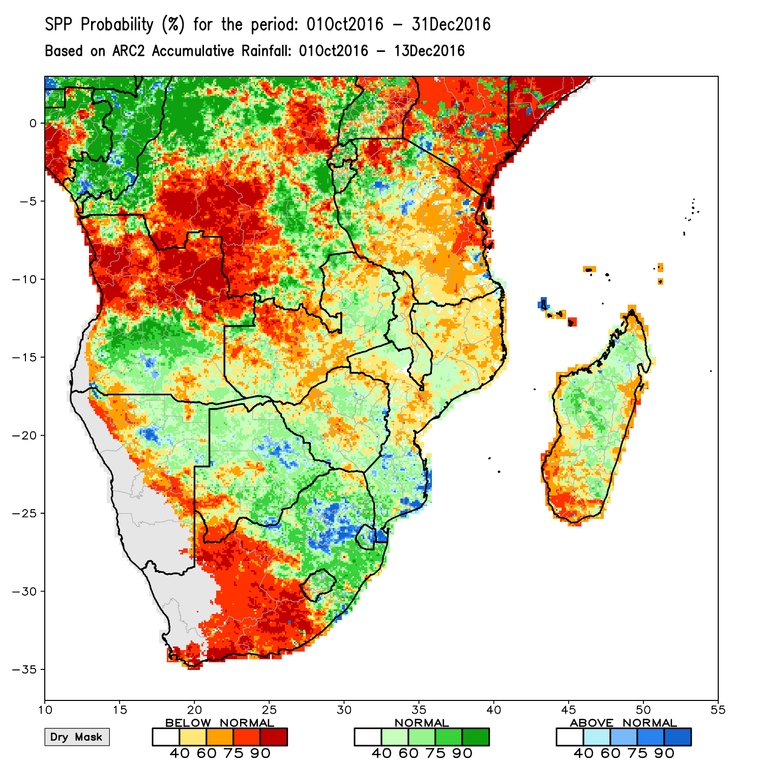
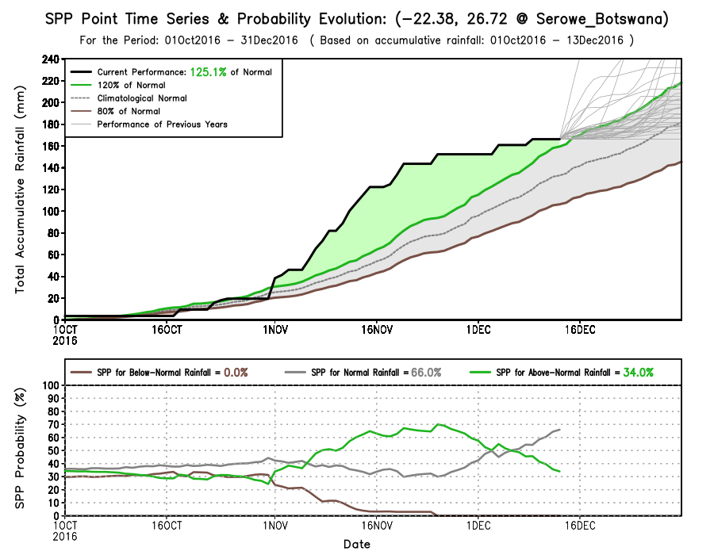

Slide 25
Application and Dissemination of NOAA products
Product Staging (http): http://www.cpc.ncep.noaa.gov/products/international/

Slide 26
Questions / Comments …?

