Slide 1
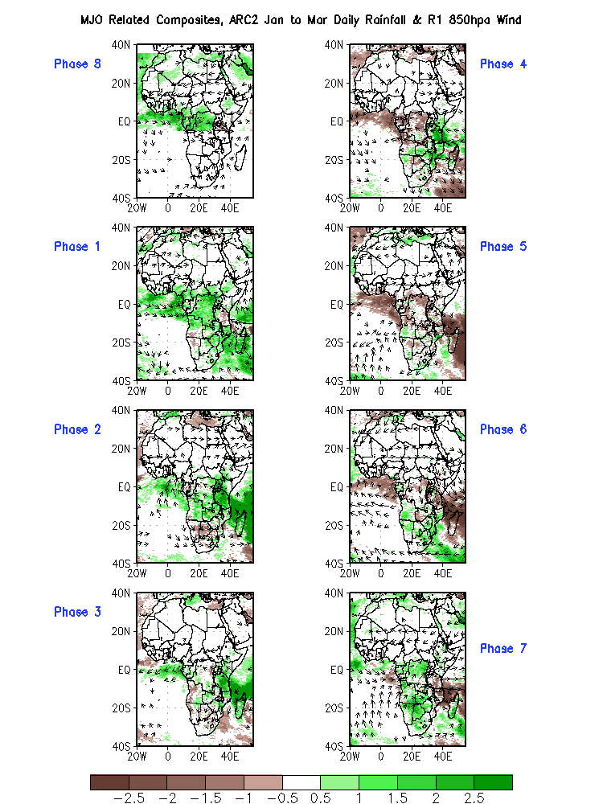
Original Composite - JFM

Slide 2
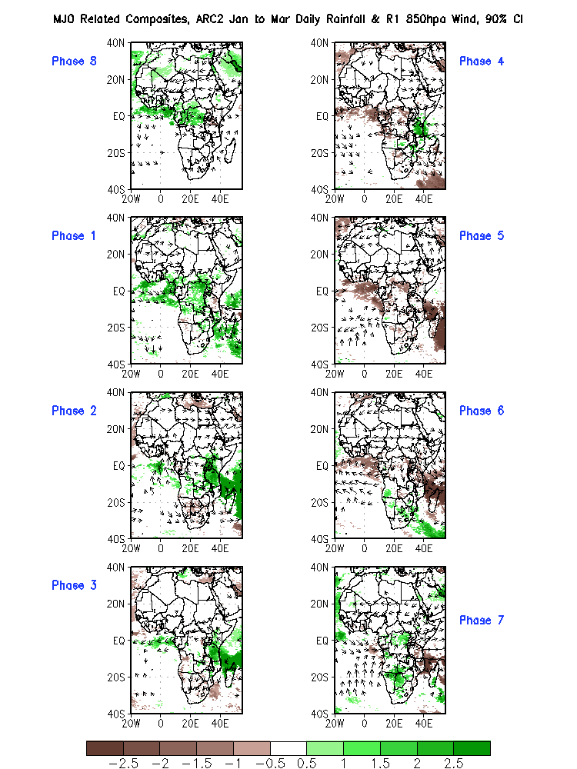
JFM, 90%

Slide 3
JFM, 95%

Slide 4
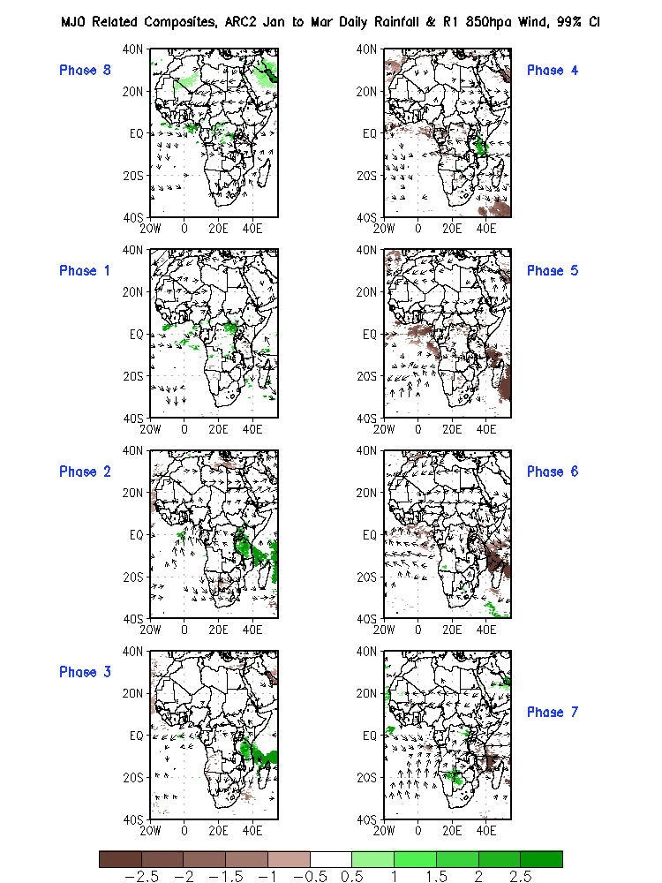
JFM, 99%

Slide 5
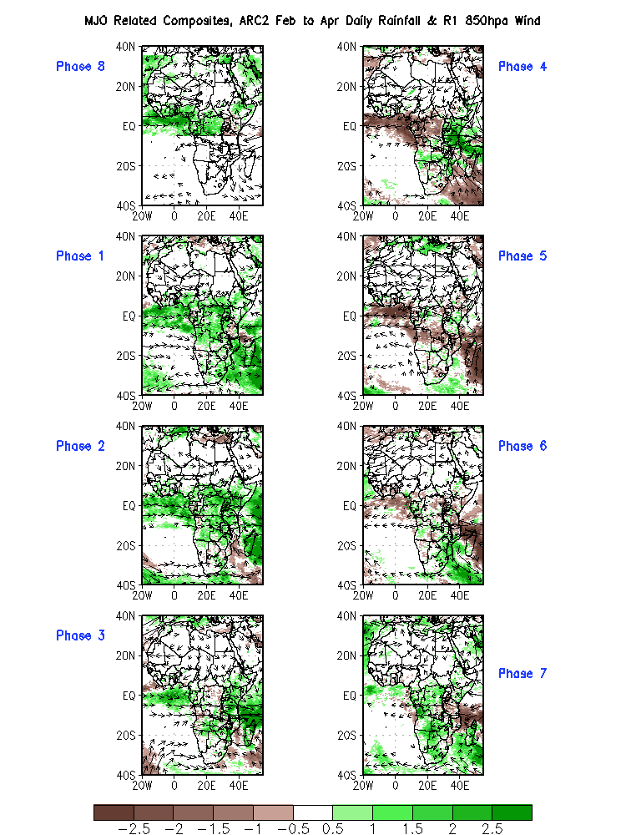
Original Composite - FMA

Slide 6
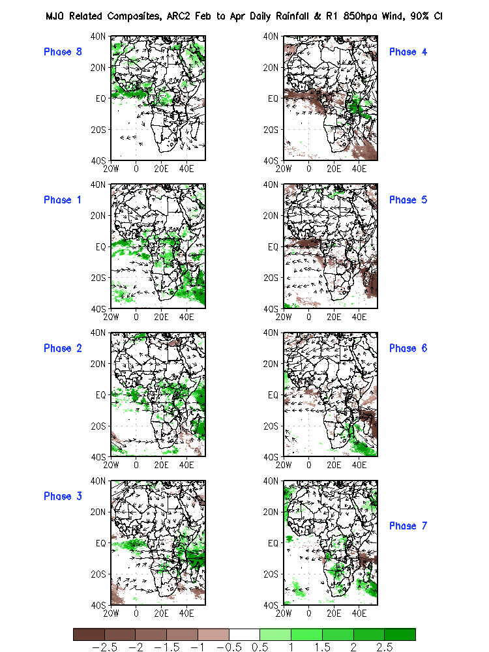
FMA, 90%

Slide 7
FMA, 95%

Slide 8
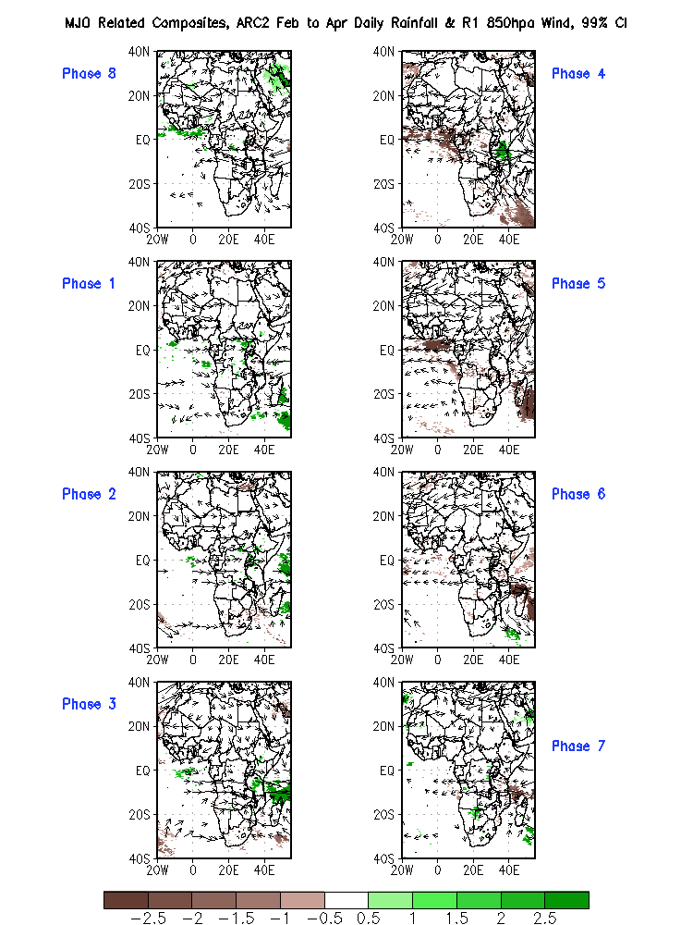
FMA, 99%

Slide 9
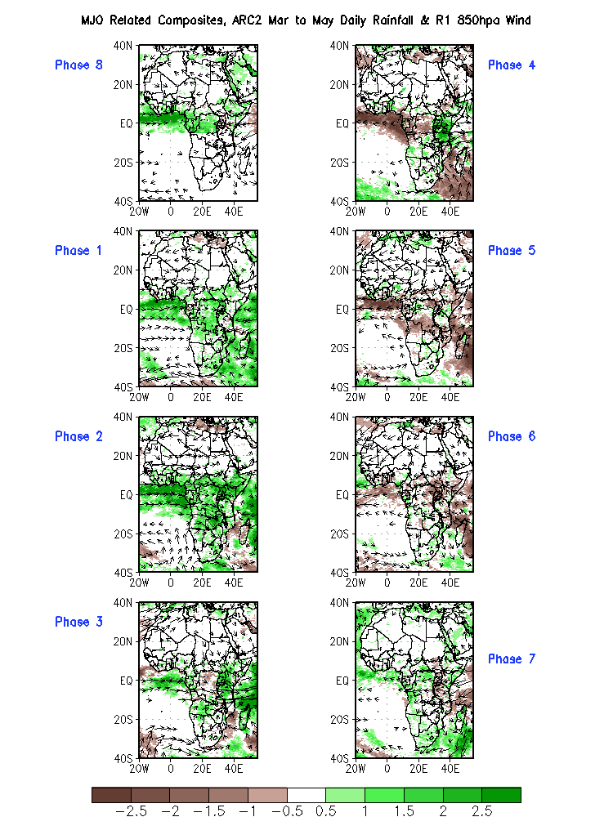
Original Composite - MAM

Slide 10
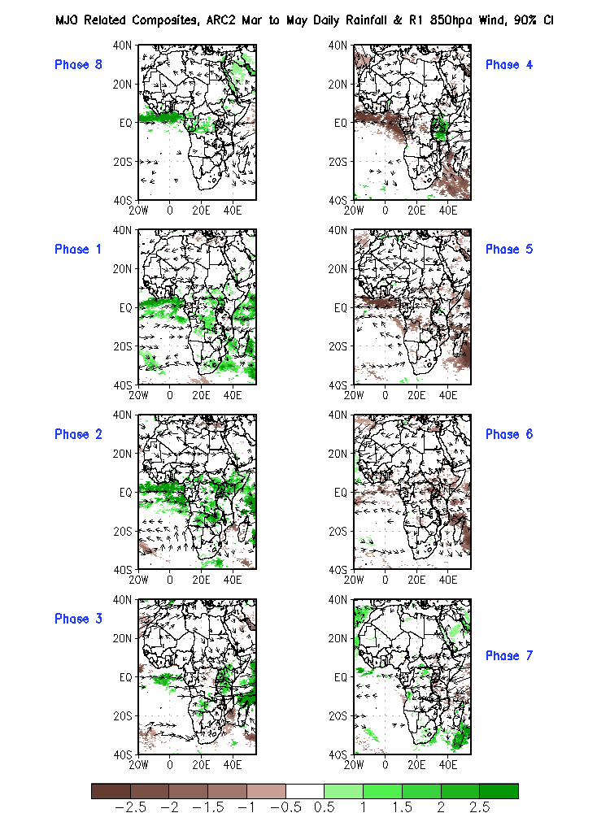
MAM, 90%

Slide 11
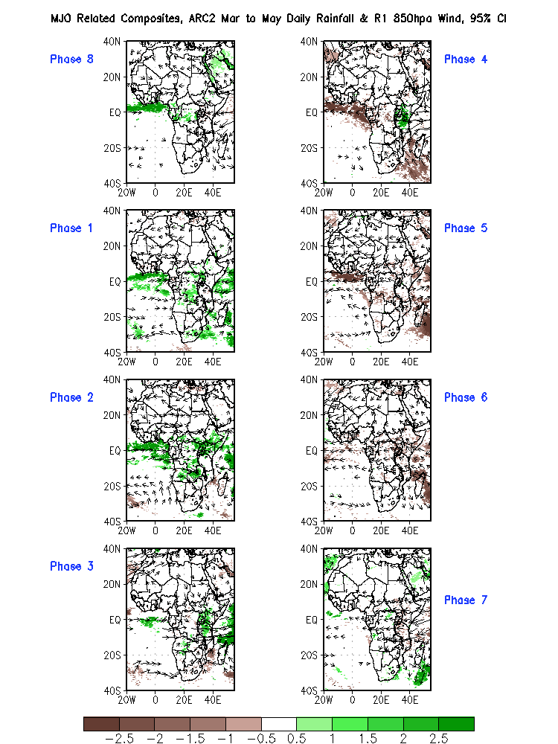
MAM, 95%

Slide 12
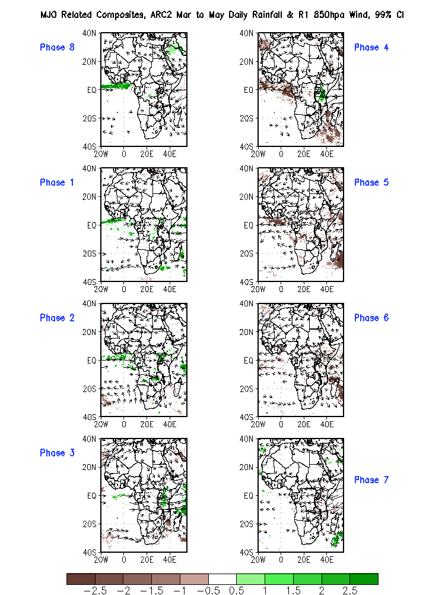
MAM, 99%

Slide 13
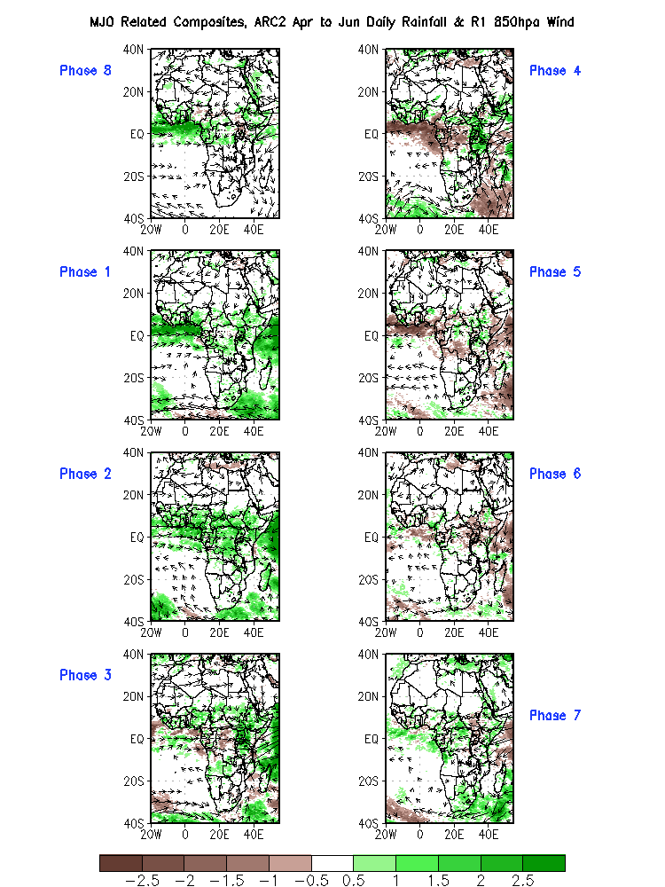
Original Composite - AMJ

Slide 14
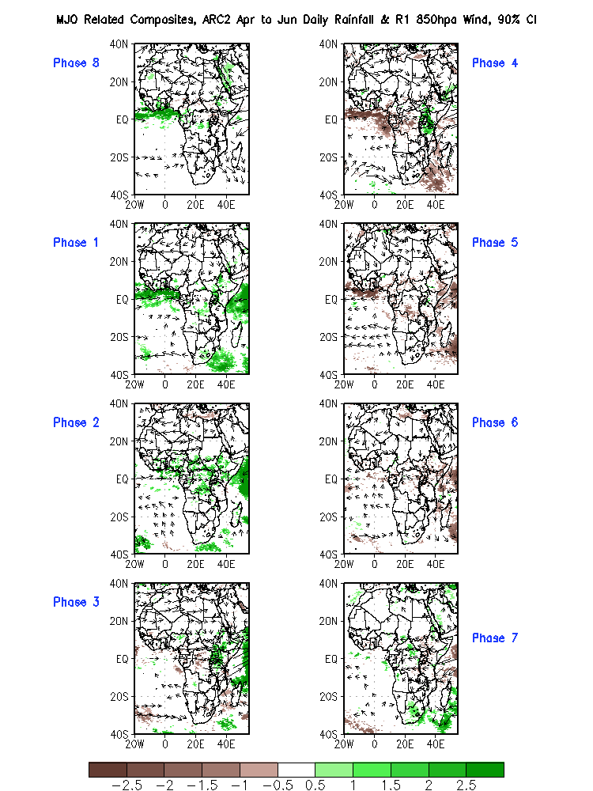
AMJ, 90%

Slide 15
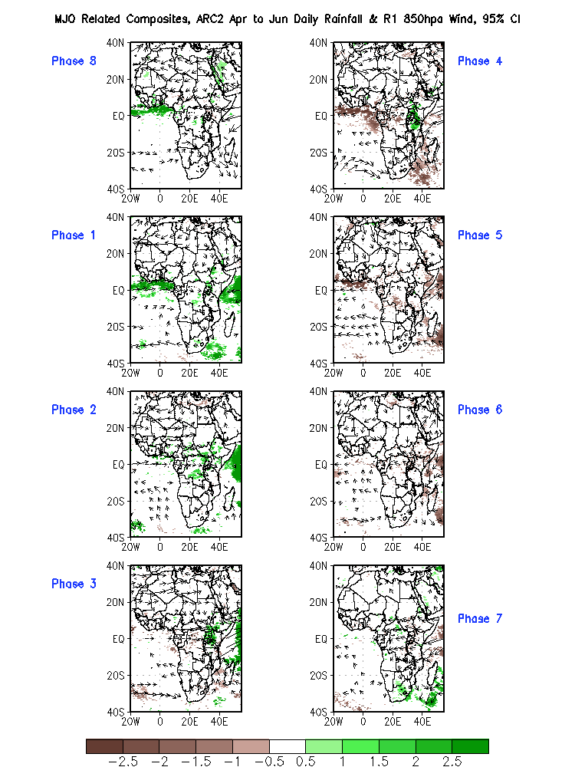
AMJ, 95%

Slide 16
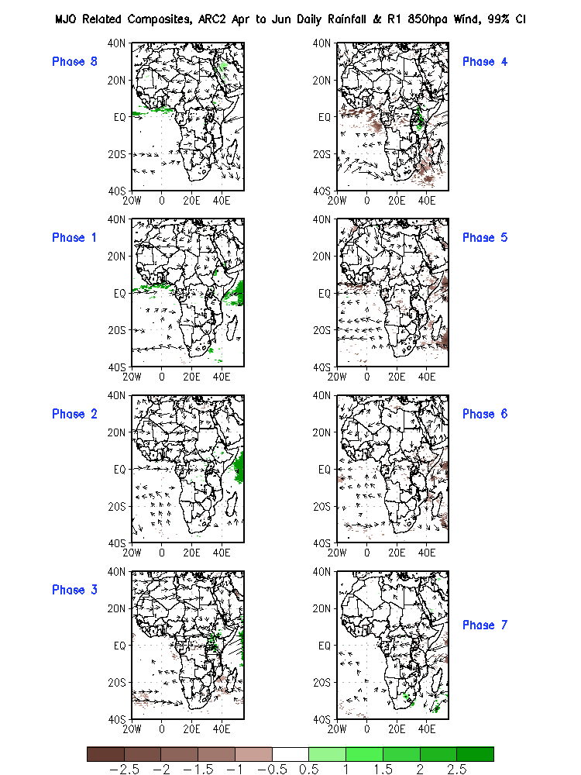
AMJ, 99%

Slide 17
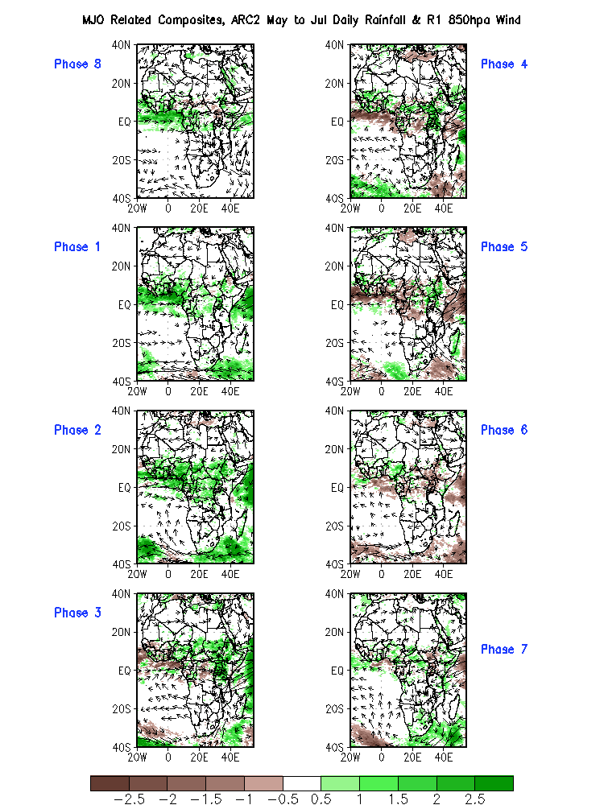
Original Composite - MJJ

Slide 18
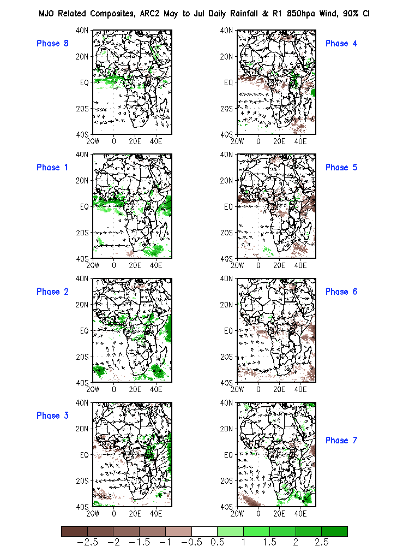
MJJ, 90%

Slide 19
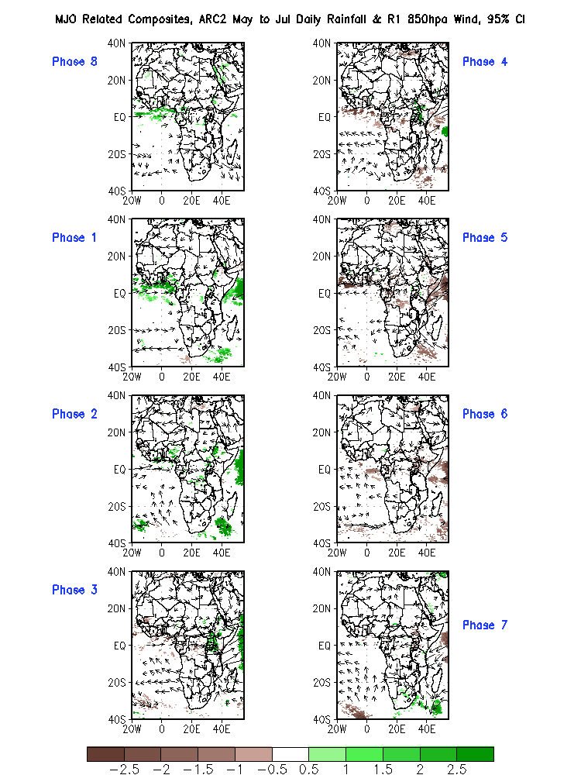
MJJ, 95%

Slide 20
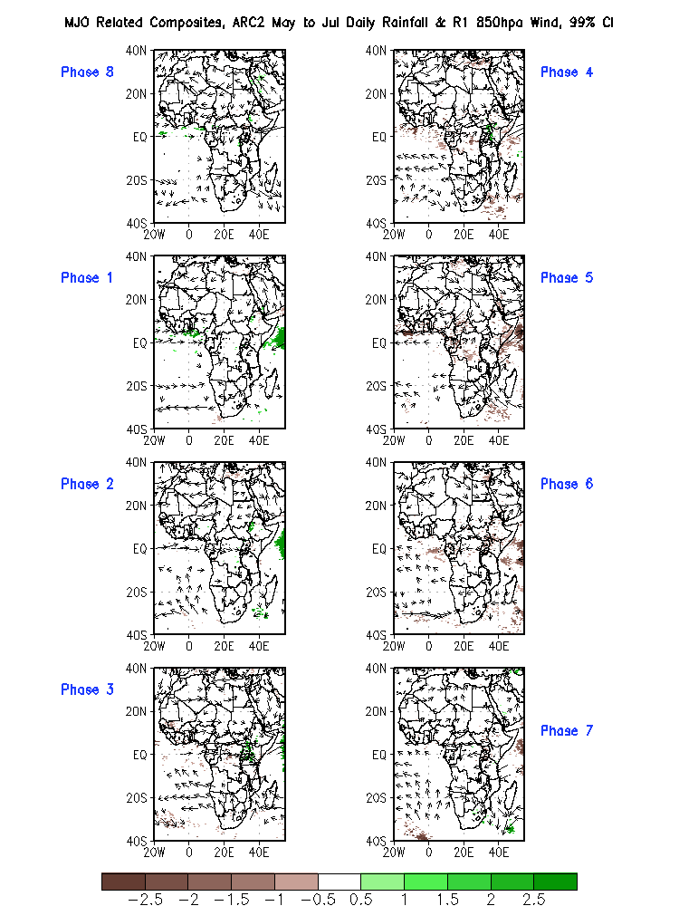
MJJ, 99%

Slide 21
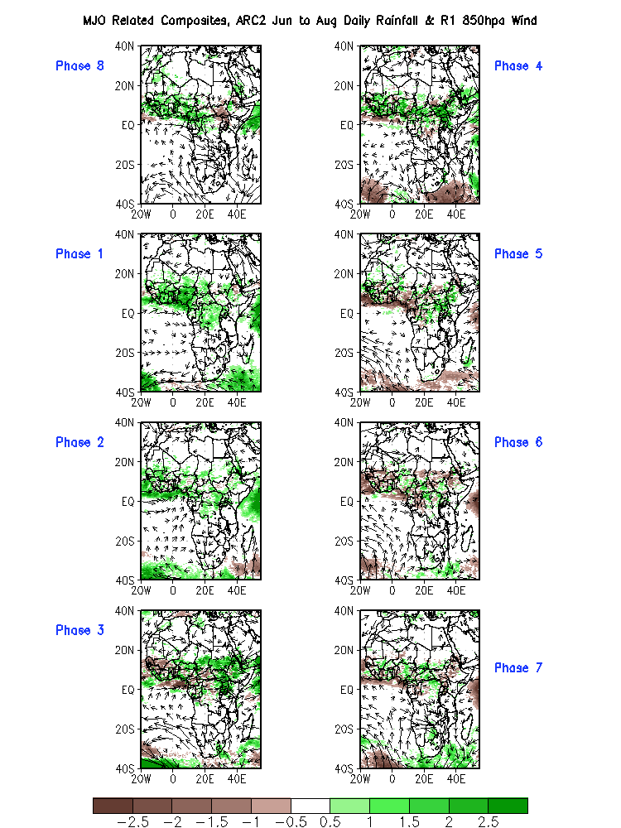
Original Composite - JJA

Slide 22
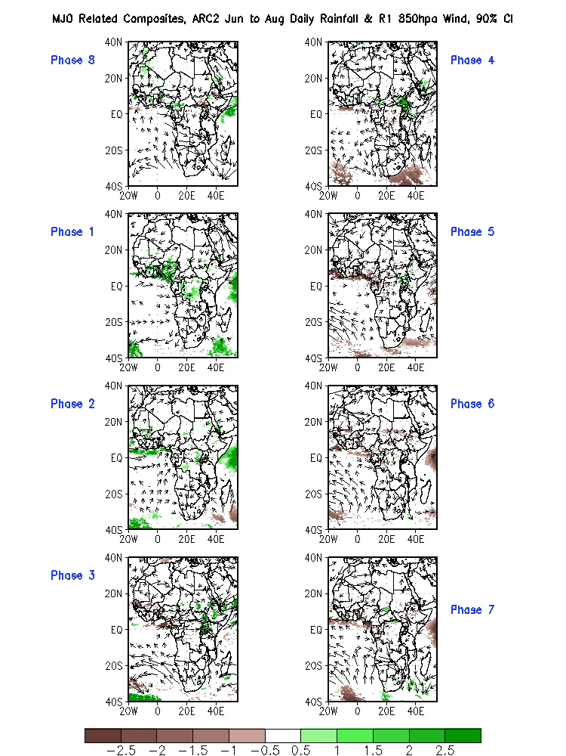
JJA, 90%

Slide 23
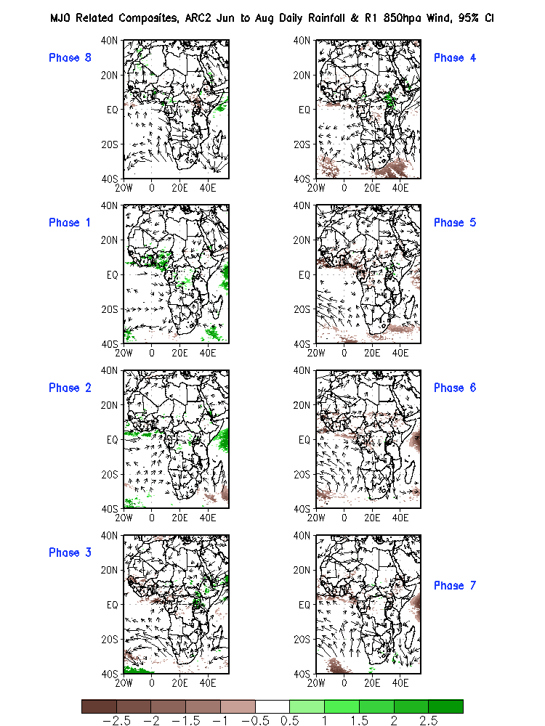
JJA, 95%

Slide 24
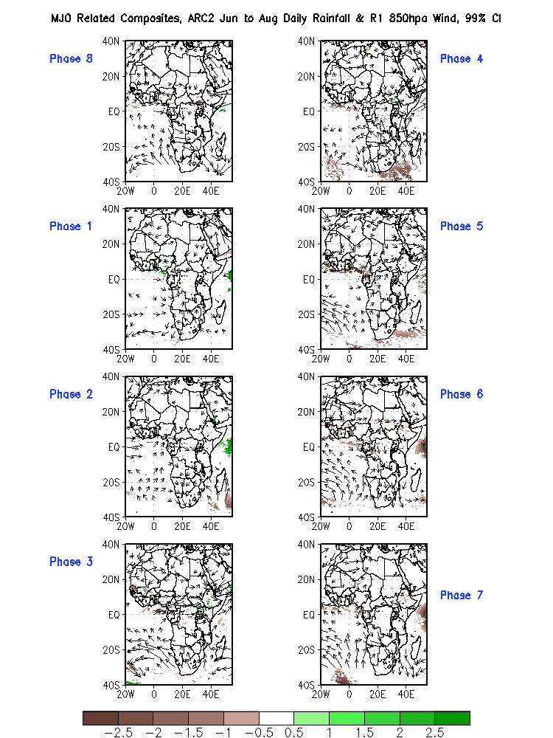
JJA, 99%

Slide 25
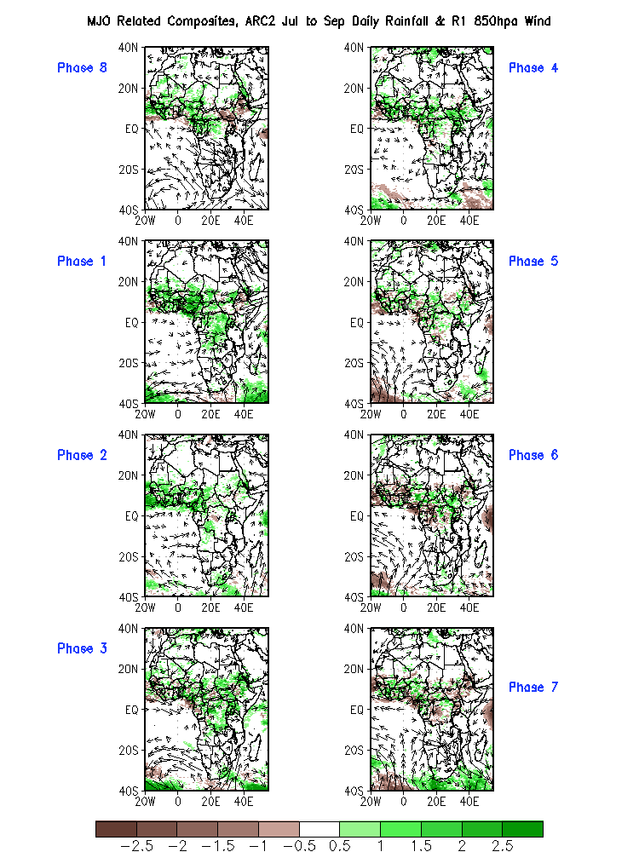
Original Composite - JAS

Slide 26
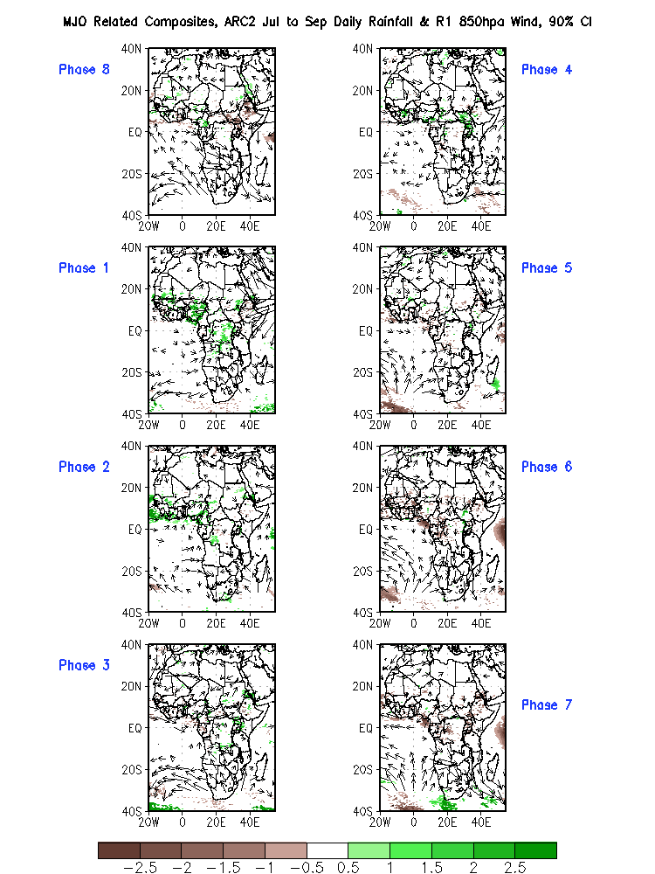
JAS, 90%

Slide 27
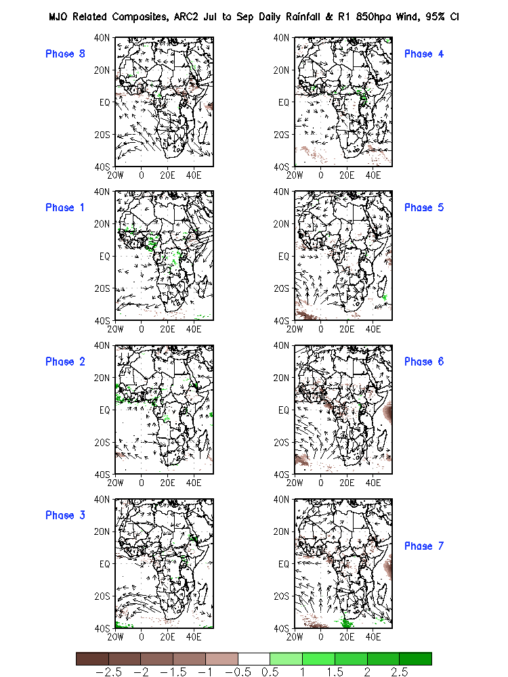
JAS, 95%

Slide 28
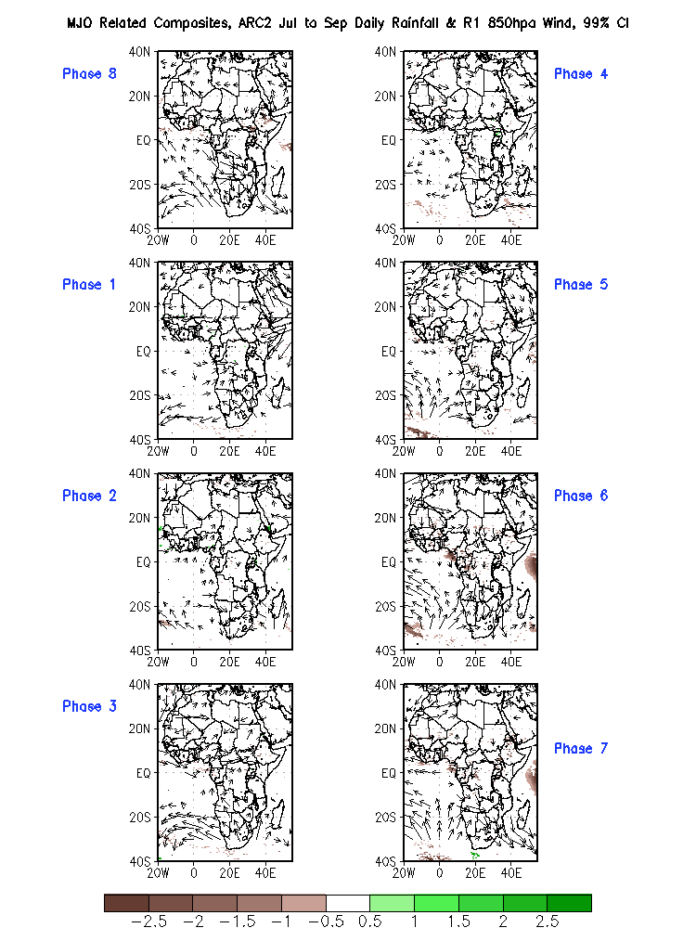
JAS, 99%

Slide 29
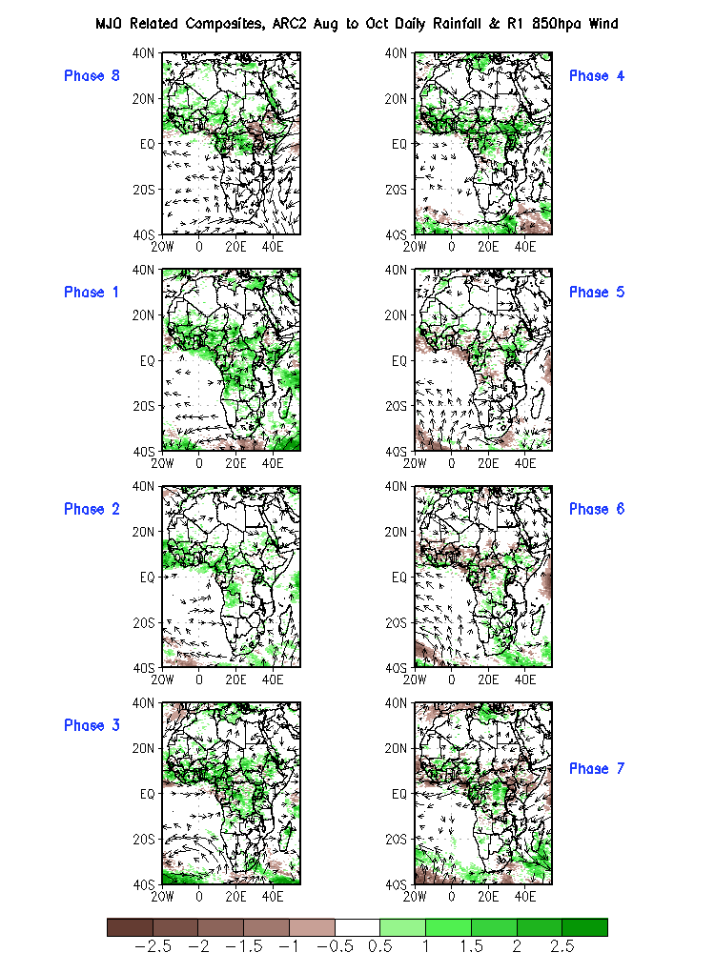
Original Composite – ASO

Slide 30
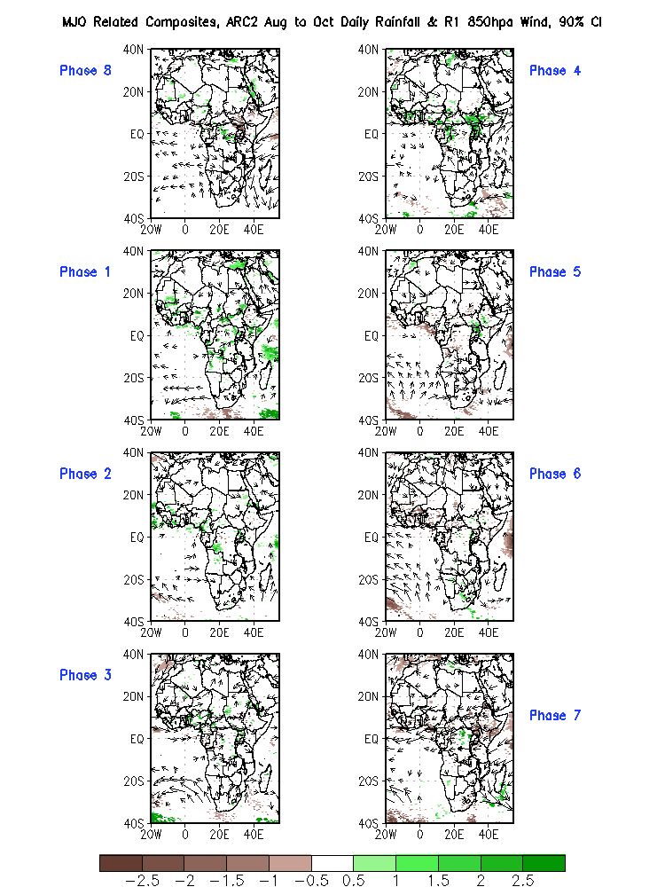
ASO, 90%

Slide 31
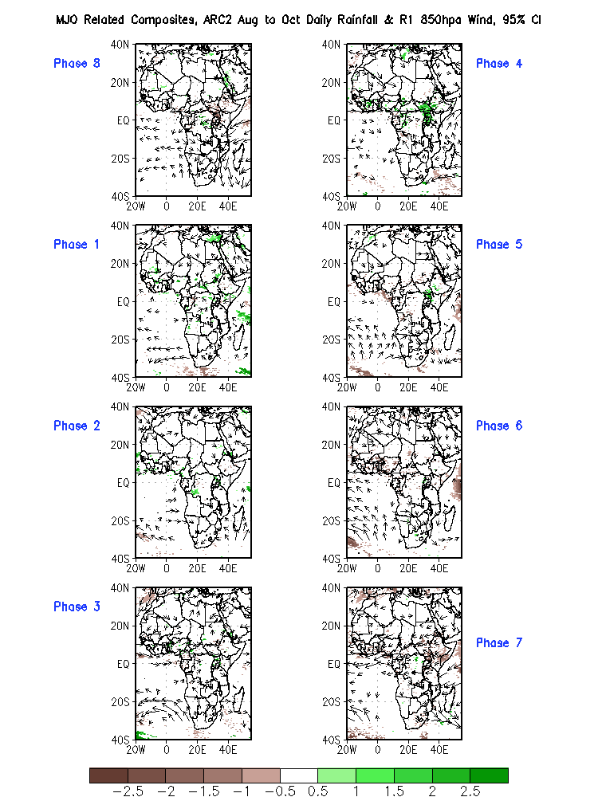
ASO, 95%

Slide 32
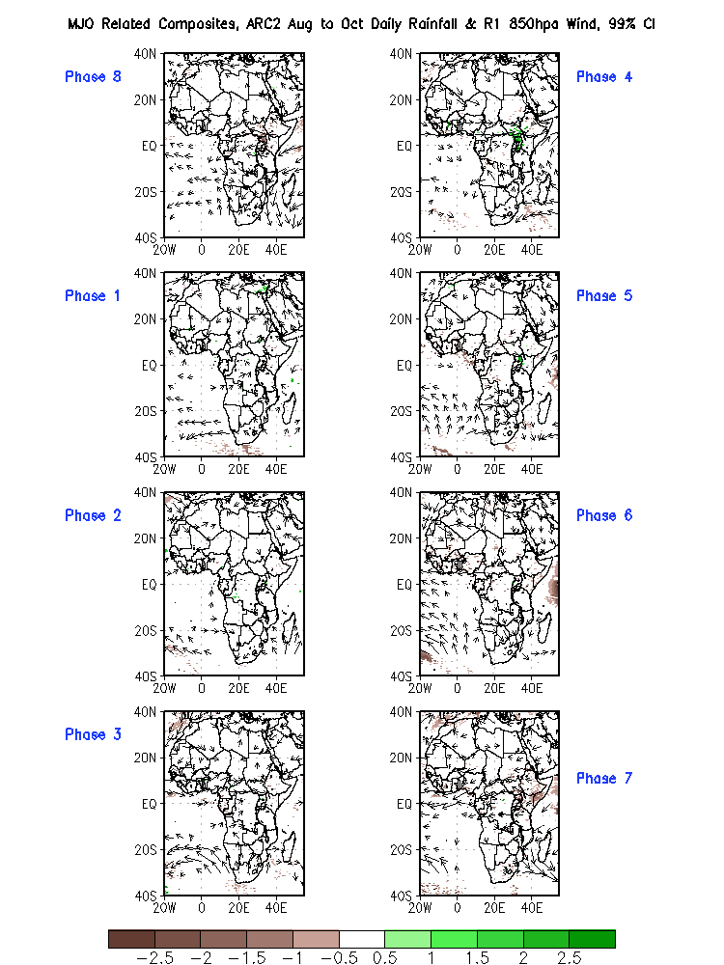
ASO, 99%

Slide 33
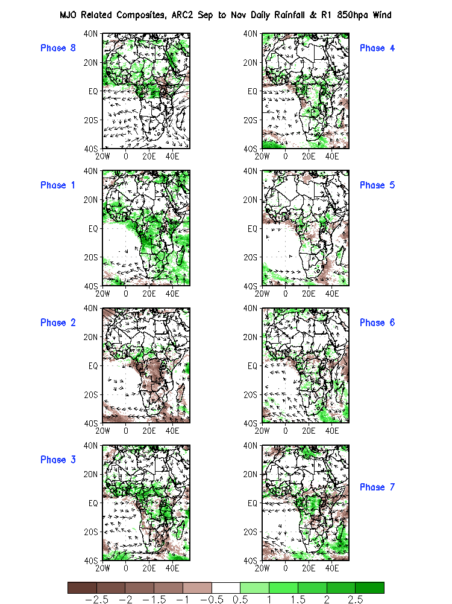
Original Composite – SON

Slide 34
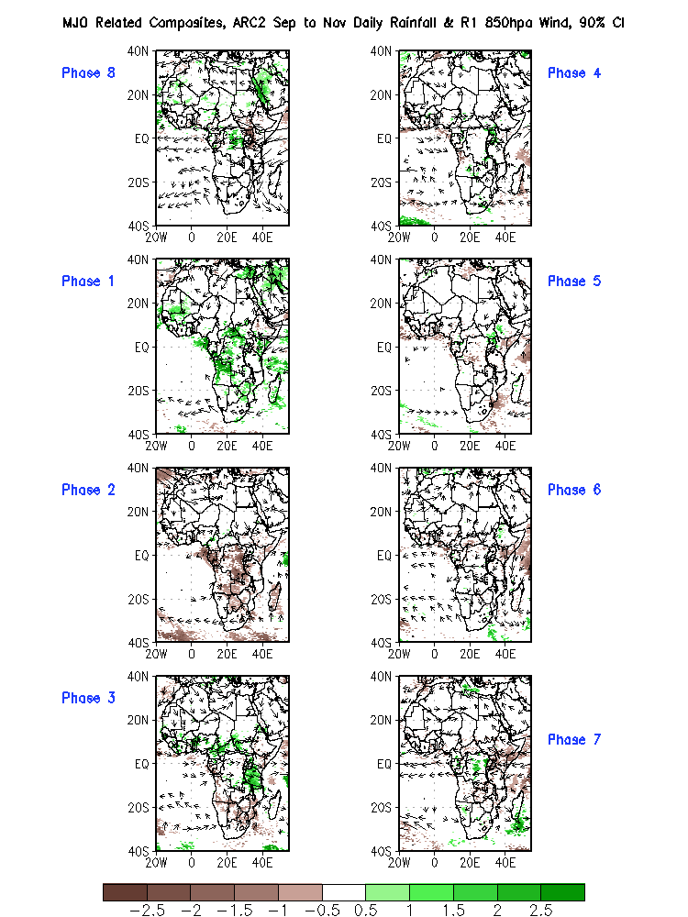
SON, 90%

Slide 35
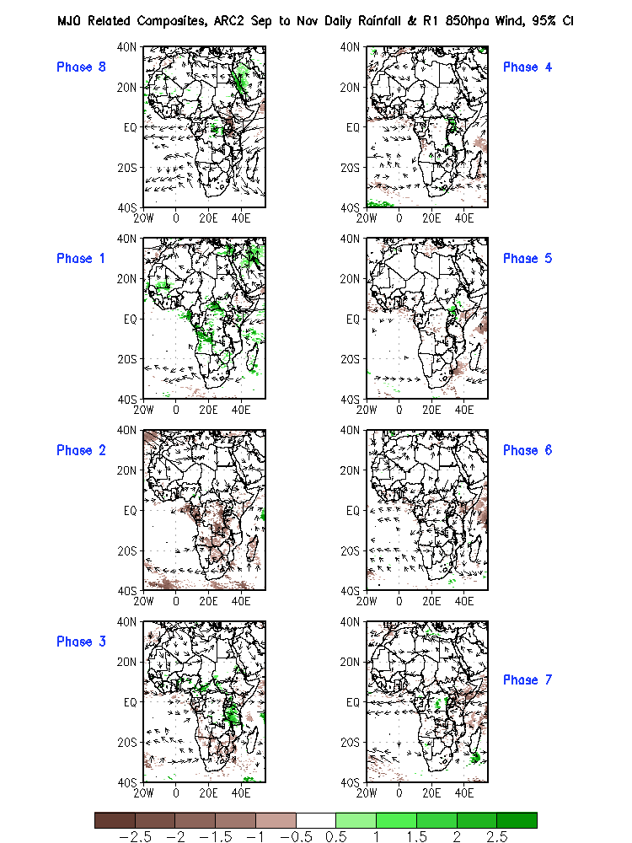
SON, 95%

Slide 36
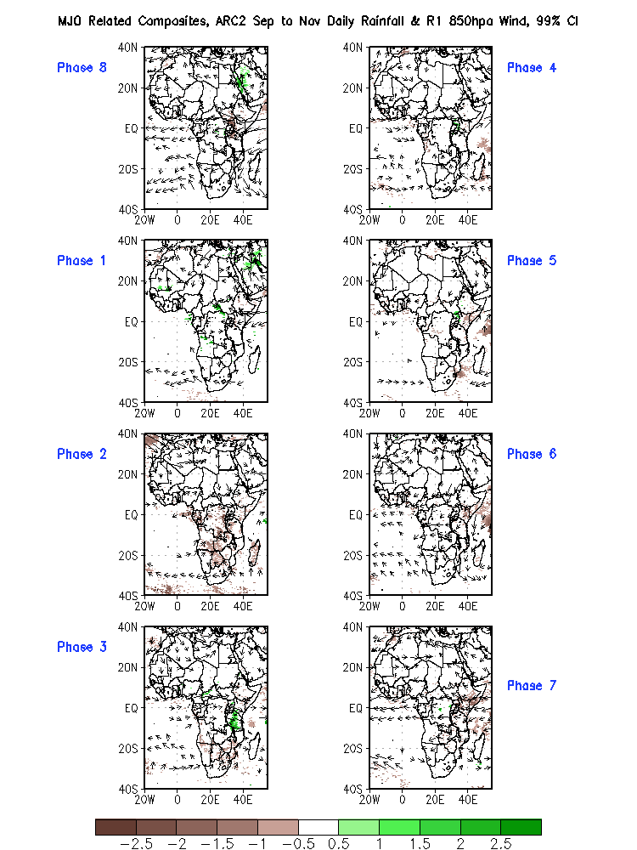
SON, 99%

Slide 37
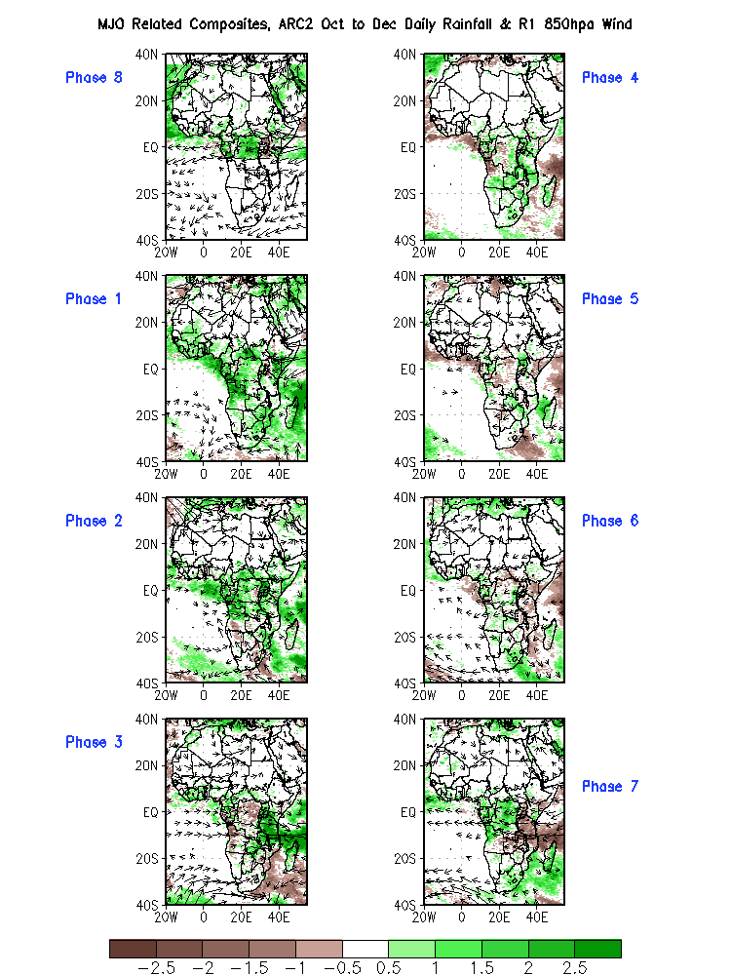
Original Composite – OND

Slide 38
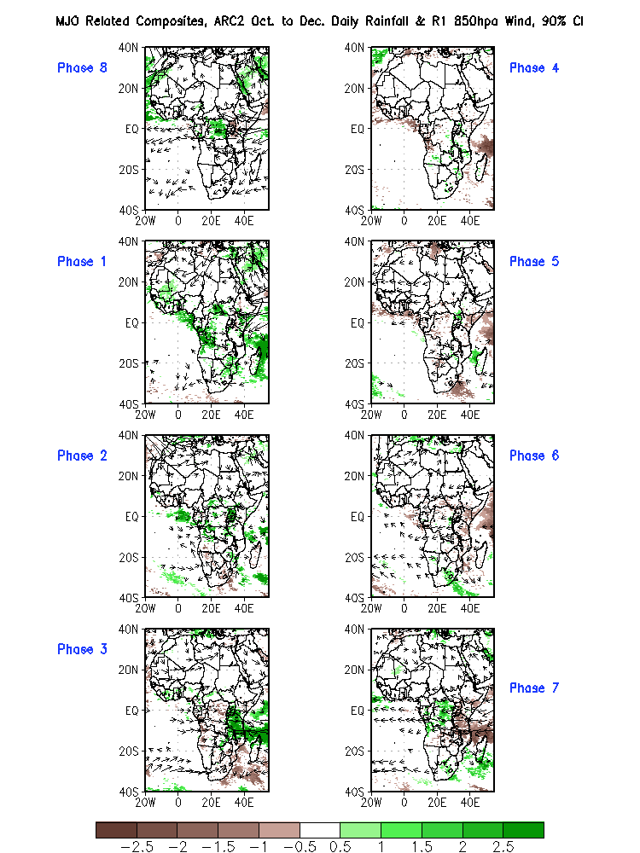
OND, 90%

Slide 39
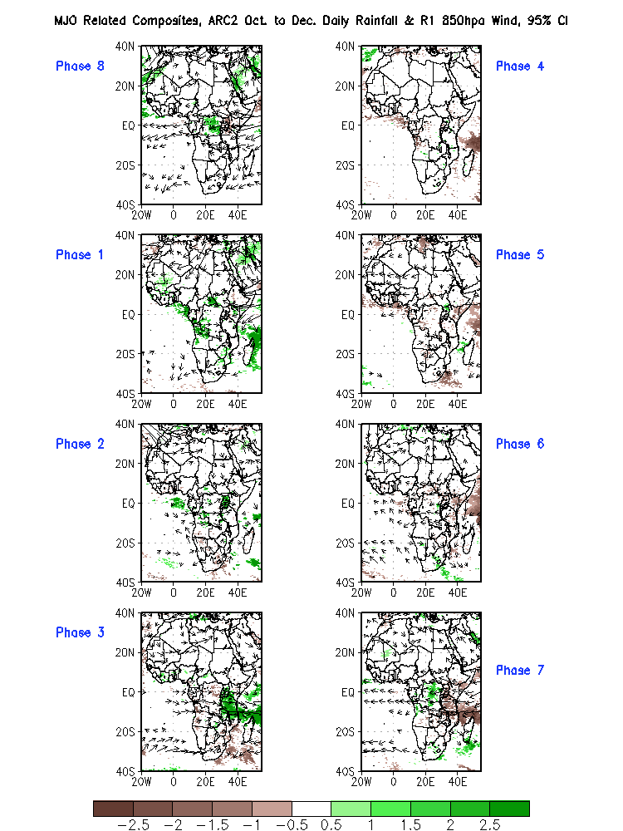
OND, 95%

Slide 40
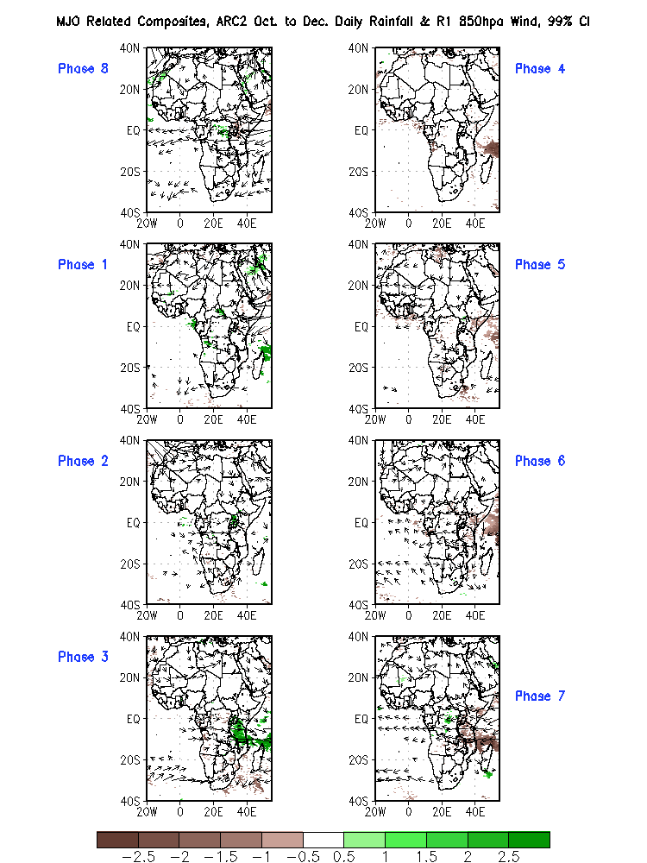
OND, 99%

Slide 41
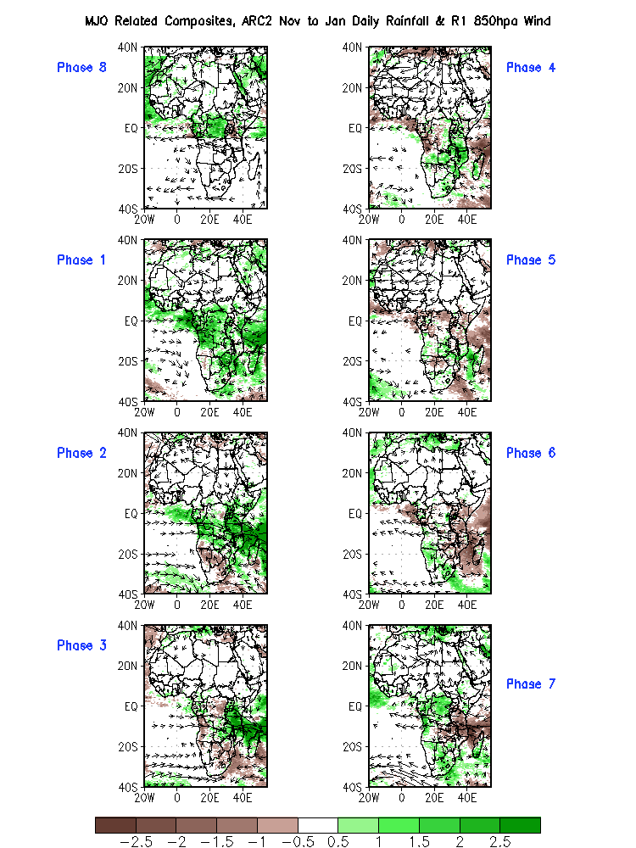
Original Composite – NDJ

Slide 42
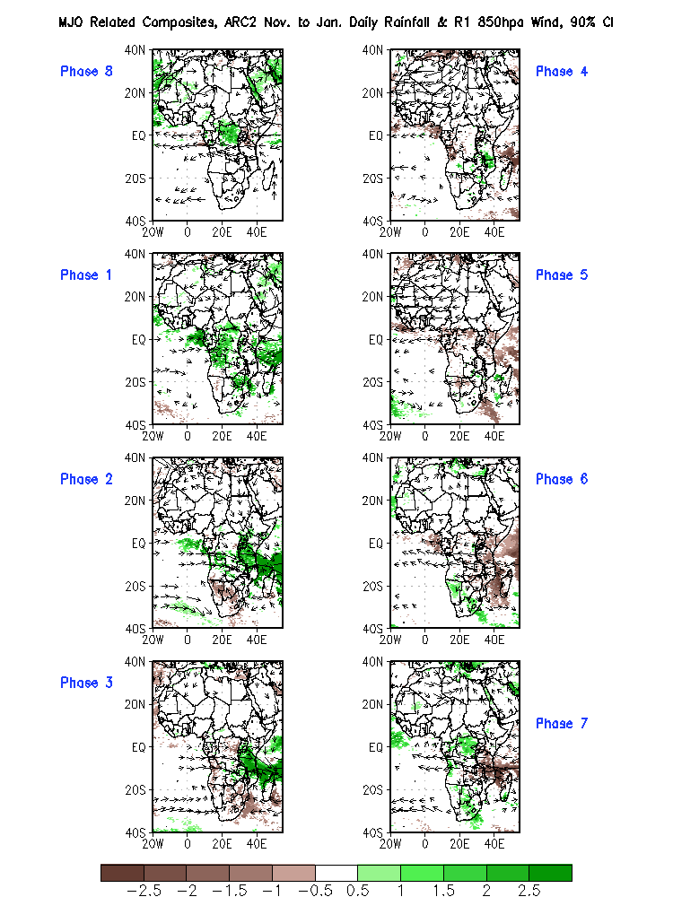
NDJ, 90%

Slide 43
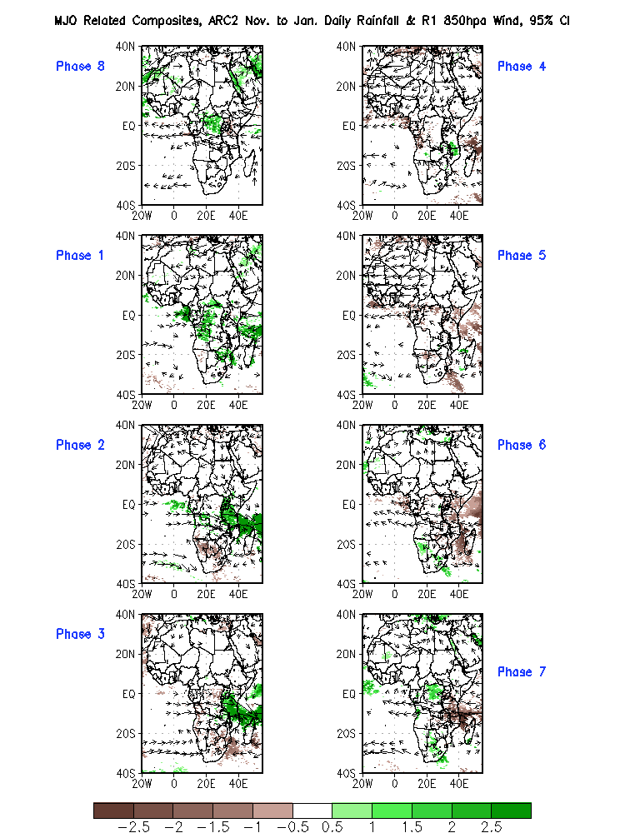
NDJ, 95%

Slide 44
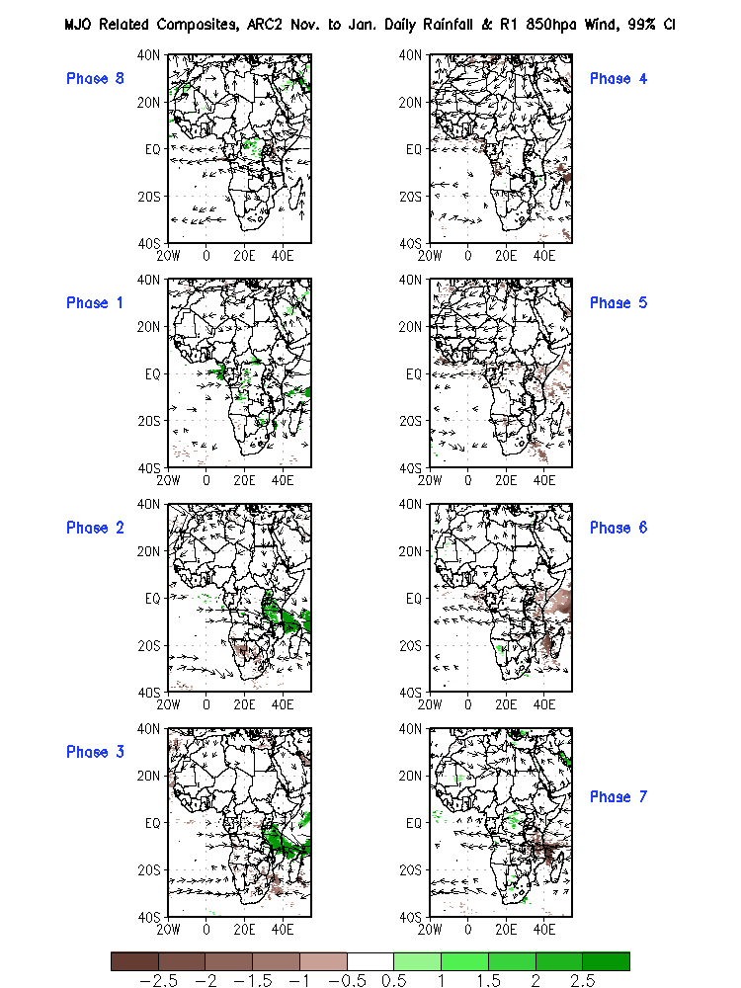
NDJ, 99%

Slide 45
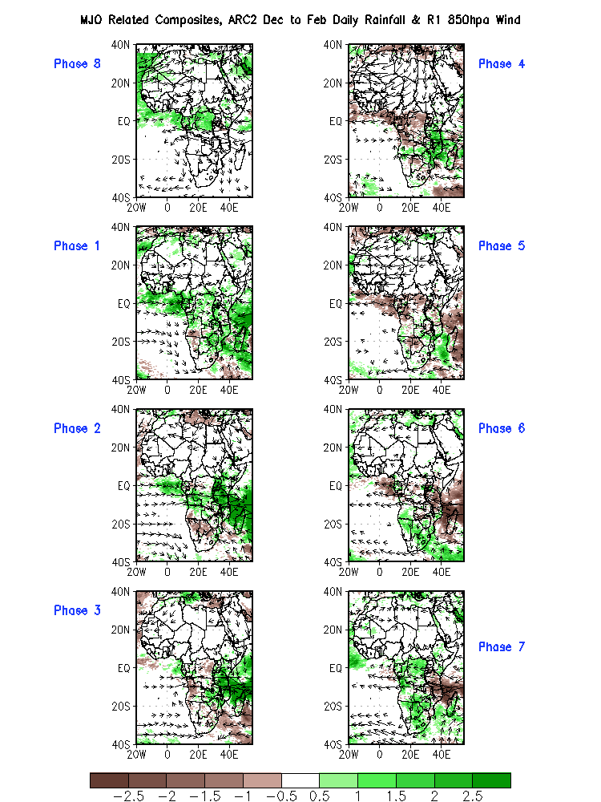
Original Composite – DJF

Slide 46
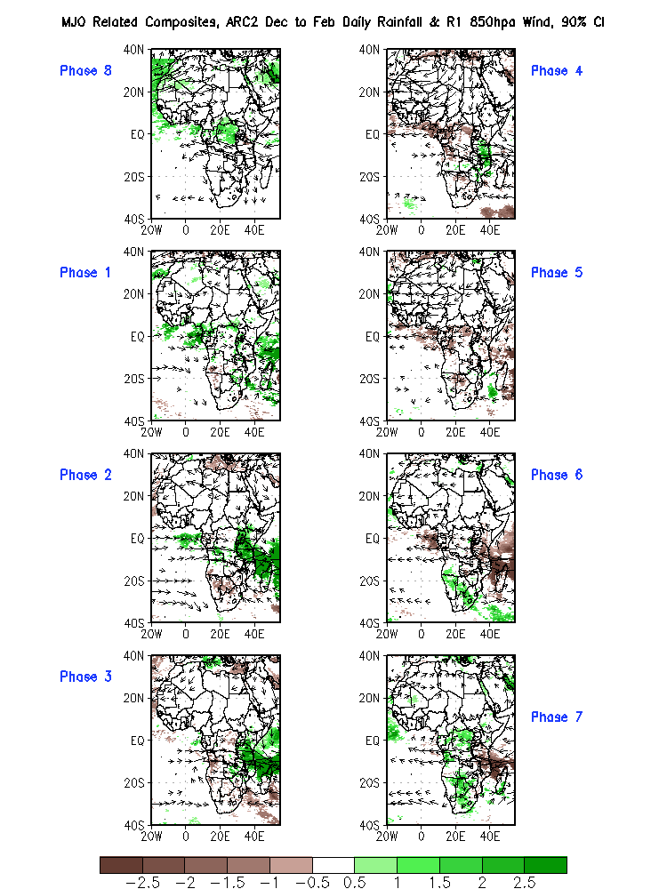
DJF, 90%

Slide 47
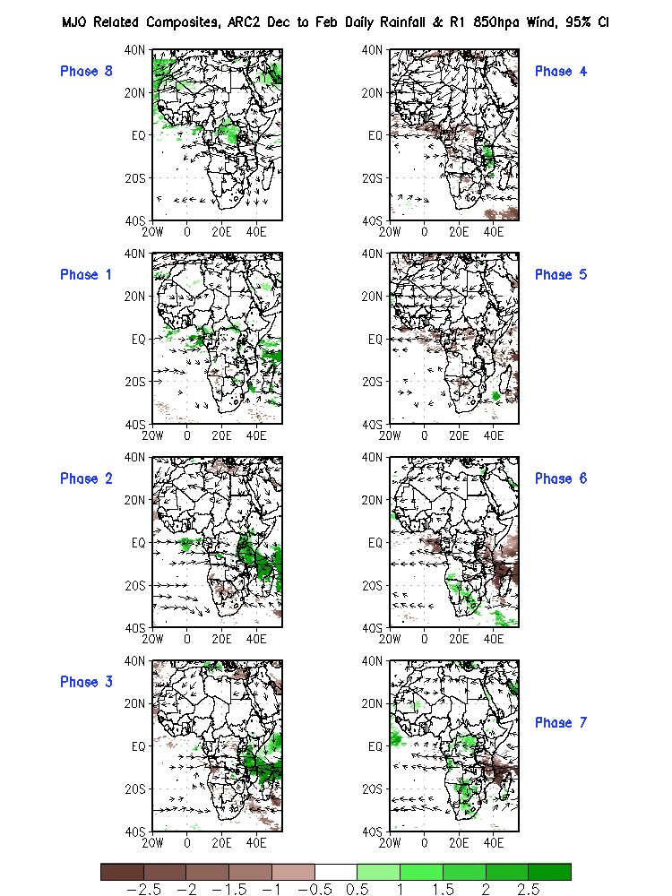
DJF, 95%

Slide 48
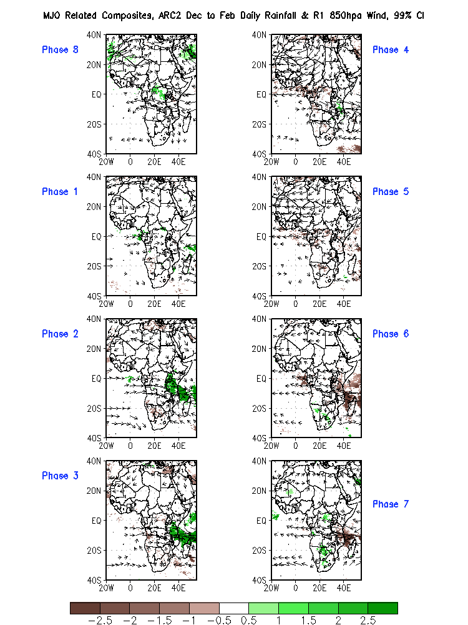
DJF, 99%

