Slide 1
Reanalysis R2
WCOSS: It takes about 3 days for 1-year R2.
Years completed for two 5-year runs
ALL: 2004, 2005, 2006, 2007 (with TAO)
noTAO: 2004, 2005, 2006, 2007 (without TAO)
How to know if an observation is used in data assimilations
For observational data, their values of quality mark (qm) determine whether the observations in BUFR files are used in data assimilations or not.
quality_mark_threshold = 2
Observations with a qm equal to or less than this threshold will be retained.
Observations with a qm greater than this threshold will be discarded.
How to exclude TAO surface wind observations from R2
Set the related observation error to be a missing value (10⁹)
New quality mark = 9 for TAO wind observations
PREBUFR files don’t include QuikSCAT wind data.

Slide 2
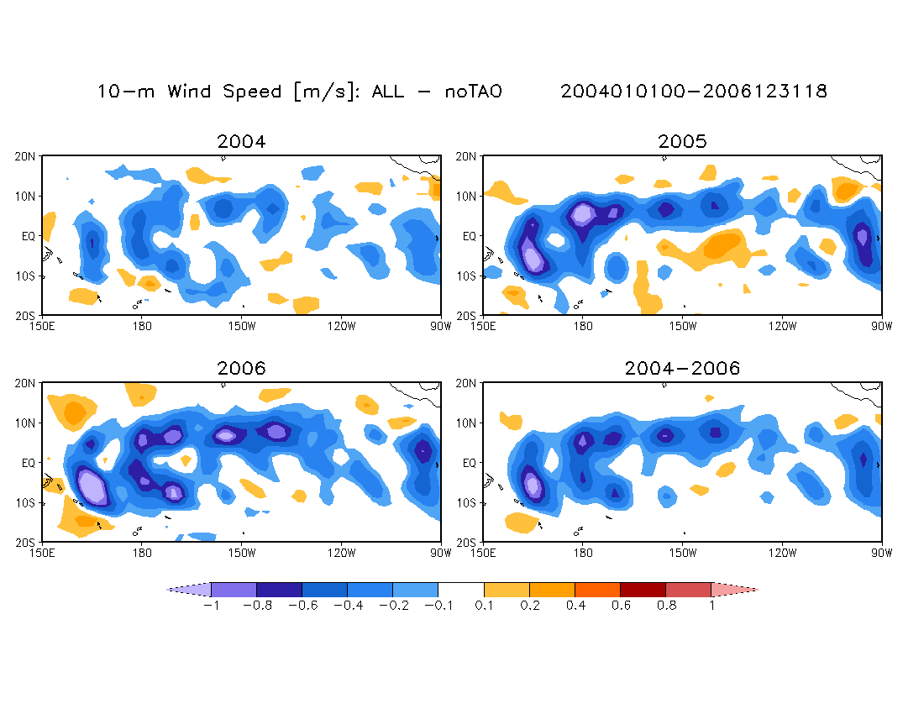
Unlike the ECMWF result (next slide), ALL has weaker winds.
/sss/cpc/shared/Hui.Wang/home/data/Ana_5yr/s3_diff_wnd10m.annual.gs

Slide 4
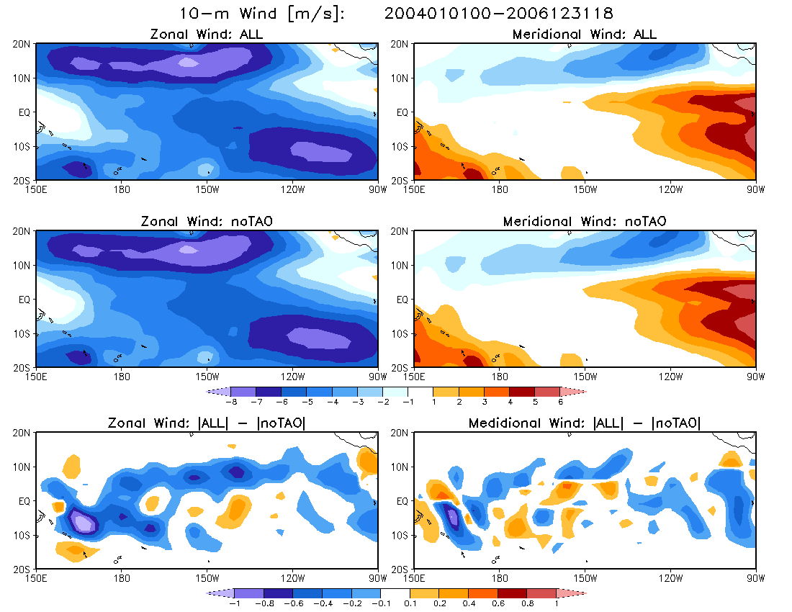
3-yr mean
Stronger easterlies
Difference
/sss/cpc/shared/Hui.Wang/home/data/Ana_5yr/
s3_diff_wnd10m.uv.gs

Slide 5
How many observational data from ocean platforms are used in the data assimilations for R2?
Ocean platforms: SHIP, BUOY, C-MAN(Coastal Marine Automated Network)
BUFR message type: SFCSHP
Variables: P, Q, T, Z, U, V
oiqc.anl.2004010600.bufr → SFCSHP.2004010600
BUFR file Text file
#------------------------------------------------------------------------------------------------------------------------------------
#SID XOB YOB DHR ELV TYP T29 ITP lev var OB qm pc rc fc an cat
#------------------------------------------------------------------------------------------------------------------------------------
51304 189.99 -4.99 0.000 0.0 282.0 562.0 99.0 1 P 1013.0 3.0 1.0 99999999 99999999 99999999 6.0
51304 189.99 -4.99 0.000 0.0 282.0 562.0 99.0 1 Q 99999999 99999999 99999999 99999999 99999999 99999999 6.0
51304 189.99 -4.99 0.000 0.0 282.0 562.0 99.0 1 T 99999999 99999999 99999999 99999999 99999999 99999999 6.0
51304 189.99 -4.99 0.000 0.0 282.0 562.0 99.0 1 Z 99999999 99999999 99999999 99999999 99999999 99999999 6.0
51304 189.99 -4.99 0.000 0.0 282.0 562.0 99.0 1 U -4.9 2.0 1.0 99999999 -5.2 99999999 6.0
51304 189.99 -4.99 0.000 0.0 282.0 562.0 99.0 1 V -8.5 2.0 1.0 99999999 -11.8 99999999 6.0
Lon Lat ATLAS OBS Quality Forecast
buoy U,V mark

Slide 6
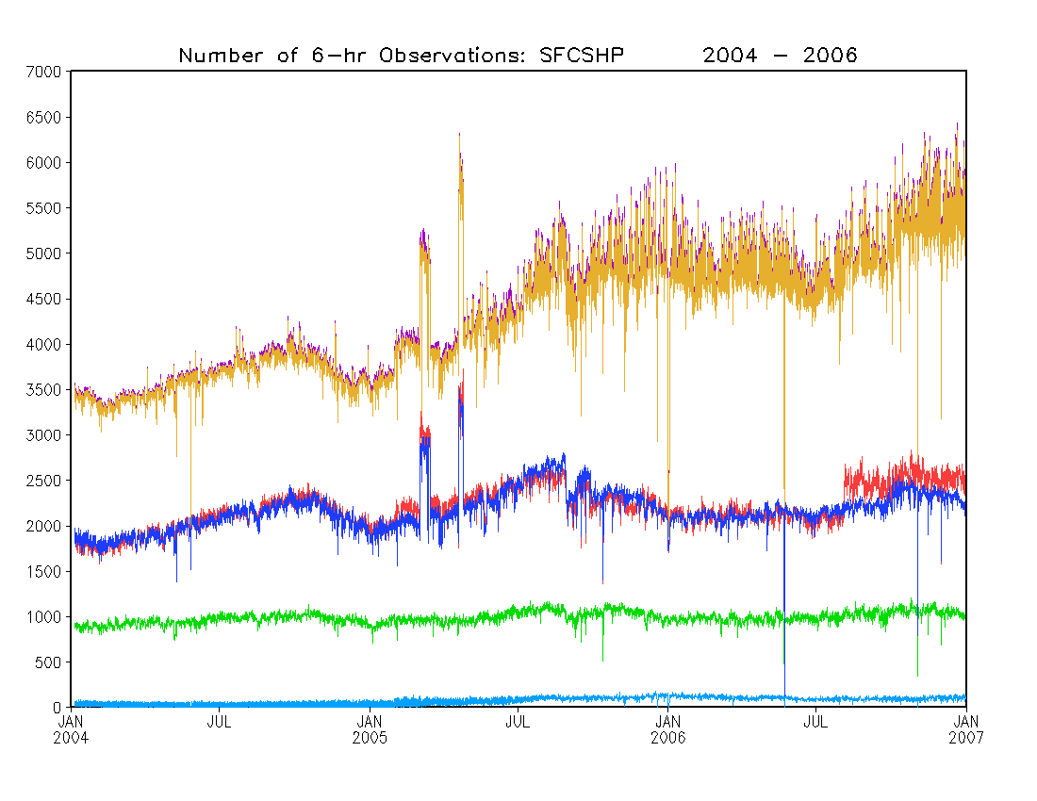
Z
Number of OBS
P
T
U,V
Q
U,V (TAO)

Slide 7
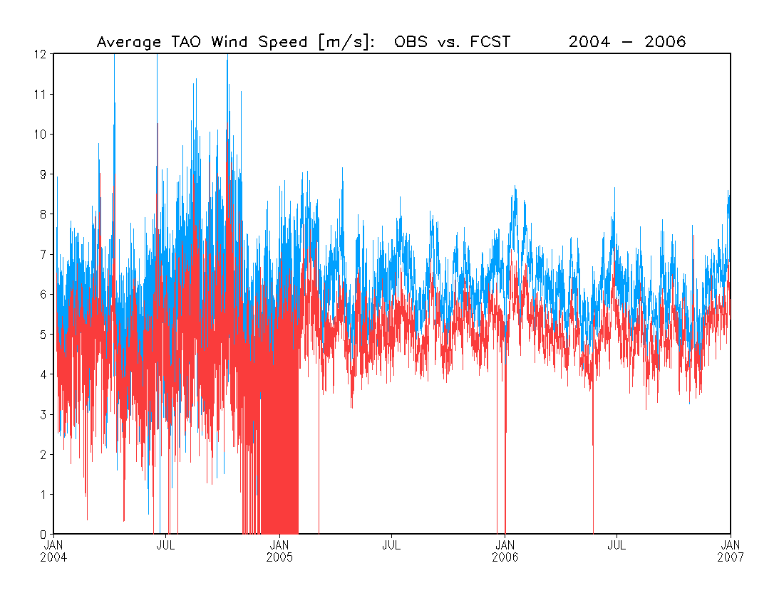
Wind Speed
TAO OBS
FCST
Wind speed [m/s]
Overall, the mean first guess values (FCST) are larger than the mean TAO observations.

Slide 8
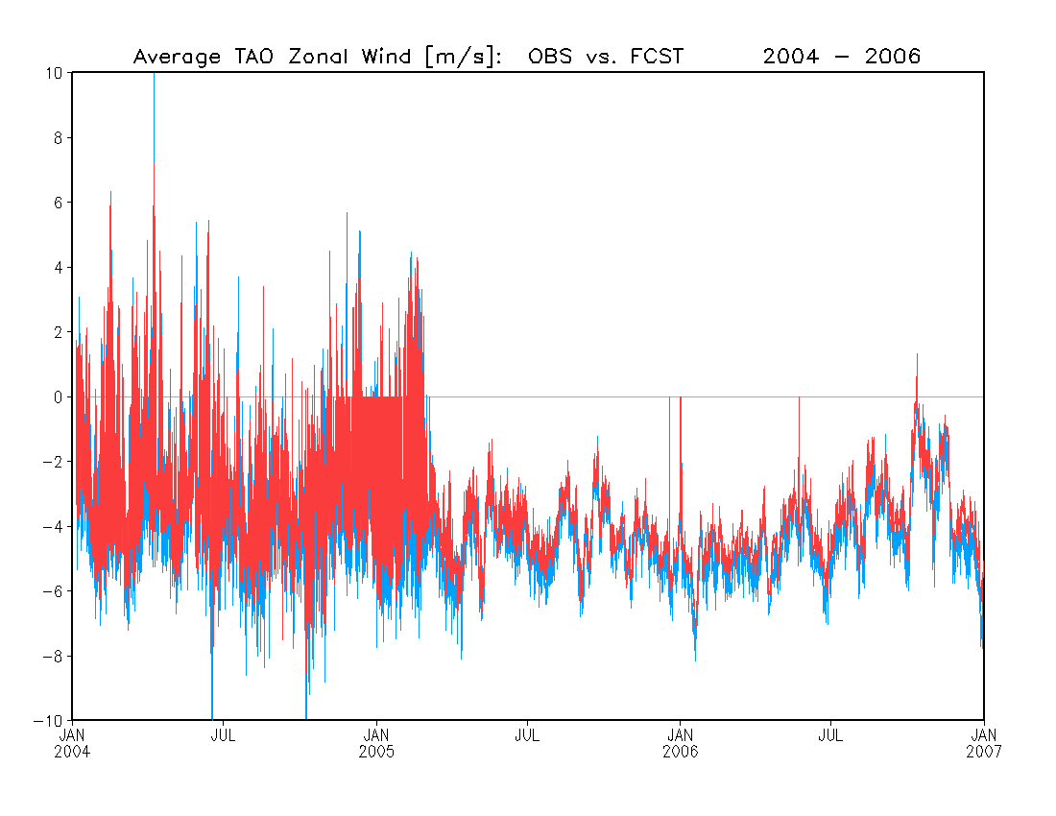
Zonal Wind
TAO OBS
FCST
Zonal wind [m/s]

Slide 9
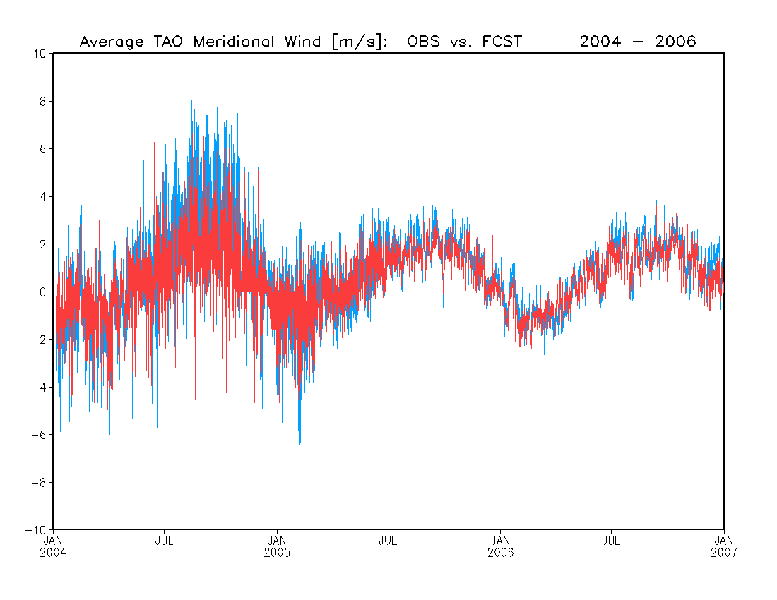
Meridional Wind
TAO OBS
FCST
Meridional wind [m/s]

