Slide 1
5-Day Forecasts
Feb and Mar 2008:
60 days, 4xdaily: total 240 5-day forecasts
Initial conditions:
R2
noTAO
5-day evolution of RMS difference between the two sets of runs
Averaged over the 240 forecasts

Slide 2
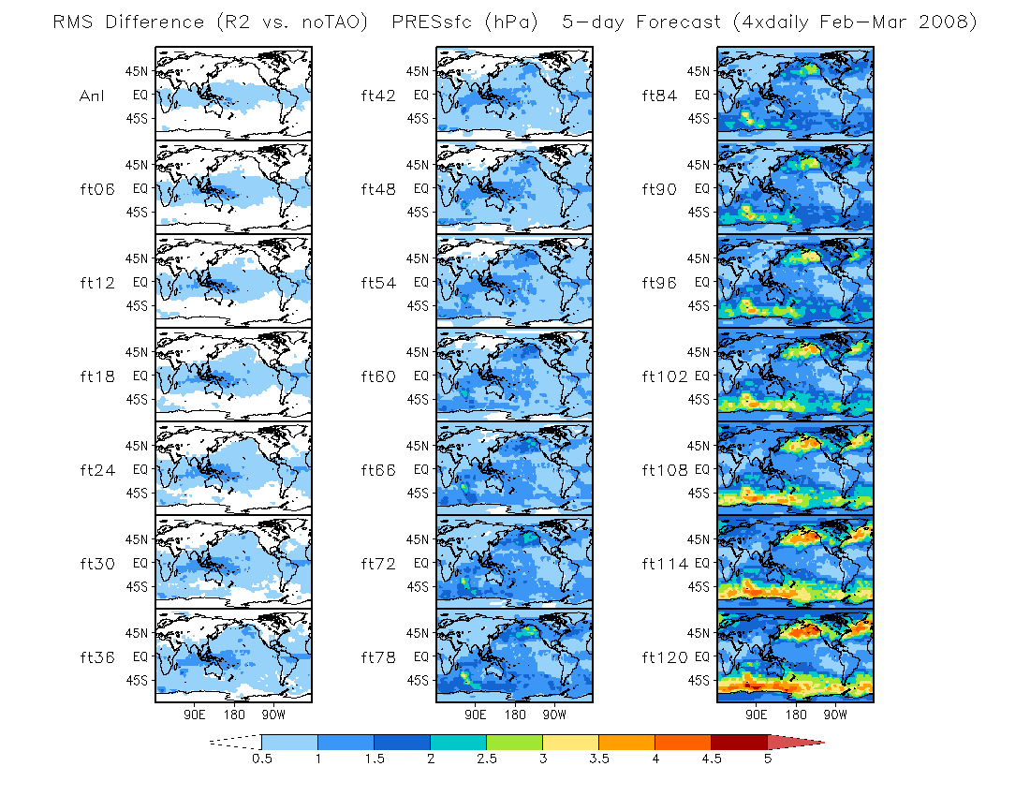

Slide 3
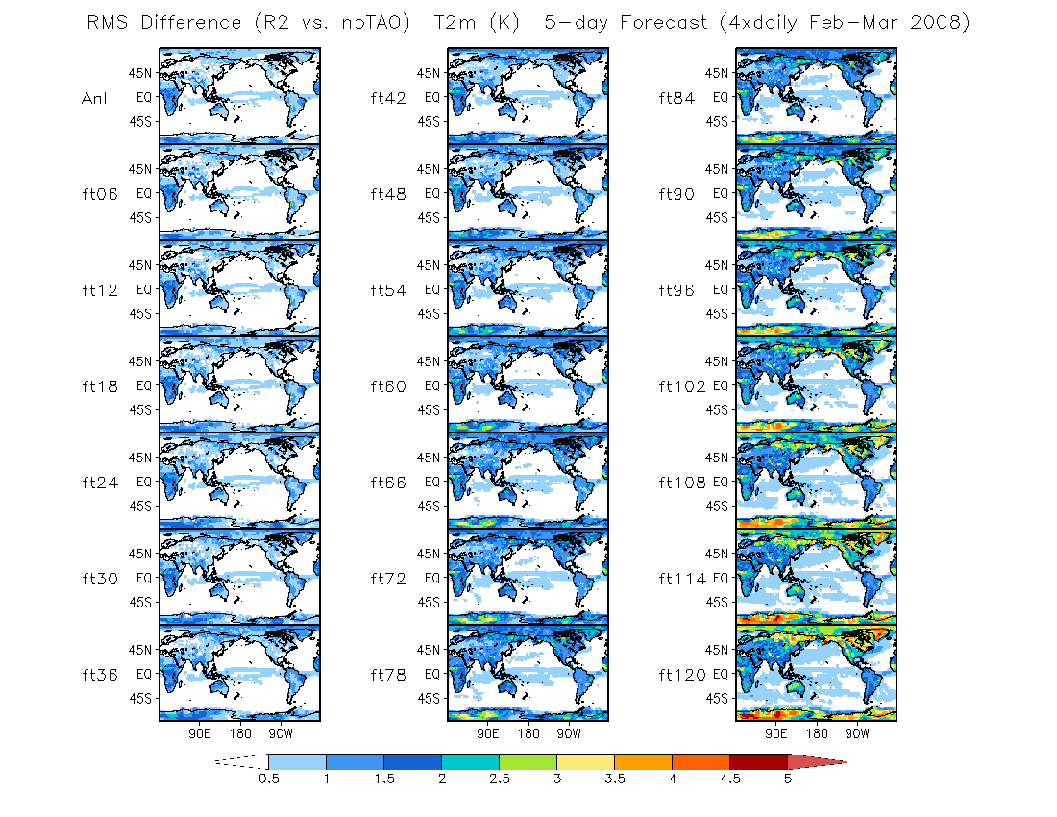

Slide 4
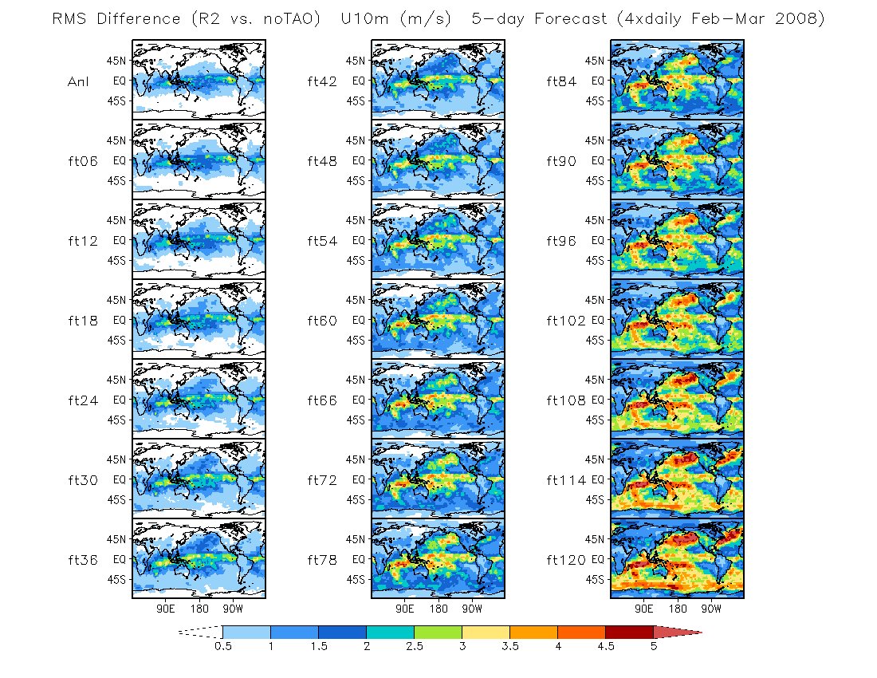

Slide 5
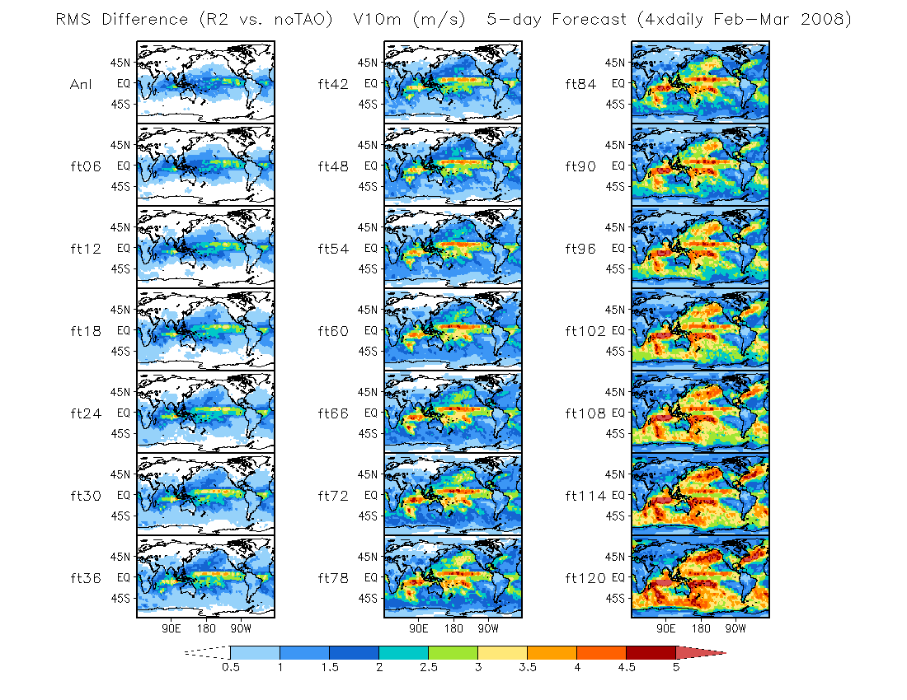

Slide 6
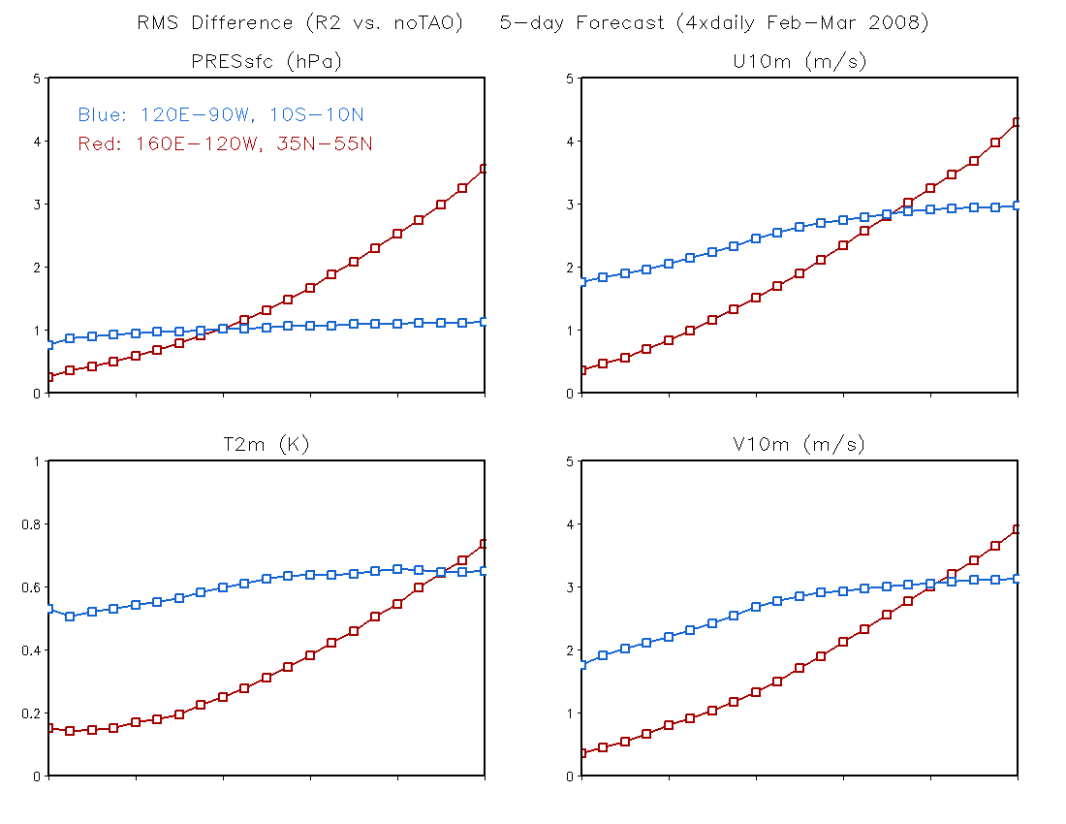
0 1 2 3 4 5
0 1 2 3 4 5
Day
Day
0 1 2 3 4 5
0 1 2 3 4 5
Day
Day

