Slide 1
Development of Experimental Severe Weather Outlook for Weeks 2 to 4
Week-2 Severe Weather Discussion
20 July 2017

Slide 2
Year 1
Week 2 forecast
Model data: Variables from GEFS forecasts
OBS data: CFSR
SW: LSR (Local Storm Report)
Hail
Tornado
Damaging wind
SCP: Supercell Composite Parameter
SCP = (CAPE/1000 J kg⁻¹)×(SRH/50 m⁻² s⁻²)×(BWD/20 m s⁻¹)
CAPE: convective available potential energy
BWD: bulk wind difference
SRH: storm-relative helicity

Slide 3
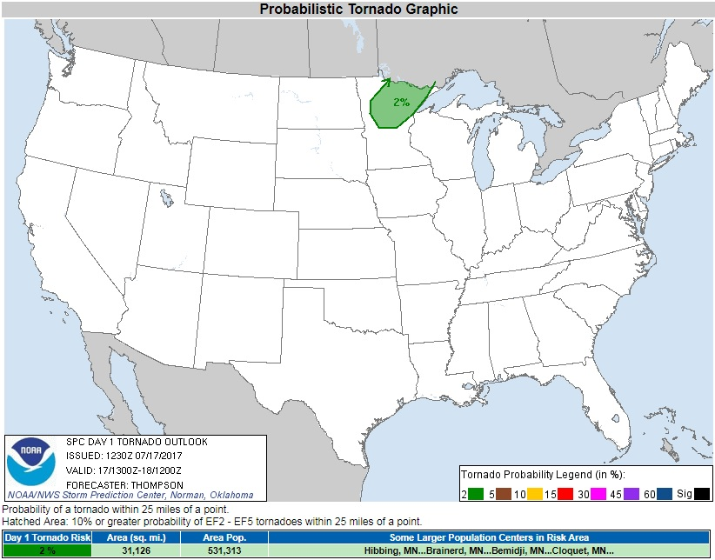
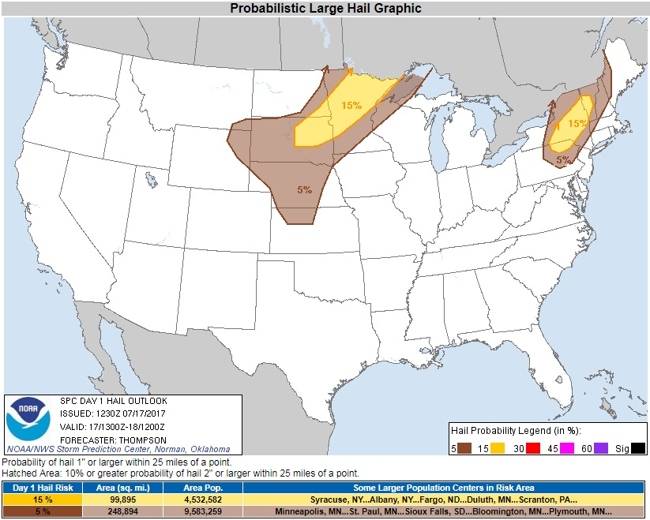
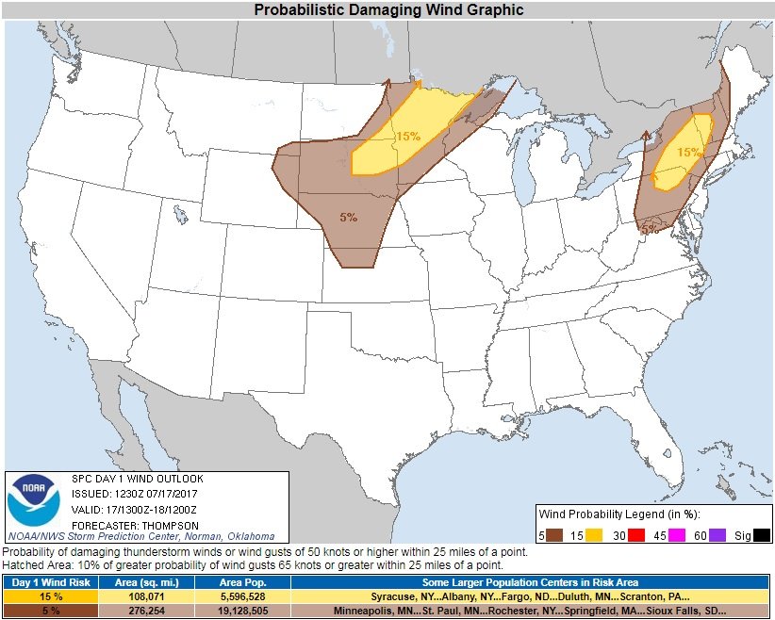
Storm Prediction Center
Severe Weather Outlook
Probabilistic forecast
Tornado
Hail
Damaging wind
Tornado
Day 1 Outlook Valid: 17/1300Z–18/1200Z
Hail
Wind

Slide 4
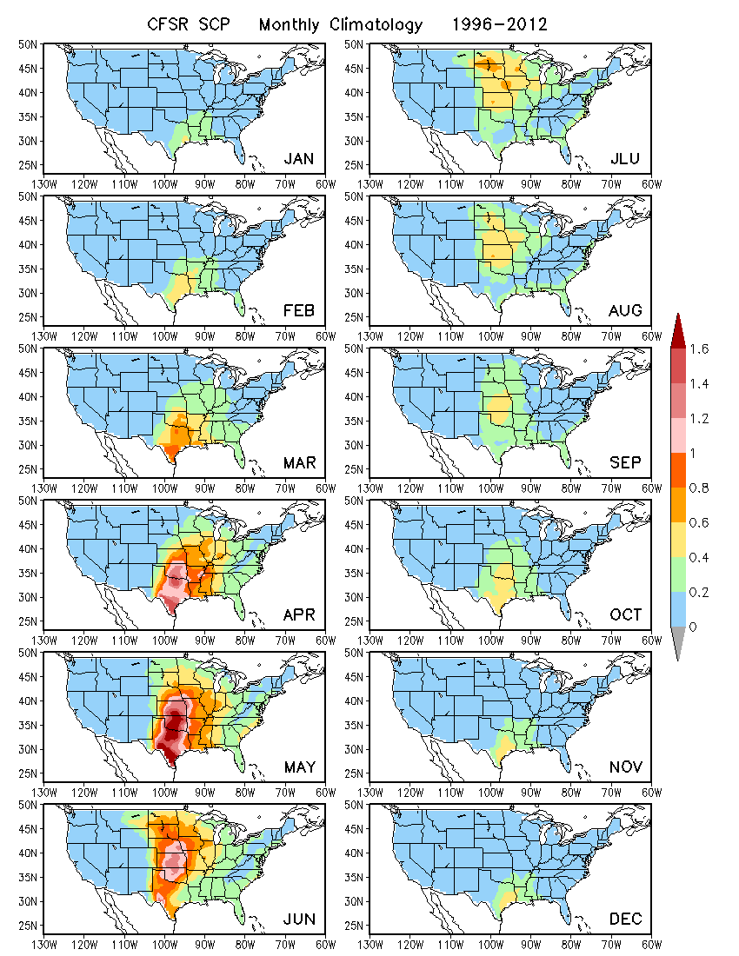
Characteristics of SCP in OBS
SCP in CFSR is the proxy for OBS.
Monthly climatology
Spatial pattern
Seasonality

Slide 5
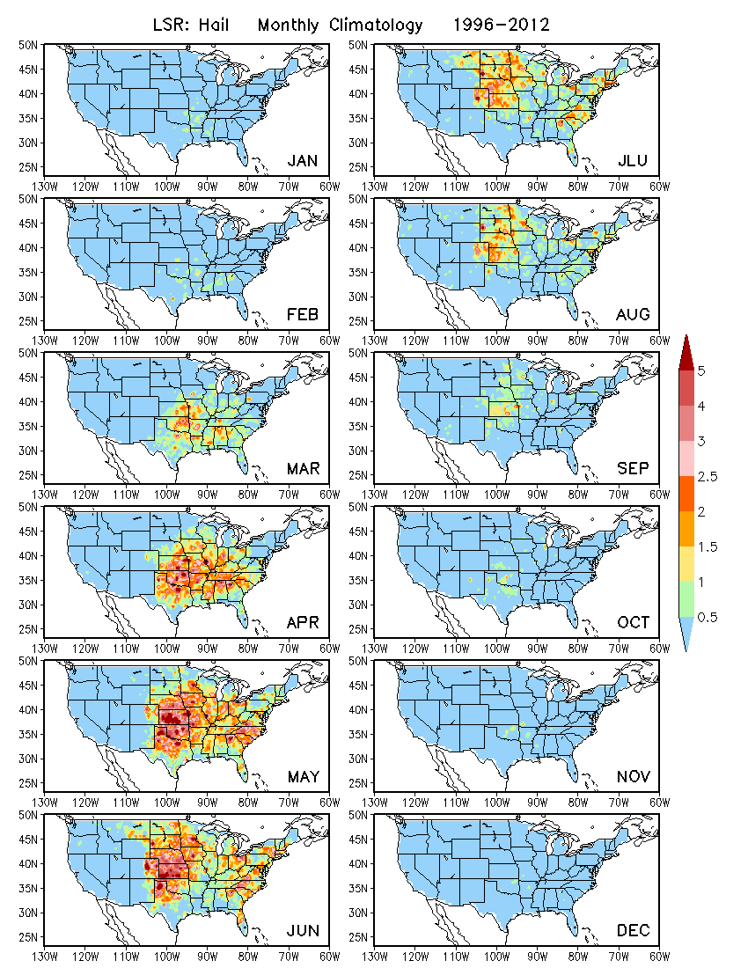
Characteristics of LSR in OBS
Hail
Monthly climatology
Spatial pattern
Seasonality

Slide 6
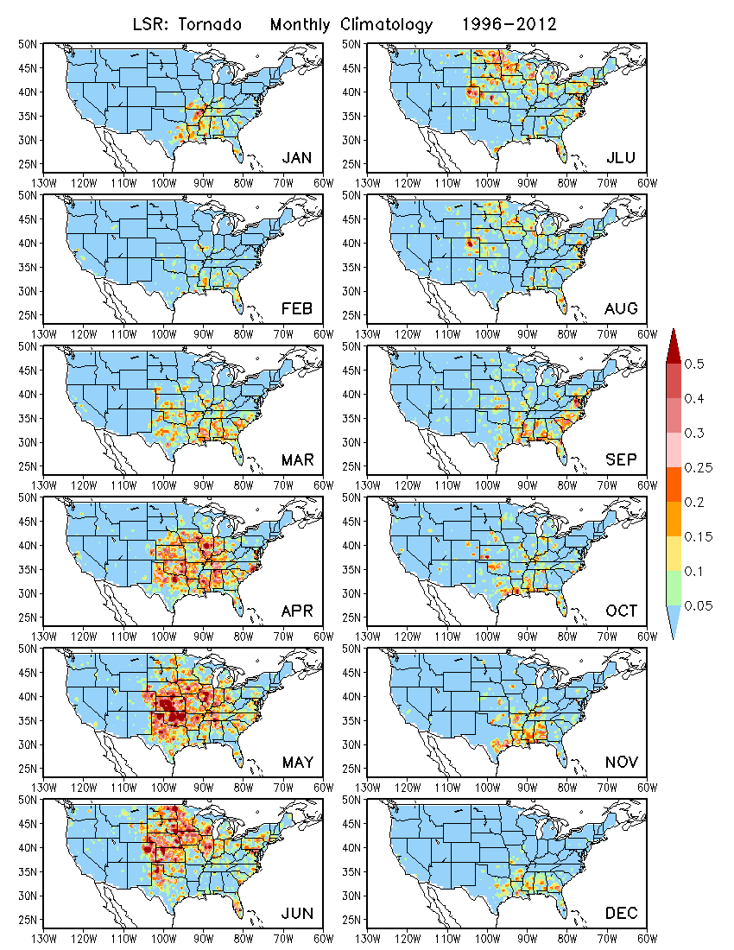
Characteristics of LSR in OBS
Tornado
Monthly climatology
Spatial pattern
Seasonality

Slide 7
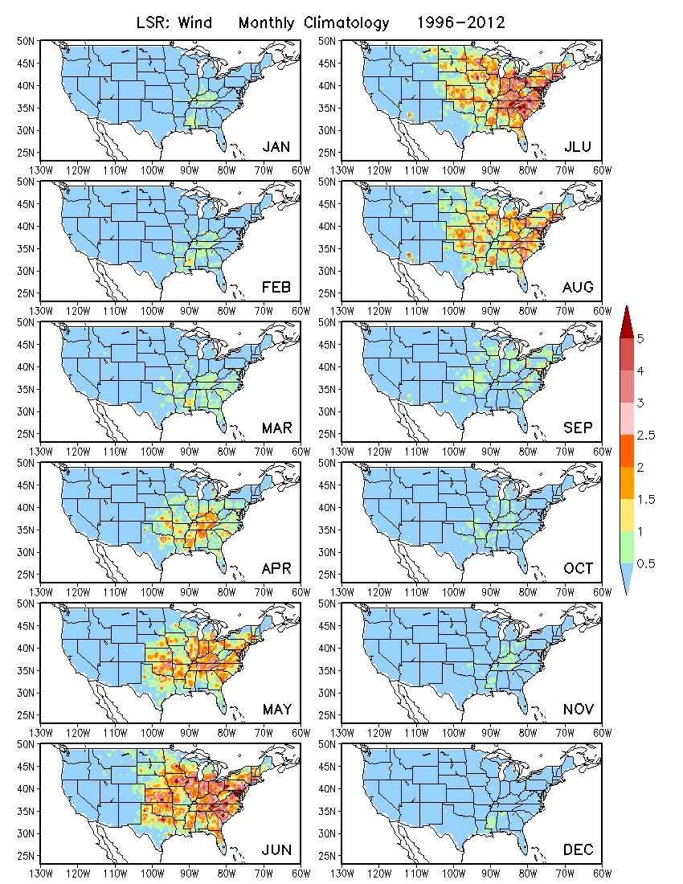
Characteristics of LSR in OBS
Wind
Monthly climatology
Spatial pattern
Seasonality

Slide 8
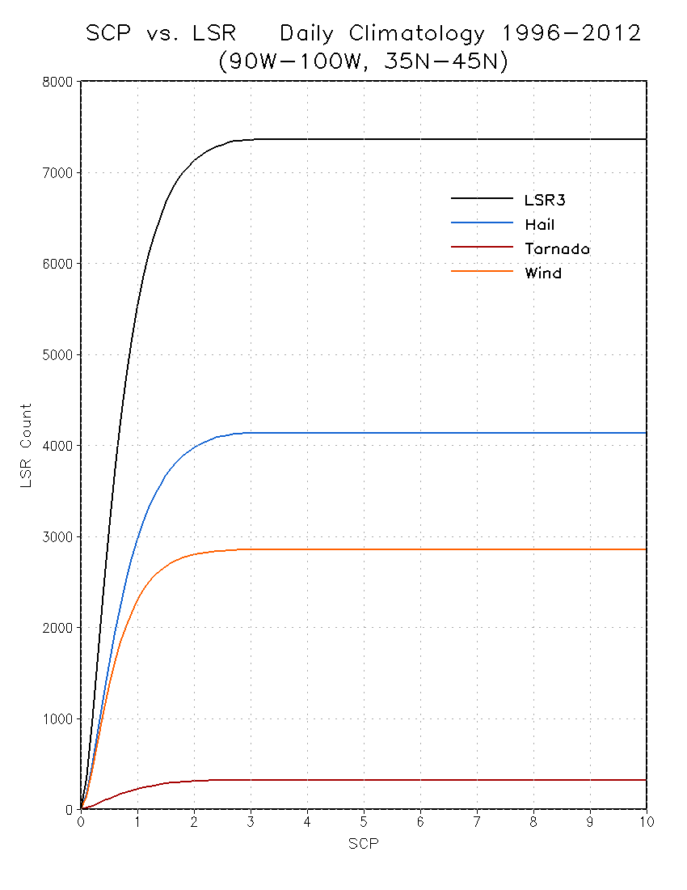
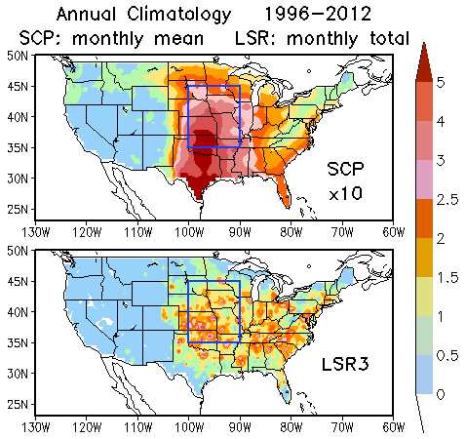
Relationship between
observed SCP and LSR
How does LSR vary with SCP?
Are there thresholds of SCP for LSR?
LSR3
Hail
?
Wind
?
Tornado

Slide 9
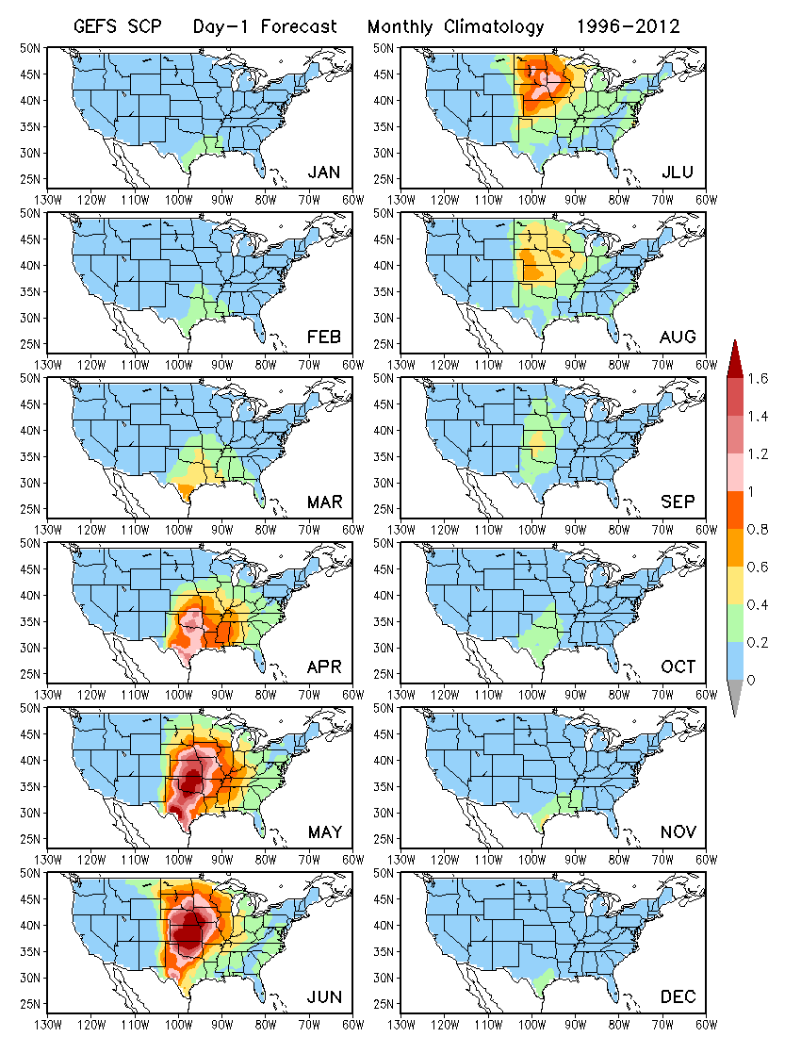
GEFS Prediction of SCP
GEFS hindcast
5 members
1996 – 2012
4 days apart
Day 1 to 16 forecasts
Monthly climatology
Spatial pattern
Seasonality

Slide 10
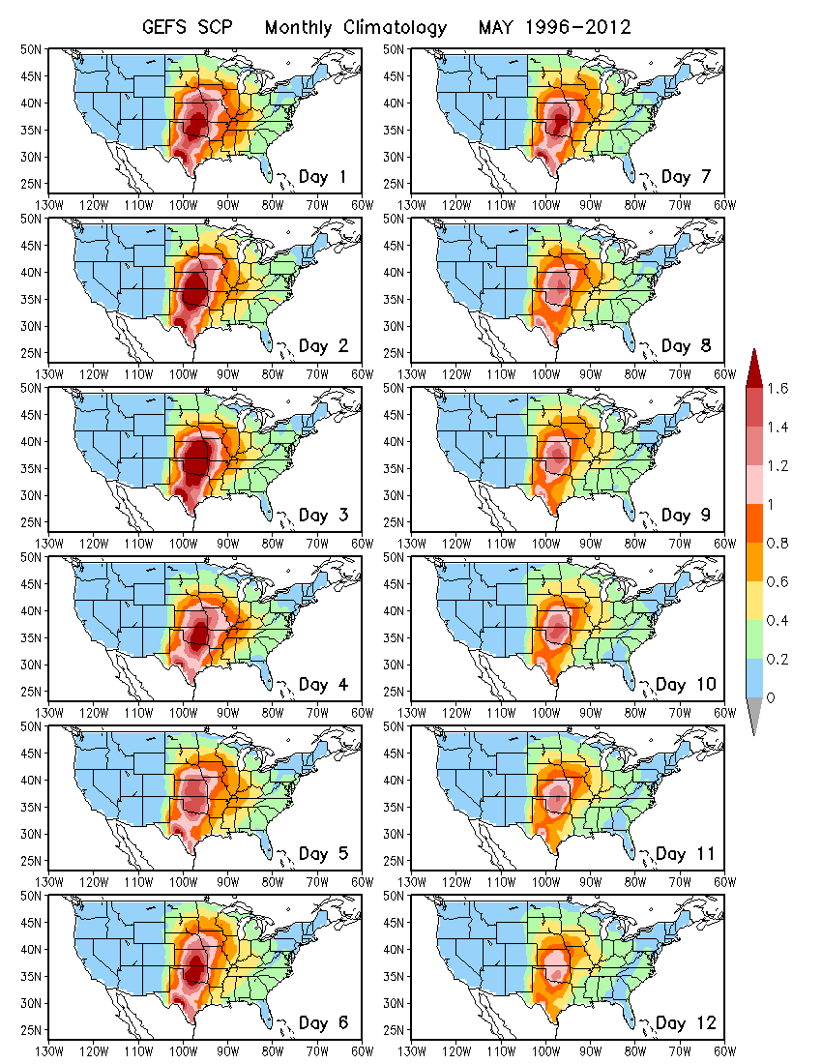
May
GEFS Prediction of SCP
GEFS hindcast
5 members
1996 – 2012
4 days apart
Day 1 to 16 forecasts
Monthly climatology
Spatial pattern
Seasonality
Lead time dependence

Slide 11
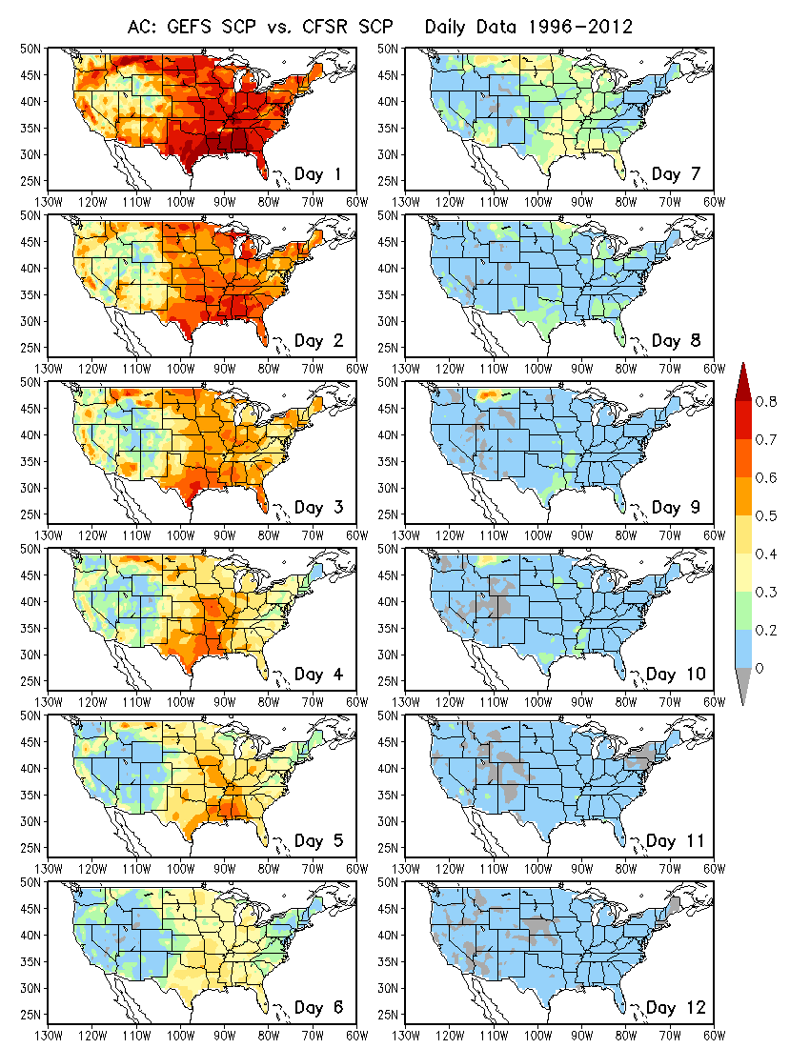
GEFS Prediction of SCP
GEFS hindcast
5 members
1996 – 2012
4 days apart
Day 1 to 16 forecasts
Monthly climatology
Spatial pattern
Seasonality
Lead time dependence
Forecast skill for SCP

Slide 12
GEFS Prediction of SCP
GEFS hindcast
5 members
1996 – 2012
4 days apart
Day 1 to 16 forecasts
Monthly climatology
Spatial pattern
Seasonality
Lead time dependence
Forecast skill for SCP
Skill for weeks 1 and 2

Slide 13
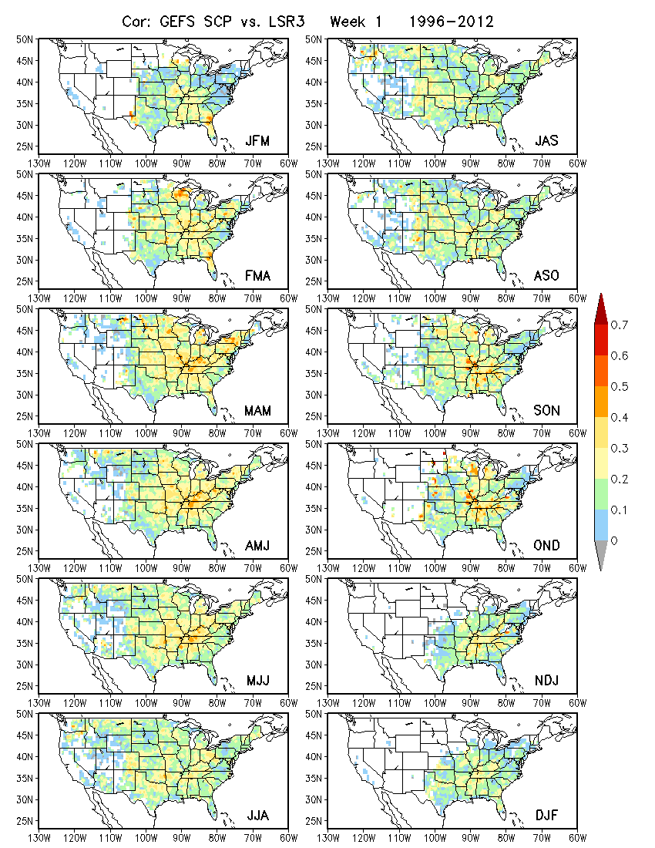
Relationship between GEFS predicted SCP and observed LSR based on hindcasts
Basis of dynamical-statistical prediction
3-month shift windows
LSR3: hail + tornado + wind
Week 1
Relatively strong relationship in spring and weak in fall

Slide 14
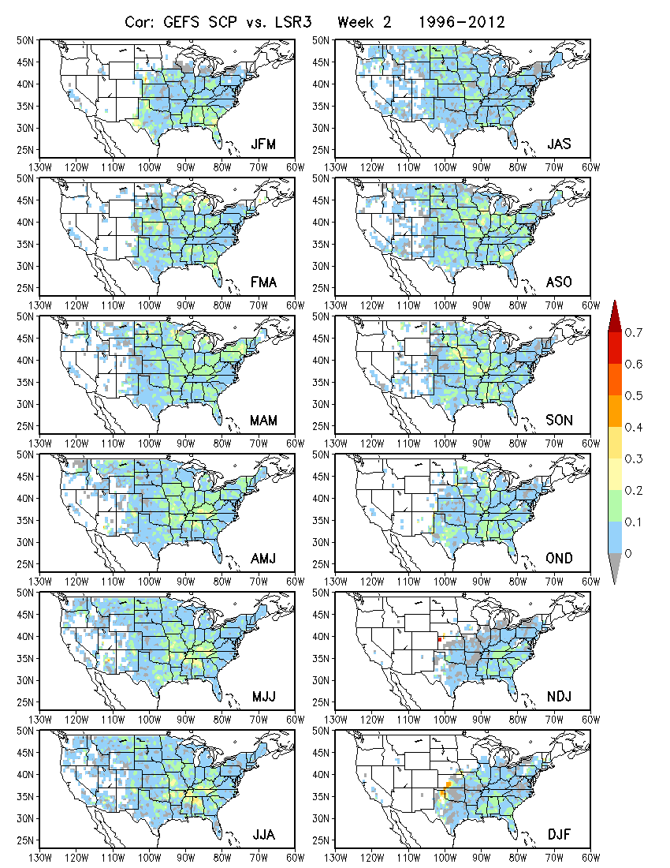
Relationship between GEFS predicted SCP and observed LSR based on hindcasts
Basis of dynamical-statistical prediction
3-month shift windows
LSR3: hail + tornado + wind
Week 2

Slide 15
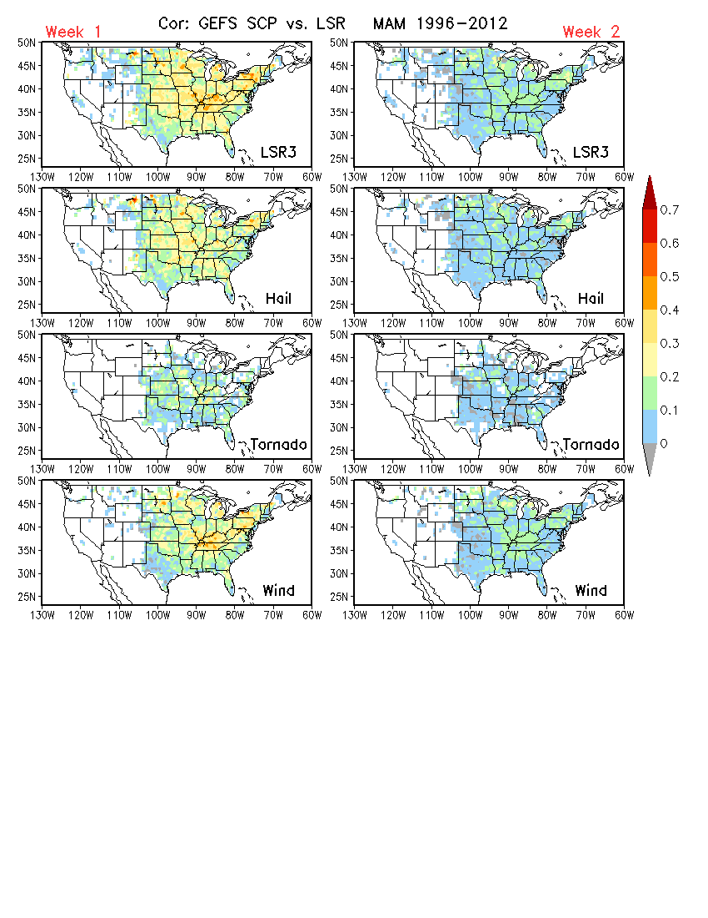
Relationship between GEFS predicted SCP and observed LSR
MAM
Week 1 and Week 2
LSR3
Hail
Tornado
Wind

Slide 16
Linear regression model for forecasting LSR3
Using GEFS predicted SCP as a predictor
Week-1 and week-2 forecasts for MAM
Forecast skill assessed based cross-validation
Anomaly correlation (AC)
Hit rate (3 categories, 33% each)

Slide 17
Questions from Melissa
What was the major goal of the completed work?
Week 2 forecast for LSR
Was verification performed for the SCP for week-2 GEFS forecasts?
Climatology
Seasonality
Anomaly correlation
What do the verification results indicate in terms of skill?
Low skill for week 2
Based on verification should the SCP be pursued as the variable to forecast?
Yes / No

Slide 18
Questions from Melissa
Can we produce probabilistic formatted forecasts from the SCP that is scientifically sound? Can these be calibrated? SCP involves 3 parameters, how would this work?
Yes, based the spread of ensemble members
Based on discussion involving the potential use of SCP to produce calibrated, probabilistic forecasts, should we try to think of a different methodology? Would that be able to be scaled to weeks 3/4?
Yes
What should the time aggregation be?
?

