Slide 1
Summary of Week 3–4 Severe Weather Project
Hui Wang, Alima Diwara, Arun Kumar, David DeWitt
Acknowledgment: Brad Pugh, Daniel Harnos, Melissa Ou
Jon Gottschalck, Stephen Baxter, Matthew Rosencrans
12 September 2017

Slide 2
Goals
To expand development and perform additional evaluation of Week-2 severe weather potential model guidance
To explore the potential and develop experimental forecast tools for severe weather at Week 3 – 4 time range
Year 1
Week-2 forecast (hybrid model)
Model predicted environmental condition (SCP)
Empirical relationship between model SCP and OBS SW
To support Week-2 U.S. Hazard Outlook

Slide 3
SCP (Supercell Composite Parameter)
SCP = (CAPE/1000 J kg⁻¹)×(SRH/50 m⁻² s⁻²)×(BWD/20 m s⁻¹)
CAPE: convective available potential energy
BWD: bulk wind difference
SRH: storm-relative helicity
Data
Model data: GEFS hindcast/forecast
OBS data: CFSR
SW: LSR (Local Storm Report)
Hail
Tornado
Damaging wind
LSR regrided --- 0.5º×0.5º

Slide 4
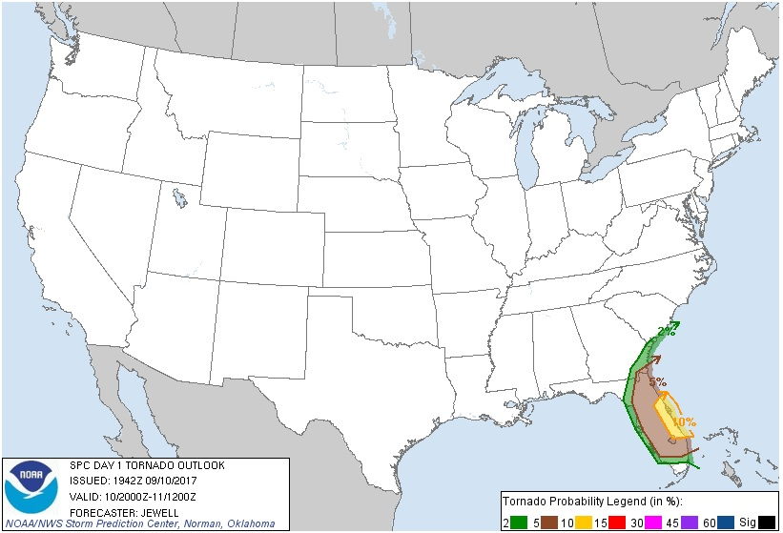
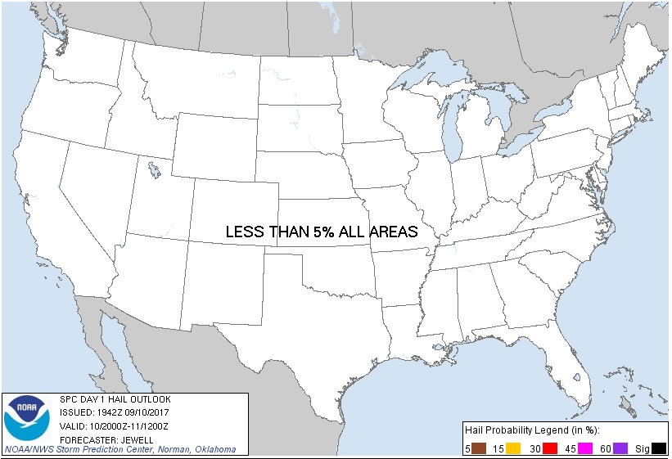
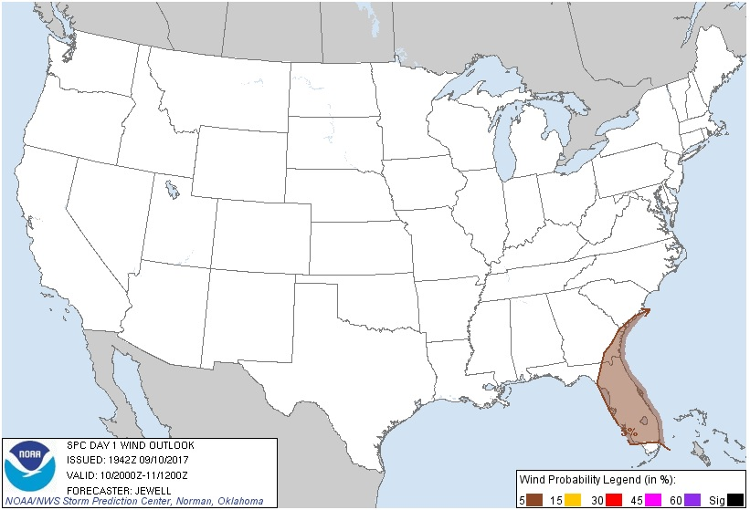
Storm Prediction Center
Example of
Severe Weather Outlook
Probabilistic forecast
Tornado
Hail
Damaging wind
Tornado
Day 1 Outlook Valid: 10/2000Z–11/1200Z
Hail
Wind

Slide 5
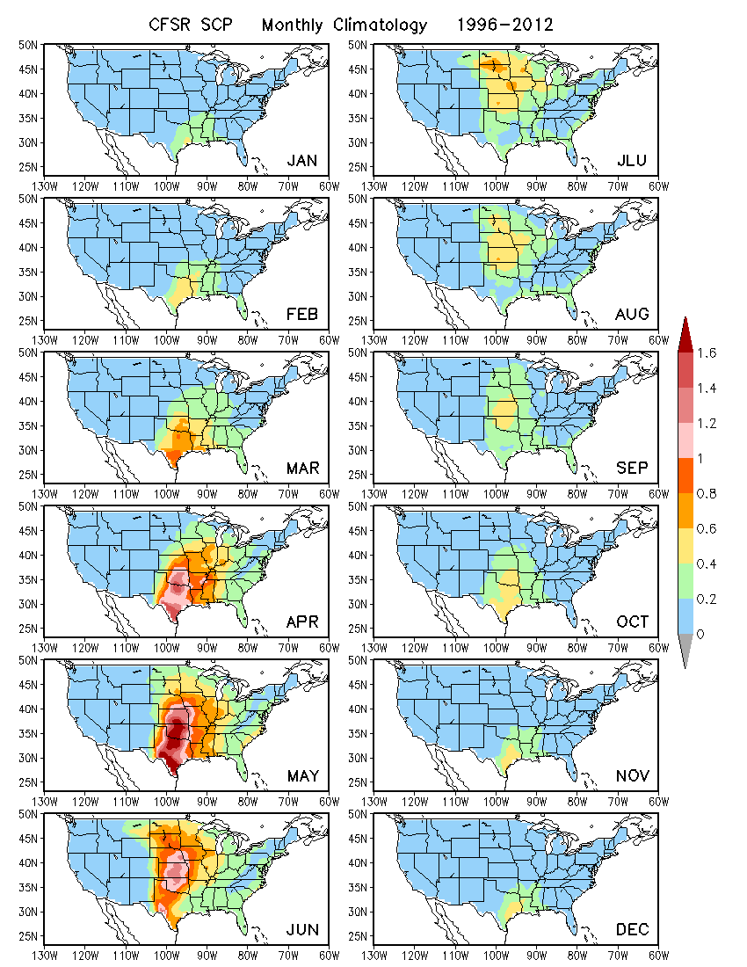
Characteristics of SCP in OBS
SCP in CFSR is the proxy for OBS.
Monthly climatology
Spatial pattern
Seasonality

Slide 6
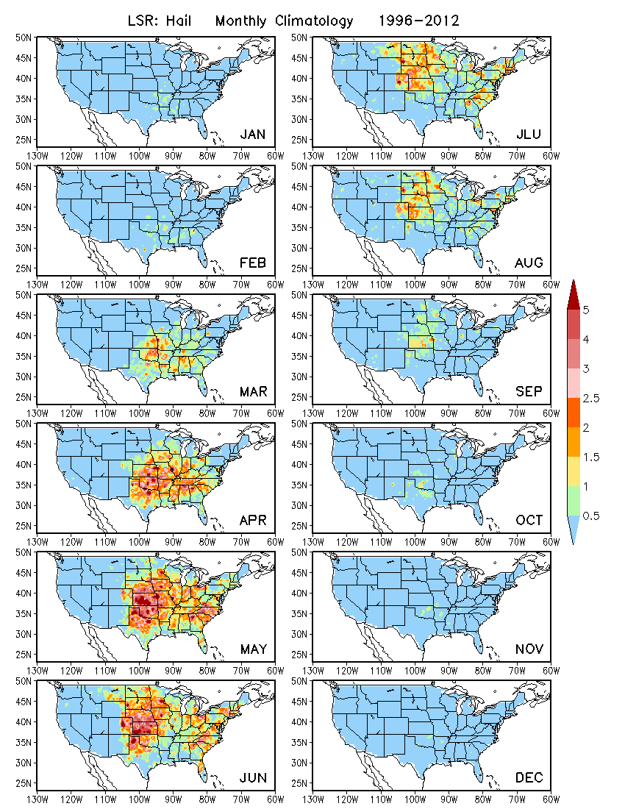
Characteristics of LSR in OBS
Hail
Monthly climatology
Spatial pattern
Seasonality

Slide 7
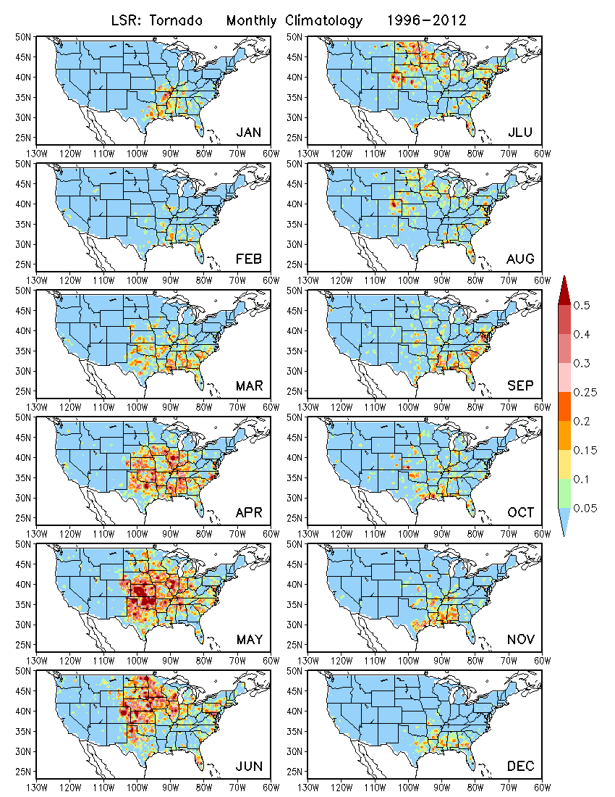
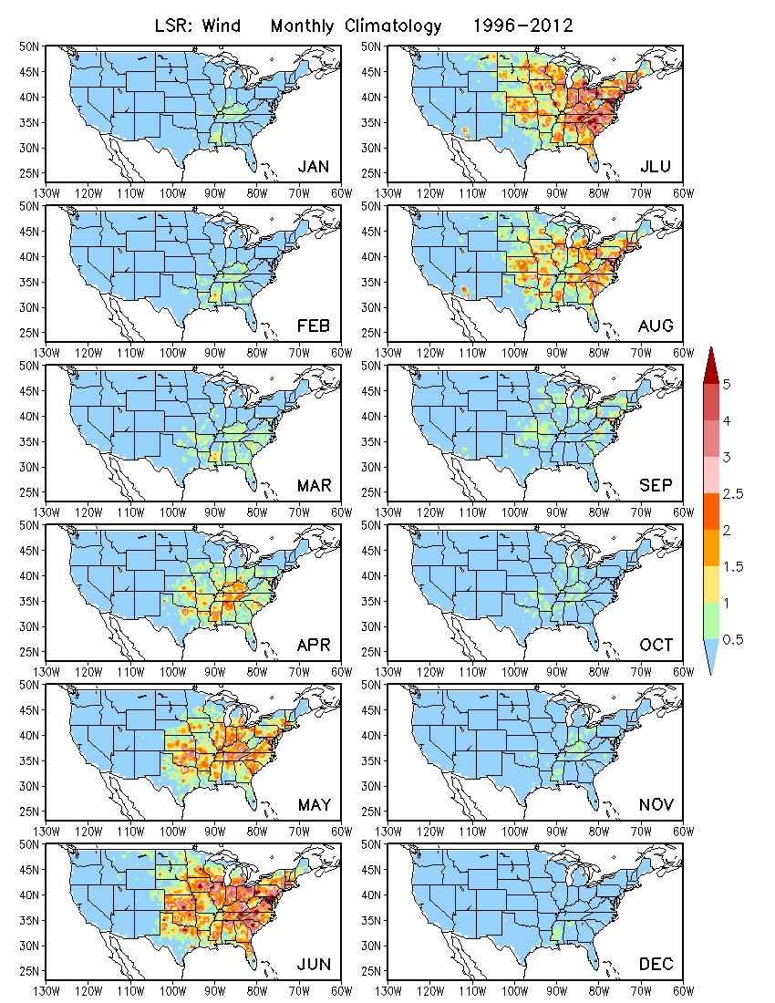
Tornado
Characteristics of LSR in OBS
Wind

Slide 8
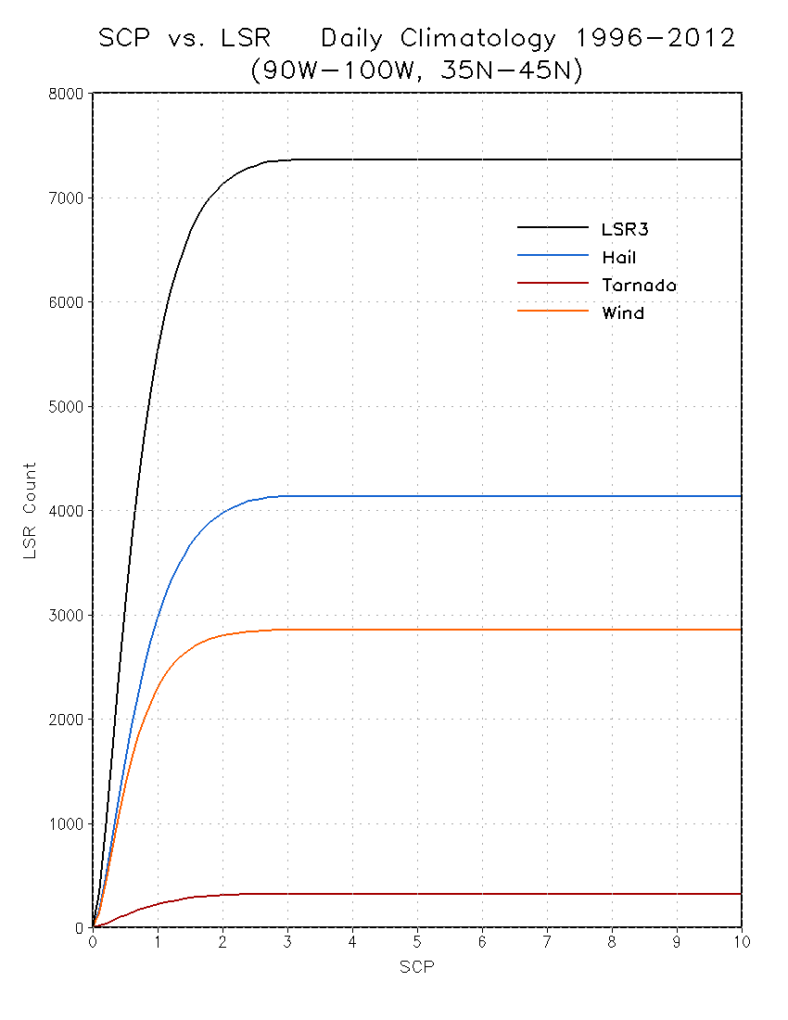
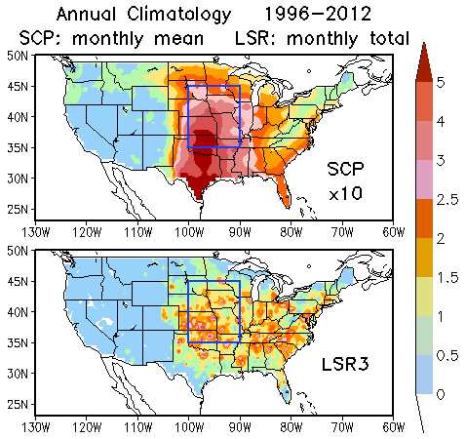
Relationship between
Observed SCP and LSR
How does LSR vary with SCP?
Are there thresholds of SCP for LSR?
LSR3
Hail
Wind
Tornado

Slide 9
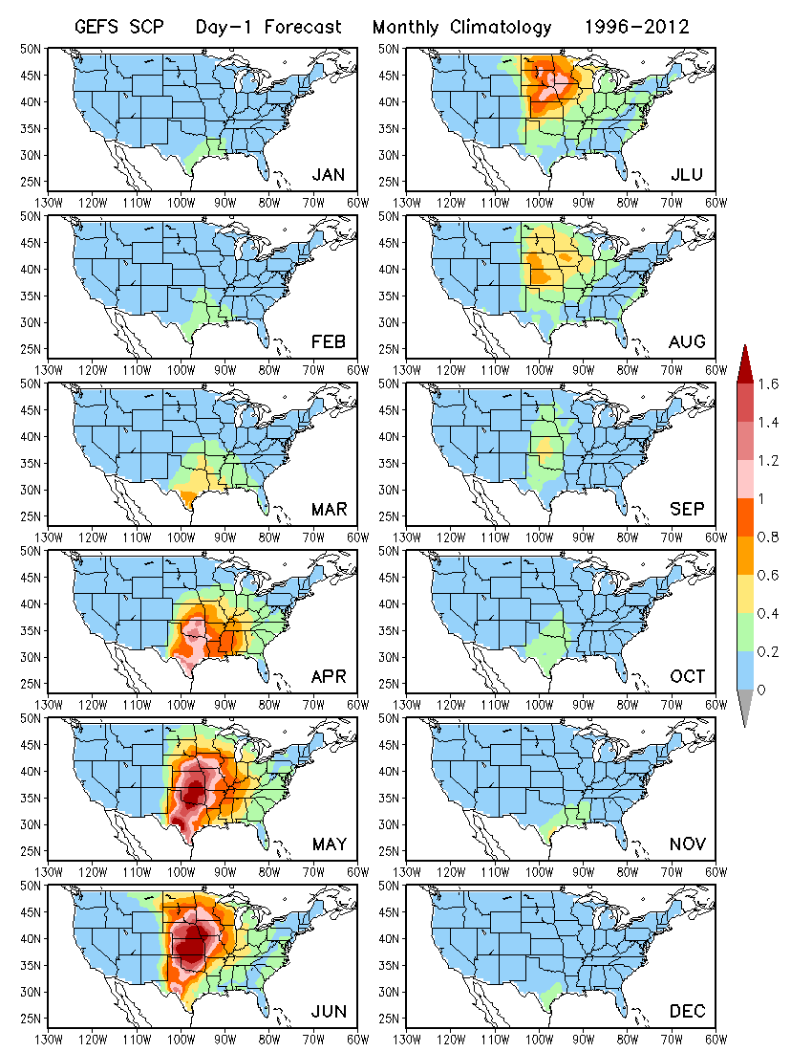
GEFS Prediction of SCP
GEFS hindcast
5 members
1996 – 2012
4 days apart
Day 1 to 16 forecasts
Monthly climatology
Spatial pattern
Seasonality
Day-1 Forecast

Slide 10
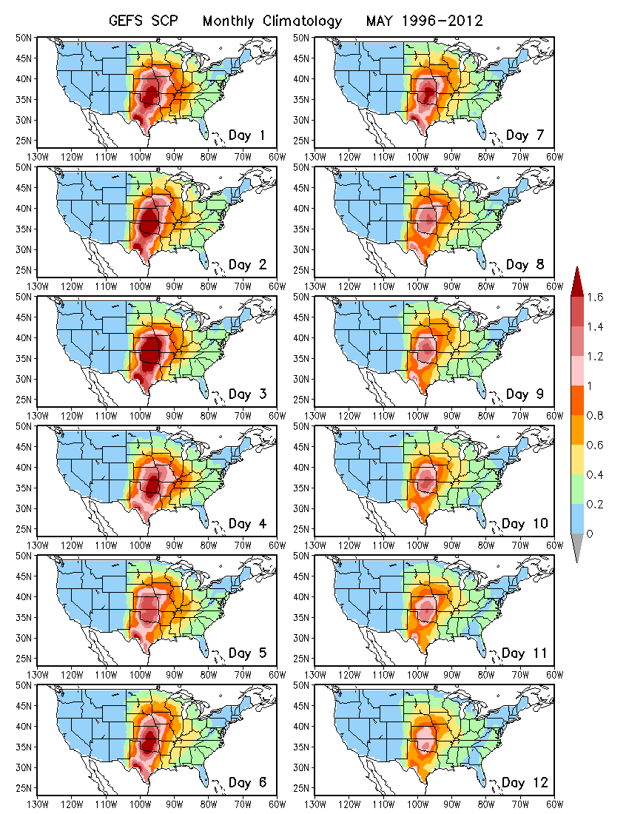
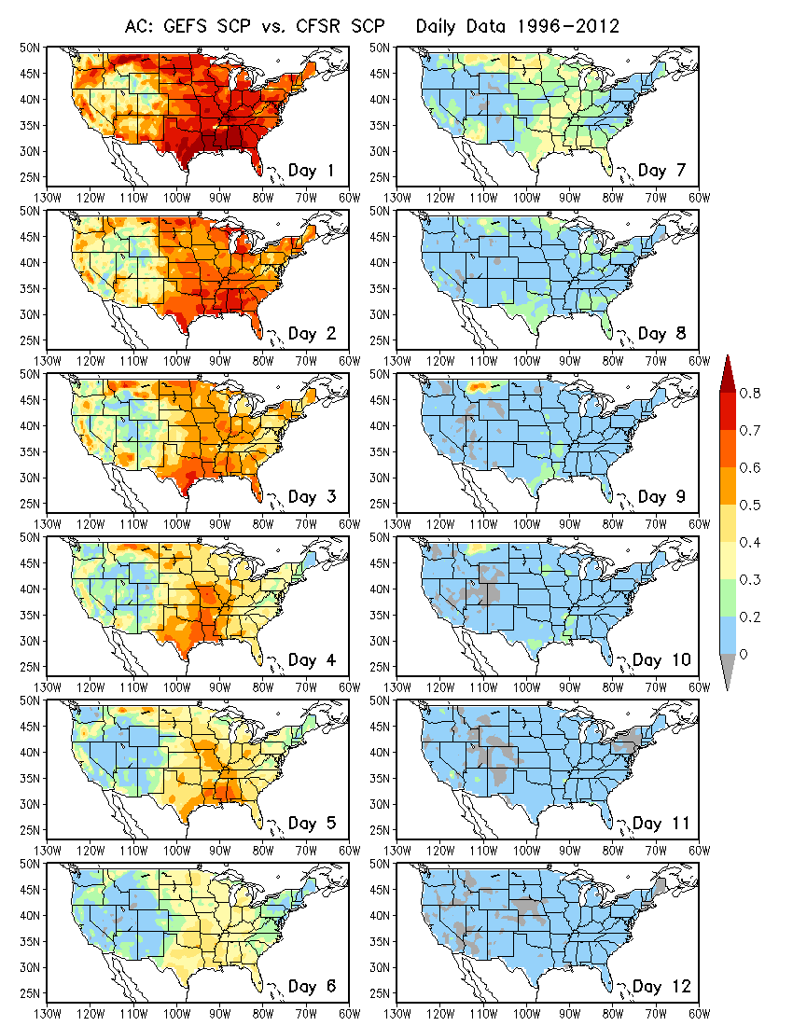
GEFS Prediction of SCP
Lead Time Dependence
Forecast Skill for SCP
Daily data
May

Slide 11
GEFS Prediction of SCP
Skill for Weeks 1 and 2
Anomaly Correlation (AC)

Slide 12
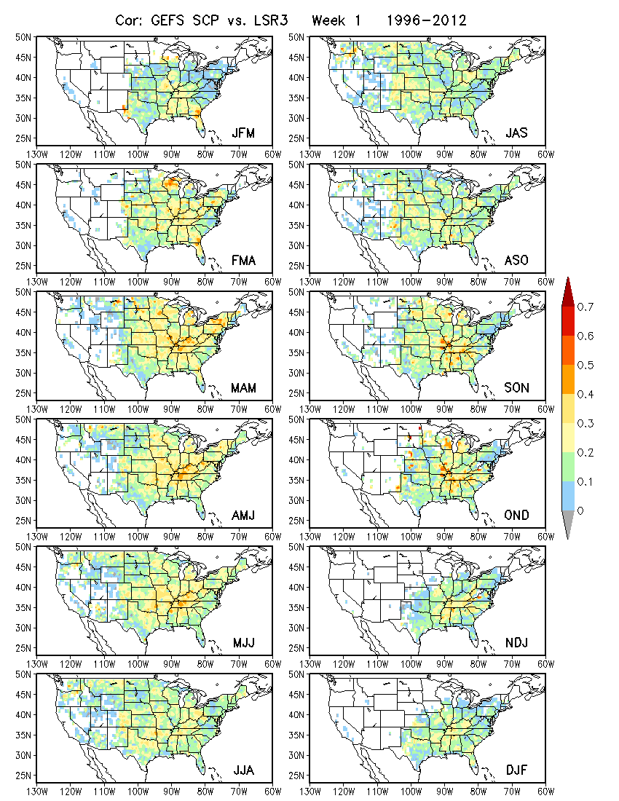
Relationship between GEFS predicted SCP and observed LSR based on hindcasts
Basis of dynamical-statistical prediction
3-month shift windows
LSR3: hail + tornado + wind
Week 1
Relatively strong relationship in spring and weak in late fall/early winter

Slide 13
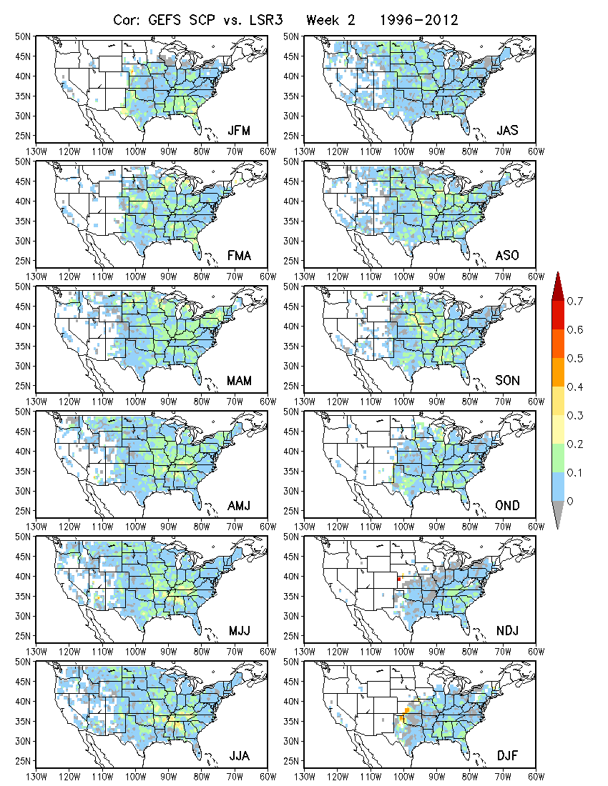
Relationship between GEFS predicted SCP and observed LSR based on hindcasts
Basis of dynamical-statistical prediction
3-month shift windows
LSR3: hail + tornado + wind
Week 2
Weak relationship

Slide 14
Linear regression model for forecasting LSR3
Using GEFS predicted SCP as a predictor
Week-1 and week-2 forecasts for MAM
Forecast skill assessed based cross-validation
Anomaly correlation (AC)
Hit rate (3 categories, 33% each)

Slide 15
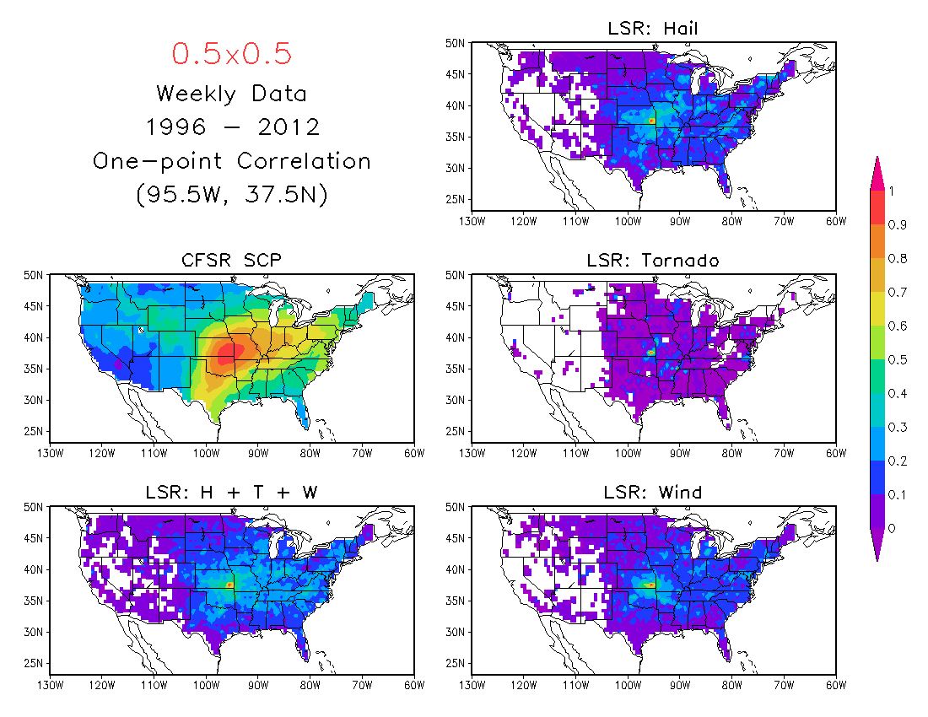

Slide 16
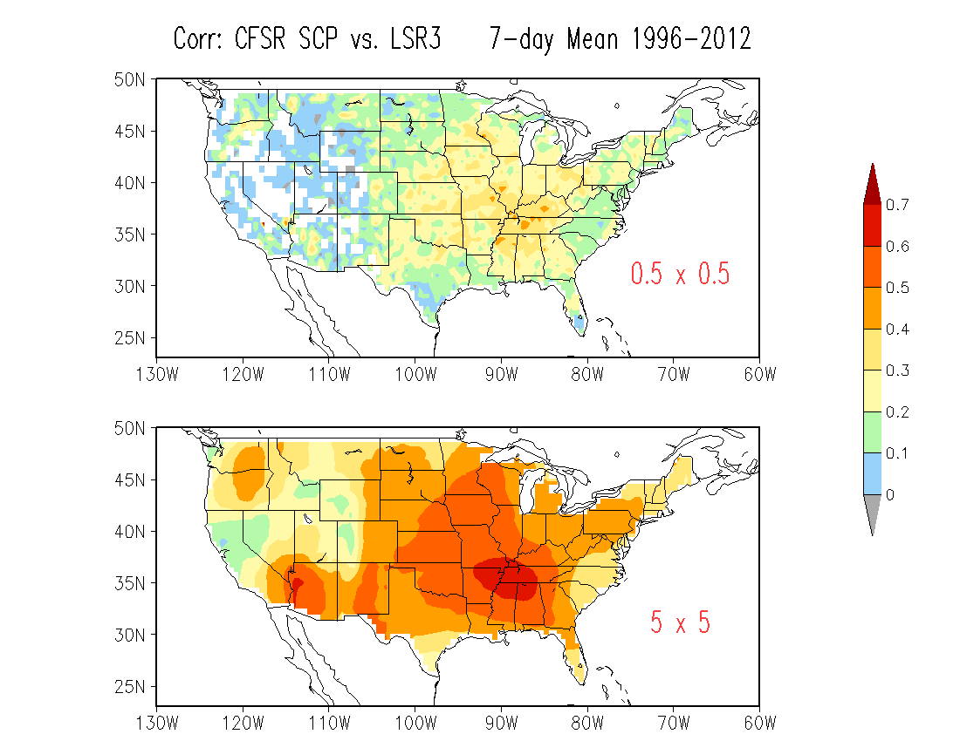
OBS
Significantly increased correlation

Slide 17
0.5º×0.5º
Week 1 Week 2
3-month Window

Slide 18
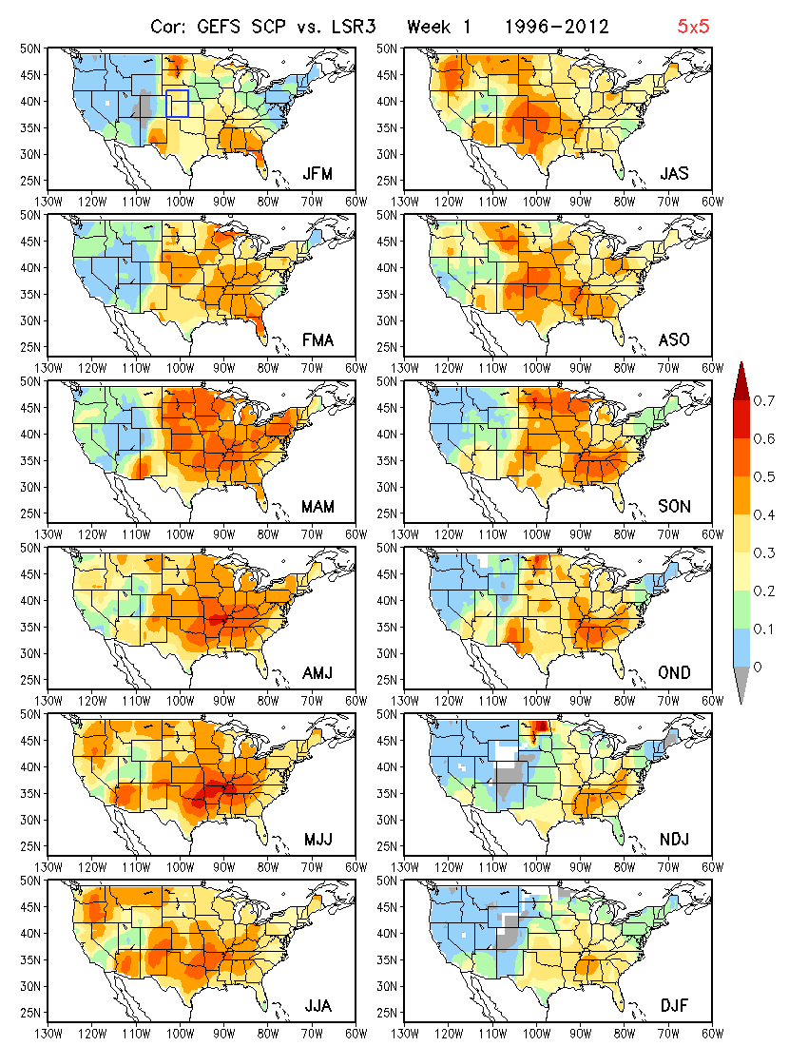
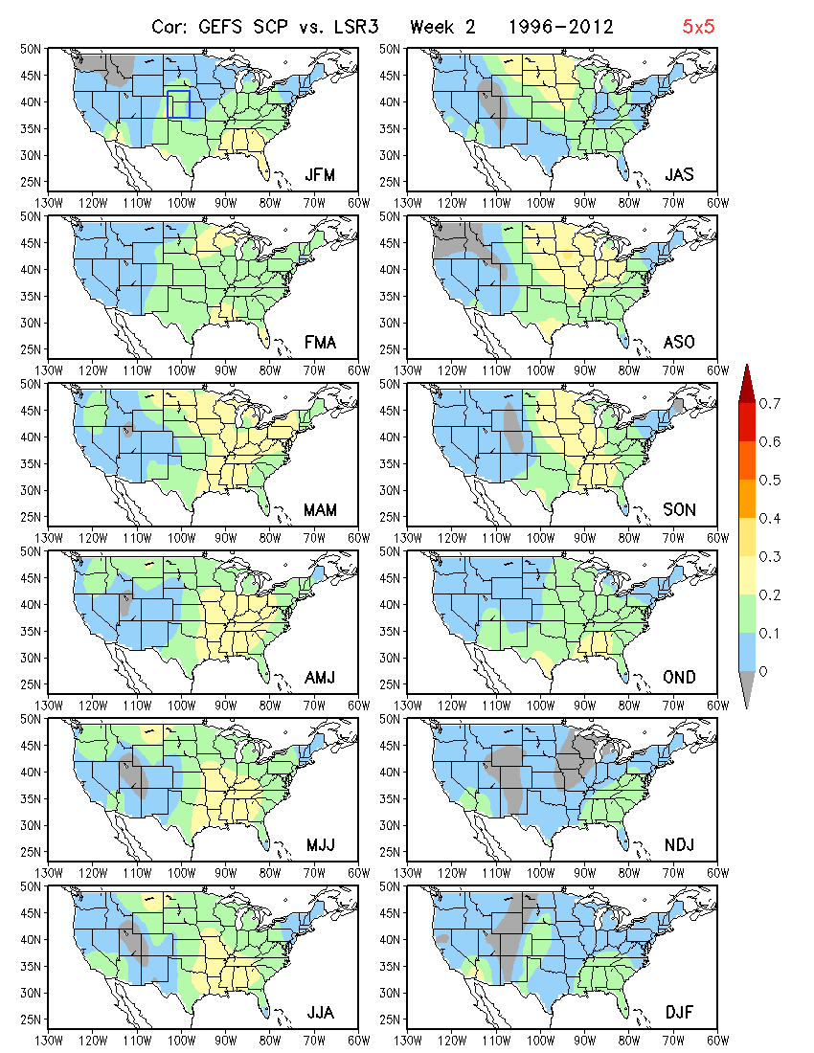
5º×5º
Week 1 Week 2
3-month Window

Slide 19
5º×5º
0.5º×0.5º

Slide 20
Summary
Following Carbin et al. (2016), SCP was selected as a variable to represent the large-scale environment and link the model forecast to severe weather.
The hybrid model forecasts suggest a low skill for week-2 severe weather.
The forecast skill can be improved by using 5º×5º area-averaged anomalies.

Slide 21
Future Work
To extend the analysis for Weeks 3 – 4 using the CFSv2 45-day hindcast.
To explore potential predictors for Week 3 – 4 severe weather, such as SST.

