Slide 1
CFSv2-based Dynamical–Statistical Forecast for the
2017 Hurricane Season
Date: 07/21/2017 CFS ICs: 07/05 – 07/19/2017
Background Information
Prediction methodology
Hurricane climatology (entire season)
Definitions of above-, near-, & below-normal seasons
Forecasts
ASO SST and wind shear anomaly (CFSv2 ensemble forecast)
Hurricane season forecast for the Atlantic basin
Hurricane season forecast for the Eastern Pacific
Forecast range is determined by forecast ± one standard deviation of inter-member spreads.
Probability forecast is based on 60 members of CFSv2 forecasts and NOAA’s definitions of below-, near- and above-normal criteria.

Slide 2
Prediction Methodology
Atlantic Seasonal Hurricane Activity
2 predictors Regression period: 1982–2016
CFS ASO MDR U200–U850
Observed preseason NATL SST
MDR: 20ºW – 80ºW, 10ºN – 20ºN
NATL: 30ºW – 60ºW, 55ºN – 65ºN
E. Pacific Seasonal Hurricane Activity
2 predictors Regression period: 1982–2016
CFS A_{ug}S_{ep} CTP U200–U850
CFS A_{ug}S_{ep} CNP SST
CTP: 165ºE – 135ºW, 10ºS – 7.5ºN
CNP: 165ºE – 135ºW, 20ºN – 36ºN

Slide 3
Climatology
Entire Hurricane Season
Atlantic
Period | 1982 – 2016 | 1982 – 1994 | 1995 – 2016
Hurricane | 6.3 | 4.5 | 7.4
Named Storm | 12.0 | 8.5 | 14.1
Major Hurricane | 2.6 | 1.3 | 3.4
ACE | 102.5 | 60.3 | 127.5
Eastern Pacific
Period | 1982 – 2016 | 1982 – 1994 | 1995 – 2016
Hurricane | 9.1 | 10.5 | 8.2
Named Storm | 16.1 | 18.0 | 15.1
Major Hurricane | 4.4 | 5.2 | 3.9
ACE | 116.4 | 150.0 | 96.5

Slide 4
Definitions of Above-, Near-, and Below-Normal Seasons
ATLANTIC Season Type | Range of Hurricanes | Range of Named Storms | Range of Major Hurricanes | Range of ACE
Above-Normal | ≥ 7 | ≥ 13 | ≥ 3 | ≥ 120%
Near-Normal | 5–6 | 9–12 | 2 | 71.4–120%
Below-Normal | ≤ 4 | ≤ 8 | ≤ 1 | ≤ 71.4%
E. PACIFIC Season Type | Range of Hurricanes | Range of Named Storms | Range of Major Hurricanes | Range of ACE
Above-Normal | ≥ 9 | ≥ 17 | ≥ 5 | ≥ 115%
Near-Normal | 7–8 | 13–16 | 3–4 | 80–115%
Below-Normal | ≤ 6 | ≤ 12 | ≤ 3 | ≤ 80%
ACE median: 92.5 (Atlantic) 100.4 (E. Pacific)

Slide 6
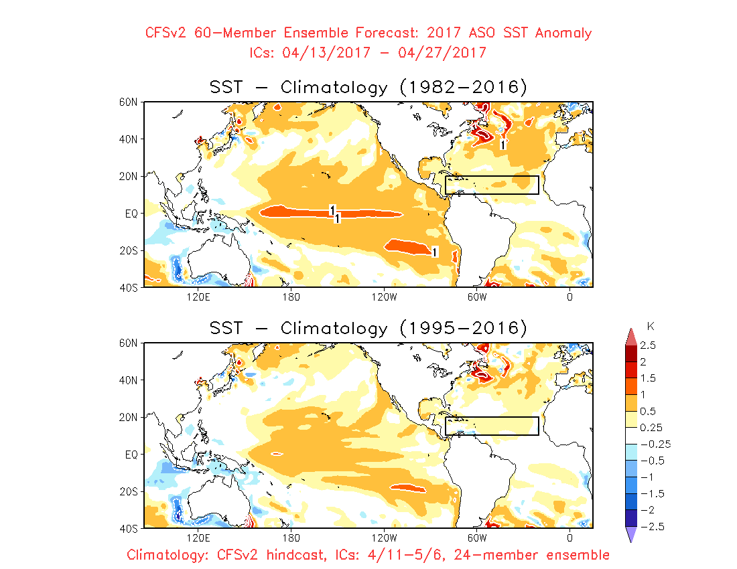
April ICs
MDR

Slide 7
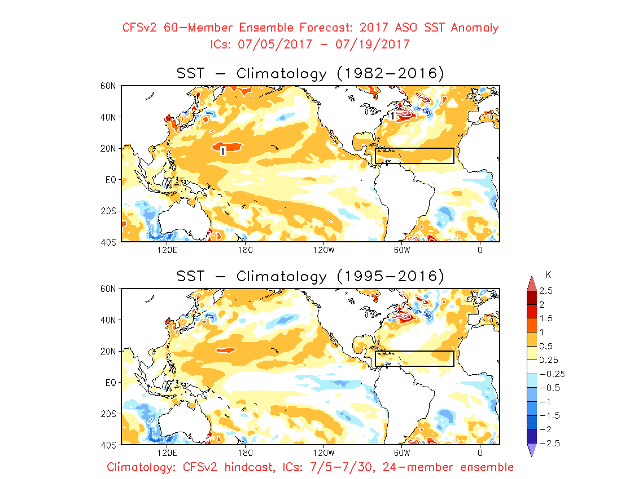
July ICs
MDR

Slide 8
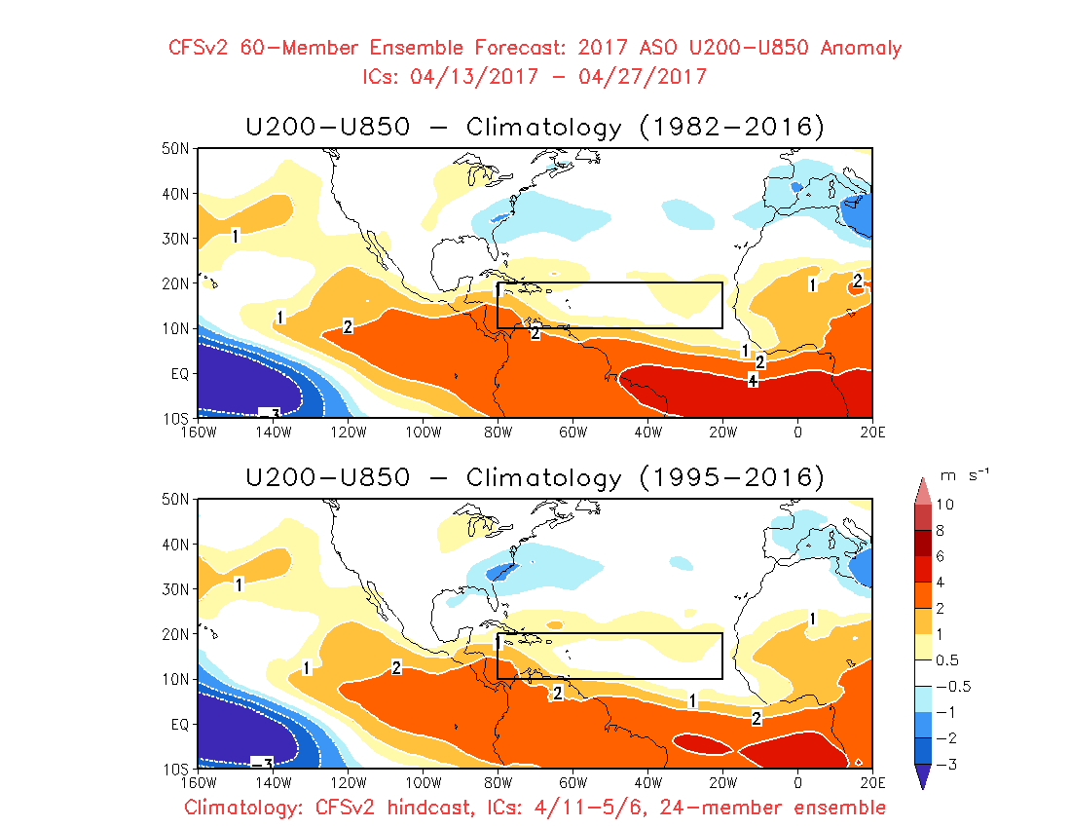
April ICs
MDR

Slide 9
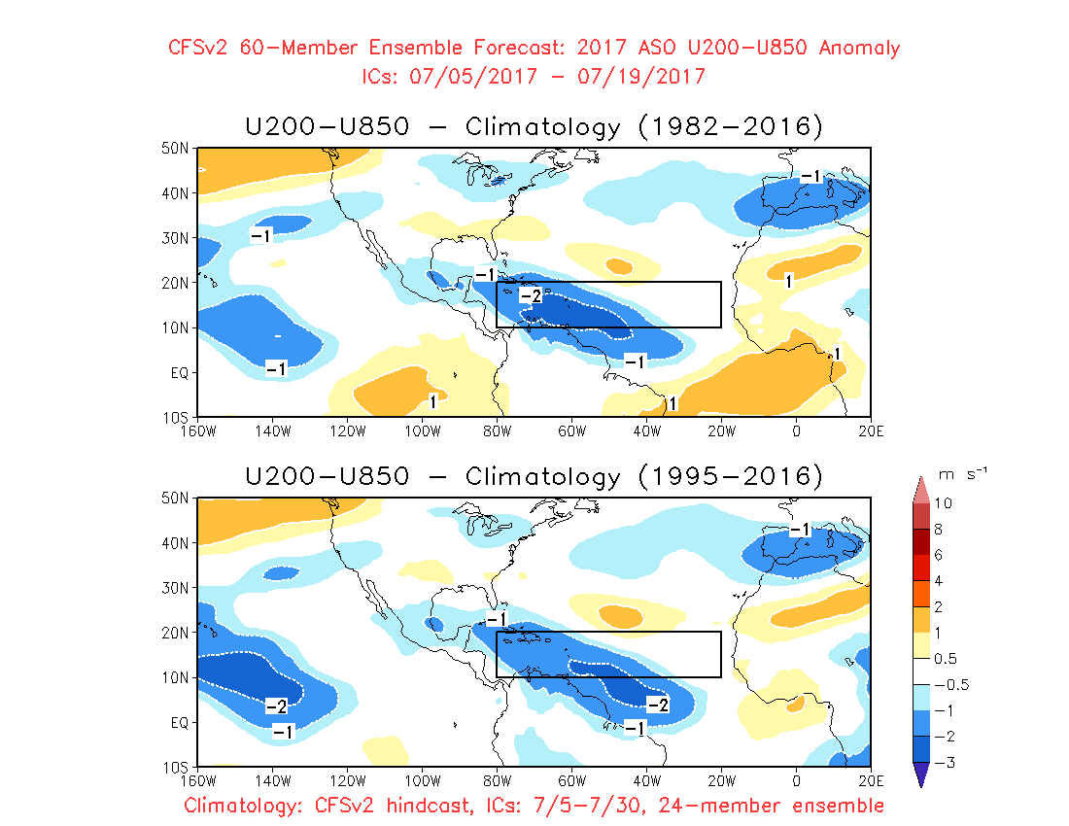
July ICs
MDR

Slide 10
Forecasts of the Atlantic
CFSv2 ICs | April ICs: 04/13 – 04/27/2017 | July ICs: 07/05 – 07/19/2017
Hurricanes Range Probability | 6 5 – 7 17% 57% 26% | 7 6 – 8 0% 25% 75%
Named Storms Range Probability | 11 9 – 13 6% 69% 25% | 13 12 – 14 0% 42% 58%
Major H Range Probability | 2 2 – 3 1% 54% 45% | 3 2 – 4 0% 19% 81%
ACE Range Probability | 101% 74% – 129% 16% 59% 25% | 129% 104% – 154% 0% 35% 65%
Below, Near & Above Normal
Below Near Above
Normal
Below Near Above
Below Near Above
Below Near Above
Below Near Above
Below Near Above
Below Near Above
Below Near Above

Slide 11
Forecasts of the E. Pacific
CFSv2 ICs | April ICs: 04/13 – 04/27/2017 | July ICs: 07/05 – 07/19/2017
Hurricanes Range Probability | 10 9 – 11 0% 7% 93% | 8 7 – 8 8% 81% 11%
Named Storms Range Probability | 17 16 – 18 0% 45% 55% | 14 13 – 15 3% 92% 5%
Major H Range Probability | 5 4 – 6 7% 32% 61% | 3 2 – 3 85% 14% 1%
ACE Range Probability | 93% 75% – 111% 21% 66% 13% | 68% 54% – 82% 81% 19% 0%
Below, Near & Above Normal
Below Near Above
Normal
Below Near Above
Below Near Above
Below Near Above
Below Near Above
Below Near Above
Below Near Above
Below Near Above

