Slide 1
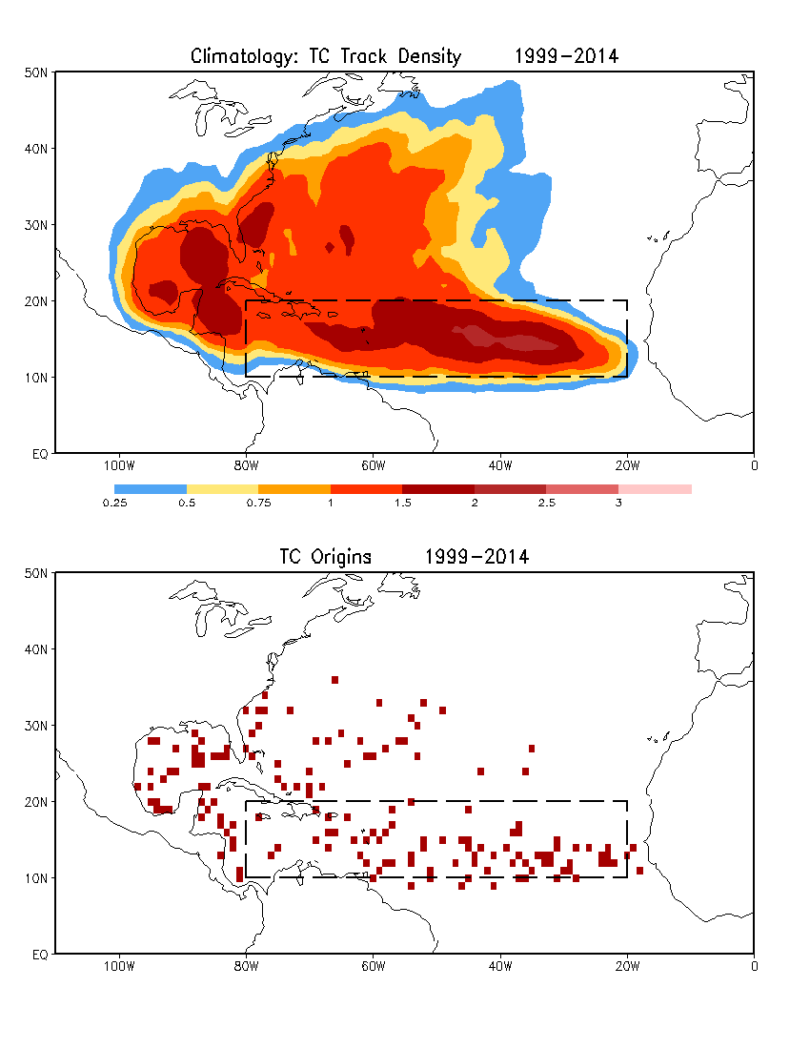
Data: HURDAT2

Slide 3
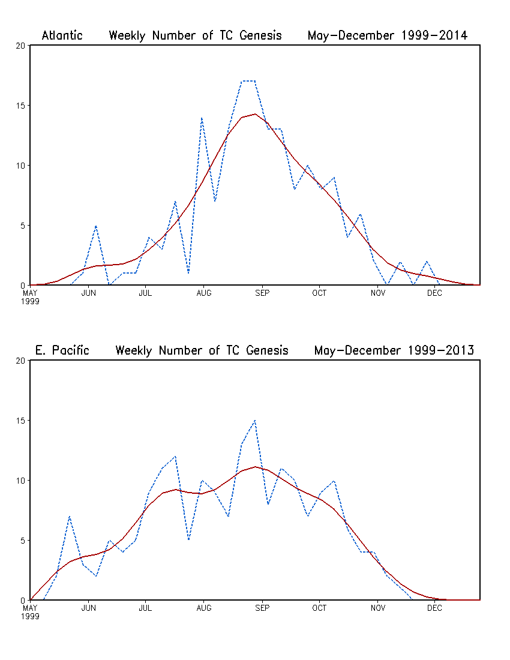
May–December:
35 x 7 days
Raw data
Multiple passes of a 1-2-1 filter

