Slide 2
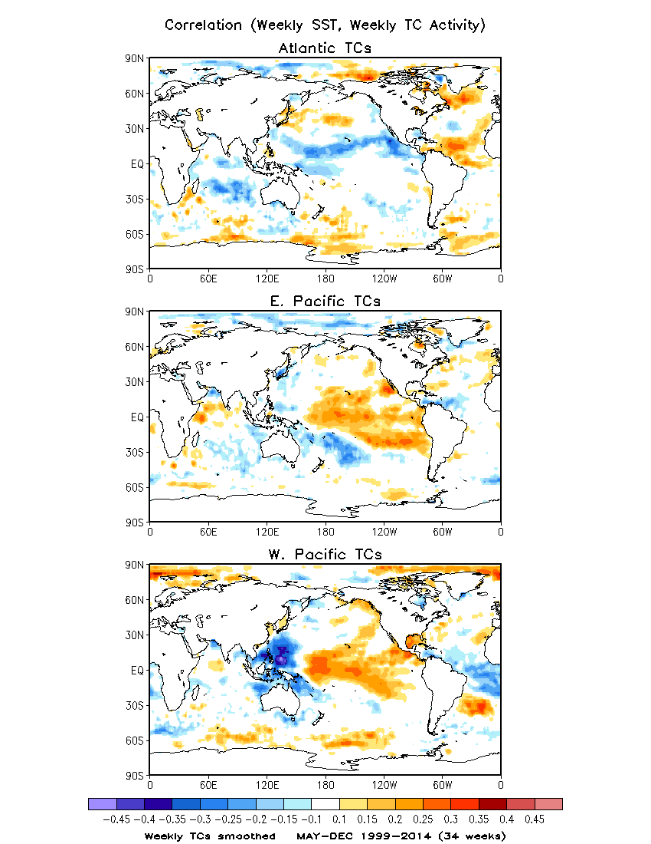
Correlation between
Weekly SST and Weekly TC Activity
Weekly TC activity smoothed
Example of Atlantic weekly TC activity
Smoothed vs. Unsmoothed
Color shadings (correlation > 0.1):
Above the 95% significance level
/cpc/namecpt/hui/2015_R2O/SST

Slide 3
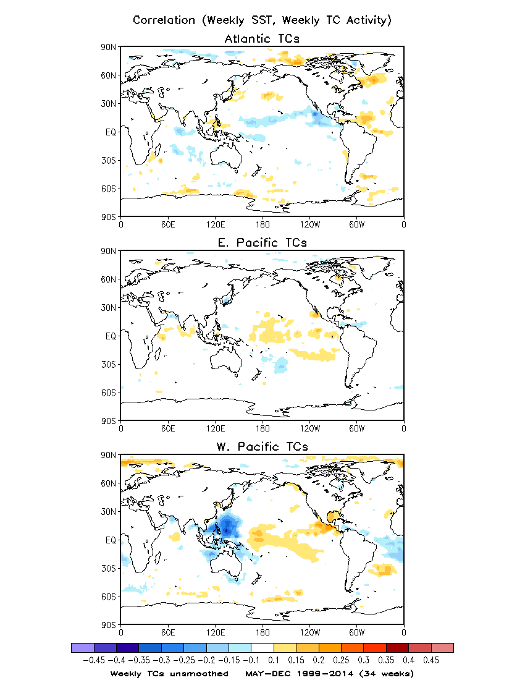
Correlation between
Weekly SST and Weekly TC Activity
Weekly TC activity unsmoothed
Example of Atlantic weekly TC activity
Smoothed vs. Unsmoothed

Slide 4
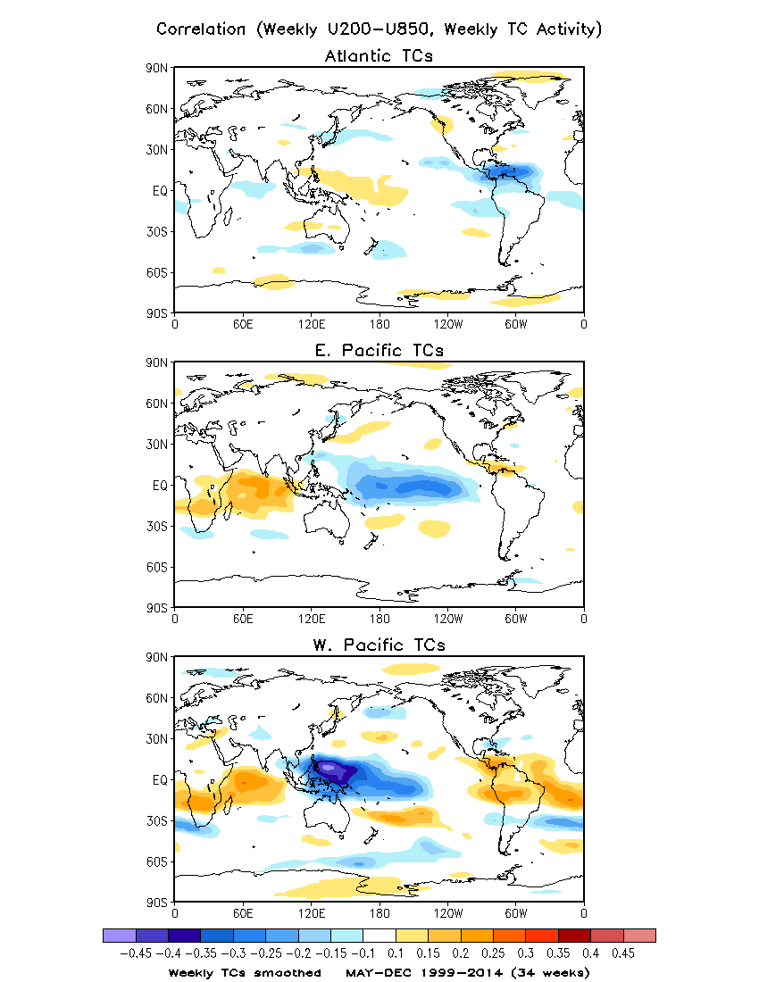

Slide 5
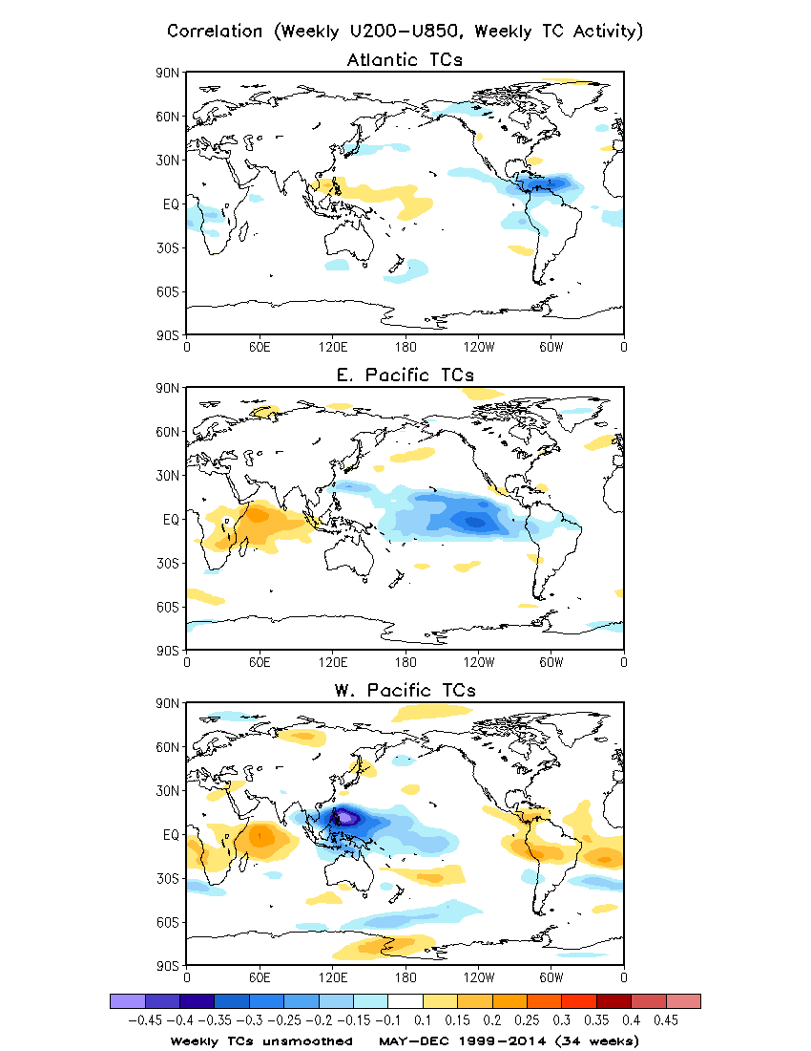

Slide 6
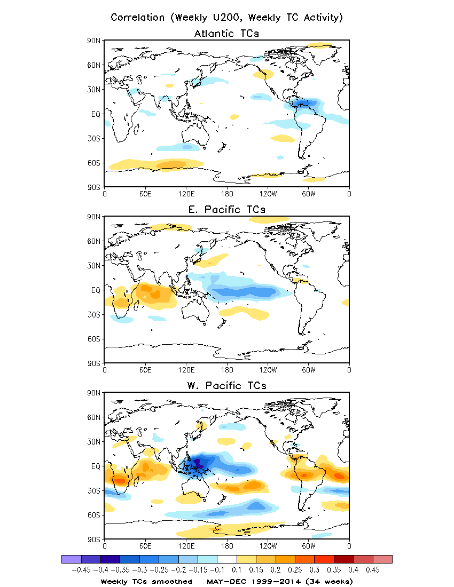

Slide 7
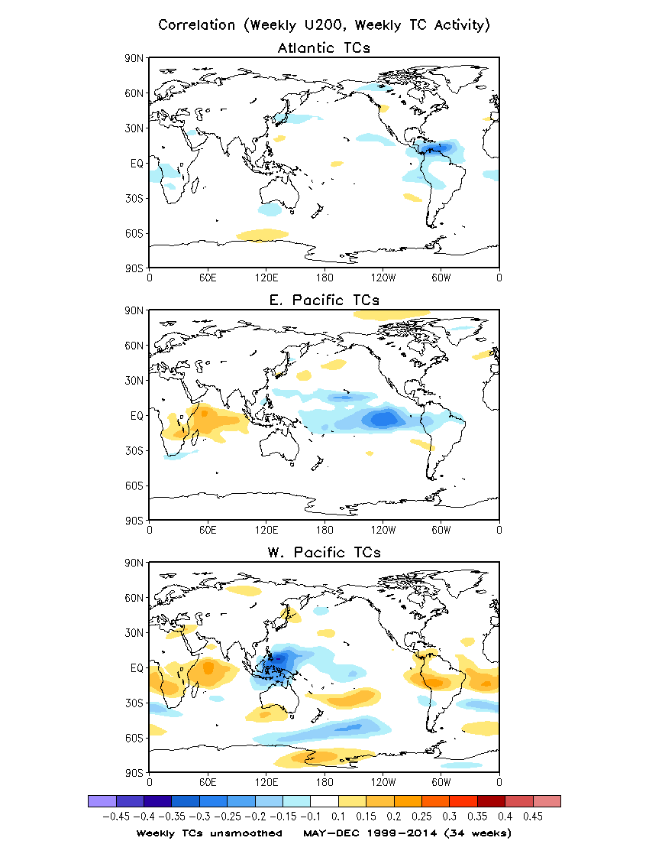

Slide 8
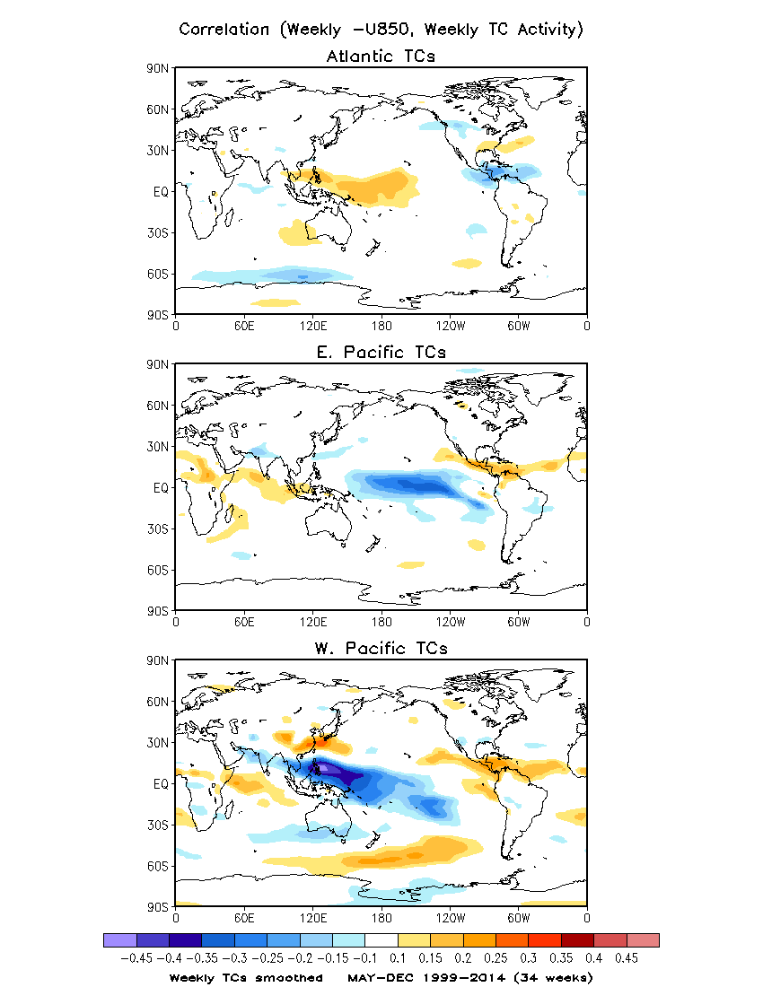

Slide 9
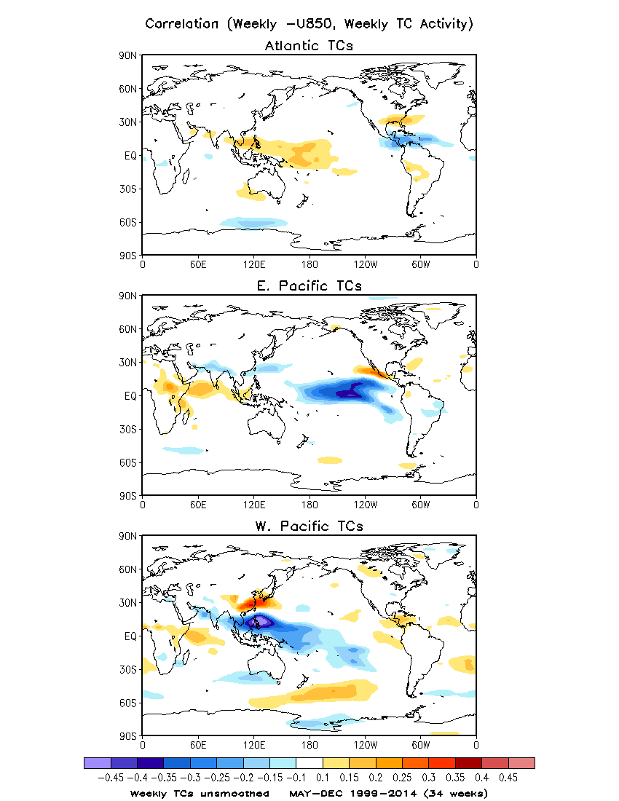

Slide 10
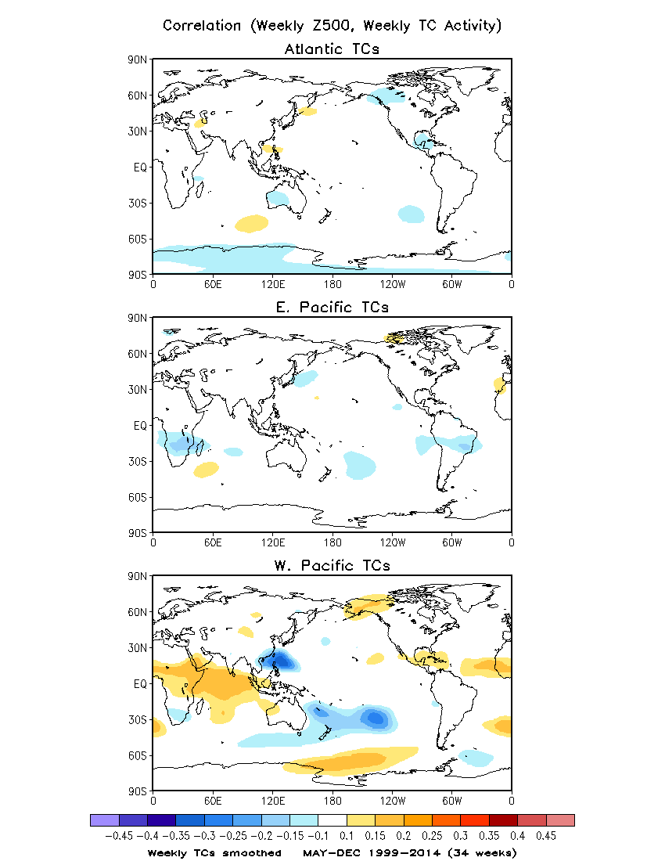

Slide 11
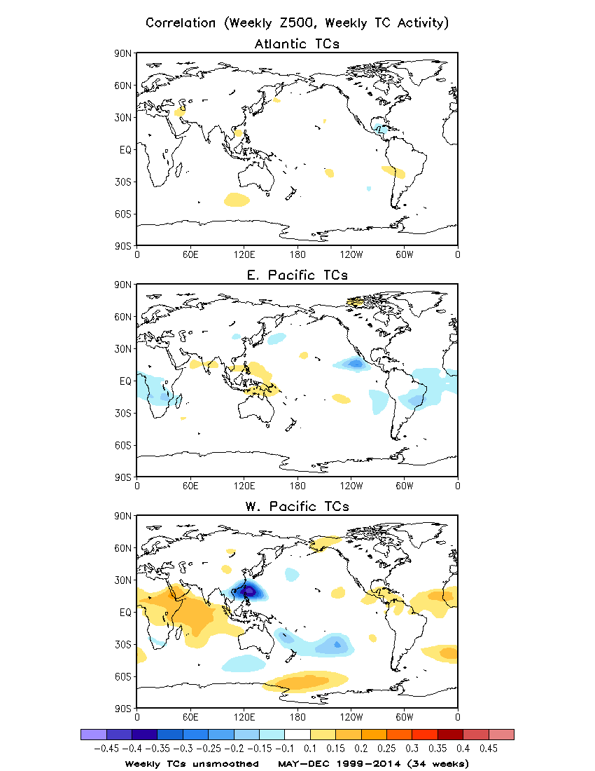

Slide 12
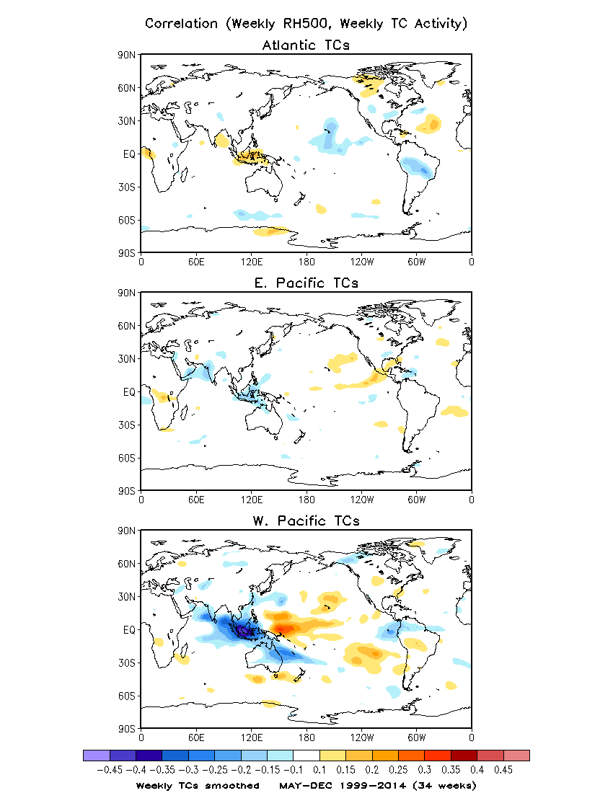

Slide 13
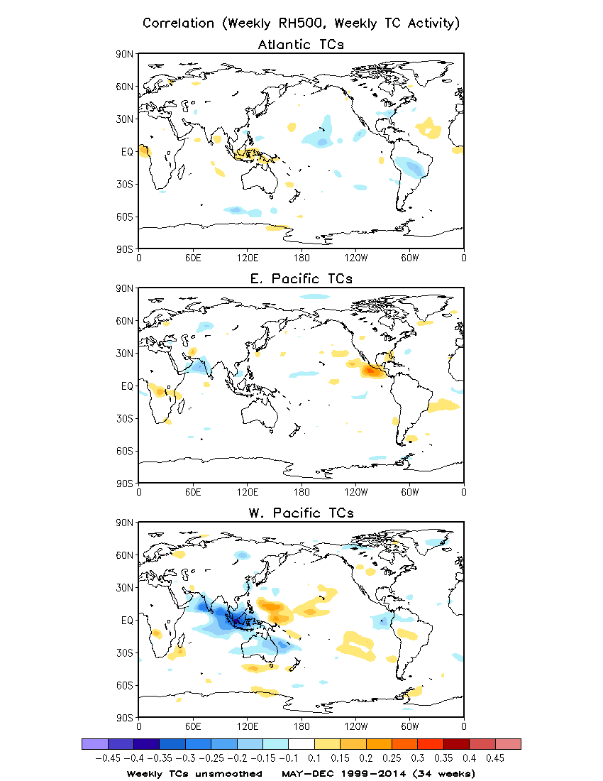

Slide 14
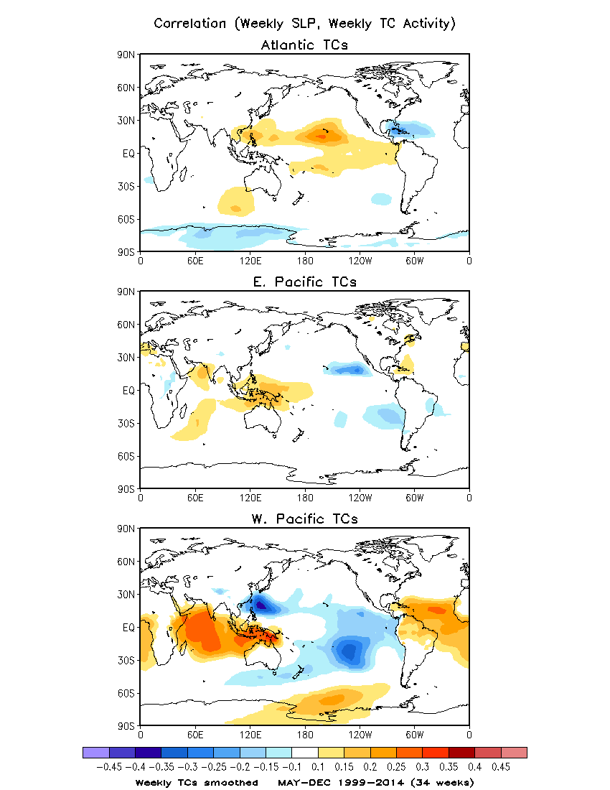

Slide 15
