Slide 1
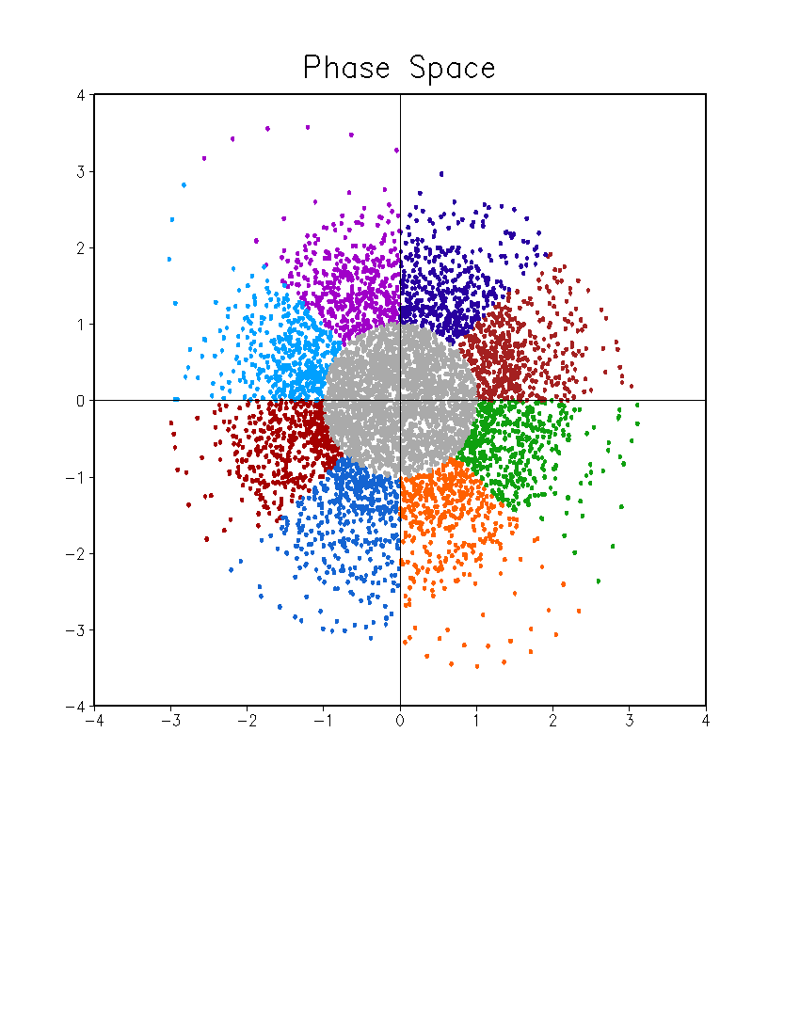
Daily MJO Index
01 Jan 1999 – 31 Dec 2014
Phase 7
Phase 6
Phase 8
Phase 5
PC2
Weak MJO
Phase 1
Phase 4
Phase 2
Phase 3
PC1

Slide 2
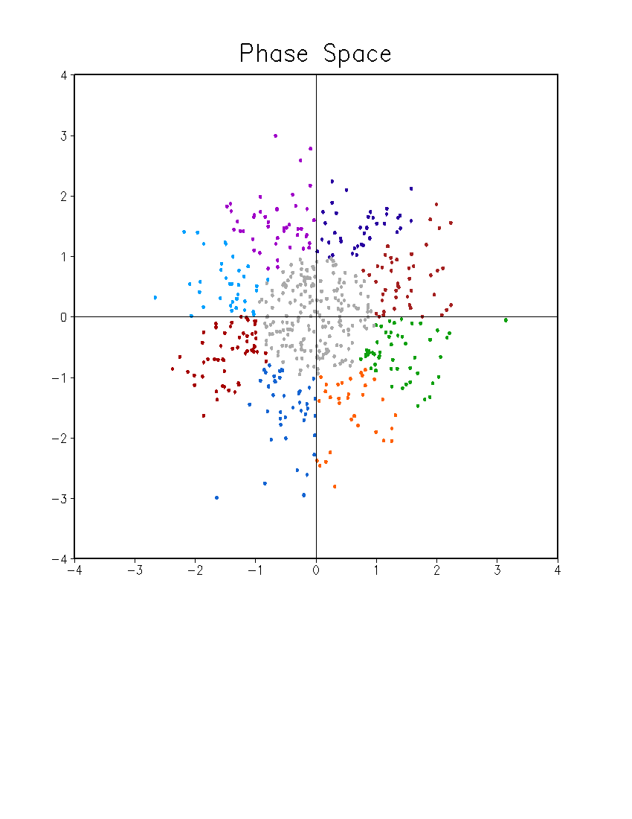
Weekly MJO Index
1999 – 2014
May – December (34 Weeks)
Sunday – Saturday
Phase 7
Phase 6
Phase 8
Phase 5
PC2
Weak MJO
Phase 1
Phase 4
Phase 2
Phase 3
PC1
Weekly MJO index:
Average of daily MJO index from Sunday to Saturday

Slide 3
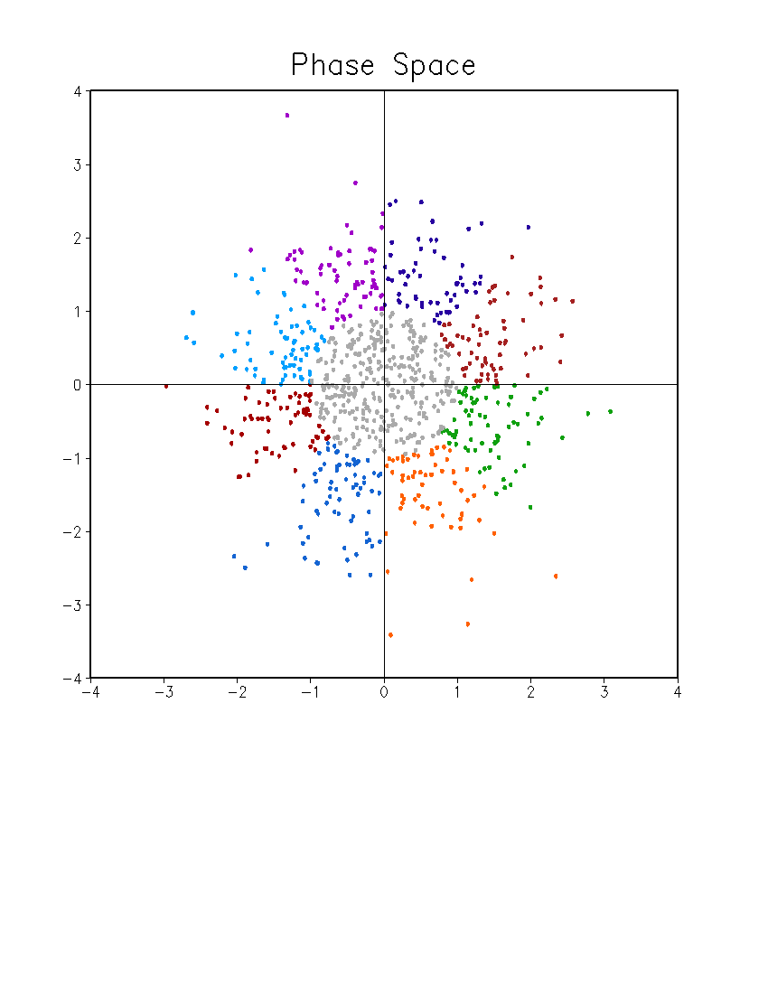
Weekly MJO Index
Based on Weekly OLR, U200, and U850
03 Jan 1999 – 27 Dec 2014
Phase 7
Phase 6
Phase 8
Phase 5
PC2
Weak MJO
Phase 1
Phase 4
Phase 2
Phase 3
PC1
Weekly OLR, U200, U850

Slide 4
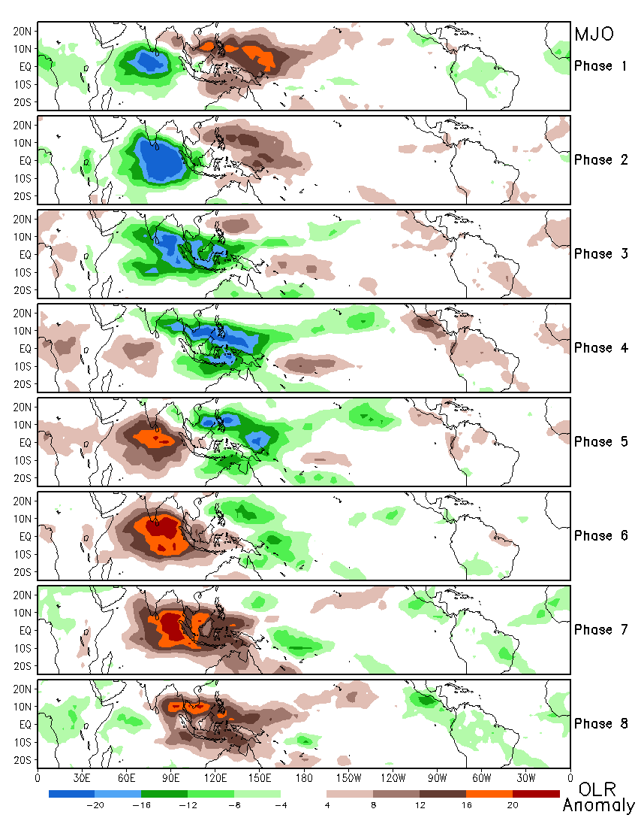
Composite of OLR Anomaly for Different MJO Phases Based on Daily MJO Index
1999 – 2014
Daily OLR Anomaly
Unfiltered

Slide 5
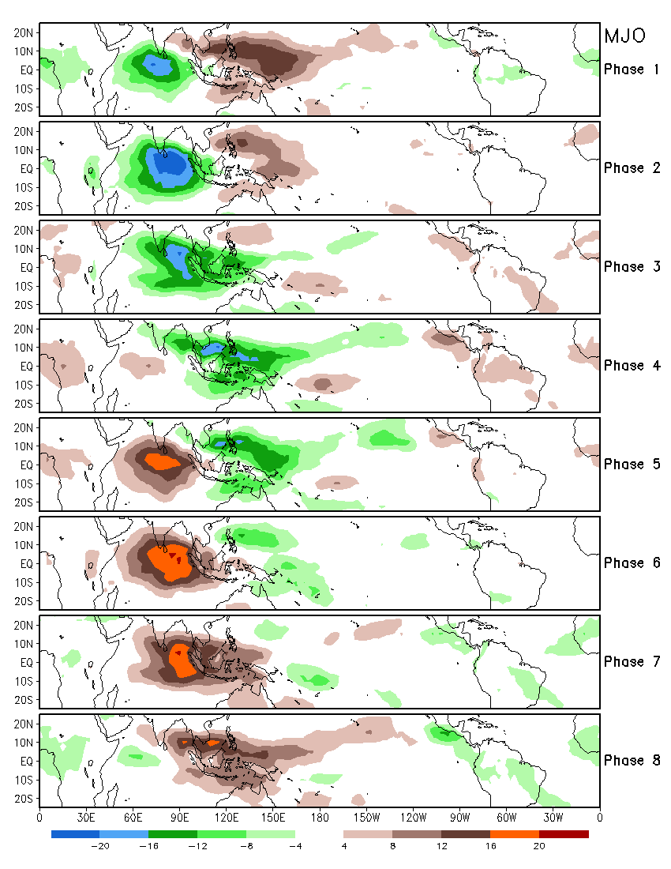
Composite of OLR Anomaly for Different MJO Phases Based on Daily MJO Index
1999 – 2014
Daily OLR Anomaly
Filtered

Slide 6
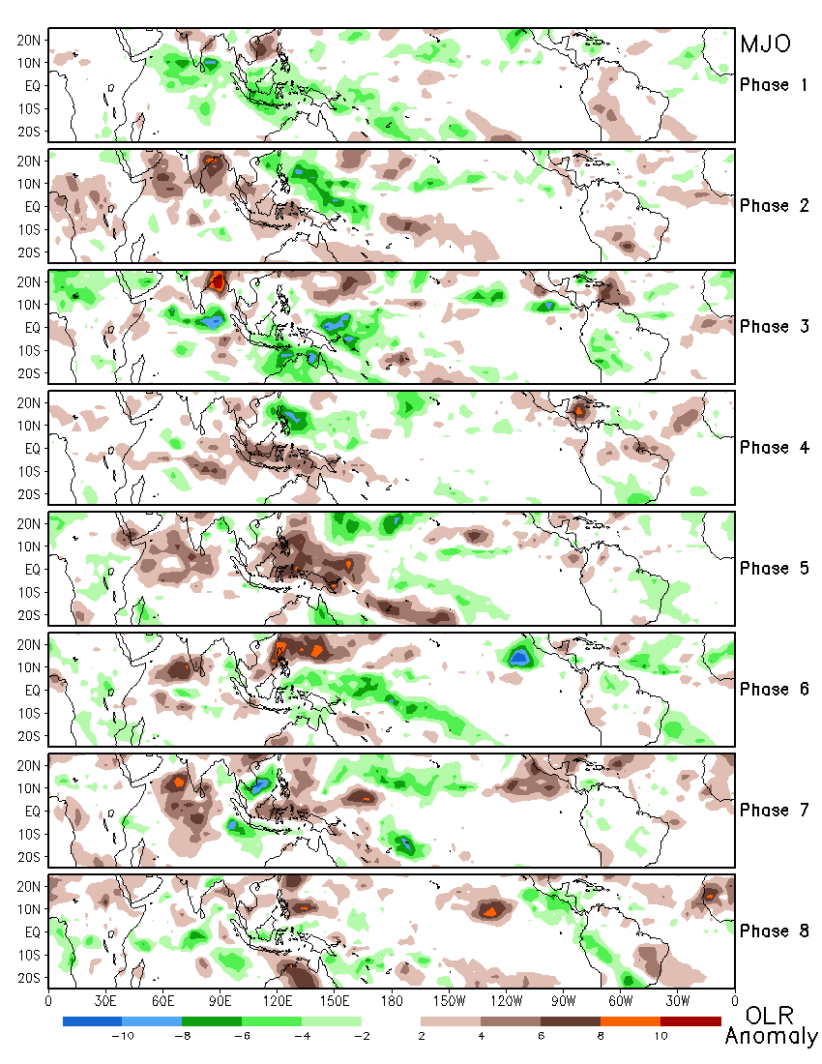
Composite of OLR Anomaly for Different MJO Phases Based on Weekly MJO Index
1999 – 2014
Weekly OLR Anomaly
Unfiltered

Slide 7
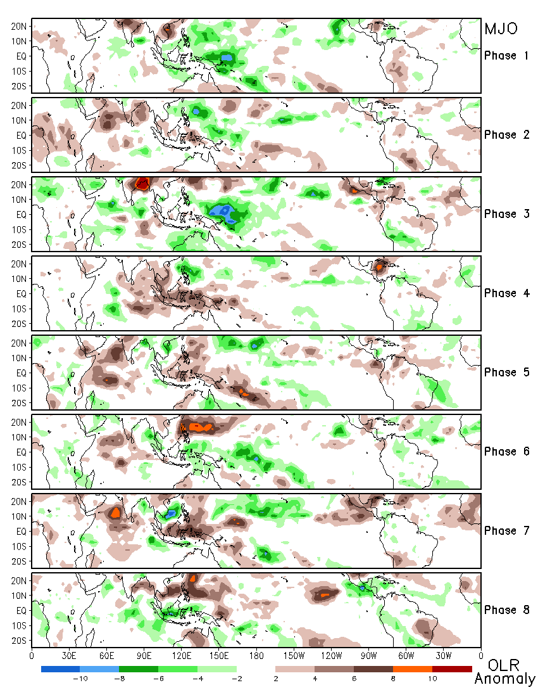
Composite of OLR Anomaly for Different MJO Phases Based on Weekly MJO Index
1999 – 2014
Weekly OLR Anomaly
Unfiltered
Weekly OLR, U200, U850

Slide 8
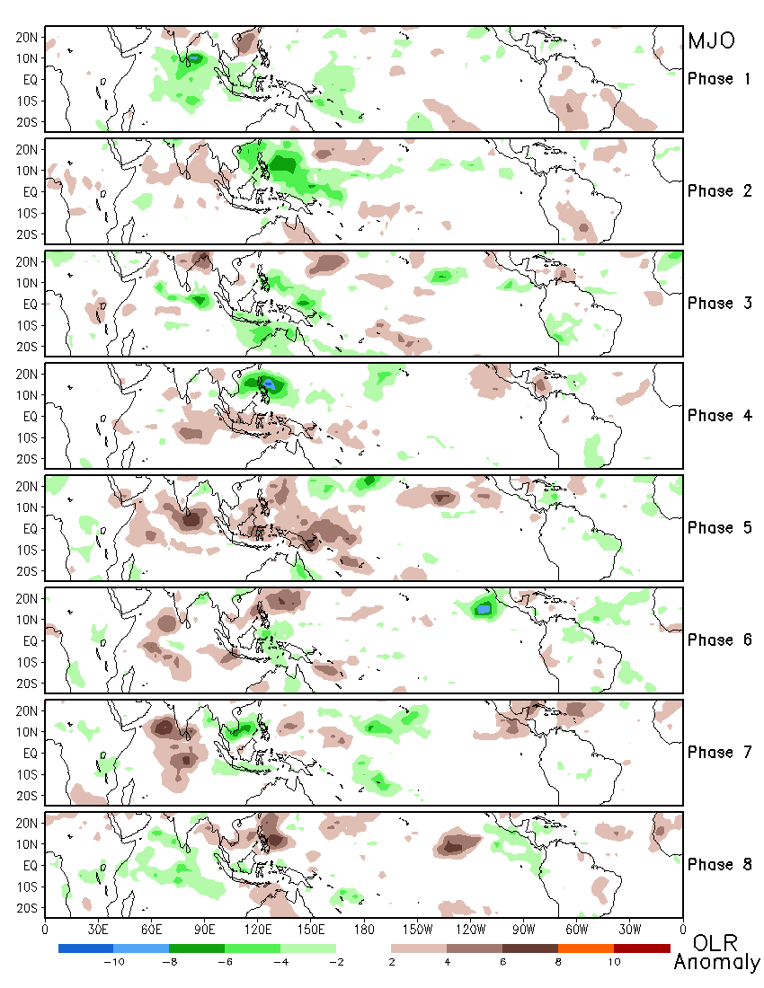
Composite of OLR Anomaly for Different MJO Phases Based on Weekly MJO Index
1999 – 2014
Weekly OLR Anomaly
Filtered

Slide 9
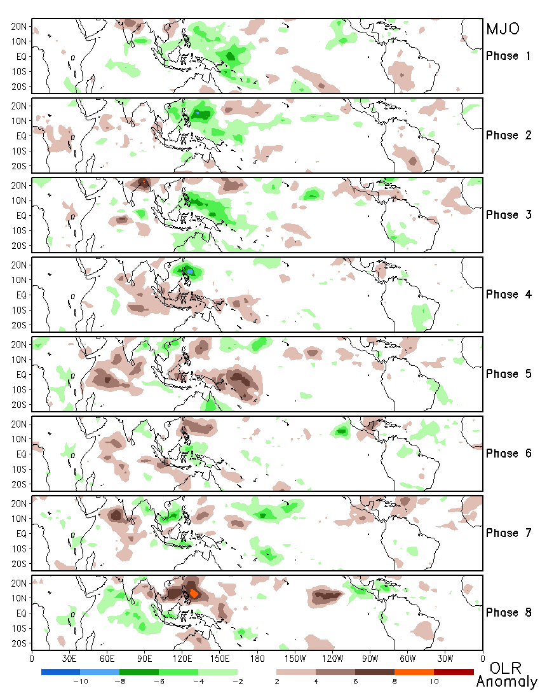
Composite of OLR Anomaly for Different MJO Phases Based on Weekly MJO Index
1999 – 2014
Weekly OLR Anomaly
Filtered
Weekly OLR, U200, U850

Slide 11
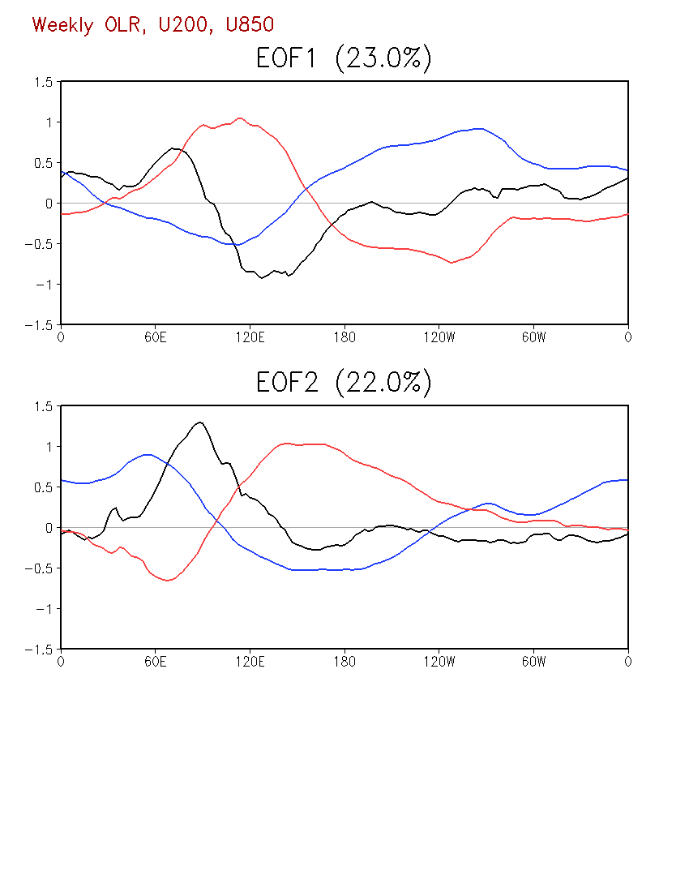
OLR U850 U200

Slide 12
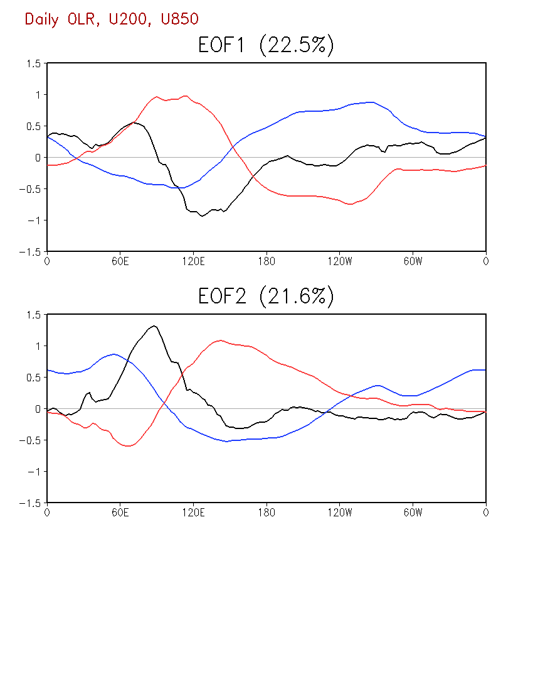
OLR U850 U200

Slide 14
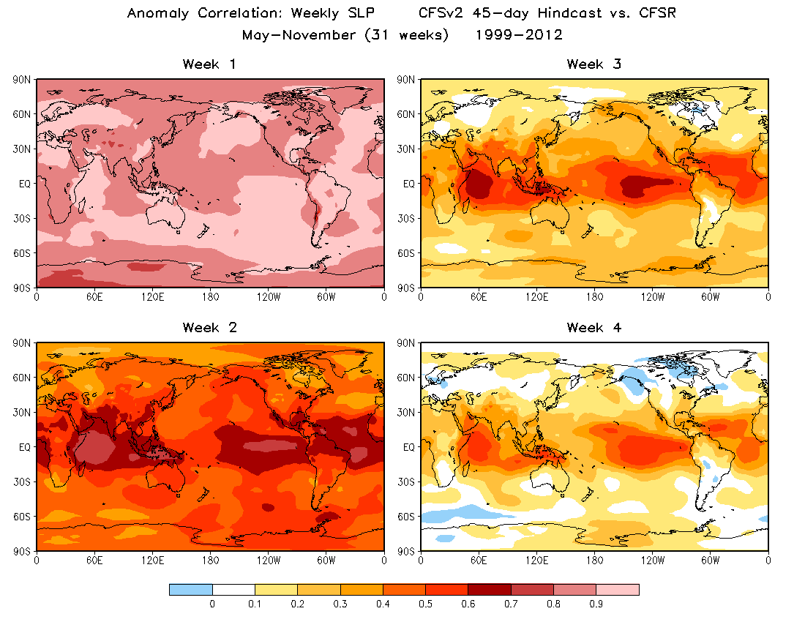

Slide 15
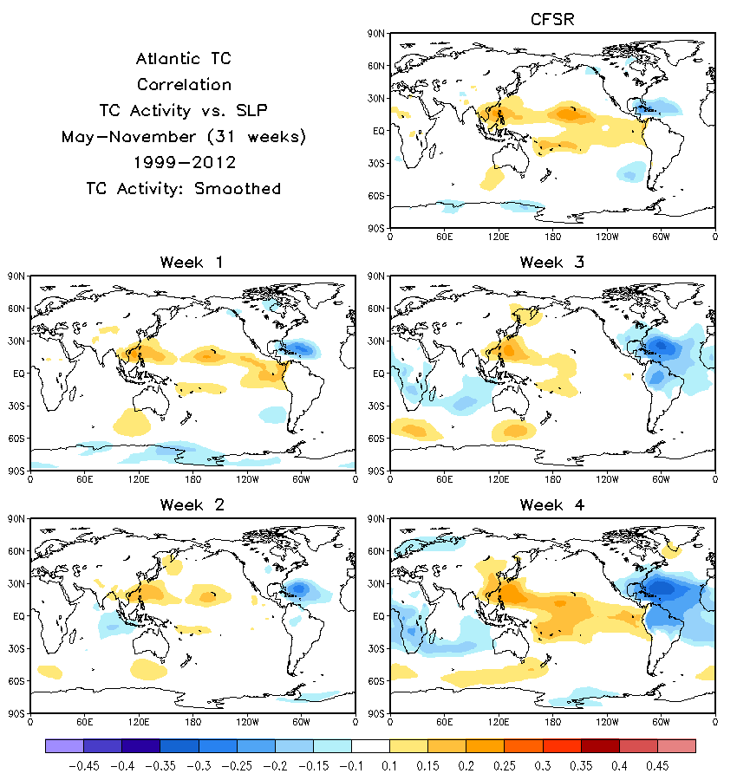

Slide 16
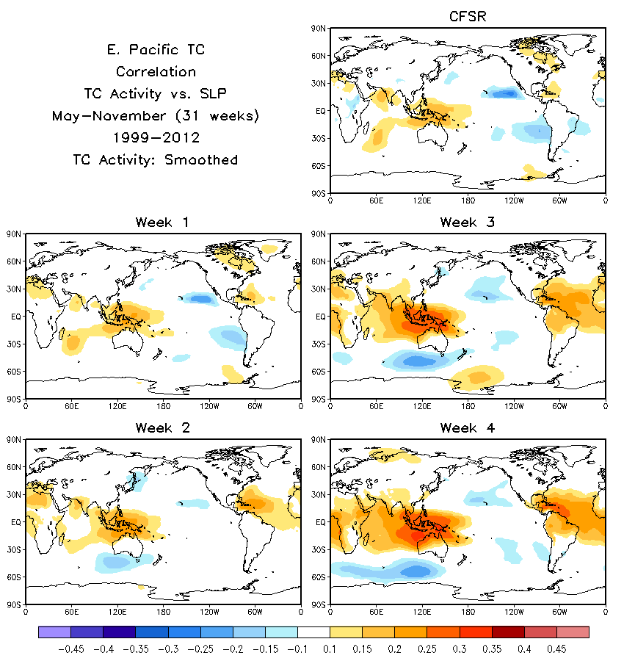

Slide 17
