Slide 1
Application of NMME for the Intraseasonal Prediction of Tropical Cyclones over the Atlantic and North Pacific Basins
Jae-Kyung E. Schemm and Hui Wang
NOAA Climate Prediction Center

Slide 3
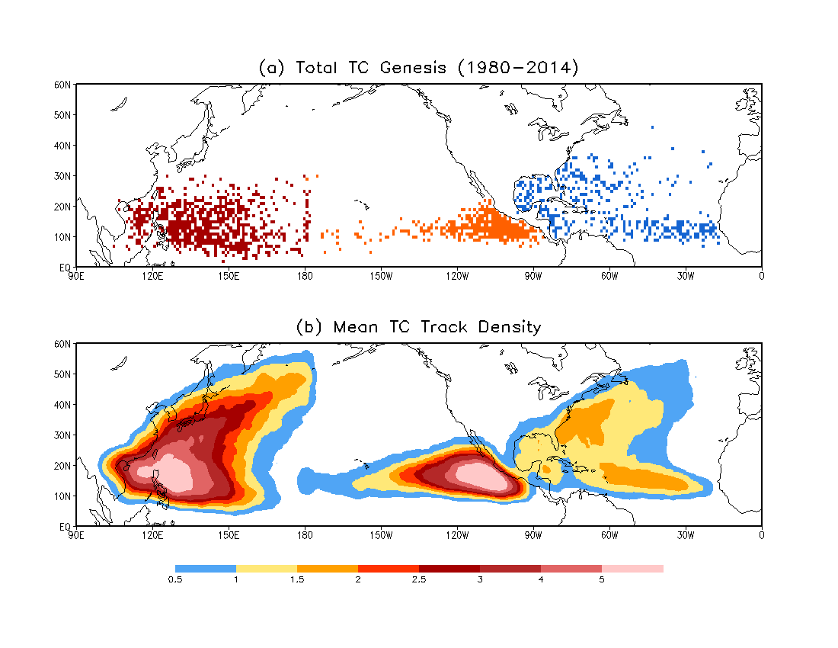

Slide 4
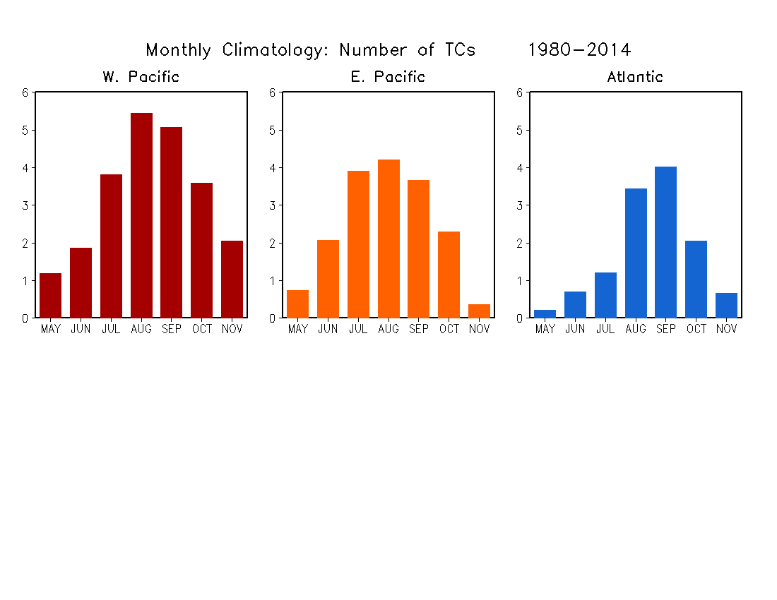

Slide 6
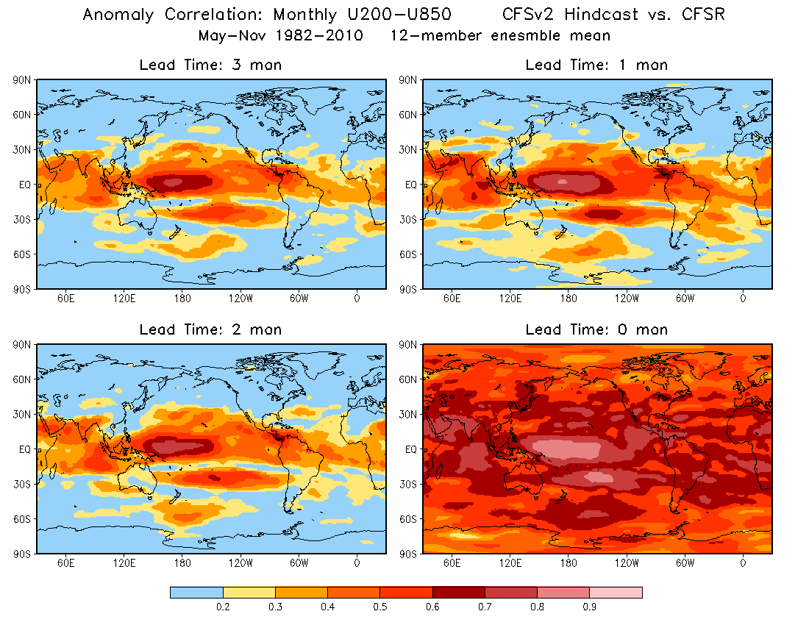
AC: U200–U850

Slide 7
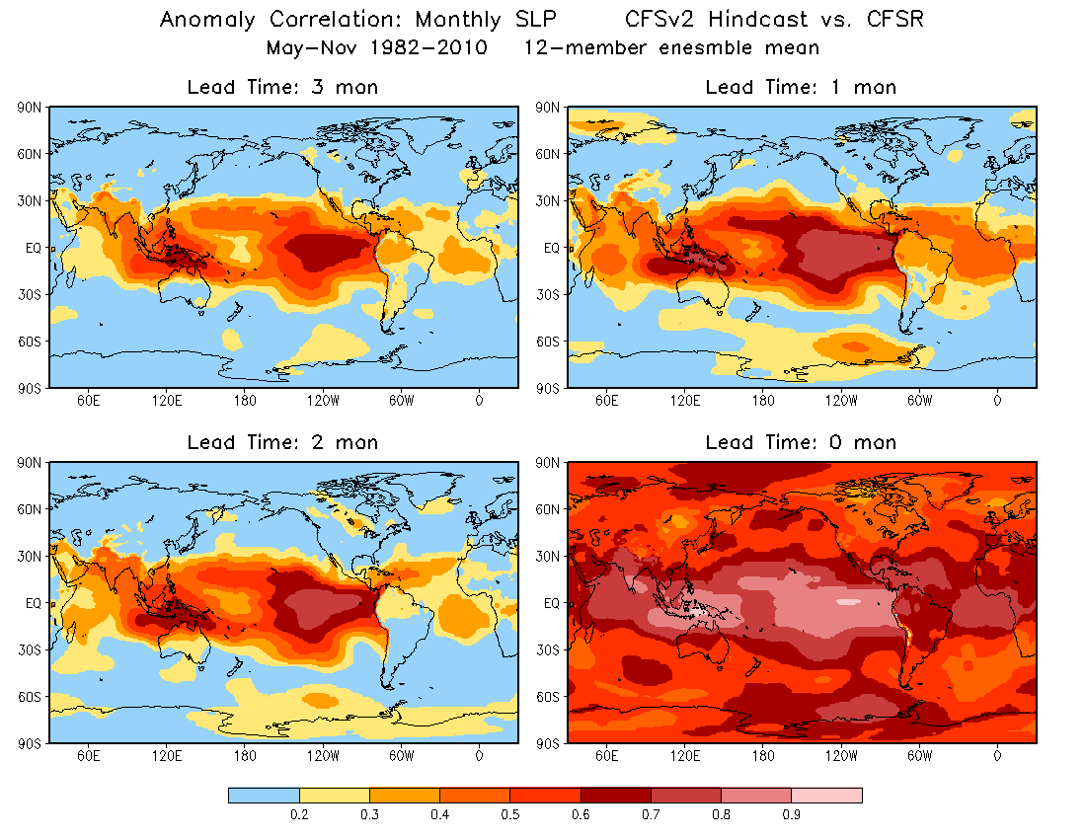
AC: SLP

Slide 8
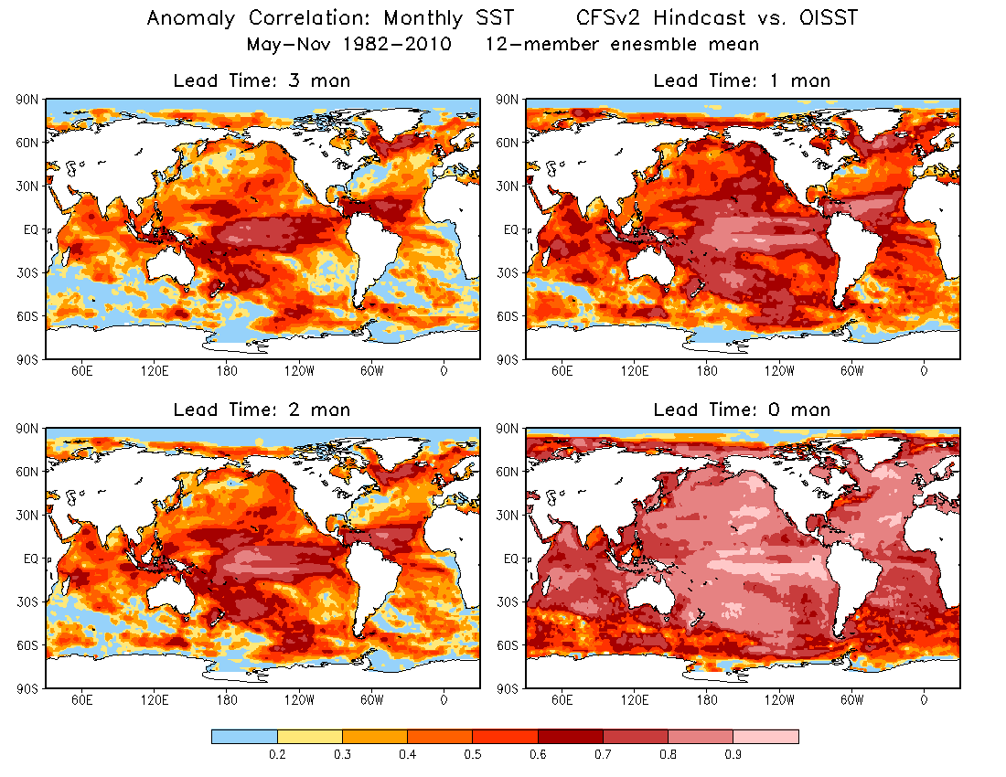
AC: SST

