Slide 1
Scatter Plots: SST vs. (OLR, Taux, LH, DSW)
SST, OLR, LH, DSW: Nino 3.4 region (120º – 170ºW, 5ºS – 5ºN)
Taux: Zonal wind stress in (170ºE – 130ºW, 5ºS – 5ºN)
LH: Latent heat flux
DSW: Downward shortwave flux
OBS
SST: NCDC1x1
OLR: NOAA Interpolated OLR
Taux, LH, DSW: ERAI (LH also from OAflux)
CFS: 20 member, 0-month forecast
Five years selected: 2010, 2011, 2012, 2014, 2017
Months: May, Jun, Jul, Aug (Developing phase)

Slide 2
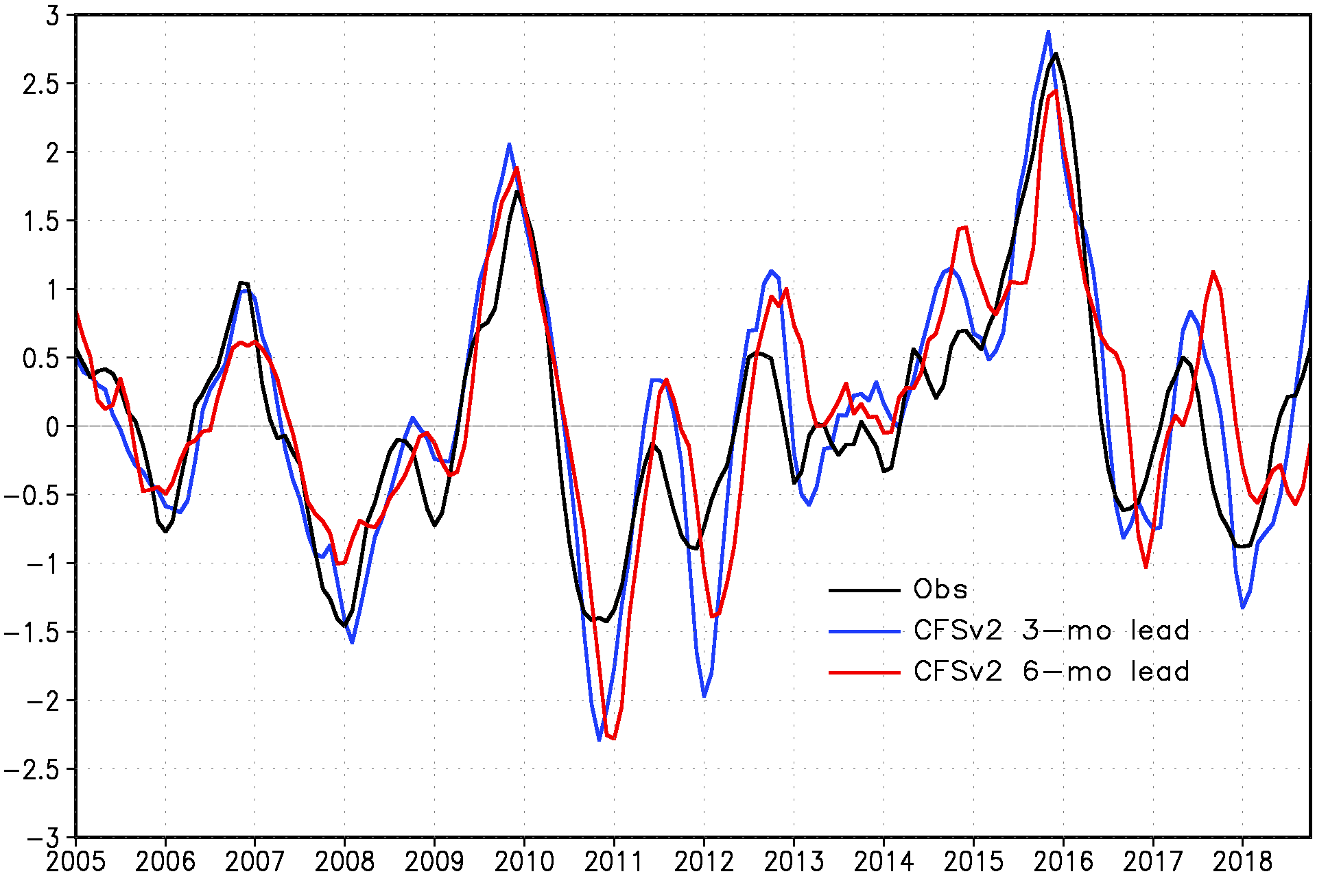
Nino 3.4 Index
False alarms
Delayed transitions
Stronger amplitude
2010 2011 2012 2014 2017
(Wanqiu Wang)

Slide 3
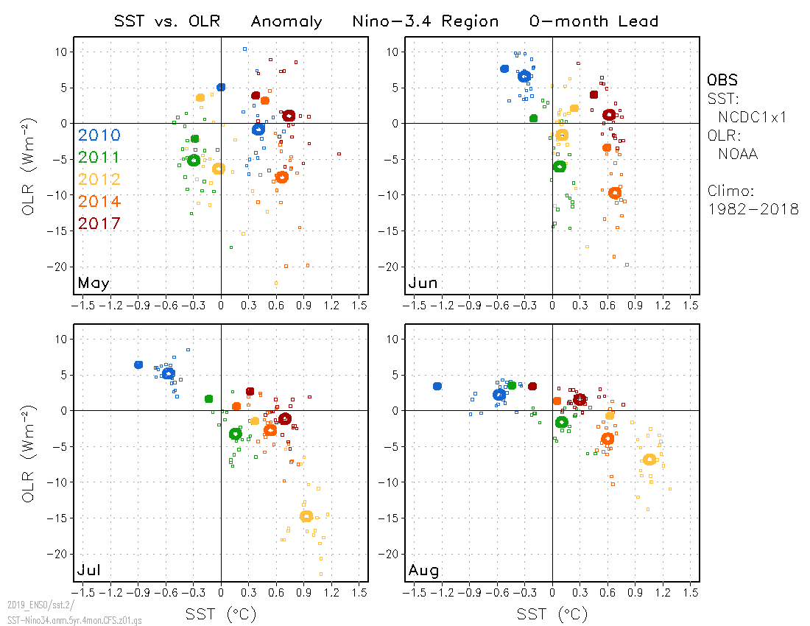
Warmer SST
Less OLR
OBS
CFSv2:
Mean (20 runs)
Individual runs (20)

Slide 4
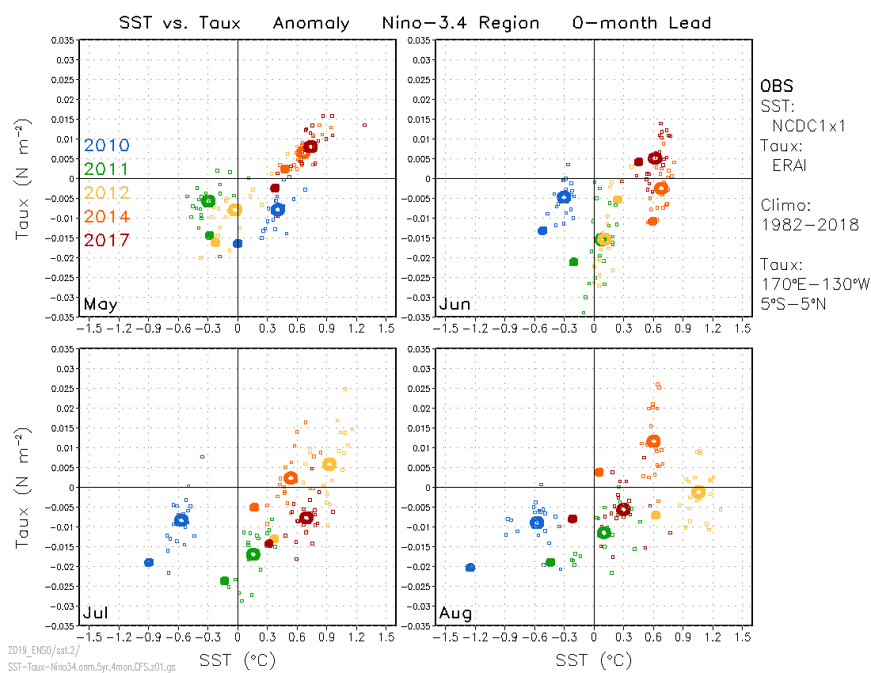
Warmer SST
Larger Taux

Slide 5
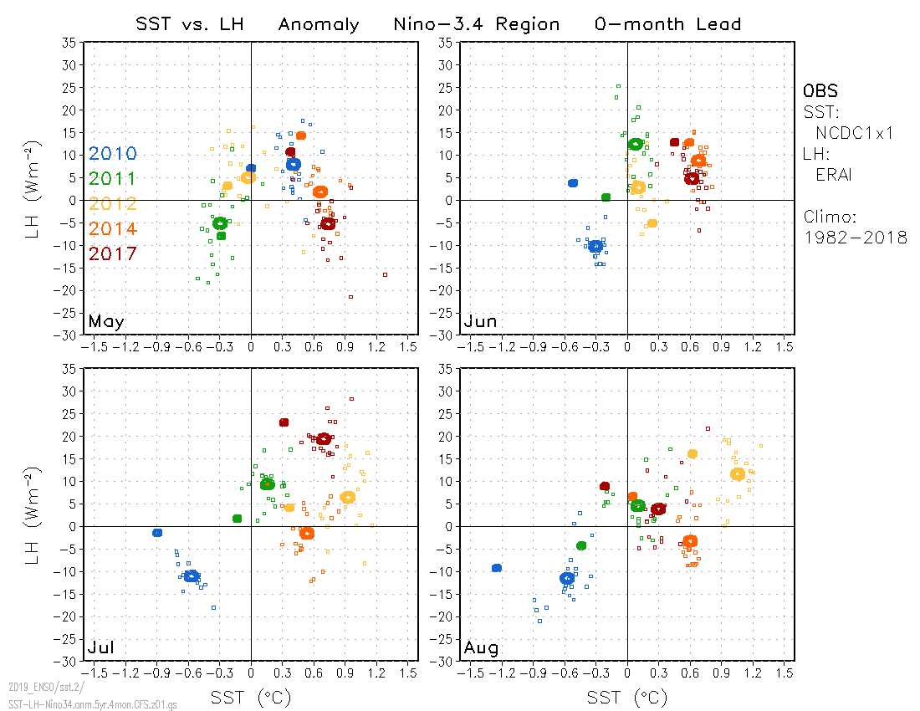

Slide 6
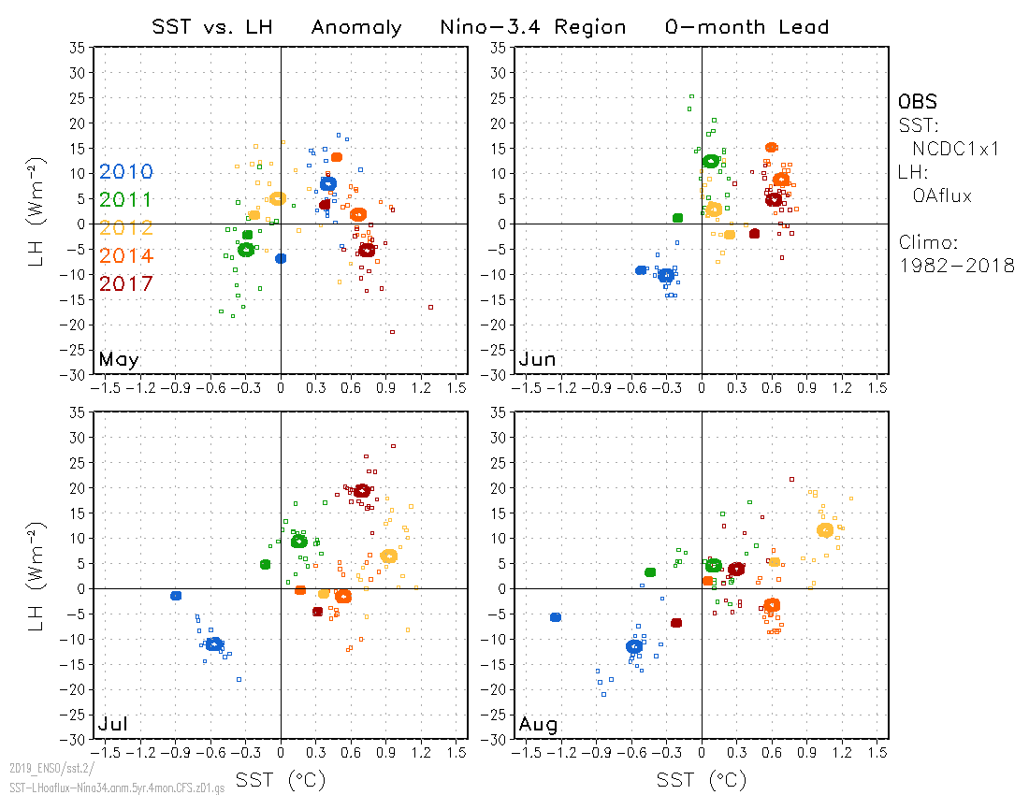

Slide 7
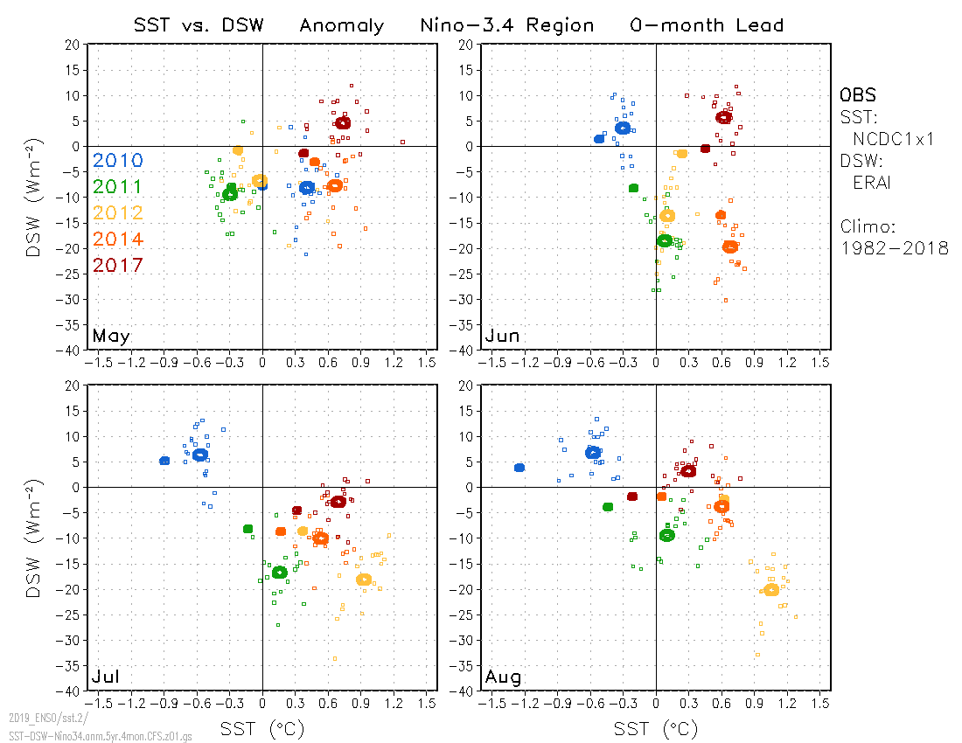
Larger amplitude of SW flux

