Slide 1
Weekly Meeting
26May2017
CFSR SCP monthly climatology
Working on correlation between CFSR SCP and GEFS SCP forecasts with different leads
Anomaly correlation
Rank correlations (2)

Slide 2
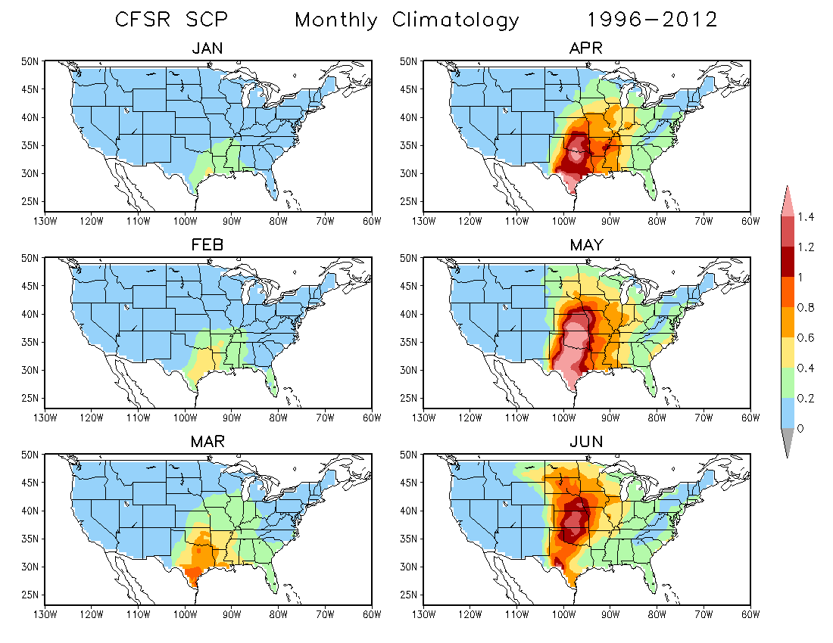

Slide 3
