Slide 1
Weekly Meeting
09Jun2017
PDF of daily mean CAPE, BWD, and SRH over the U.S. from the CFSR data for understanding the PDF of SCP
CAPE: convective available potential energy
BWD: bulk wind difference
SRH: storm-relative helicity
SCP: supercell composite parameter
SCP = (CAPE/1000 J kg⁻¹) × (SRH/50 m⁻² s⁻²) × (BWD/20 m s⁻¹)
Correlation between GEFS forecasted 7-day mean SCP and CFSR SCP, 1996–2012, lead time: day 1 – day 8

Slide 2
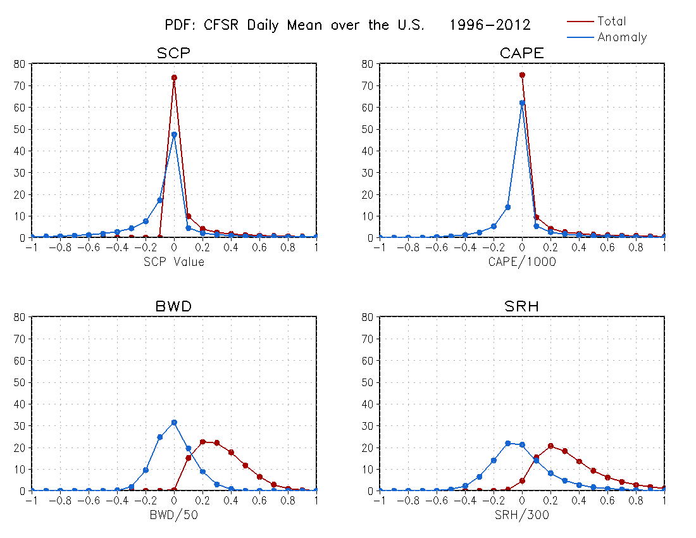
Non-Gaussian distribution
Percentage
Percentage
Percentage
Percentage

Slide 3
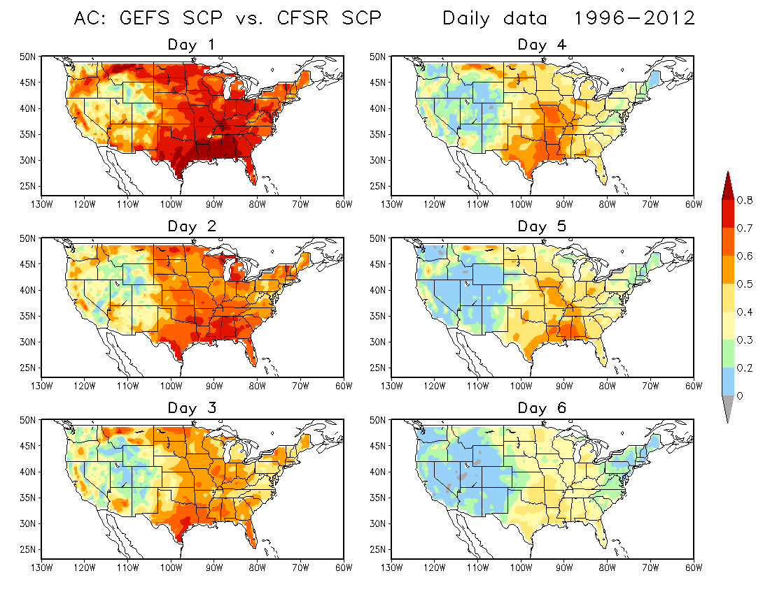

Slide 4
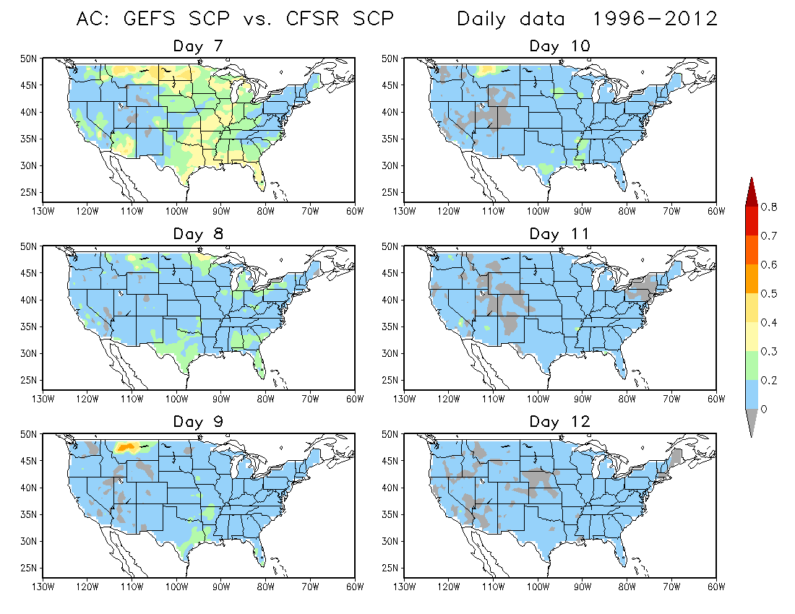

Slide 5
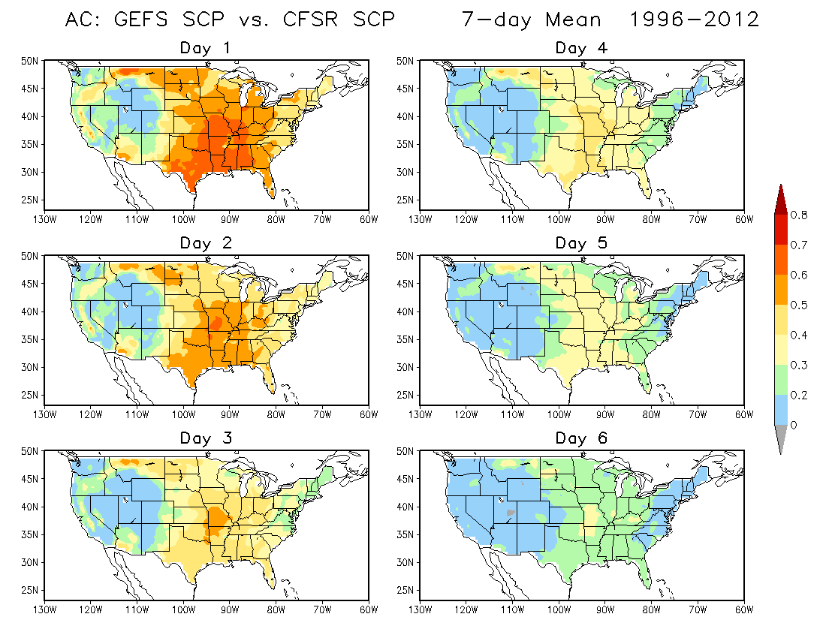
Day 1 – day 7 average
Day 2 – day 8 average

Slide 6
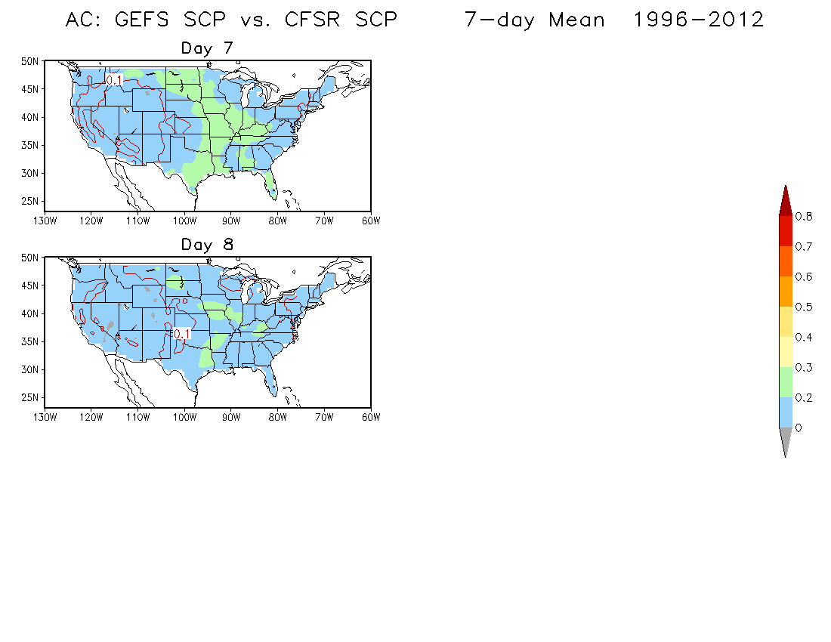
Day 8 – day 14 average
(Week 2)

