Slide 1
Weekly Meeting
16Jun2017
Relationship between SCP and LSR
LSR: Local Storm Report (hail, tornado, damaging wind)
Anomaly correlation (AC)
Seasonality
Conditional AC (SCP >= 1)

Slide 2
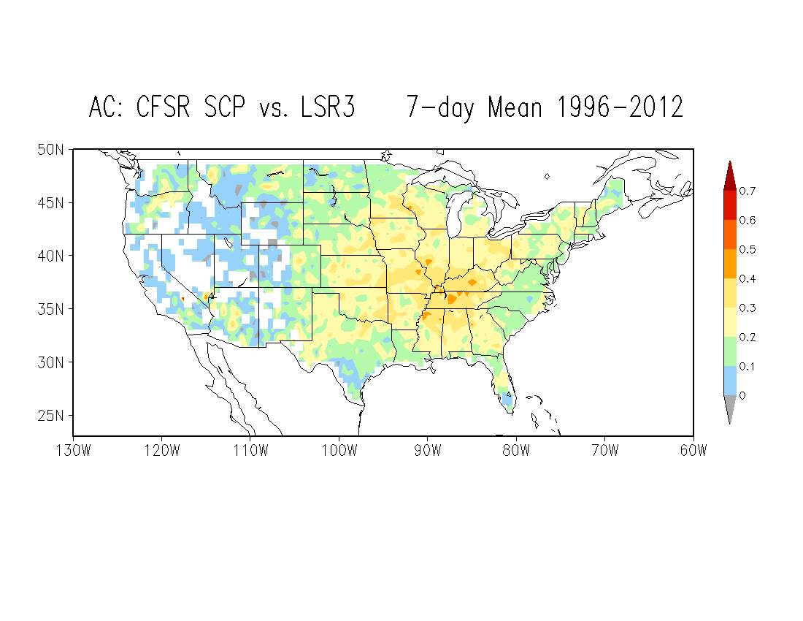
LSR3: Hail + Tornado + Wind

Slide 3
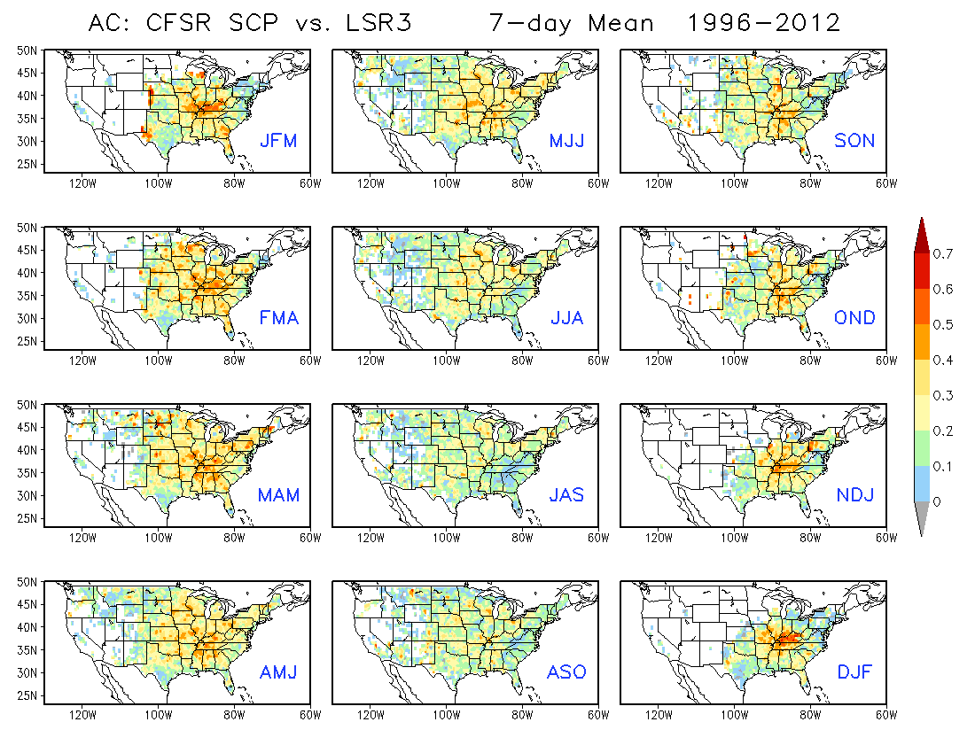

Slide 4
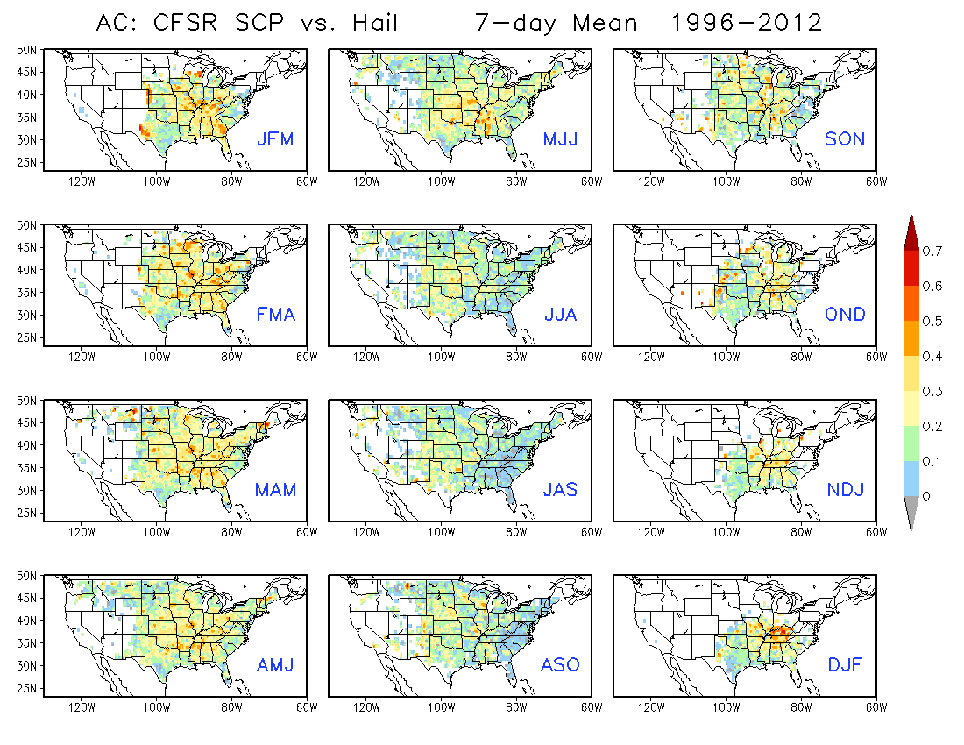

Slide 5
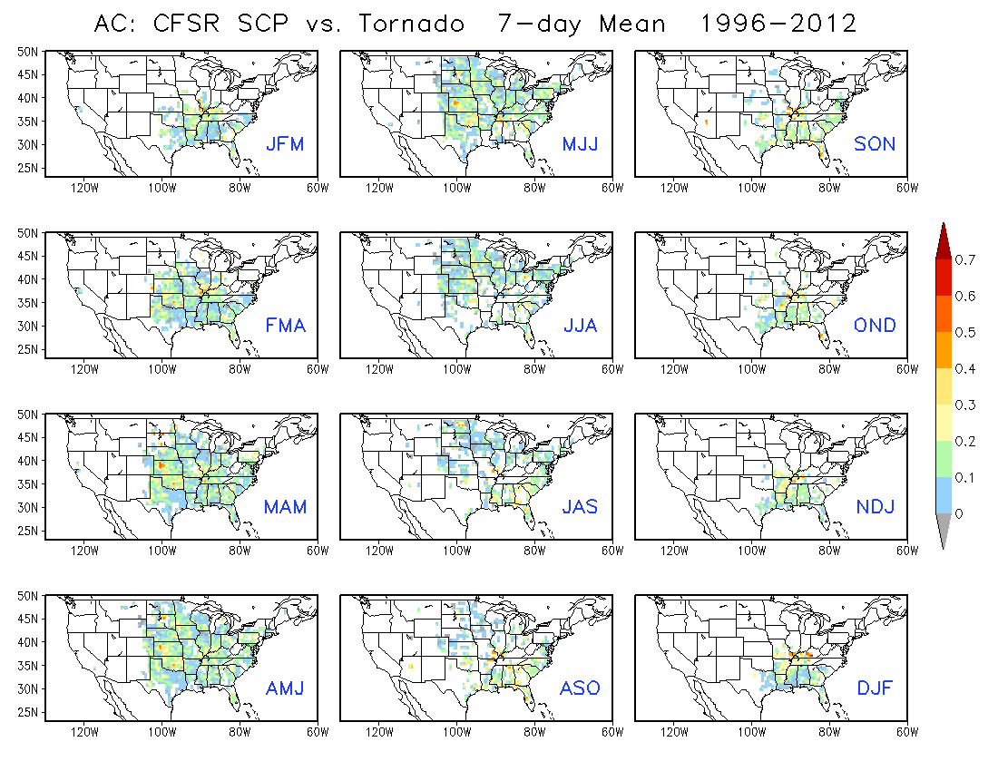

Slide 6
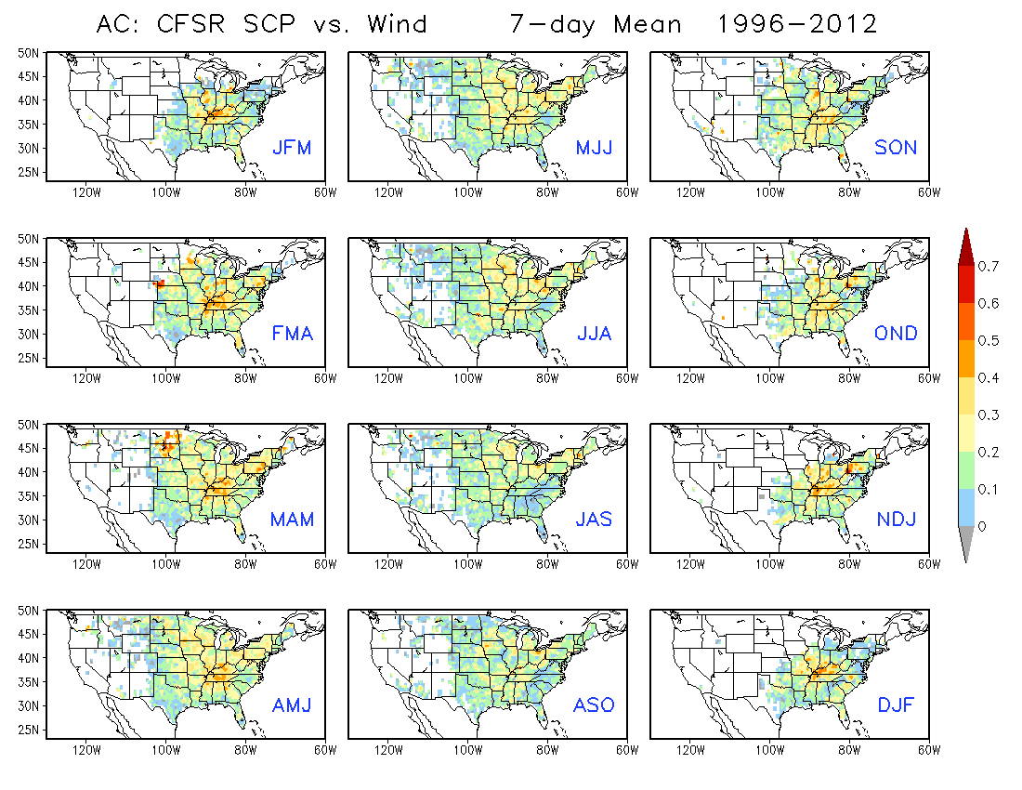

Slide 7
Anomaly correlation between CFSR SCP and LSR
Correlation only for SCP >= 1 (Conditional)
7-day mean data, 1996 – 2012
Correlation over 3 months for
LSR3 (hail + tornado + wind)
Hail
Tornado
Wind

Slide 8
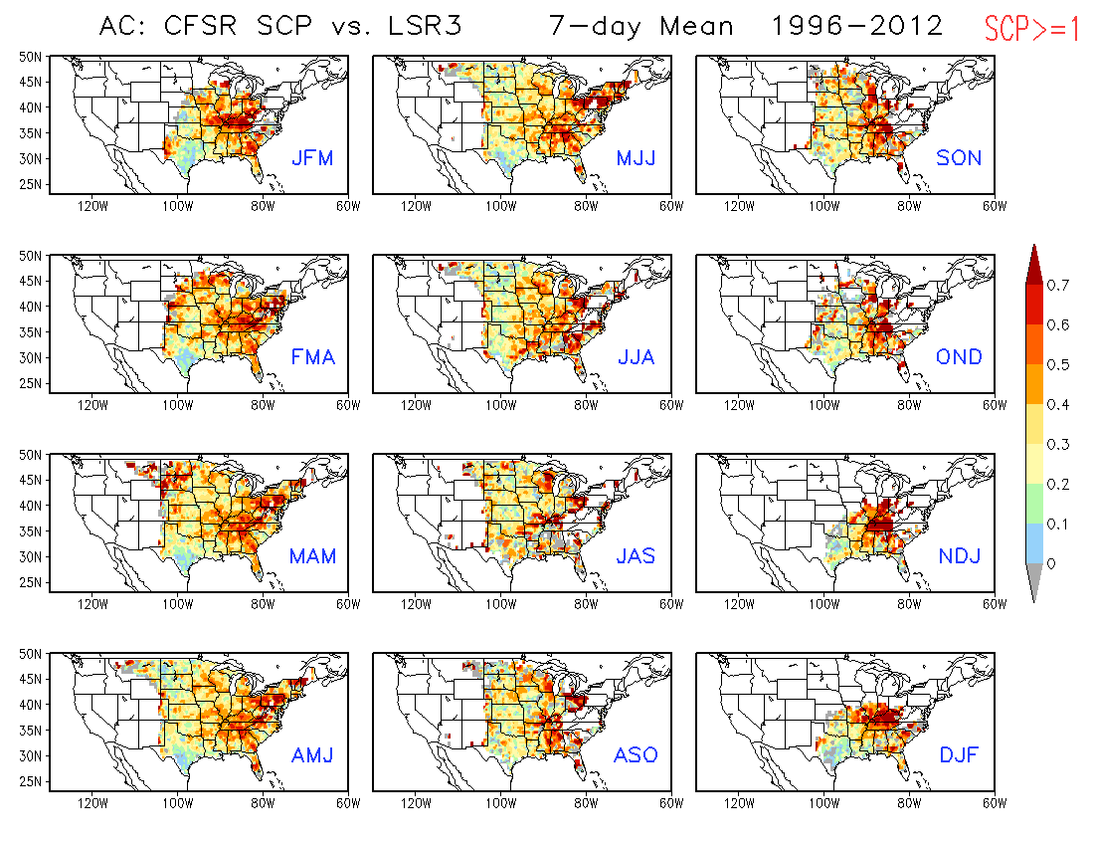

Slide 9
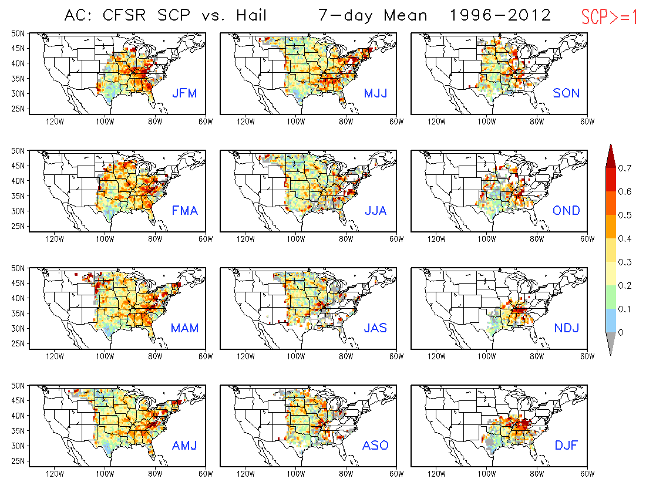

Slide 10
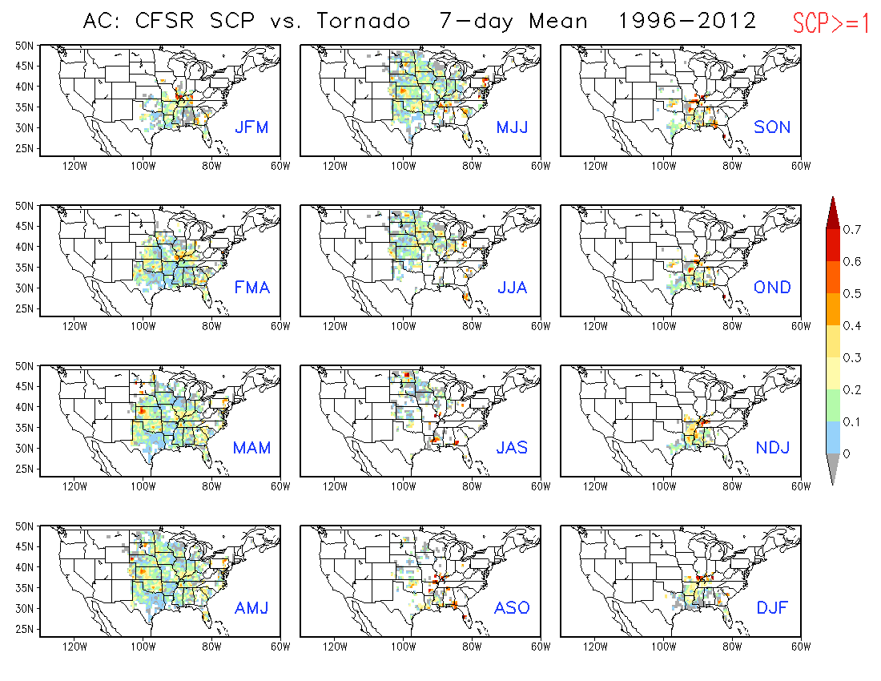

Slide 11
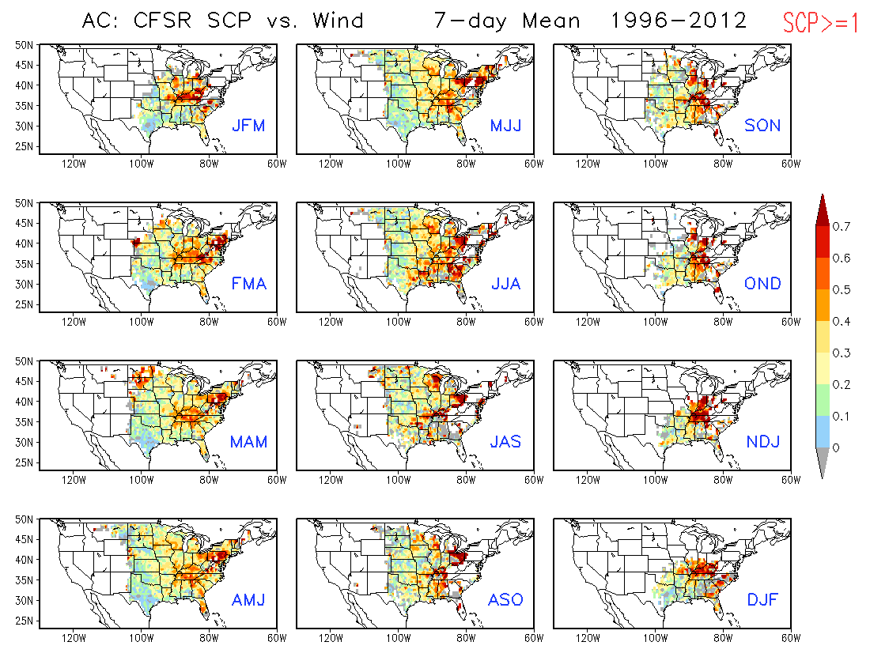

Slide 12
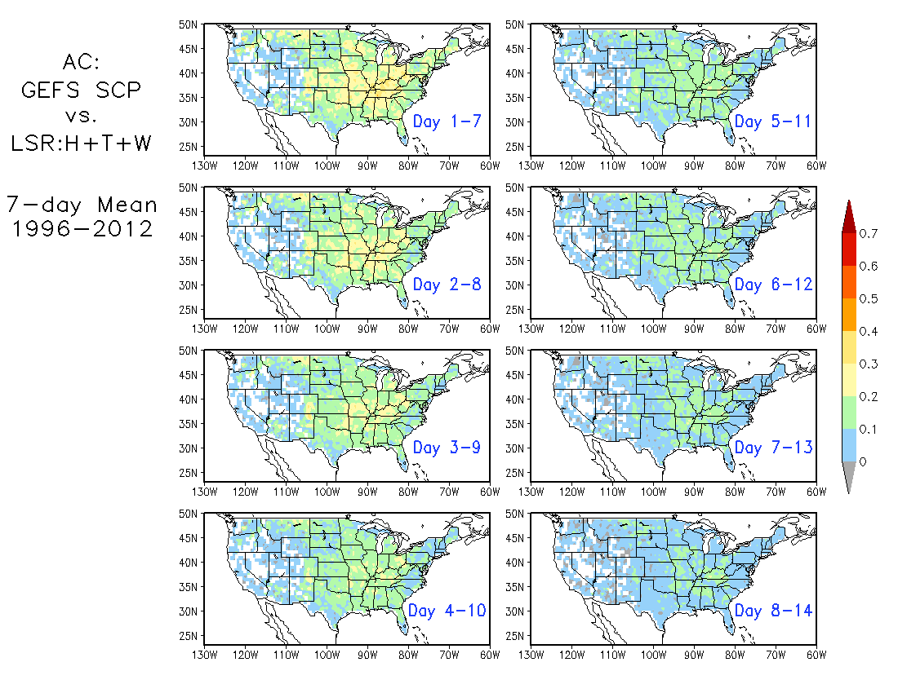
Will look at the correlations for
3-month shift windows and also for each type of LSR

