Slide 1
Weekly Meeting
07Jul2017
Co-variability between SCP and LSR
SVD analysis: CFSR SCP vs. LSR (hail, tornado, wind)
Daily data, 1996–2012
Linear regression model for forecasting LSR
Using GEFS predicted SCP as a predictor
Forecasts for MAM
Forecast skill assessed based cross-validation
Anomaly correlation
Hit rate (3 categories, 33% each)

Slide 2
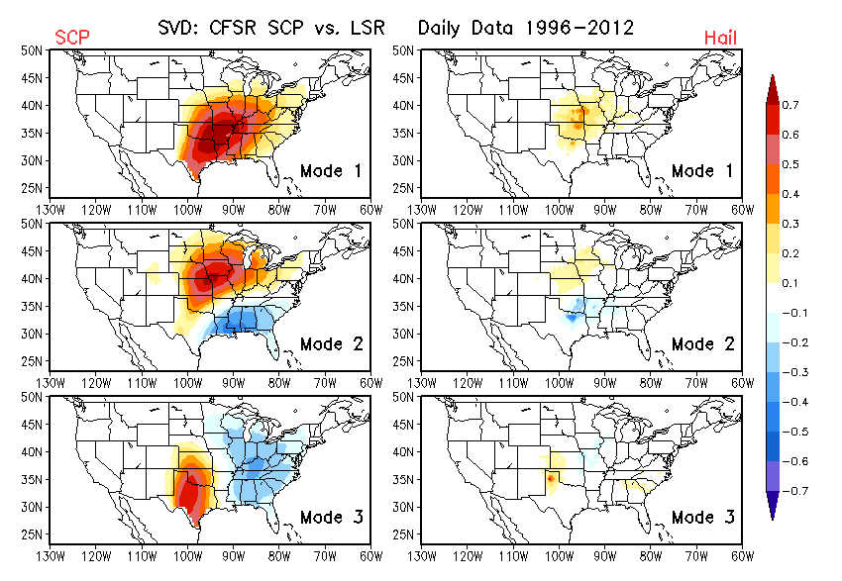
Co-variability: SCP vs. Hail

Slide 3
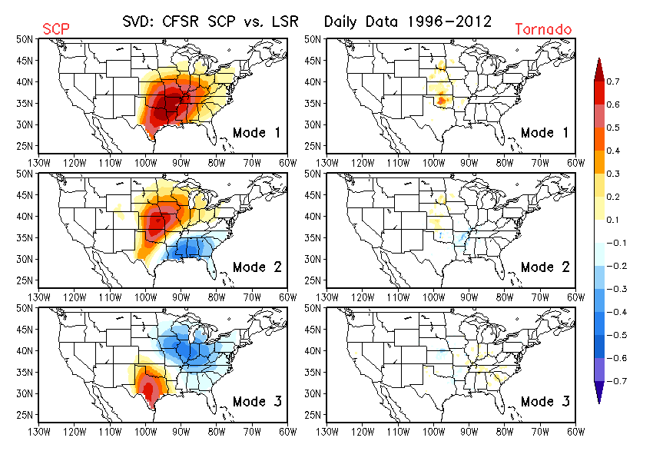
Co-variability: SCP vs. Tornado

Slide 4
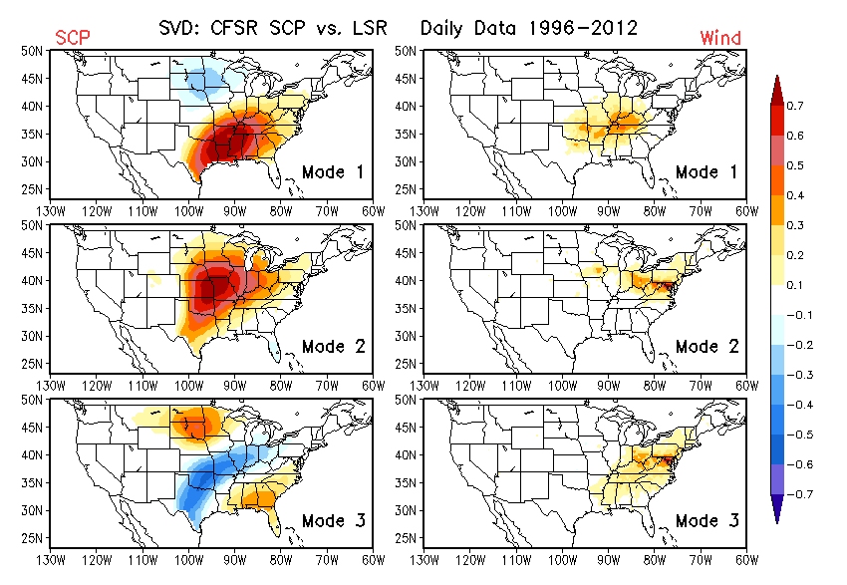
Co-variability: SCP vs. Wind

Slide 5
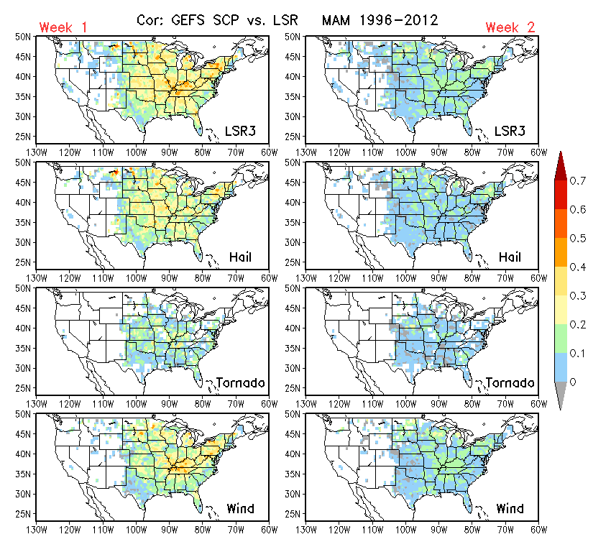
Correlation: Predicted SCP vs. LSR

Slide 6
Forecast Skill
Cross-validation

