Slide 1
Weekly Meeting
21Jul2017
Climatology and seasonality of
CAPE
BWD
SRH

Slide 2
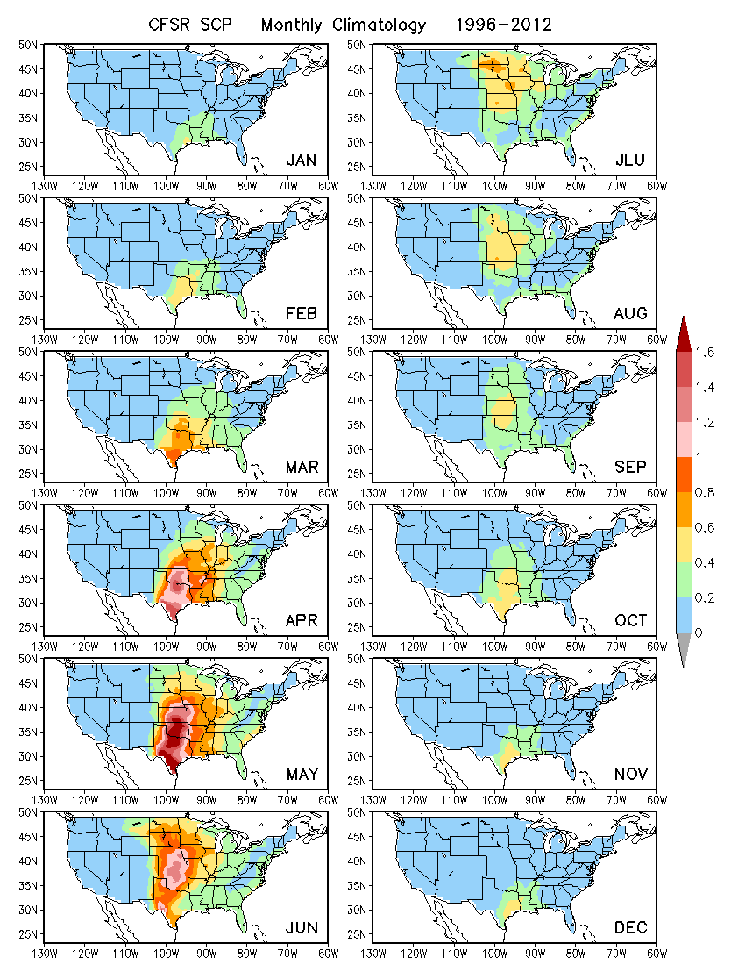
SCP

Slide 3
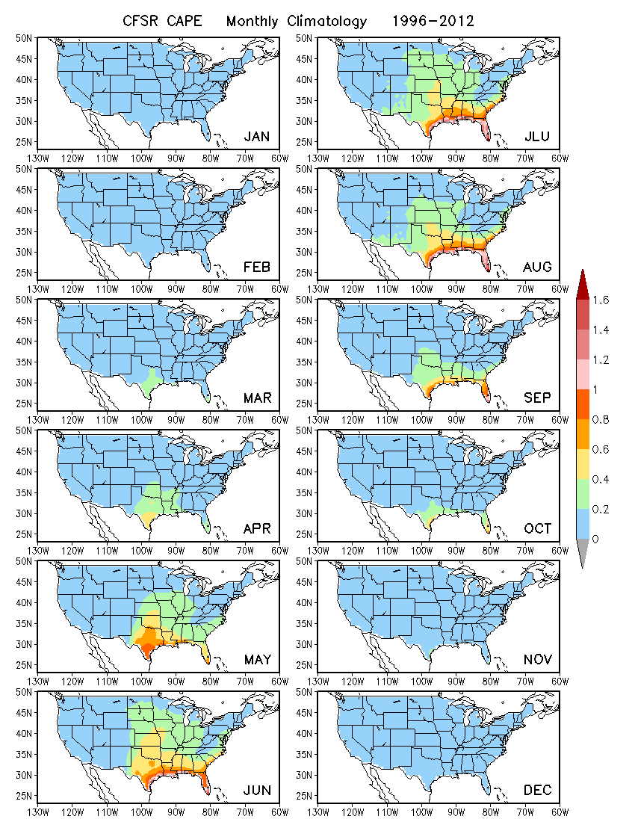
CAPE

Slide 4
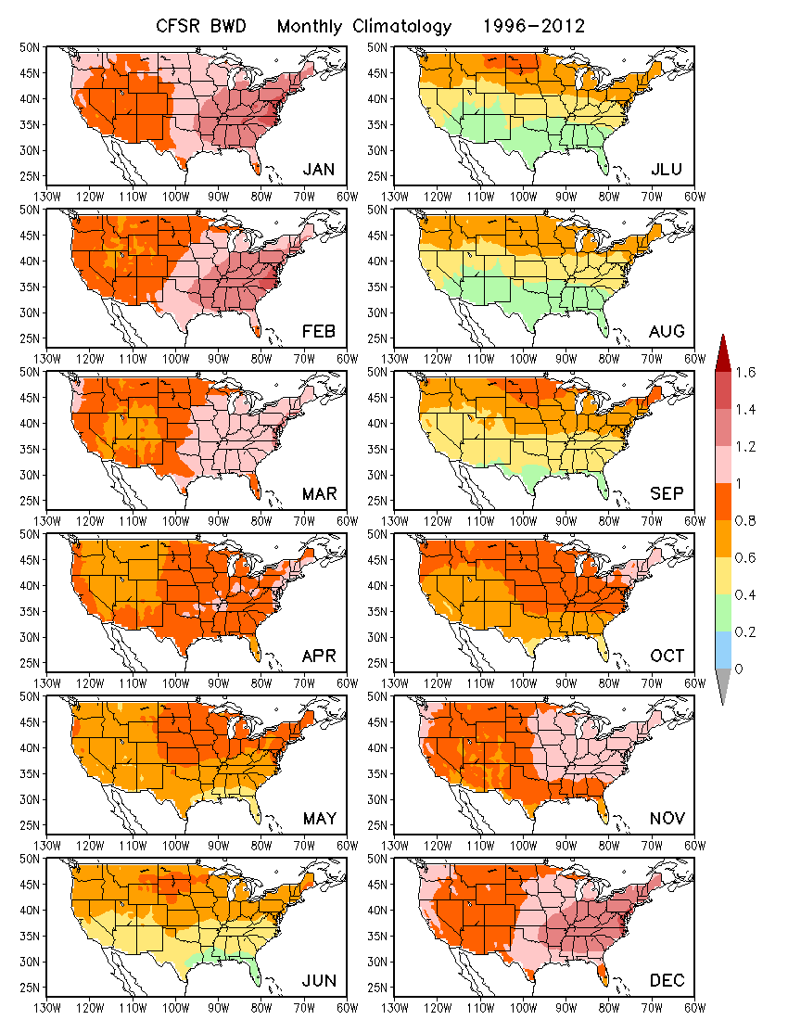
BWD

Slide 5
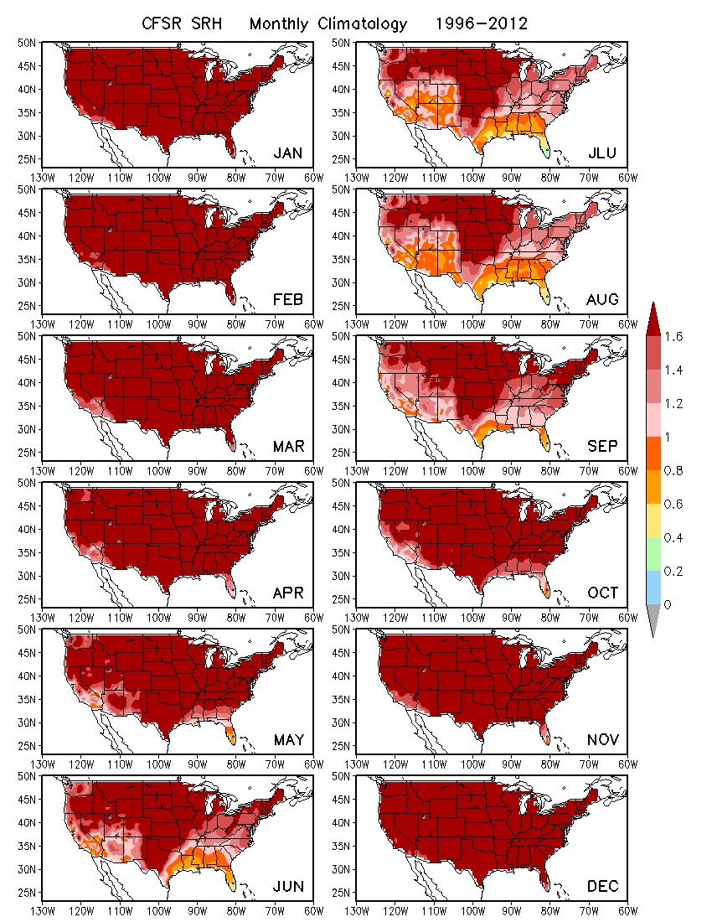
SRH

Slide 6
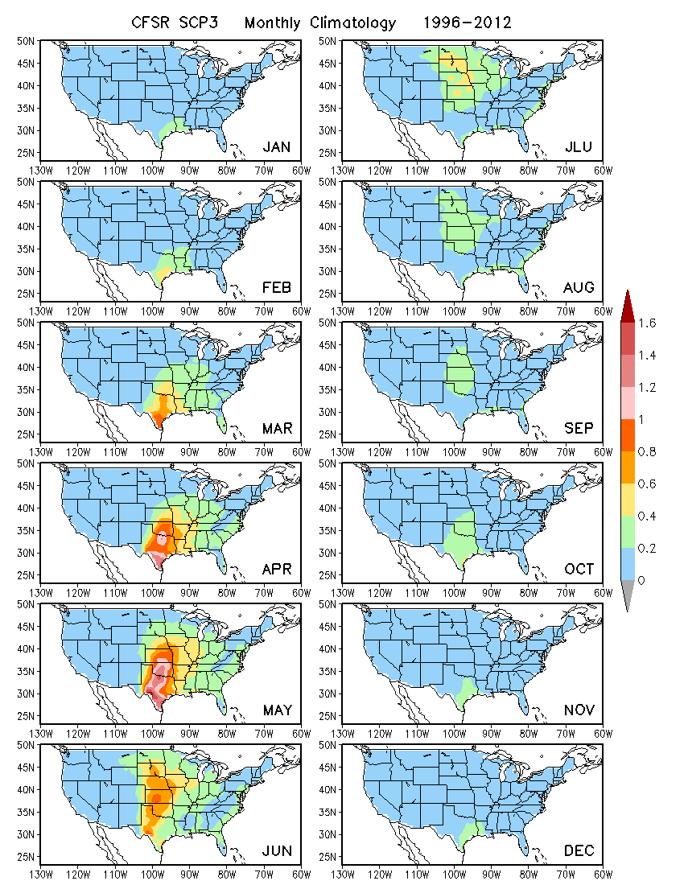
CAPE x BWD x SRH
monthly data

