Slide 1
Weekly Meeting
28Jul2017
Relationship between GEFS predicted SCP and observed LSR is the basis for the development of the hybrid forecasting system.
The forecast skill (anomaly correlation) is consistent with the correlation between GEFS SCP and OBS LSR.
A higher correlation (GEFS SCP, OBS LSR) may indicate a better forecast skill for LSR.
The correlation (GEFS SCP, OBS LSR) can be increased by averaging both SCP and LSR anomalies in a larger domain prior to calculating the correlation.
The skill for forecasting LSR over a larger area can be better than for 0.5º×0.5º.

Slide 2
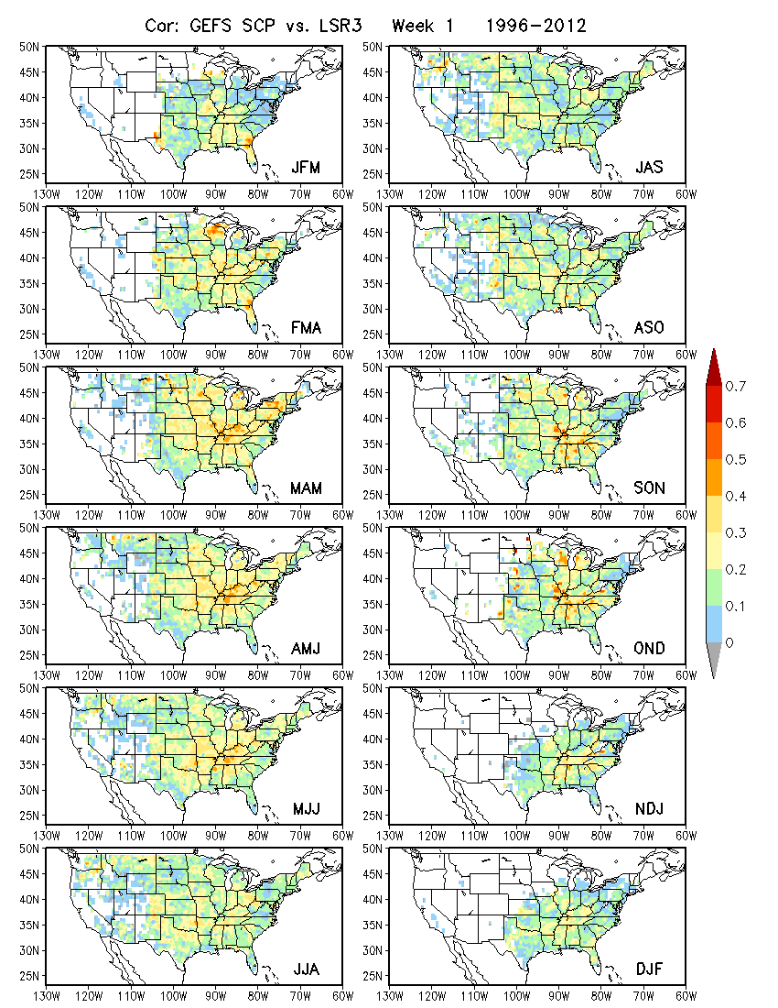
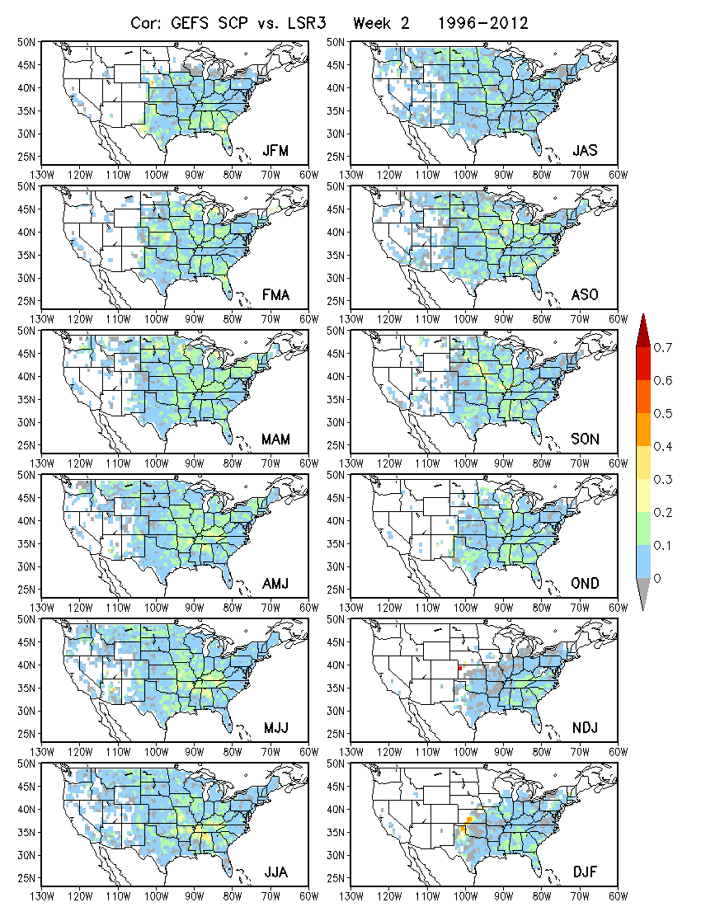
0.5º×0.5º
Week 1 Week 2

Slide 3
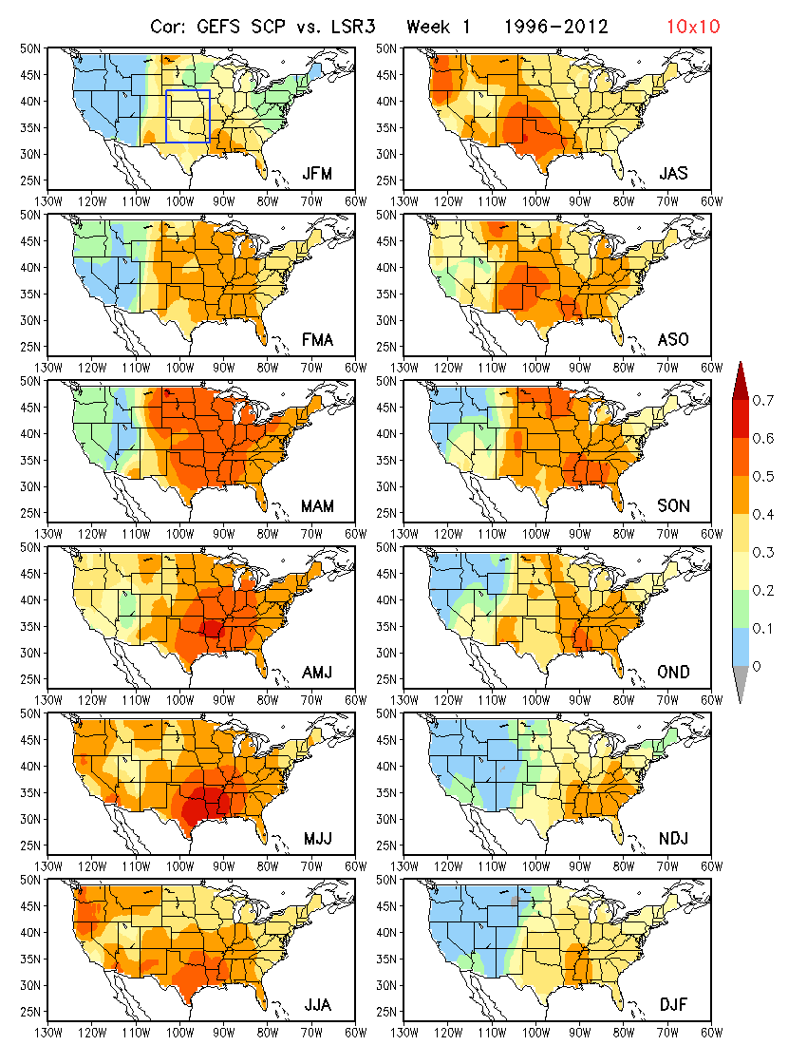
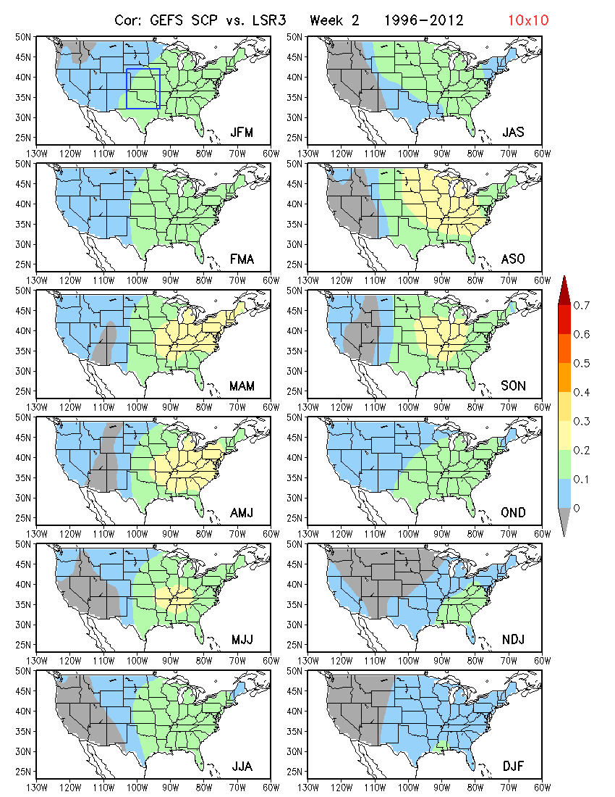
10º×10º
Week 1 Week 2

Slide 4
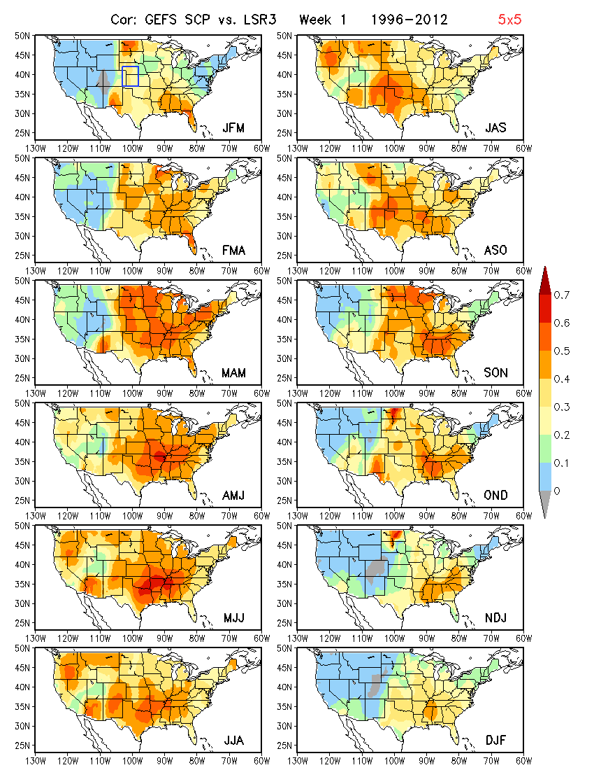
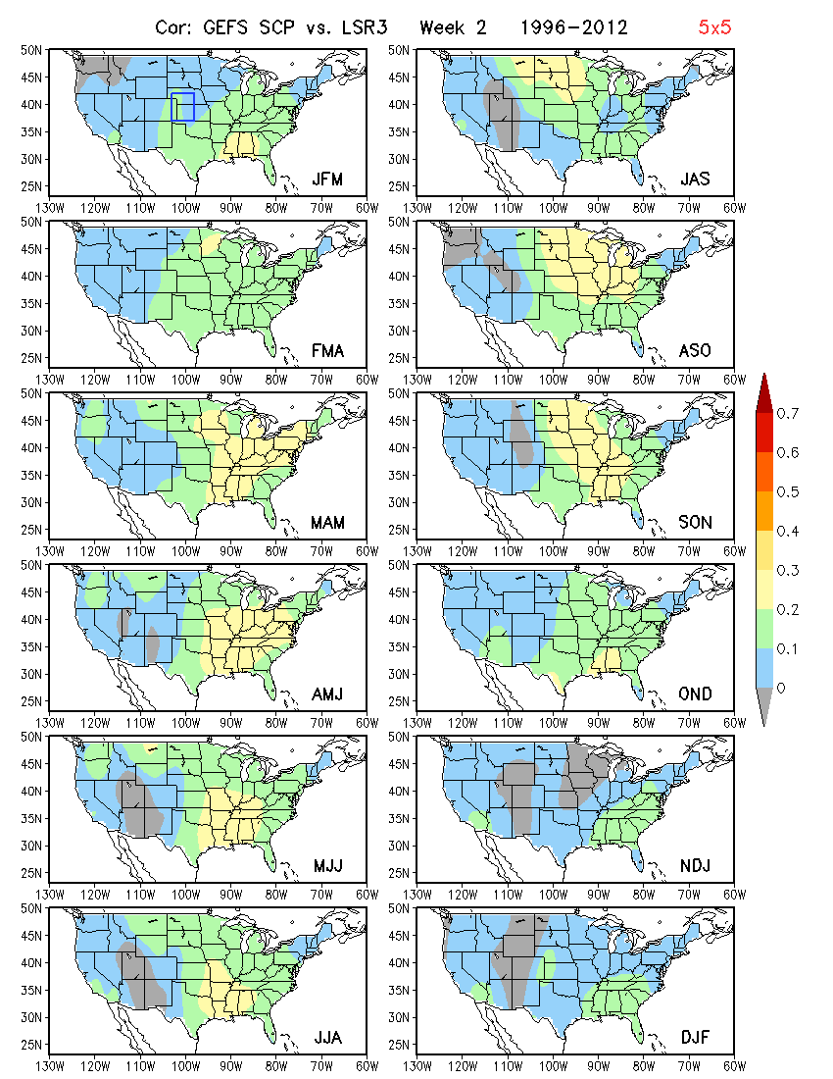
5º×5º
Week 1 Week 2

