Slide 1
Weekly Meeting
18Aug2017
Forecast SW (LSR3) with the linear regression model
Using 5º×5º box-averaged anomaly
Using GEFS predicted SCP as a predictor
Forecasts for MAM
Forecast skill assessed based on cross-validation
Anomaly correlation
Hit rate (3 categories, 33% each)
Comparison between the skills with 5º×5º box-averaged anomaly vs. 0.5º×0.5º grid
Check hit rate

Slide 2
0.5º×0.5º

Slide 3
5º×5º

Slide 4
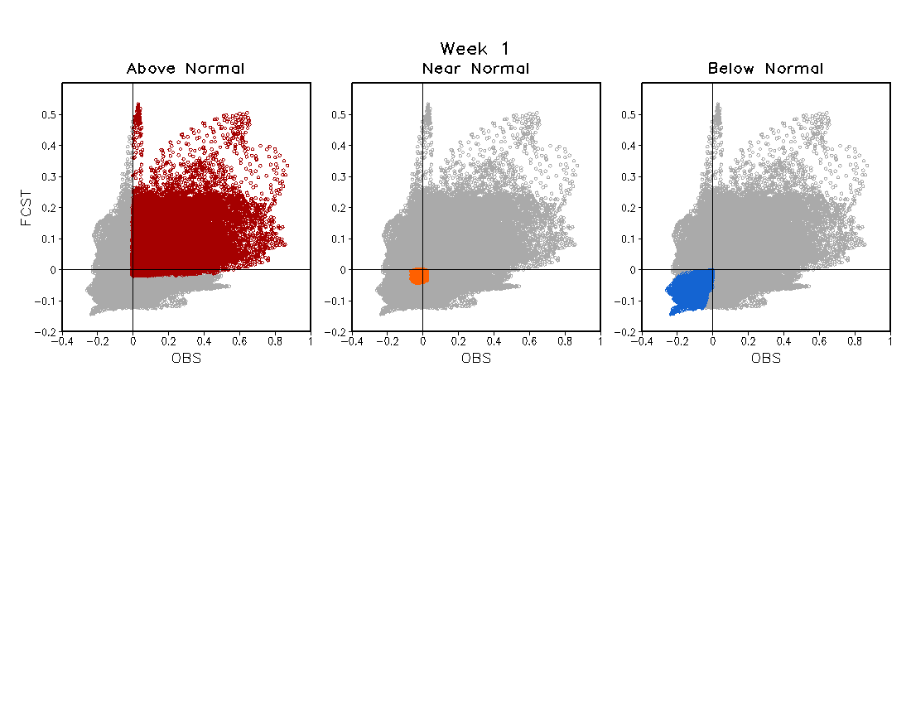
LSR3 (5º×5º)

