Slide 1
Weekly Meeting
22Sep2017
Forecast for extreme SW events
MAM 1996 – 2012
Weekly total LSR3 over the US
Time series of weekly mean forecast
Week 1 and Week 2
Forecast skill (AC)

Slide 2
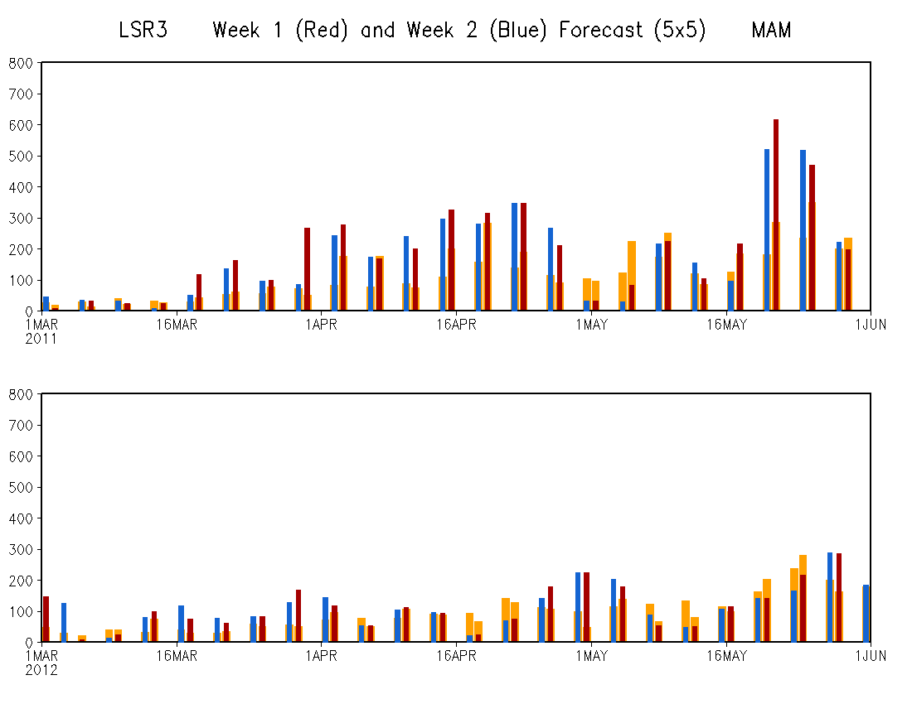
MAM 2011
Total weekly LSR3 over US
OBS
Week-1 FCST
Week-2 FCST
MAM 2012

Slide 3
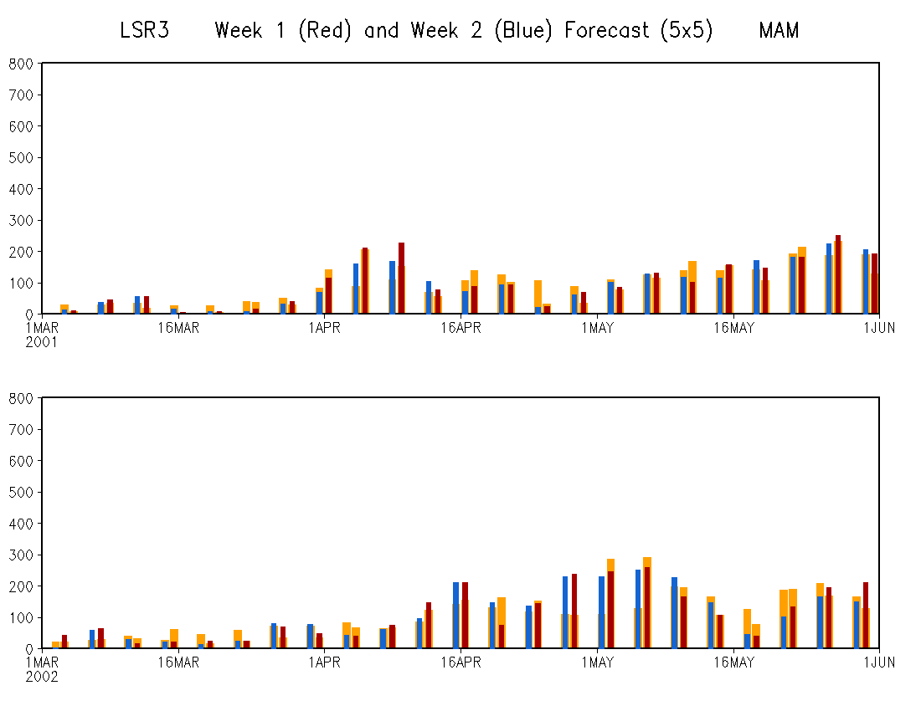
MAM 2001
MAM 2002

Slide 4
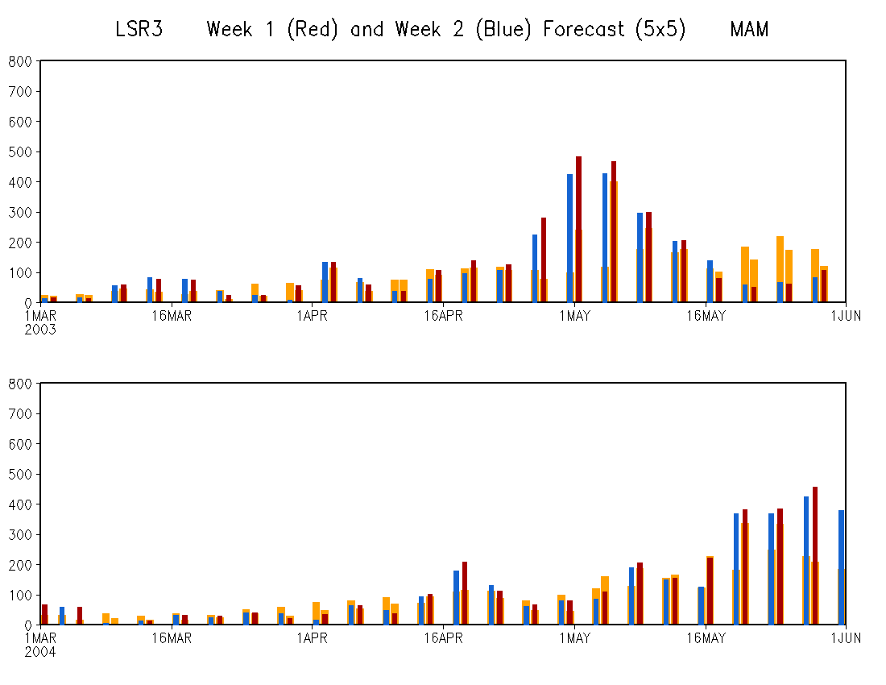
MAM 2003
AC (MAM 1996-2012)
Week-1 FCST: 0.53
Week-2 FCST: 0.20
Both above the 99% significance level
MAM 2004

