Slide 1
Weekly Meeting
03Oct2017
Examined hybrid model forecasts for three major severe weather events
Joplin Missouri tornado, May 22, 2011
Oklahoma/Kansas tornado outbreak, May 3, 1999
Central Alabama tornado outbreak, April 27, 2011
Adjustment for forecasted LSR3 anomalies
FCST LSR3 = FCST LSR3 Anomaly + OBS LSR3 Clim
SD(OBS) >> SD(FCST)
FCST LSR3 = FCST LSR3 Anomaly x SD(OBS)/SD(FCST) + OBS LSR3 Clim

Slide 2
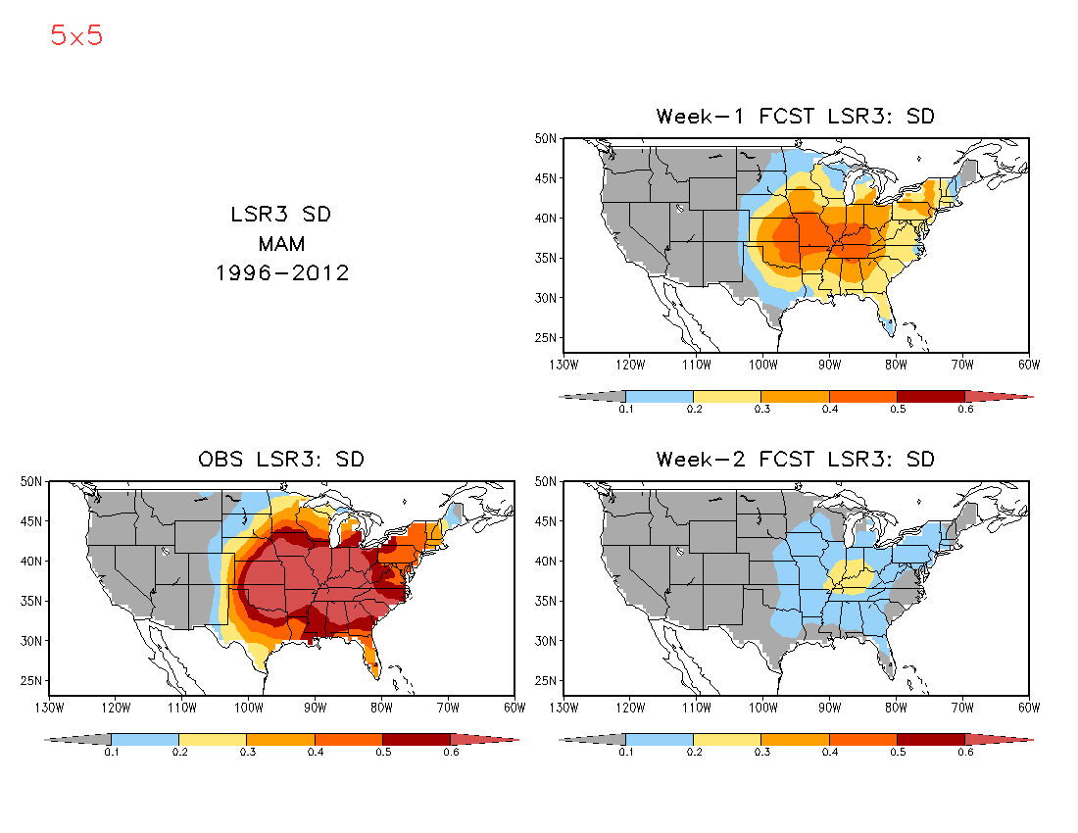
The standard deviation of the forecasted LSR3 anomalies is much smaller than the observed for both weeks 1 and 2.

Slide 3
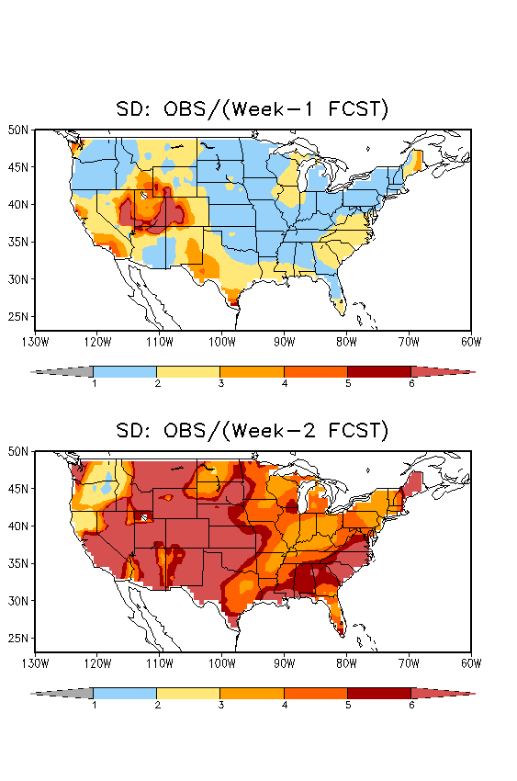
The forecasted LSR3 anomalies can be adjusted by the ratio of the observed SD of LSR3 to that of the predicted.

Slide 4
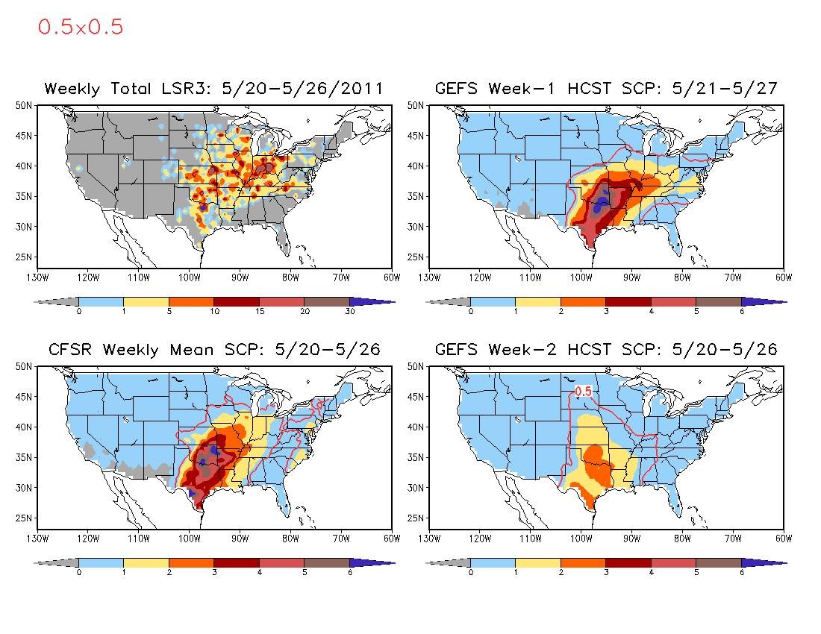
Joplin Missouri Tornado, May 22, 2011

Slide 5
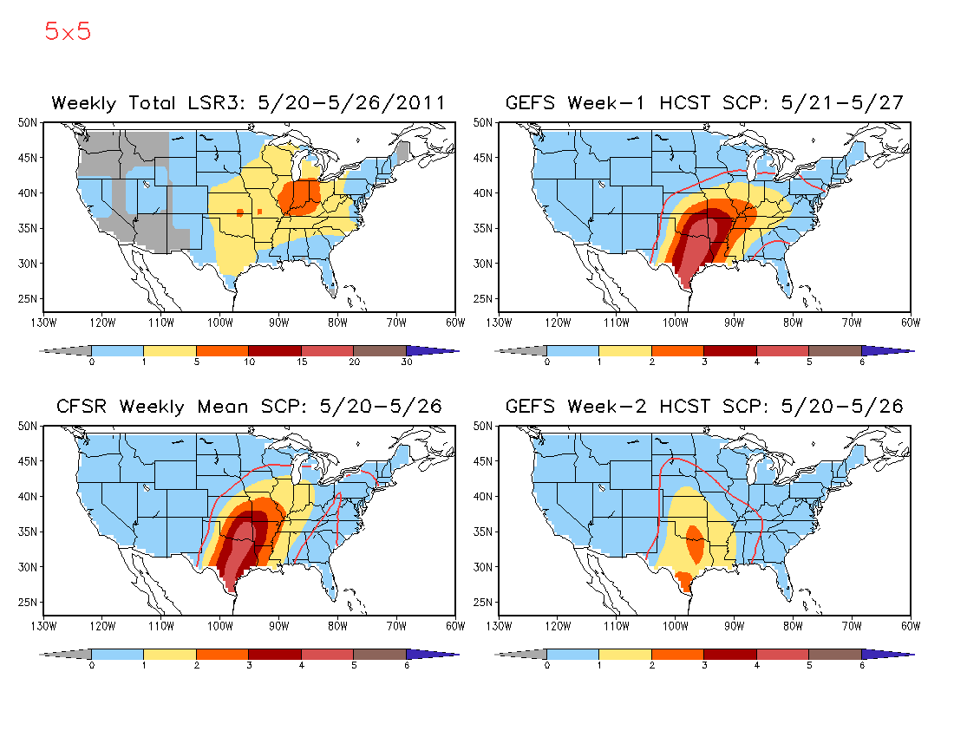
Joplin Missouri Tornado, May 22, 2011

Slide 6
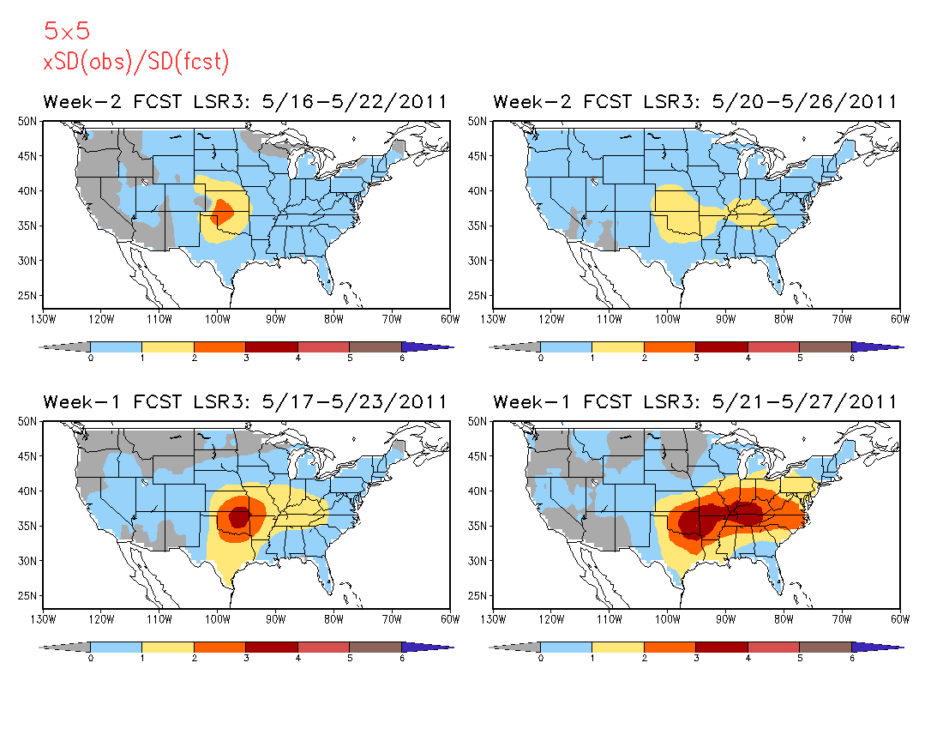
5º x 5º
Week 1 and 2 LSR3 Forecast
x SD(obs)/SD(fcst)

Slide 7
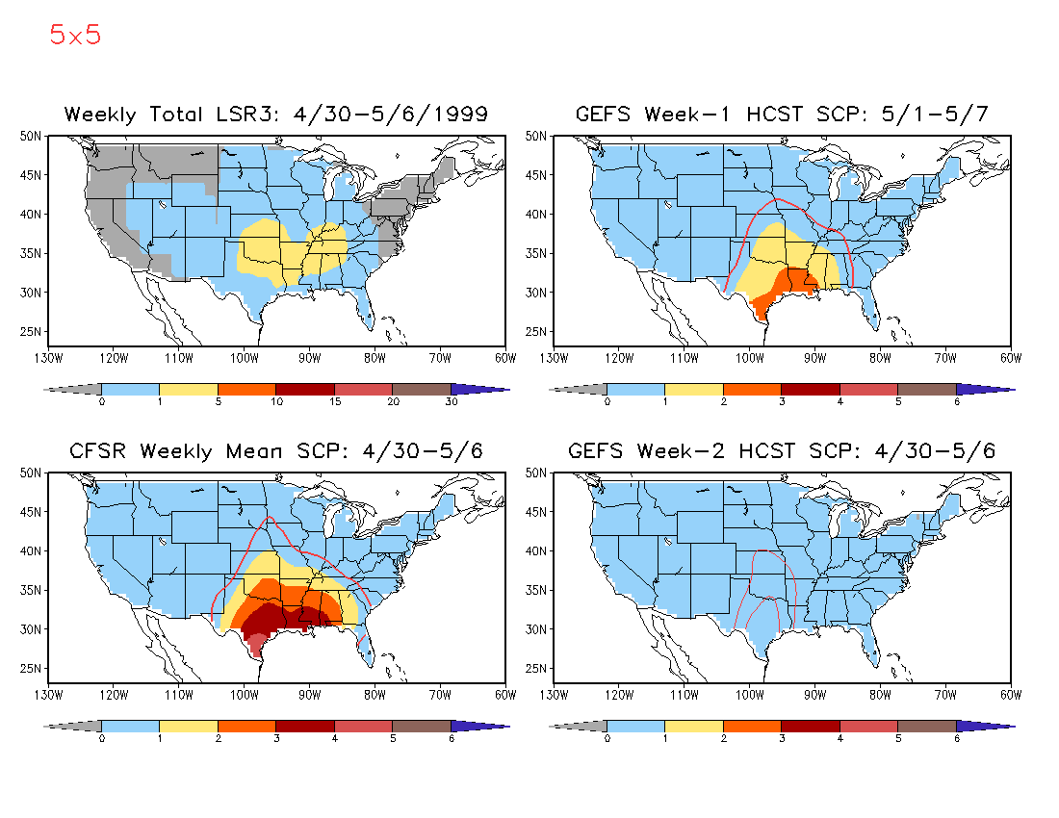
OK/KS Tornado Outbreak, May 3, 1999

Slide 8
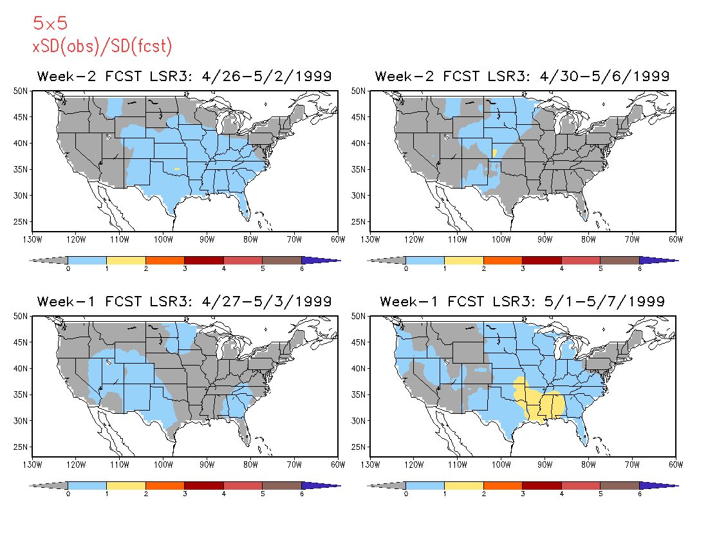
5º x 5º
Week 1 and 2 LSR3 Forecast
x SD(obs)/SD(fcst)

Slide 9
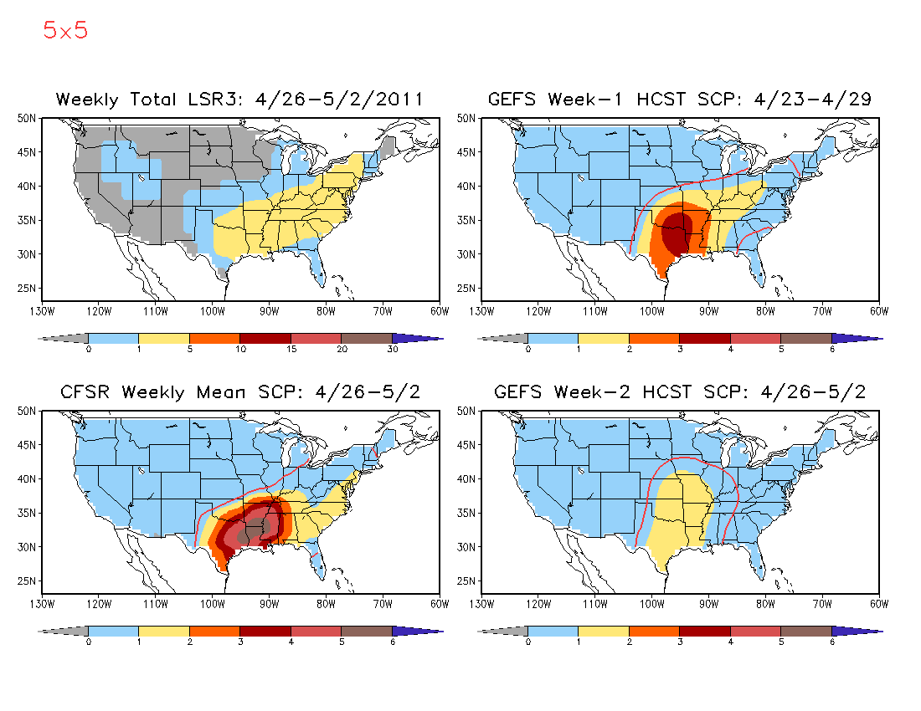
Central Alabama Tornado, April 27, 2011

Slide 10
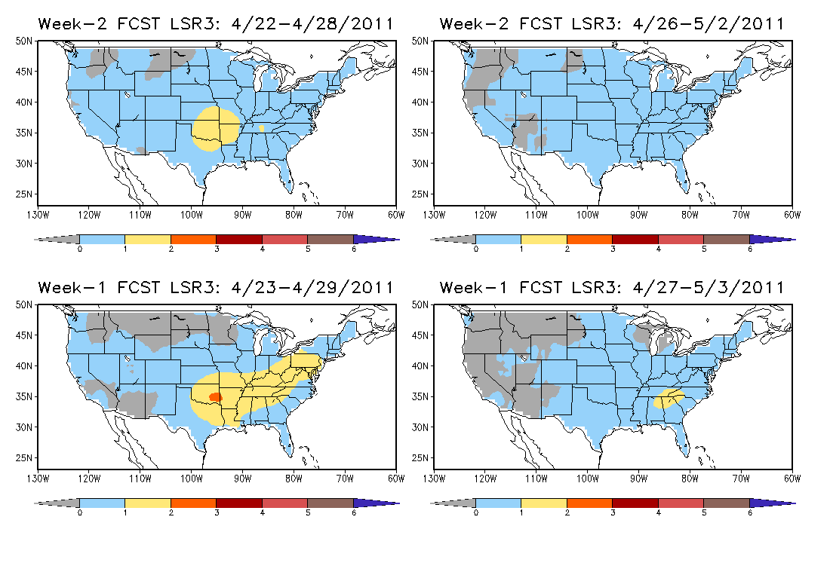
5º x 5º
Week 1 and 2 LSR3 Forecast
x SD(obs)/SD(fcst)

