Slide 1
Weekly Meeting
20Oct2017
Forecast for extreme SW events
MAM 1996 – 2012
Extreme events objectively determined Weekly total LSR3 over the US > 300
Time series of weekly mean LSR3 forecast for
Week 1 and Week 2
Extreme events were selected when both week 1 and week 2 LSR3 > 300
Week-1 and week-2 forecast for extreme events

Slide 2
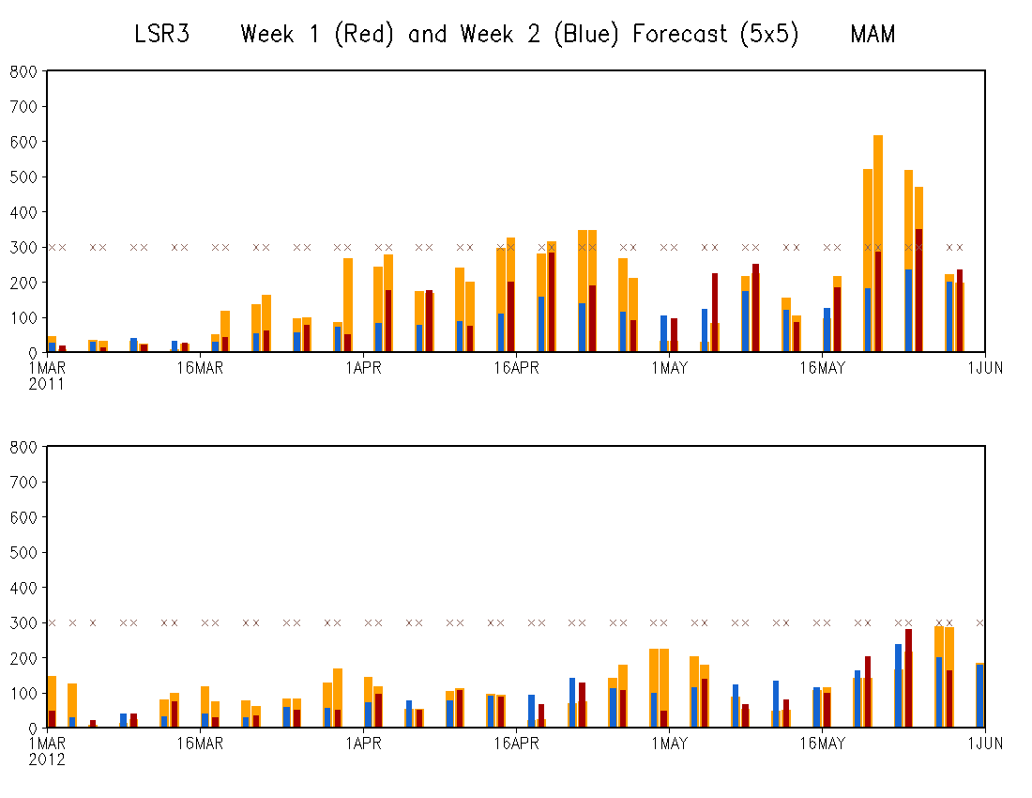
MAM 2011
Total weekly LSR3 over the U.S.
OBS
Week-1 FCST
Week-2 FCST
MAM 2012
AC (MAM 1996-2012)
Week-1 FCST: 0.53
Week-2 FCST: 0.20
Both above the 99% significance level

Slide 3
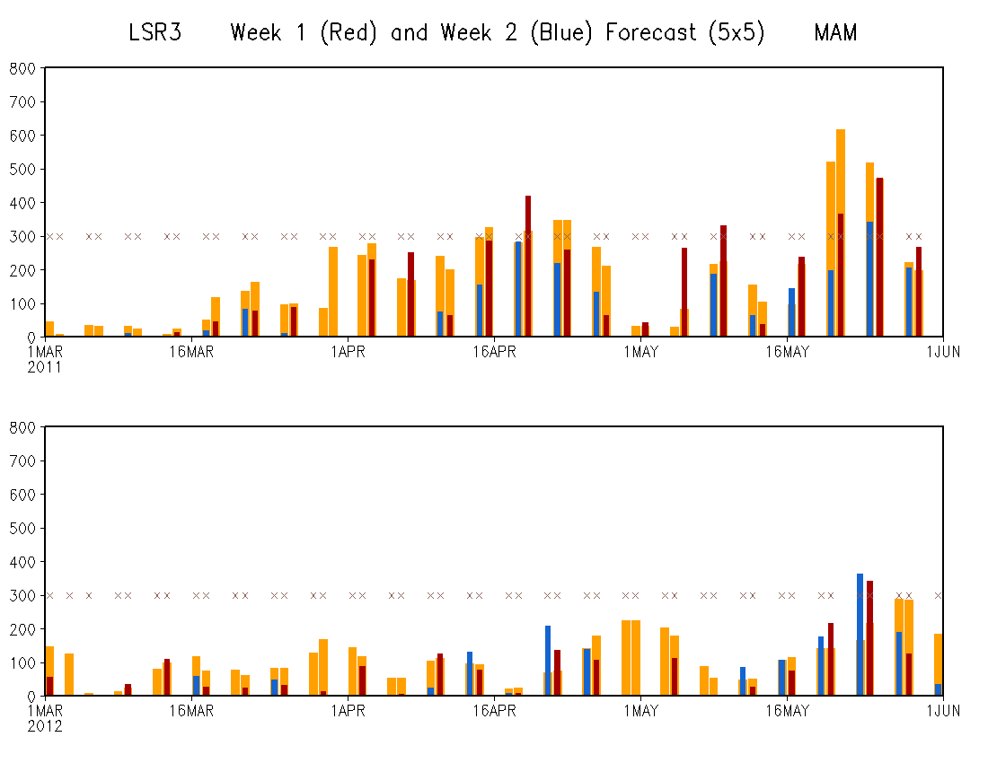
MAM 2011
Adjustment for LSR3 anomaly:
FCST anomaly x ration of SD (OBD, FCST)
MAM 2012

Slide 4
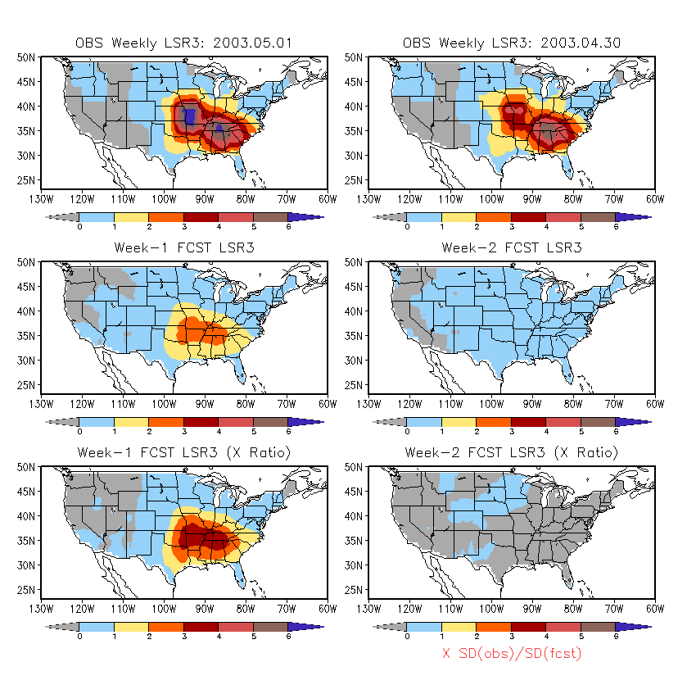
May 2003
OBS
FCST
FCST
adjusted
One-day difference between the 7 days for week 1 and week 2

Slide 5
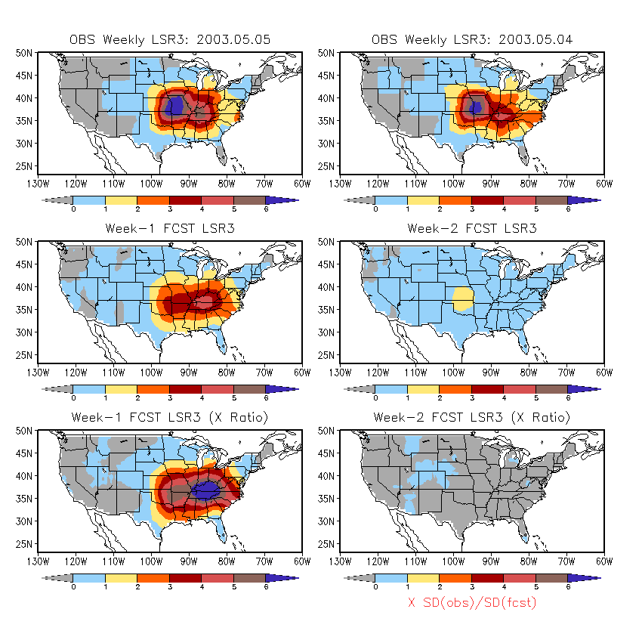
May 2003

Slide 6
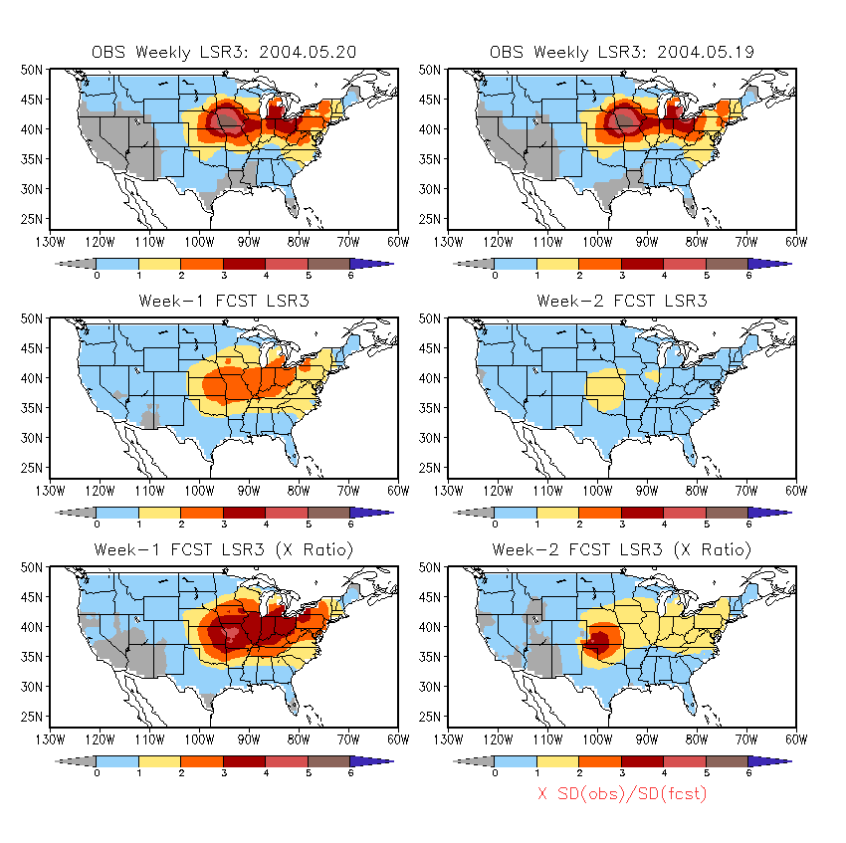
May 2004

Slide 7
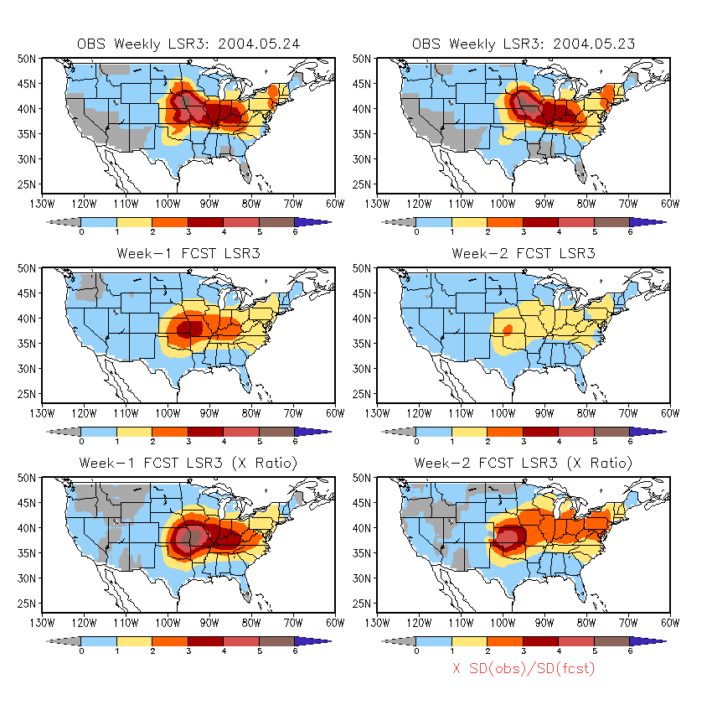
May 2004

Slide 8
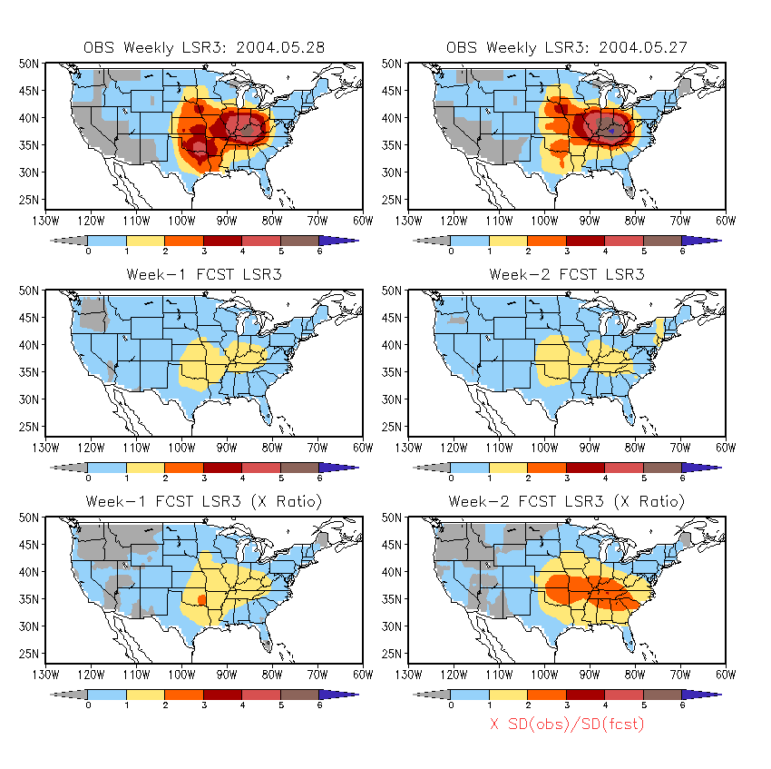
May 2004

Slide 9
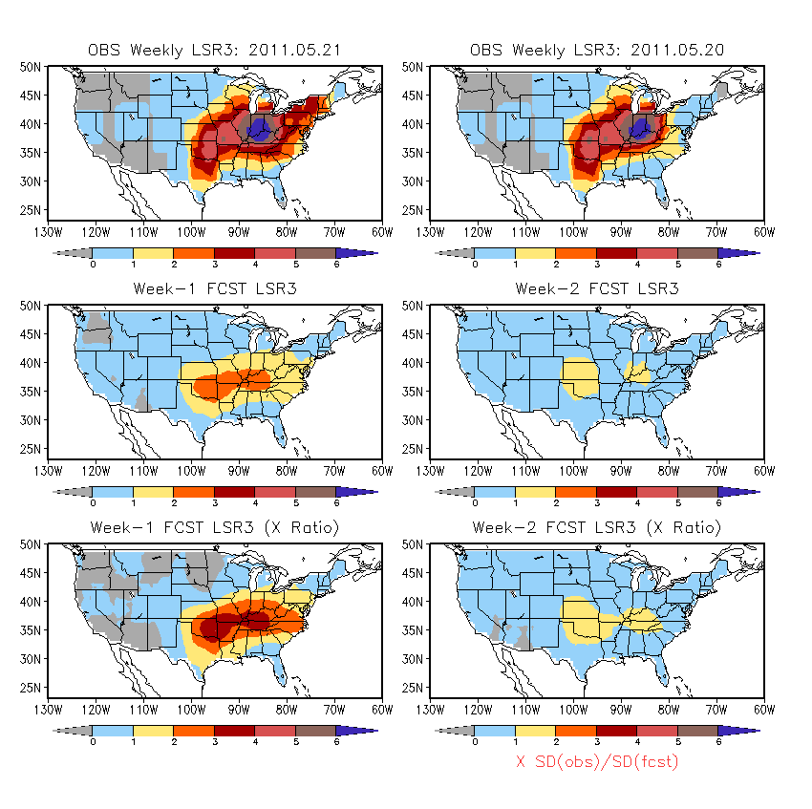
May 2011

Slide 10
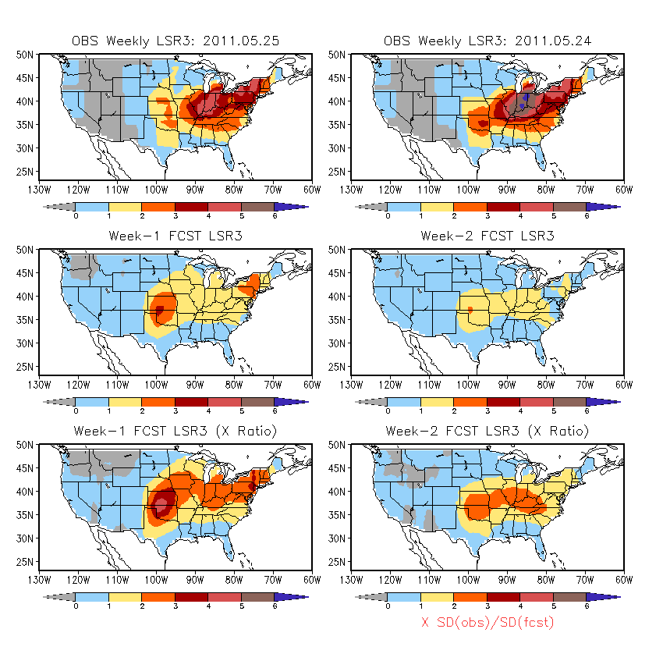
May 2011
5 out of 7 (∼70%) forecasts for extreme events show some signals of severe weather.

