Slide 1
Update
19May2017
Only over the US
-Calculated SCP (CFSR) and LSR(Hail,Tornado,Wind) monthly mean for from 1996-2012
-Calculated SCP(CFSR) climatology (1996-2012)
To do
1.Calculate the monthly correlation map from 1996-2012 of
Total SCP(CFSR) & LSR(Hail-Wind-Tornado)
SCP>1 (CFSR)&LSR(Hail-Wind-Tornado)
2.Calculate the SCP(GEFS 5 ensembles) monthly average and climatology 1996-2012.
3.Calculate the probabilistic coefficient for the SCP data

Slide 2
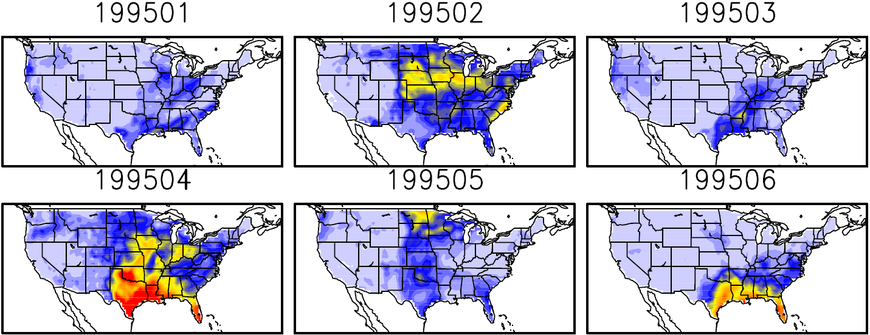
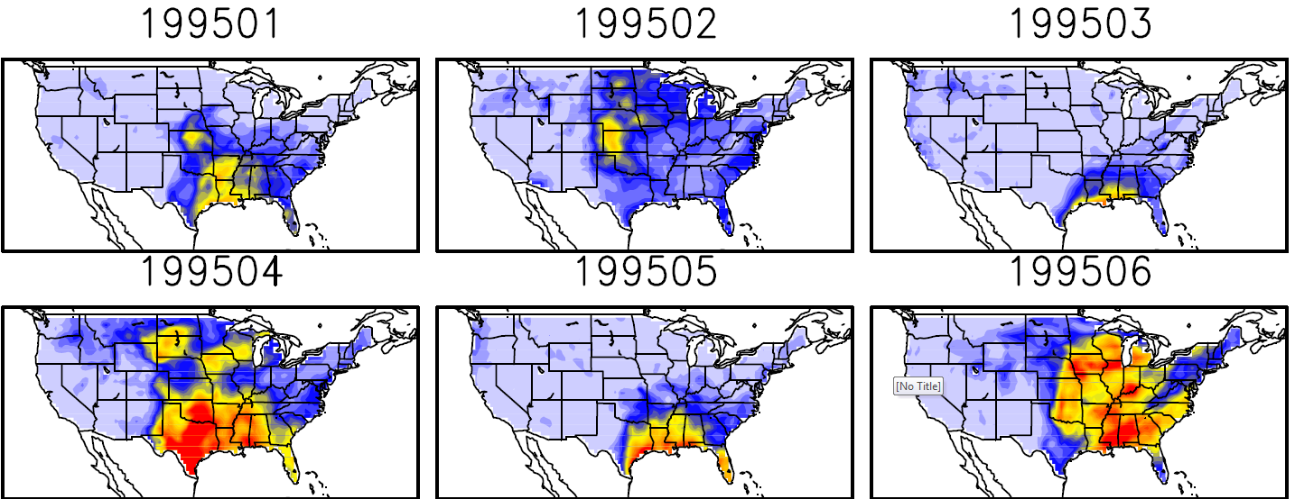
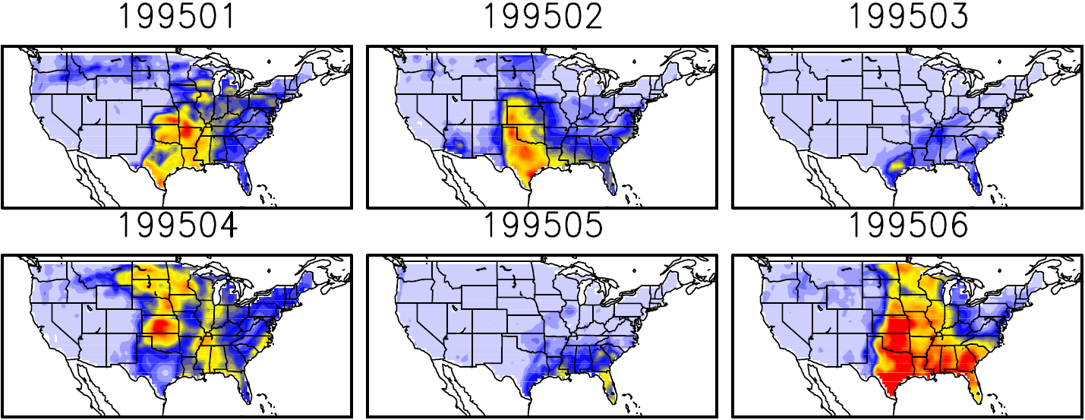
Monthly mean LSR
Hail
Tornado
Wind

Slide 3
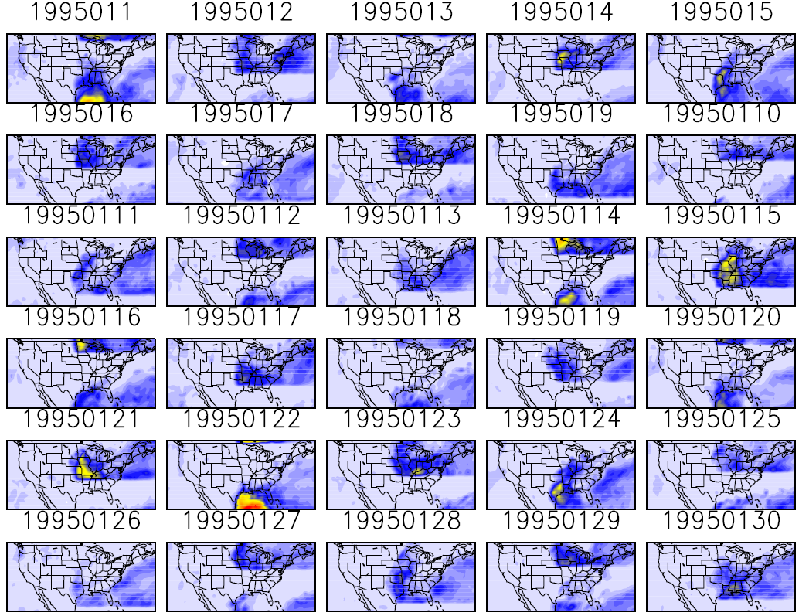
SCP(CFSR) climatology (1996-2012)

