Slide 1
Update
02June2017
Only over the US
-Calculated SCP (CFSR) monthly climatology from 1996-2012
-Calculating SCP(GEFS) 5 ensembles monthly mean and climatology (1996-2012)
1996 | 1997 | 1998 | 1999 | 2000 | 2001
2002 | 2003 | 2004 | 2005 | 2006 | 2007
2008 | 2009 | 2010 | 2011 | 2012

Slide 2
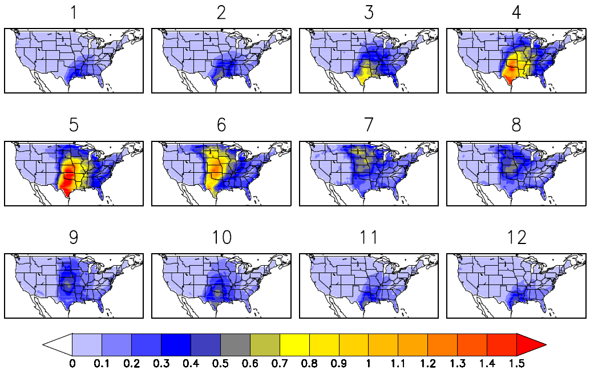
SCP(CFSR) Monthly Climatology

