Slide 1
Update
07Jul2017
Scatter plots of SCP(CFSR) and LSR3(Hail+Tornado+Wind) and separate components) 7days climatology from 1996-2012
SCP(CFSR) vs. LSR (Hail + Tornado + Wind), 7 days count
vs. Hail
vs. Tornado
vs. Wind
To do
Making scatter plots of SCP(GEFS) and LSR3(Hail+Tornado+Wind) and separate components) 7days running from 1996-2012

Slide 2
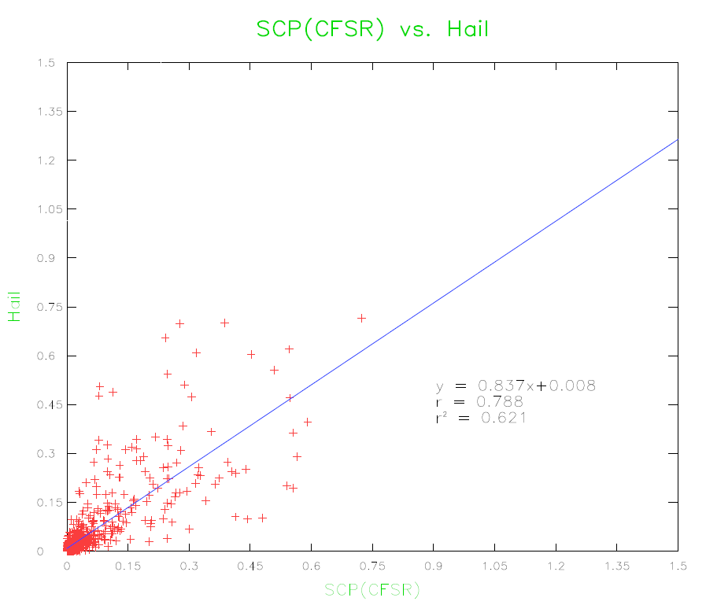
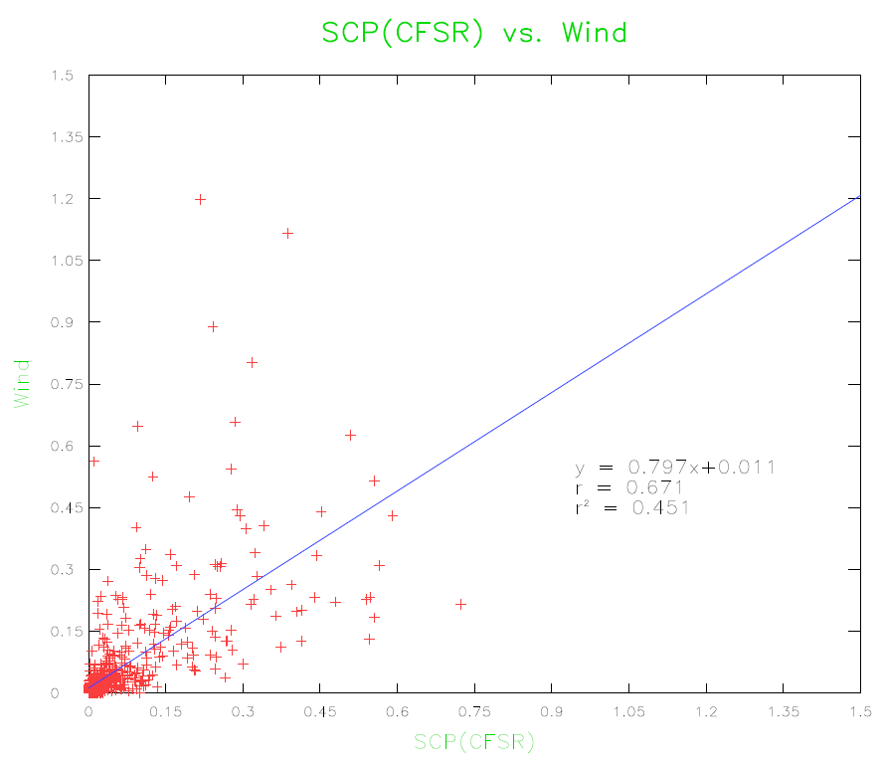
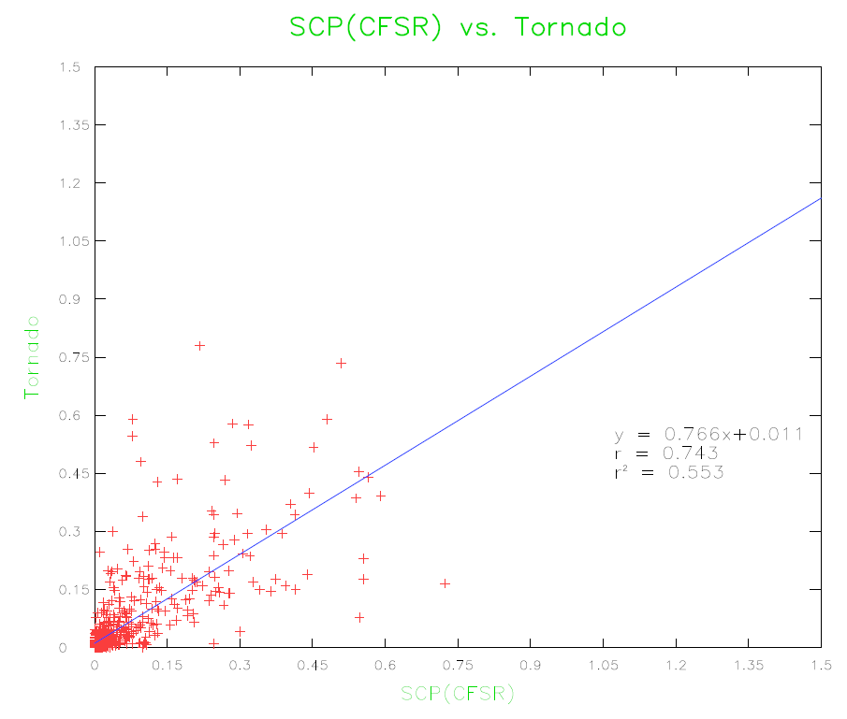
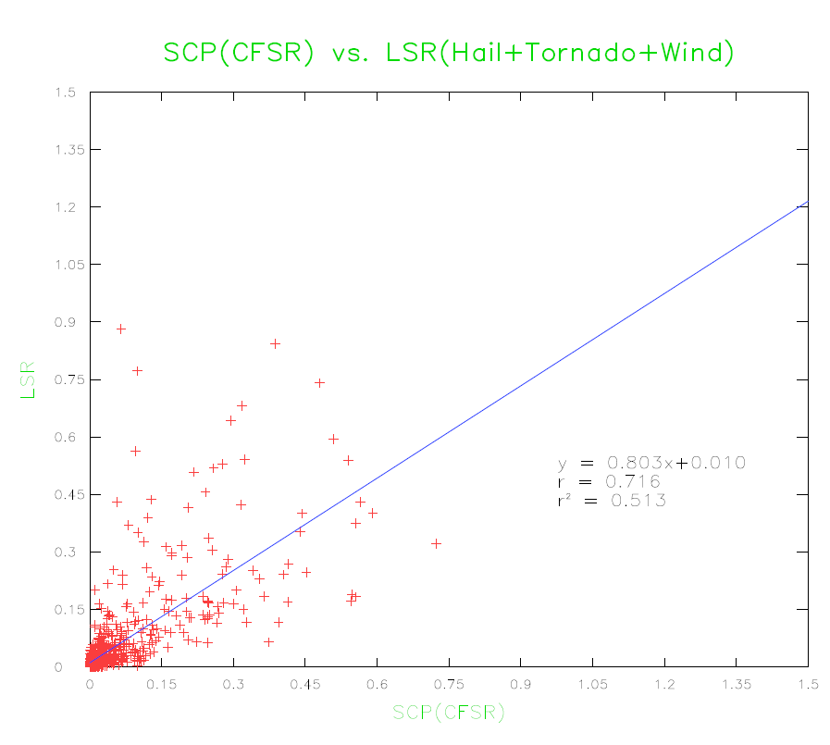
Scatter Plot of 7 days climatology of SCP(CFSR) vs. LSR3 and separately
SCP(CFSR) vs. Hail
SCP(CFSR) vs. Wind
r²=0.62
r²=0.45
Hail
Wind
SCP(CFSR)
SCP(CFSR)
SCP(CFSR) vs. Tornado
SCP(CFSR) vs. LSR3 (Hail+Tornado+Wind)
r²=0.55
r²=0.51
Tornado
LSR3
SCP(CFSR)
SCP(CFSR)

Slide 3
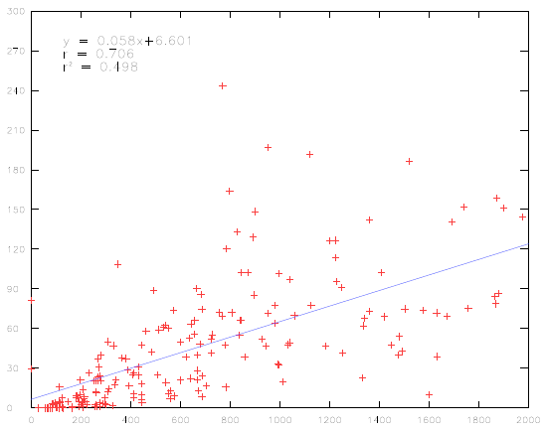
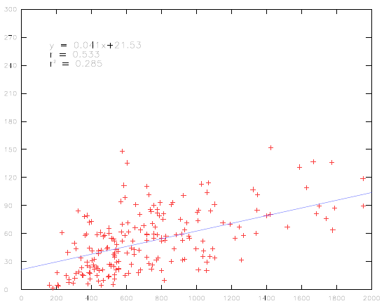
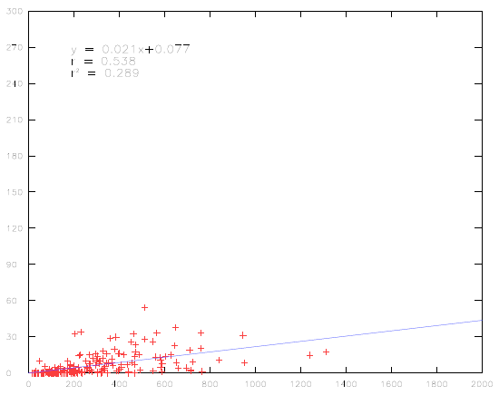
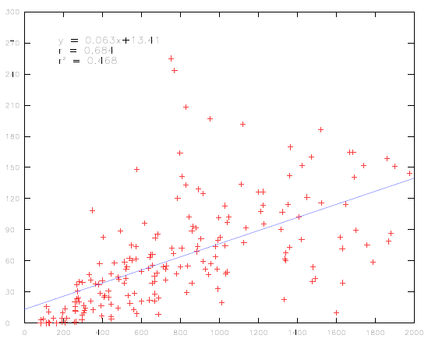
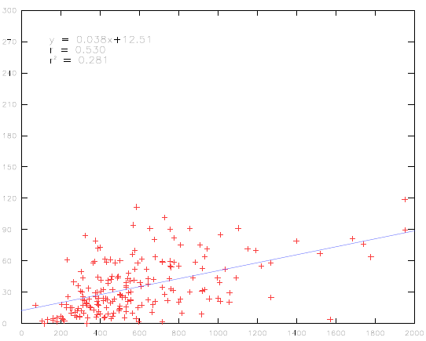
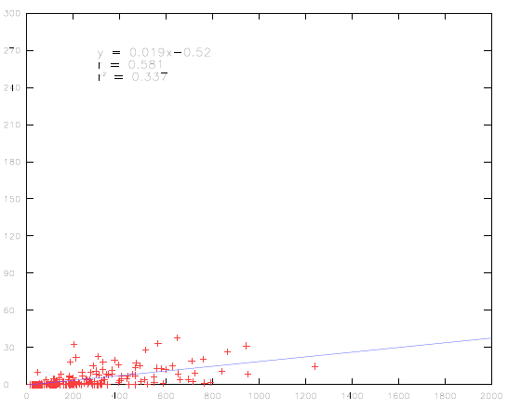
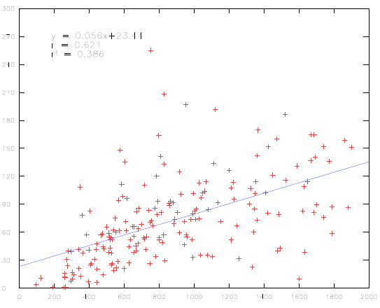
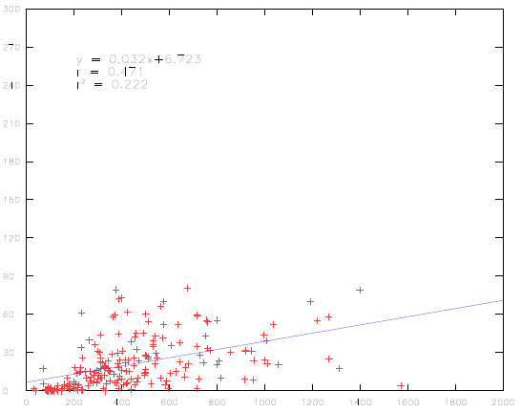
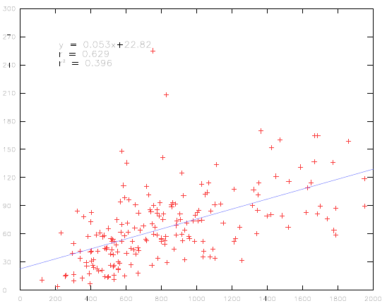
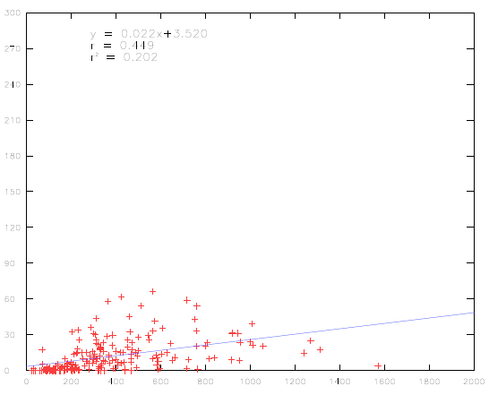
JFM
MJJ
SON
r²=0.50
r²=0.50
r²=0.28
r²=0.28
FMA
JJA
OND
r²=0.47
r²=0.28
r²=0.33
r²=0.47
MAM
JAS
r²=0.38
r²=0.22
SCP(CFSR) vs. Hail
AMJ
ASO
r²=0.40
r²=0.20

Slide 4
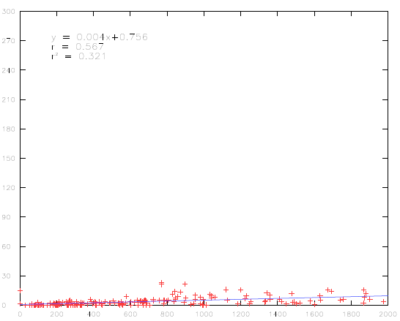
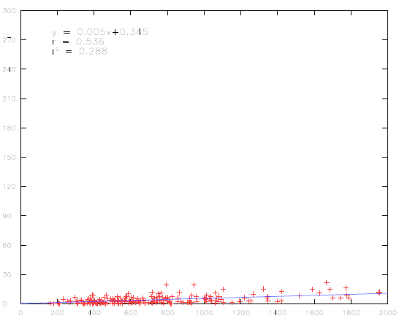
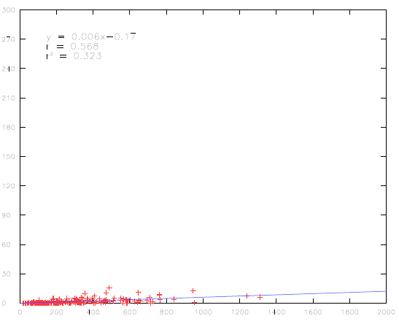
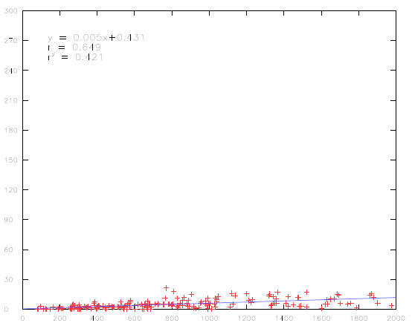
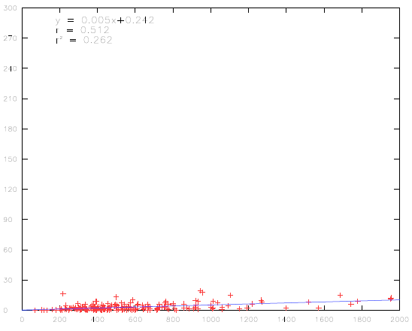
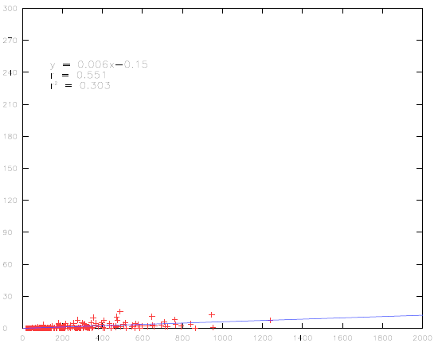
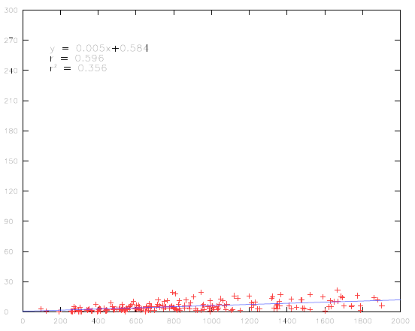
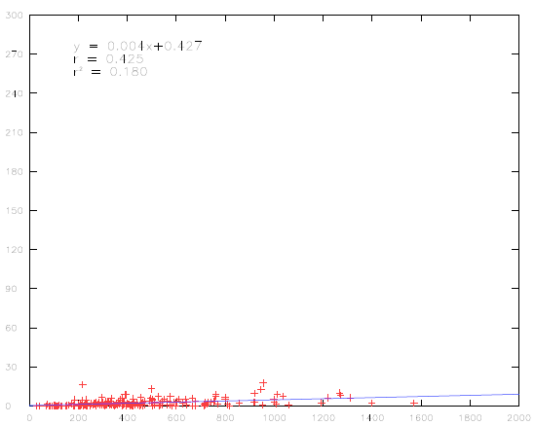
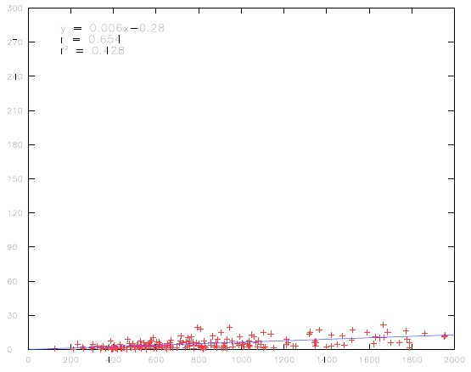
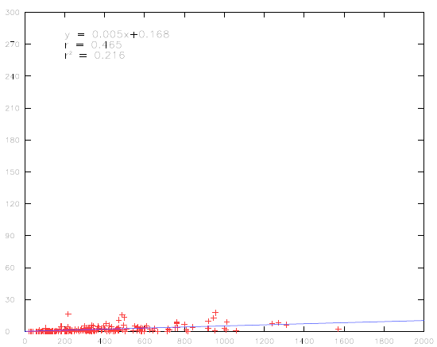
JFM
MJJ
SON
r²=0.32
r²=0.28
r²=0.32
FMA
JJA
OND
r²=0.42
r²=0.28
r²=0.30
MAM
JAS
r²=0.40
r²=0.16
SCP(CFSR) vs. Tornado
AMJ
ASO
r²=0.42
r²=0.21

Slide 5
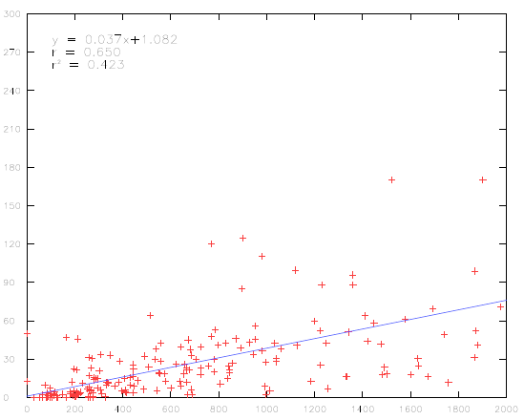
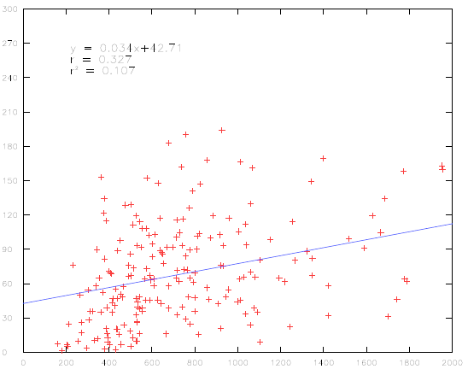
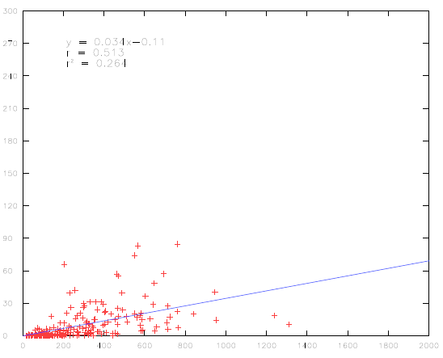
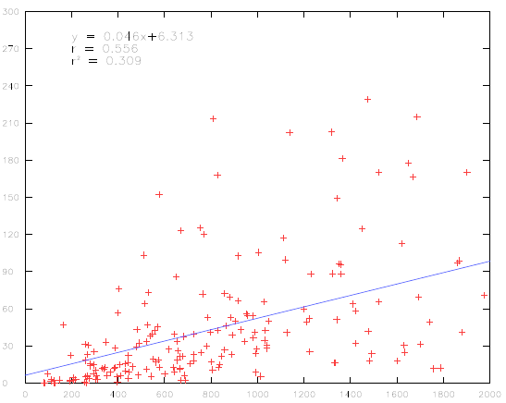
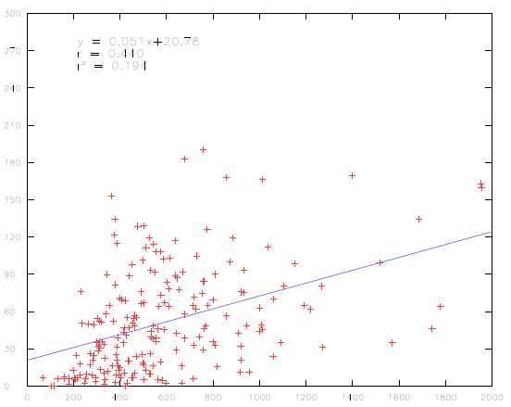
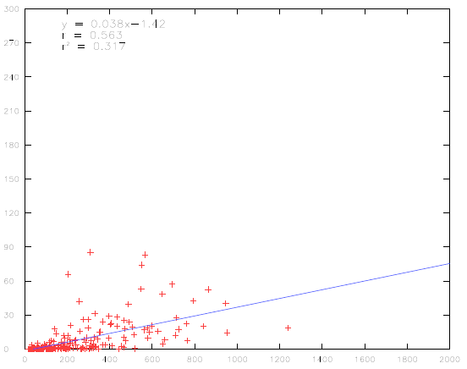
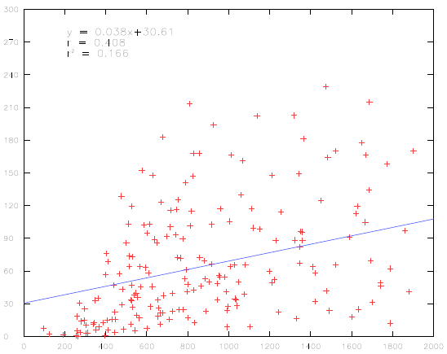
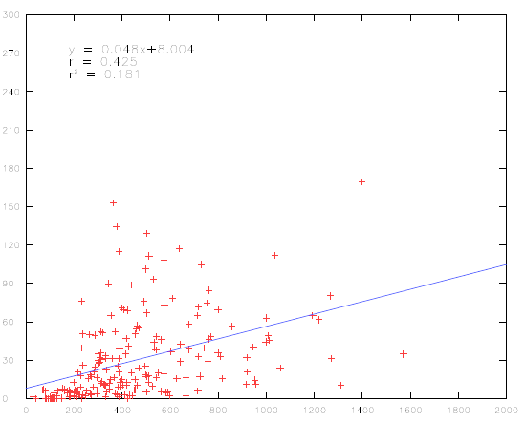
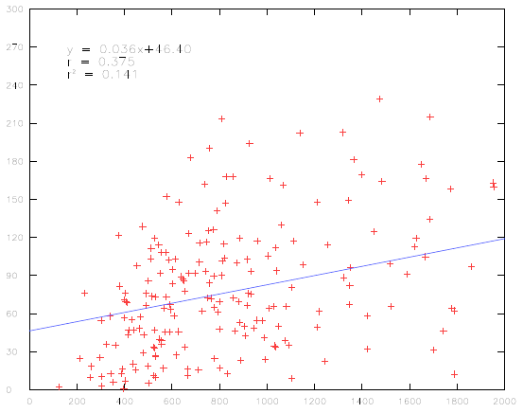
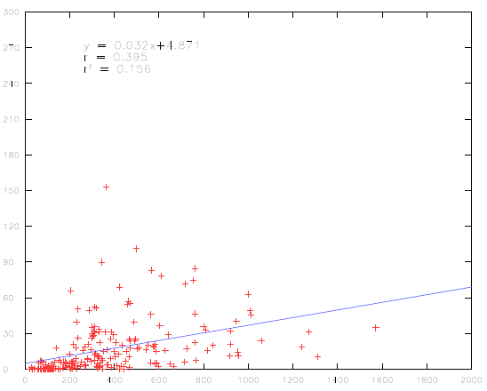
JFM
MJJ
SON
r²=0.42
r²=0.10
r²=0.26
FMA
JJA
OND
r²=0.30
r²=0.19
r²=0.32
MAM
JAS
r²=0.16
r²=0.18
SCP(CFSR) vs. Wind
AMJ
ASO
r²=0.14
r²=0.15

Slide 6
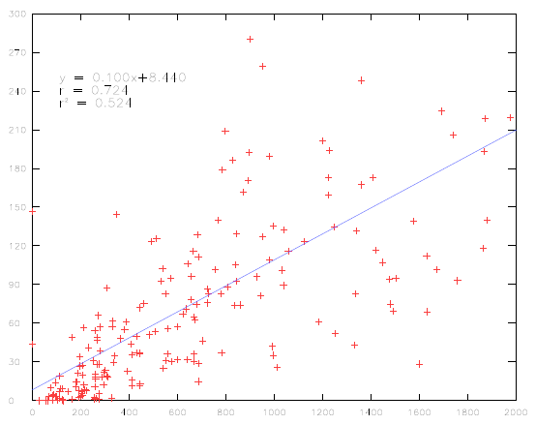
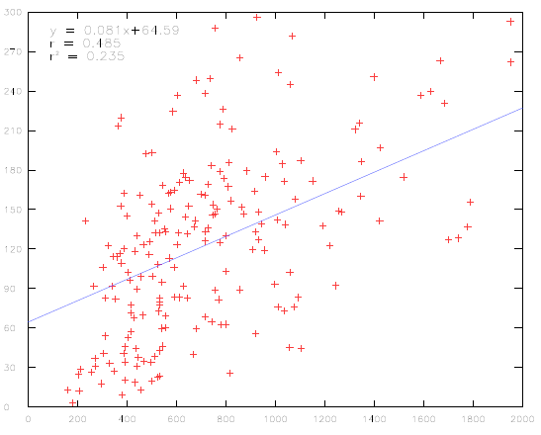
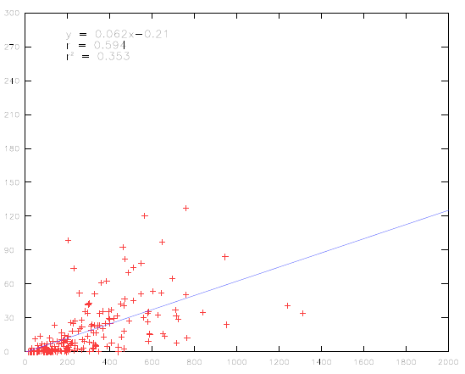
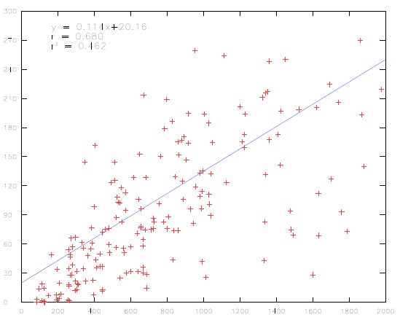
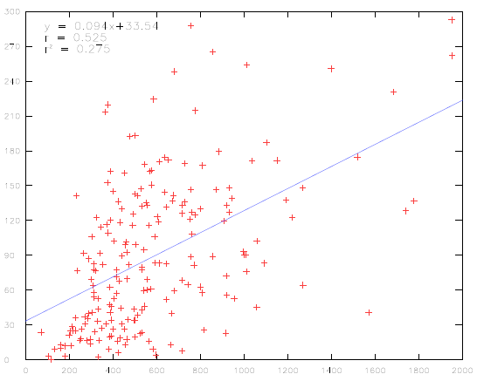
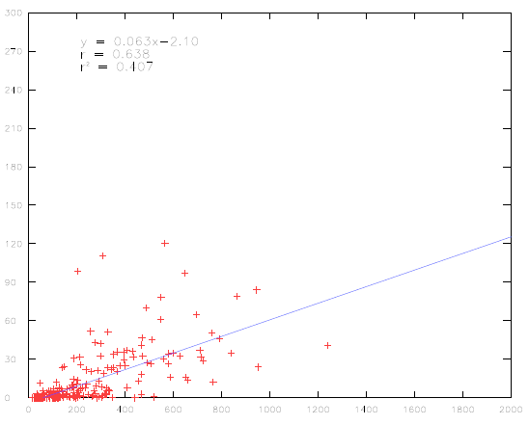
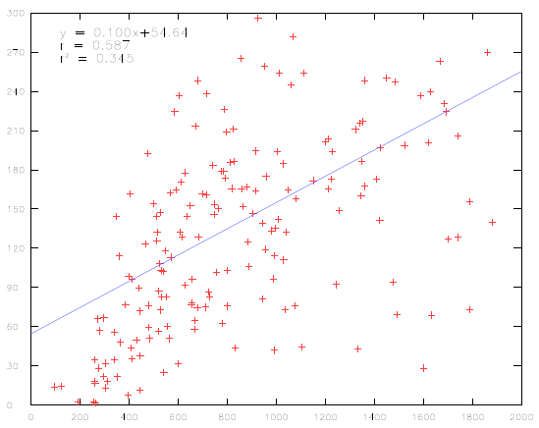
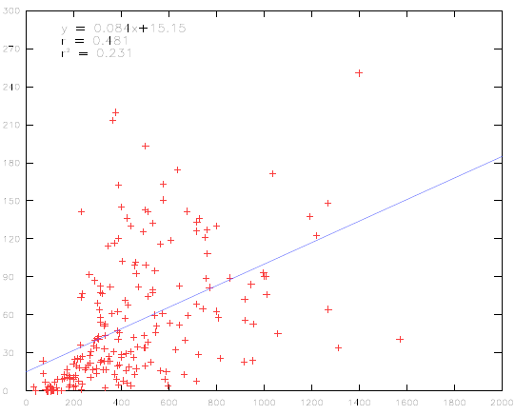
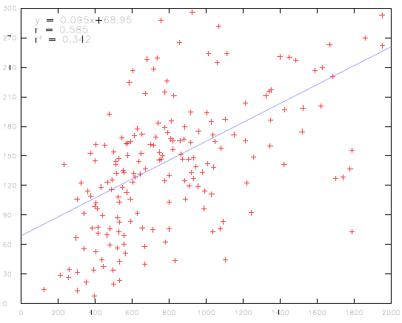
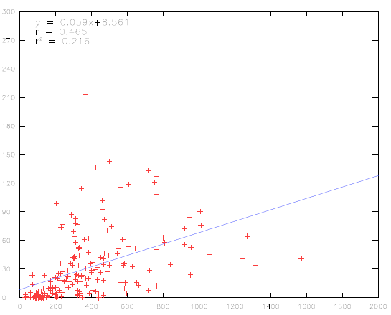
JFM
MJJ
SON
r²=0.52
r²=0.23
r²=0.35
FMA
JJA
OND
r²=0.46
r²=0.27
r²=0.41
MAM
JAS
r²=0.34
r²=0.23
SCP(CFSR) vs. LSR3
AMJ
ASO
r²=0.34
r²=0.21

