Slide 1
Update
11Aug2017
Spatial map of 3 months running CFSR (SCP) vs. LSR3(Hail+Tornado+Wind), resolution 0.5x0.5, 1x1,2.5x2.5 and 5x5
To do
Spatial map of 3 months running CFSv2 (SCP) vs. LSR3
Weekly climatology CFSv2(SCP

Slide 2
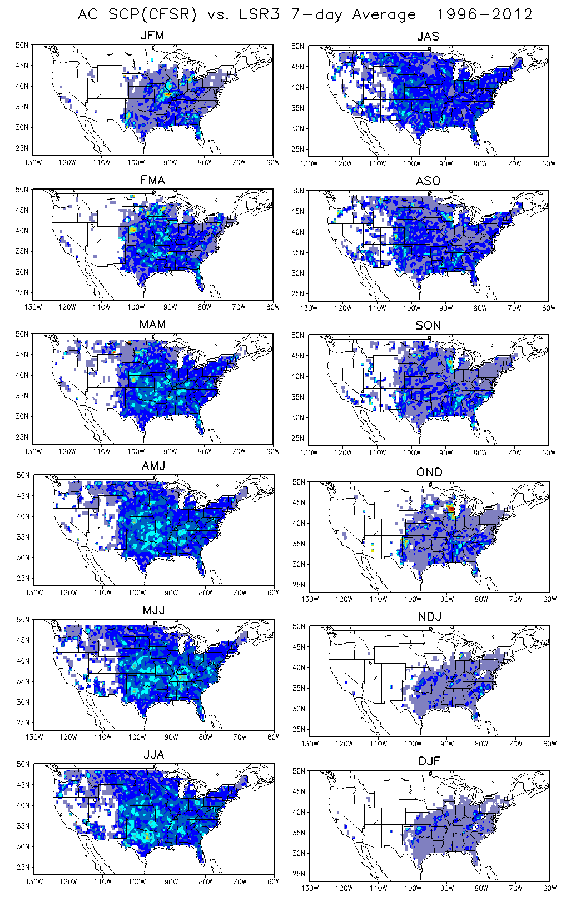
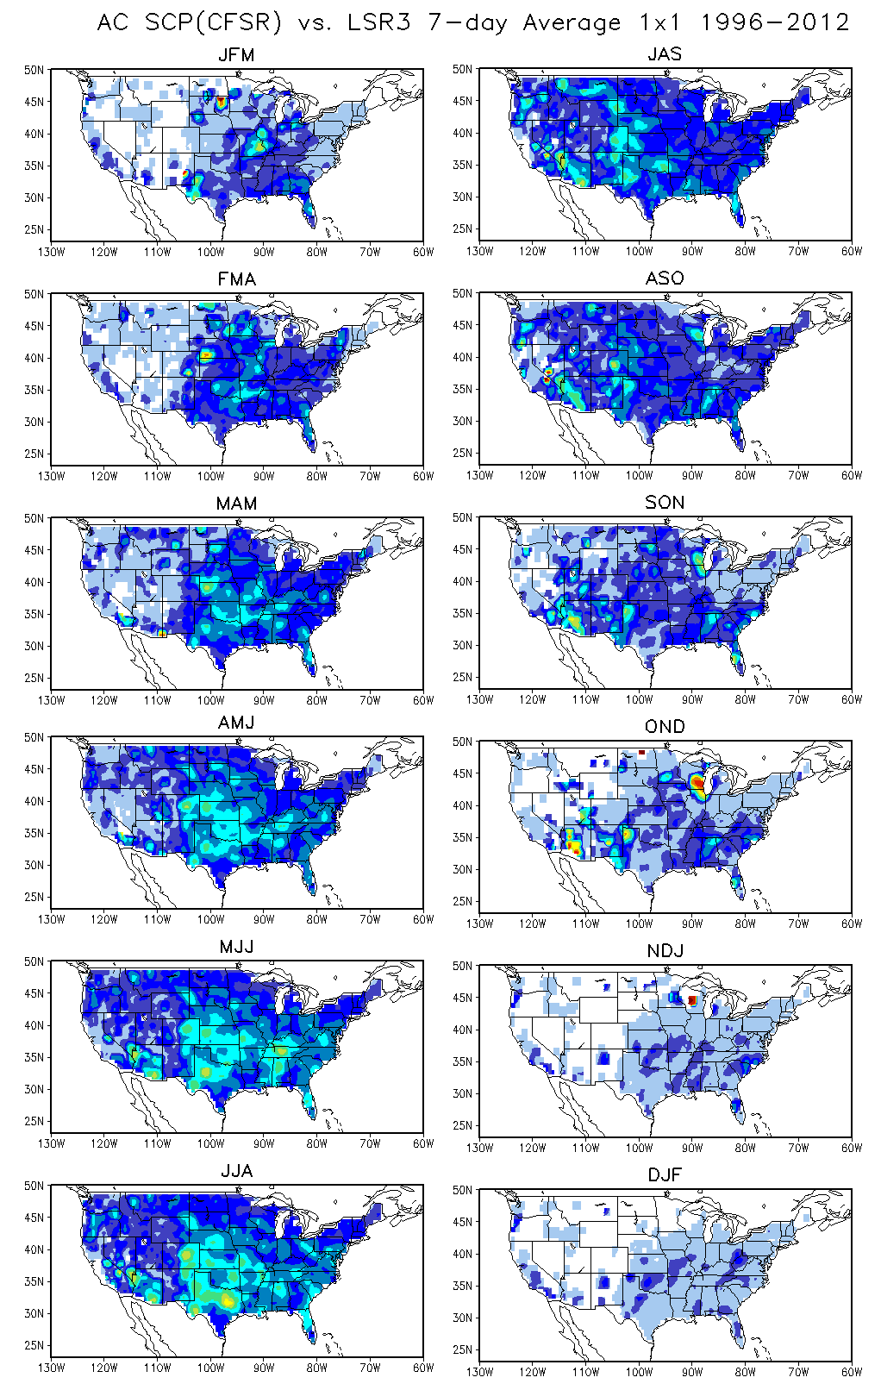

Slide 3
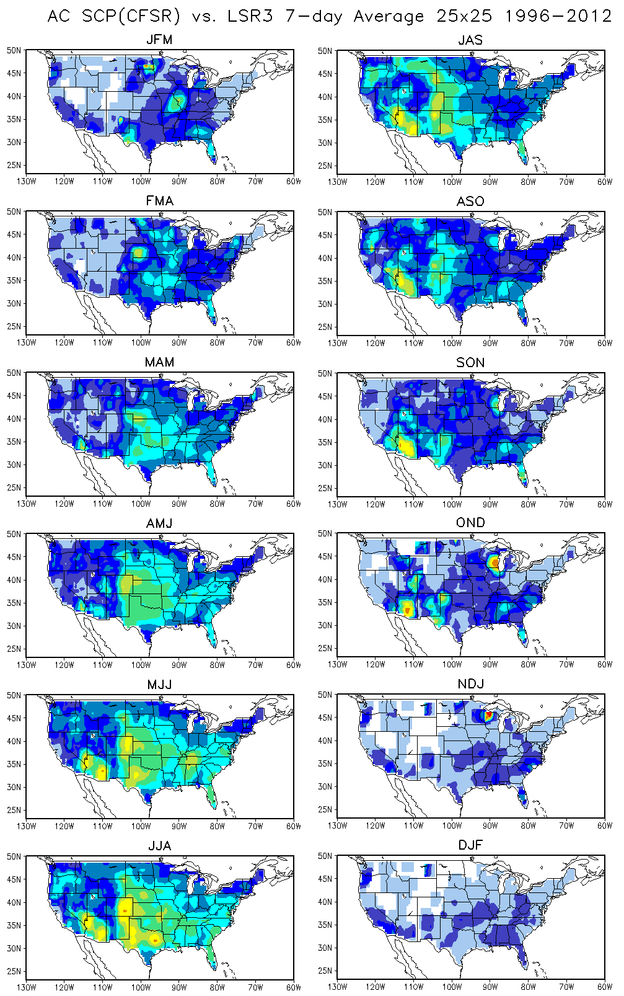
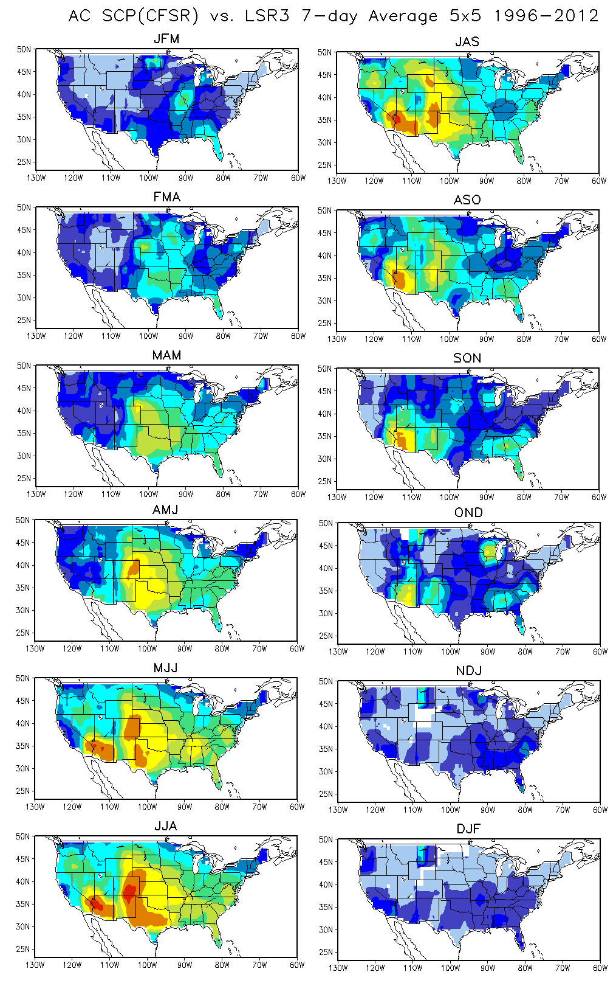

Slide 4
Variables used to calculate SCP
CAPE
372:20608286:d=1999010118:CAPE:180-0 mb above ground:anl:
BWD
381.1:20847027:d=1999010118:UGRD:0.995 sigma level:anl:
381.2:20847027:d=1999010118:VGRD:0.995 sigma level:anl:
191.1:9164366:d=1999010118:UGRD:500 mb:anl:
191.2:9164366:d=1999010118:VGRD:500 mb:anl:
SRH
339:18315112:d=1999010118:HLCY:3000-0 m above ground:anl:

