Slide 1
Update
22Sep2017
Compared SCP CFSR vs. SCP CFSv2 for April01 and May 01
Calculated SCP from 1999 to 2005
To do
Classifying the data by lead time
Downloading and processing data from 2007 to 2011

Slide 2
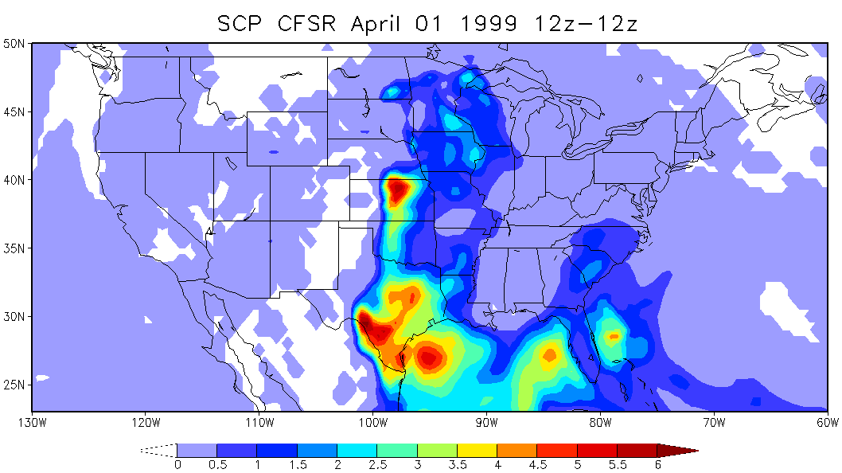
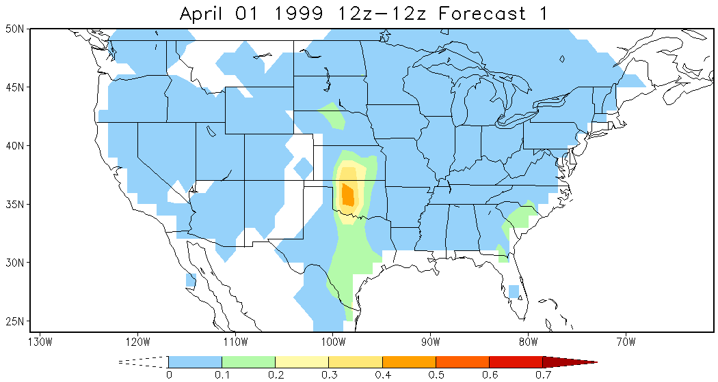
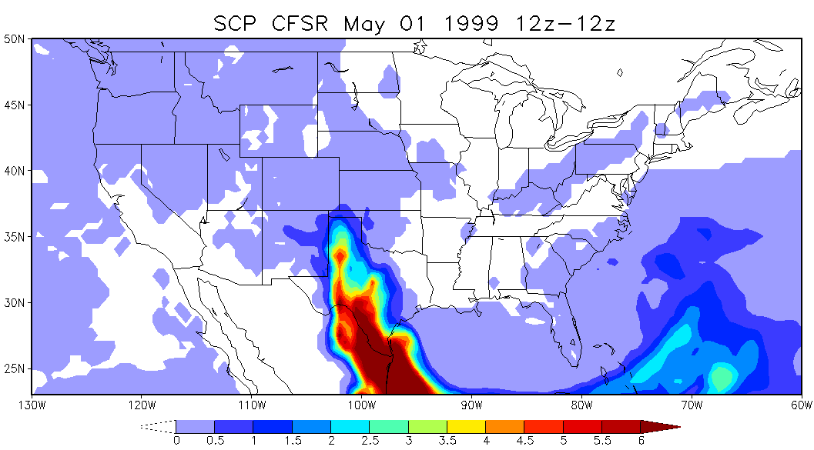
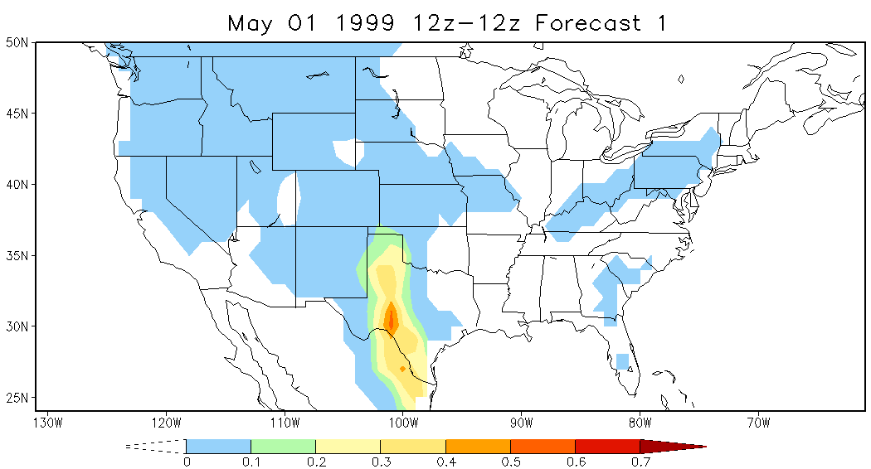
Compare SCP CFSR and SCP CFSv2 04/01 and 05/01

