Slide 1
Update
29Sep2017
Compared SCP CFSR vs. SCP CFSv2 for April01 and May 01
Re-downloading CFSv2 from 2001,stored in /cpc/cfsr/alima
To do
Calculating weekly mean

Slide 2
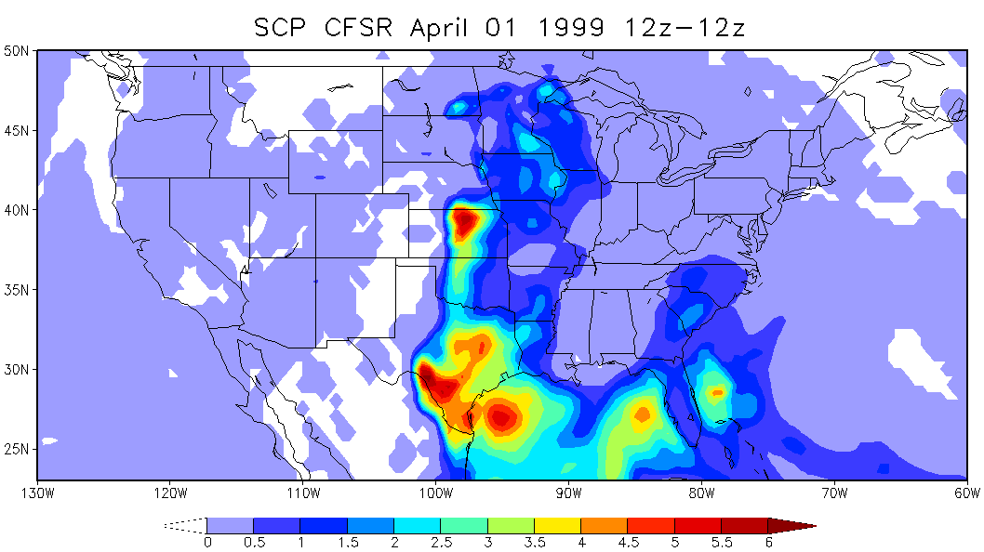
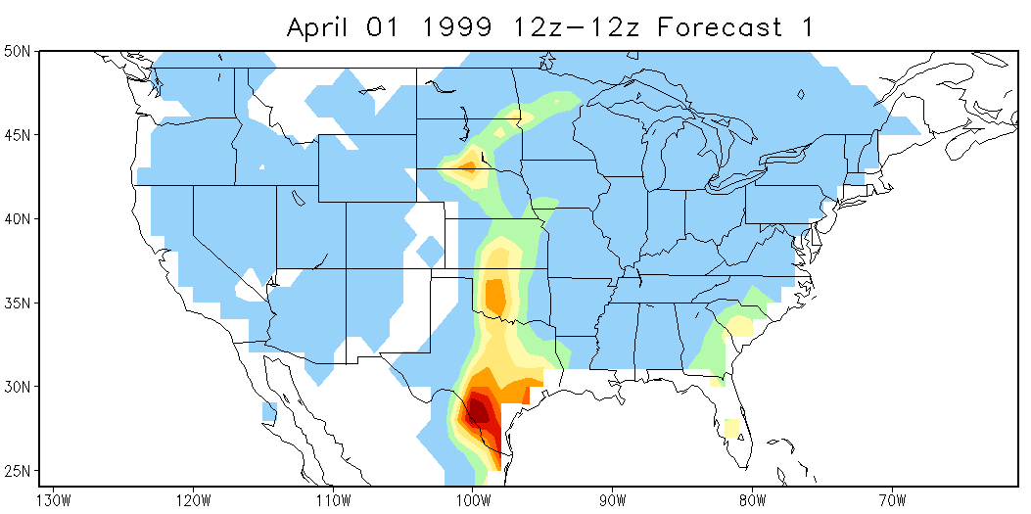
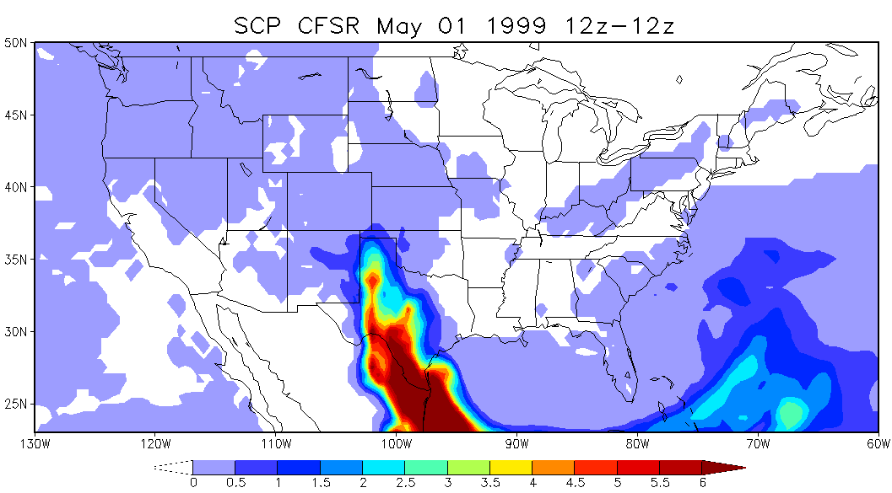
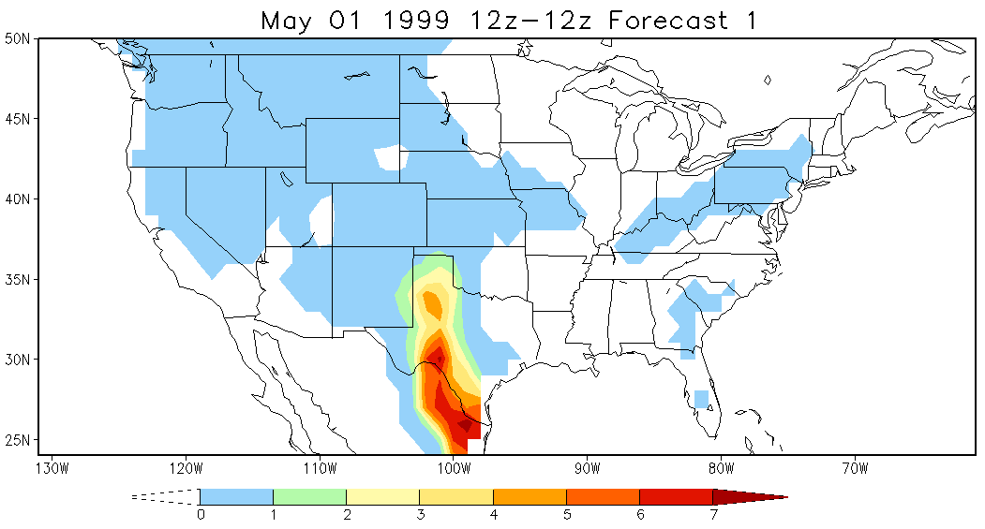
Compare SCP CFSR and SCP CFSv2 04/01 and 05/01

