Slide 1
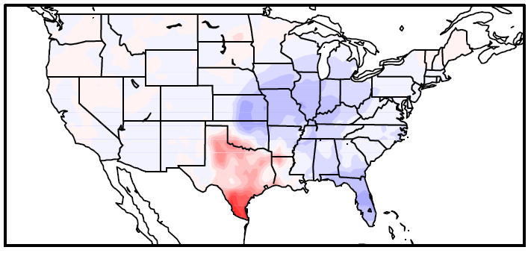
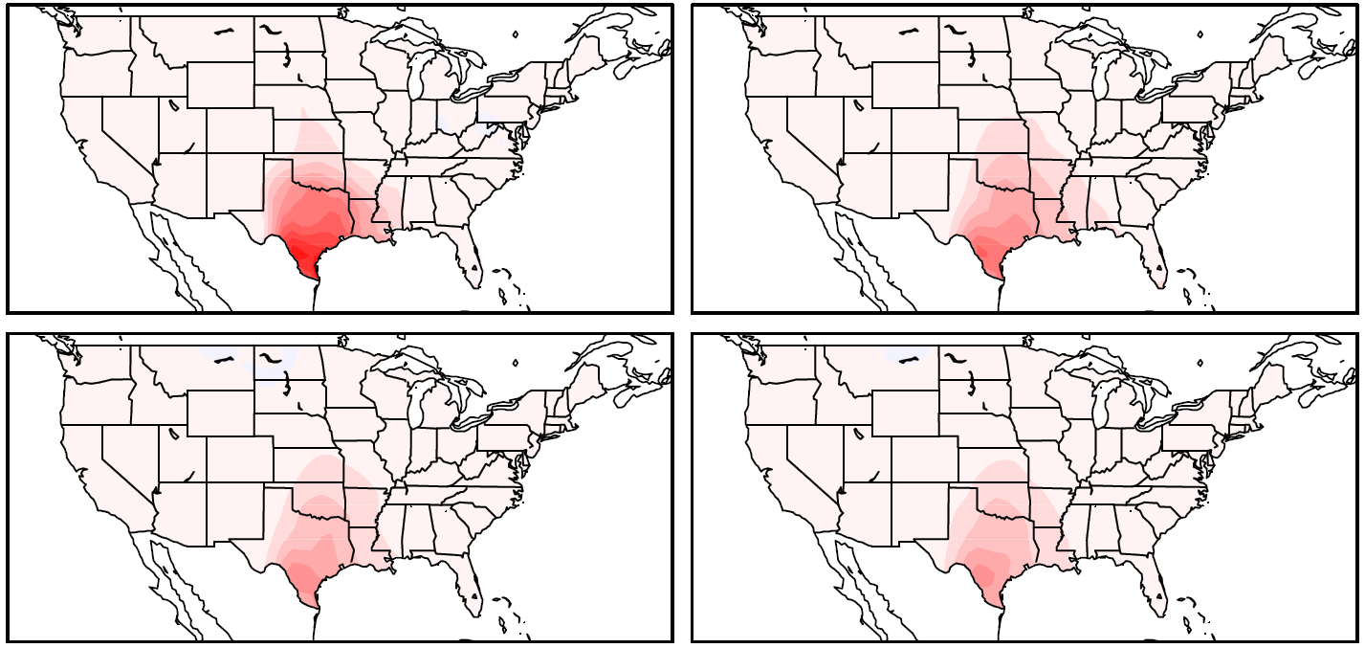
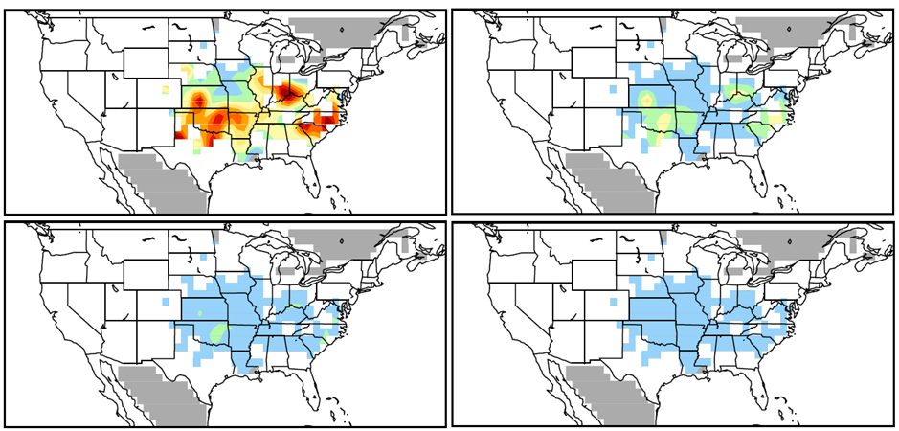
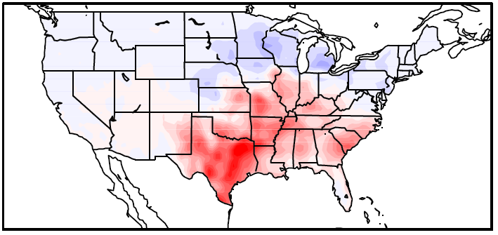
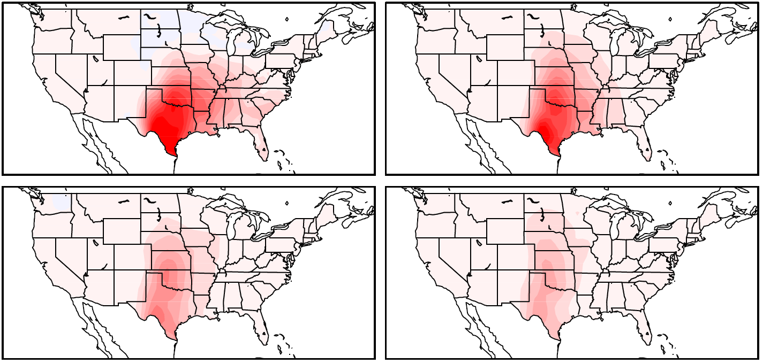
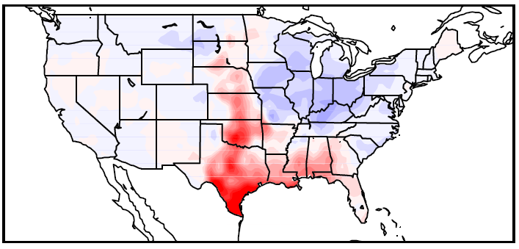
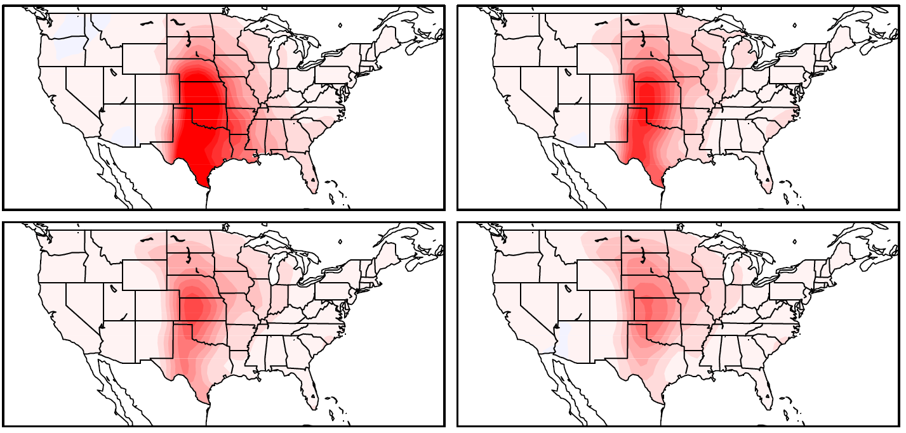
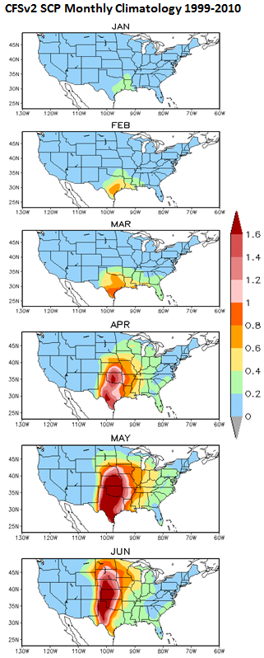
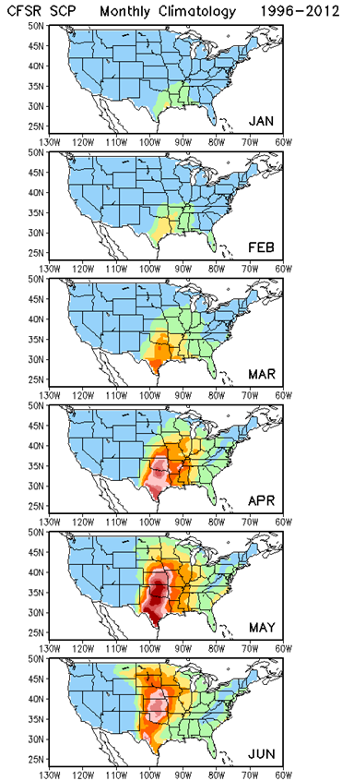
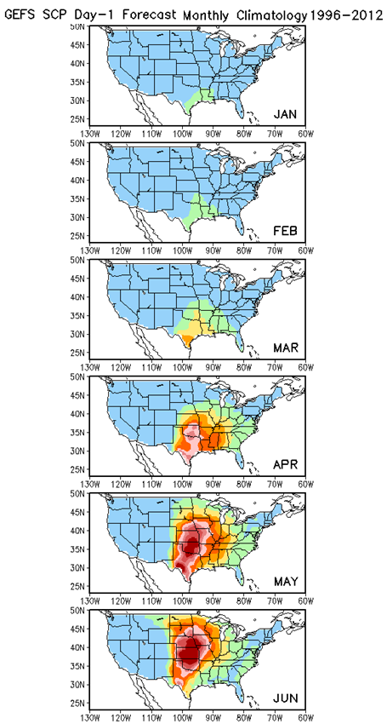
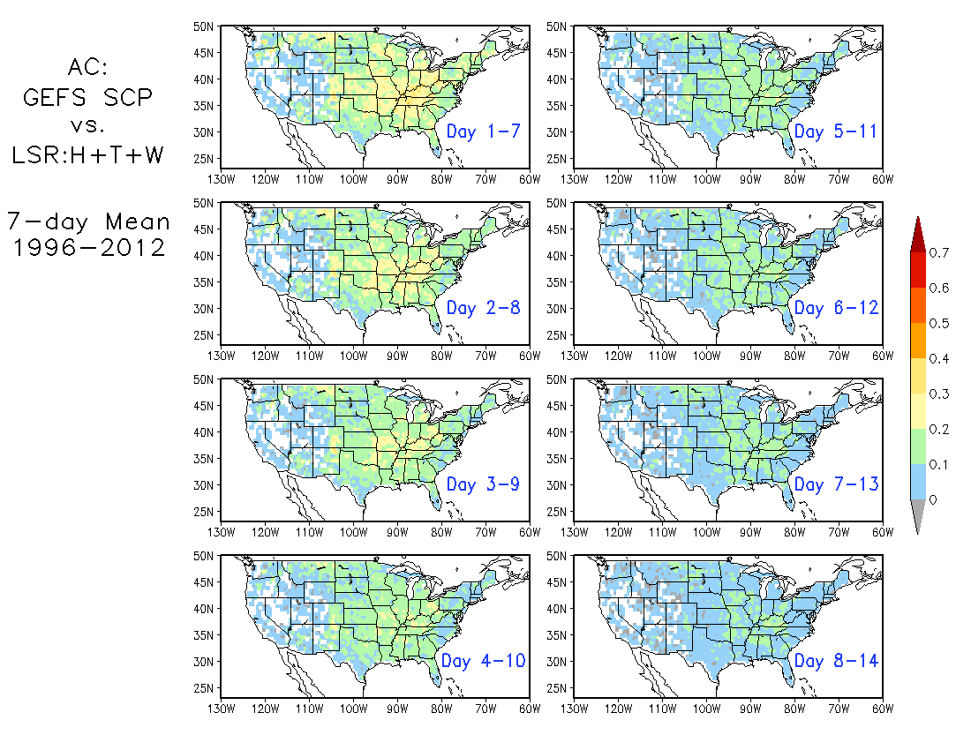
Predictive capacity for Week3-4 Severe Weather Outlook for the United States
Alima D. Soumare¹², Hui Wang¹, Arun Kumar¹, David Dewitt¹
1. NOAA/NWS/NCEP Climate Prediction Center, College Park, MD
2.INNOVIM LLC
ABSTRACT
Possible skillful prediction of Week 2 using 1996-2012 Supercell Composite Parameter (SCP) GEFS hindcast period has been observed which is required for developing an experimental Week2 Severe Weather Outlook for the United States (Wang et al. 2017, CDPW conference 2017). Similar work is done for Week3-4 CFSv2 data. SCP focuses on convective available potential energy, bulk wind difference and the helicity. The values began at zero, when the amount became higher than one as there is a substantial probability of severe weather. So the SCP is a meaningful parameter to estimate a possible predictability of severe weather formation. The SCP is derived from the NOAA National Centers for Environmental Prediction (NCEP) Climate Forecasts System Version 2 (CFSv2) 45 days forecasts. The forecast skill between SCP CFSv2-45day as a model data and the NCEP Climate Forecast System Reanalysis (CFSR) as an observation data is identified and will be explored from 1999 to 2010 for validation.
METHODS
SCP: Supercell composite parameter (Carbin et al. 2016)
SCP = (CAPE/1000 J kg⁻¹) × (SRH/50 m⁻² s⁻²) × (BWD/20 m s⁻¹)
Daily average from 6-hourly data, 12UTC to 12UTC
SCP ≥ 1: Severe weather
Observation Data
-CFSR,: daily data from 1999 to 2010
-LSR: Local Storm Report (hail, tornado, wind) from 1999 to 2010
Model Data
- CFSv2: 6 hourly data, 45 day forecasts
RESULTS
RESULTS
March
SCP CFv2 Daily Anomaly 1999-2008
SCP CFSR Daily Anomaly 1999-2008
AC SCP CFSv2 vs. LS3 Daily Data 1999-2010
Week1
Week2
March
Week3
Week4
SCP CFSR Daily Anomaly 1999-2008
April
SCP CFv2 Daily Anomaly 1999-2008
Week2
Week1
Week1
Week2
April
Week3
Week4
SCP CFSR Daily Anomaly 1999-2008
May
SCP CFv2 Daily Anomaly 1999-2008
Week3
Week4
Week1
Week2
Fig4.Weekly mean Anomaly Correlation SCP CFSv2 vs. LSR3 from 1999 to 2008, 5x5 resolution.
Monthly Climatology 1999-2010
May
Week3
Week4
CONCLUSIONS
CFSR
GEFS
CFSv2
Fig2.Left column represents the Daily anomaly MAMSCP CFSR MAM anomaly
from 1999-2008, right column represents Weekly anomaly SCP CFSv2-45day
for MAM from 1999-2008.
SCP CFSV2 is considered from January to June because of the high pick period MAM of severe weather activities. The SCP CFSv2 climatology shows a strong long term seasonal cycle compared to SCP CFSR and SCP GEFS(Fig1) however the amplitude decrease with the lead time(Fig not shown).
When averaging 12Z-12Z SCP CFSv2 (Fig.2), the anomalies shows weak values with a significant reduced coverage over the US compared to the anomaly SCP CSFR which make it almost unrealistic after Day 7 to get an anomalies correlation pattern, the confidence over the anomalies decreases as the number of members increase (Carbin et.al 2016).
The anomaly correlation between SCP CFSv2(Fig.4) and LSR3 has been improved by interpolate 5x5 resolution pattern until Week2 while Week3 and 4 does not show significant areas while the anomaly correlation between SCP GEFS and LSR3(Fig.3) shows a better coverage along Week2.
OBJECTIVE
Developing an experimental Week 3-4 Severe Weather Outlook for the United States using CFSv2 45days
Initial day
Initial day
Hui et al.2017
Fig1. Monthly climatology SCP CFSR, SCP GEFS and SCP CFSv2 from
January to June, 1999-2008. The Severe weather activity is highly observed from the beginning of March to the end of June
Fig3. Anomaly Correlation SCP GEFS vs. LSR3 7 day moving averaged from
1996 to 2012.This figure has been presented by Hui et al.2016 during the CDPW 2017

