Slide 1
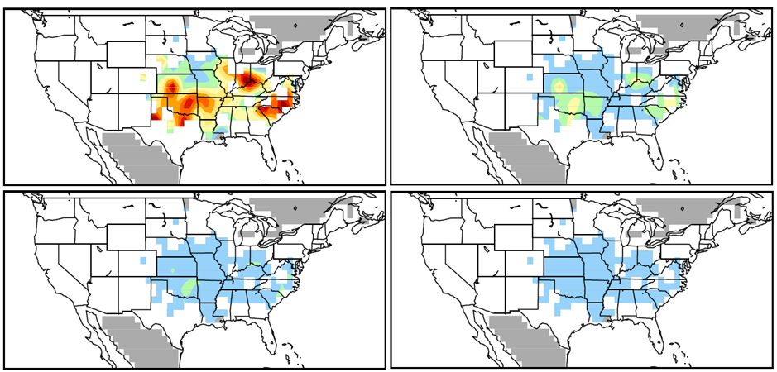
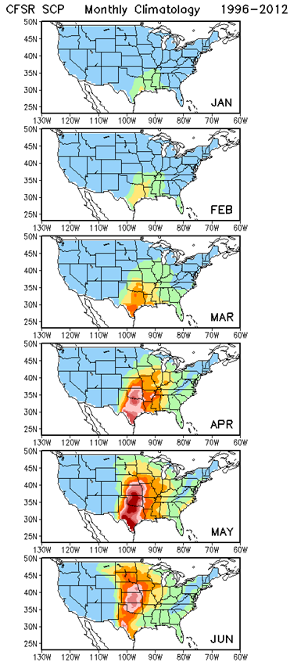
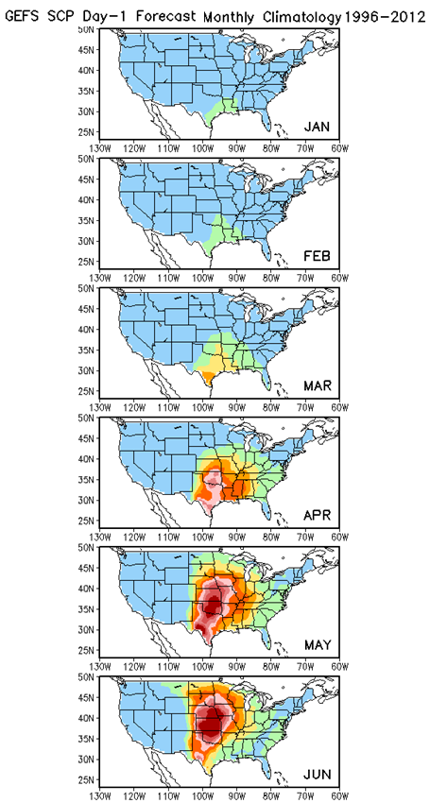
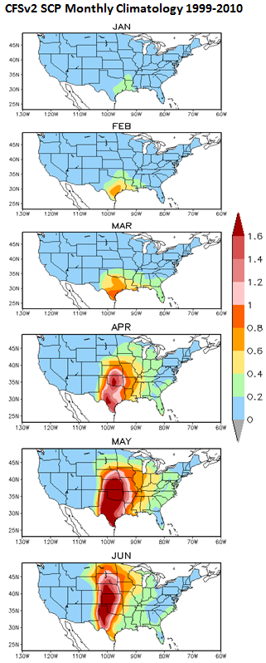
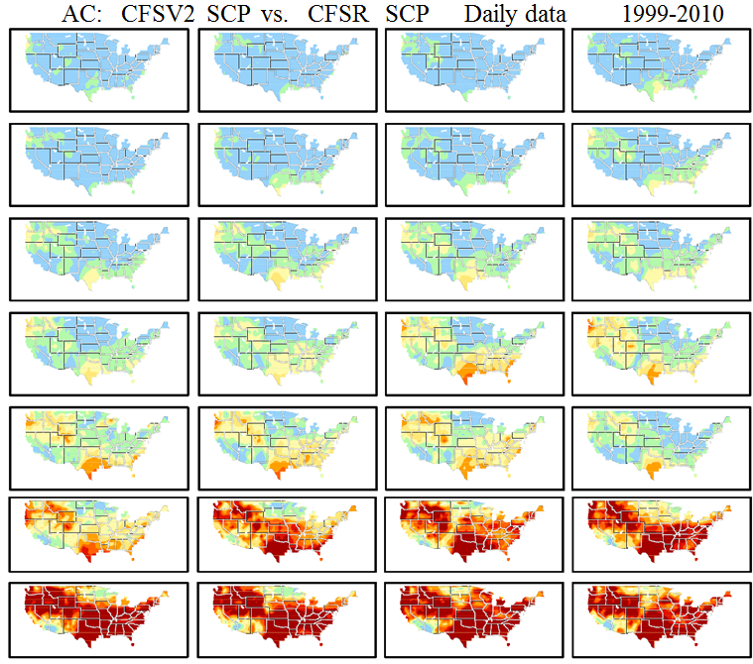
Predictive capacity for Week3-4 Severe Weather Outlook for the United States
Alima D Soumare, Hui Wang, Arun Kumar, David Dewitt,
1.CPC,NWS, NOAA
2.INNOVIM LLC
ABSTRACT
Possible skillful prediction of Week 2 using 1996-2012 Supercell Composite Parameter (SCP) GEFS hindcast period has been observed which is required for developing an experimental Week2 Severe Weather Outlook for the United States (Wang et al. 2017, CDPW conference 2017). Similar work is done for Week3-4 CFSv2 data. SCP focuses on convective available potential energy, bulk wind difference and the helicity. The values began at zero, when the amount became higher than one as there is a substantial probability of severe weather. So the SCP is a meaningful parameter to estimate a possible predictability of severe weather formation. The SCP is derived from the NOAA National Centers for Environmental Prediction (NCEP) Climate Forecasts System Version 2 (CFSv2) 45 days forecasts. The forecast skill between SCP CFSv2-45day as a model data and the NCEP Climate Forecast System Reanalysis (CFSR) as an observation data is identified and will be explored from 1999 to 2010 for validation.
METHODS
SCP: Supercell composite parameter (Carbin et al. 2016)
SCP = (CAPE/1000 J kg⁻¹) × (SRH/50 m⁻² s⁻²) × (BWD/20 m s⁻¹)
Daily average from 6-hourly data, 12UTC to 12UTC
SCP ≥ 1: Severe weather
Observation Data
-CFSR,: daily data from 1999 to 2010
-LSR: Local Storm Report (hail, tornado, wind) from 1999 to 2010
Model Data
-CFSv2: daily data, 4 members, 45 forecasts a day
RESULTS
RESULTS
AC CFSv2 SCP vs. LS3 Daily Data 1999-2010
Monthly Climatology 1999-2010
CFSR
GEFS
CFSv2
CONCLUSIONS
OBJECTIVE
Developing an experimental Week 3-4 Severe Weather Outlook for the United States
For additional information please contact:
[Name]
[Department]
[Institution or organization]
[E-mail address]

