Slide 1
Update
19Jan2018
Identified the issues with the raw data from https://nomads.ncdc.noaa.gov/modeldata/cfs_reforecast_6-hourly_45day_pgbf/ from 2000 to 2010
Sent an email to NCDC Model data manager ncei.orders@noaa.gov for more information about the issues.
To do
WCOSS account
Get the daily forecasts available from EMC

Slide 2
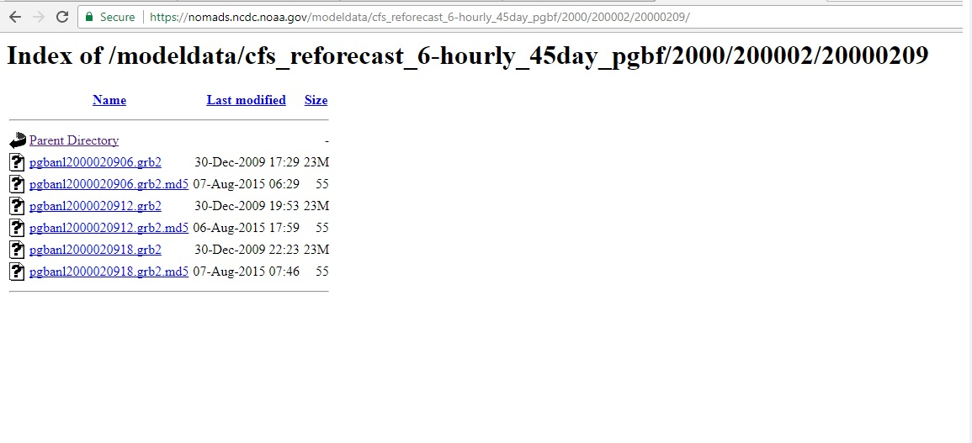

Slide 3
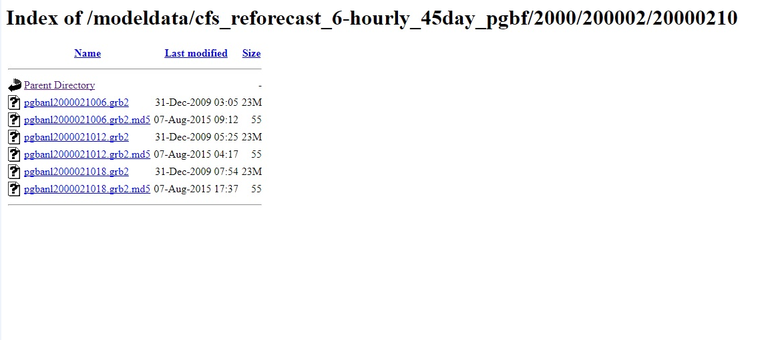
End of data
Nodata for 20000210

Slide 4
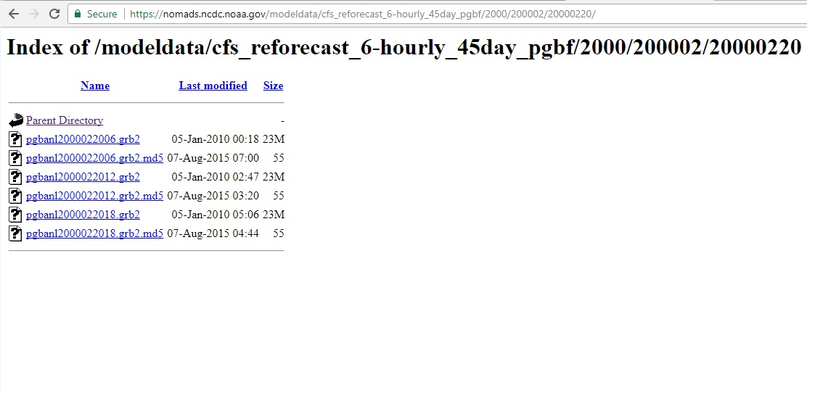
End of data
Nodata for 20000220

Slide 5
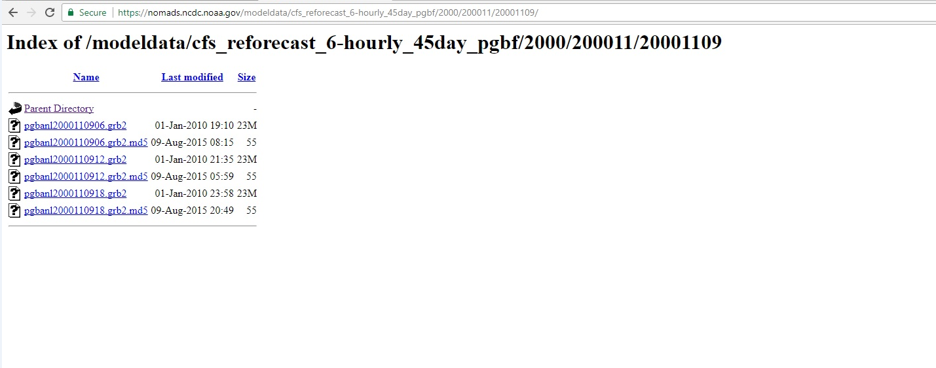
End of data
Nodata for 20001109

Slide 6
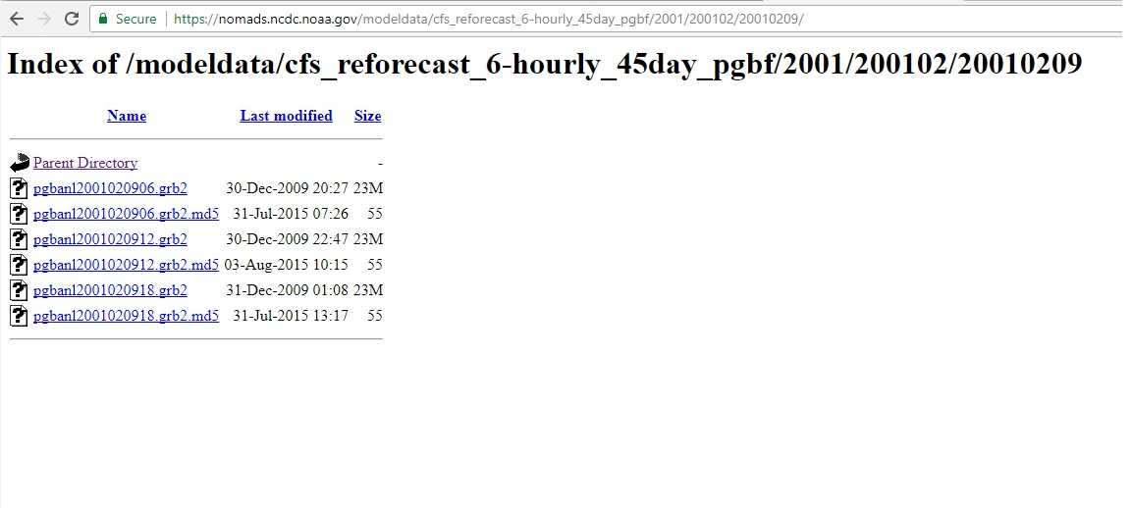
End of data
Nodata for 20010209

Slide 7
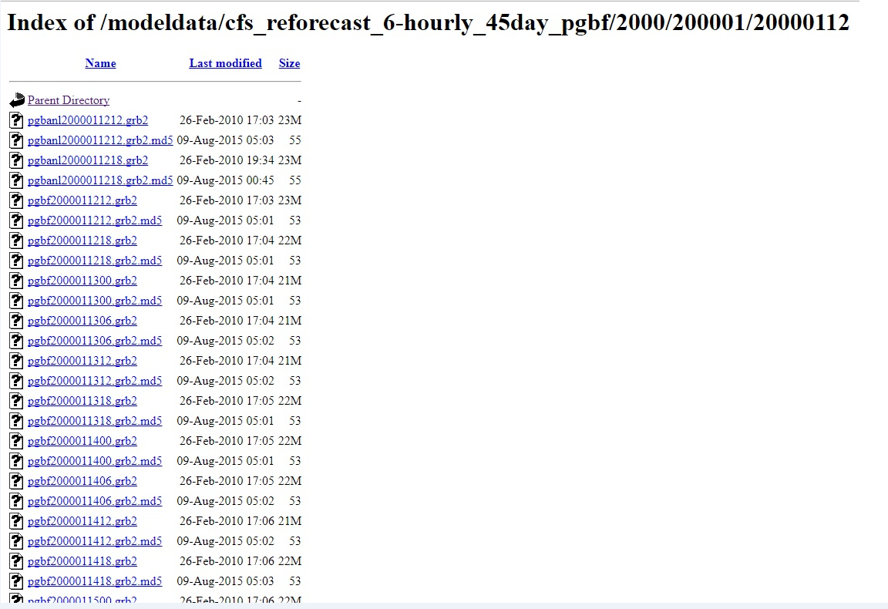
pgbf2000011206.grb2 data is missing

Slide 8
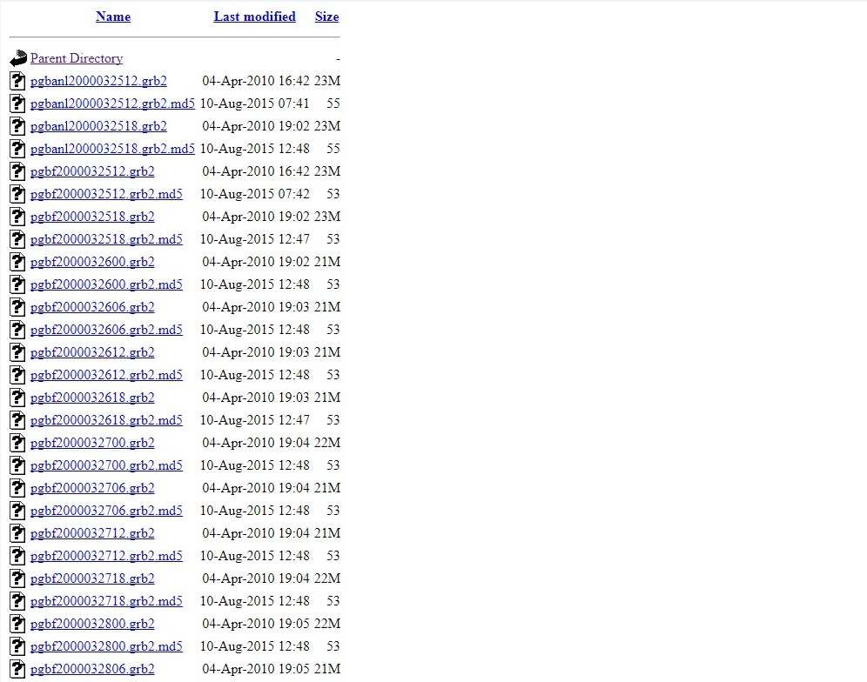
pgbf2000032506.grb2 data is missing

Slide 9
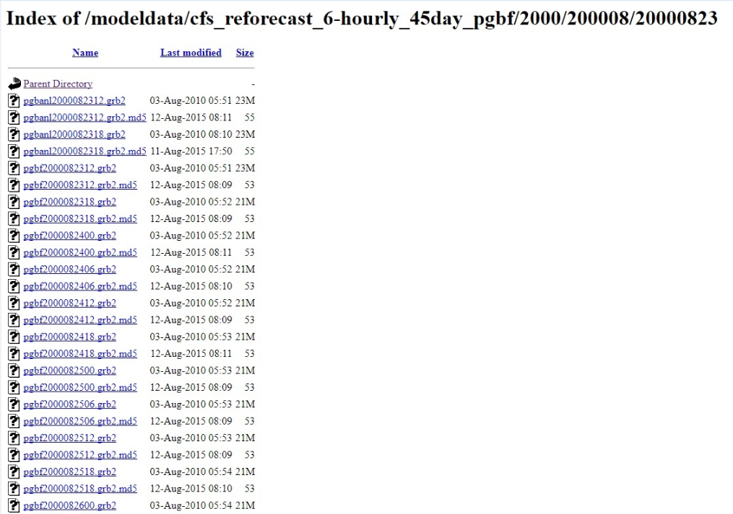
pgbf2000082306.grb2 data is missing

Slide 10
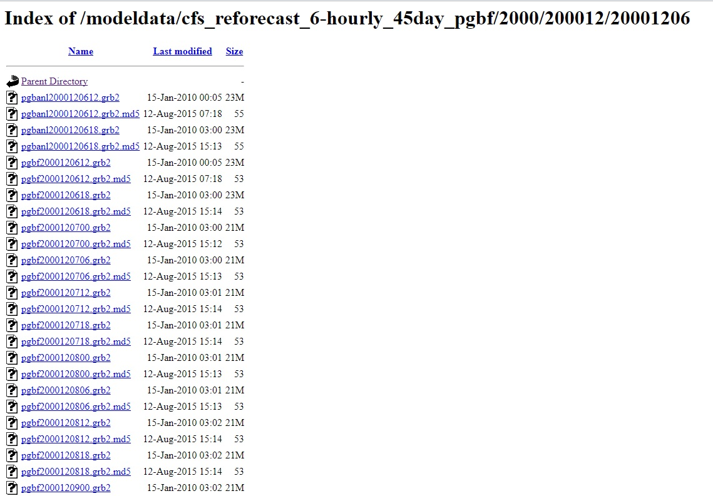
pgbf2000120606.grb2 data is missing

Slide 11
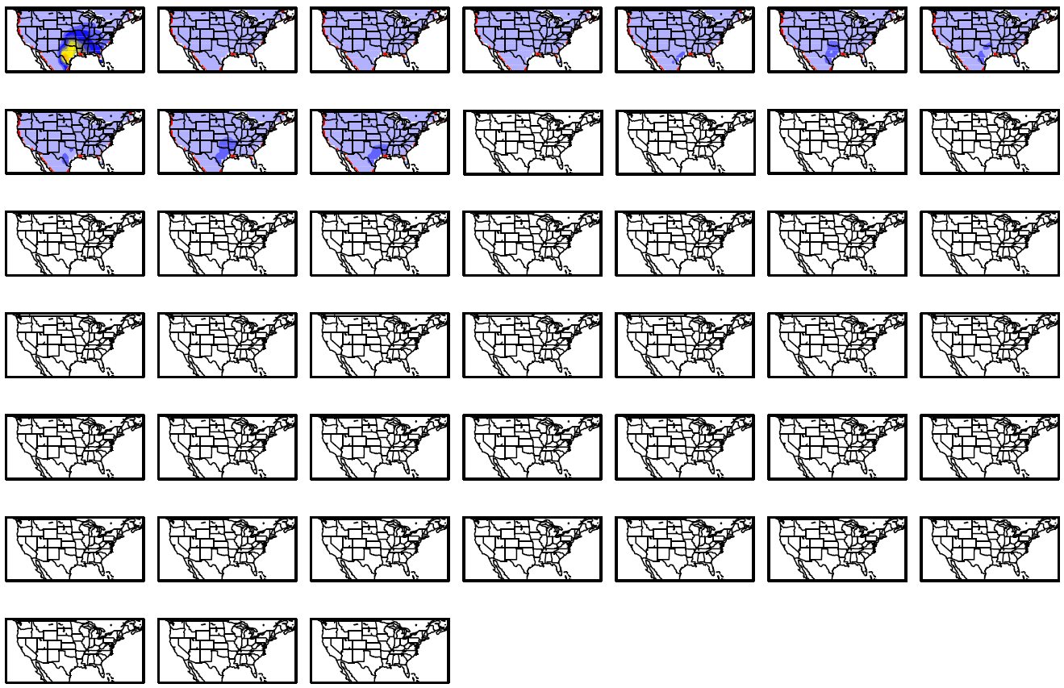
Mars
Day 1-07
Day 08-14
Day 15-21
Day 22-28
Day 29-35
Day 36-42
Day 43-45

Slide 12
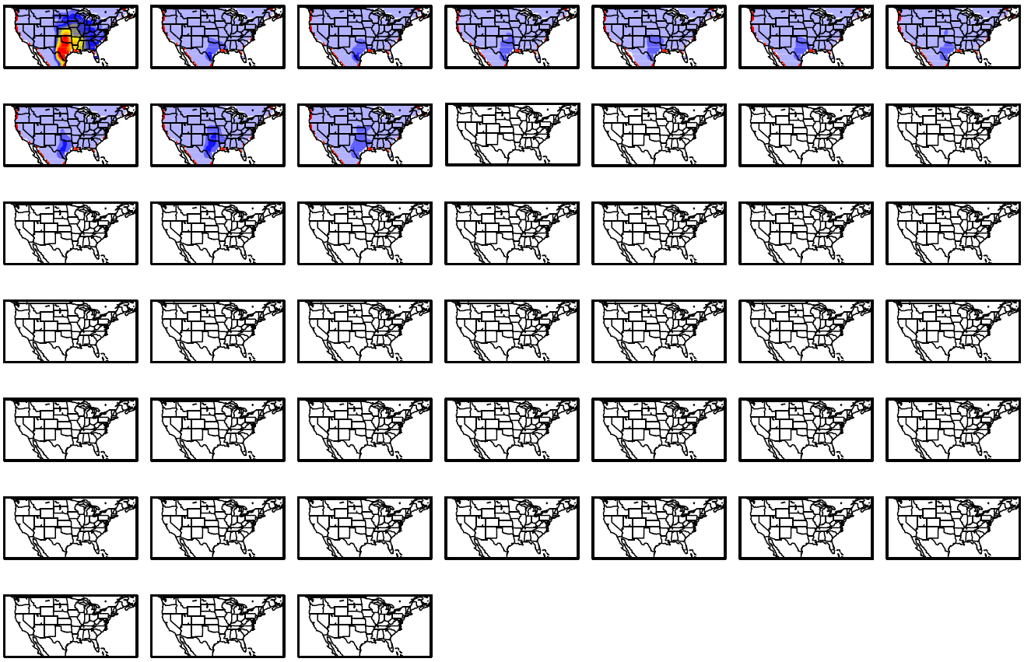
April
Day 1-07
Day 08-14
Day 15-21
Day 22-28
Day 29-35
Day 36-42
Day 43-45

Slide 13
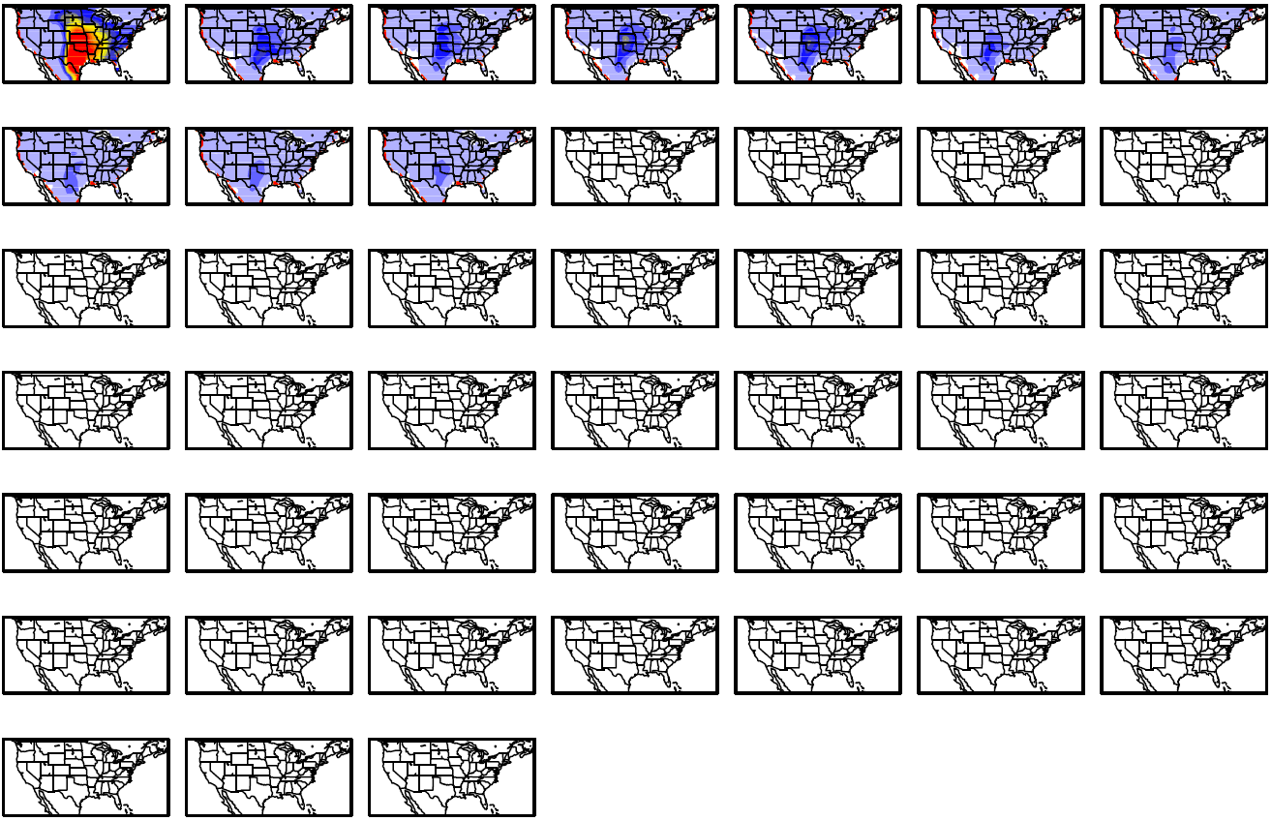
May
Day 1-07
Day 08-14
Day 15-21
Day 22-28
Day 29-35
Day 36-42
Day 43-45

Slide 14
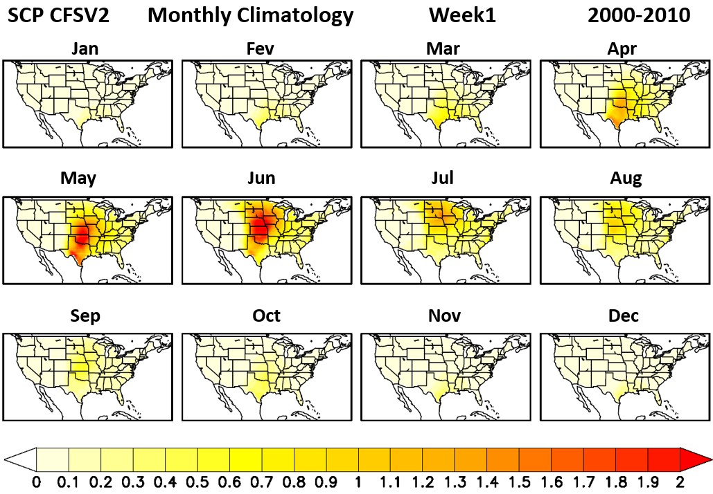

Slide 15
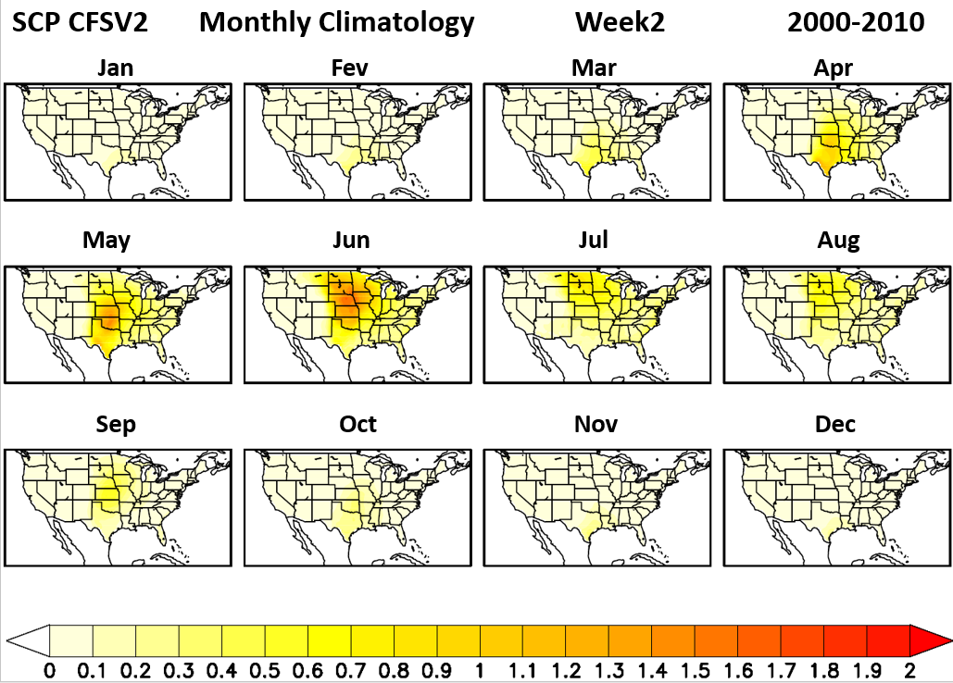

Slide 16
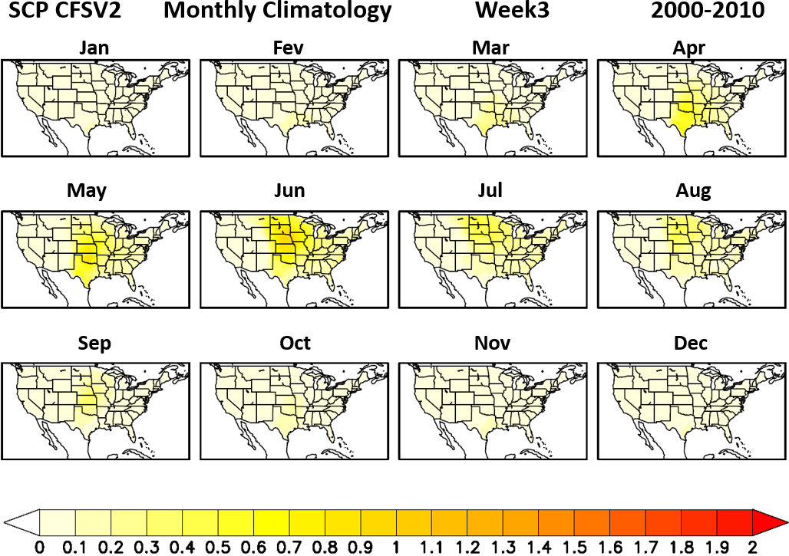

Slide 17
