Slide 1
Update
20Apr2018
CAC card renewed on 04/24/2018
Submit a request to connect CAC card on my desktop 04/25/2018
Working on
Seasonality MAM
Relationship between SCP CFSv2 and SCP CFSR
Anomaly correlation (AC)
Conditional AC (SCP >= 1)
Access Wcoss /NECPDEV/CPC-om/? Submitted a ticket ……..In progress

Slide 2
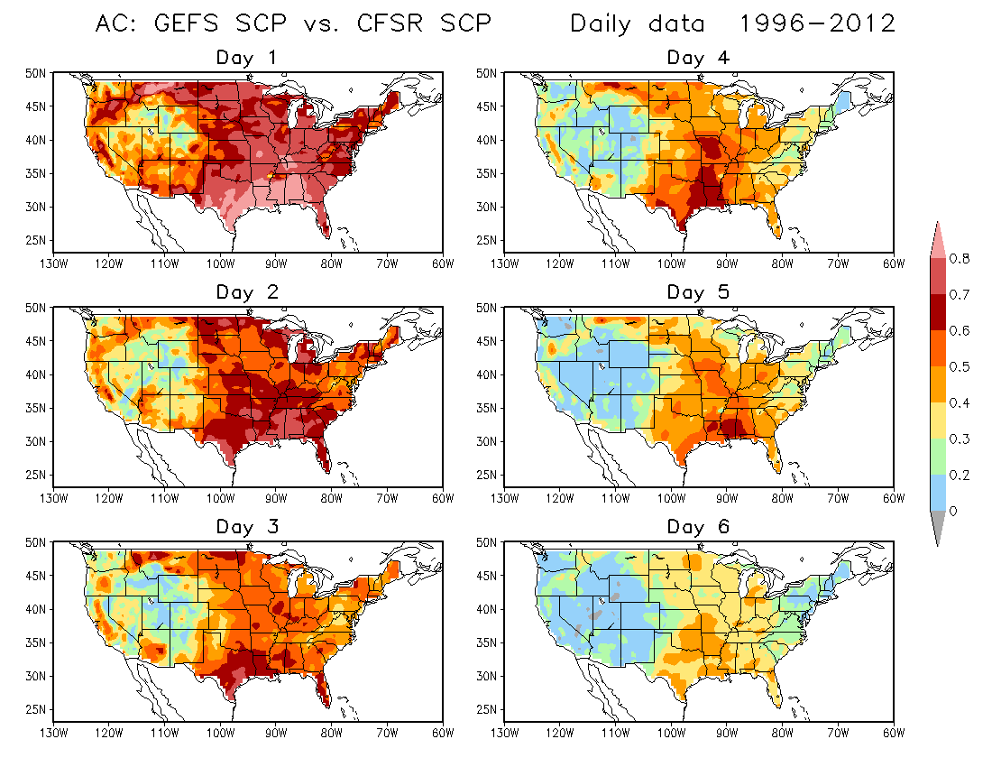
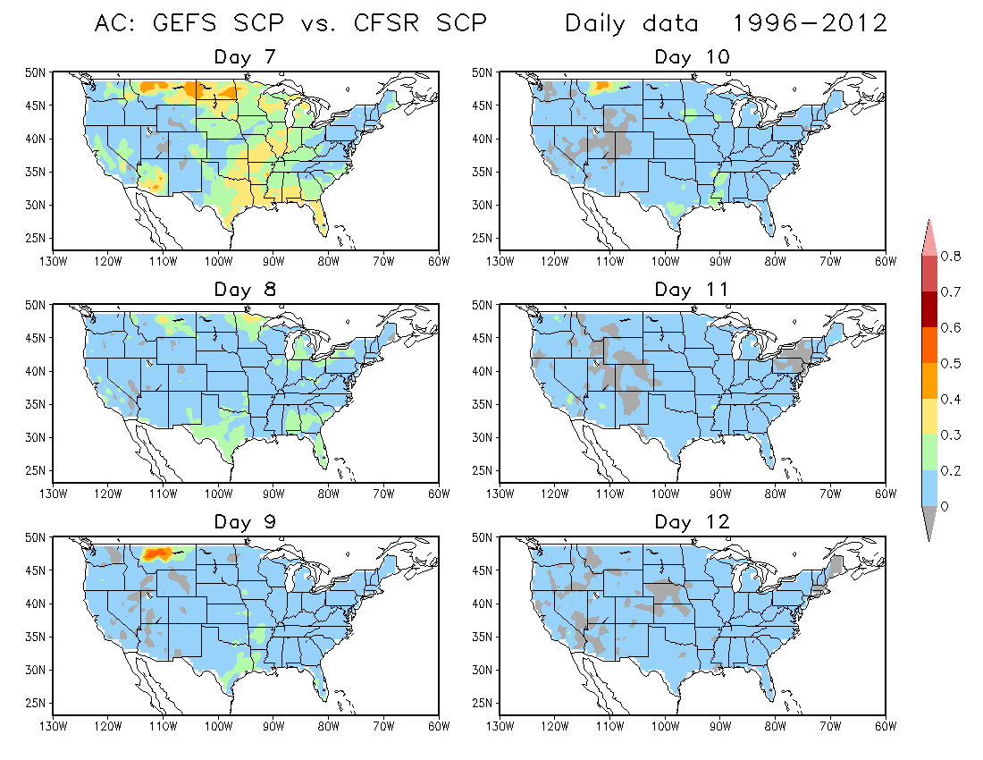
What to expect for CFSv2?
Done by Hui Wang

Slide 3
Monthly climatology
MARCH
Day10
Day9
Day8
Day7
Day6
Day5
Day4
Day3
Day2
Day1
APRIL
Day10
Day9
Day8
Day7
Day6
Day5
Day4
Day3
Day2
Day1
MAY
Day10
Day9
Day8
Day7
Day6
Day5
Day4
Day3
Day2
Day1

