Slide 1
Weekly Meeting
08Juin2018
CFSv2 hindcast
1999 – 2011, 12 years
Each year 365 days, 90 forecasts, 6 hourly
4 members
SCP from January to June from 1999 to 2010
Request more space work to Don 6TB, requested considered and will keep me posted
1999 2000 2001 2002 2003 2004 2005 2006 2007 2008 2009 2010

Slide 2
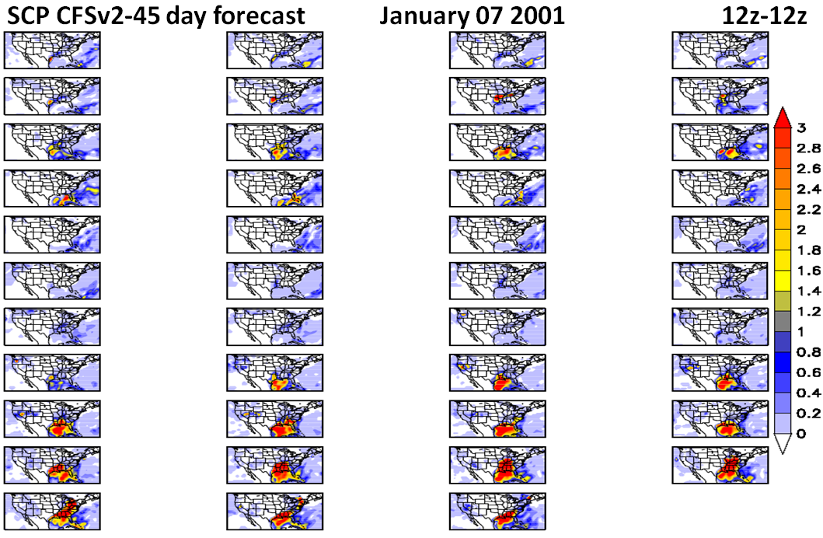

Slide 3
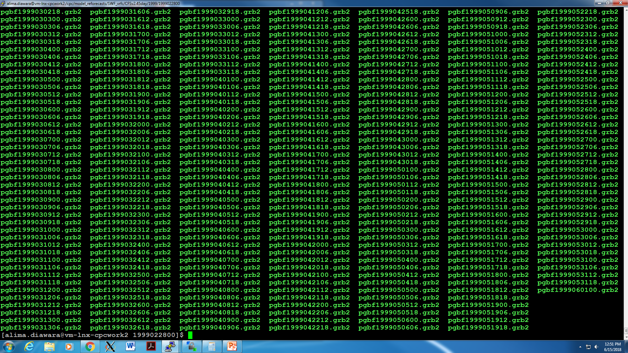
90 days forecasts

