Slide 1
Update
13Jul2018
January to May of Years 1999 to 2004
Monthly mean
Forecast Week 1-2-3-4
12Z-12Z
4 members
Working on
Processing from 2005

Slide 2
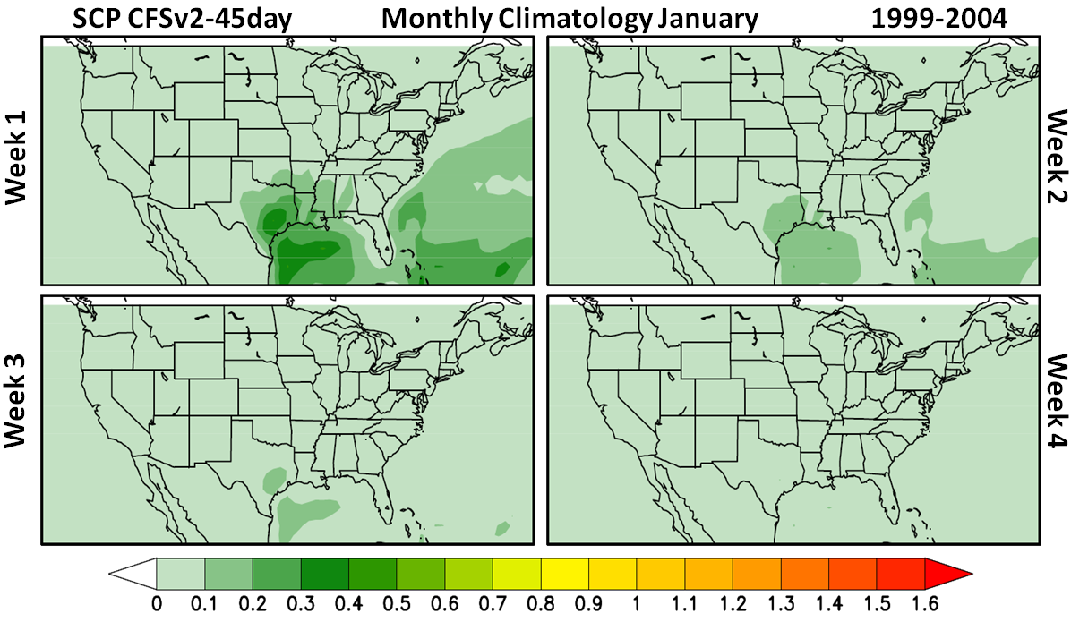

Slide 3
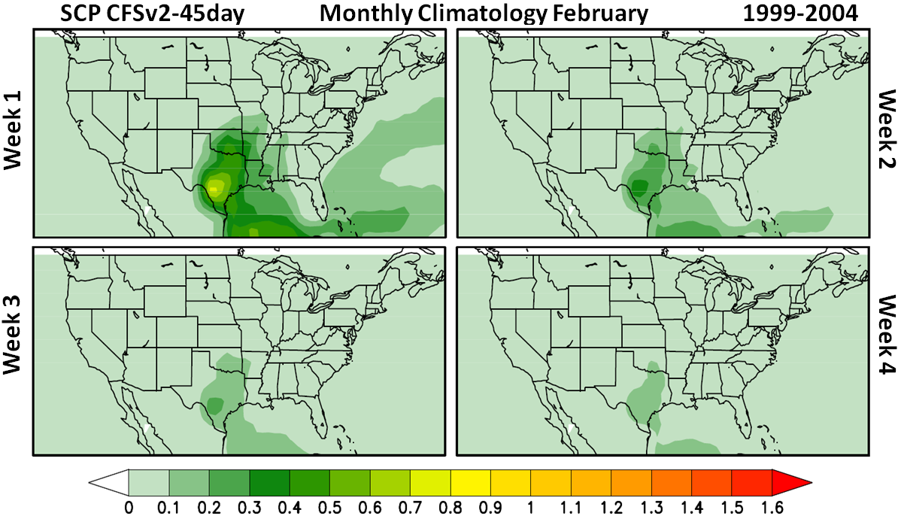

Slide 4
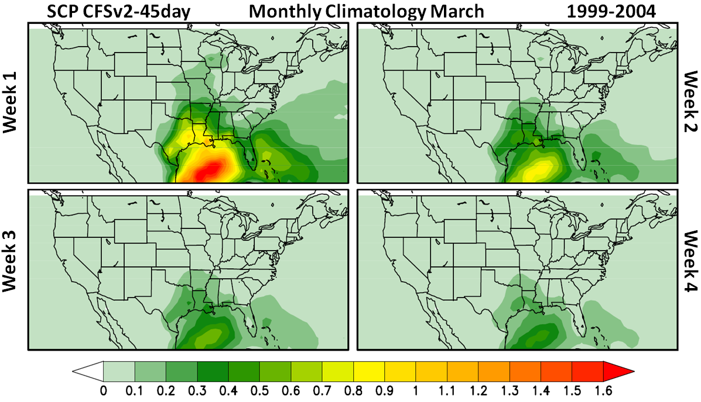

Slide 5
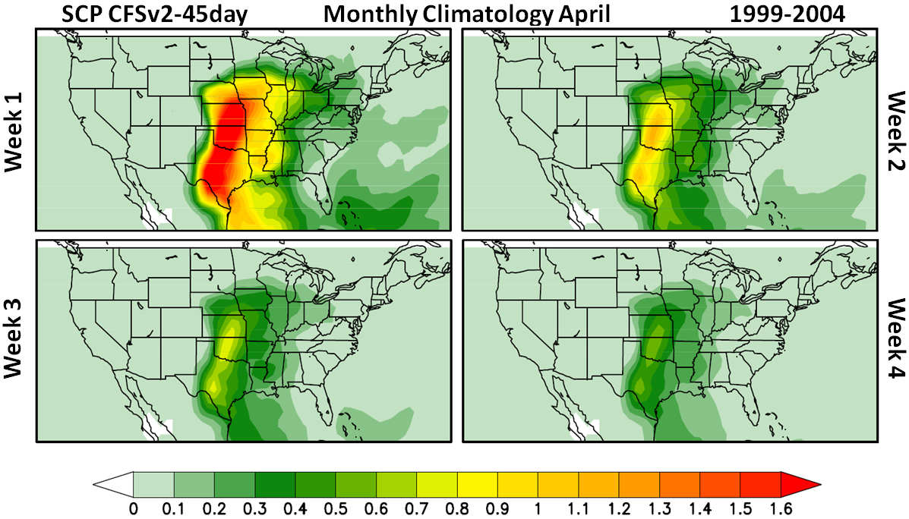

Slide 6
