Slide 1
Update
10Aug2018
CFSv2-45days hindcast
The seasonal cycle MAM for Week 1 2 3 and 4 from 1999 to 2004
Calculated AC SCP-CFSv2 and AC SCP-CFSR
To do
Calculate the forecast skill between model (SCP CFSv2) and observation (SCP CFSR)

Slide 2
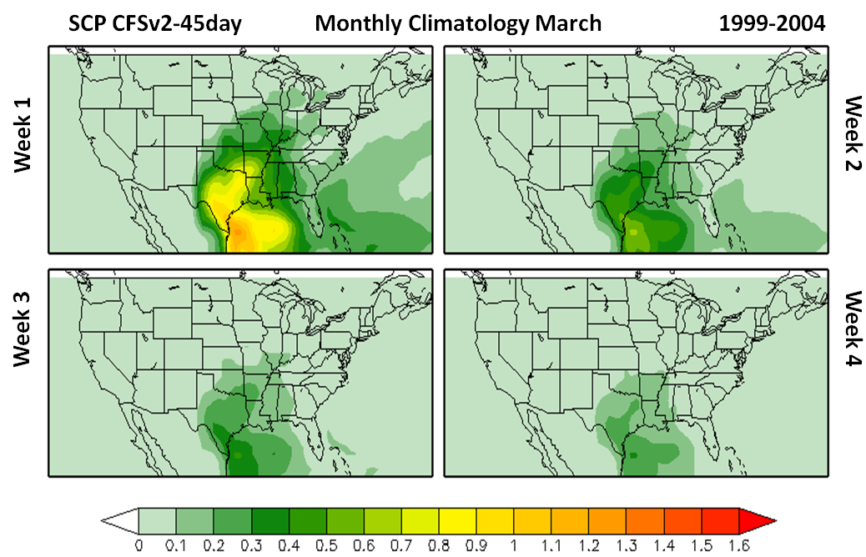

Slide 3
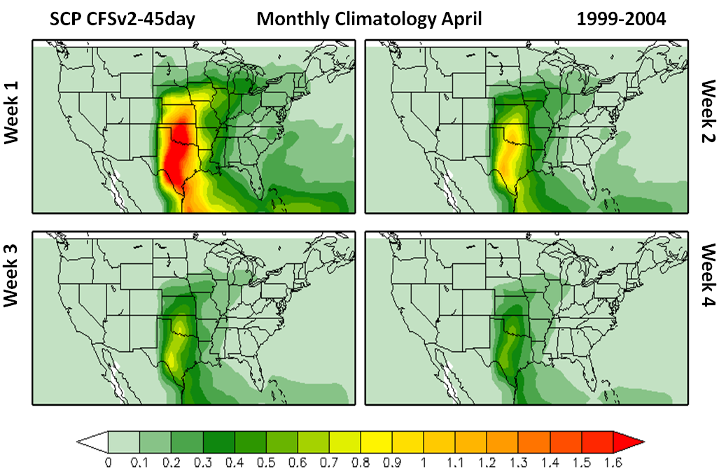

Slide 4
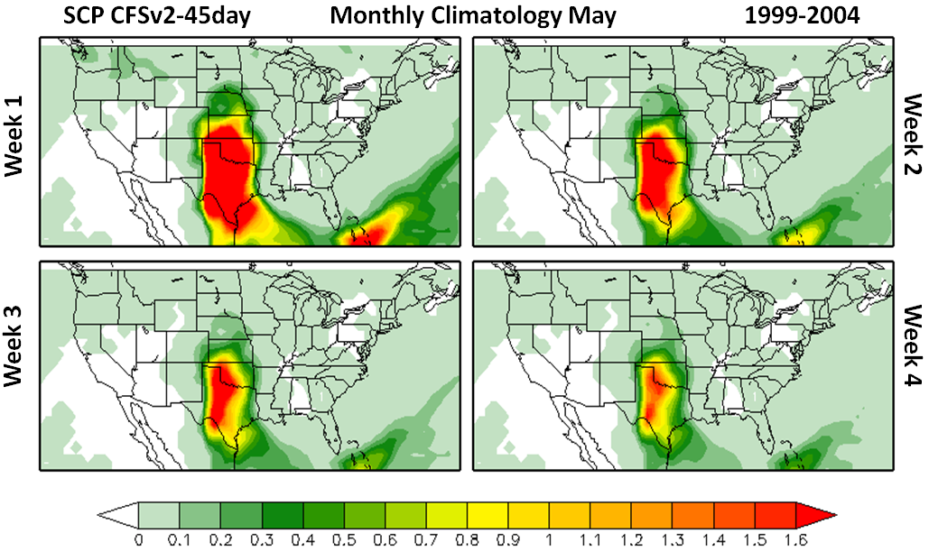

Slide 5
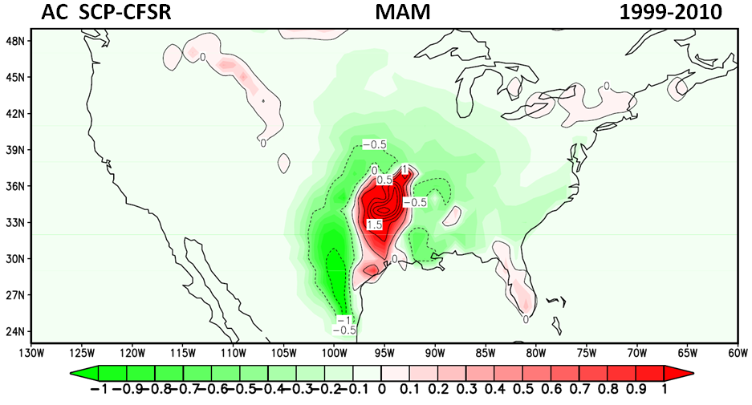

Slide 6
